Slide 1
PIZZA CONNECTION
A project by
Davide Curcio & Andrea Lovati

Slide 2


Slide 3
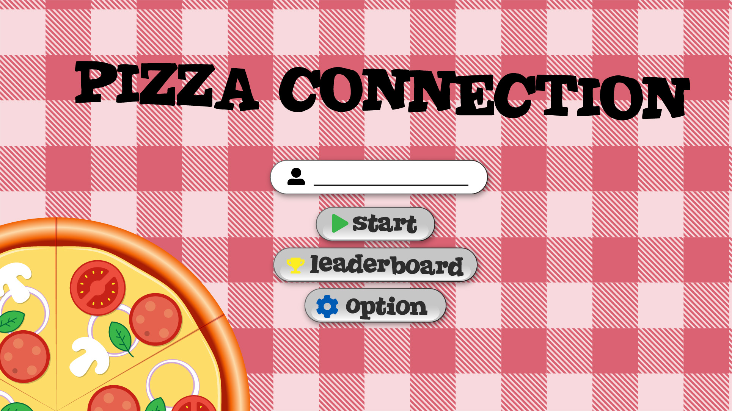

Slide 4
