Slide 1
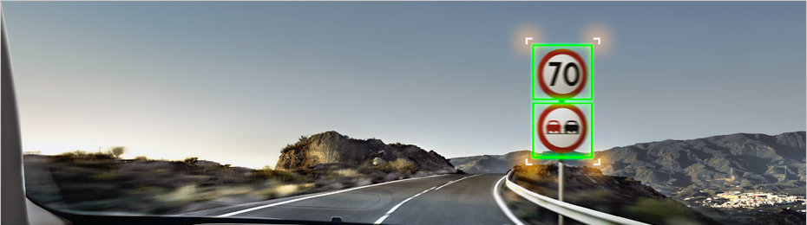
Praktikum - Maschinelles Lernen
1 - auto-news.de
Mobiler Fahrassistent für die Android Plattform
Verkehrsschildassistent

Slide 2
Pipeline

Slide 3
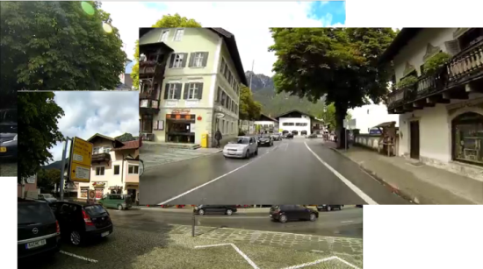
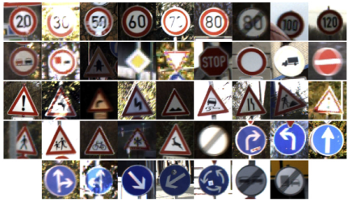
Erkennenung von Verkehrsschilder
Traffic Sign Detection
Negative Bilder
Cascade Trainer
K1
K2
Kn
Positive Bilder
<number> | Luis Ibargüen / David Geisler

Slide 4
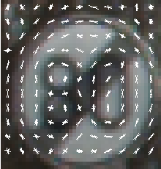

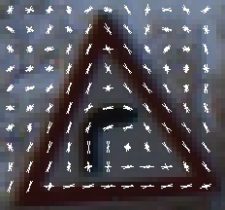
Erkennenung von Verkehrsschilder
Traffic Sign Detection
Histogram of Oriented Gradients (HOG)
<number> | Luis Ibargüen / David Geisler

Slide 5
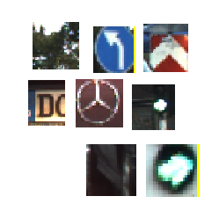
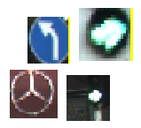
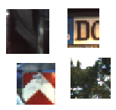
Erkennenung von Verkehrsschilder
Traffic Sign Detection
Frame Patches
Schilder?
K1
…
Nicht Schilder
<number> | Luis Ibargüen / David Geisler

Slide 6

Erkennenung von Verkehrsschilder
Traffic Sign Detection
Kn
…
Schilder? von K(n-1)
Nicht Schilder
<number> | Luis Ibargüen / David Geisler

Slide 7



Traffic Sign Recognition
Convolutional Neural Network

Slide 8
Traffic Sign Recognition
Convolutional Neural Network

Slide 9
Traffic Sign Recognition
Convolutional Neural Network
feature map
convolution layer

Slide 10
Traffic Sign Recognition
Convolutional Neural Network
feature map
convolution layer
convolution layer

Slide 11
Traffic Sign Recognition
Convolutional Neural Network
feature map
feature map
feature map
feature map
convolution
convolution
convolution
full connected neuronal network

Slide 12
Traffic Sign Recognition
Deep Learning
Input
Hidden
Output

Slide 13
Traffic Sign Recognition
Deep Learning
Input
Hidden
Output

Slide 14
Traffic Sign Recognition
Deep Learning
Trainingsdaten für darunter liegenden Layer
Input
Hidden
Output

Slide 15
Traffic Sign Recognition
Deep Learning
Trainingsdaten für darunter liegenden Layer
Input
Hidden
Output

Slide 16
Traffic Sign Recognition
Deep Learning
Input
Hidden
Output

Slide 17
Danke.
Luis Ibargüen
l.ibargueen-gonzalez@student.uni-tuebingen.de
David Geisler
david.geisler@student.uni-tuebingen.de

