Slide 1
Smart Greenhouse.
Davide Marchetti / 815990
Laboratorio IoT / Prof. Paolo Napoletano
A.A. 2020 / 2021

Slide 2
Materials.
Name | Quantity | Description
DHT11 + 10kΩ resistor | 1 | Monitor temperature/humidity
Photoresistor + 10kΩ resistor | 1 | Monitor the light amount
Soil Humidity Detection Module | 1 | Monitor the soil moisture
Push Button | 1 | Control information displayed on the LCD
LEDs (Red/Green) | 2 | Visualize system status
LCD Display 16x2 | 1 | Show the sensor details

Slide 3
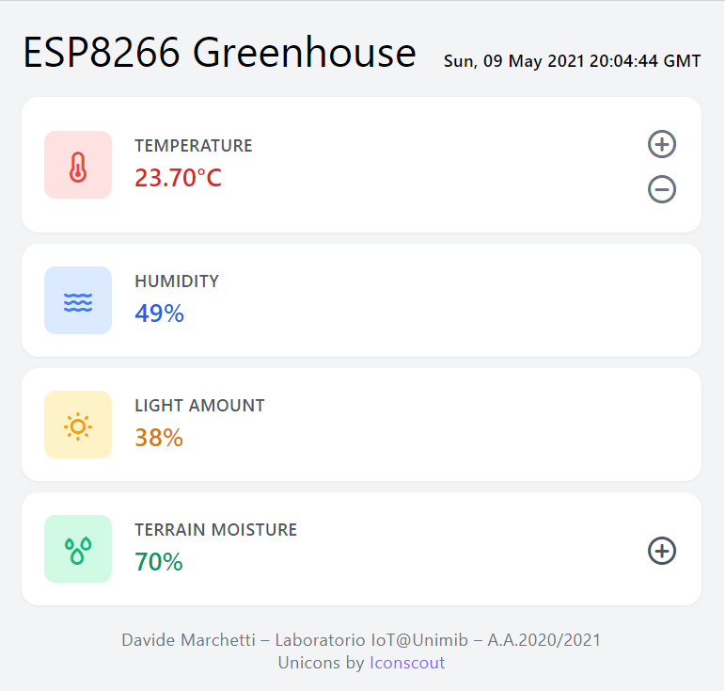
Method.
Temperature
If temperature is outside the 22°C-26°C range, adjust the temperature (turn on the red led).
Humidity
Monitors the ambient humidity.
Light
Monitors the ambient light amount.
Temperature can be adjusted manually through a web interface.
Terrain Moisture
If moisture < 30%, water the terrain (turn on the green led).
Watering can be forced through a web interface.
Fig.1: Smart Greenhouse web interface
ADDITIONAL INFORMATION:
LCD Display is organized in pages, one for each sensor reading. The push button allows to loop through the pages.
Sensor readings are stored in InfluxDB every two seconds.
The MCU exposes a web interface (implemented in Vue.js) through an HTTP server to monitor and control the system.

Slide 4
Method.
Draw data on display
Ensure Wi-Fi and InfluxDB are connected
Check thresholds
Handle web server requests
Push data to Influx
Handle button presses
Read sensors

Slide 5
Final Remarks.
Soil Moisture Detector Sensor is not always accurate and responsive.
Smart Greenhouse system works as designed, despite the limited number of analog and digital pins of the ESP8266.
Future extensions:
Adjustment of humidity and light amount.
Monitoring of more parameters.
Settings customization without firmware modifications.
Use capacitive soil moisture detection sensors instead of resistive ones.

Slide 6
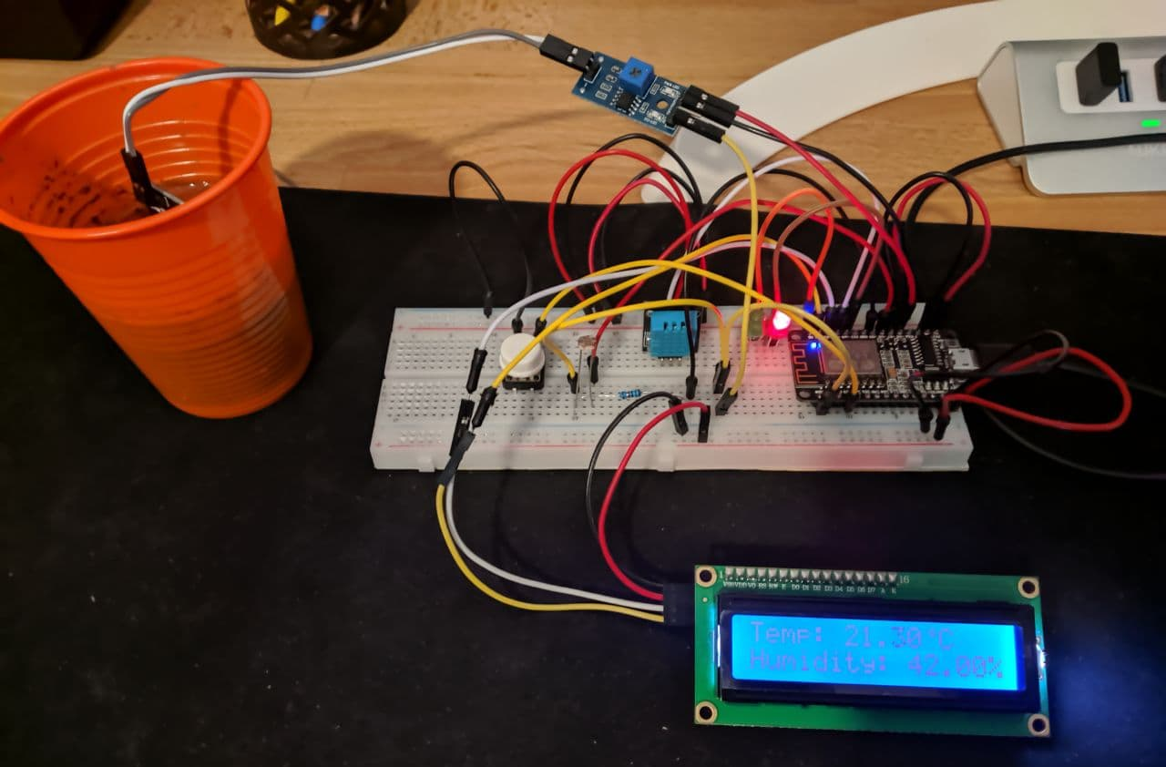
Final Remarks.

