Slide 1
Smart Parking.
Team:
Davide Marchetti / 815990
Mattia Vincenzi / 860579
Laboratorio IoT / Prof. Paolo Napoletano
A.A. 2020 / 2021

Slide 2
Prototype.

Slide 3
Materials (hardware).
Name | Quantity
ESP 8266 | 6
ESP 32 (Master) | 1
Ultrasonic sensor (HC-SR04) | 1
Pir motion sensor (HC-SR501) | 1
Lettore RFID (MFRC 522) | 1
Photoresistor | 1
LEDs (red, green, blu and white) | 9
Servo motor | 2
Buzzer | 1
Push button | 1
Display 16x2 | 1
Resistors | 14

Slide 4
Materials (software).
Name
Visual Studio Code (C++)
Mosquitto MQTT broker
MySQL
InfluxDB
HTML + TailwindCSS + Vue.js
Web Socket
Telegram
OpenWeather

Slide 5
Architecture.

Slide 6


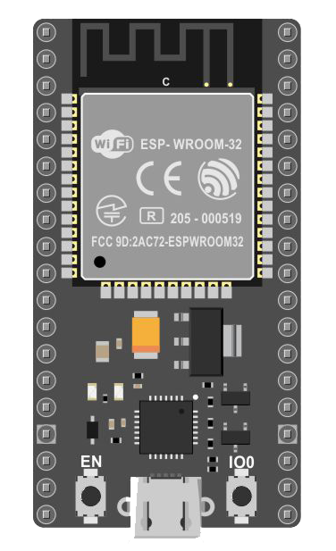

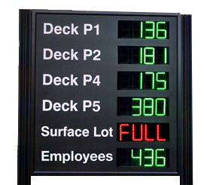


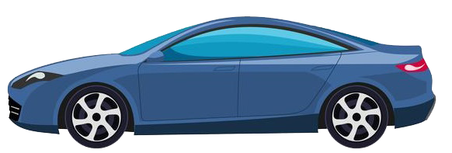
MQTT (1/3).
Every sensor will auto-configure itself after each boot with JSON payloads exchanged though MQTT.
Master will always wait for configuration requests on a defined topic.
Configuration mechanism
Send a configuration request for the current subsystem type.
Request the configuration from MySQL.
Obtain and customize the configuration for the specific device (mac_address).
Reply to the requester with the final configuration.
2
3
MASTER
1
4
EXTERNAL DISPLAY
LIGHT SYSTEM
PARKING SENSOR

Slide 7
MQTT (2/3).
2
3
6
Given its configuration, each subsystem knows which topic to publish on and will collect data regularly.
Data publishing mechanism
Send a JSON payload with the raw data.
If necessary, data are processed (mean over a defined time amount) and published on InfluxDB.
MASTER
5
1
4
EXTERNAL DISPLAY
LIGHT SYSTEM
PARKING SENSOR

Slide 8
MQTT (3/3).
2
3
MASTER
A last will message will be delivered on its own topic when the connection to the subsystem is lost or upon a device failure.
1
4
EXTERNAL DISPLAY
LIGHT SYSTEM
PARKING SENSOR

Slide 9
How it works.

Slide 10
Roof and OpenWeather API.

Slide 11
Gate, Deep Sleep and EEPROM.

Slide 12
Lights.

Slide 13
Alarm.

Slide 14
Car Park.

Slide 15
Telegram bot.

Slide 16
Last Will.

Slide 17
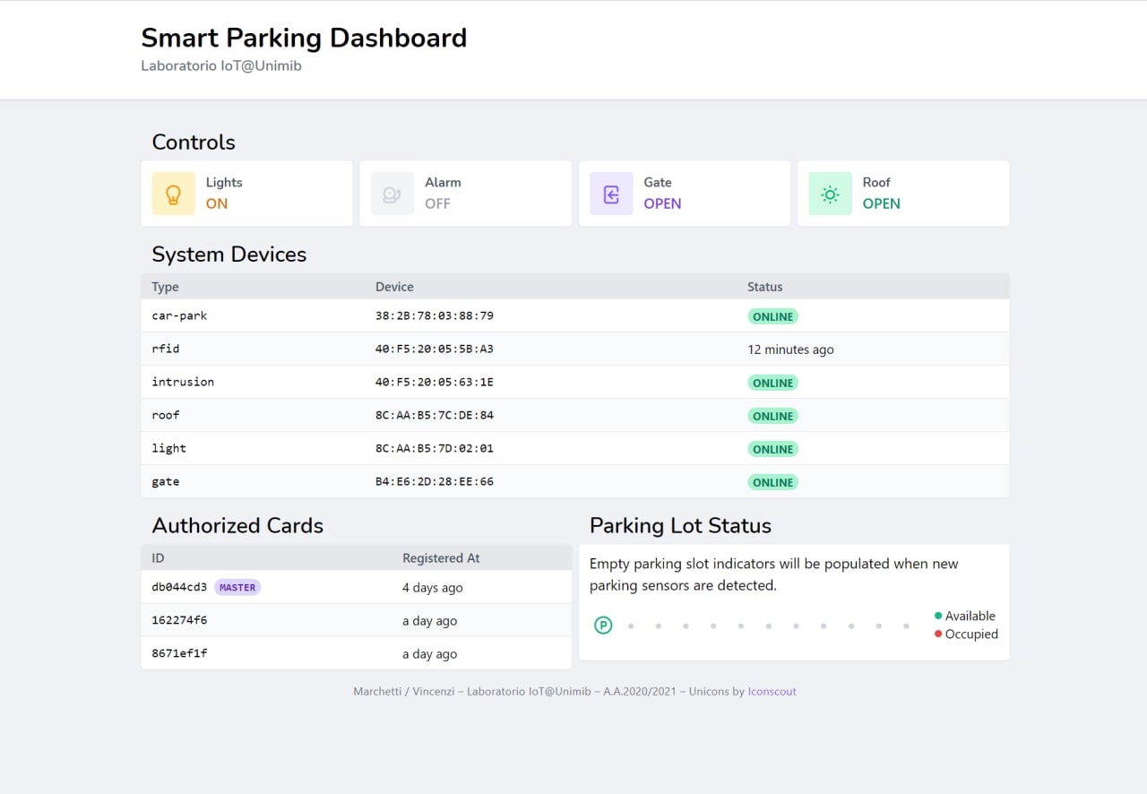
Dashboard.
Developed with TailwindCSS and Vue.js

Slide 18
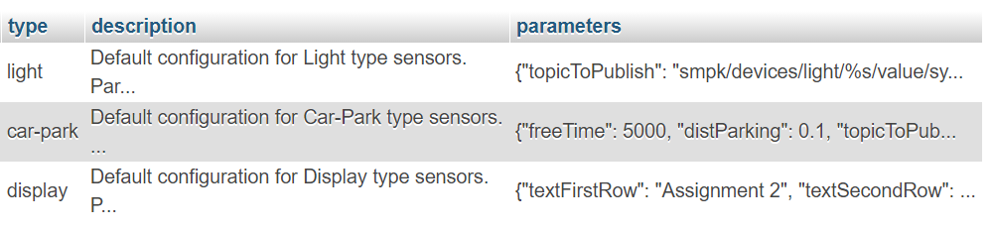
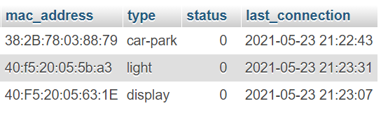
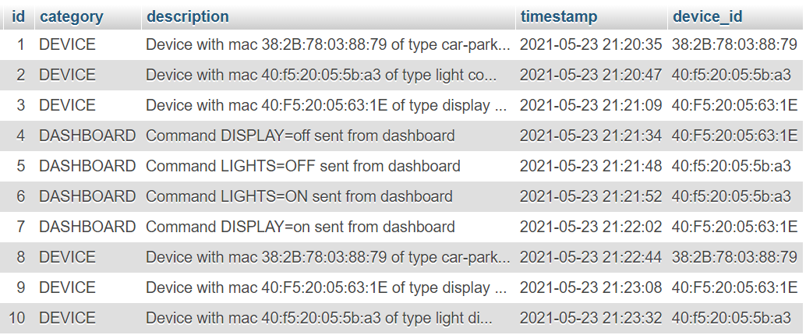
MySQL.
Configuration Examples
Recorded Devices
Recorded Events

Slide 19
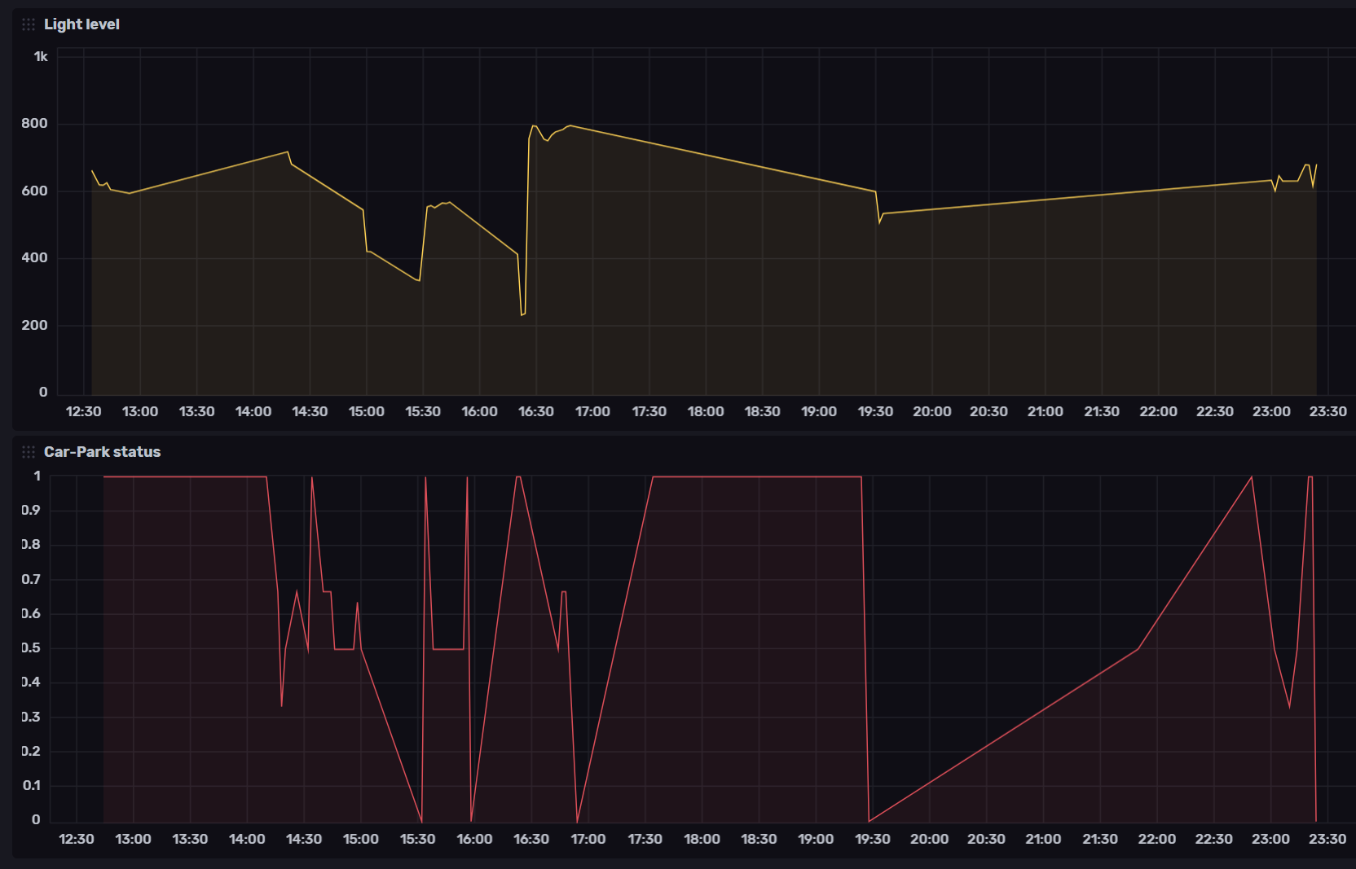
InfluxDB.

Slide 20
Final Remarks.

