Slide 1

Docker for .NET Developers
Seamless CI/CD and releases, if that’s the Docker dream… why is it such a nightmare for dotnet developers?
Notes:
If you’ve seen docker done well using dotnet core, you’ll agree docker empowers a CI/CD pipeline so simple you could trust an intern to trigger the release.

Slide 2





https://DaveWritesCode.com
linkedin.com/in/DaveWritesCode
@_DaveWritesCode
Notes:
My name is David and I made just enough mistakes to break into this industry 5 years ago after pursuing a degree in education.
I wanted to be a teacher because I’ve historically lacked confidence and if it weren’t for the teachers I’ve had, I wouldn’t have the courage to do the things I do.
That said, I’m giving this presentation not as an educator or engineer, but as a catalyst for confidence.

Slide 3
Onboarding (optional)
https://github.com/dvdmrk/DockerPresentation/tree/main/Scripts
Install Chocolatey
Install Docker Desktop
This includes the docker cli
All other dependencies are optional and encouraged
Application dependencies will be installed on the container images
You will be able to access the DB through Heidi SQL or SSMS
PRO TIP: Enable Windows Sandbox to avoid version conflicts and all changes will be isolated and erased after the VM is closed.
Notes:
If you’d like to follow along with the demo towards the end of this presentation: get started by following the instructions in the Scripts README.md.
I’m going to running the demo from within Microsoft Sandbox. That means I’ll be running docker containers on a virtual machine.

Slide 4
Onboarding Tools
https://github.com/dvdmrk/DockerPresentation/blob/main/Scripts/docker-onboarding.ps1
This onboarding file is for a brand-new machine, you might not need everything.
Running linux containers requires a linux subsystem because linux containers cannot share a kernel with windows, this means windows 10 pro/ enterprise users should enable Hyper-V.

Slide 5
What is Docker?
Docker is an open-source containerization platform.
It enables developers to package applications into containers
Containers are standardized executable components called images.
Containers are comprised of application source code and the the system libraries/ dependencies required to run that code in any environment.
This makes it easy for us to develop and deploy apps in a way that includes dependencies.
Because dependencies/ libraries/ and source are preconfigured and coded- they will run the same no matter where they are deployed to or what machine they’re on.
BENEFITS: system agnostic, simpler to use, less work to develop, easier to maintain and deploy.
Notes:
If you’re watching at home, I do not recommend taking a shot every time I say containers.

Slide 6
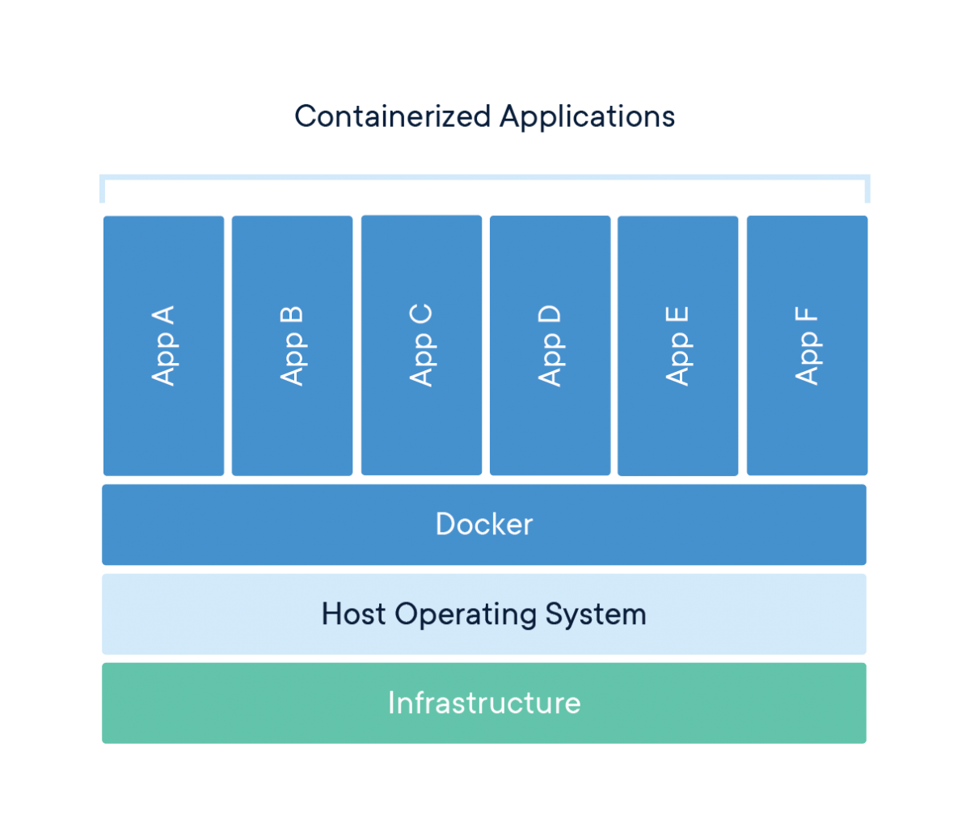
Containers Explained
Infrastructure - Laptop
Host Operating System
Windows 10 Pro – Hyper-V Provided WSL
Docker – Containerization Platform
App A - API Project
App B - Angular Project
App C – PostgreSQL
App D – SQL
App E & F – GO, Node, Dynamo
Notes:
This will make more sense when we look at the code

Slide 7
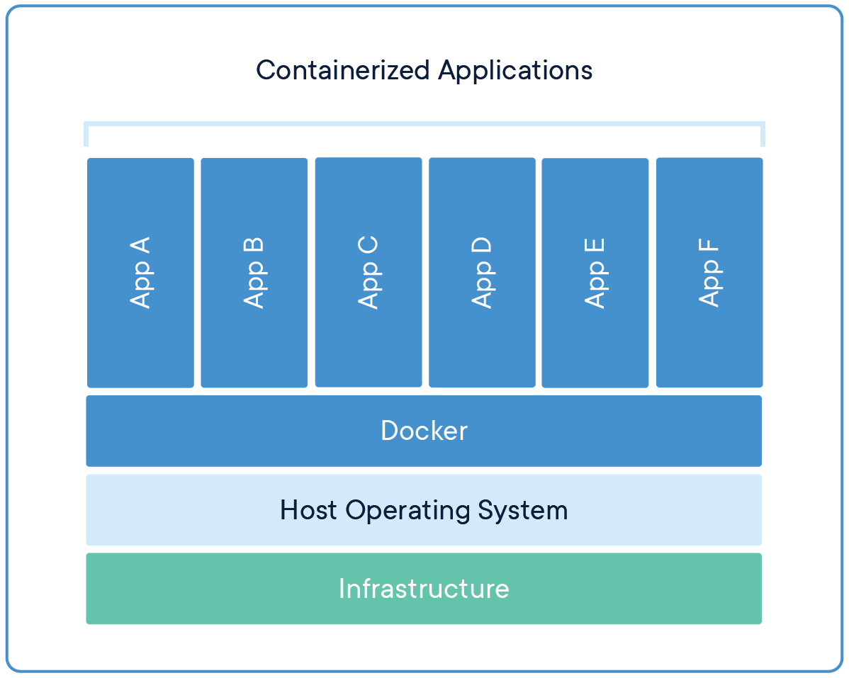
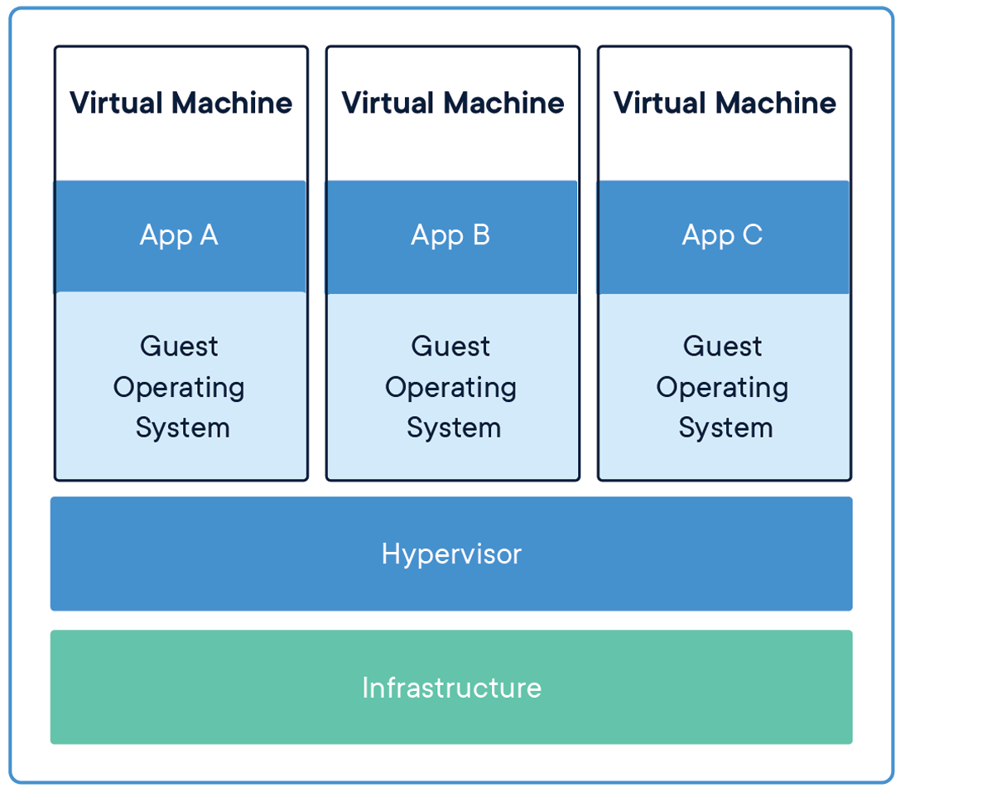
Containers vs VMs
Docker Containers are an abstraction at the app layer whereas Virtual Machines are an abstraction of physical hardware turning one machine into many.
Docker containers take up less space then VMs by sharing an OS whereas VMs include a full copy of an OS.

Slide 8
File Structure
https://github.com/dvdmrk/DockerPresentation/tree/main/Scripts#file-structure

Slide 9
Demo

