Slide 1
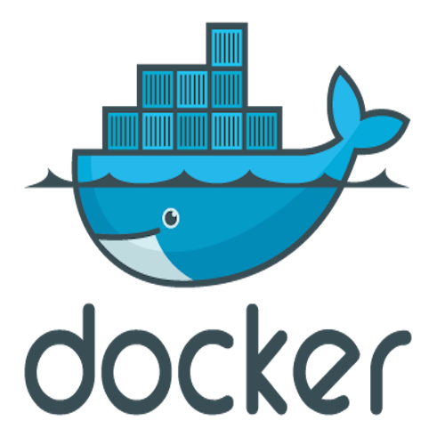
What is Docker?
Notes:
Now that I have your attention:

Slide 2
Docker for .NET Developers
Seamless CI/CD and releases, if that’s the Docker dream… why is it such a nightmare for dotnet developers?
Notes:
Raise you hand if:
- You’ve heard of docker
You use docker regularly
You’re a docker expert
Docker is a paradigm shift, it has a learning curve, but once you understand where it fits in the software development process, it’s a great tool to have in the toolbox.

Slide 3





https://DaveWritesCode.com/blog
linkedin.com/in/DaveWritesCode
@_DaveWritesCode
Notes:
For those of you who don’t know me, my name is David Merk and I made just enough mistakes to break into this industry 5 years ago after going to school to be a teacher. I was inspired to become a teacher by the movie school of rock. If you haven’t seen it, Jack Black teaches a class full of band nerds to be rock stars. Growing up struggling with confidence, I always wanted a teacher like this, and decided it was my responsibility to become this sort of teacher. However, I eventually came to understand that there’s no room for confidence in the public school curriculum so I returned to an earlier passion: programming. I’ve been writing code since before I could ride roller coasters, and with that paradigm I’m hopeful we all feel like docker rockstars after this presentation.

Slide 4
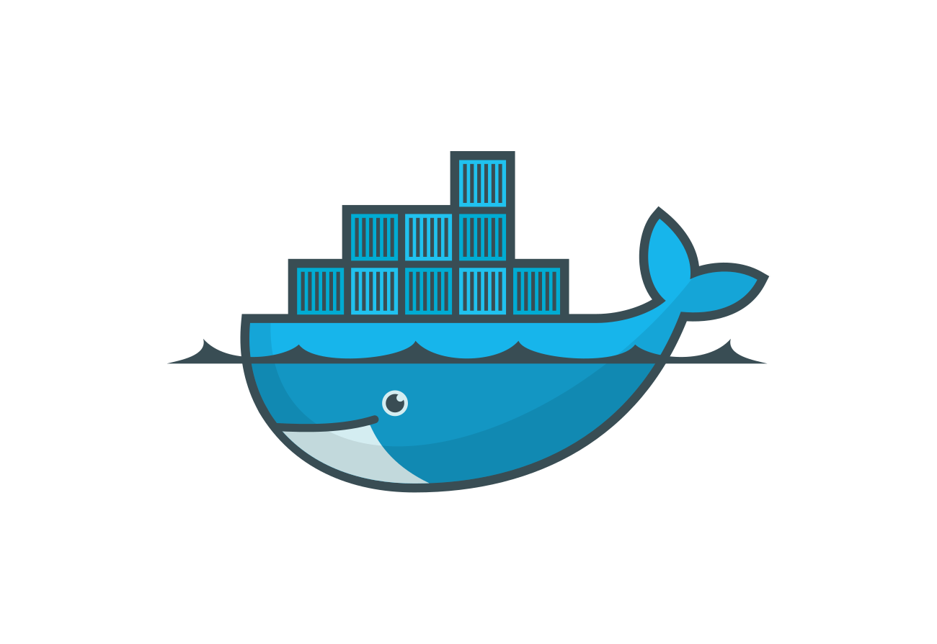
Introduction
Onboarding
What is Docker?
Docker CICD Dream
Source Code
Dockerfile
Docker Compose
Build Server
Build the image
Run the container
Push the image
Pull the image
Deploy/ Scale
Docker Compose
Docker Swarm
Questions
Additional Resources
Contact info
Container Registry

Slide 5

Docker Onboarding
Required:
Docker `choco install docker-desktop`
Recommended:
.NET `choco install dotnetcore-sdk`
Node.JS `choco install nodejs`
Git Bash `choco install git`
VS Code `choco install visualstudiocode`
Optional:
SSMS `choco install ssms`
Heidi SQL `choco install heidisql`
MySQL Workbench `choco install mysql.workbench`
https://bit.ly/2Y1FUx6
Notes:
Chocolatey is a package manager. I’ve used it to codify and automate the developer requirements of this presentation.

Slide 6
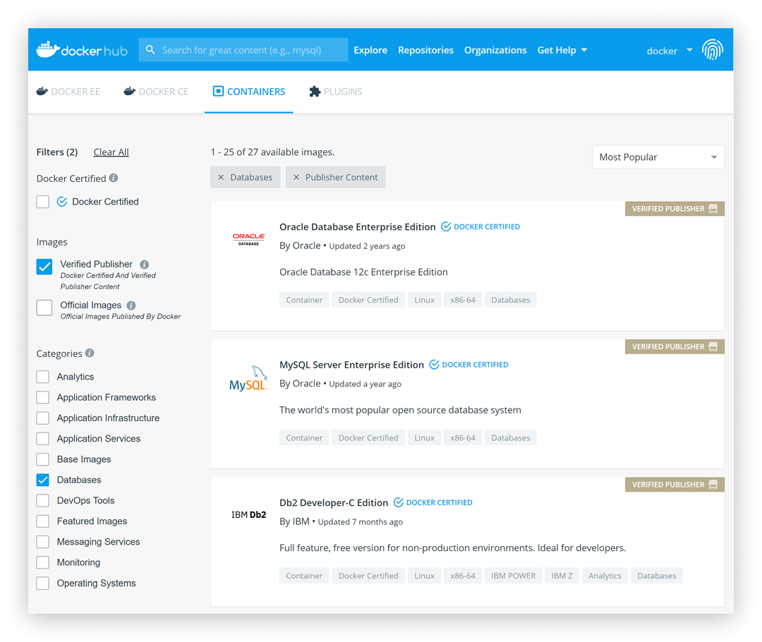
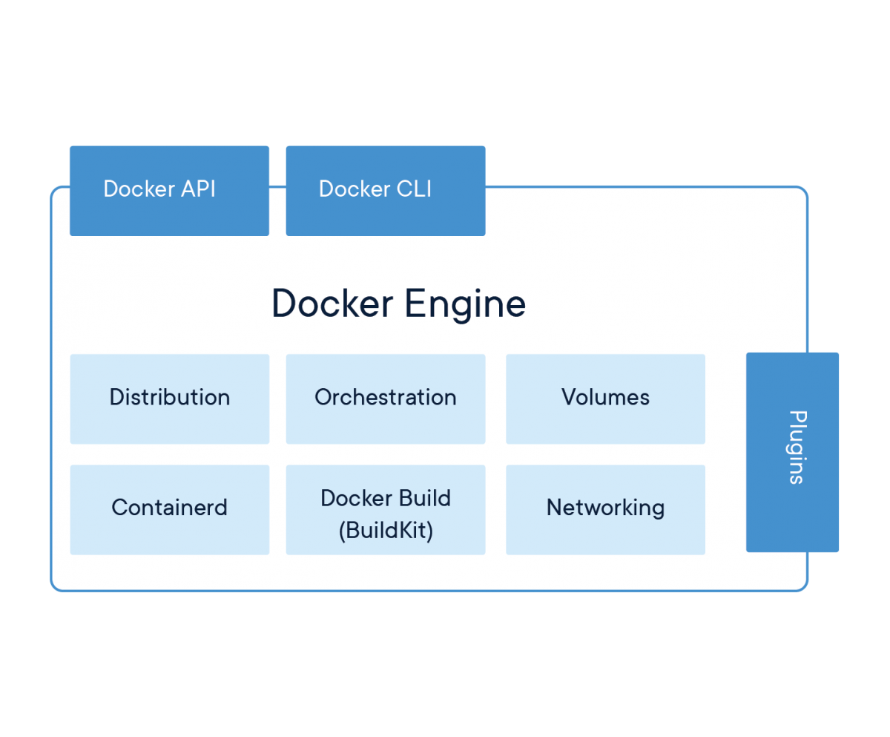
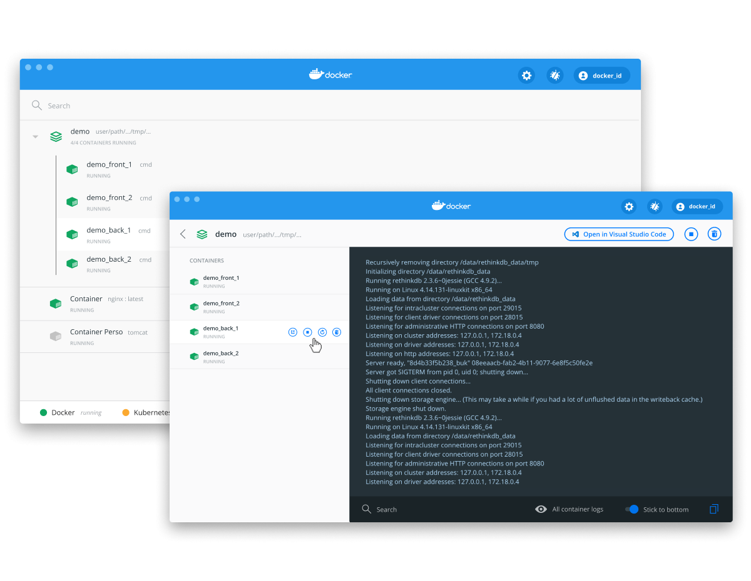
What is Docker?
Docker is a set of platform as a service products that use OS-level virtualization to deliver software in packages called containers.
Containers are comprised of application source code, system libraries, and the dependencies required to run your code in any environment.
A declaratively configured application image will run the same no matter what server, computer, or graphing calculator it’s are deployed to.

Slide 7
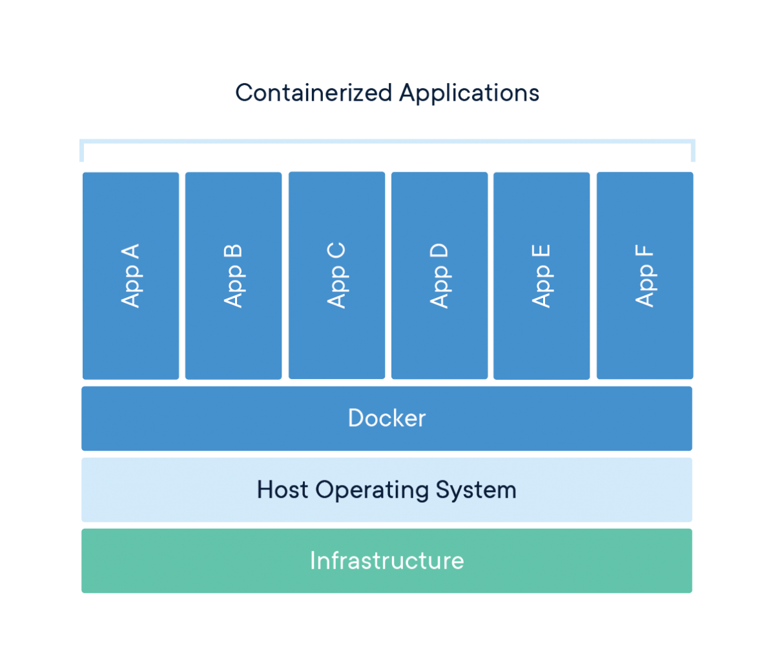
Containers Explained
App A - API Project
App B - Angular Project
App C – PostgreSQL
App D – SQL
App E & F – GO, Node, DynamoDB
Docker – Sharing Linux Kernel Running WSL
Host Operating System
Windows 10 Pro
Infrastructure - Laptop
Notes:
This will make more sense when we look at the code

Slide 8
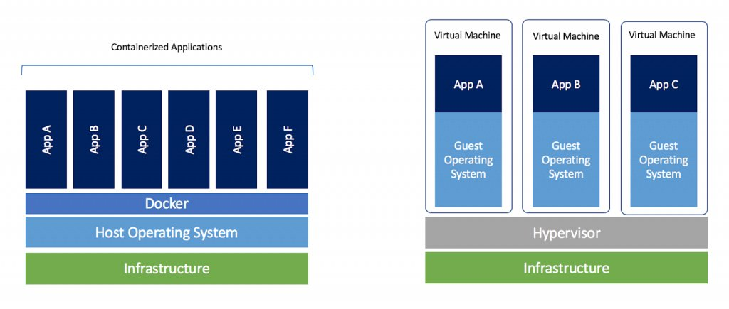
Containers vs VMs
Docker Containers are an abstraction at the app layer whereas Virtual Machines are an abstraction of physical hardware turning one machine into many.
Docker containers take up less space then VMs by sharing an OS whereas VMs include a full copy of an OS.

Slide 9
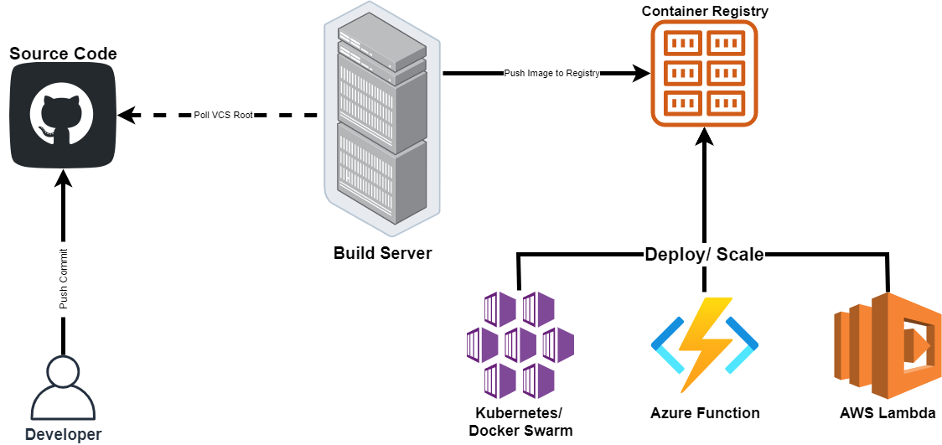
Docker CICD Dream

Slide 10
Source Code

Slide 11
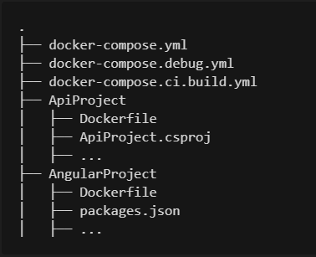

File Structure
https://bit.ly/2Y1FUx6

Slide 12
API Dockerfile

Slide 13
Angular Dockerfile

Slide 14
Docker Compose

Slide 15
Build Server

Slide 16
Build an Image
Build an Image
docker image build –t {{docker hub id}}/{{repo name}}:{{version}} .
docker image build –t dvdmrk/d4dd-web:latest -f JumpStartSpa .
docker image build –t {{docker hub id}}/{{repo name}}:{{version}} –f {{docker file location}} .
docker image build -t dvdmrk/d4dd-api:latest -f JumpStart.Api/Dockerfile .

Slide 17
List Images
docker images
docker image ls

Slide 18
Remove Image
docker image rm {{docker hub id}}/{{repo name}}:{{version}}
docker image rm {{space delimited list of image ids}}

Slide 19
Run a Container
docker container run –d –name {{desired container name}} –p {{desired port: exposed port}}
\ {{image name}}
docker container run –d --name api -p 8081:80 dvdmrk/d4dd-api:latest
docker container run –d --name web -p 8081:80 dvdmrk/d4dd-web:latest
http://localhost:8081

Slide 20
List Containers
docker ps
docker ps –a (list all regardless of status)
docker containers ls
docker containers ls (list all regardless of status)

Slide 21
Stop Containers
docker container stop {{space delimited list of container ids}}
http://localhost:8081

Slide 22
Start Containers
docker container start
http://localhost:8081

Slide 23
Container Registry

Slide 24
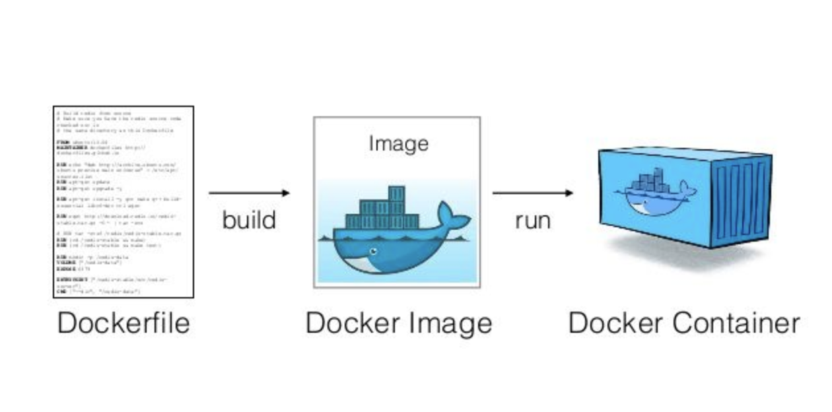
Containers vs Images
Images are build time constructs
An image is like a class
Containers are runtime constructs
A container is like an instance of a class

Slide 25
Docker Registries
DockerHub
ECR – Elastic Container Registry
ACR - Azure Container Registry

Slide 26
Docker Login
docker login

Slide 27
Push Image to Registry
docker image push {{docker hub id}}/{{repo name}}:{{version}}
docker image push dvdmrk/d4dd-api:latest
docker image push dvdmrk/d4dd-web:latest

Slide 28
Pop Quiz
How do we list all containers?
docker ps -a
How do we remove a container?
docker rm {{container id/ name}}
How do we list all images?
docker images
How do we remove an image?
docker rm {{image id/ name}}
How do we run a container?
docker container run -d --name {{container name}} -p {{port:port}} {{image name}}
http://localhost:8081

Slide 29
Recap
Notes:
Build an image
Push an image
Run/ Stop/ Start a container

Slide 30
Deploy/ Scale

Slide 31
Docker Compose
Compose
A tool for defining and orchestrating multiple docker containers
docker-compose -v
Docker Compose
A yaml config file containing the parameters and services required to run your application.
docker-compose up
docker-compose –f docker-compose.ci.yml up
Volumes
Preserves state across multiple service instantiations
Networks
By default a single network is configured

Slide 32
Docker Swarm
Manager vs Worker
Create a cluster - docker swarm init
Copy the join command to join multiple worker nodes into a single cluster.
List nodes - docker node ls
Deploy service
docker service create –name {{service name}} –replicas {{number of desired replicas}} {{image name}}
docker service create --name web -p 8080:80 --replicas 3 jumpstartweb
List services – docker service ls
Scale a service
docker service scale {service name}={desired number of instances}
docker service scale web=5

Slide 33
Pop Quiz
How do you list all images?
docker images ls
How do you list all running containers?
docker ps
How do you remove a container?
docker rm {{container name/ id}}
How do you list all running containers?
docker ps
What is unique about this?
One service is newer

Slide 34
Docker Stack
Launch Stack
docker stack deploy -c docker-compose.stack.yml {{service name}}
docker stack deploy -c docker-compose.stack.yml d4dd
List Stacks
docker stack ls
Inspect Stack
docker stack services {{service name}}
docker stack services d4dd
Inspect Container
docker stack ps {{service name}}
docker stack ps d4dd
Scale with stack file
Save and redeploy
Remove Stack
docker stack rm {{stack name}}
docker stack rm d4dd

Slide 35
Additional Resources
Docker Interactive Lab
Nigel Poulton - Getting Started with Docker
Docker - What are containers?
What is Docker (In 5 Minutes)
Docker for .NET Developers
CNCF Meetup

Slide 36
https://DaveWritesCode.com/blog
linkedin.com/in/DaveWritesCode
@_DaveWritesCode
Notes:
My name is David and I made just enough mistakes to break into this industry 5 years ago after pursuing a degree in education.
I wanted to be a teacher because I’ve historically lacked confidence and if it weren’t for the teachers I’ve had, I wouldn’t have the courage to do the things I do.
That said, I’m giving this presentation not as an educator or engineer, but as a catalyst for confidence.

