Slide 1

Docker for .NET Developers
Seamless CI/CD and releases, if that’s the Docker dream… why is it such a nightmare for dotnet developers?
Notes:
If you’ve seen docker done well using dotnet core, you’ll agree docker empowers a CI/CD pipeline so simple you could trust an intern to trigger the release.

Slide 2





https://DaveWritesCode.com/blog
linkedin.com/in/DaveWritesCode
@_DaveWritesCode
Notes:
My name is David and I made just enough mistakes to break into this industry 5 years ago after pursuing a degree in education.
I wanted to be a teacher because I’ve historically lacked confidence and if it weren’t for the teachers I’ve had, I wouldn’t have the courage to do the things I do.
That said, I’m giving this presentation not as an educator or engineer, but as a catalyst for confidence.

Slide 3
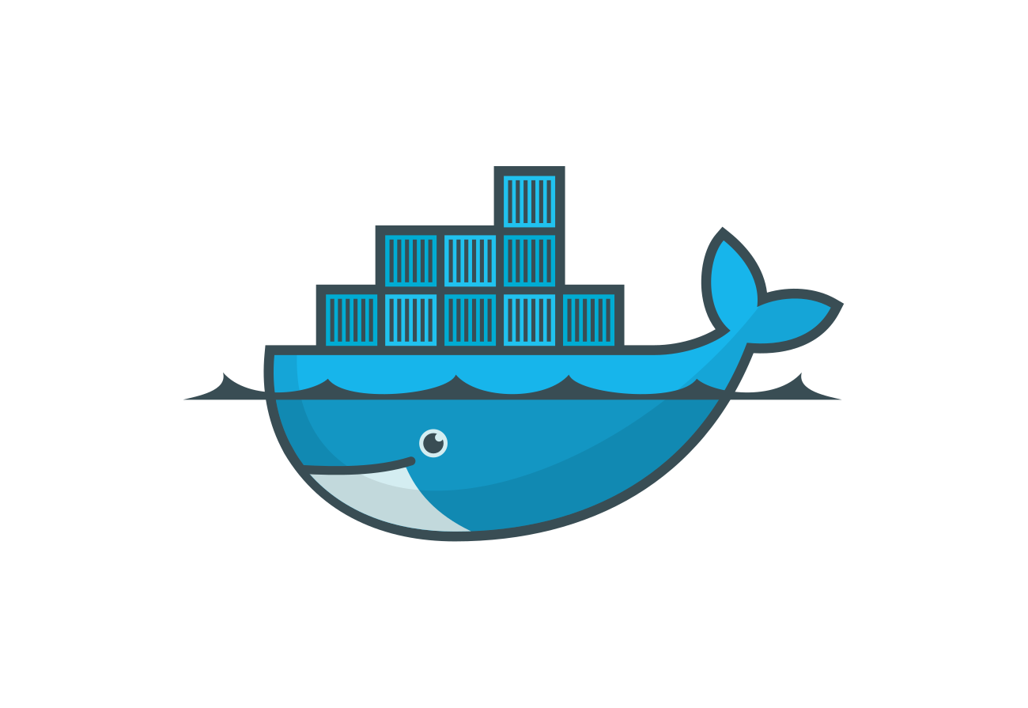
Introduction
Onboarding
What is Docker?
Docker CICD Dream
Source Code
Dockerfile
Docker Compose
Build Server
Build the image
Run the container
Exec the container
Container Registry
Push the image
Pull the image
Deploy/ Scale
Docker Compose
Docker Swarm
Questions
Additional Resources
Contact info

Slide 4

Docker Onboarding
Required:
Docker `choco install docker-desktop`
Recommended:
.NET `choco install dotnetcore-sdk`
Node.JS `choco install nodejs`
Git Bash `choco install git`
VS Code `choco install visualstudiocode`
Optional:
SSMS `choco install ssms`
Heidi SQL `choco install heidisql`
MySQL Workbench `choco install mysql.workbench`
Notes:
If you’d like to follow along with the demo towards the end of this presentation: get started by following the instructions in the Scripts README.md.
I’m going to running the demo from within Microsoft Sandbox. That means I’ll be running docker containers on a virtual machine.

Slide 5
What is Docker?
Docker is an open-source containerization platform.
It enables developers to package applications into containers
Containers are standardized executable components called images.
Containers are comprised of application source code and the the system libraries/ dependencies required to run that code in any environment.
This makes it easy for us to develop and deploy apps in a way that includes dependencies.
Because dependencies/ libraries/ and source are preconfigured and coded- they will run the same no matter where they are deployed to or what machine they’re on.
BENEFITS: system agnostic, simpler to use, less work to develop, easier to maintain and deploy.
Notes:
If you’re watching at home, I do not recommend taking a shot every time I say containers.

Slide 6
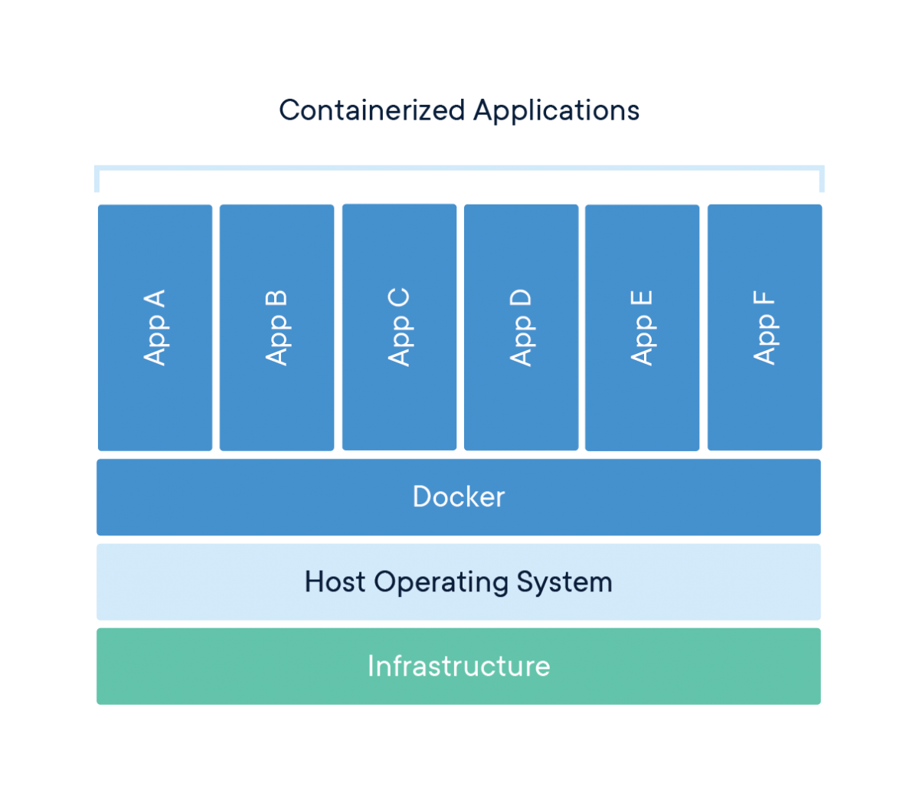
Containers Explained
App A - API Project
App B - Angular Project
App C – PostgreSQL
App D – SQL
App E & F – GO, Node, DynamoDB
Docker – Sharing Linux Kernel Running WSL
Host Operating System
Windows 10 Pro
Infrastructure - Laptop
Notes:
This will make more sense when we look at the code

Slide 7
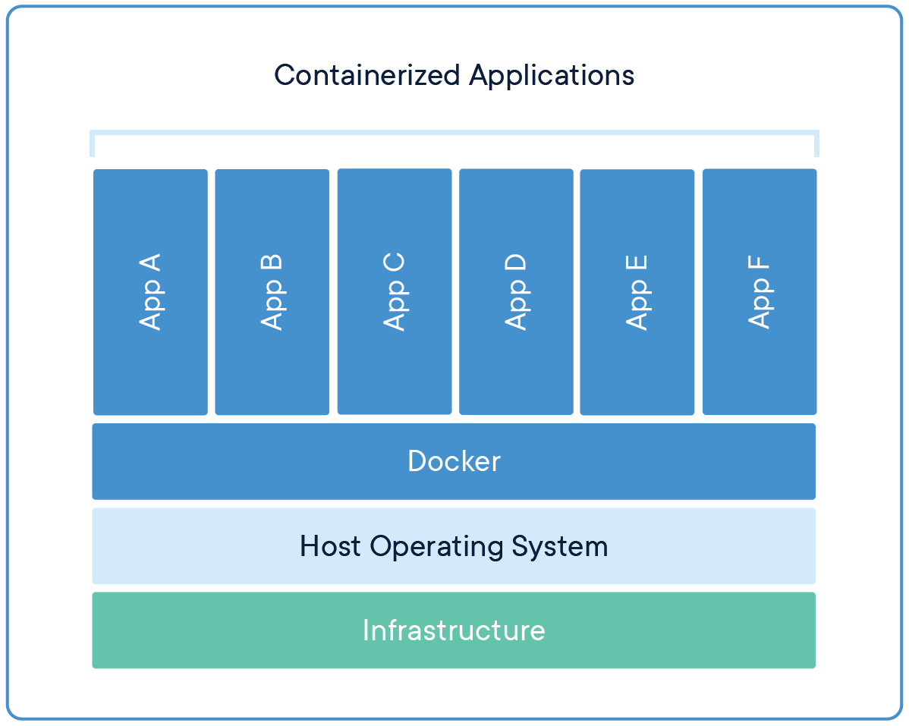
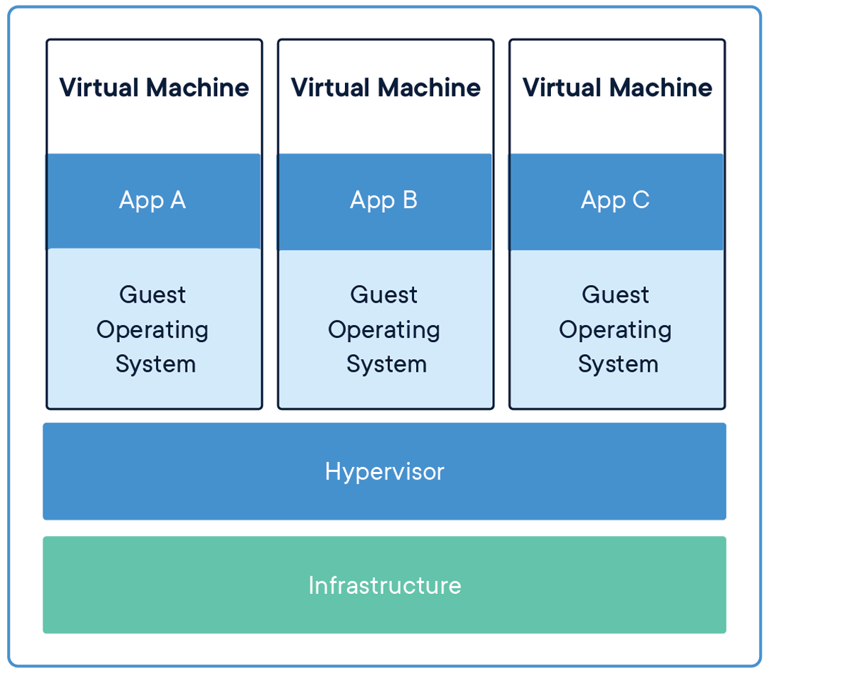
Containers vs VMs
Docker Containers are an abstraction at the app layer whereas Virtual Machines are an abstraction of physical hardware turning one machine into many.
Docker containers take up less space then VMs by sharing an OS whereas VMs include a full copy of an OS.

Slide 8
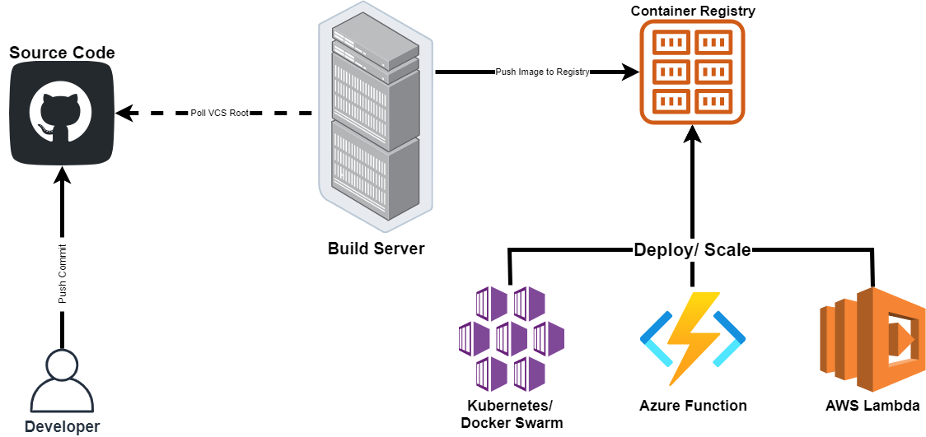
Docker CICD Dream

Slide 9
Source Code

Slide 10
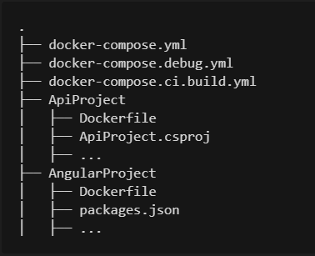
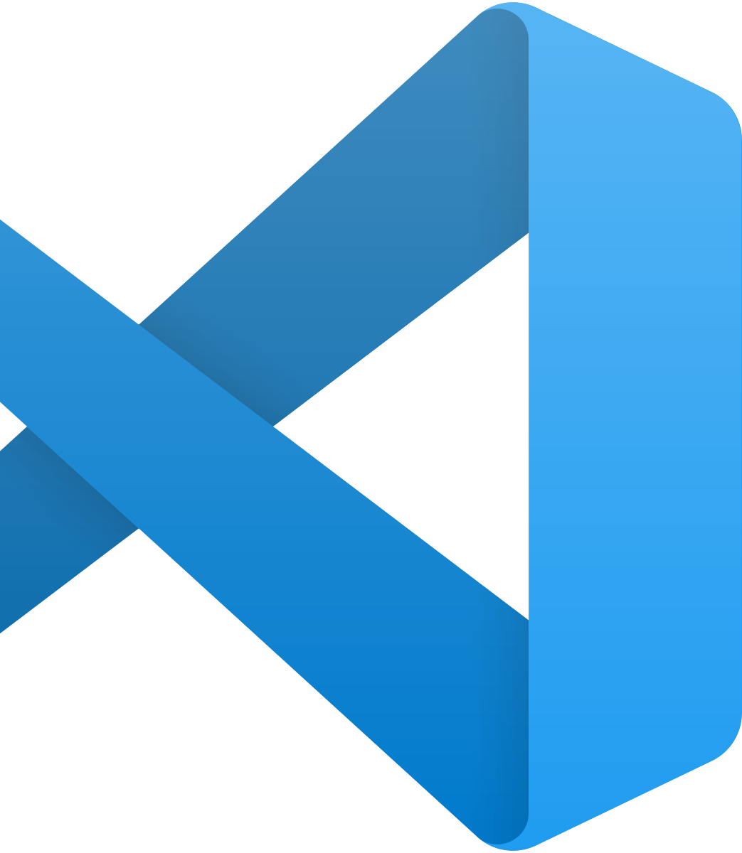
File Structure

Slide 11
API Dockerfile

Slide 12
Angular Dockerfile

Slide 13
Docker Compose

Slide 14
Build Server

Slide 15
Build an Image
Build an Image
docker image build –t {{docker hub id}}/{{repo name}}:{{version}} .
docker image build –t dvdmrk/d4dd-web:latest .
docker image build –t {{docker hub id}}/{{repo name}}:{{version}} –f {{docker file location}} .
docker image build -t dvdmrk/d4dd-api:latest -f JumpStart.Api/Dockerfile .

Slide 16
List Images
docker images
docker image ls

Slide 17
Remove Image
docker image rm {{docker hub id}}/{{repo name}}:{{version}}
docker image rm {{space delimited list of image ids}}

Slide 18
Run a Container
docker container run –d –name {{desired container name}} –p {{desired port: exposed port}}
\ {{image name}}
docker container run –d --name api -p 8081:80 dvdmrk/d4dd-api:latest
docker container run –d --name web -p 8081:80 dvdmrk/d4dd-web:latest
http://localhost:8081

Slide 19
List Containers
docker ps
docker ps –a (list all regardless of status)
docker containers ls
docker containers ls (list all regardless of status)

Slide 20
Stop Containers
docker container stop {{space delimited list of container ids}}
http://localhost:8081

Slide 21
Start Containers
docker container start
http://localhost:8081

Slide 22
Container Registry

Slide 23
Containers vs Images
Images are build time constructs
An image is like a class
Containers are runtime constructs
A container is like an instance of a class

Slide 24
Docker Registries
DockerHub
ECR – Elastic Container Registry
ACR - Azure Container Registry

Slide 25
Docker Login
docker login

Slide 26
Push Image to Registry
docker image push {{docker hub id}}/{{repo name}}:{{version}}
docker image push dvdmrk/d4dd-api:latest
docker image push dvdmrk/d4dd-web:latest

Slide 27
Pop Quiz
How do we list all containers?
docker ps -a
How do we remove a container?
docker rm {{container id/ name}}
How do we list all images?
docker images
How do we remove an image?
docker rm {{image id/ name}}
How do we run a container?
docker container run -d --name {{container name}} -p {{port:port}} {{image name}}
http://localhost:8081

Slide 28
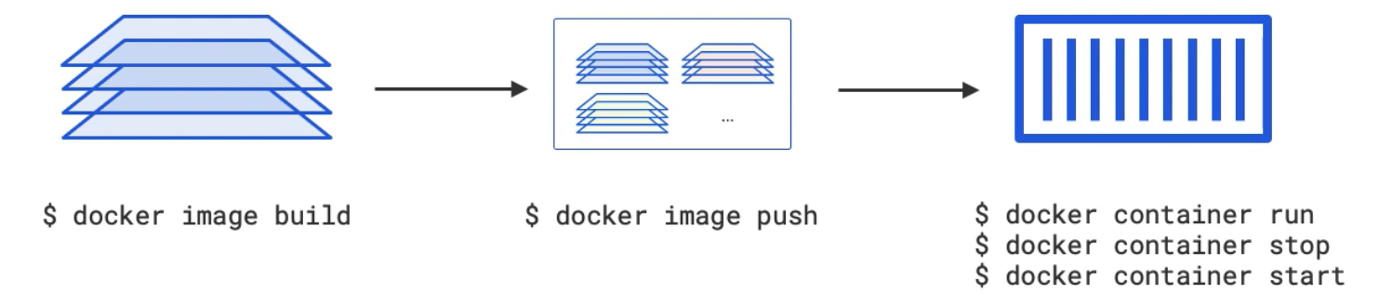

Slide 29
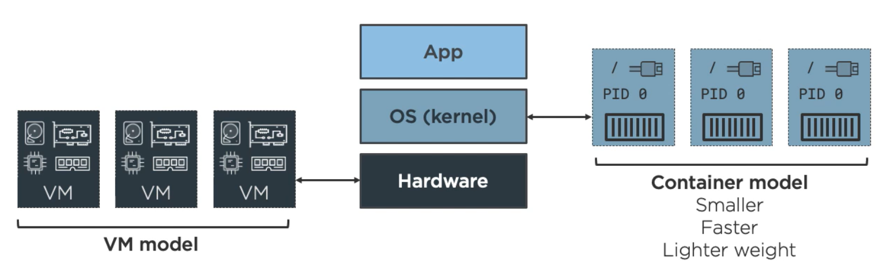

Slide 30
Deploy/ Scale

Slide 32
Additional Resources
Docker Interactive Lab
Nigel Poulton - Getting Started with Docker
Docker - What are containers?
What is Docker (In 5 Minutes)
Docker for .NET Developers
CNCF Meetup

Slide 33
https://DaveWritesCode.com/blog
linkedin.com/in/DaveWritesCode
@_DaveWritesCode
Notes:
My name is David and I made just enough mistakes to break into this industry 5 years ago after pursuing a degree in education.
I wanted to be a teacher because I’ve historically lacked confidence and if it weren’t for the teachers I’ve had, I wouldn’t have the courage to do the things I do.
That said, I’m giving this presentation not as an educator or engineer, but as a catalyst for confidence.

