Slide 1
Refactoring your health
A Developers Guide to Outliving your Framework

Slide 2

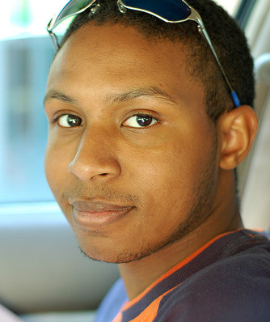

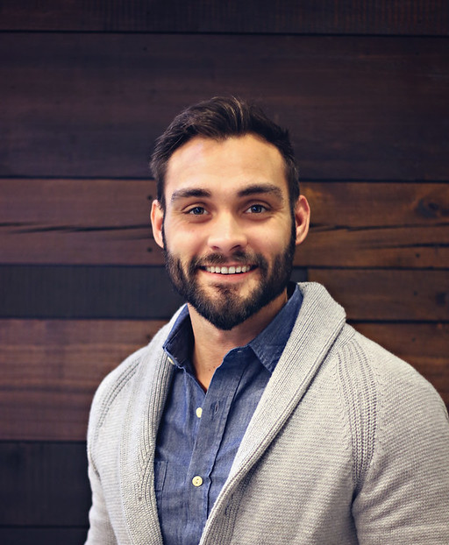

Presenters
David Merk – QSR Automations
https://DaveWritesCode.com
https://github.com/dvdmrk
https://linkedin/in/DaveWritesCode
Tony Thigpen – ALLTOUR
https://TonyThigpen.com
https://github.com/TonyTornado
https://www.linkedin.com/in/tt2k13/

Slide 3

Thesis:
“If you’re not happy with the life you have, it’s your responsibility to find a life that will make you happy.” ~ Two guys who weren’t happy with their lies so they quit their jobs, became developers, and gave this presentation

Slide 4
Health toxic industry
Snacks
Drinks
Catering
Notes:
I’m not complaining, I’m just saying, none of these options are healthy. Every time I go to the .NET Meetup, it’s Pizza. All of my favorite booths this week are giving out candy and Redbull. Why is no one giving out water? I’ve seen exceptionally talented developers walk 3 blocks to get a bottle of water.

Slide 5
Docility and isolation
Chips, Sodas, Pizza, Sitting all Day, Working Remote…
This is how we get recruited, and these are our benefits.
Notes:
Still, keep in mind. I’m not complaining. I’m also not trying to call anyone out. Like I said, these are our “benefits.” And we are so lucky to have them. It’s nothing personal, I just can’t give a presentation where I talk about healthy eating habits and blame the person who’s eating the food they’ve been so generously provided.

Slide 6
Productivity stability
With a mantra like “Eat, Sleep, Code…”
Notes:
With a mantra like eat sleep code, and that’s the goal, and that’s what success looks like. And that’s Mark Zuccherberg, Bill Gates, Elon Musk… and I have great respect and appreciation, and I’m the last person who should say this because all my heros work 90 hours a week; but that’s our industry. I’m not trying to call anyone out for having loyal employees, I just can’t talk about work life balance until after I’ve recognized the reason why it’s imbalanced.

Slide 7
That’s the problem
We work in an industry that wants us to learn new languages, but doesn’t want us to live long enough to see them become unsupported.
Notes:
This is the most important topic in the world to me, and I wanted to bring my friend and gym mentor to speak on this subject because between the 2 of us we have almost 100 years of exercise experience. We hit two-a-days, the math works out.

Slide 8
What’s the solution
Small steps, of increasing complexity, every single day, for the rest of your life…
Notes:
You don’t have to change everything. But if you start making changes, and holding yourself accountable to those changes, you will notice a difference.
This presentation is about the easy aspects of your life that you can refactor to live healthier.

Slide 9
Lets talk about your diet
How often do you eat out?
How much water do you drink in a day?
Notes:
This isn’t the presentation where we tell you we’re perfect. It’s the presentation where we tell you we’re flawed and give you some tools that we use on our best days. Tony has some awesome snacking habbits.

Slide 10

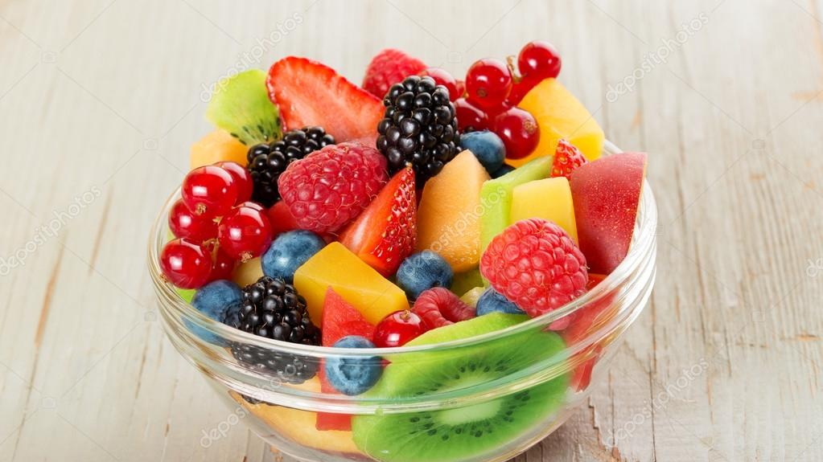
THE BMr
AND IIfYM
Notes:
Let’s talk about the Basal Metabolic Rate and “If it meets your macros.” Has anyone here heard of the BMR? Do you know the calculation? Me neither, but I know if I don’t go to the gym and I eat more than 2000 calories a day. I’m not here to body shame you for not being a certain shape, I’m saying take care of yourself, this is how we take care of ourselves.

Slide 11
Exercise doesn’t have to be a chore
Get a Standing desk
Take a Nice walk
Toss a medicine ball at stand up
Go to the gym with me
Notes:
As a guy who lifts a lot of days of the week, that is not the way to be healthy. That’s not even why I do it. I do it to be social, and if anyone ever wants to go to my gym you have an open invitation. For me the gym is mental health. Choose what’s best for you.
As QSR we talk 2 walks every day, they last 15 to 20 minutes and they’re through nature. It’s social, its cardiovascular, it’s enjoyable. We get vitamin D, we get to know our co-workers as people.

Slide 12

exercise
Start where you are
Use what you’ve got
Do what you can.
Notes:
The moral of the story is that the best exercise is the one you want to do again, but for the purpose of this presentation, Tony is going to teach you some exercises.

Slide 13
What is work life balance?
It’s having the energy to write code or learn a new language in your free time.
Notes:
No, I’m actually asking… just kidding. I work for a company that promotes both professional development and work life balance. Work life balance is having the energy to write code or learn a new language in your free time. Work life balance is when you get off work and have the energy and mood to go home and: cook dinner, talk to loved ones, be outside.
Work life balance is sick days, mental health days, maternity and paternity leave, bereavement.
Work life balance is receiving mentorship and encouragement.
Work life balance is working with technologies you love on products you’re proud of.
Work life balance is flexible schedules and remote options.

Slide 14

The end

Slide 15

special Thanks
https://www.qsrautomations.com/company/careers/

Slide 16
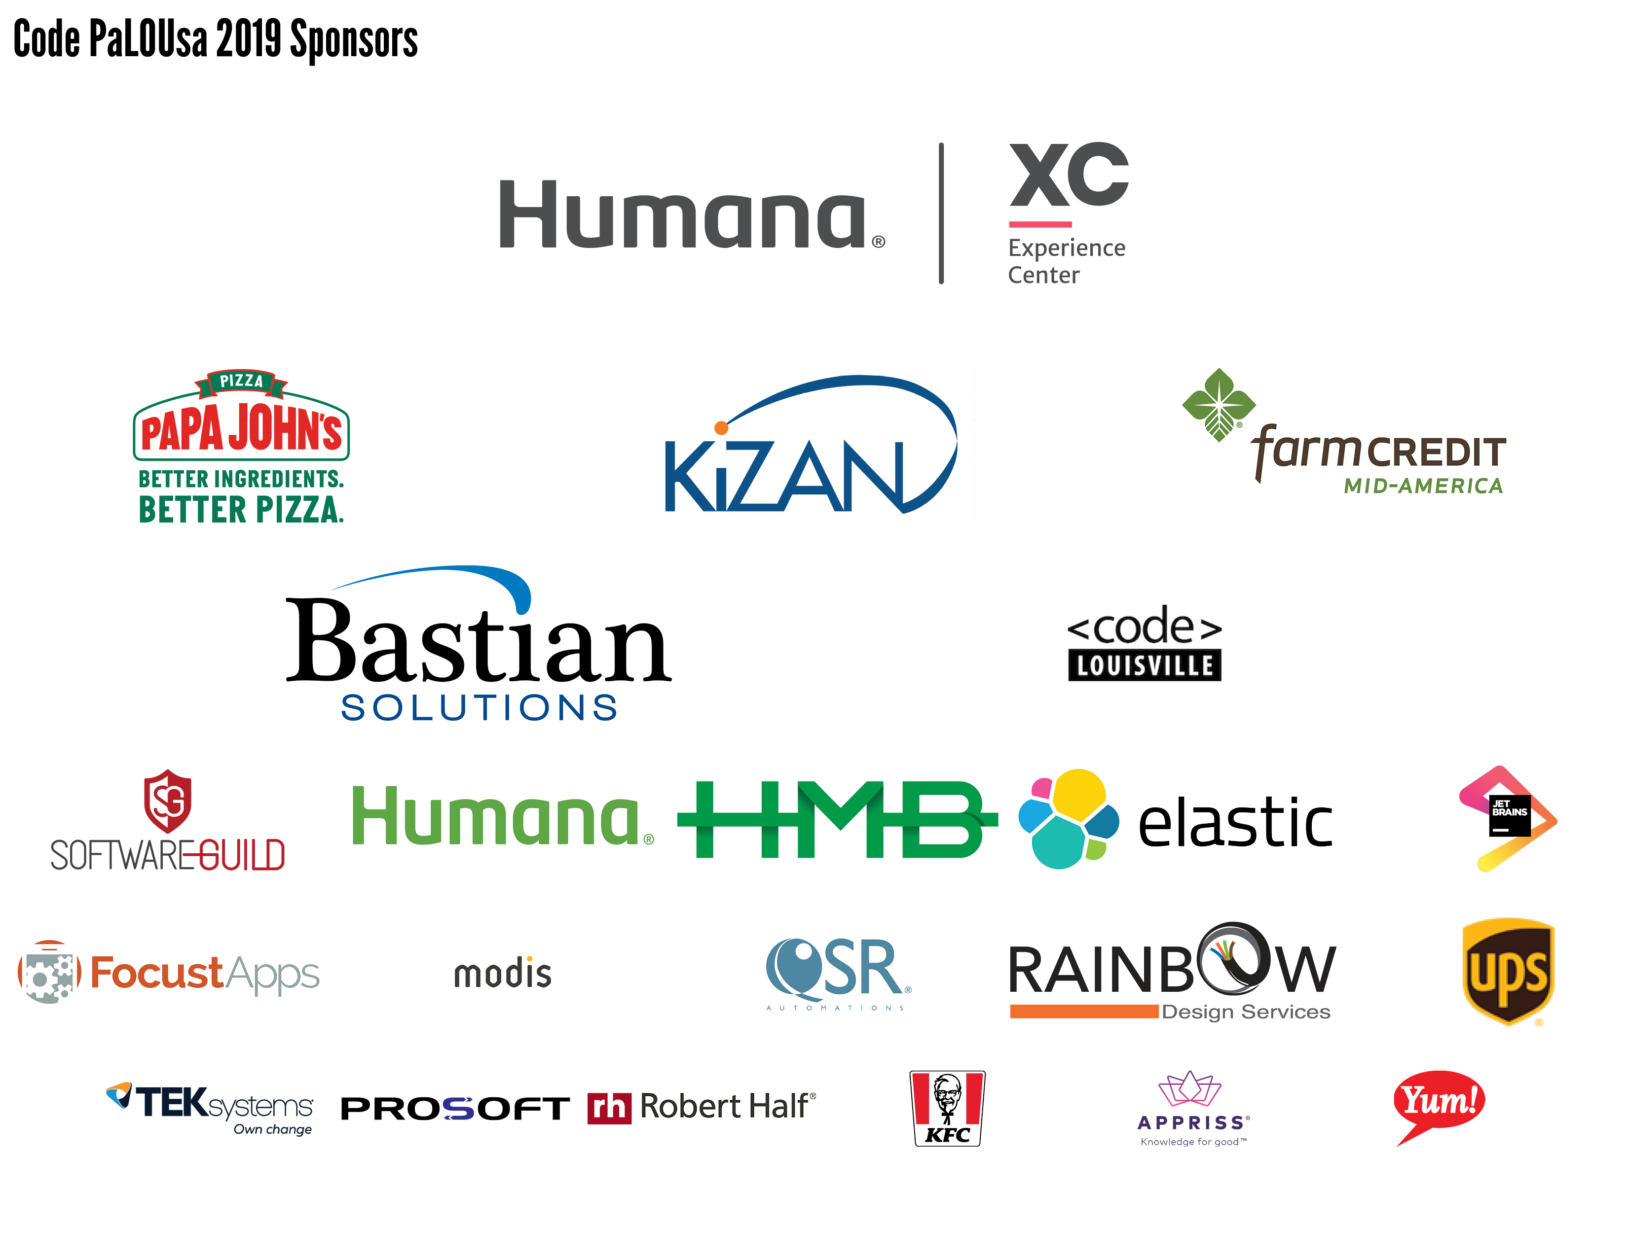

Slide 17
Presenters
David Merk – QSR Automations
https://DaveWritesCode.com
https://github.com/dvdmrk
https://linkedin/in/DaveWritesCode
Tony Thigpen – ALLTOUR
https://TonyThigpen.com
https://github.com/TonyTornado
https://www.linkedin.com/in/tt2k13/

