Slide 1

Microsoft Engage 2022
PRESENTATION
DATA ANALYSIS
Presented by:
VEDANT DESHMUKH

Slide 2
Introduction
We as humans always analyze certain situations and then make some decisions, be it on self-level or group level.
In the present data-driven world, a huge amount of data is available, and the analysis can be vital in decision making and getting success.
Currently with the advent of strong mathematical foundations and technological advancements, data analytics is being adopted in every industry.
Analysis of data can help in drawing many useful insights which can help in setting a future action plan.

Slide 3
Objective
To perform overall and individual data analysis for automobile companies.
To determine how this analysis can be used in the real world.
To develop an interactive web application for showing results

Slide 4
Present Study:
I have used provided sample automobile dataset for the current investigation.
Using 2021 data from Google, the 'sale_quantity’ column has been added to the dataset, which represents the number of units sold for the corresponding model.
Analysis is divided into 2 parts: a) Overall b) Individual
In the overall analysis, various features have been analyzed for all companies together.
In individual analysis, various features have been analyzed for individual companies.
After obtaining results and drawing final conclusions, the Streamlit library has been used to develop a web application for showing the same.

Slide 5
Methodology
Analysis
Results
Exploring Data
1
3
5
2
4
6
Data Processing
and Cleaning
Web Application
Conclusion
5

Slide 6





Libraries Used:
For Data manipulation and analysis
For working with arrays
For plotting graphs
numpy
For creating web application
For data visualization

Slide 7
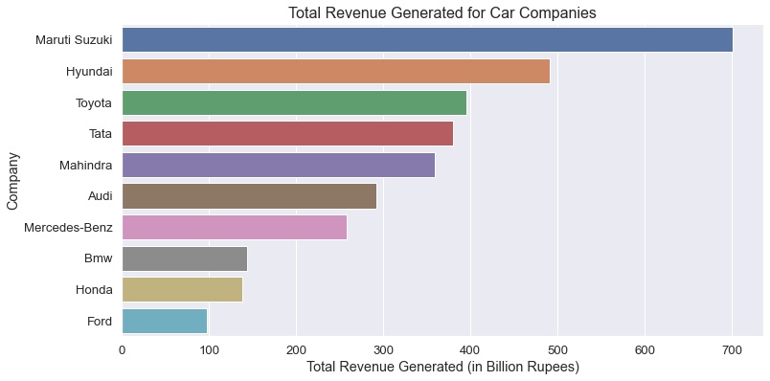
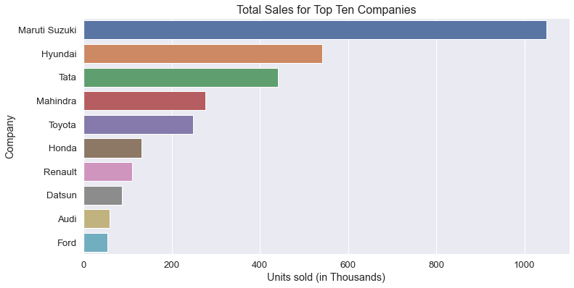
Few Results: Overall Analysis
Fig 1
Fig 2

Slide 8
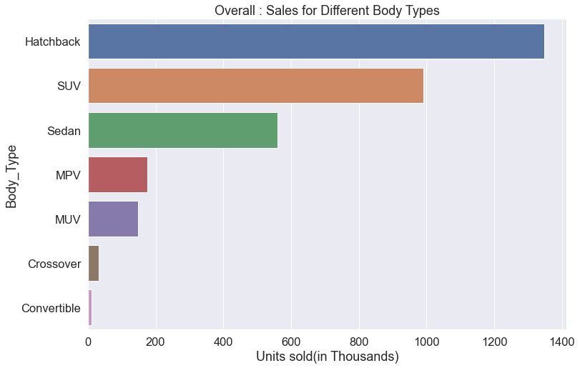
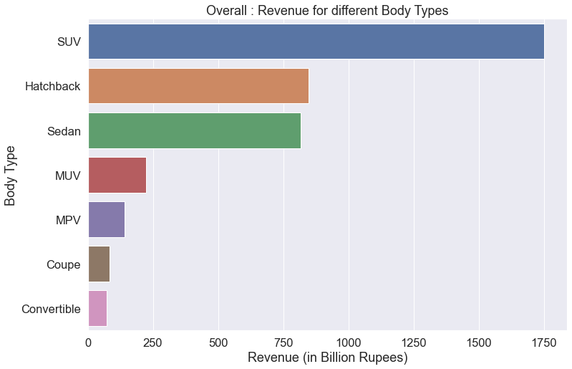
Few Results: Overall Analysis
Fig 3
Fig 4

Slide 9
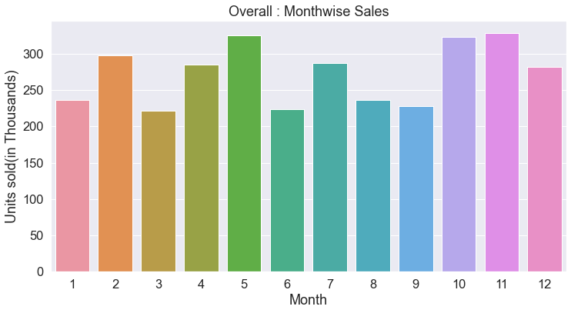
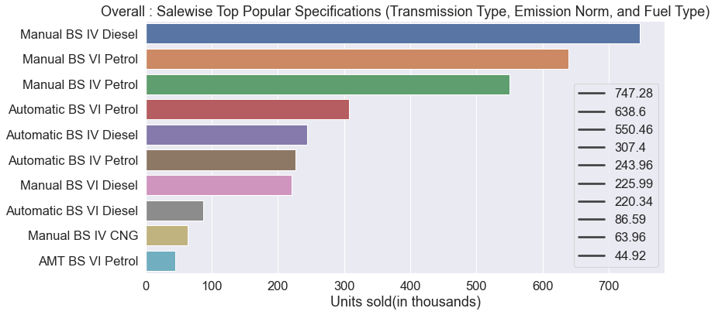
Few Results: Overall Analysis
Fig 5
Fig 6

Slide 10
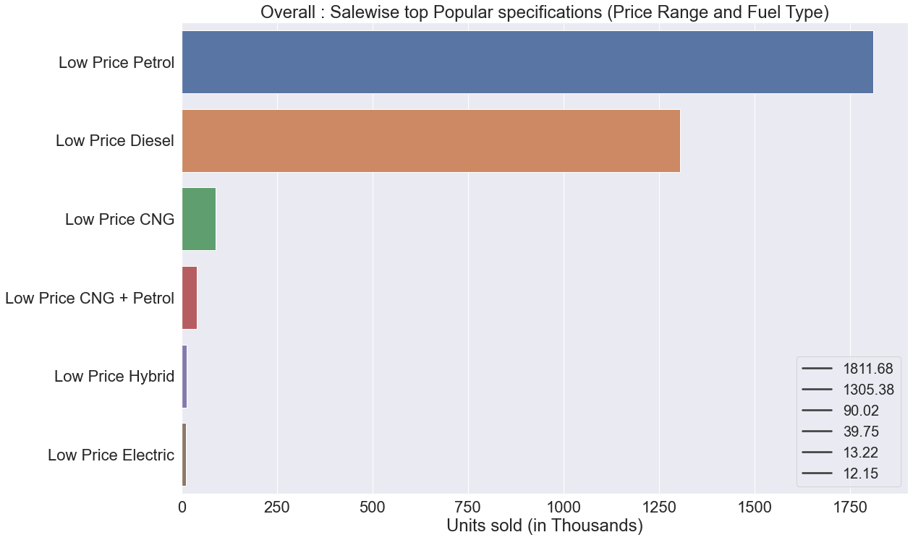
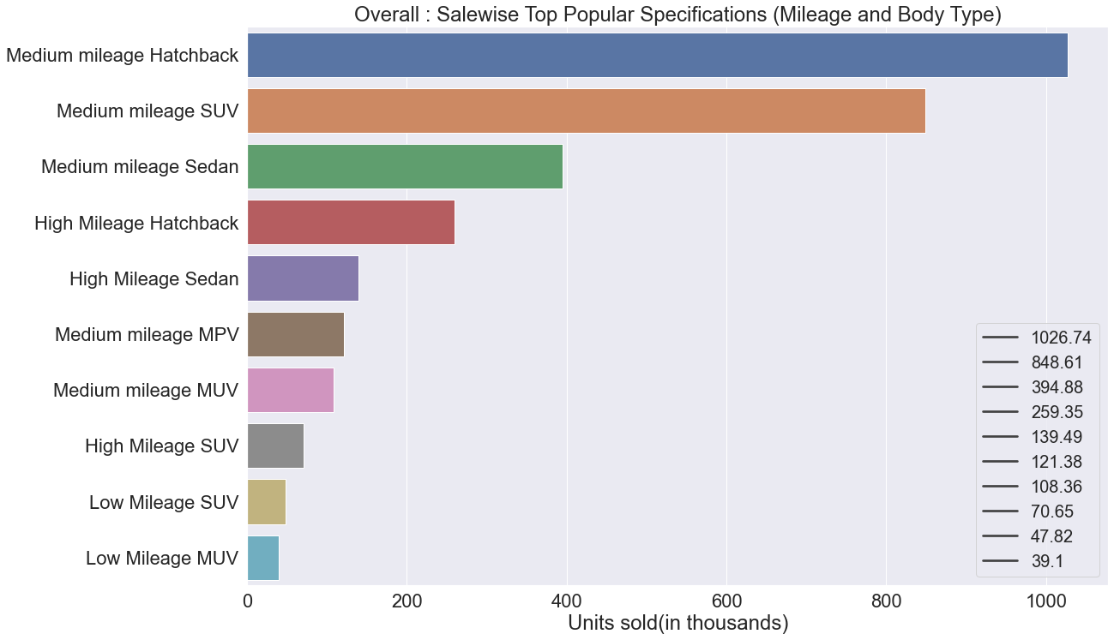
Few Results: Overall Analysis
Fig 7
Fig 8

Slide 11
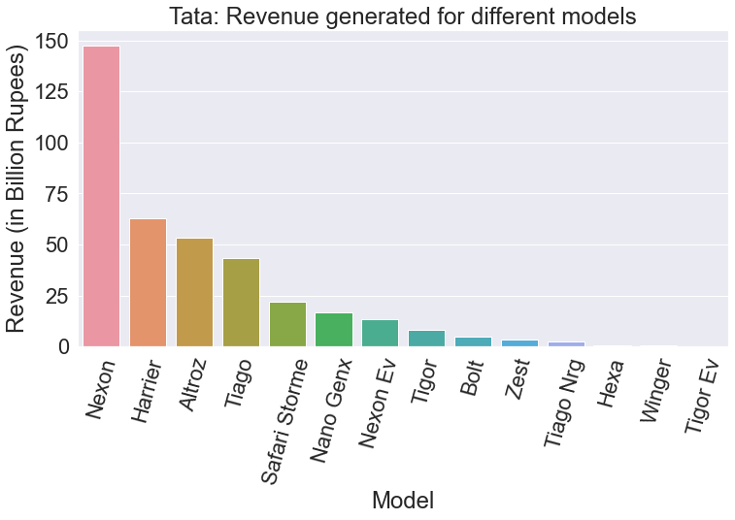
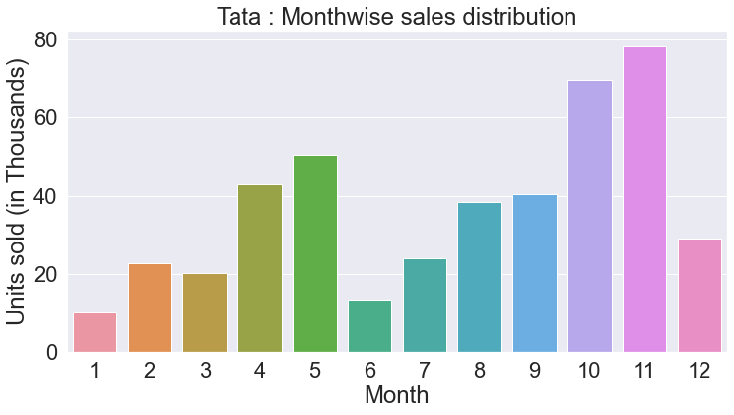
Few Results: Individual Analysis
Fig 9
Fig 10

Slide 12
Results:
Maruti Suzuki has the highest total revenue around 700 Billion Rupees.
Sales for hatchbacks are highest, making it the most popular car type.
Revenue-wise SUV is at the top position.
Overall sales are at peak around the period of October-November.
Individual analysis of Tata also shows that sales are at high around the period of October-November.
Overall: Sales-wise following combinations of features are the Most popular
a. Transmission Type, Emission Norm, and Fuel Type: -> Manual, BS-IV, Diesel
b. Mileage, Body Type: -> Medium Mileage (12-24 Km/Litre), Hatchback
c. Price Range and Fuel Type: -> Low price (Below 1.5 Million Rs), Petrol
Overall: Petrol cars have the highest share of sales, among various fuel type cars

Slide 13
Conclusions
The automobile dataset has been analyzed in the current study.
The study can provide a variety of insights that can aid in improved decision-making.
For example, a company can choose the best time to launch a new product by looking at the month-by-month sales distribution.
When designing a new automobile, the popularity of different specifications can be taken into account.
There are various elements to consider when determining the best timing to launch a product, automobile specs, etc. Including such factors in the analysis would undoubtedly aid in better decision-making.
When compared to existing high-performing rivals, a company can utilize this sort of research to identify areas for development.

Slide 14
Conclusions cont.
Here, I have assumed that this is a one-year dataset (2021). Furthermore, we can gain precise information about trends by gathering and analyzing data for numerous years.
In addition, Machine learning can be used for both predictive and descriptive analyses.
With further data, performing sales forecasting, can help us anticipate the number of sales based on features.
These sorts of comprehensive data analytics can help us find solutions to a range of topics, including:
a. Should a certain type of automobile be produced?
b. What should the specifications be?
c. In a given quarter, how many units should be produced?
d. Is there a downward trend in sales?
and so on.
Furthermore, sentiment analysis can provide us with information on people's sentiment towards a product.
This is a very vast field, and it has a lot of scope for future research

Slide 15
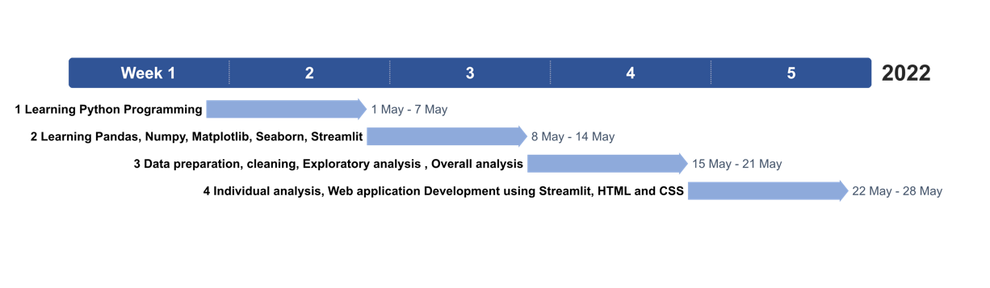
Timeline

Slide 16
References
acehacker.com/microsoft/engage2022/#challengesThe Analysis
streamlit.io
matplotlib.org
seaborn.pydata.org
pandas.pydata.org
online.officetimeline.com

Slide 17
Thank You!

