Slide 1
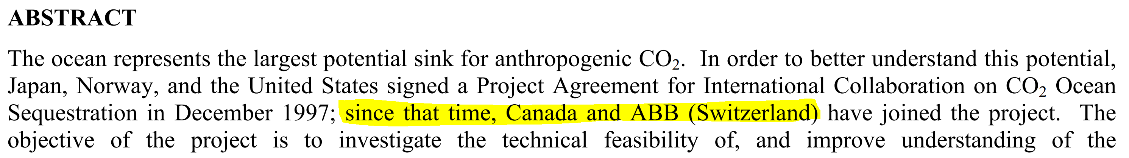
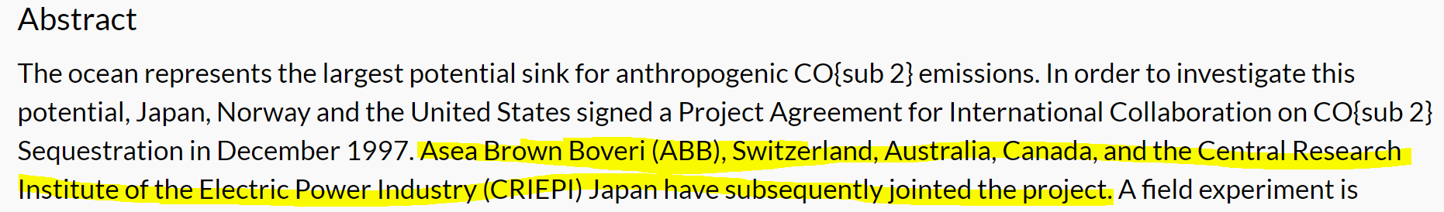

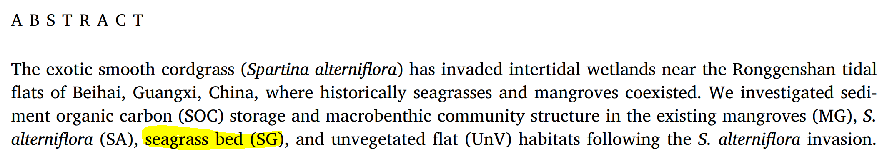
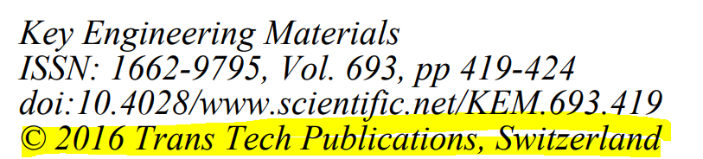

Switzerland
International Group (Int. Grp)
TOTAL: 20 papers
Copyright
Name Mistakes
With Springer, MDPI and other journals
Abbreviation of “Seagrass bed” = SG confused with the canton of St Gall (SG) in Switzerland

Slide 2
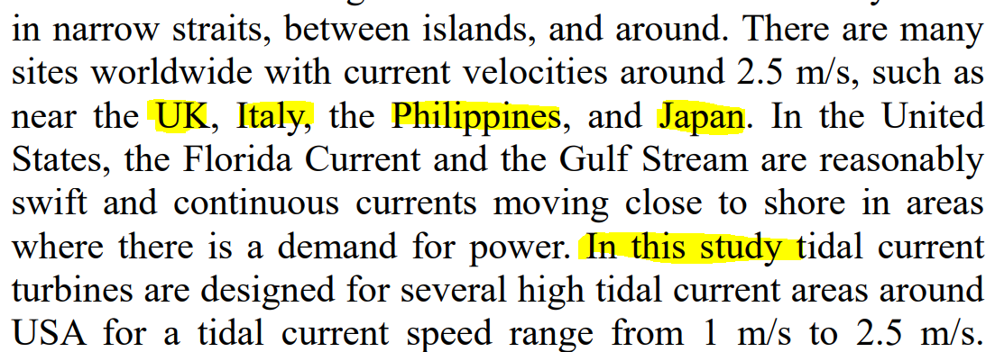
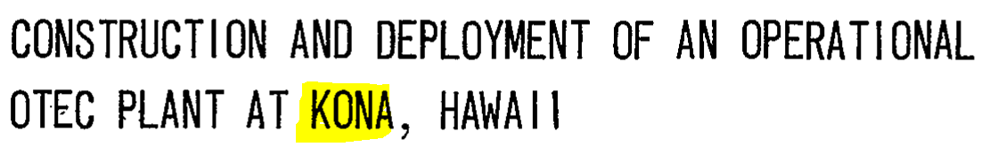

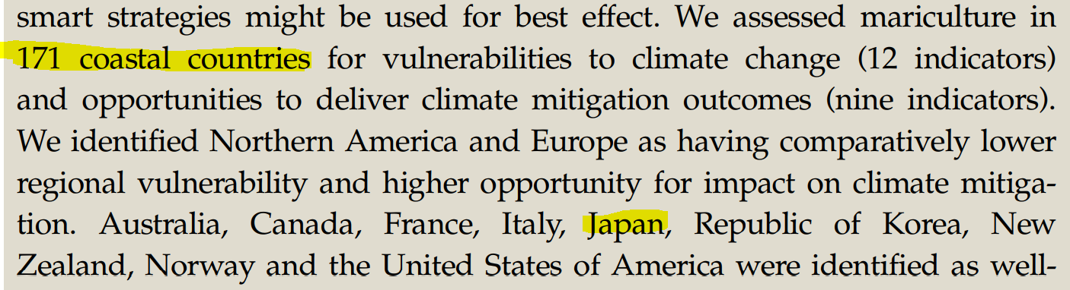
Japan
Comparison/Example
Country mentioned only in the summary, as an example.
TOTAL: 20 papers
Kumejima (city in Japan), used for a comparison
Name mistake
Higher Scale
Kona identified as a city in Hawaii but also as a Japanese City called Kona-zaki

Slide 3
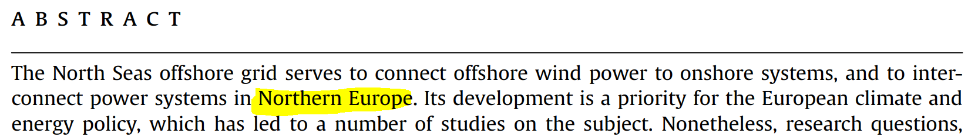
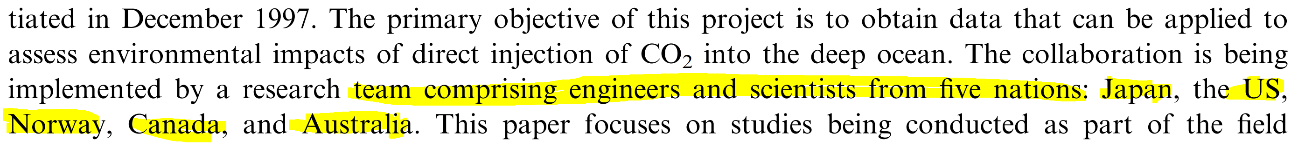
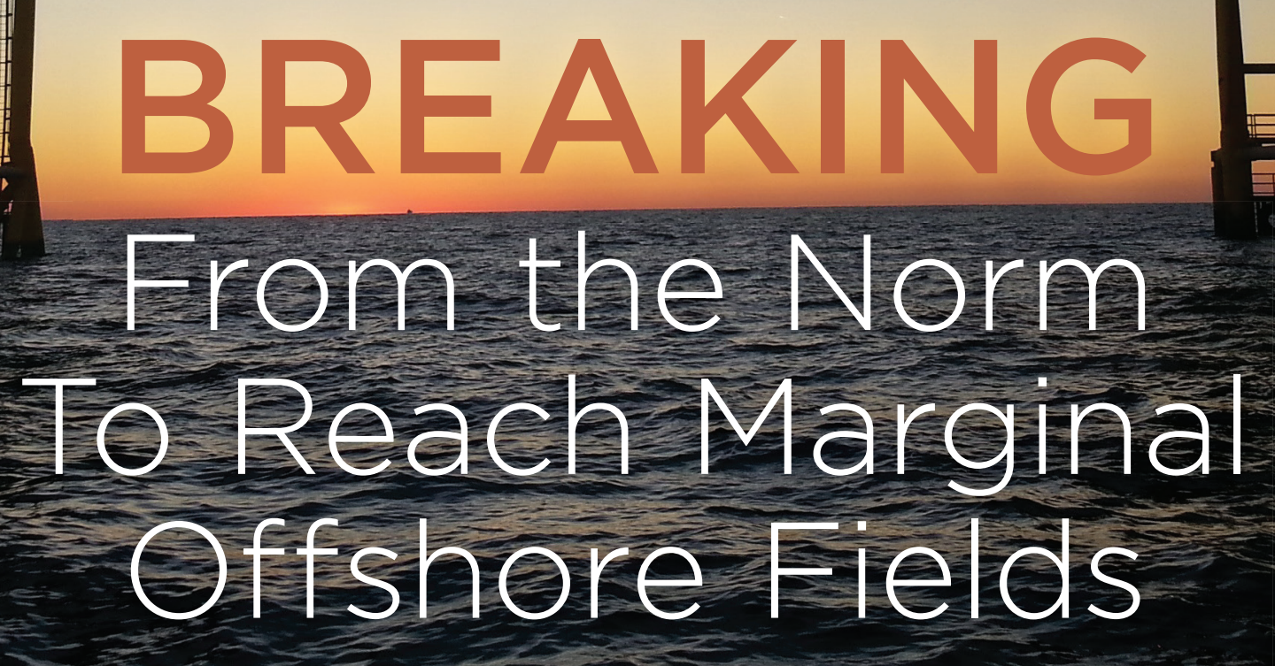
Norway
Higher Scale
TOTAL: 20 papers
Norway is identify because of the words "Northern Europe".
While the study is about the North Seas, other countries like the UK, Belgium, Netherlands, Germany or Denmark are not identified.
International Group (Int. Grp)
Name mistake
Comparison/Example
Romania is identified based on the word "Marginal" since Margina is a city in Romania.
Norway well identified. But other countries like Canada identified because mentioned in a opening statement.

Slide 4
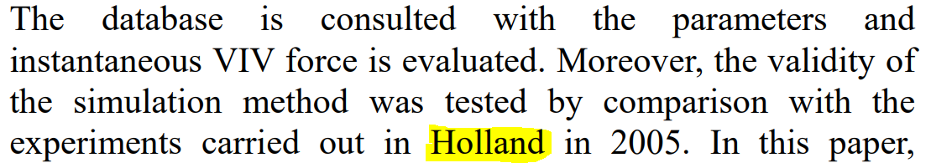
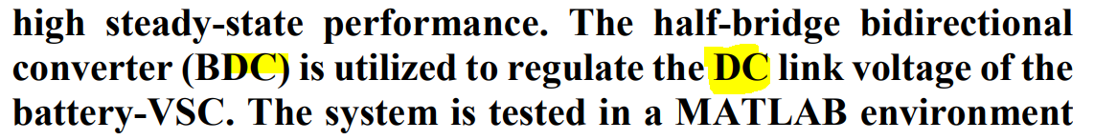
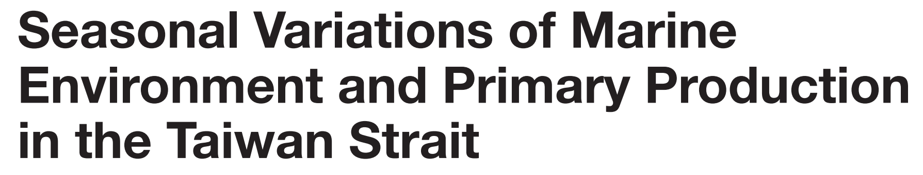
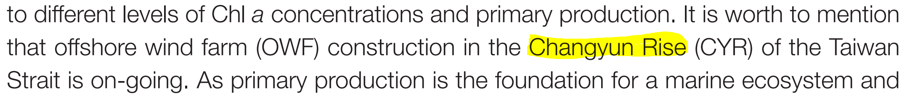

United States
Name Mistake
Holland not associated to the Netherlands but to a US city located in Michigan
DC system (Direct Current) is confused with Washington DC
TOTAL: 20 papers
Changyun Rise confused with Changyŏn, a region in North Korea. Don’t understand why USA ?!
Affiliation
No study location BUT:
Affiliation is taken into account to identify Germany
The word Germany is associated to the city called New Germany (Minnesota, USA)
➔ Double error

Slide 5
Results with the 80 articles together
Mistakes for which we don’t
have a solution (for know – We will find one ^^)

Slide 6
Bottom countries (Check on 100 papers)
TRUE = All countries are well identified and none are missing.
50% True = The “bottom” country is well identified but there is a mistake with other countries
FALSE = At least one error on the “bottom” country.

Slide 7
Bottom countries (Check on 100 papers)
In 25% of the case, there is an error that I don’t understand…

Slide 8
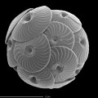
Bottom countries (Check on 100 papers)
19% of the papers
17 unique cases (very specific)
Term “silt+clay size classes” is associated an island called Silk Cayes in the Belize
Calcidiscus quadriperforatus
➔ Calcidicus (Libyan city)
35% or 35$ is associated to the Sector 35, a neighbourhood in Iraq
Term Oligo in Oligo-Miocene is confused with the city called Oligo in Uganda
El Salvador is confused with an Argentinian city called "San Salvador de Jujuy"

Slide 9
Bottom countries (Check on 100 papers)
7% of the papers
LTI (Lineat Time Invariant) is confused with the Altai mountain in Mongolia
NEPA (National Environmental Policy Act) is associated to Nepal
EWEA (European Wind Energy Association) is associated to Edea, a city in Cameroon

Slide 10
Bottom countries (Check on 100 papers)
7% of the papers
e.g., Study at the European scale but only two countries are identified because cited as example in the summary.

Slide 11
Bottom countries (Check on 100 papers)
5% of the papers
Country cited as an example, or at the of the summary as an opening statement.

Slide 12
Bottom countries (Check on 100 papers)
1% of the papers
➔ Filter location that corresponds to the name of one of the author

Slide 13
Bottom countries (Check on 100 papers)

