Slide 1
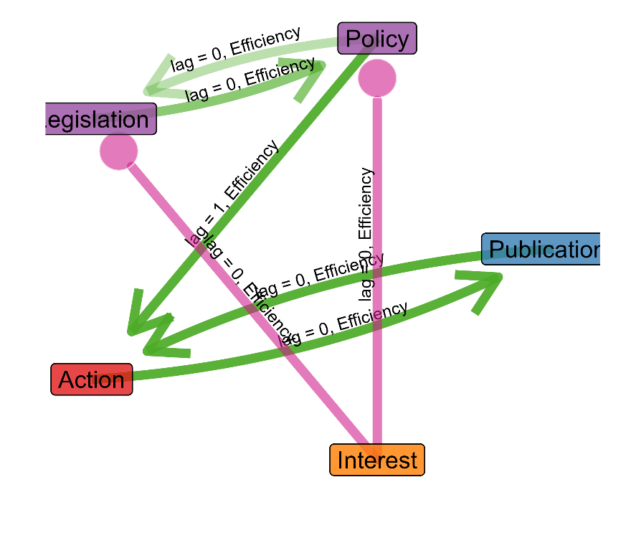
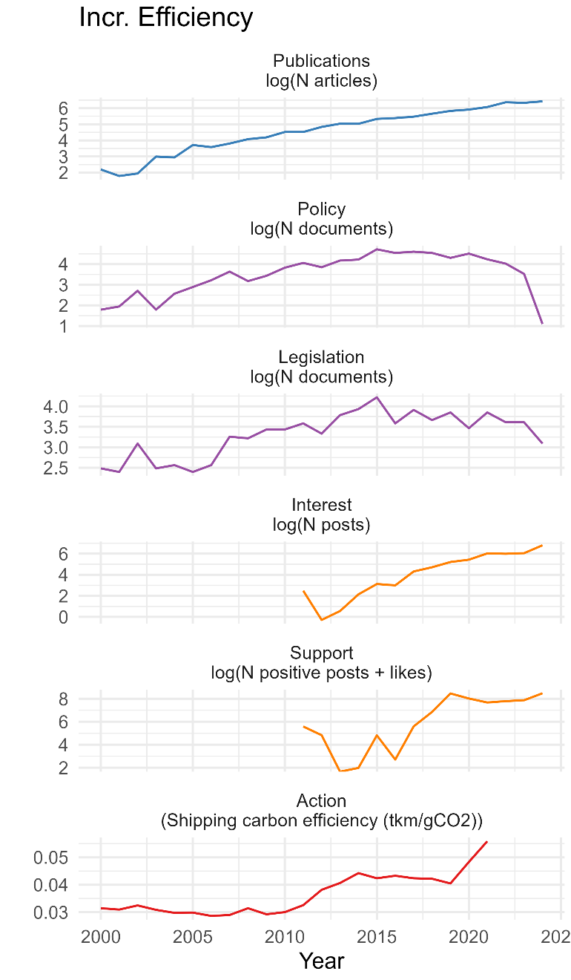
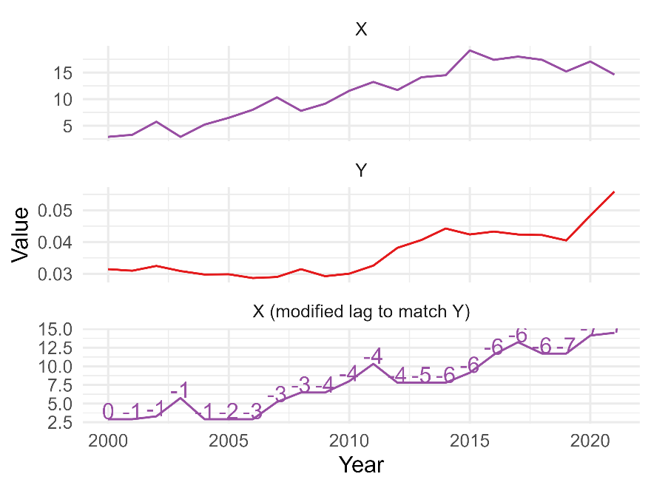
1. For each ORO, metrics of nodes in the publication to action network are assembled
2. Each pair of metrics evaluated using variable-lag transfer entropy
3. Significant edges are combined into a signed network
(example showing Incr. Efficiency)
(example showing from legislation (node X) to action (node Y))
Time series of node X adjusted to match Y using dynamic time warping in order to calculate variable-lag transfer entropy (VL-TE).
VL-TE result: Significant, TE ratio = 75.4, correlation = 0.8

