Slide 1
Table Extraction Proof of Concept
David Hull & Joseph Leonardo
RBC
Single Table Weekly August 16th 2026

Slide 2
What are we trying to do?
Structured Data
Source Documents IE. PDF, Excel
Extraction pipeline
Column A | Column B | Column C
… | … | …
… | … | …
… | … | …
… | … | …
Single Table Database

Slide 3
What are we trying to do?
Structured Data
Source Documents IE. PDF, Excel
I focused on the extraction pipeline that transforms source documents into structured data.
Extraction pipeline
Column A | Column B | Column C
… | … | …
… | … | …
… | … | …
… | … | …
Single Table Database

Slide 4
What makes extraction hard?
Scanned PDF
Hard
PDF w/ Text only
Intuition 1.
The more structure a source document has already, the easier it is to extract reliably because the less our system has to infer
Solving
PDF w/ Semantic Tags
Excel
Database
Easy
More
Structure
Less

Slide 5
Intuition 2.
A reliable data pipeline must be deterministic: same input = same output
Why should we want determinism?
Reproducibility: We can reproduce the previous result with confidence.
Testing: We can explain whether a code change caused an output change.
Auditability: We can explain how our model produced a given output.
LLMs: Fundamentally non-deterministic this is a feature not a bug.

Slide 6
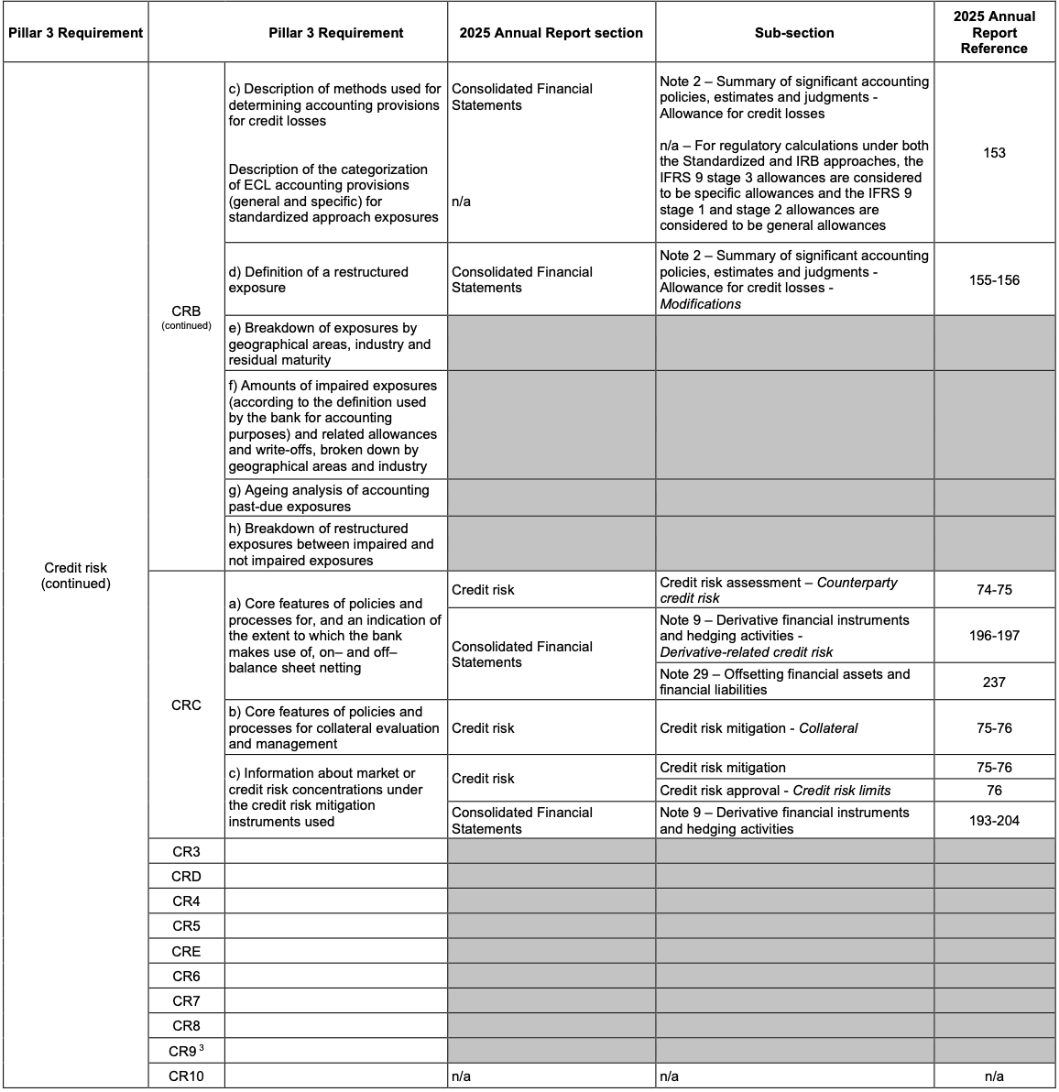
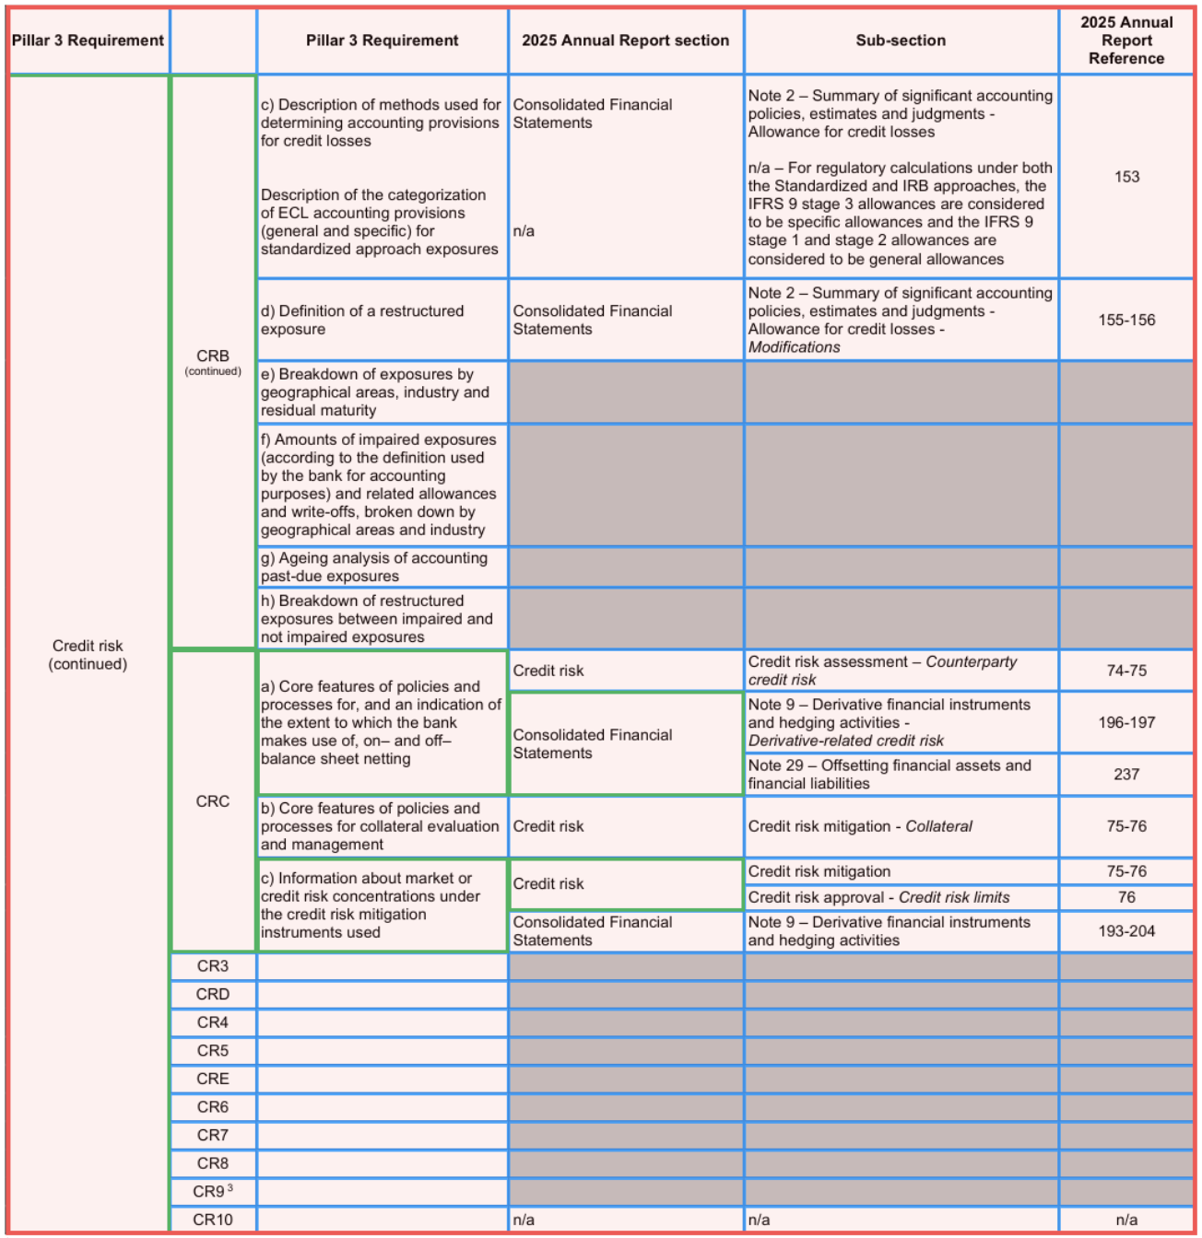
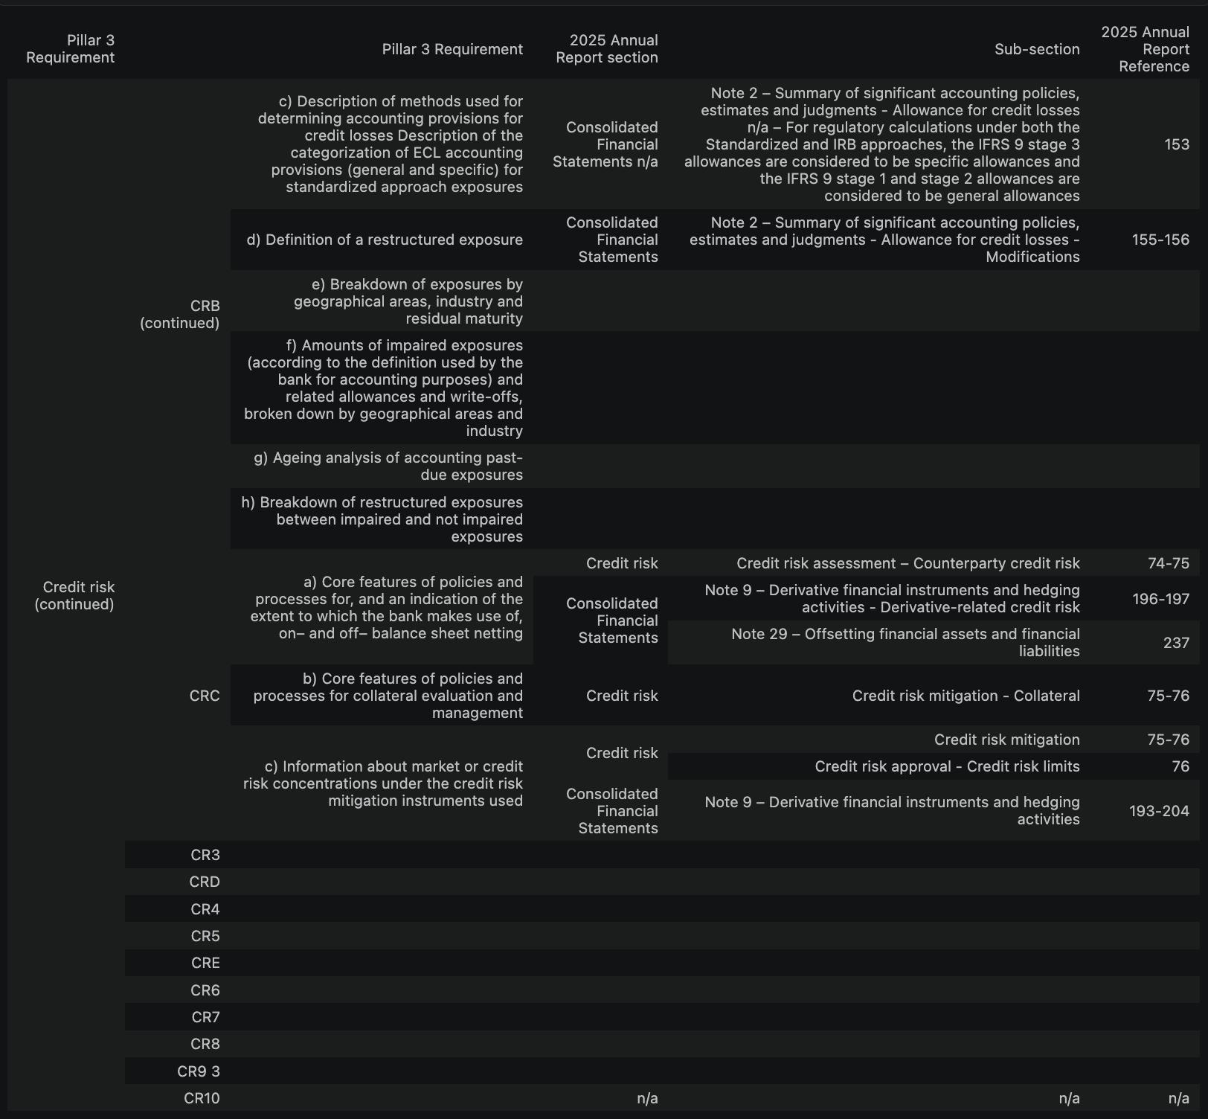
Current extraction pipeline approach We can change this maybe to be more simple and explainatory.
Find the table
Reconstruct the cell grid
Extract cell content

Slide 7
The more structure we have the less we have to infer. Can you add definitions maybe we make a flow chart or something. Let’s focus on non-LLM solutions for now then we can re-visit when bottleneck occur.
What do we need? | Available information | Approach | Accuracy
Text Content | Embedded text | Direct text extraction | Very high
Text Content | Image / scan | OCR | Medium
Table Structure | Semantic tags | Use tags directly | Very high
Table Structure | Vector lines | Reconstruct geometry exactly | Very high
Table Structure | Neither | Table Transformer | Medium

Slide 8
We can do a live demo after this slide

