Slide 1
Executive Growth Plan
Board-ready summary for campaign optimization

Slide 2
Decision Requested Today
Approve a 4-week pilot to increase investment in B + Email.
Objective: grow revenue while keeping conversion stable.
Scope: creative, landing page and customer segmentation tests.
Governance: weekly KPI review and decision rules.

Slide 3
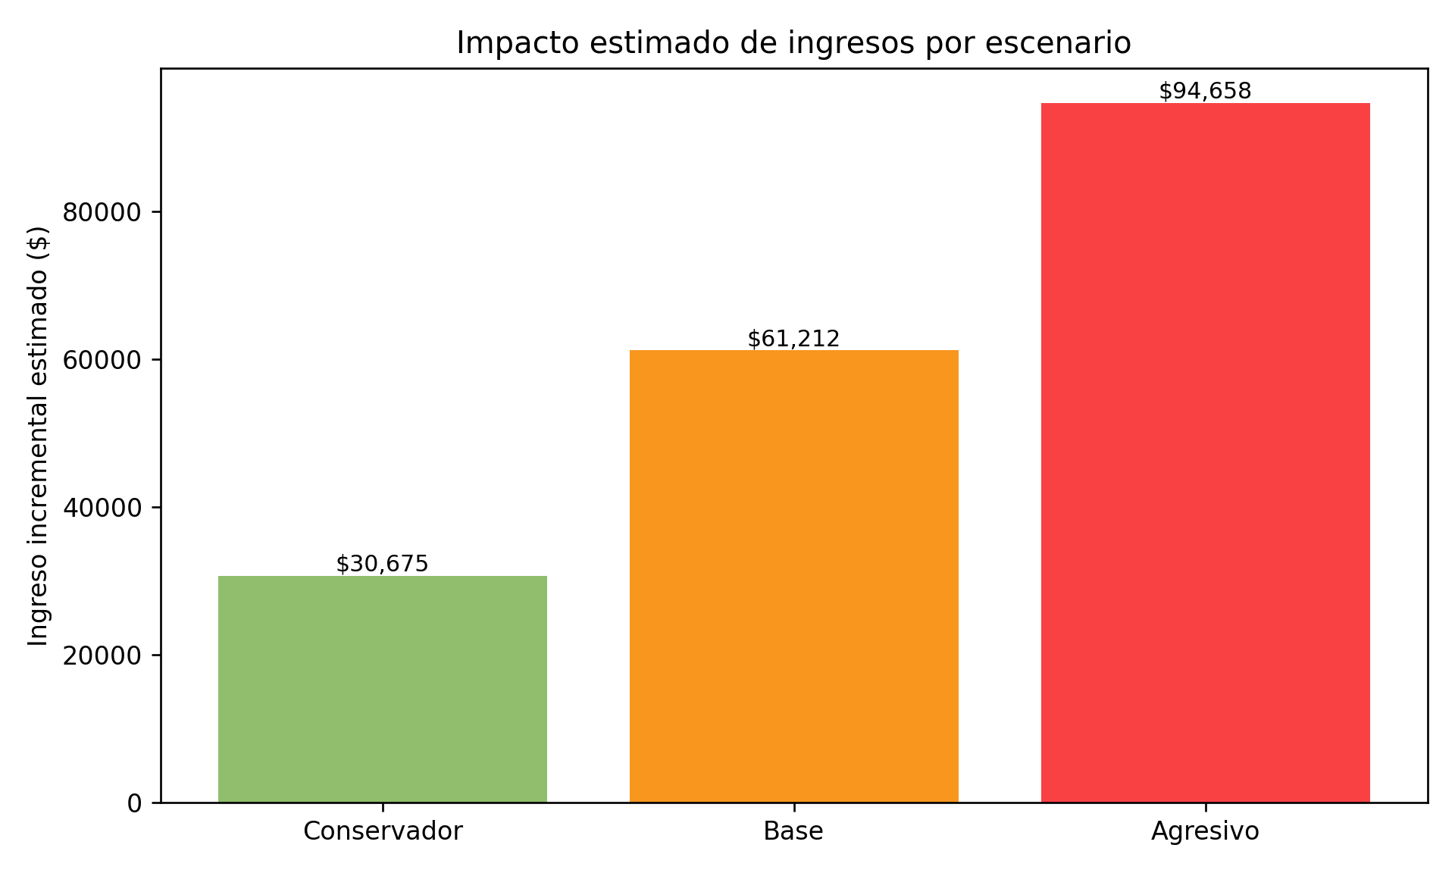
Expected Financial Impact
Executive readout
Top current combo: B + Email
Current total revenue: $2,314,743
Recommend approving pilot under controlled KPI guardrails.

Slide 4
30-60-90 Execution Plan
0-30: launch pilot and set baseline
31-60: run A/B tests and optimize winning variants
61-90: scale proven tactics and formalize budget rebalance
Owners: Marketing Performance, BI, and Sales

Slide 5
Risks and Mitigation
Risk: audience fatigue in top channel
Mitigation: rotate creatives weekly and cap frequency
Risk: volume growth with lower lead quality
Mitigation: enforce minimum conversion and ticket thresholds
Risk: seasonality bias
Mitigation: compare against a 4-week historical control

