Slide 1
Marketing Campaign Performance
Executive briefing: campaign, channel, and customer insights

Slide 2
KPI Snapshot
Total interactions: 100,000
Total revenue: $2,314,742.53
Conversion rate: 47.71%
Average time on site: 134.6 sec
Average ticket (converted): $48.52

Slide 3
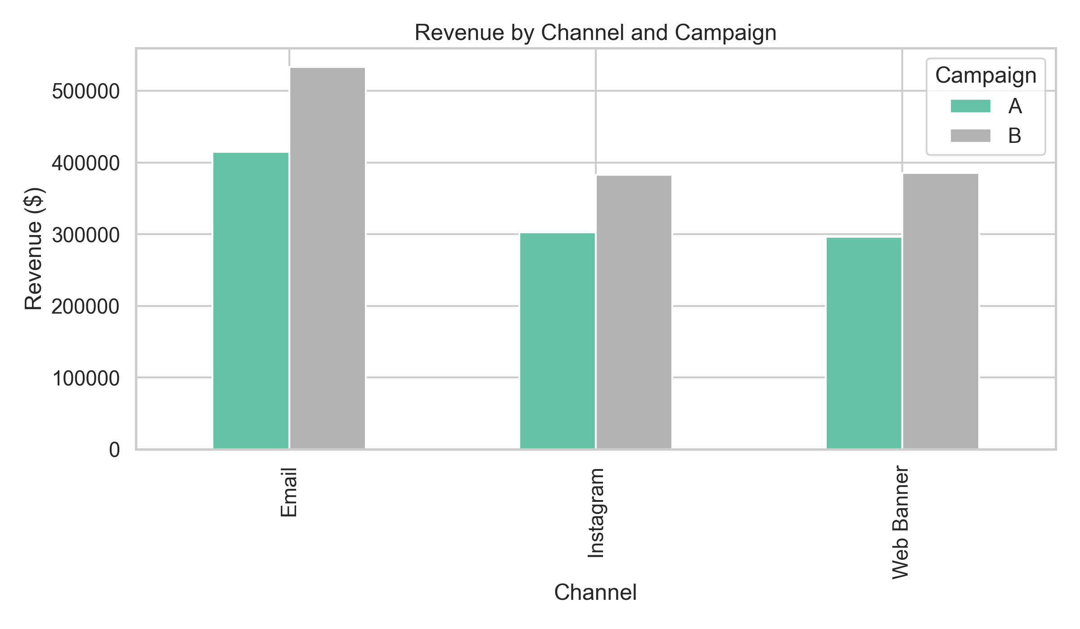
Revenue by Channel and Campaign

Slide 4
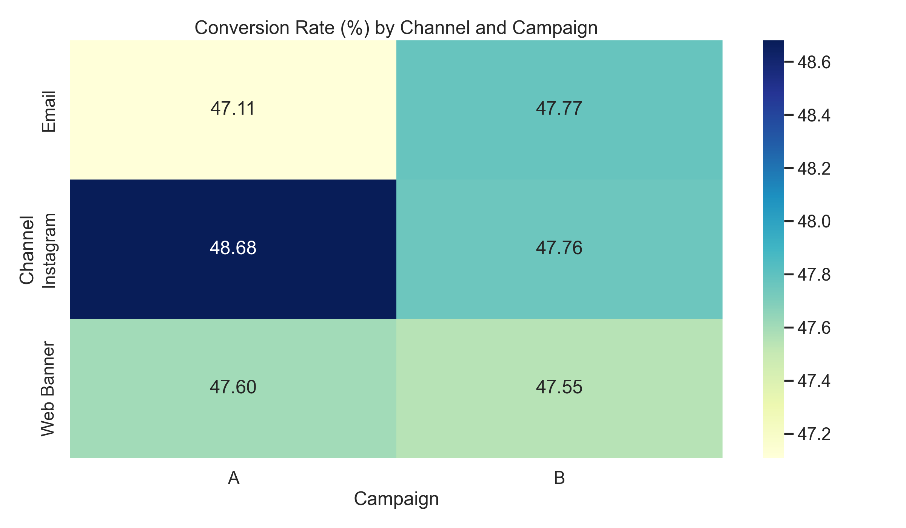
Conversion Heatmap

Slide 5
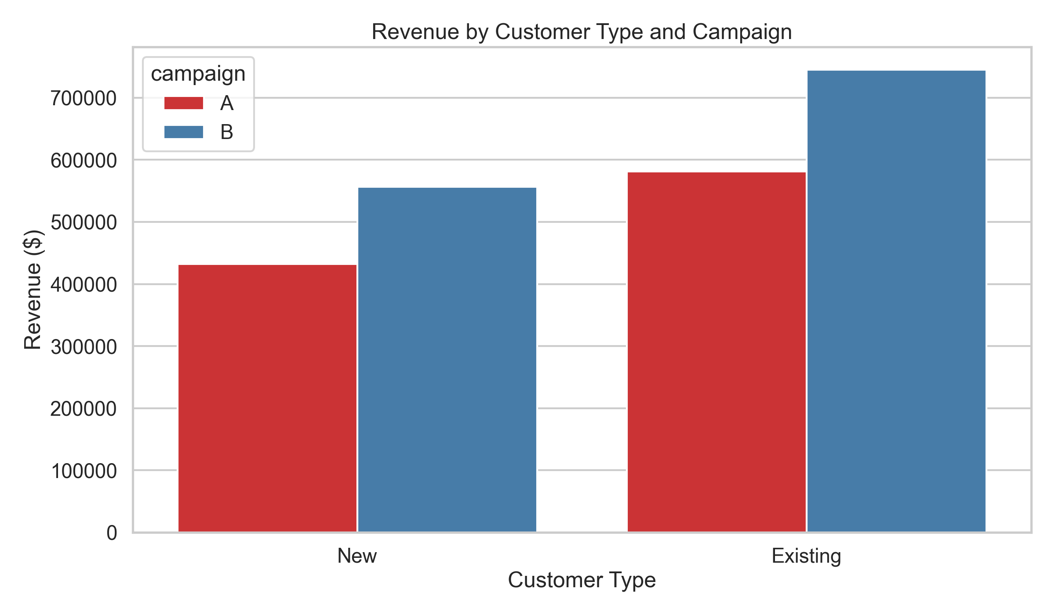
Revenue by Customer Type

Slide 6
Recommendations
Scale investment in B + Email as the top revenue combination.
Run A/B tests by channel to optimize conversion.
Use separate messaging for New vs Existing customers.
Apply weekly KPI governance to rebalance budget.

