Slide 1
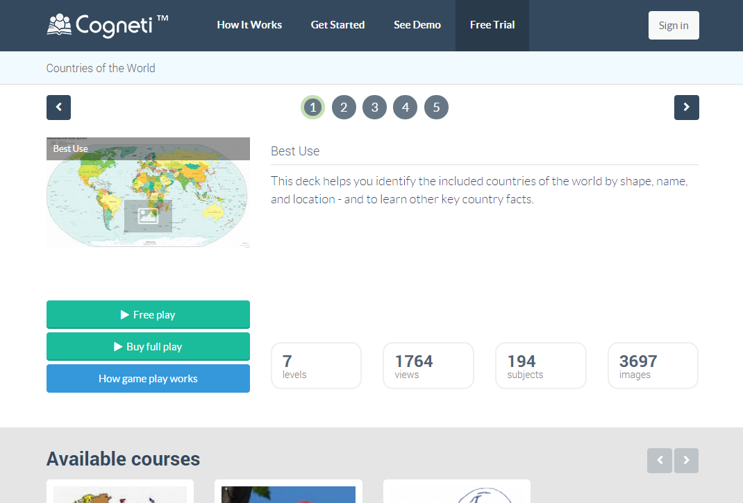
1. Change ‘Free Trial’ to ‘Courses’ in menu.
2. Button ‘Free play’ change to ‘Free trial’
3. Button ‘Buy full play’ to ‘Buy’
4. Filter available courses based on flag = TRUE.

