Slide 1

NEW SOS ALARMS
By: Daniel Vilajeti

Slide 2
Background
Efficient data analysis
Record keeping
Modular
Easy modification

Slide 3
SQL Side

Slide 4
Source of Data
CNIGuard sends .csv files which are later sent to SQL via sql import jobs
Data is loaded into sos.SensorData and sos.SensorLocations
Copies of .csv files are archived

Slide 5
All sos Boxes
Easy access: sos.SOS_Structures
Query behind view is tricky and long
Number of active boxes fluctuates
Inefficient

Slide 6
New tables
For record keeping purposes a few new tables were created
sos.Alarms stores all alarms sent out
sos.AlarmsTracked stores all tracked/acknowledged alarms
sos.AlarmTypes stores all alarms (active and inactive)
sos.TestTypes stores the test’s details behind each alarm

Slide 7
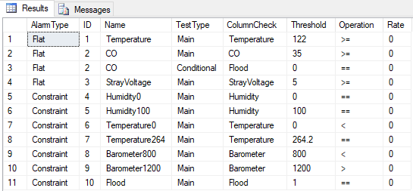

Slide 8
Deprecated tables
Older tables created previously to track alarms no longer needed
Tables that include ‘Test’ in their name are to be ignored

Slide 9
Python side

Slide 10
Why python?
Easy to learn
Data visualization
More tools for data analysis

Slide 11
structure
4 classes that handle entire retrieval and analysis of data
alarms.py
sos.py
sql_email.py
db.py
Additional files include helper code
styles.py

Slide 12




sos
alarm
sql_email

Slide 13
Alarm.py
The purpose of this class is to reduce the interaction the user has with the other classes. Here the entire alarm process with exception to the provision of data is sourced. All computations and orchestration of the other classes is implemented in this class allowing other devs to easily trace the logic behind the entire system.
analyze(…) analyzes the data of a given sos box
record_alarm(…) records the alarms triggered for the given sos box
trigger_alarm(…) builds email to then send to team

Slide 14
Sos.py
The sole purpose of this class is to act as a container for all data belonging to an sos box. This includes readings as well as structure info like Borough, MSPlate, S tructureType, etc.
get_unanalyzed_data()
get_structure_info()

Slide 15
Sql_email.py
This class provides the functionality to send emails using the sql stored procedure sp_send_dbmail
send_email(…)

Slide 16
Styles.py
This file includes all helper functions used in designing the table seen on emails. The contents of this class are entirely abstracted from the user since they need not call any of these functions explicitly.
draw_table(…)

Slide 17
Db.py
The purpose of the db class is to provide easy access and connection to the SQL server. The class handles the signin/authentification process of getting onto the SQL server and allows users access to its functionality.
get_conn()
close_conn()

Slide 18
What’s next?

Slide 19
Potential improvements
Accounting for structure history
Dynamic analysis of data
Machine learning?
Code/SQL free alarm management
Moving alarm system to the server

