Slide 1
Data
Category | Element | Description | Example
🔹 Temporal structure | n_steps_input | Length of the sequence used as input (temporal history). | 81 steps
 | n_steps_output | Subsequent steps used as output (future prediction).
 | Sliding windows | Samples are generated by sliding through the temporal sequence with a 1-frame step. | If N_t=10, we obtain 81-10+1 = 72 samples
 | Sample form | Data Block (n_{input}, H, W, C). | 81, 256, 256, 11

Slide 2
Category | Element | Description | Example
🔹 Physical parameters | α (activity) | Intensidad de las fuerzas activas del sistema. | Negativo: pushers Positivo: pullers
 |  | β (alineamiento) | Tendencia de las partículas a alinearse con su entorno.
 | ζ (acoplamiento flujo–orientación) | Interacción entre el flujo y la orientación de las partículas. | ζ alto → vórtices grandes
🔹 Simulated Data | Chanels (11) | Magnitudes físicas calculadas en cada punto del campo.

Slide 3
Chanel | Physical meaning
c | Density or local concentration
u_x, u_y | Velocity field components
D_xx, D_xy, D_yy | Deformation tensor components
S_xxxx, S_xxxy, S_xxyy, S_xyyy, S_yyyy | Fourth-order moments (anisotropy and spatial correlations)
Project: Use autoencoders and variational autoencoders to learn low-dimensional latent representations that capture key features and phase transitions in active matter systems.
By analyzing the latent space with PCA and t-SNE, reveals transitions between dynamic regimes, meaningful clustering of physical phases, and interpretable organization related to the system’s underlying parameters.

Slide 4
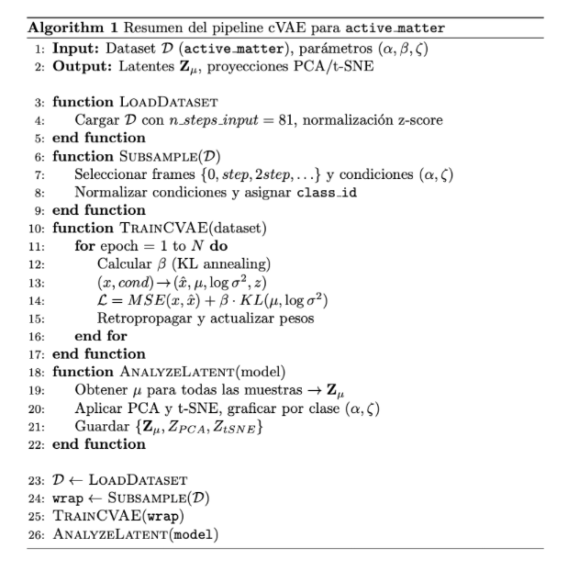
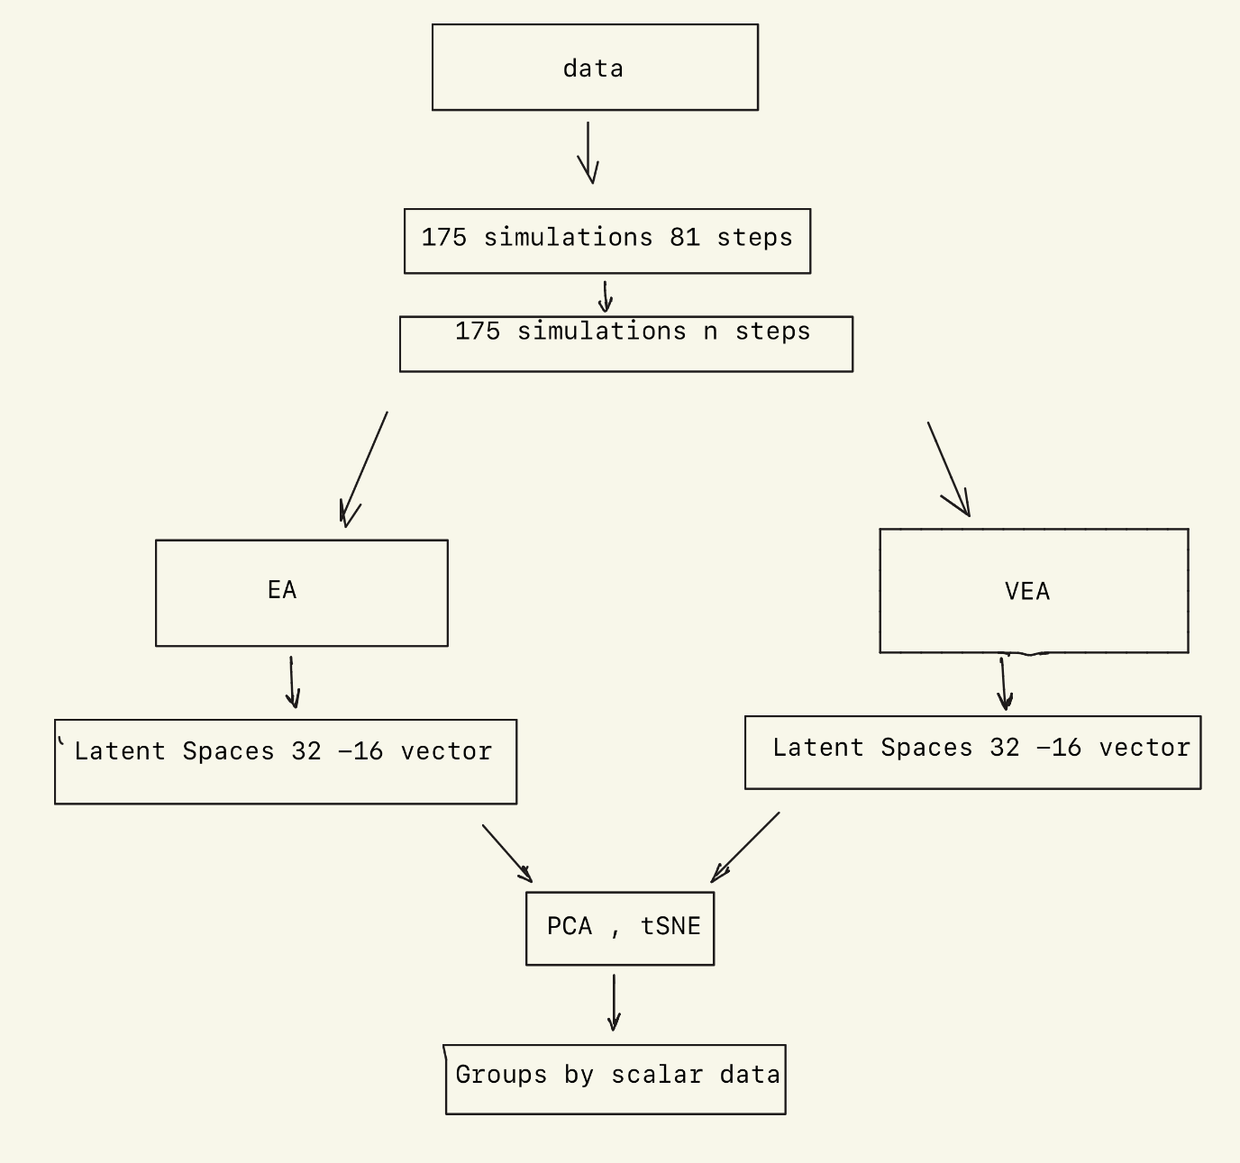
Identify low-dimensional latent structures revealing active-matter dynamic phases.

Slide 5
Architecture
Part | What it does | Shape / Size
Input | A short movie (sequence) of physical fields | (11 variables, 9 time steps, 256×256 pixels)
Encoder | Compresses the movie into a small numeric code | Becomes a 256-number feature vector
Condition | Adds the physical parameters (α, ζ) | 2 numbers
Latent space | Final compact representation that summarizes the system | 32 numbers (latent size = 32)
Decoder | Uses the 32 numbers and (α, ζ) to rebuild the movie | Output same size as input
Loss function | Compares input and output to learn good reconstructions | Uses error + regularization

