Slide 1
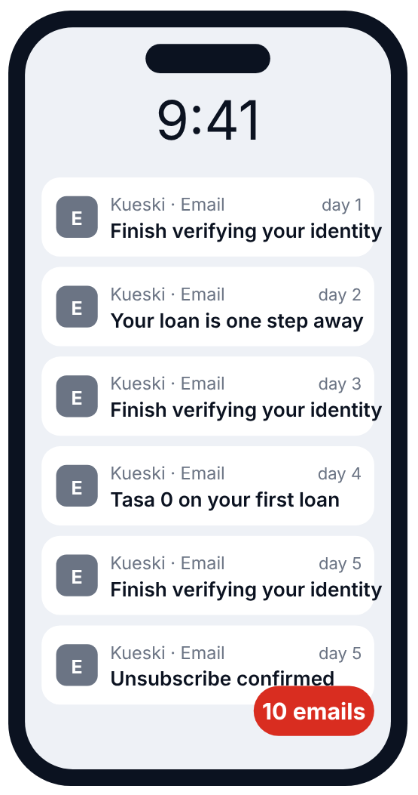
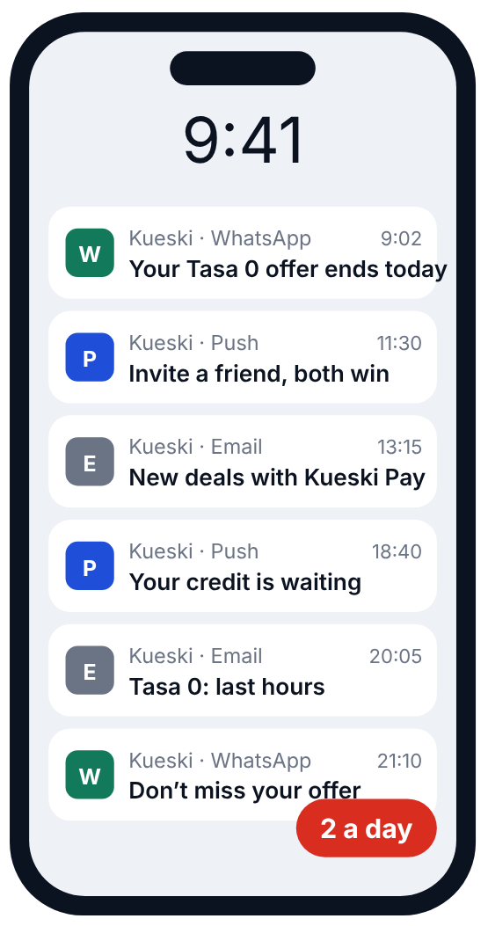
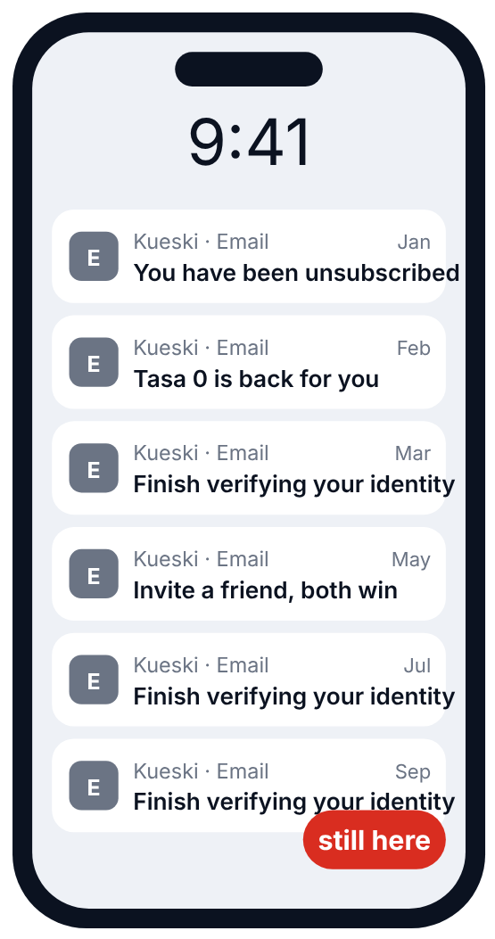
Seen from the person’s phone, this is what our messages feel like: three real cases
THE PERSON WHO JUST SIGNED UP
OUR MOST ACTIVE CUSTOMER
THE PERSON WHO ALREADY SAID NO
10 emails
2 a day
58K
on 210 of the 273 days
promotional emails from us after they unsubscribed
339K people (1.7% of the base) got 482 messages each in nine months. When three campaigns hit someone on the same day, we are in 63% of those clashes.
before she unsubscribed, around day 5
45K people who had unsubscribed still got 79K promotions; 58K were ours. The verification reminder kept arriving for nine months.
70K new users unsubscribed from our emails, typically 5 days and 10 emails in. Half did it on the sign-up reminder, which arrives almost 6 times a month.
AND
59% of all messages go through a channel that person has never responded to: emails to people who only read WhatsApp, push to people who never open push.
Source: Braze audit, Jan to Sep 2026 (deck v6, pages 8, 18, 24, 35, 52, 63). Screens are illustrative; numbers are real. 58K = Marketing promotional emails to people already unsubscribed.
5

