Slide 1
Gender recognition by voice
Dvir Gev & Aviad Gilboa
209530583 316080514
Project link

Slide 2
Introduction
The purpose of this project is to develop and implement an AI system that can accurately predict the gender of a speaker based on a given voice recording.
We have selected this open-source git as our starting point for our work.
Through the process of developing and optimizing this model, we have gained an understanding of various concepts in the field of machine learning, including improving and optimizing the model to achieve better results

Slide 3
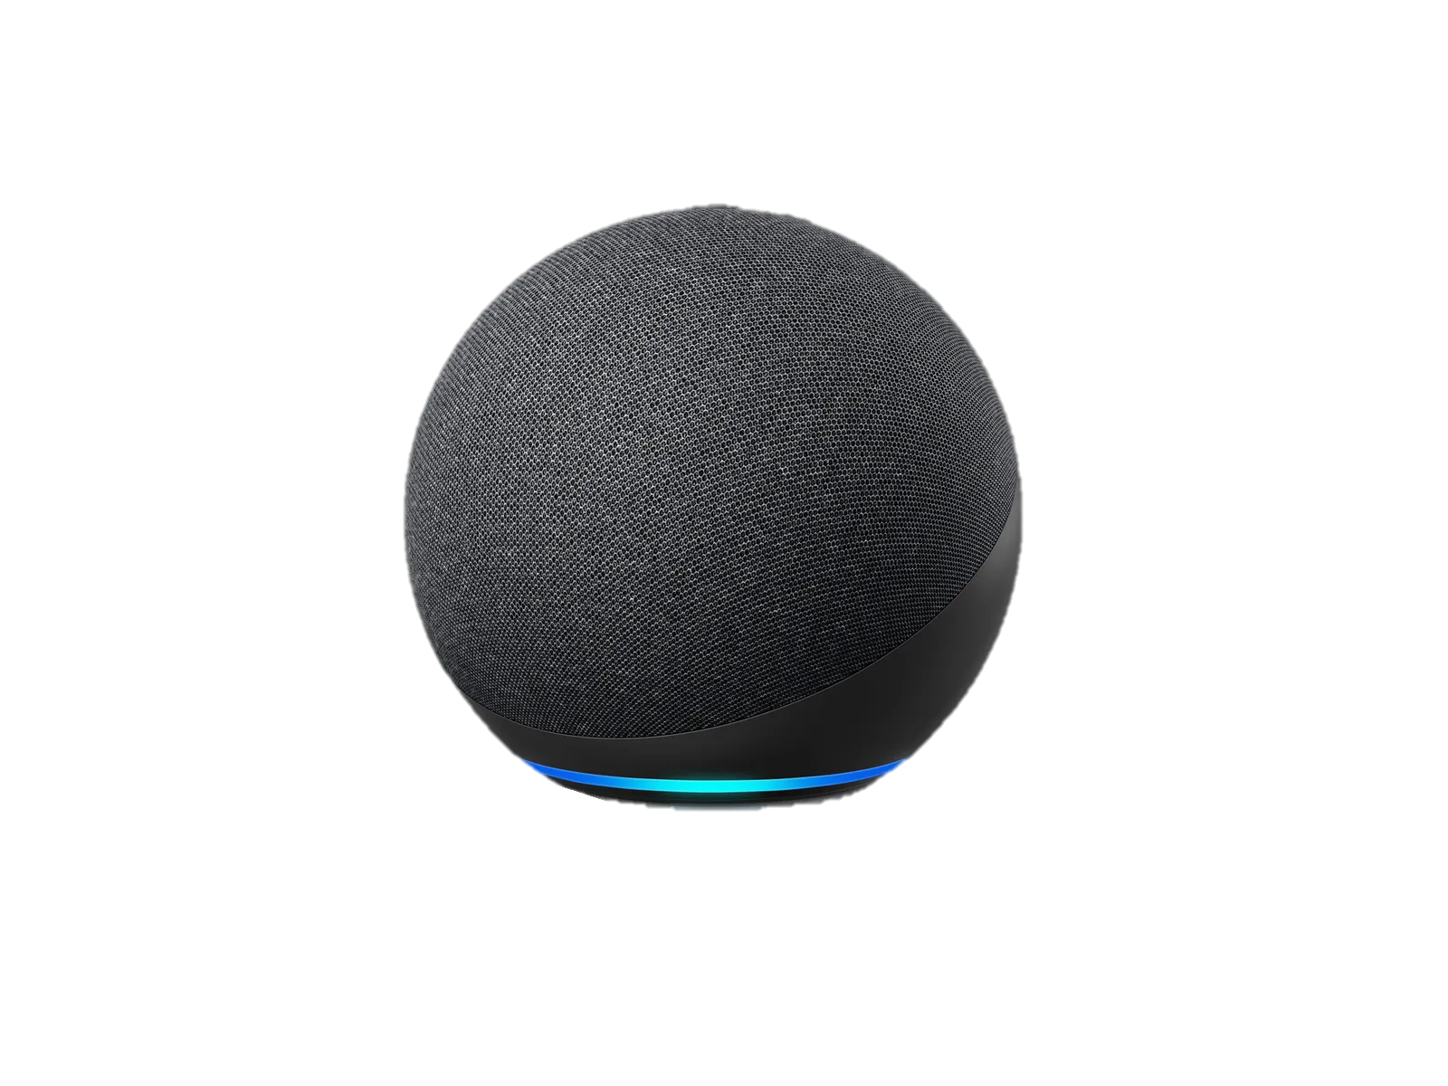
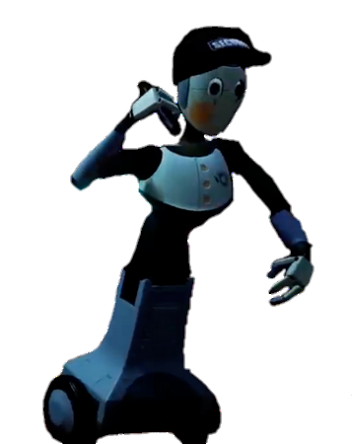
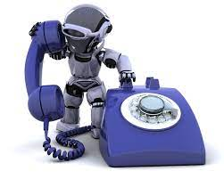

Introduction
Accurate prediction of the gender of a speaker can be valuable in a variety of situations:
Voice assistants (Siri, Alexa, Google Assist,...)
Virtual worlds (Metaverses, video games, ...)
Services on the phone (automats and humans)
Defense services (e.g. women's services at the club)
And it can also be a basis for other uses…

Slide 4

Dataset
The dataset we using in the project is the commonvoice-Mozilla dataset.
In our approach to coding, we took the following details into account:
Adventages of The dataset
Large amount of data The length of each file is avg 4 second. Learning from short time with the real-time speaker. diversity of English speakers diversity of aged speakers equal number of any gender voice
Disadvantages of The dataset
Only English speaker – other languages have a different accent and volume No children’s voices (less relevant) No recording interruption, like in the real world.

Slide 5
Current Approach
Our original Git project wanted to write a tutorial to teach about deep learning, using Tensorflow framework.
He focused on the following:
Preparing the Dataset
He only filtered the labeled samples in the genre field.
He balanced the dataset so that the number of female samples is equal to male samples.
He used the Mel Spectrogram extraction technique to get a vector of the length 128 from each voice sample.
Building the Model
He used a deep feed-forward neural network with 5 hidden layers
Training the Model
He trains the model using the previously loaded dataset.
Testing the Model
He reached 91% accuracy on samples that the model has never seen before.

Slide 6
Improvements - Accuracy
The approach for training the model using a neuron network.
Current approach:
Convert all the dataset to Wav audio files using ffmpeg.
Adding features to our NumPy vector using a function that take details from the voice file and returns the vector file.
For short the time the model training with the new vector, That be like 5 times bigger we add early stopping for the train model
Change the value of the Dropout from 0.3 to 0.55 in the training progress to avoid a minimal the overfitting
Adding PCA algorithm to inspect the un-relevant features for our predicted mission.
Calculate the optimal Incline for deciding the index of the last important features we will use for the predictions and training.
Saving the PCA model for use with this information in our testing file mission

Slide 7
Improvements - Performance
noisy files – why do we not insert
Reliable speaker – we consider that the speaker not try to lie about his gender.
The adding features – make parameters worthier, but it save time (early stop the improvement of the model).
Overfitting
PCA
Predict our model on new files.

Slide 8
Results
Baseline
91.16% | Accuracy
90.4% | Precision
91.62% | Recall
91.01% | F1-Score
116.37 Sc | Time
Add features to the train and predict vector without PCA
92.41% | Accuracy
88.8% | Precision
97.8% | Recall
92.64% | F1-Score
Sc 84.83 | Time
Add features to the train and predict vector with PCA
97.74% | Accuracy
98.59% | Precision
96.76% | Recall
97.66% | F1-Score
58.75 Sc | Time

Slide 9
Code Questions
PCA.py :
plotPCA: from the internet with adding our parameters.
find incline – from Lior and Gal project.
convertmp3ToWav.py: by Aviad
fromSali.py
makeNewDataBase.py: by Aviad & Dvir
more_test.py: by Dvir
test.py: from the basic project and changes by us.
utils.py: from the basic project and changes by us.
train.py: from the basic project and changes by us.
preparation.py: from the basic project and changes by us.

Slide 10
Discussion – Algorithms
PCA
Calculate the incline of the last feature in the PCA
Neuron network
Early stoping

Slide 11
Discussion – Open Questions & Future Work

