Slide 1
Crypto Project
****
****
****
Dvir Bublil

Slide 2
Project task
An application of secure access to database. ( read and edit )
The secure works on two levels, first level create session key using McEliece ,second level encryption and decryption using Salsa20 + digital signature (ECDSA) to authentication the message.

Slide 3
Algorithms
McEliece cryptosystem
Salsa20 cipher
ECDSA

Slide 4
McEliece
McEliece is an asymmetric encryption algorithm
The algorithm was developed in 1978 by Robert McEliece
The algorithm is based on error correction using a binary linear code (Hamming Code)
Hamming code is an error-correcting code.

Slide 5
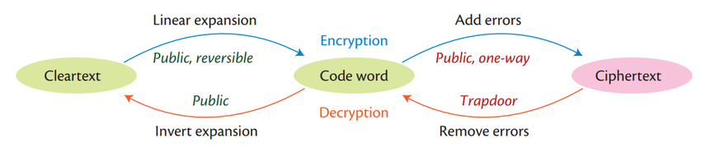
General Idea of McEliece

Slide 6
Hamming Code
error correction/detection
Hamming code
Linear error correcting code
Detect
Can detect up to two-bits binary codes error
Correct
Can correct one-bit binary codes error

Slide 7
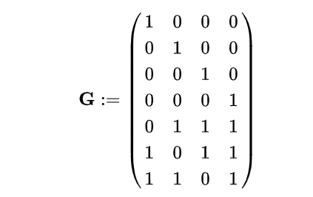
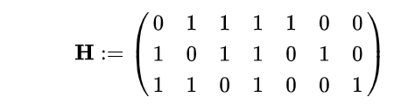
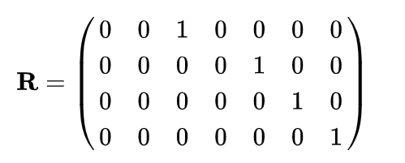
Hamming code matrix
Notes:
G=genetator matrix
H= pairity check matrix
R=G⁻¹

Slide 8



systematic encoding map
Generator of Hamming code (7,4)
Multiply vector x of length k, will produce code word of length n
$$Enc\left(x_{1},x_{2},x_{3},x_{4}\right)=\left(x_{1},x_{2},x_{3},x_{4},\overset{P3}{\overbrace{x_{2}⊕x_{3}⊕x_{4}}}, \overset{P2}{\overbrace{x_{1}⊕x_{3}⊕x_{4}}},\overset{P1}{\overbrace{{, x}_{1}⊕x_{2}⊕x_{4}}}\right)$$
$$G$$
$$X$$
Notes:
Enc() is function which transform vector X from vector with size of four to vector with size of 7 with three final bits to parity check. The final bits are the parity check as result that the generator matrix builds like the identity matrix in size of the k first column also know as systematic encoding map
the result is mod 2. because we are over finite field, we replace the addition operation to xor operation

Slide 9

Example of the correcting code
$$X=\left(\begin{aligned}1 \\ 0 \\ 1 \\ 1\end{aligned}\right),G∙X=\left(\begin{aligned}1 \\ 0 \\ 1 \\ 1 \\ 0 \\ 1 \\ 0\end{aligned}\right), adding the error in place i=1 using vector e_{1}=\left(\begin{aligned}1 \\ 0 \\ 0 \\ 0 \\ 0 \\ 0 \\ 0\end{aligned}\right) G∙X+e_{1}=\left(\begin{aligned}0 \\ 0 \\ 1 \\ 1 \\ 0 \\ 1 \\ 0\end{aligned}\right) \\ find the potion of the error using H the pairity check: \\ H\left(G∙X+e_{1}\right)=\left(\begin{aligned}0 \\ 0 \\ 1\end{aligned}\right), the error is in place 1 according to the pairuty check, we can correct the error \\ there and get the original codeword \\ note: if there is no error that was insert H∙G∙X=\left(\begin{aligned}0 \\ 0 \\ 0\end{aligned}\right)$$

Slide 10
Example of Hamming code (7,4)
1 | 0 | 1 | 1
1 | 0 | 1 | 1 | 0 | 1 | 0
Using systematic encoding map
0 | 0 | 1 | 1 | 0 | 1 | 0
1 | 0 | 1 | 1 | 0 | 0 | 1
Insert one error
Correct the error the message is in the 4 MSB bits using H

Slide 11
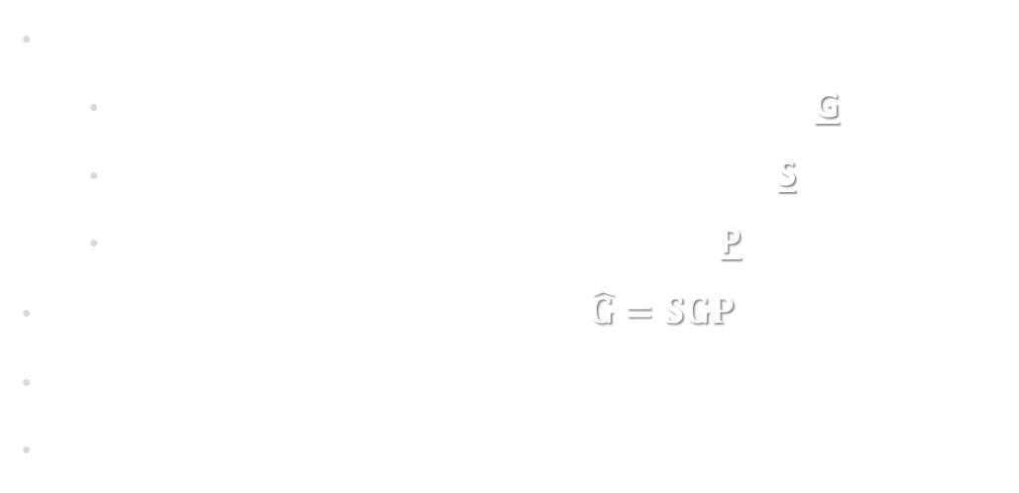
McEliece Key Generation
Bob selects:
Matrix $n×k$ generator matrix for HC(7,4) G
A random $k×k$ binary invertible matrix S
A random $n×n$ permutation matrix P.
Bob computes the $k×n$ matrix $\hat{G}=SGP$.
Bob’s public key is $(\hat{G},t)$
Bob’s private key is (G,S,P)

Slide 12
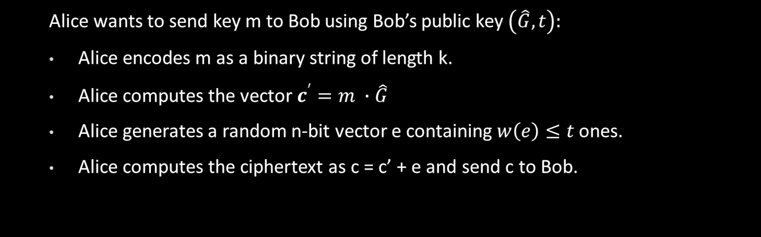
McEliece Encryption
Alice wants to send key m to Bob using Bob’s public key $\left(\hat{G},t\right):$
Alice encodes m as a binary string of length k.
Alice computes the vector $c^{′}=m ∙\hat{G}$
Alice generates a random n-bit vector e containing $w\left(e\right)≤t$ ones.
Alice computes the ciphertext as c = c’ + e and send c to Bob.

Slide 13
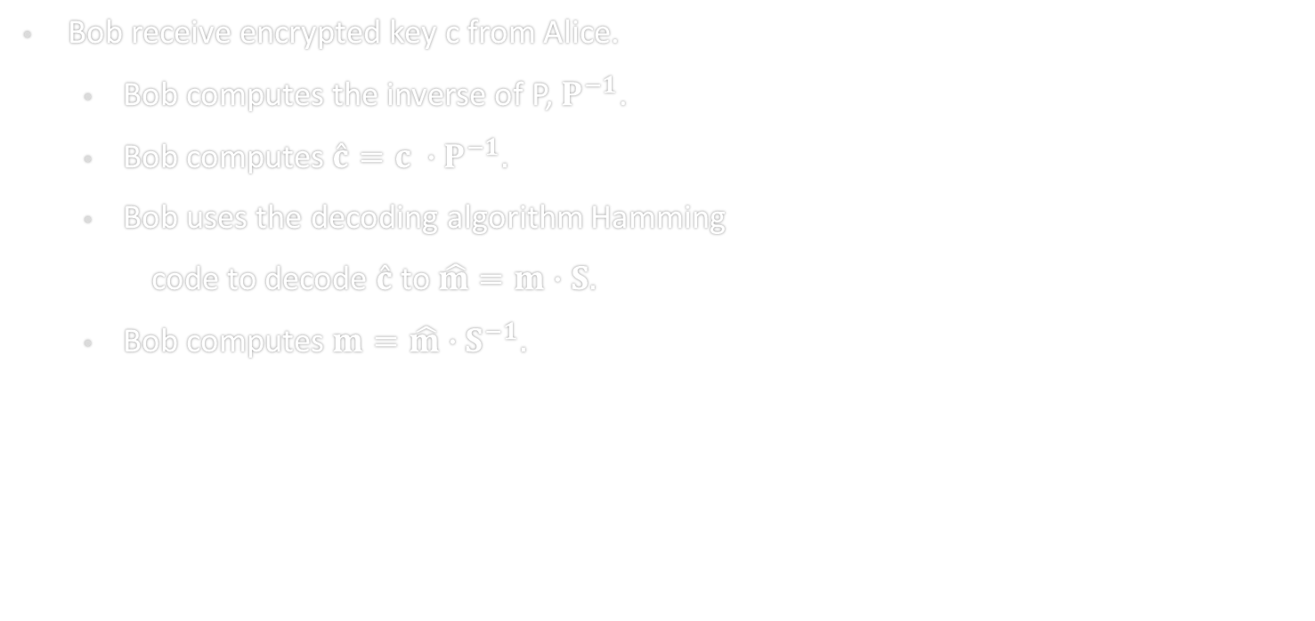
McEliece Decryption
Bob receive encrypted key c from Alice.
Bob computes the inverse of P, $P^{−1}$.
Bob computes $\hat{c}=c ∙P^{−1}.$
Bob uses the decoding algorithm Hamming
code to decode $\hat{c}$ to $\hat{m}=m∙S.$
Bob computes $m=\hat{m}∙S^{−1}.$

Slide 14

McEliece Proof of Decryption
To decrypt Alices message :
Bob computes :
$$cP^{−1}=\left( m∙\hat{G}+e_{1}\right)P^{−1}=\left(m∙S∙G∙P+e_{1}\right)P^{−1}=m∙S∙G+e_{1}P^{−1}=m∙S∙G+e_{2}=H∙\left(m∙S∙G+e_{2}\right)=H∙m∙S∙G+H∙e_{2}=0+H∙e_{2}=H∙e_{2} \\ from H∙e_{2} we find the bit that was flipped and then \\ we can correct him. \\ the result of this that we obtain the message m∙S therefore we can$$ compute m$:$ $$\hat{m}∙S^{−1}=m∙S∙S^{−1}=m−the original message$$
Notes:
?

Slide 15

Our Hopes:
Eve can see the public key and the encrypted message .
Hope 1: $\hat{G}$ looks like a completely random matrix to Eve.
Hope 2: decoding a coding linear code its NP hard

Slide 16
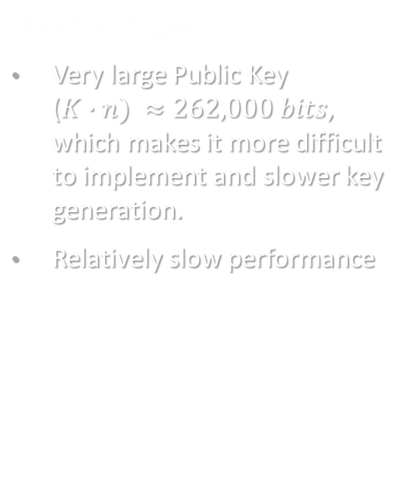
Advantages and Disadvantages
Advantages:
Is based on a NP hard math problem which makes it resistant even to quantum compute power.
“Key privacy” - Can't discover the private key from the public key , makes it more secure against attacks
Disadvantages:
Very large Public Key ($K∙n) ≈262,000 bits$, which makes it more difficult to implement and slower key generation.
Relatively slow performance

Slide 17
Mecliece Cryptanalysis
Key-recovery attacks
Code-Based attacks
Structural attacks
Algebraic attacks

Slide 18
McEliece in our project
Bob (server) generate the public key, and private key using McEliece
Bob distribute the public key to all the clients
Alice (client) encrypt the Salsa20-key(session key), using Bob public key with McEliece and send it to Bob
Bob decrypt Alice message (session key) using his private key.
Bob and Alice are aware of a shared session key and now they can use salsa20 algorithm to encrypt/decrypt their messages(symmetric algorithm)

Slide 19
Salsa20
Developed by Daniel J.Bernstein in 2005
Salsa20 is a modern and efficient stream symmetric cipher.
Significantly faster then other algorithms(AES ..)
Withstood various attacks and has not been broken
Widely adopted and used in variety of applications
Submitted to eSTREAM project of the European Network of Excellence

Slide 20
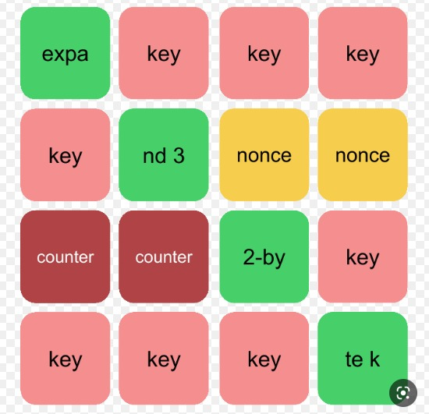
Algorithm input
Secret key – 32 or 16 bytes (we using 32 bytes)
8 byte long nonce with block number
Four constant vectors – received from expansion function
Block counter

Slide 21
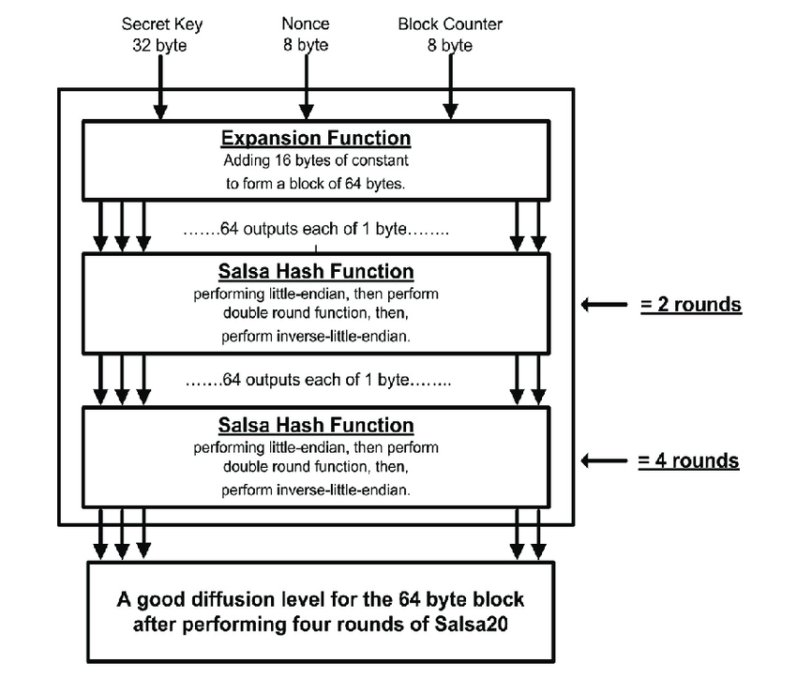
Diagram algorithm

Slide 22

How the Algorithm work
Initial state-matrix 4X4 that contains (nonce, key, counter and constant)
10 rounds of DoubleRound.
DoubleRound get the matrix as input and mixed the rows (using the function rowround) and the cloumns (using the function columnround ).
At start it mixed the columns after the mixed of the columns it mixed rows. (using the function quarterround)
After the mixing it add the result to the initial state
The output is 64 Bytes of mixed words
The chipertext will be the result of output$⊕$plaintext
Notes:
לעבור על השקף

Slide 23
The Algorithm use
Pseudorandom function (PRF)
Expansion function
Hash function
Quarterround function
Doubleround function
Littleendian function
Rowround function
Columnround function

Slide 24
Quarterround function
Getting 4 words(y0, y1, y2, y3) , and return 4 word sequence (z0, z1, z2, z3)
Using:
adding mod 2³²
rotate round
xor
# The other algorithms (doubleround ,rowround, columnround)
using Quarterrround function

Slide 25
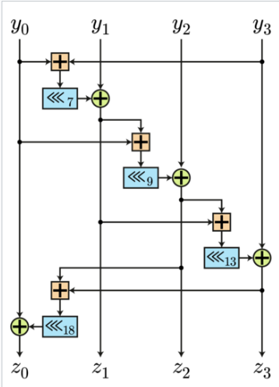
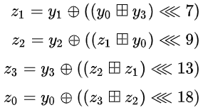

Slide 26
This operations are designed to mix the bits of the input
words in a non linear manner, which makes it more difficult for an attackers to predict the output .
The output is used to generate the keystream for the cipher.
Notes:
The goal of the operations is to mix the bits of the input (in non linear manner)

Slide 27



Salsa20 encrypt/decrypt
M – message in max length of 2⁷⁰ bytes
V – initial vector
I – counter
K – key
Ci – encrypted message
mi- word block of 64 bytes
Encrypt:
Decrypt:
Notes:
How its theoretically looks to encrypt and decrypt ( dividing the block if greater then 64 bytes ) and the decrypt work as the encrypt because :
1.salsa20 symmetrical algorithm
2.Xor is commutative
the I used for make the blocks un connected for each (not dependency its not a BEC)
Salsa20 is work in CTR mode (nonce and etc)

Slide 28
Advantages and Disadvantages
Advantages:
Has a strong security track record , not been broken yet.
Speed , Salsa20 is relatively fast , is well suited for high speed applications.
Has a compact design , making it easy to implements in variety of applications
Disadvantages:
Is a relatively new cipher , lake of studies and information
Limited key size of 256 bits, which may not be sufficient for all applications
Limited block size of 64 bytes, may be too small for some applications
Notes:
Advantages :
security record
fast then other , therefore more usable in RT codes/applications
compacity design – easy to implementation
Disadvantages:
new , wasn’t expose to analysis and scrutiny
size of key limited to 256
size of block in limited to 64 bytes

Slide 29
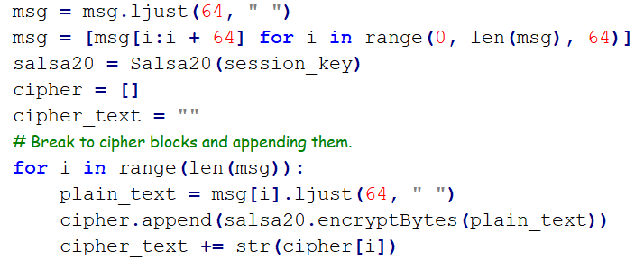
Salsa20 in our project
Encrypt the client request, and the server response
Decode the client request , and the server response
By using the agreed key that they both know before starting to encrypt/decrypt by using salsa20
Notes:
Is used to encrypt/decrypt any server/client message . (after they were agreed about the key)

Slide 30
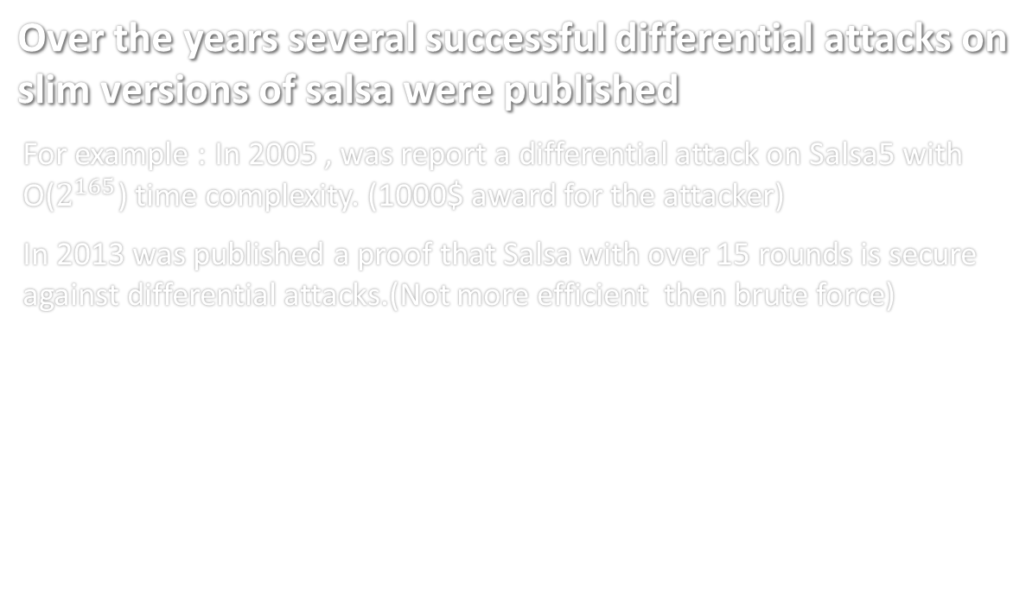
Salsa20 Cryptanalysis
Over the years several successful differential attacks on slim versions of salsa were published
For example : In 2005 , was report a differential attack on Salsa5 with O($2^{165}$) time complexity. (1000$ award for the attacker)
In 2013 was published a proof that Salsa with over 15 rounds is secure against differential attacks.(Not more efficient then brute force)
Notes:
There were differential attacks that works on limited additions of salsa (salsa5, etc’…)
2005 – salsa5 was cracked by one of this attacks.
2003 – proof that salsa15+ provide defense to this attacks.

Slide 31
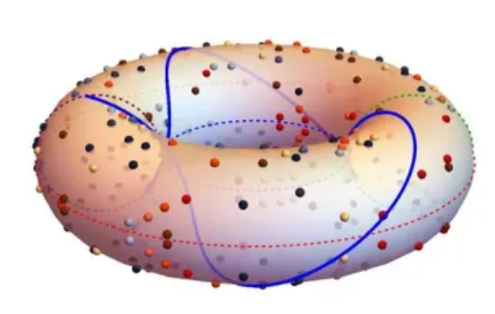
ECDSA
ECDSA – Elliptic Curve Digital Signature Algorithm
Is a cryptographic algorithm used to sign digital messages
It can be used to verify the authenticity and integrity of a message , and the sender
Its more difficult to crack(use ECC keys)
Notes:
Ellptic curve – set of points that describes by equation
Cryptography method that her target to verify authenticity and integrity of M , using elliptic curve.
(sign a message and verify).
The algorithm using dots on the curve and using addition and “mirror” to get the requested (sign) message(dot ).
Comparing hash's :
With ECDSA, Alice will sign a message with her private key, and then Bob will use her public key to verify that she signed the message ,comparting hash’s to check

Slide 32
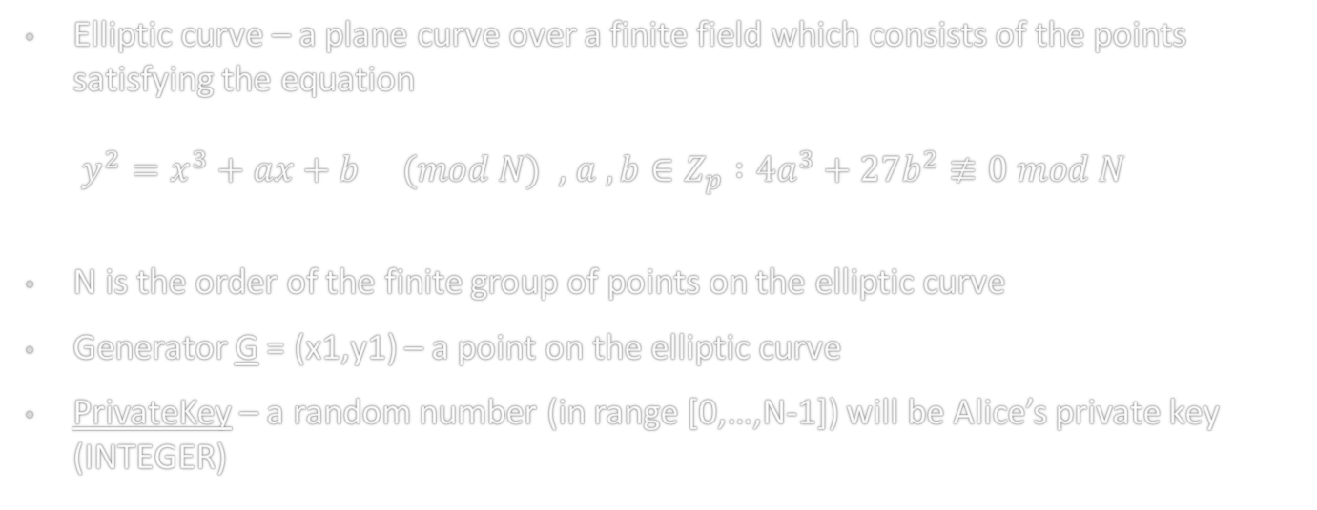
ECDSA – Definitions
Elliptic curve – a plane curve over a finite field which consists of the points satisfying the equation $y^{2}=x^{3}+ax+b (mod N)$ , $a , b∈Z_{p} :4a^{3}+27b^{2}≢0 mod N$
N is the order of the finite group of points on the elliptic curve
Generator G = (x1,y1) – a point on the elliptic curve
PrivateKey – a random number (in range [0,…,N-1]) will be Alice’s private key (INTEGER)
Notes:
Now lets talk about some definitions about the ECDSA
Rule : the curve most satisfying the non-singular equation.
N order of the finite group
G – generated point in the curve
PrivateKey- random number , that with this number we getting the public key.

Slide 33
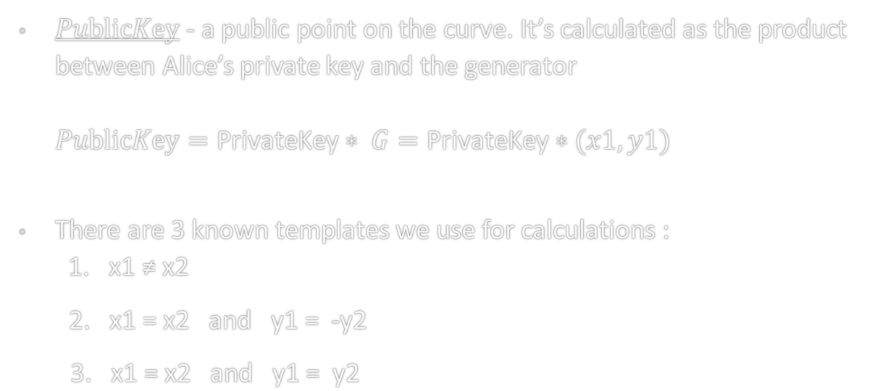
$PublicKey$ - a public point on the curve. It’s calculated as the product between Alice’s private key and the generator $PublicKey=\text{PrivateKey}∗ G=\text{PrivateKey}∗(x1, y1)$
There are 3 known templates we use for calculations : 1. x1 ≠ x2
2. x1 = x2 and y1 = -y2
3. x1 = x2 and y1 = y2
Notes:
Another point in the curve ( the public key ) we getting it my “multiply” the privatekey and the G
3 ways to use additions in this group :

Slide 34
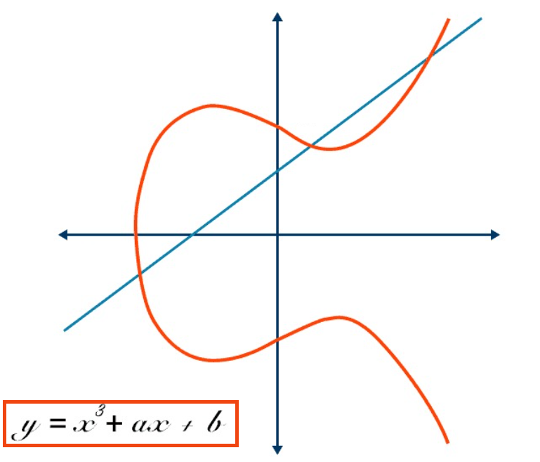
Addition Definitions
First Case :
x1 ≠ x2 : (x1,y1) + (x2,y2) = (x3,y3) ∈ E where :
x3 = m² - x1 - x2
y3 = m*(x1 – x3) - y1
m = (y2 – y1) / (x2 – x1)
Second Case :
x1 = x2 and y1 = - y2
(x1,y1) + (x2,y2) = (x3,y3) ∈ E where :
(x , y) + (x ,-y) = O (the point at infinity)
We got the identity element O.
Notes:
Case 1 : this is the equations to do the calculations for two random points on the cruve
Case 2: adding symmetric point , we will get inifinty , that’s good because we want that group rules (commutative and etc will be allow) a+0 = a

Slide 35
Third Case :
x1 = x2 and y1 = y2 : (x1,y1) + (x2,y2) = (x3,y3) ∈ E where :
x3 = m² - x1 - x2
y3 = m(x1 – x3) - y1
m = (3x12 + a) / 2y1
Notes:
Case 3: adding the same point , this is the equations , that’s works like “ product “ in others group . 2a = a + a

Slide 36
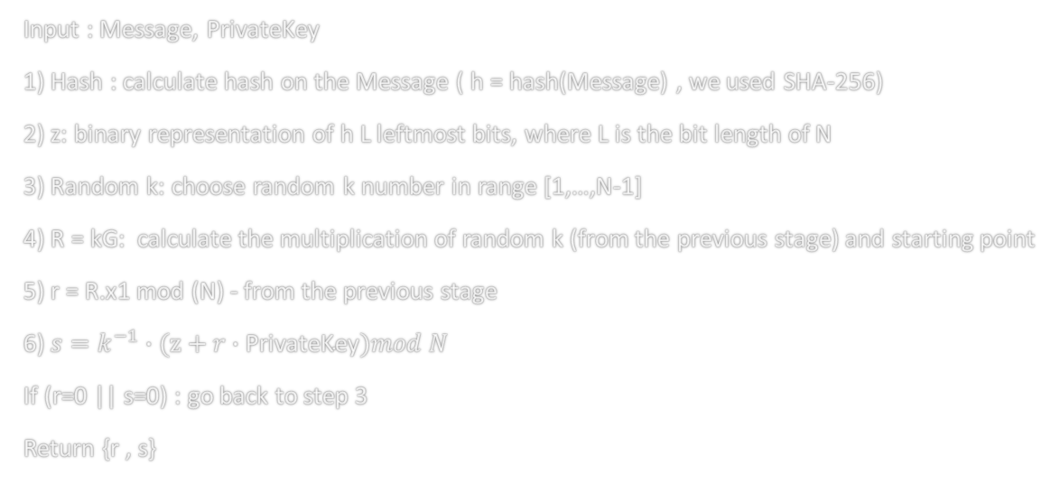
Stages in Generating a Signature
Input : Message, $\text{PrivateKey}$
1) Hash : calculate hash on the Message ( h = hash(Message) , we used SHA-256)
2) z: binary representation of h L leftmost bits, where L is the bit length of N
3) Random k: choose random k number in range [1,…,N-1]
4) R = kG: calculate the multiplication of random k (from the previous stage) and starting point
5) r = R.x1 mod (N) - from the previous stage
6) $s=k^{−1}∙(z+r∙\text{PrivateKey})mod N$
If (r=0 || s=0) : go back to step 3
Return {r , s}

Slide 37
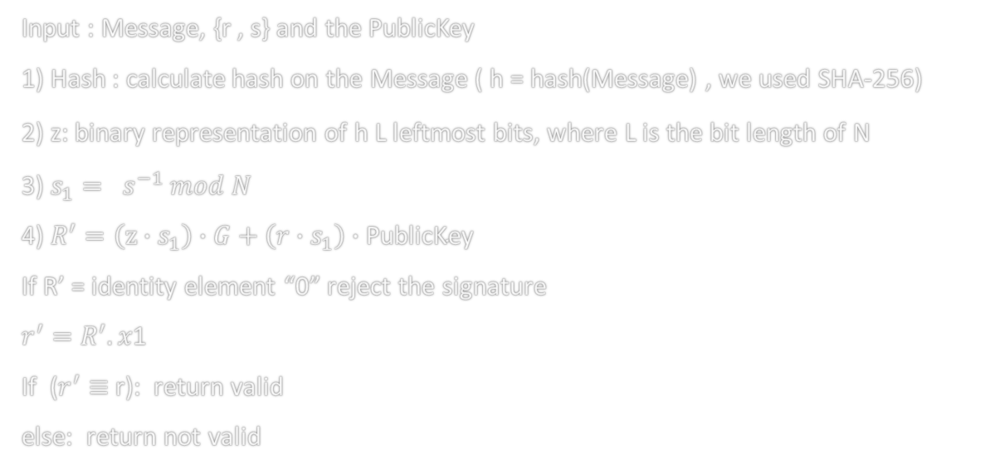
Stages in Signature Verification
Input : Message, {r , s} and the PublicKey
1) Hash : calculate hash on the Message ( h = hash(Message) , we used SHA-256)
2) z: binary representation of h L leftmost bits, where L is the bit length of N
3) $s_{1}= s^{−1} mod N$
4) $R^{′}=\left(z∙s_{1}\right)∙G+\left(r∙s_{1}\right)∙\text{PublicKey}$
If R’ = identity element “0” reject the signature
$r^{′}=R^{′}.x$1
If ($r^{′}≡$ r): return valid
else: return not valid

Slide 38
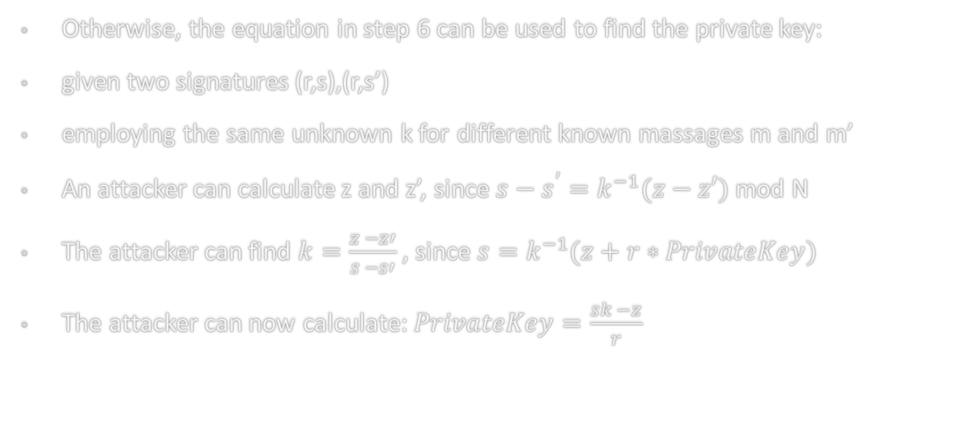
Stages in Generating a Signature
It is important to choose a different random k every time we generate a Signature
Otherwise, the equation in step 6 can be used to find the private key:
given two signatures (r,s),(r,s’)
employing the same unknown k for different known massages m and m’
An attacker can calculate z and z’, since $s−s^{′}=k^{−1}(z−z′)$ mod N
The attacker can find $k=\frac{z −z′}{s −s′}$ , since $s=k^{−1}(z+r∗PrivateKey)$
The attacker can now calculate: $PrivateKey=\frac{sk −z}{r}$
Notes:
Such a failure in random number generation caused users of Android Bitcoin Wallet to lose their funds in August 2013

Slide 39
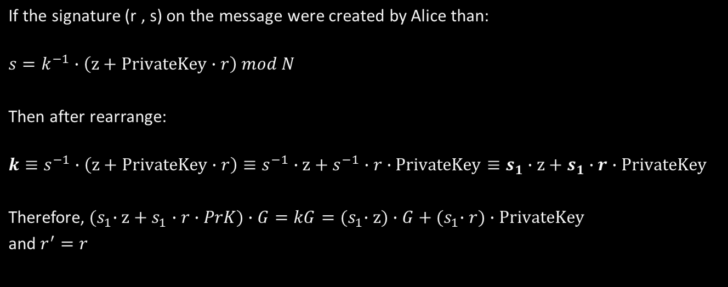
ECDSA proof of Correctness
If the signature (r , s) on the message were created by Alice than:
$$s=k^{−1}∙\left(z+PrivateKey∙r\right) mod N$$
Then after rearrange:
$$k≡s^{−1}∙\left(z+PrivateKey∙r\right)≡s^{−1}∙z+s^{−1}∙r∙PrivateKey≡s_{1}∙z+s_{1}∙r∙PrivateKey$$
Therefore,${ (s}_{1}∙z+s_{1}∙r∙PrK)∙G=kG={(s}_{1}∙z)∙G+{(s}_{1}∙r)∙PrivateKey$
and $r^{′}=r$

Slide 40
Advantages and Disadvantages
Advantages:
Efficient then other DSA algorithms (like RSA..)
Requires less computational resources to execute.
Small key size and provide the same secure level.
Widely used in various applications
Flexibility. (allows different secure levels)
Disadvantages:
If choosing weakness parameters (small prime numbers ) its expose to attacks. And the attacker can extract the private key , by find point on curve with small prime order.
Not random number generation(K). (the attackers can predict the K).

Slide 41
ECDSA in our project
We using ECDSA to digital sign any message that’s transfer between the server and client.

Slide 42




Summary
salsa20
Public key
Private key

Slide 43
Summary
salsa20
Private key
Public key

Slide 44

Summary
salsa20
Private key
Public key

Slide 45
Summary
salsa20
Private key
Public key

Slide 46

Summary
salsa20
Private key
Public key

Slide 47
Summary
Private key
salsa20
Public key

Slide 48

Summary
salsa20
Private key
Encrypted
Message

Slide 49
Summary
salsa20
Private key
Encrypted
Message

Slide 50
Summary
salsa20
Private key
Encrypted
Message

Slide 51
Summary
salsa20
Private key
Encrypted
Message

Slide 52
Summary
salsa20
Encrypted
Message
Private key

Slide 53
Summary
salsa20
salsa20

Slide 54
Summary
salsa20
salsa20

Slide 55

Summary
salsa20
salsa20
message

Slide 56
Summary
salsa20
salsa20
message

Slide 57

Summary
salsa20
salsa20
Cipher text

Slide 58
Summary
salsa20
salsa20
Cipher text

Slide 59
Summary
salsa20
salsa20
Cipher text

Slide 60
Summary
salsa20
salsa20
Cipher text

Slide 61
Summary
salsa20
Cipher text
salsa20

Slide 62
Summary
salsa20
Cipher text
salsa20

Slide 63
Summary
salsa20
salsa20
message

Slide 64
Thank you for listening

