Slide 1
Matrix Exponential
Padé Method
Noah Soskha - 315685990
Dvir Bublil - 315731570

Slide 2
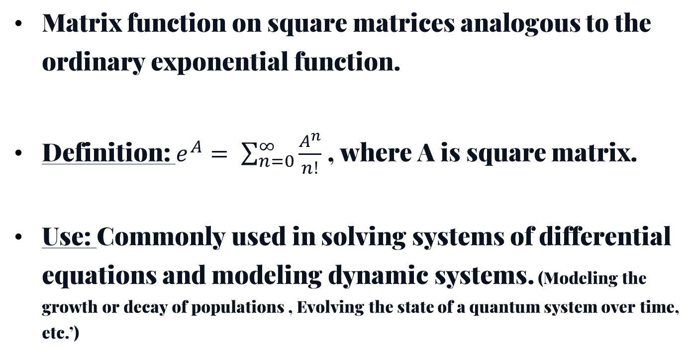
Introduction
Challenges of Computing Matrix Exponential
1) High computational cost for large matrices
2) Numerical stability issues for certain
matrices
Matrix Exponential
Matrix function on square matrices analogous to the ordinary exponential function.
Definition: $e^{A}= \sum_{n=0}^{∞}{\frac{A^{n}}{n!}}$ , where A is square matrix.
Use: Commonly used in solving systems of differential equations and modeling dynamic systems. (Modeling the growth or decay of populations , Evolving the state of a quantum system over time, etc.’)
Methods for Computing Matrix Exponential
1) Direct Methods (Jordan canonical form, Eigenvalue decomposition)
2) Series Methods (Taylor series, Scaling and squaring method)
3) Approximation Methods (Algorithms for efficient computation)

Slide 3
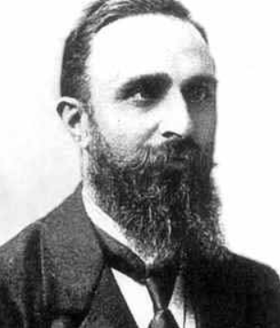
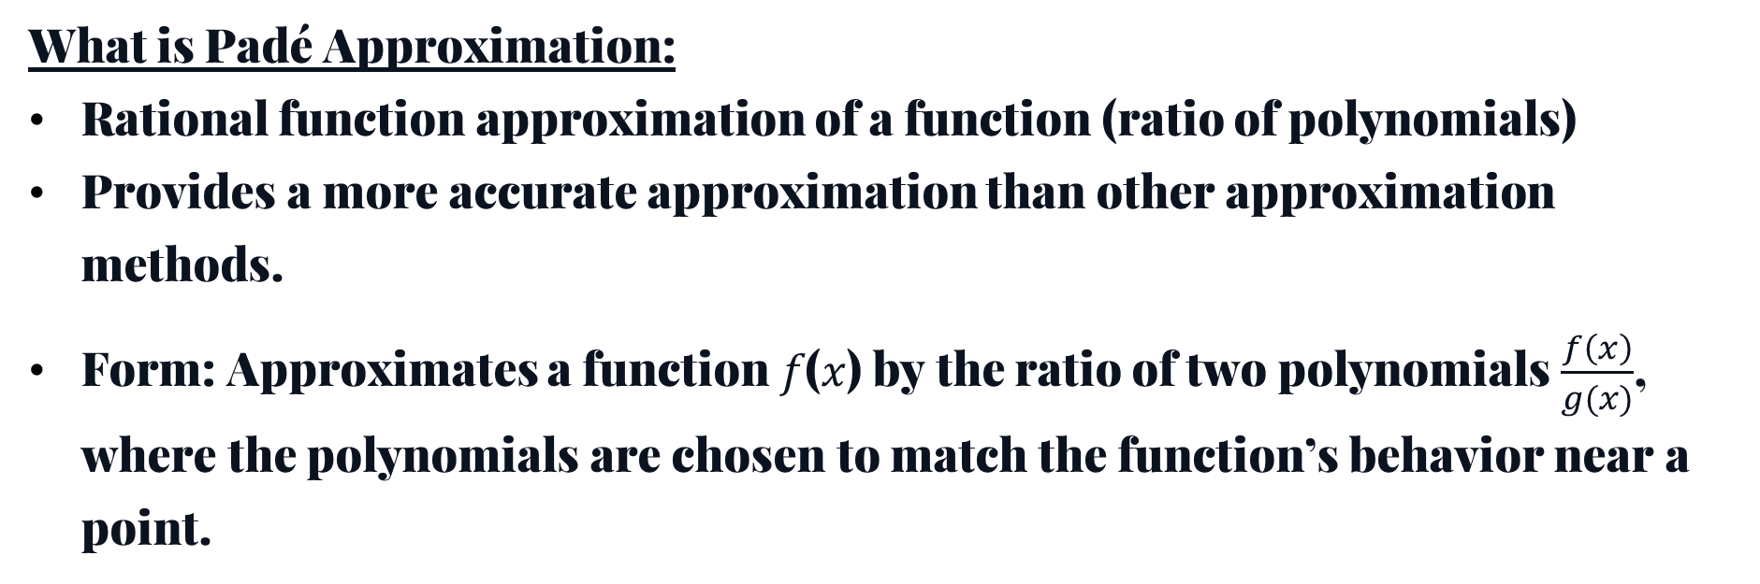

Padé Method
What is Padé Approximation:
Rational function approximation of a function (ratio of polynomials)
Provides a more accurate approximation than other approximation methods.
Form: Approximates a function 𝑓(𝑥) by the ratio of two polynomials $\frac{f\left(x\right)}{g(x)}$, where the polynomials are chosen to match the function’s behavior near a point.
https://en.wikipedia.org/wiki/Pad%C3%A9_approximant
Padé Approximation for Matrix Exponential
Approximating $e^{At}$ with a rational function of matrices.
Can improve accuracy and efficiency compared to direct computation.

Slide 4
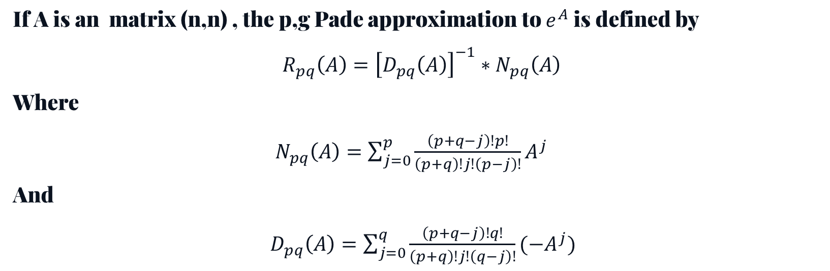
Padé Method equitation's
If A is an matrix (n,n) , the p,g Pade approximation to $e^{A}$is defined by
$$R_{pq}\left(A\right)={\left[D_{pq}\left(A\right)\right]}^{−1}∗N_{pq}\left(A\right)$$
Where
$N_{pq}\left(A\right)=\sum_{j=0}^{p}{\frac{\left(p+q−j\right)!p!}{\left(p+q\right)!j!\left(p−j\right)!}A^{j}}$
And
$D_{pq}\left(A\right)=\sum_{j=0}^{q}{\frac{\left(p+q−j\right)!q!}{\left(p+q\right)!j!\left(q−j\right)!}{(−A}^{j})}$

Slide 5
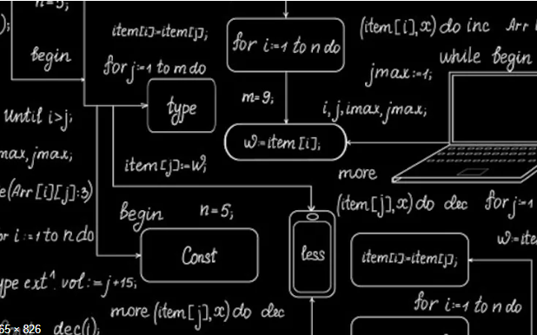
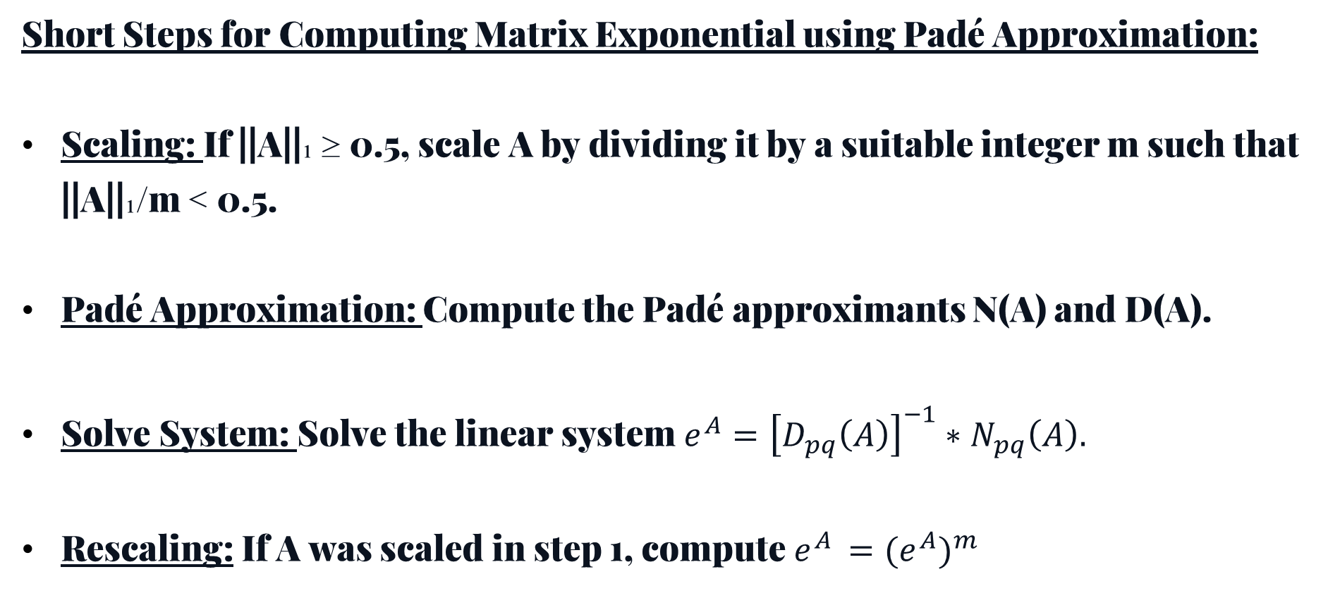
The Algorithm
Short Steps for Computing Matrix Exponential using Padé Approximation:
Scaling: If ||A||₁ ≥ 0.5, scale A by dividing it by a suitable integer m such that ||A||₁/m < 0.5.
Padé Approximation: Compute the Padé approximants N(A) and D(A).
Solve System: Solve the linear system $e^{A}={\left[D_{pq}\left(A\right)\right]}^{−1}∗N_{pq}\left(A\right).$
Rescaling: If A was scaled in step 1, compute $e^{A }={{(e}^{A})}^{m}$
https://www.business-standard.com/article/technology/what-is-an-algorithm-how-the-computers-know-what-to-do-with-data-120101700251_1.html

Slide 6
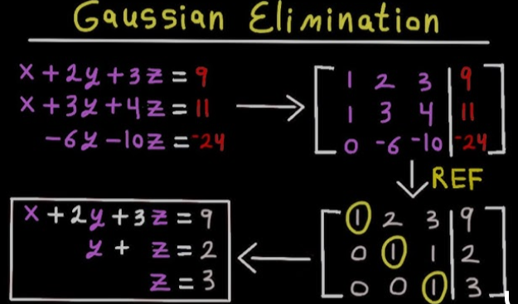
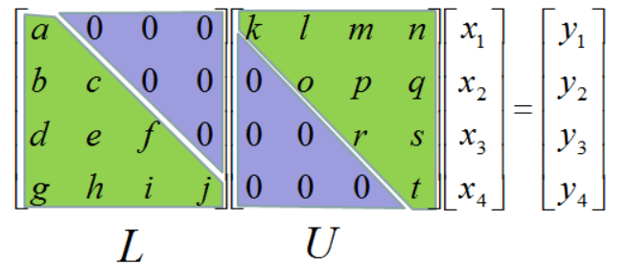
Handling the Linear Solver
The core step in the Padé approximation method involves solving the linear system.
This system needs to be solved efficiently and accurately for the method to be successful.
Therefore, we use : Gaussian Elimination(Pyhton) , LU Decomposition (Haskell)
Gaussian Elimination:
Method:
Solves a system of linear equations by transforming the matrix to row echelon form (or reduced row echelon form).
Steps:
Use row operations (swap, scale, add/subtract) to eliminate variables in successive rows.
Once in upper triangular form, perform back substitution to find the solution.
LU Decomposition:
Method:
Decomposes a matrix A into a product of a lower triangular matrix L and an upper triangular matrix U, i.e., A=LU.
Steps:
Obtain the matrices L and U, where L contains the multipliers and U is upper triangular.
Use L and U to solve systems of equations more efficiently, by first solving Ly=b, then Ux=y.
https://www.youtube.com/watch?v=xCXRp2b8gNs
https://www.sharetechnote.com/html/Handbook_EngMath_Matrix_Decomposition_LU.html

Slide 7
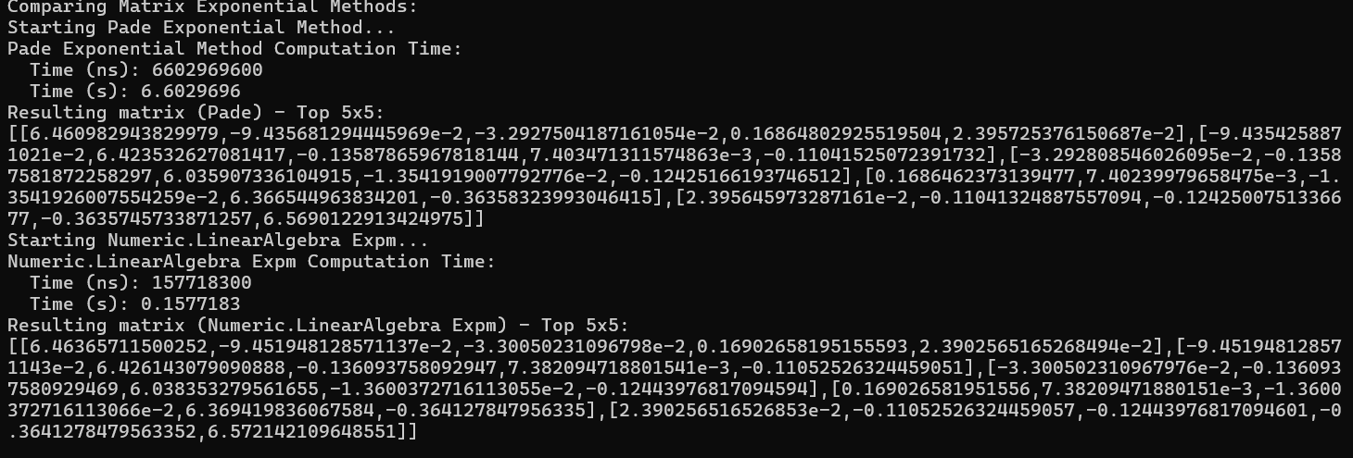
Results - Haskell

Slide 8
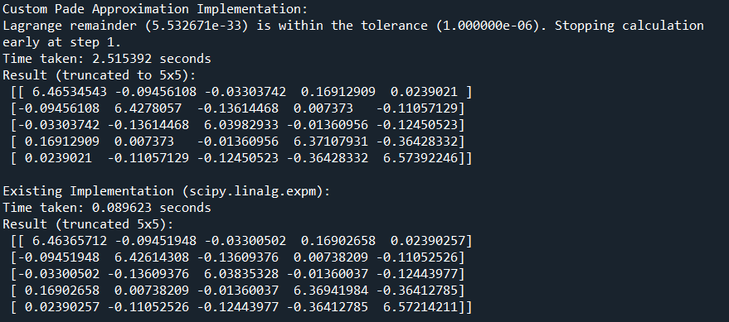
Results - Python

Slide 9
Advantages and Disadvantages
Haskell:
Python:
Advantages:
Advantages:
Parallelization
Memory-efficient
Customizability: Allows deep control over the mathematical steps
Easy to debugging
Disadvantages:
Readability
Disadvantages:
Limited parallelization support; not automatic for matrix operations.

Slide 10
Thanks

