Slide 1
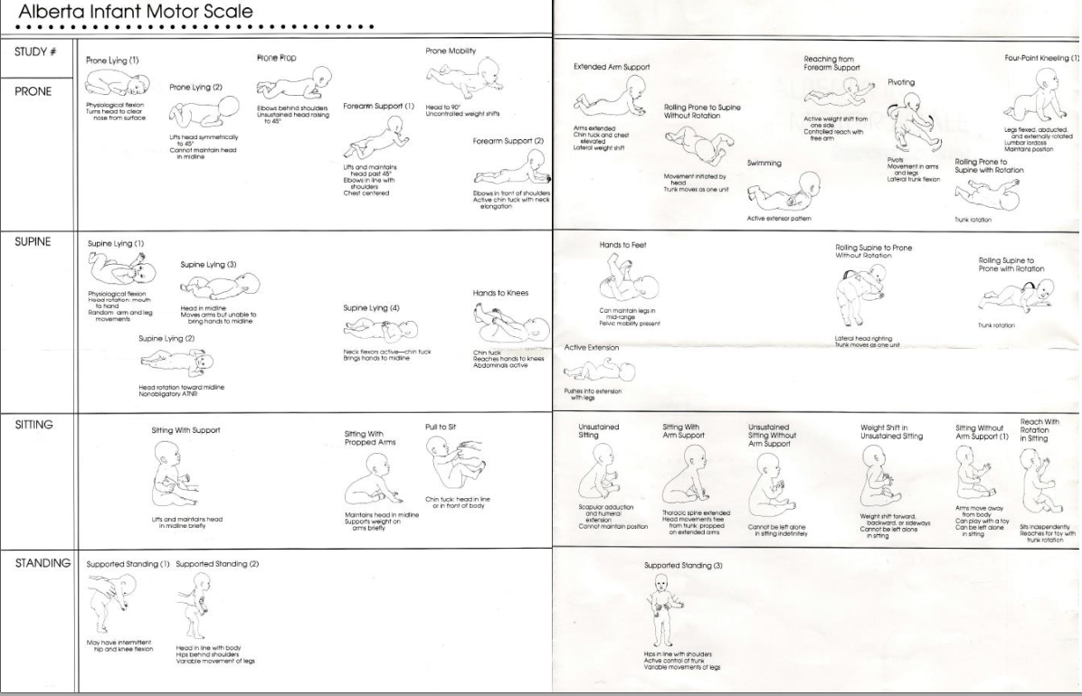
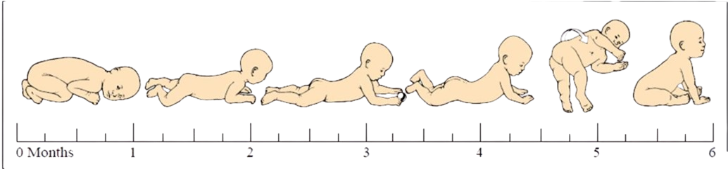
10
Example
7
7
Stage 4/5
3
27 – up to age 6 months

Slide 2
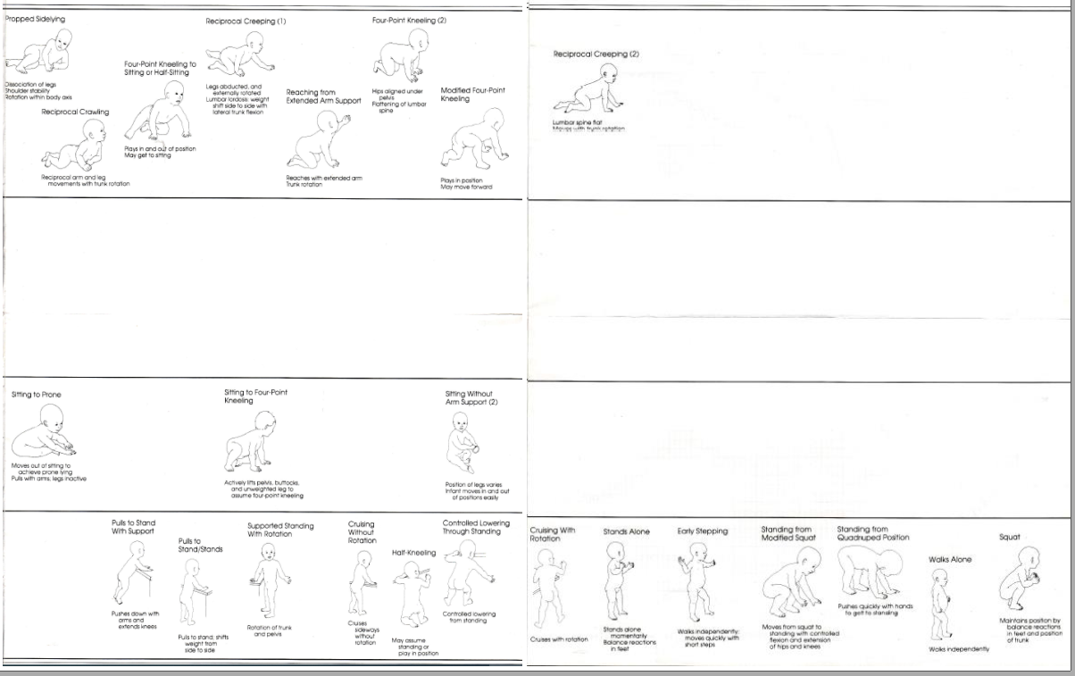
Example
Stage 4/5

