Slide 1
MuJoCo Battle Royale
Emergent multi-agent sumo through self-play
One shared policy → balance · dominance · active pushing
Workshop in Autonomous Systems Simulation (20973)
Oshri Belay · Dvir Gilad

Slide 2
THE CHALLENGE
One policy, three behaviours — in the hard melee (n ≥ 4)
Balance
Dominance
Active pushing
N identical copies each win ≈ 1/N
1 trained beats N−1 untrained
win by shoving opponents out
self-play converged to a fair equilibrium, no degenerate exploit
the learned behaviour is genuinely skilful, not mutually cancelling
not by outlasting a shrinking boundary — real ejection
Why it's hard: in a 3+ free-for-all, committing to a push exposes you to everyone else — the symmetric best response is to wait, so games collapse to cautious draws (0.07 resolution at n=4).
MuJoCo Battle Royale · self-play sumo
2

Slide 3
SYSTEM
Clean Architecture — dependencies point inward
Interfaces
SelfPlayEnv (Gym) · BattleRoyaleEnv (PettingZoo) · CLIs
depend
only
inward
↓
reward &
observation
are pure fns
→ identical in
train/eval/render
Application
Trainer · Evaluator · SnapshotPool · MetricsTracker
Domain
Agent · Arena · RewardCalculator · ObservationBuilder · EliminationService · Elo
Infrastructure
MuJoCoEnvironment · XMLBuilder · loggers · VideoRecorder · YamlLoader
MuJoCo Battle Royale · self-play sumo
3

Slide 4
PHYSICS · 1
Each agent: a damped puck on two slide joints
The model
Why damping is essential
▸ 2-D force actuation, no rotation — F = 14·u per axis
▸ Linear joint damping c = 4 (not frictionless)
▸ Cylinder = collision + mass; humanoid = visual only (0 mass)
With c = 0 the arena is frictionless: any net force integrates into unbounded velocity and agents slide off the edge uncontrollably.
“Winning” degenerates into being the last to fall off by accident — a 1/N artifact, not skill.
Damping turns “impossible to control” into “a controllable sumo.”
m·v̇ = F − c·v
terminal speed v∞ = F/c = 3.5 m/s
(bounded — damping makes the task learnable)
MuJoCo Battle Royale · self-play sumo
4

Slide 5
PHYSICS · 2 — THE KEY FINDING
The bottleneck was braking distance, not reward
Every reward trick failed at n ≥ 3 until we found the real constraint — a hard dynamical one:
d_brake = v∞ · τ = (F/c)·(m/c) = F·m / c²
braking distance grows with mass — and mass = density × volume
Heavy (ρ 1000, m ≈ 7 kg)
d_brake ≈ 5.5 m ≫ 1.2 m arena
cannot stop in the ring → caution + self-ejection; dominance capped at −0.26
Light (ρ 150, m ≈ 1.1 kg)
d_brake ≈ 0.96 m < 1.2 m arena
can stop & commit; shoves displace more → dominance +0.98
MuJoCo Battle Royale · self-play sumo
5

Slide 6
LEARNING · REWARD
Every reward term fixes a specific failure
Term | Value | Fixes
Win bonus | +10 | winning (≈+13) dominates turtling (≈−1.2)
Elimination / Death | +1 / −1 | signal for ejecting; penalty for self-ejecting
Survival / Time | +.001 / −.003 | anti-suicide floor; idling mildly unprofitable
Push shaping | +2.0·Δ | dense gradient toward ejecting (potential-based)
Approach shaping | +0.4·Δ | learn to hunt a passive target
Edge penalty | −1·depth | stop overshooting your own edge
Draw penalty | = loss | kills the run-out-the-clock equilibrium
The one inequality
win
≈ +13
≫
turtle
≈ −1.2
>
suicide
−1
Potential-based shaping (Ng et al. 1999): scaling it speeds learning without changing the optimum — so the annealed “aggression boost” is safe.
MuJoCo Battle Royale · self-play sumo
6

Slide 7
LEARNING · SELF-PLAY
One shared policy vs a pool of its own past selves
▸ Single-agent view. SelfPlayEnv = one learner vs N−1 frozen opponents → a clean win/loss per episode.
▸ δ-uniform snapshot pool. Opponents sampled uniformly from all 100 past checkpoints — no Red-Queen cycling.
▸ Agent-count curriculum. Start at n=2 (zero exposure), ramp to n=4 — the shove skill forms 1v1 and is carried into the melee.
▸ Draw = loss + high γ (0.997). A timed-out draw costs like a death; γ reaches ~333 steps back so caution stops paying mid-game.
▸ Rotation randomisation. Random spawn rotation each episode — the policy can't memorise a slot; enables the 1/N balance result.
PPO MlpPolicy 2×64 · lr 3e-4 · n_steps 2048 · γ 0.997 · 1.5 M steps ≈ 30–40 min on CPU
MuJoCo Battle Royale · self-play sumo
7

Slide 8
RESULTS
One policy hits all three targets at n = 4 / 6, generalising to n = 8
Behaviour | n=2 | n=4 | n=6 | n=8
Active pushing (self-play resolution, no storm) | 0.88 | 0.91 | 0.79 | 0.78
Dominance edge (1 trained vs n−1 random) | +1.00 | +0.98 | +0.85 | +0.56
Balance (per-slot share, ideal 1/n) | 0.50 | 0.25 | 0.17 | 0.13
At n=4: 99% wins vs three untrained opponents; four copies resolve 91% of games by a real push-out.
Zero-shot to n=8 (2× training): pushing holds (0.78), learner almost never eliminated (loss 0.01); edge softens to +0.56. Stable across 1.0–1.5 M steps.
MuJoCo Battle Royale · self-play sumo
8

Slide 9
HOW WE GOT THERE
The two levers that finally combined
Run | Change | n4 push | n4 dom | Verdict
direct n=4 | train straight at n=4 | 0.07 | — | melee-risk equilibrium: all draws
curriculum | n=2→4 + aggression boost | 0.64 | −0.33 | carries the shove in; can't clear randoms
sumo_arena | + smaller arena + storm | ~0 | +0.08 | storm resolves but replaces pushing
sumo_openai | + draw = loss | 0.26 | −0.26 | nails 1v1 (+0.90); n≥3 self-ejects
sumo_light | + light agents (ρ 150) | 0.91 | +0.98 | braking < arena → all three at once
Two independent unlocks: OpenAI's draw=loss incentive (nailed 1v1) + the mass / braking-distance physics fix (removed the self-ejection ceiling).
MuJoCo Battle Royale · self-play sumo
9

Slide 10
HONESTY — A NEGATIVE RESULT
Perfect balance is fragile — and that's the finding
sumo_light's n=4 share is slightly uneven (≈ [.20 .19 .32 .29]) from an observation tie-break on the symmetric spawn. All three fixes evened it — but each collapsed the aggression:
Fix attempted | Balance | Cost
Spawn jitter (angular + radial) | evened | dominance +0.98 → +0.02
Spawn jitter (angular only) | evened | pushing 0.91 → 0.24
Observation neighbour-shuffle (no physics change) | — | total passivity (0.00 everywhere)
The draw-penalty aggressive optimum is a knife-edge: clearing opponents is hard to learn, so any training-time noise tips the policy back to the safe passive draw-equilibrium. Perfect balance needs an equivariant architecture — future work.
MuJoCo Battle Royale · self-play sumo
10

Slide 11
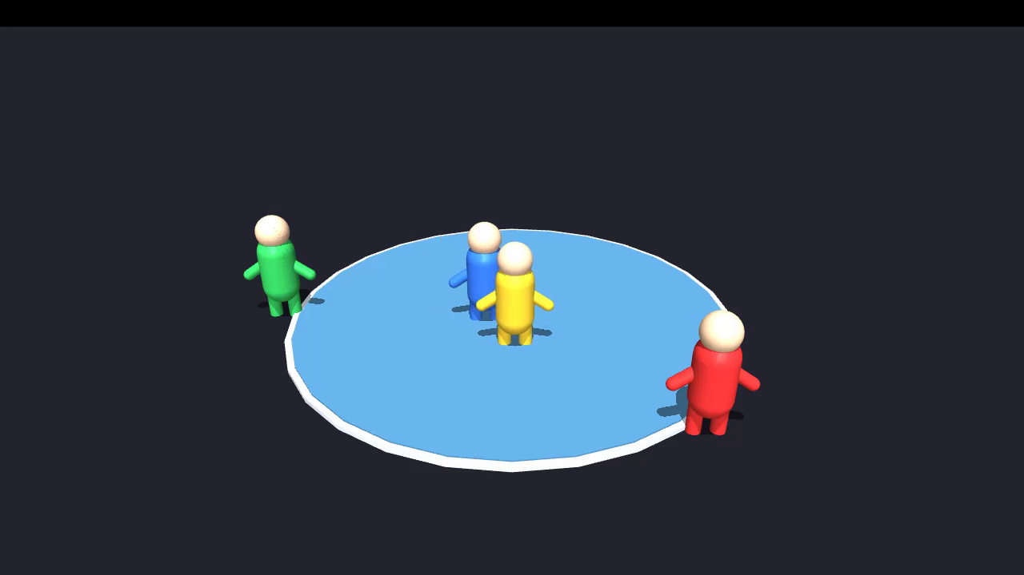
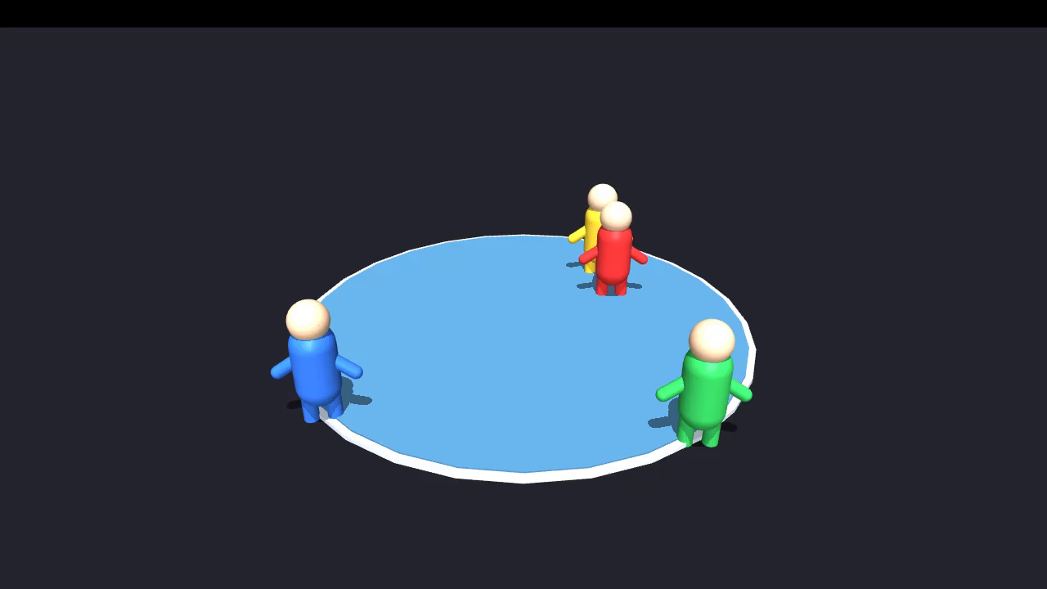
SEE IT MOVE
Emergent push-outs — and 1-vs-3 dominance
Self-play n=4 — every winner ejects the others
Dominance — red = trained, others random
▶ Full captioned reel: media/battle_royale_results.mp4 (pushing, generalisation (n=6/8) & dominance, ~80 s)
MuJoCo Battle Royale · self-play sumo
11

Slide 12
TAKEAWAYS
What made it work
▸ Physics can be the real bottleneck. A braking distance larger than the arena capped every reward-only attempt.
▸ Make draws cost. Scoring a timeout like a loss (+ high γ) destroys the cautious equilibrium.
▸ Curriculum the hard structure. Form the skill where it's easy (1v1), carry it into the melee.
▸ Symmetry is a tool and a trap. Rotation-randomisation buys 1/N balance; an observation tie-break costs a little back.
▸ Report the dead ends. The negative results localised the bottleneck and are documented in full.
Reproduce: train --config config/sumo_light.yaml · docs: METHODOLOGY.md · DESIGN.md · RUNBOOK.md

