Slide 1
A variety of variants
Dvir Yitzchaki

Slide 2
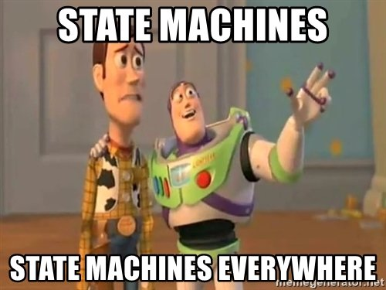

Slide 3
State machines
Disconnected
Connecting
connect()
disonnect()
acknowledge()
Interrupted
Disconnected time
Reconnect timer
Connected
Last ping time
Connected time
Connection ID
interrupt()
Kalle Huttunen - Implementing State Machines with std::variant

Slide 4
State machines – first try
struct Connection { enum class State { DISCONNECTED, CONNECTING, CONNECTED, CONNECTION_INTERRUPTED }; std::string m_serverAddress; ConnectionId m_id; std::chrono::system_clock::time_point m_connectedTime; std::optional<std::chrono::milliseconds> m_lastPingTime; std::chrono::system_clock::time_point m_disconnectedTime; Timer m_reconnectTimer; State m_state = State::DISCONNECTED; };

Slide 5
State machines – first try
void interrupt() {
switch (m_state) {
case State::DISCONNECTED:
case State::CONNECTING:
m_state = State::DISCONNECTED;
break;
case State::CONNECTED:
m_disconnectedTime = std::chrono::system_clock::now();
notifyInterrupted(m_disconnectedTime);
m_reconnectTimer = Timer{5000};
m_state = State::CONNECTION_INTERRUPTED;
break;
case State::CONNECTION_INTERRUPTED:
break;
}
}

Slide 6
State machines – first try
void disconnect() {
// maybe need to kill timer?
m_state = State::DISCONNECTED;
}

Slide 7
State machines – problems
Data is accessible where it shouldn’t be
Can’t use RAII
We want to make illegal states unrepresentable

Slide 8


Slide 9
Types
WHAT IS A TYPE?
The set of values that can inhabit an expression
may be finite or "infinite"
characterized by cardinality
Expressions have types
A program has a type
Using Types Effectively - Ben Deane - CppCon 2016

Slide 10
LET'S PLAY A GAME
To help us get thinking about types.
I'll tell you a type.
You tell me how many values it has.
There are no tricks: if it seems obvious, it is!

Slide 11
LEVEL 1
Types as sets of values

Slide 12
LEVEL 1
How many values?
bool;

Slide 13




LEVEL 1
How many values?
bool;
2 (true and false)

Slide 14
LEVEL 1
How many values?
char;

Slide 15
LEVEL 1
How many values?
char;
256

Slide 16
LEVEL 1
How many values?
void;

Slide 17
LEVEL 1
How many values?
void;
0

Slide 18
LEVEL 1
How many values?
enum FireSwampDangers : int8_t { FLAME_SPURTS, LIGHTNING_SAND, ROUSES };

Slide 19
LEVEL 1
How many values?
enum FireSwampDangers : int8_t { FLAME_SPURTS, LIGHTNING_SAND, ROUSES };
3

Slide 20
LEVEL 1
How many values?
template <typename T> struct Foo { T m_t; };

Slide 21
LEVEL 1
How many values?
template <typename T> struct Foo { T m_t; };
As much as T

Slide 22
END OF LEVEL 1

Slide 23
Algebraic data types
Algebraically, a type is the number of values that inhabit it.
These types are equivalent:
bool; enum class InatorButtons { ON_OFF, SELF_DESTRUCT };
Let's move on to level 2.

Slide 24
LEVEL 2
Aggregating Types

Slide 25
LEVEL 2
How many values?
std::pair<char, bool>;

Slide 26
LEVEL 2
How many values?
std::pair<char, bool>;
256 * 2 = 512

Slide 27
LEVEL 2
How many values?
struct Foo { char a; bool b; };

Slide 28
LEVEL 2
How many values?
struct Foo { char a; bool b; };
256 * 2 = 512

Slide 29
LEVEL 2
How many values?
std::tuple<bool, bool, bool>;

Slide 30
LEVEL 2
How many values?
std::tuple<bool, bool, bool>;
2 * 2 * 2 = 8

Slide 31
LEVEL 2
How many values?
template <typename T, typename U> struct Foo { T m_t; U m_u; };

Slide 32
LEVEL 2
How many values?
template <typename T, typename U> struct Foo { T m_t; U m_u; };
(# of values in T) * (# of values in U)

Slide 33
END OF LEVEL 2

Slide 34
Product type
When two types are "concatenated" into one compound type, we multiply the # of inhabitants of the components.
This kind of compounding gives us a product type.

Slide 35
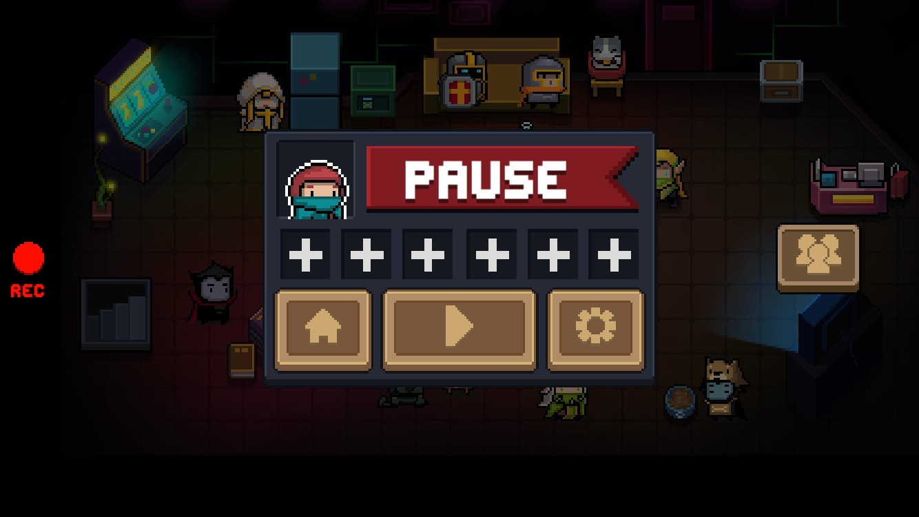

Slide 36
std::variant
std::variant<int, std::string> v; v = 42; std::cout << std::get<int>(v) << '\n'; // prints 42 try { std::cout << std::get<std::string>(v) << '\n'; // throws } catch (const std::bad_variant_access &e) { std::cout << e.what() << '\n'; // prints 'bad variant access' } // std::cout << std::get<long>(v) << '\n'; // doesn't compile v = "forty two"; std::cout << std::get<std::string>(v) << '\n'; // prints 'forty two'

Slide 37
std::variant
if (auto p = std::get_if<std::string>(&v)) { std::cout << "we have a string: " << *p << '\n';} else { std::cout << "we don't have a string\n"; }

Slide 38
std::visit
using Var = std::variant<int, std::string>; Var duplicate(const Var& v) { struct Duplicater { Var operator()(int i) { return i * 2; } Var operator()(const std::string &s) { return s + s; } }; return std::visit(Duplicater{}, v); }

Slide 39
History
2002 – Boost.Variant started by Eric Friedman, Itay Maman
2004 – Release on Boost 1.31.0
2014 – std::variant proposed to C++ standard by Axel Naumann - N4218
2017 – std::variant released as part of C++17

Slide 40
Implementations
Standard Template Library - http://en.cppreference.com/w/cpp/utility/variant
Boost - http://www.boost.org/doc/libs/1_66_0/doc/html/variant.html
Qt - http://doc.qt.io/qt-5/qvariant.html
Michael Park – (back ported std::variant to C++11) https://github.com/mpark/variant
Jonathan Müller - https://foonathan.net/doc/type_safe
Mapbox - https://github.com/mapbox/variant
Gnome - https://developer.gnome.org/glibmm/unstable/classGlib_1_1Variant.html

Slide 41
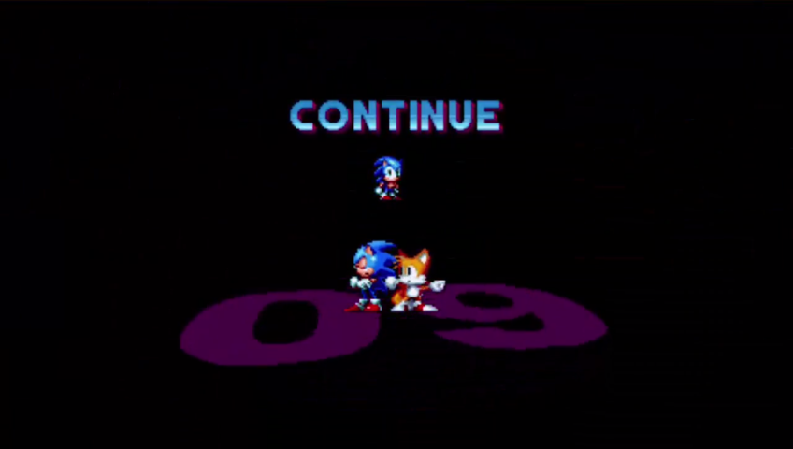

Slide 42
LEVEL 3
Alternating Types

Slide 43
LEVEL 3
How many values?
std::optional<char>;

Slide 44
LEVEL 3
How many values?
std::optional<char>;
256 + 1 = 257

Slide 45
LEVEL 3
How many values?
std::variant<char, bool>;

Slide 46
LEVEL 3
How many values?
std::variant<char, bool>;
256 + 2 = 258

Slide 47
LEVEL 3
How many values?
template <typename T, typename U> struct Foo { std::variant<T, U> m_v; };

Slide 48
LEVEL 3
How many values?
template <typename T, typename U> struct Foo { std::variant<T, U> m_v; };
(# of values in T) + (# of values in U)

Slide 49
END OF LEVEL 3

Slide 50
Sum type
When two types are "alternated" into one compound type, we add the # of inhabitants of the components.
This kind of compounding gives us a sum type.

Slide 52
Union limitations
If a union contains a non-static data member with a non-trivial special member function (copy/move constructor, copy/move assignment, or destructor), that function is deleted by default in the union and needs to be defined explicitly by the programmer.
If a union contains a non-static data member with a non-trivial default constructor, the default constructor of the union is deleted by default unless a variant member of the union has a default member initializer.

Slide 53
Unions – first try
struct S {
S() { std::cout << "S Ctor\n"; }
~S() { std::cout << "S Dtor\n"; }
};
union foo {
int n;
S s;
};
int main() {
foo f;
}
Union.cpp:25:7: error: use of deleted function ‘foo::foo()’
foo f;
^

Slide 54
Unions – second try
struct S {
S() { std::cout << "S Ctor\n"; }
~S() { std::cout << "S Dtor\n"; }
};
union foo {
int n;
S s;
foo() { new (&s) S(); }
~foo(){};
};
int main() { foo f; }

Slide 55
Unions – second try
struct S {
S() { std::cout << "S Ctor\n"; }
~S() { std::cout << "S Dtor\n"; }
};
union foo {
int n;
S s;
foo() { new (&s) S(); }
~foo(){};
};
int main() { foo f; }
Output:
S Ctor

Slide 56
Unions – second try
struct S {
S() { std::cout << "S Ctor\n"; }
~S() { std::cout << "S Dtor\n"; }
};
union foo {
int n;
S s;
foo() { new (&s) S(); }
~foo(){};
};
int main() { foo f = 2; }
Union.cpp:22:22: error: conversion from ‘int’ to non-scalar type ‘foo’ requested
int main() { foo f = 2; }
^

Slide 57
Unions – third try
struct S {
S() { std::cout << "S Ctor\n"; }
S(const S&) { std::cout << "S copy Ctor\n"; }
~S() { std::cout << "S Dtor\n"; }
};
struct foo {
enum class State { INT, S };
State state;
union {
int n;
S s;
};
foo(int i) : state(State::INT) { new (&n) int(i); }
foo(S s) : state(State::S) { new (&this->s) S(s); }
foo() : foo(S{}) {}
~foo() {
switch (state) {
case State::INT:
break;
case State::S:
s.~S();
break;
}
};
};
int main() { foo f; }

Slide 58
State machines – variant
struct Connection { struct Disconnected {}; struct Connecting {}; struct Connected { ConnectionId m_id; std::chrono::system_clock::time_point m_connectedTime; std::optional<std::chrono::milliseconds> m_lastPingTime; }; struct ConnectionInterrupted { std::chrono::system_clock::time_point m_disconnectedTime; Timer m_reconnectTimer; }; using State = std::variant<Disconnected, Connecting, Connected, ConnectionInterrupted>; State m_state; std::string m_serverAddress; };

Slide 59
State machines – variant
void disconnect() {
m_state = Disconnected();
// if state was interrupted then ~Timer() would be called
}

Slide 60
State machines – variant
void interrupt() { struct InterruptedEvent { InterruptedEvent(Connection &c) : m_c(c) {}
State operator()(const Disconnected &) { return Disconnected(); }
State operator()(const Connecting &) { return Disconnected(); }
State operator()(const Connected &) { const auto now = std::chrono::system_clock::now(); m_c.notifyInterrupted(now); return ConnectionInterrupted(now, 5000); }
State operator()(const ConnectionInterrupted &s) { return s; } private: Connection &m_c; }; m_state = std::visit(InterruptedEvent(*this), m_state); }

Slide 61
State machines – variant
struct InterruptedEvent { InterruptedEvent(Connection &c) : m_c(c) {}
template <typename T> State operator()(const T &) { return Disconnected(); }
State operator()(const Connected &) { const auto now = std::chrono::system_clock::now(); m_c.notifyInterrupted(now); return ConnectionInterrupted(now, 5000); }
State operator()(const ConnectionInterrupted &s) { return s; } private: Connection &m_c; }; void interrupt() { m_state = std::visit(InterruptedEvent(*this), m_state); }

Slide 62


Slide 63
Lambda visitation
void interrupt() {
m_state = std::visit(
overload(
[this](const Connected &) -> State {
const auto now = std::chrono::system_clock::now();
notifyInterrupted(now);
return ConnectionInterrupted(now, 5000);
},
[](const ConnectionInterrupted &s) -> State { return s; },
[](const auto & /*default*/) -> State { return Disconnected(); }),
m_state);
}

Slide 64
Inheriting from lambdas – c++17
template <typename... Funcs> struct overload_set : Funcs... {
using Funcs::operator()...; // exposes operator() from every base
};
template <typename... Funcs>
overload_set<Funcs...> overload(Funcs &&... funcs) {
return {std::forward<Funcs>(funcs)...};
}

Slide 65
Inherting from lambdas – c++11
template <typename...> struct overload_set {
void operator()() {}
};
template <typename Func, typename... Funcs>
struct overload_set<Func, Funcs...> : Func, overload_set<Funcs...> {
using Func::operator();
using overload_set<Funcs...>::operator();
overload_set(const Func &f, const Funcs &... fs)
: Func(f), overload_set<Funcs...>(fs...) {}
};
template <typename... Funcs>
overload_set<Funcs...> overload(Funcs &&... funcs) {
return {std::forward<Funcs>(funcs)...};
}

Slide 66
constexpr if visitation
void interrupt() {
m_state = std::visit(
[this](const auto &state) -> State {
// Needed to properly compare the types
using T = std::decay_t<decltype(state)>;
if constexpr (std::is_same_v<T, Connected>) {
const auto now = std::chrono::system_clock::now();
notifyInterrupted(now);
return ConnectionInterrupted(now, 5000);
} else if constexpr (std::is_same_v<T, ConnectionInterrupted>) {
return state;
} else {
return Disconnected();
}
},
m_state);
}

Slide 67


Slide 68
{
"firstName": "John",
"lastName": "Smith",
"isAlive": true,
"age": 27,
"address":
{
"streetAddress": "21 2nd Street",
"city": "New York“
},
"phoneNumbers":
[
{
"type": "home",
"number": "212 555-1234"
},
{
"type": "office",
"number": "646 555-4567"
}
],
"spouse": null
}

Slide 69
JSON
JSON data types
Null
Number
String
Boolean
Array
Object

Slide 70
JSON – first try
using JsonValue = std::variant<nullptr_t, // null int, // number std::string, // string bool, // boolean std::vector<JsonValue>, // array std::vector<std::pair<std::string, JsonValue>> // object >;
error C2065: 'JsonValue': undeclared identifier

Slide 71
JSON – add a level of indirection
struct JsonArray; struct JsonObject; using JsonValue = std::variant<nullptr_t, // null int, // number std::string, // string bool, // boolean std::unique_ptr<JsonArray>, // array std::unique_ptr<JsonObject> // object >;

Slide 72
JSON – add a level of indirection
template <typename T, typename... Args> std::vector<T> make_vector(Args &&... args) { std::vector<T> res; (res.emplace_back(std::forward<Args>(args)), ...); return res; } struct JsonArray { std::vector<JsonValue> array; template <typename... Args> JsonArray(Args &&... args) : array(make_vector<JsonValue>(std::forward<Args>(args)...)) {} }; struct JsonObject { std::vector<std::pair<std::string, JsonValue>> object; template <typename... Args> JsonObject(Args &&... args) : object(make_vector<std::pair<std::string, JsonValue>>(std::forward<Args>(args)...)) {} };

Slide 73
JSON – construction
JsonValue construct() { using namespace std::string_literals; using p = std::pair<std::string, JsonValue>; return std::make_unique<JsonObject>( p{"firstName"s, "phn"s}, p{"lastName"s, "Smith"s}, p{"isAlive"s, true}, p{"age"s, 27}, p{"address"s, std::make_unique<JsonObject>(p{"streetAddress"s, "21 2nd Street"s}, p{"city"s, "New York"s})}, p{ "phoneNumbers"s, std::make_unique<JsonArray>( std::make_unique<JsonObject>(p{"type"s, "home"s}, p{"number"s, "212 555-1234"s}), std::make_unique<JsonObject>(p{"type"s, "office"s}, p{"number"s, "646 555-4567"s})), }, p{"spouse"s, nullptr}); }
{
"firstName": "John",
"lastName": "Smith",
"isAlive": true,
"age": 27,
"address":
{
"streetAddress": "21 2nd Street",
"city": "New York“
},
"phoneNumbers":
[
{
"type": "home",
"number": "212 555-1234"
},
{
"type": "office",
"number": "646 555-4567"
}
],
"spouse": null
}

Slide 74
JSON – visitation
std::ostream &operator<<(std::ostream &ost, const JsonValue &json) { std::visit(overload([&ost](const nullptr_t &) { ost << "null"; }, [&ost](const std::unique_ptr<JsonArray> &value) { // should we check for null ptr? ost << "[\n"; std::copy(begin(value->array), end(value->array), std::ostream_iterator<JsonValue>(ost, ",\n")); ost << ']'; }, [&ost](const std::unique_ptr<JsonObject> &value) { // should we check for null ptr? ost << "{\n"; std::for_each(begin(value->object), end(value->object), [&](const auto &p) { ost << p.first << ": " << p.second << ",\n"; }); ost << '}'; }, [&ost](const auto &value) { ost << value; }), json); return ost; }

Slide 75
JSON – Boost::variant + recursive_wrapper
struct JsonArray; struct JsonObject; using JsonValue = boost::variant<nullptr_t, int, std::string, bool, boost::recursive_wrapper<JsonArray>, boost::recursive_wrapper<JsonObject>>; struct JsonArray { std::vector<JsonValue> array; JsonArray(std::initializer_list<JsonValue> il) : array(il) {} }; struct JsonObject { std::vector<std::pair<std::string, JsonValue>> object; JsonObject(std::initializer_list<std::pair<std::string, JsonValue>> il) : object(il) {} };

Slide 76
JSON – Boost construction
JsonValue construct() { using namespace std::string_literals; return JsonObject{ {"firstName"s, "John"s}, {"lastName"s, "Smith"s}, {"isAlive"s, true}, {"age"s, 27}, {"address"s, JsonObject{{"streetAddress"s, "21 2nd Street"s}, {"city"s, "New York"s}}}, { "phoneNumbers"s, JsonArray{ JsonObject{{"type"s, "home"s}, {"number"s, "212 555-1234"s}}, JsonObject{{"type"s, "office"s}, {"number"s, "646 555-4567"s}}}, }, {"spouse"s, nullptr}}; }
{
"firstName": "John",
"lastName": "Smith",
"isAlive": true,
"age": 27,
"address":
{
"streetAddress": "21 2nd Street",
"city": "New York“
},
"phoneNumbers":
[
{
"type": "home",
"number": "212 555-1234"
},
{
"type": "office",
"number": "646 555-4567"
}
],
"spouse": null
}

Slide 77
JSON – Boost visitation
std::ostream &operator<<(std::ostream &ost, const JsonValue &json) { boost::apply_visitor(overload([&ost](const nullptr_t &) { ost << "null"; }, [&ost](const JsonArray &value) { ost << "[\n"; std::copy(begin(value.array), end(value.array), std::ostream_iterator<JsonValue>(ost, ",\n")); ost << ']'; }, [&ost](const JsonObject &value) { ost << "{\n"; std::for_each( begin(value.object), end(value.object), [&](const auto &pair) { ost << pair.first << ": " << pair.second << ",\n"; }); ost << '}'; }, [&ost](const auto &value) { ost << value; }), json); return ost; }

Slide 78
N4510 - Minimal incomplete type support for standard containers
struct JsonValue; using JsonArray = std::vector<JsonValue>; using JsonObject = std::vector<std::pair<std::string, JsonValue>>; struct JsonValue { std::variant<nullptr_t, // null int, // number std::string, // string bool, // boolean JsonArray, // array JsonObject // object > value; template <typename Arg, REQUIRES(!std::is_same_v<std::decay_t<Arg>, JsonValue>)> JsonValue(Arg &&arg) : value(std::forward<Arg>(arg)) {} };

Slide 80
LEVEL 4
Function Types

Slide 81
LEVEL 4
How many values?
bool f(bool);

Slide 82
LEVEL 4
How many values?
bool f(bool);
4

Slide 83
LEVEL 4
f1
f3
f2
f4

Slide 84
LEVEL 4
bool f1(bool b) { return b; } bool f2(bool) { return true; } bool f3(bool) { return false; } bool f4(bool b) { return !b; }

Slide 85
LEVEL 4
How many values?
char f(bool);

Slide 86
LEVEL 4
How many values?
char f(bool);
256 * 256 = 65,536

Slide 87
LEVEL 4
How many values?
enum class Foo { BAR, BAZ, QUUX }; char f(Foo);

Slide 88
LEVEL 4
How many values?
enum class Foo { BAR, BAZ, QUUX }; char f(Foo);
256 * 256 * 256 = 16,777,216

Slide 89
LEVEL 4
How many values?
template <class T, class U> U f(T);

Slide 90

LEVEL 4
How many values?
template <class T, class U> U f(T);
$${|U|}^{|T|}$$

Slide 91
END OF LEVEL 4

Slide 92
Functions
The number of values of a function is the number of different ways we can draw arrows between the inputs and the outputs.
When we have a function from A to B, we raise the # of inhabitants of B to the power of the # of inhabitants of A.

Slide 93
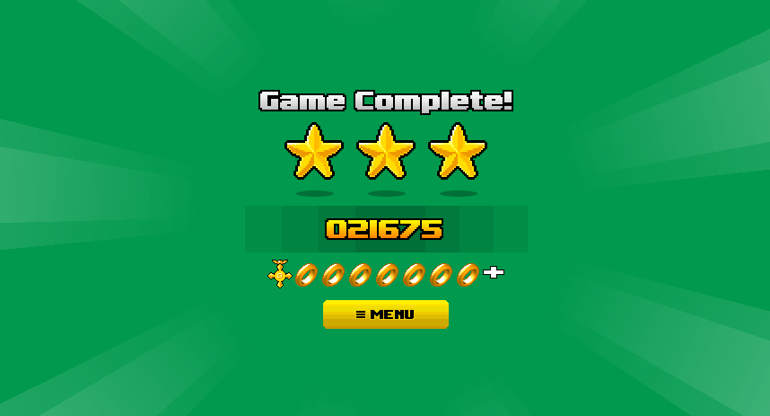

Slide 94
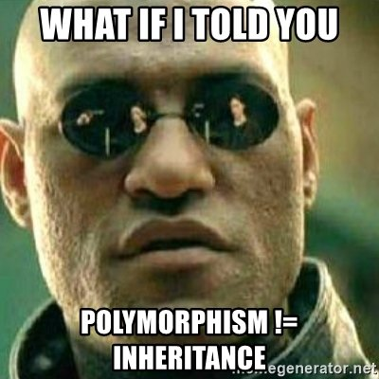

Slide 95
Inheritance – interface
struct Shape { virtual double area() const = 0; virtual ~Shape() = default; };

Slide 96
Inheritance – derived
struct Square final : Shape { explicit Square(double length) : length{ length } {} double area() const override { return length * length; } double length; }; struct Circle final : Shape { explicit Circle(double radius) : radius{ radius } {} double area() const override { constexpr double PI = 3.141592653589793238463; return PI * radius * radius; } double radius; };

Slide 97
Inheritance - usage
const std::unique_ptr<Shape> shapes[] = {std::make_unique<Square>(4), std::make_unique<Circle>(2)}; const auto areaSum = std::accumulate(std::begin(shapes), std::end(shapes), 0.0, [](double current, const std::unique_ptr<Shape> &shape) { return current + shape->area(); }); std::cout << "area sum = " << areaSum << '\n';

Slide 98
Inheritance - usage
const std::unique_ptr<Shape> shapes[] = {std::make_unique<Square>(4), std::make_unique<Circle>(2)}; const auto areaSum = std::accumulate(std::begin(shapes), std::end(shapes), 0.0, [](double current, const std::unique_ptr<Shape> &shape) { return current + shape->area(); }); std::cout << "area sum = " << areaSum << '\n';
Output:
area sum = 28.5664

Slide 99
Variant – “derived”
struct Square { explicit Square(double length) : length{length} {} double length; }; struct Circle { explicit Circle(double radius) : radius{radius} {} double radius; };

Slide 100
Variant – bundling
struct Square { explicit Square(double length) : length{length} {} double length; }; struct Circle { explicit Circle(double radius) : radius{radius} {} double radius; }; using Shape = std::variant<Square, Circle>;

Slide 101
Variant – operation
double area(const Shape &shape) { return std::visit( overload( [](const Square &square) { return square.length * square.length; }, [](const Circle &circle) { constexpr double PI = 3.141592653589793238463; return PI * circle.radius * circle.radius; }), shape); }

Slide 102
Variant – usage
const Shape shapes[] = {Square{4}, Circle{2}}; const auto areaSum = std::accumulate( std::begin(shapes), std::end(shapes), 0.0, [](double current, const Shape &shape) { return current + area(shape); }); std::cout << "area sum = " << areaSum << '\n';

Slide 103
Variant – usage
const Shape shapes[] = {Square{4}, Circle{2}}; const auto areaSum = std::accumulate( std::begin(shapes), std::end(shapes), 0.0, [](double current, const Shape &shape) { return current + area(shape); }); std::cout << "area sum = " << areaSum << '\n';
Output:
area sum = 28.5664

Slide 104
Inheritance – adding functionality
struct Shape { virtual double area() const = 0; virtual double perimeter() const = 0; virtual ~Shape() = default; };

Slide 105
Inheritance – adding functionality
struct Square final : Shape { explicit Square(double length) : length{ length } {} double area() const override { return length * length; } double perimeter() const override { return 4 * length; } double length; }; struct Circle final : Shape { explicit Circle(double radius) : radius{ radius } {} double area() const override { return PI * radius * radius; } double perimeter() const override { return 2 * PI * radius; } double radius; private: static constexpr double PI = 3.141592653589793238463; };

Slide 106
Variant – adding functionality
struct Square { explicit Square(double length) : length{length} {} double length; }; struct Circle { explicit Circle(double radius) : radius{radius} {} double radius; }; using Shape = std::variant<Square, Circle>;

Slide 107
Variant – adding functionality
double perimeter(const Shape &shape) { return std::visit( overload([](const Square &square) { return 4 * square.length; }, [](const Circle &circle) { constexpr double PI = 3.141592653589793238463; return 2 * PI * circle.radius; }), shape); }

Slide 108
Inheritance – adding type
struct Circle final : Shape { explicit Circle(double radius) : radius{radius} {} double area() const override { constexpr double PI = 3.141592653589793238463; return PI * radius * radius; } double radius; };

Slide 109
Variant – adding type
struct Triangle { Triangle(double base, double height) : base{base}, height{height} {} double base, height; }; using Shape = std::variant<Square, Circle, Triangle>;

Slide 110
Variant – adding type
double area(const Shape &shape) { return std::visit( overload( [](const Square &square) { return square.length * square.length; }, [](const Circle &circle) { constexpr double PI = 3.141592653589793238463; return PI * circle.radius * circle.radius; }), shape); }
error: no matching function for call to ‘__invoke(overload_set<area(const Shape&)::<lambda(const Square&)>, area(const Shape&)::<lambda(const Circle&)> >, std::variant_alternative_t<2, std::variant<Square, Circle, Triangle> >&)’

Slide 111
Variant – adding type
double area(const Shape &shape) { return std::visit( overload( [](const Square &square) { return square.length * square.length; }, [](const Circle &circle) { constexpr double PI = 3.141592653589793238463; return PI * circle.radius * circle.radius; }, [](const Triangle &triangle) { return triangle.base * triangle.height / 2; }), shape); }

Slide 112
Comparison
Inheritance | std::variant
Need not know all the derived types upfront (open-world assumption) | Must know all the cases upfront (closed-world assumption)
Dynamic Allocation (usually) | No dynamic allocation
Intrusive (must inherit from the base class) | Non-intrusive (third-party classes can participate)
Reference semantics (think how you copy a vector of pointers to base class?) | Value semantics (copying is trivial)
Algorithm scattered into classes | Algorithm in one place
Language supported (Clear errors if pure-virtual is not implemented) | Library supported (poor error messages)
Creates a first-class abstraction | It’s just a container
Keeps fluent interfaces | Disables fluent interfaces. Repeated std::visit
Adding a new operation (generally) boils down to implementing a polymorphic method in all the classes | Adding a new operation simply requires writing a new free function
Source: http://cpptruths.blogspot.co.il/2018/02/inheritance-vs-stdvariant-based.html

Slide 114


Slide 115
C++ ADT
Product types:
struct – language based
std::tuple – library based
Sum types:
std::variant – library based
No language based type

Slide 116
lvariant
A language based variant:
lvariant user_information { std::string name; int id; };
David Sankel - Pattern Matching and Language Variants

Slide 117
Recursive
lvariant json_value { std::map<std::string, std::unique_ptr<json_value>> object; std::vector<std::unique_ptr<json_value>> array; std::string string; double number; bool boolean; std::monostate null; };

Slide 118
Before
struct set_score { std::size_t value; }; struct fire_missile {}; struct fire_laser { unsigned intensity; }; struct rotate { double amount; }; struct command { std::variant<set_score, fire_missile, fire_laser, rotate> value; };

Slide 119
After
lvariant command { std::size_t set_score; std::monostate fire_missile; unsigned fire_laser; double rotate; };

Slide 120
Before – visitation
std::ostream &operator<<(std::ostream &stream, const command &cmd) { std::visit( overload( [&](const set_score &ss) { stream << "Set the score to " << ss.value << ".\n"; }, [&](const fire_missile &) { stream << "Fire a missile.\n"; }, [&](const fire_laser &fl) { stream << "Fire a laser with " << fl.intensity << " intensity.\n"; }, [&](const rotate &r) { stream << "Rotate by " << r.amount << " degrees.\n"; }), cmd.value); return ostream; }

Slide 121
After – pattern matching
std::ostream &operator<<(std::ostream &stream, const command &cmd) { return inspect(cmd) { set_score value => stream << "Set the score to " << value << ".\n"; fire_missile _ => stream << "Fire a missile.\n"; fire_laser intensity => stream << "Fire a laser with " << intensity << " intensity.\n"; rotate degrees => stream << "Rotate by " << degrees << " degrees.\n"; }; }

Slide 122
Before – switch on enum
enum color { red, yellow, green, blue }; const Vec3 opengl_color = [&c] { switch (c) { case red: return Vec3(1.0, 0.0, 0.0); break; case yellow: return Vec3(1.0, 1.0, 0.0); break; case green: return Vec3(0.0, 1.0, 0.0); break; case blue: return Vec3(0.0, 0.0, 1.0); break; default: std::abort(); } }();

Slide 123
After – pattern matching
enum color { red, yellow, green, blue }; const Vec3 opengl_color = inspect(c) { red => Vec3(1.0, 0.0, 0.0) yellow => Vec3(1.0, 1.0, 0.0) green => Vec3(0.0, 1.0, 0.0) blue => Vec3(0.0, 0.0, 1.0) };

Slide 124
Before – inspecting struct contents
struct player { std::string name; int hitpoints; int lives; };
void takeDamage(player &p) { if (p.hitpoints == 0 && p.lives == 0) gameOver(); else if (p.hitpoints == 0) { p.hitpoints = 10; p.lives--; } else if (p.hitpoints <= 3) { p.hitpoints--; messageAlmostDead(); } else { p.hitpoints--; } }

Slide 125
After – pattern matching
struct player { std::string name; int hitpoints; int lives; };
void takeDamage(player &p) { inspect(p) { {hitpoints : 0, lives : 0} => gameOver(); {hitpoints:hp @0, lives : l} => hp = 10, l--; {hitpoints:hp} if (hp <= 3) => { hp--; messageAlmostDead(); } {hitpoints : hp} => hp--; } }

