Slide 1
GLA SMART MAP

Slide 2

Presented By:
Ashish Parihar 181500141
Natesh Chauhan 181500416
Rohit Singh 181500592
Vishal Singh 181500808
Supervised By:
Mr. Neeraj Khanna
Caption
Department of Computer Engineering and Applications

Slide 3
Problems
Many students use GPS embedded smart phones having internet connection in it. So, why we should not use these technologies to help the students where they want to go in the university.
Students find difficulty to find their respective classes rooms, academic blocks, hostels, etc.

Slide 4
Introduction
In order to provide facilities, we’ve introduced GLA Smart Map app:
This application will serve the purpose of introducing students to reach to the block or place where they want to go in the university and this app is very helpful for the newly joined students . It is completely responsive app.

Slide 5
Objectives
Implement an application with a suitable interface by means of using the open source platforms a mobile phone application.
User can search the landmark where they want to go.
It will display the dedicated routes and directions for the user.
To provide information about Events of several clubs and sports departments.

Slide 6
This is how the project looks like

Slide 7
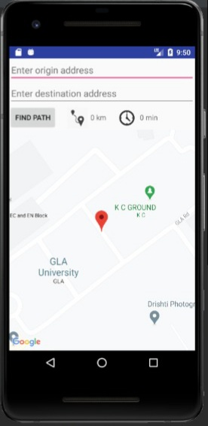
Caption

Slide 8
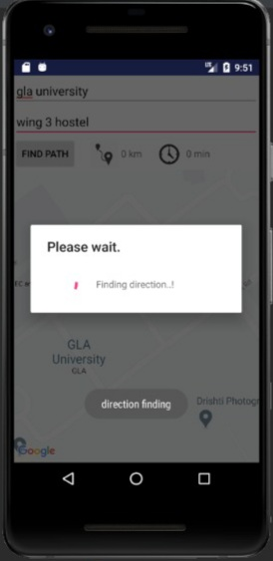
Caption

Slide 9
Testing
We tested GLA Smart Map app on different devices and found consistent in all aspects.
We follow User Testing strategy in order to check the performance of app and a list of questionnaire is asked to user to evaluate the efficiency,effectiveness of the app and satisfaction of the user.

Slide 10
Technology used

Slide 11
GOOGLE API
Google APIs are application programming interfaces (APIs) developed by Google which allow communication with Google Services and their integration to other services. Examples of these include Search, Gmail, Translate or Google Maps. Third-party apps can use these APIs to take advantage of or extend the functionality of the existing services.
The APIs provide functionality like analytics, machine learning as a service (the Prediction API) or access to user data (when permission to read the data is given). Another important example is an embedded Google map on a website, which can be achieved using the Static maps API, Places API or Google Earth API.
FEATURES:-
• Cloud Machine Learning Engine API.
• Google Maps.
• Cloud Natural Language API.
• Google Cloud Vision API.
• Google Cloud Video Intelligence API.
• Cloud Speech-to-Text and Text-to-Speech APIs
• Cloud Translation API.
• Hangouts Chat API.

Slide 12
THANK YOU

