Slide 1

CLIFF WALKING IMPLEMENTATION
BY:
PRUDHVI RAO SIDDURI (00730354)
VINEETH KUMAR DEEPALA (00725520)

Slide 2
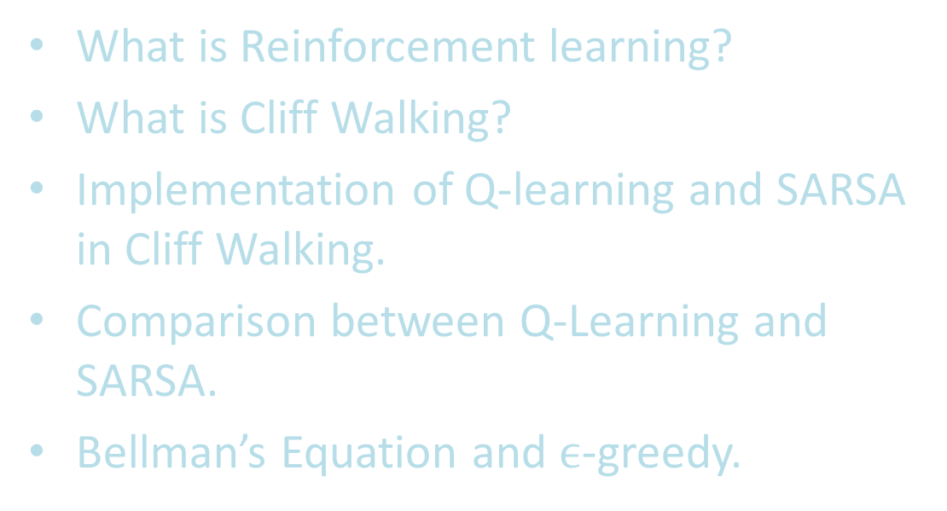
WHAT YOU LEARN:
What is Reinforcement learning?
What is Cliff Walking?
Implementation of Q-learning and SARSA in Cliff Walking.
Comparison between Q-Learning and SARSA.
Bellman’s Equation and $ϵ$-greedy.

Slide 3
What is RL?
Reinforcement learning (RL) is a branch of machine learning that studies how intelligent agents should operate in each environment to maximize the concept of cumulative reward.
Reinforcement learning, along with supervised and unsupervised learning, is one of the three main machine learning paradigms.

Slide 4
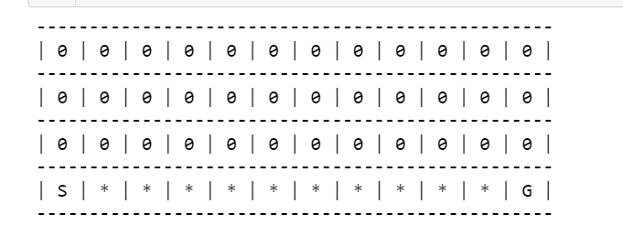
WHAT IS CLIFF WALKING?
Cliff Map used
Cliff walking is a scenario in which the AI agent may find itself at any possible location within the environment.
AI agent must learn to reach the target location without falling off the cliff(which is represented by one or more locations) even though the agent does not know which is the target location.
The AI agent’s possible actions are to move UP, DOWN, LEFT, or RIGHT.
AI agent learns environment by relying on and updating the Q-values by Q-Learning technique and SARSA.

Slide 5
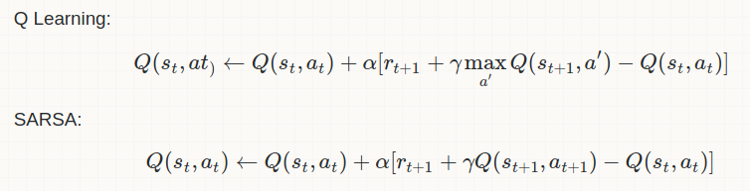
Q-Learning and SARSA
The greedy strategy is used to learn the Q-value in the Q-Learning technique, which is an Off Policy technique. The SARSA approach, on the other hand, is an On Policy that learns the Q-value from the present policy's activity.

Slide 6
APPROACH
Defining a function called ‘Cliff’. We are implementing the cliff map.
The Cliff Map will represent the board and will be able to:
Keep track of where an agent is right now.
Determine the agent's next move and if the game is over when given an action.
As a reward, provide feedback.
Rewarding the agent with ‘-1’ transitions except to those into the region marked ‘Cliff’.

Slide 7
Contd..
Applying Q-learning and SARSA for getting the agent to the desired location.
Comparing the agent’s behavior between two methods.
SARSA takes safest path and Q-Learning uses optimal and shortest path

Slide 8
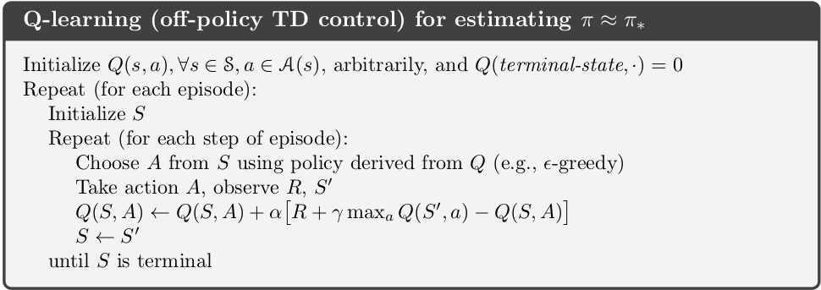
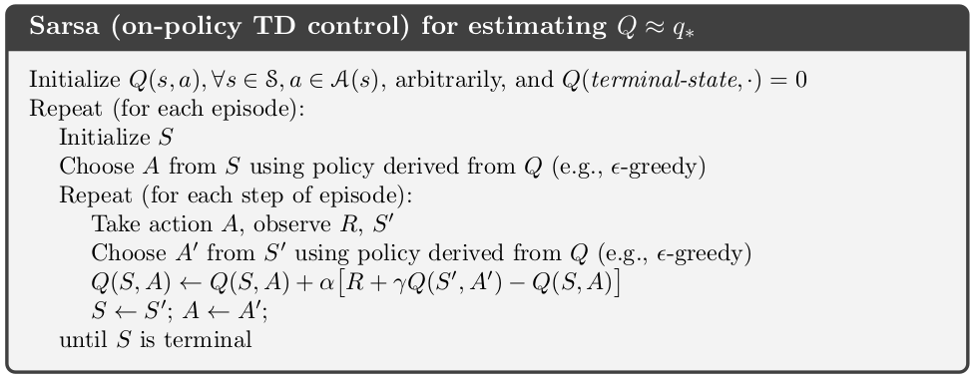
Q-Learning vs SARSA
SARSA
Q-LEARNING

Slide 9
WHEN TO USE Q-LEARNING AND SARSA?
Q-LEARNING
SARSA
Learning is cheap
You want to explore a lot
The action problem is easy to solve
Rewards while learning doesn’t matter
You are risk-seeking
Learning is expensive
You don’t need to explore everything
The action problem is hard to solve
Rewards while learning matters
You are risk-averse

Slide 10
Conclusion
Q-learning appears to produce a shorter (often optimal) path and so a better solution on the surface, but this ignores the intricacies that lie beneath.
Q-learning learns values for the best policy, the one that travels right up to the cliff's edge. Unfortunately, because of the "epsilon-greedy" action selection, it periodically falls off the cliff.
SARSA, on the other hand, considers the action chosen and learns the longer but safer way via the grid's top reaches. Despite the fact that Q-learning learns the values of the optimal policy, it performs worse online than SARSA, which learns the roundabout policy. Of course, both techniques would asymptotically converge to the optimal policy if were gradually reduced.

