Slide 1
SemanticTraj
Shamal AL-Dohuki, Farah Kamw, Ye Zhao, Jing Yang, Chao Ma, Yingyu Wu, Xinyue Ye, Fei Wang, Xin Li, Wei Chen
A New Approach to Interacting with Massive Taxi Trajectories Dan Manzo

Slide 2
Overview
Taxi trajectory data records realtime moving paths sampled as a series of positions associated with vehicle attributes over urban road networks
Massive trajectory data contains abundant knowledge about a city and its citizens which has been widely used in urban computing

Slide 3
Tasks
Scenario 1: A shopping mall has a plan to open shuttle buses for their customers. Its manager wants to investigate where and when visitors take taxis to the mall.
Task 1: “For the taxi trips arriving at the shopping mall, what are their major pick-up locations?
Notes:
For Task 1, the manager needs to: (1) select a region enclosing the
mall on the map to display drop-off points; (2) select a given time
period; (3) brush to filter those points related to this mall inside this
region; (4) display the corresponding pick-up points of passenger trips
on the map; (5) observe the map to find hot locations with a high
density of pick-up points; (6) find the streets and POIs of these hot
locations. Then, the candidate streets/POIs for shuttle stops are found

Slide 4
Tasks
Scenario 2: Two witnesses reported a criminal suspect taking a taxi passing South Street and North Street between 3pm and 3:20pm. A policeman wants to find suspicious taxi paths.
Task 2: “What are the taxi trips passing South Street and North Street between 3pm and 3:20pm? What are the other streets/POIs they visited?
Notes:
For Task 2, the policeman needs to (1) select a region around North
Street on the map; (2) select the time period from 3pm to 3:20pm in a
time selection tool (e.g., a slider); (3) brush to select all GPS sample
points residing on North street; (4) display the GPS points in the same
taxi trips with the selected points from (3); (5) repeat steps (1)-(3) to
select points on South Street. After these steps, the required taxi trips
are found; (6) Find other streets they also passed

Slide 5
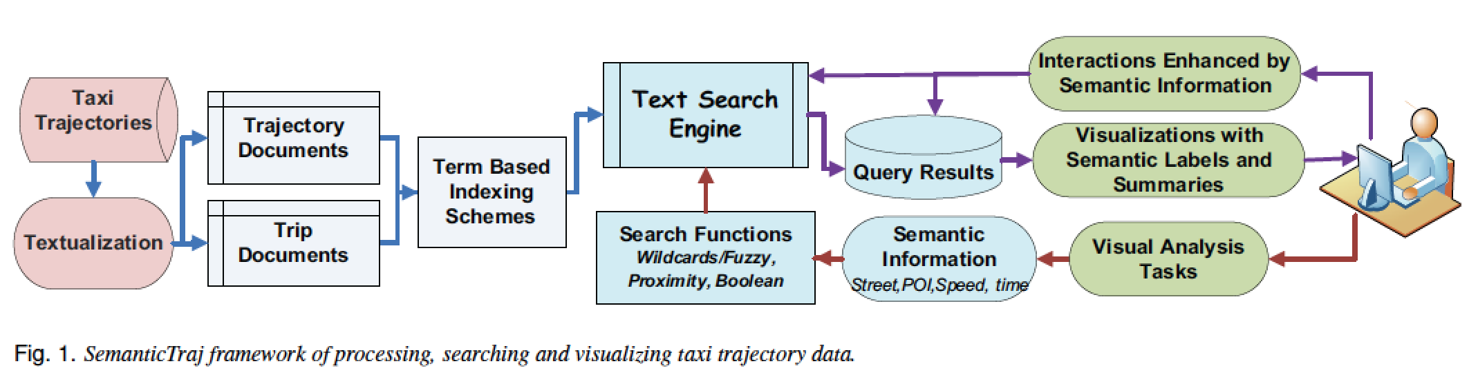
SemanticTraj
Notes:
These
terms are referred to as semantic information in this paper. Then, users
can visually study the results with a set of visual representations enhanced
by the semantic information.
Most people are familiar with the process of phrasing queries as
keywords to dig up information. In SemanticTraj, the experience is
extended to taxi trajectory data, leading to a new paradigm of the interaction
between users and trajectory data, in addition to selection or
brushing over maps. In particular, taxi trajectory data is transformed
into “taxi documents” by a process of “textualization”, which projects
a GPS point to a street or POI name, and maps a numerical speed value
into a descriptive term (e.g., slow, normal, fast). The semantic information
gives direct cues of geographical and transportation information
for users living in the city. Users are allowed to retrieve matching data
from keywords of interest using text search engine (Apache Lucene
in our experiments)

Slide 6
Objectives
Utilizing the trajectory data has been categorized into three main categories
the study of the collective behavior of a city’s population
the traffic flow
the operators (e.g. drivers)

Slide 7
Taxi Data
Each sample includes:
GPS location
(longitude and latitude)
vehicle ID
speed
time
occupancy status
direction
Notes:
Massive trajectory datasets are acquired by taxis traveling over cities.
A taxi trajectory records consecutive samples at an interval of a few
seconds in a given time period. Each sample includes the GPS location
(longitude and latitude), vehicle ID, speed, time, occupancy status,
direction, and possibly other attributes. A taxi trip consists of those
samples when the taxi was hired by customers. It then refers to one
taxi service trip for passengers

Slide 8
Taxi Data
SemanticTraj allows users to retrieve and visually explore a taxi trajectory dataset such as:
Task1: Taxi trips passing a street in a given time period;
Task2: Taxi trips passing multiple streets in given time periods with different logic conditions;
Task3: Taxi trips with single or multiple POIs;
Task4: Taxi trajectories passing given streets and POIs;
Task5: Taxi trajectories with specific behaviors in travel speed (e.g., slow, fast, change from slow to fast)

Slide 9
Example Queries
Task Question: What are the pick-up and drop-off locations for the trips passing S?
Query Condition: fS in Street Names in Cg.
Task Question: What are the trips picking up passengers at S1during T1 AND dropping them off at S2 during T2?
Query Condition: ffS1 in Pick-up Street AND Pick-up Time in T1g AND fS2 in Drop-off Street AND Drop-off Time in T2gg.

Slide 10
Example Queries
Task Question: Given all the taxi trajectories passing S during T, what is their average speed? How many are occupied?
Query Condition: fS in Street Names in C(T)g
Task5 Question: What are the taxis whose speed shows an abrupt speed-up from slow to very fast (across normal) during T?
Query Condition: fSlow VeryFast 1 in DSpeed in C(T)g
Notes:
Boolean Query: A boolean query combines multiple queries
of individual terms with boolean conditions. It allows users to
quickly conduct a task (e.g., Task2) which retrieves trajectories
by multiple conditions
Range Query: A range query matches the documents whose
terms fall into the supplied range. For example, we can query
taxi pick-up time between [07:00:00 TO 10:00:00], or query fare
of taxi trips larger than 30.
Wildcard and Fuzzy Query: A wildcard query supports users
with single and multiple missing characters in query terms. Users
can query a street without clearly remembering the name in full,
such as north* for north ave or north str. A fuzzy query finds any
matched terms with Levenshtein Distance. For example, north
can find terms like lorth or nortn.
Proximity Query: A proximity query supports matching words
within a specific distance in text. For example, a query of “slow
veryFast 1” finds those documents where slow and fast happen
within two consecutive words. The query helps users immediately
find a speed change event from slow to fast beyond normal

Slide 11
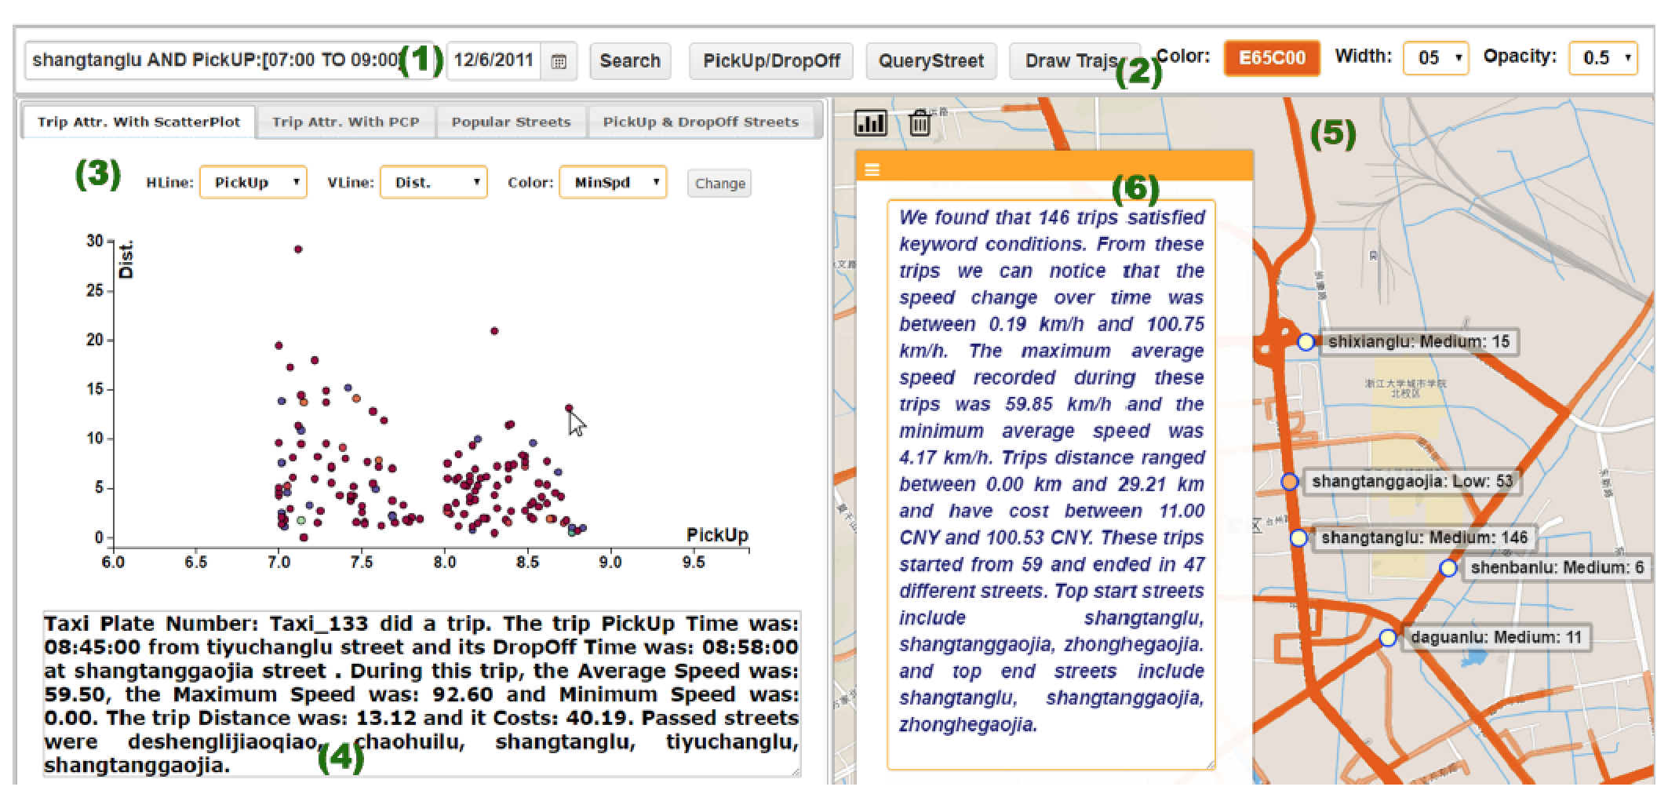
Visualizations
Notes:
Using SemanticTraj to visualize taxi trips which passed Shangtanglu street of Hangzhou, China in the morning (7am-9am) of Dec 6, 2011. See details
in Sec. 7. (1) Query input box accepting semantic query conditions as Shangtanglu AND PickUp:[7:00-9:00]; (2) Visualization control panel for adjusting the
appearance; (3) Scatterplot view for users to study search results. Other visual tools can be selected in this view; (4) Meta-summary of a selected trip which
automatically summarizes the trip fact; (5) Map view showing trip trajectories. Text labels are displayed on critical streets about its role in these trips; (6) A
meta-summary of the group of all 146 result trips. Users can interact with the name tags to filter trips

Slide 12
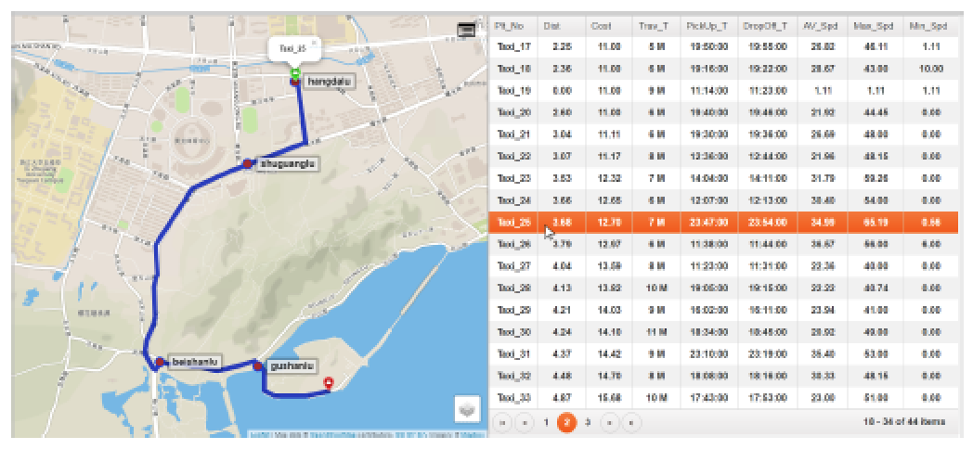
Visualizations
Notes:
Using a table view to study individual taxi trajectories

Slide 13
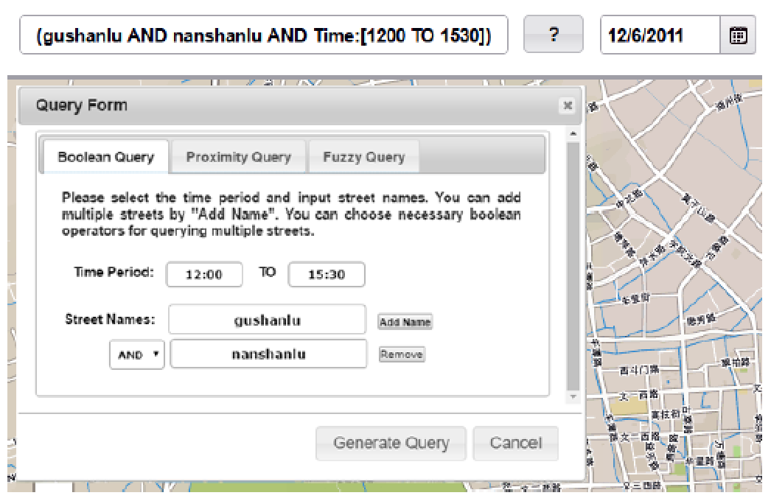
Visualizations
Notes:
Fig. 5. Users can fill in a form to automatically generate query sentence in the
input box.

Slide 14
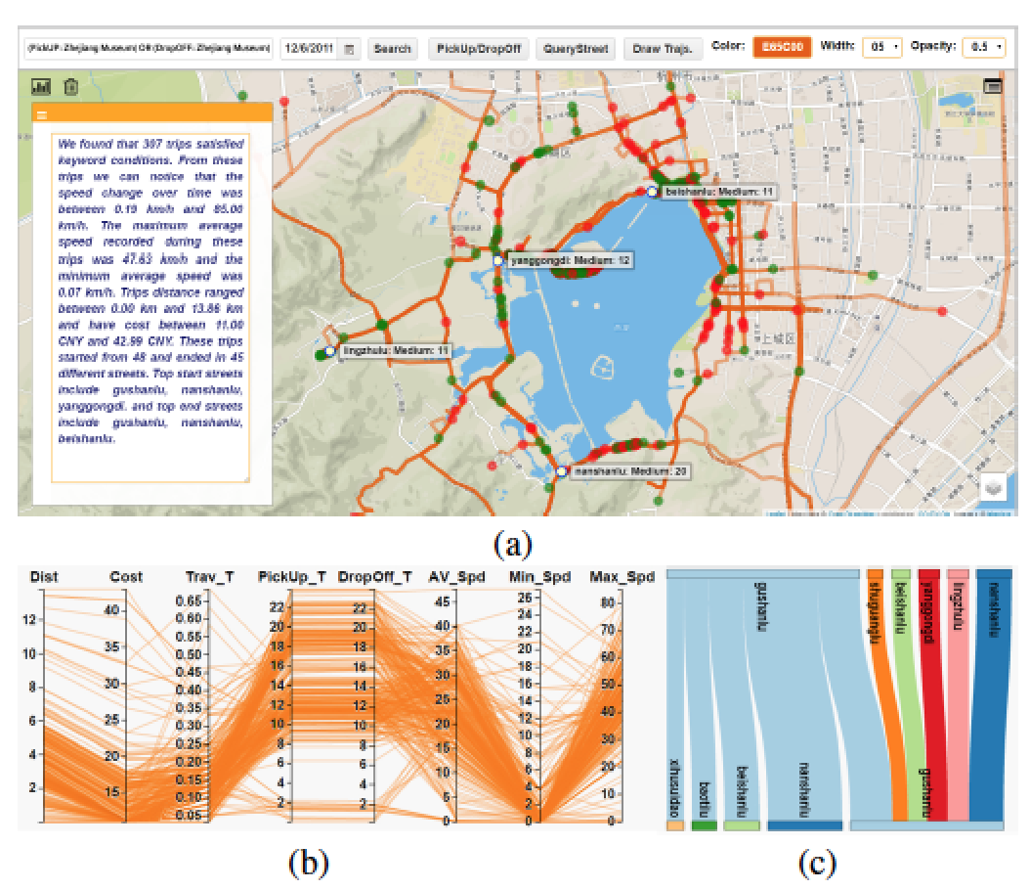
Visualizations
Notes:
Fig. 6. Provide shuttle buses for tourists of Zhejiang Museum after query taxi
trips leaving or arriving at the museum. (a) Taxi trips are shown where street
names with frequent pick-ups (potential bus stops) are easily found by the text
labels; (b) The PCP view of the trips show their attributes. (c) The parallel sets
view reveals the pick-up and drop-off relations.

Slide 15
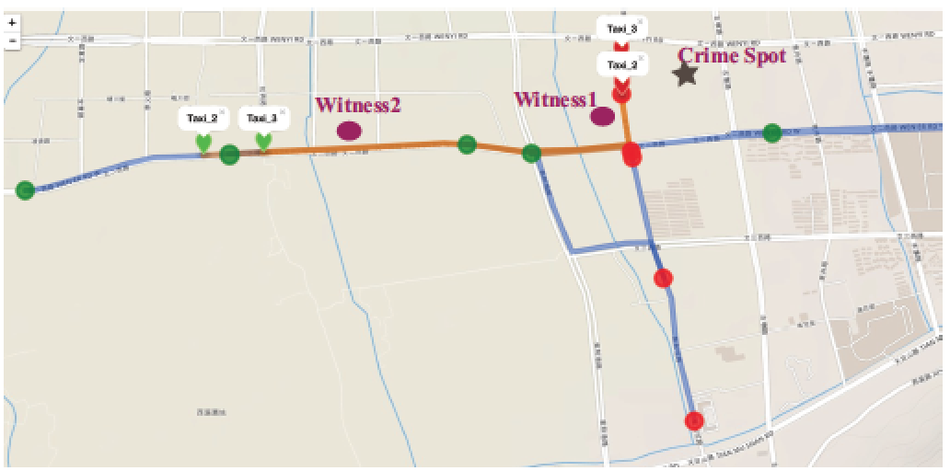
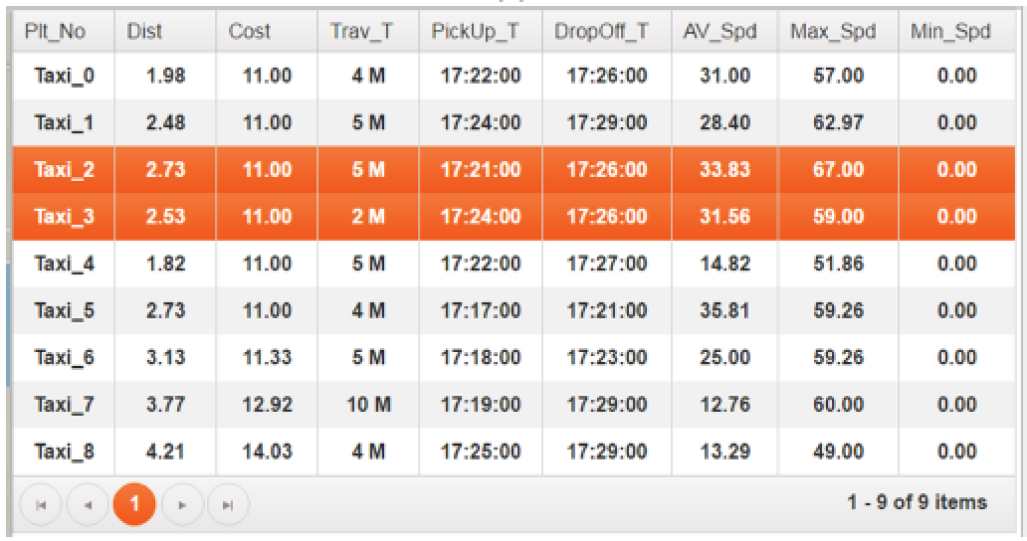
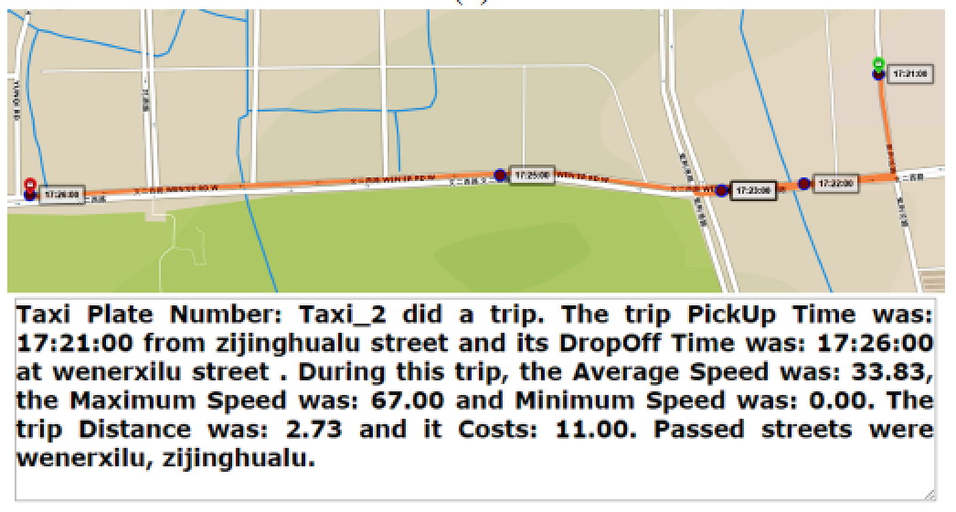
Visualizations
Notes:
Fig. 7. Find a criminal suspect passenger on taxi trips. (b) All result trips
shown on the map; (b) A list of the trips on the table; (c) One of the two suspicious
trips.

Slide 16
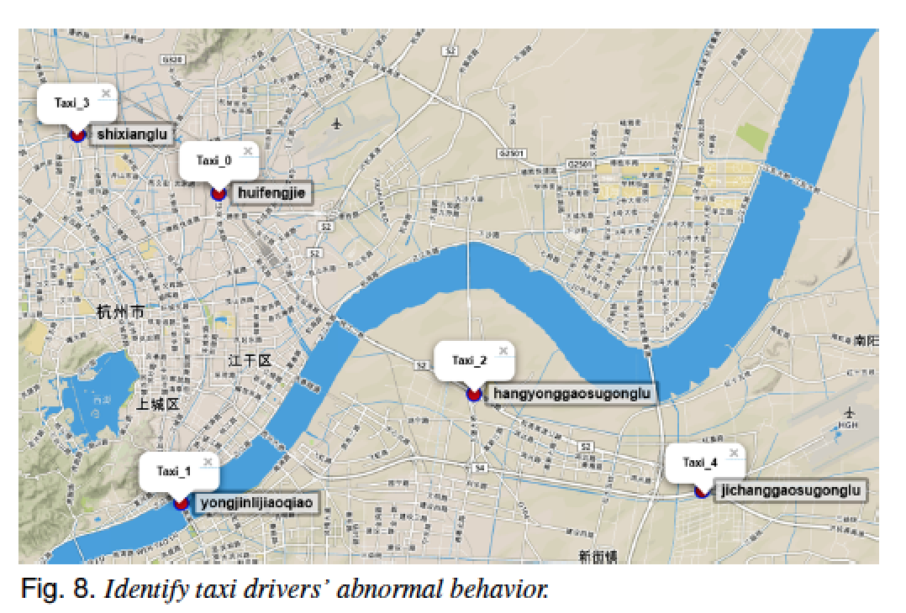
Visualizations

Slide 17
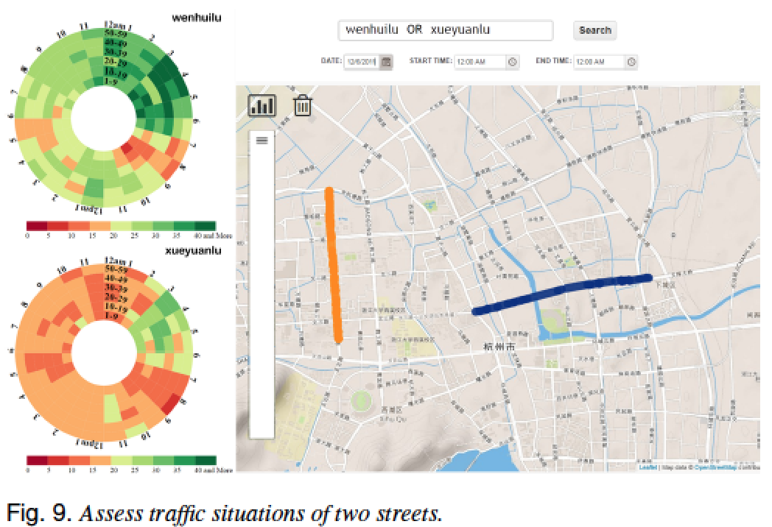
Visualizations

Slide 18
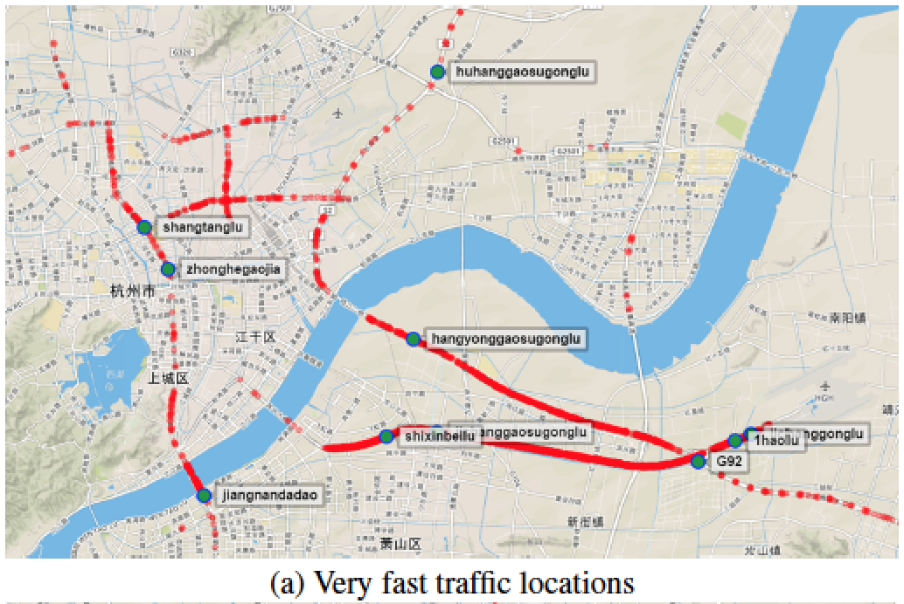
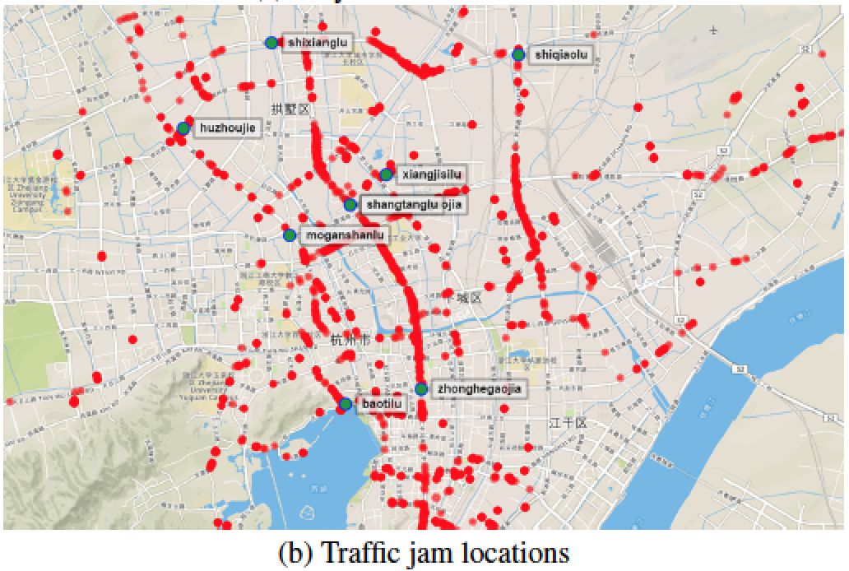
Visualizations

Slide 19
Feedback
“This tool is very useful because it is closer to our understanding of the real place featured with names instead of a virtual location represented by numbers”
“It allows users who have very few spatial data handling skills to conduct space-time data analysis easily and effectively”
Notes:
The criminologist has been working with police departments on
fighting urban crime. She provided the following feedback: “Visual
query using text search engine is an innovation for policing strategy.
Street or POI names are more straightforward to criminologists than
abstract geometry or spatial coordinates. This tool is very useful because
it is closer to our understanding of the real place featured with
names instead of a virtual location represented by numbers
As a former urban planner and currently an urban geographer, I
have spent years of efforts on understanding the vehicle flow on the urban
street network and its uneven traffic distribution across space and
over time. Many methods have been tried, ranging from surveys and
field observation to spatial statistical analysis. However, these methods
do not recognize the difficulty of big transportation data and impossibility
of visualizing such data using conventional approaches. It
warrants notice that spatial distribution of real traffic flow in the street
network may vary from time to time, which poses a challenge to store
and query the data for real-time use. The developed tool can solve two
major issues: store and query the increasing data size especially realtime
feature; analyze and identify the network structure of transportation
flow in a fast and visual platform. This tool is a good example of
spatial intelligence, which allows efficient data integration for largevolume
and near real time spatial and non-spatial data (multi-source
data). In addition it allows users who have very few spatial data handling
skills to conduct space-time data analysis easily and effectively.
Hence, this tool can serve as a practice, research and education platform
by delivering geographic information service in the data-rich age
which is featured by the unprecedented terabytes of digitized data.

