Slide 1
Welcome to New York
an interactive visualization of NYC’s Stop and Frisk program
Dan Manzo

Slide 2
Background
Stop and Frisk is controversial
Once ruled unconstitutional
Topic of Presidential debates

Slide 3
Data Source
All stop and frisk stops from 2003-2015 in NYC
Data on race, gender, location, reason, force used, weapons/contraband recovered

Slide 4
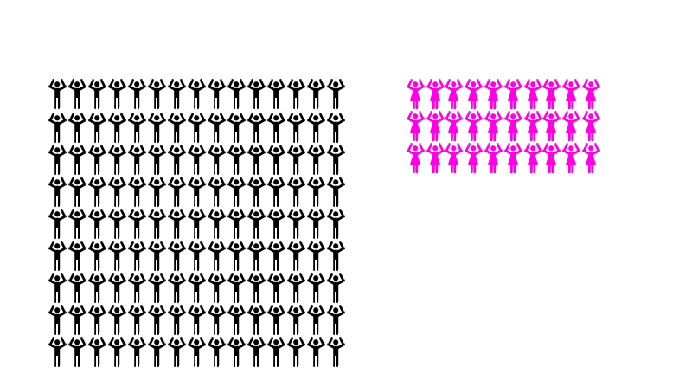
Visualizations

Slide 5
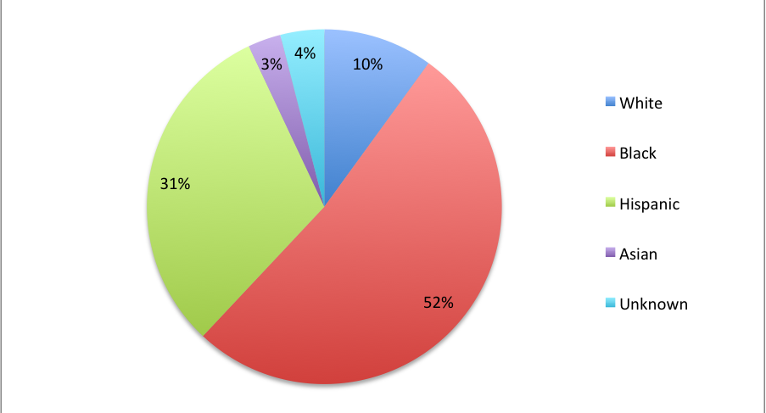
Visualizations

Slide 6
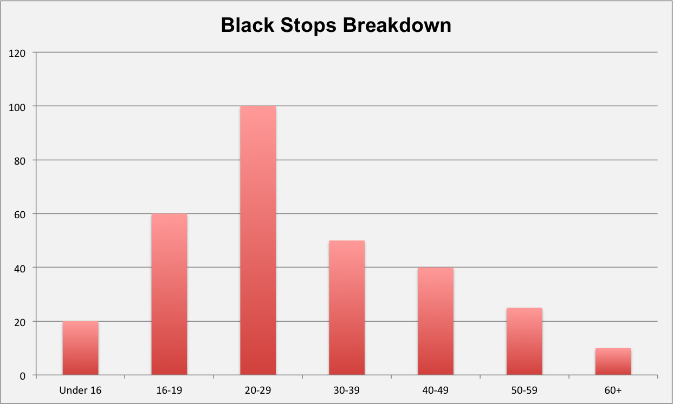
Visualizations

Slide 7
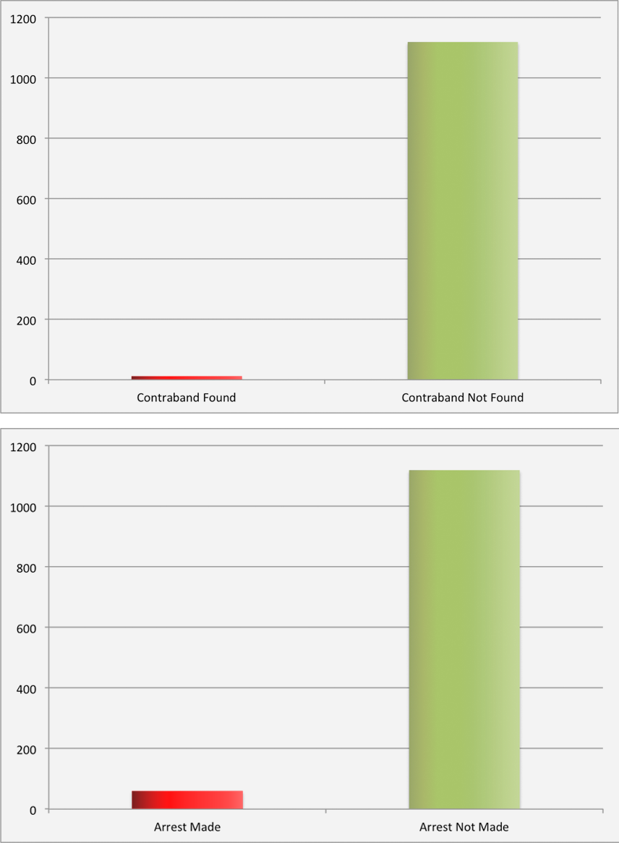
Visualizations

Slide 8
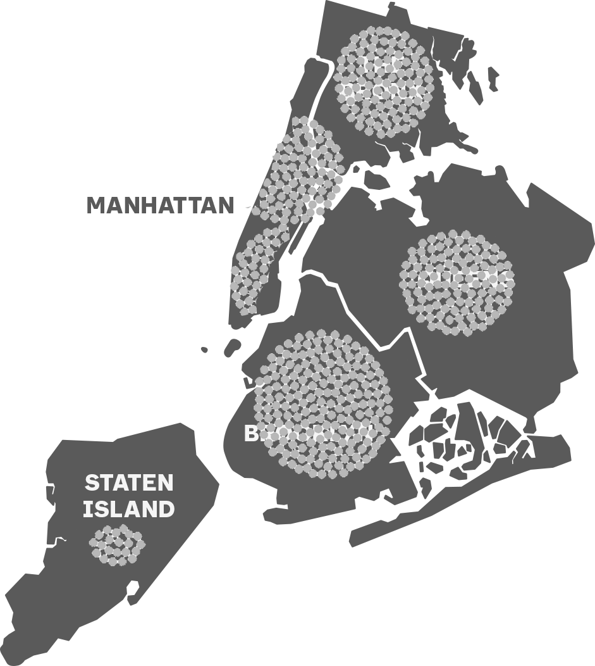
Visualizations

Slide 9
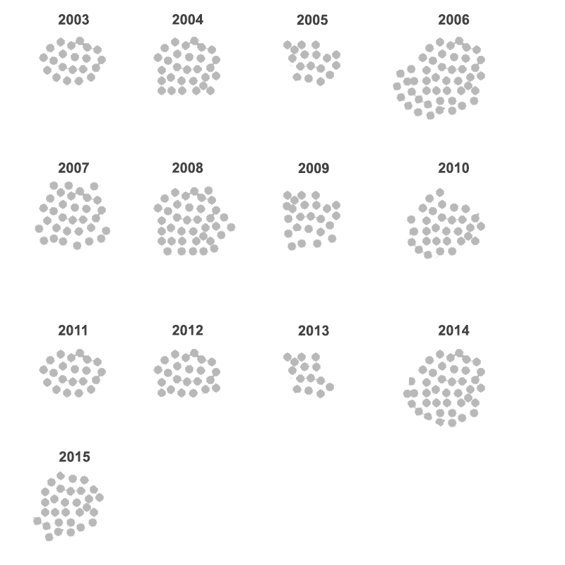
Visualizations

