Slide 1
Text-To-SQL System
Natural Language to SQL Conversion
Project documentation summary
Authors: Daniel Radu, Mihailescu Dominic-Dorian
BDNSV / FMI-UNIBUC
2026

Slide 2
Project Goal
Motivation
SQL databases are powerful but difficult to query for non-expert users
Natural language interfaces improve accessibility
Goal
Convert natural language questions into safe, executable SQL queries
Ensure correctness using schema awareness and validation

Slide 3
System Overview
What does the system do?
Input: natural language question
Output: SQL query + query results
Main features
Multi-step processing pipeline
Multiple LLM providers
Strong focus on safety and correctness

Slide 4
Architecture
Text-to-SQL Pipeline
Extract database schema
Build prompt with schema + few-shot examples
Generate SQL query
Validate SQL (syntax, schema, read-only)
Execute query and summarize results

Slide 5
Providers
Supported Providers :
Naive – rule-based baseline
OpenAI – GPT models via API
Ollama (local)
  phi3
  qwen
  codellama
  Starcoder
Key idea
All providers use schema context
All Ollama models benchmarked automatically

Slide 6
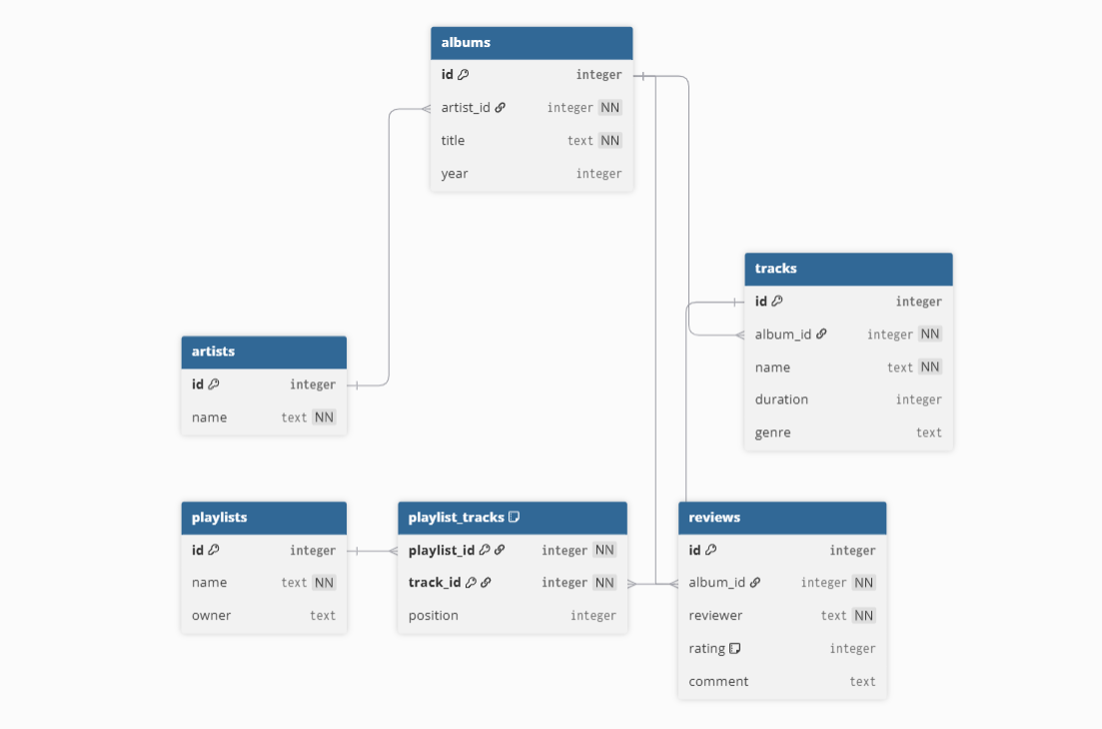
Data Model

Slide 7
SQL Validation
Why validation matters
Prevent unsafe or invalid queries
Ensure reliable execution
Validation steps
SQL syntax parsing (sqlglot)
Enforce SELECT-only queries
Validate tables and columns against schema

Slide 8
Evaluation and Results
Evaluation Metrics
Exact Match (EM)
Execution Accuracy (EX)
Error breakdowns
Key Results
Naive: very low accuracy
Ollama (qwen, codellama): high execution accuracy
Shows importance of schema-aware prompts + validation

Slide 9
Conclusion
Functional and safe Text-to-SQL system
Modular multi-provider architecture
Strong benchmarking support
Future Improvements
More complex schemas and joins
Improved prompt strategies
Fine-tuned or specialized models
User feedback integration

