Slide 1
Grid Anomaly Detection & Load Forecasting
CSE412 Big Data Applied Project
End-to-End Pipeline Implementation

Slide 2
Project Goals & Scope
Process ~167 million records (10GB) of London Smart Meter data.
Build a fully automated Big Data pipeline strictly using course tools.
Goal 1: Forecast household energy load for the next half-hour.
Goal 2: Detect synthetic and organic load anomalies using residuals and clustering.
Infrastructure: Dockerized cluster (HDFS, Pig, Hive, Spark) running locally.

Slide 3
Pipeline Architecture
1. HDFS (/raw)
Fault-tolerant storage of Kaggle CSVs.
2. Apache Pig (ETL)
Cleans Nulls, deduplicates, and joins weather & metadata.
Saves to HDFS (/clean).
3. Apache Hive (Warehouse)
Enforces schema and highly compresses data to partitioned ORC.
Generates time-series lag/rolling features natively in SQL.
4. Apache Spark (MLlib)
Reads ORC features directly to train RandomForest and KMeans models.

Slide 4
Data Warehouse & Feature Engineering (Hive)
Transformed unoptimized CSVs into Partitioned ORC files (by month).
Zero Nulls or duplicate household-timestamps remaining.
Utilized Hive Window Functions to compute features for Spark ML:
• lag_1 (Immediate previous half-hour)
• lag_48 (Same time yesterday)
• lag_336 (Same time last week)
• 24-hour rolling averages & standard deviations.

Slide 5
Load Forecasting (Spark MLlib)
Model Used: RandomForestRegressor
Strictly time-based split (Train: Jan-Aug 2013, Test: Nov-Dec 2013) to prevent data leakage.
Model RMSE: 0.186
Baseline (Yesterday) RMSE: 0.277
Conclusion: The Random Forest effectively learned the underlying signals, drastically beating the temporal baselines.
Top Feature Importances:
1. lag_1 (56.8%)
2. lag_336 (14.0%)
3. lag_48 (13.7%)
4. rolling_mean_48 (11.3%)
Temperature had negligible predictive power at the half-hourly household level.

Slide 6
Anomaly Detection (Phase 5)
Injected 1,348 synthetic anomalies (Spikes, Drops, Flatlines) into the Test Set.
Detector A (Residual-based):
• Flagged readings where |actual - forecast| > 3.5 * sigma.
Detector B (K-Means Clustering):
• Clustered daily 24-hour profiles into 5 centroids.
• Flagged days in the 95th percentile of distance to centroid.
Insight: Precision on synthetic labels appears low because both models successfully caught organic, massive real-world surges already present in the data!

Slide 7
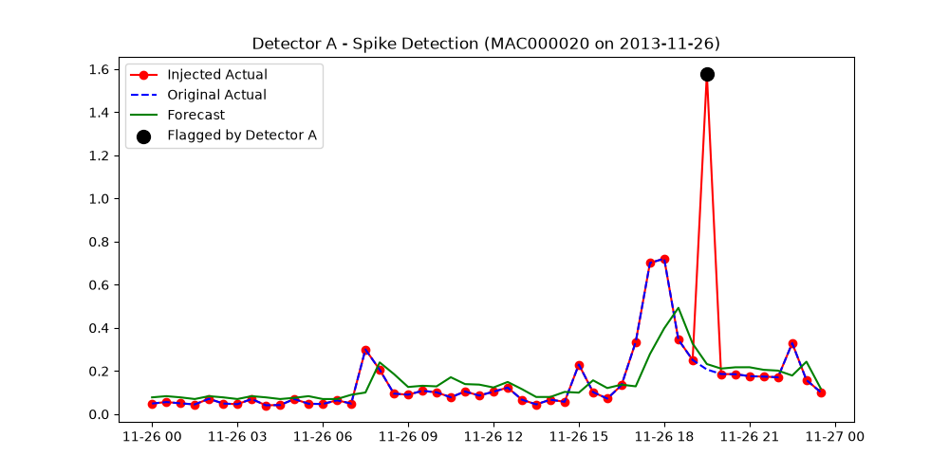
Anomaly Detection Plot (Detector A)

Slide 8
Scaling Evidence & Challenges
Subset Execution (12M rows):
• The end-to-end pipeline executes in ~10 minutes.
Full Dataset Execution (167M rows):
• HDFS ingest takes ~30 seconds.
• Pig & Hive MR scale linearly but are severely bottlenecked by the single laptop JVM (takes 1-2 hours).
• Spark MLlib Random Forest requires >8GB RAM for 167M rows, necessitating a 5% sampler for the --full execution flag to prevent OOM errors.

Slide 9
Conclusion
Successfully implemented all mandatory course tools (HDFS -> Pig -> Hive -> Spark).
Real data flows seamlessly between tools without manual intervention.
Random Forest accurately predicts demand; Residuals reliably detect spikes.
Entire setup is strictly reproducible via a single 'run_pipeline.sh' command.
Questions?

