Slide 1
CMake
Feature Walkthrough
Instructive Examples
Lessons Learned
Best Practices for HBK

Slide 2
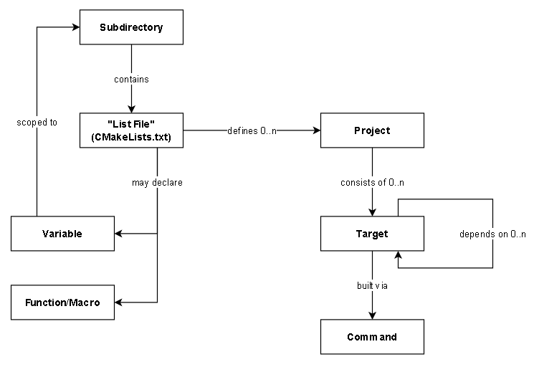
CMake’s “Object Model”
Project – A conceptual grouping of targets; has a name, version number, and other metadata
Target – A “thing” to be “built” which may depend on other “things”
Command – A way to “build” a “target” from “sources”
Subdirectory – A hierarchical tree of variable scopes (variables in one subdirectory are visible to all child subdirectories)
“List File” – Fancy CMake term for the CMakeLists.txt file
Variable – There are “normal” and “cache” variables (details later)
Functions & Macros – Just what it sounds like; difference is a “function” introduces a new scope while a “macro” uses its parent’s scope (just like a C function vs. preprocessor macro)

Slide 3
CMake – What is a “Target”?
A target is “a thing to be built.”
Targets are built via commands. Most target type / language combinations are built in, but custom targets and commands can be defined.
Targets may depend on other targets.
Targets may have properties which are used by the build commands to affect the build.
Things like C/C++ include directories, compiler options, etc. are handled via properties.
These properties have scopes which affect how they propagate to other dependent targets.

Slide 4
CMake – Property Scopes
PUBLIC - The setting applies to the target itself and to dependent targets.
  Public header include paths
  Compile options which a target and its dependencies must agree on
PRIVATE – The setting applies to the target itself but not to dependent targets.
  Compile options such as warning/error levels which do not affect dependents
  Statically-linked libraries which are self-contained in the target (no instances passed from a target to its dependencies/dependents)
INTERFACE – The setting applies only to dependents
  Very common use case: “fake” targets imported via find_package()
  In some cases, public headers which a library itself doesn’t need, e.g. generated code

Slide 5
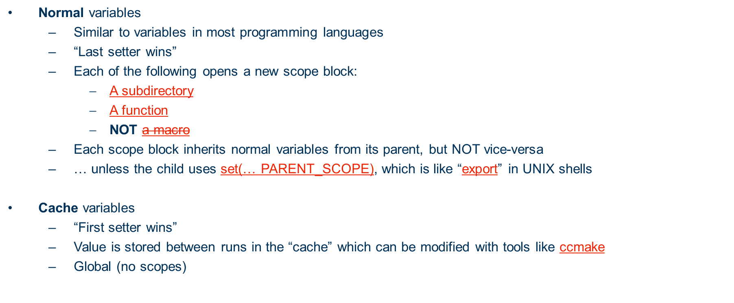
CMake – Variable Types

Slide 6
CMake – Packages (1) Overview
Packages can be “exported” so that find_package() can find them
Exports typically result in the following being installed:
  A “package configuration file” (libnameConfig.cmake)
    Contains user-defined setup like find_dependency()
    Can be generated automatically by CMake or via a template
    Includes libnameTargets.cmake
  A “package version file” (libnameConfigVersion.cmake) (optional, but highly recommended)
    Checks if the installed version is “compatible” with the requested one
    Can be generated automatically by CMake (according to a version compatibility policy) or generated manually by the user for complex version compatibility rules
  A “targets” file (libnameTargets.cmake)
    Generates the imported targets with appropriate interface properties for linking to parent targets
  One or more “configuration” files (libnameTargets-noconfig.cmake, or -release, -debug, etc.)
    Contains custom settings for a particular build configuration when side-by-side configurations are installed

Slide 7
CMake – Packages (2) Steps to Produce
Install the library itself: install(TARGETS …)
  If needed: install public headers: install(FILES …) or install(DIRECTORIES …)
Generate the “targets” file: install(EXPORT …)
Generate the “config” file
  From a custom template: configure_package_config_file()
Generate the “version” file
  CMake-generated using a canned compatibility policy:
  write_basic_package_version_file()
Install the targets, config, and version files: install(FILES …)

Slide 8
CMake – Packages (3) Steps to Consume
It’s easy!!
  find_package(pkgname 1.2.3 REQUIRED)
Troubleshooting - Where does it look?
  It needs to find:
    pkgnameConfig.cmake (or pkgname-config.cmake)
    pkgnameConfigVersion.cmake (or pkgname-config-version.cmake)
  In:
    A standard location
    Locations set in CMAKE_PREFIX_PATH
    Explicit location set in pkgname_DIR

Slide 9
CMake - FetchContent
Fetches and loads packages from an external source
Fetching logic inherited from ExternalProject
How does it work?
  The idea is simple:
    1. Download / check out the project in _deps (or a user-specified location)
    2. Load it with add_subdirectory()
What else does it do?
  It can “redirect” future calls to find_package() so that the fetched content satisfies the package dependency

Slide 10
CMake – FetchContent – Lessons Learned
(Almost…) Always use the find-else-fetch pattern!
  … unless it’s GTest!
  Or any other development-only dependency that should not be installed locally due to e.g. high probability of version conflict
  If cmake >= 3.24 is available, use FIND_PACKAGE_ARGS to save a step!
Don’t use FetchContent_Populate() unless you really need to!
  Use FetchContent_MakeAvailable() instead, and save a step!
Don’t encode authentication (e.g. GitHub PAT) in URLs if it’s at all possible to avoid it!
  For GitHub, use credential helpers (e.g. “gh” CLI tool) instead!
Avoid SSH, prefer HTTPS wherever possible!
  Authentication is usually easier
  SSH is more often blocked than HTTPS

Slide 11
CMake – Other Tips and Lessons Learned
Always use namespaces and namespaced aliases for targets!
  This (mostly) avoids issues where you give target_link_libraries() the wrong library name and don’t know it!
Never use global compile flags / include dirs / etc.!
  Use target-scoped settings and correct PRIVATE/PUBLIC/INTERFACE scope.
Keep it simple – as much as possible!
  If you find yourself manually specifying include paths to a CMake-managed dependency, or drilling into that project’s internal CMake variables, or find_library()-style variables, you’re probably doing it wrong!

Slide 12
CMake – What We Didn’t Cover ☹ Maybe Next Time?
Side-by-Side Configurations
  Debug / Release
  Shared / Static
  Multithreaded / Single-Threaded
Testing Framework
  enable_testing()
  add_test()
Additional find_package() modes (Module Mode, etc.)
Presets
Package Components (e.g. Boost)
Custom Targets / Commands
Cross-compilation and Toolchains
Policies
Script Mode

Slide 13
CMake – Questions?
Thanks for your time!

