Slide 1
Disease-
A simple search engine, with a simple web crawler that focus on the disease
Rujun Yao

Slide 2
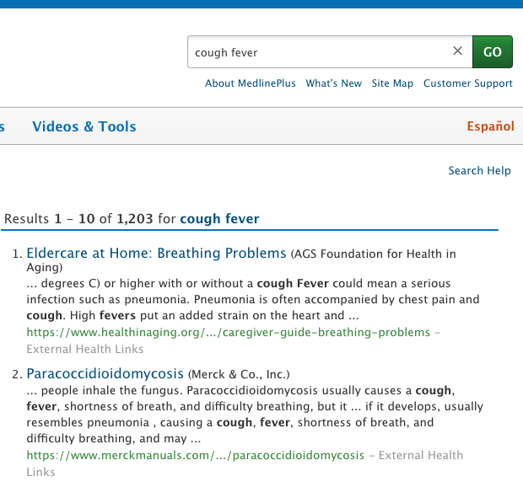
Problems
Current pandemic of COVID-19
It is hard to search for symptoms from search engine
Low efficiency of Hospital
”Shelter In Place” Order

Slide 3
Solution
Web crawler to crawl a medical website (depth = 3)
Html parser to parse links and text (a tag href attr)
Store texts locally (offline)
Indexed locally stored documents (inverted index term:docids)
Query keywords
Tf-idf cosine score rank system

Slide 4
Seed
https://www.cdc.gov/
Many unrelated information
Pages in other language
Disease page, symptoms page are separated
https://www.who.int/
Same problem as cdc
https://medlineplus.gov/
Information are gathered together (related info)

Slide 5
Crawler
Initialization: visited_set(), front_queue(), seed
For each link in the queue:
Check if the link is valid. (external links? Spanish?)
Extract links, add all valid link into front_queue
Extract metadata and texts, save texts as local docs

Slide 6
Indexer
Remove pos of term in inverted index
Form: {term1: {docID, docID, …}, term2: {docID, docID,…}, …}
Other information: vector length, term frequency, document frequency and inverse document frequency, stop-word list
Since there are up to 10,000 documents, The indexing process will take lot of time and memory, all of the information can be cached in disk storage.
Use pickle.dump() and pickle.load() to save or load dictionary data structure in disk as binary file.

Slide 7
Query
Cosine similarity and tf-idf
Could load index from file system
Use subprocess to open the retrieved documents.

