Slide 1
Directional association inference challenged by severe dropout in single­-cell RNA­seq data
Eliška Dvořáková
dvorael1@fel.cvut.cz
supervisor: Prof. Joe Song

Slide 2
Motivation
Single-cell RNA sequencing (scRNA) allows to gain RNA-seq from small amount of initial material. (single cell)
New field of study focus on data from single cell.
scRNA suffers from 0.9 dropout.
Methods for Bulk RNA-seq performs close to random
New methods FunChisq [1].

Slide 3
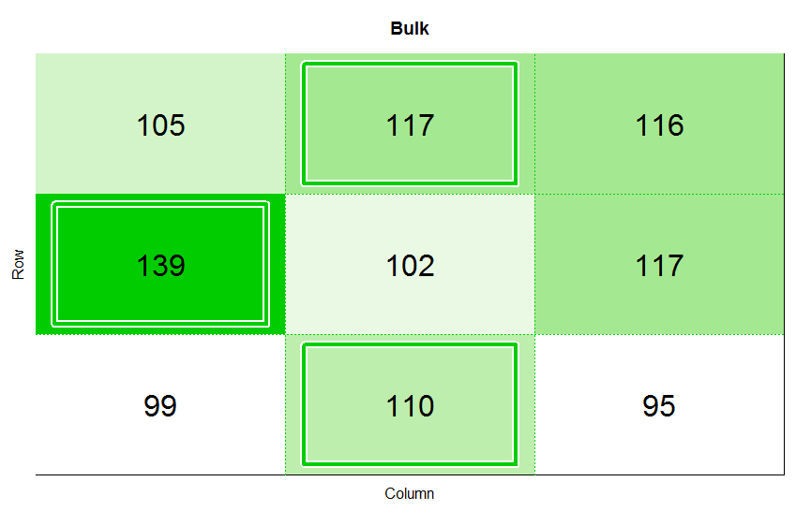
Bulk RNA-seq
Input material: multiple cell
No dropout
1000 samples

Slide 4
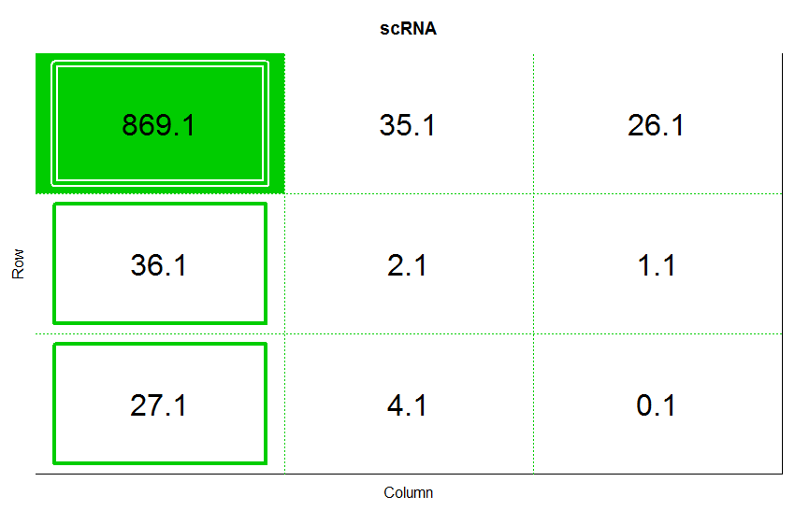
Single-cell RNA-seq
Input material: single cell
0.9 dropout
1000 samples

Slide 5
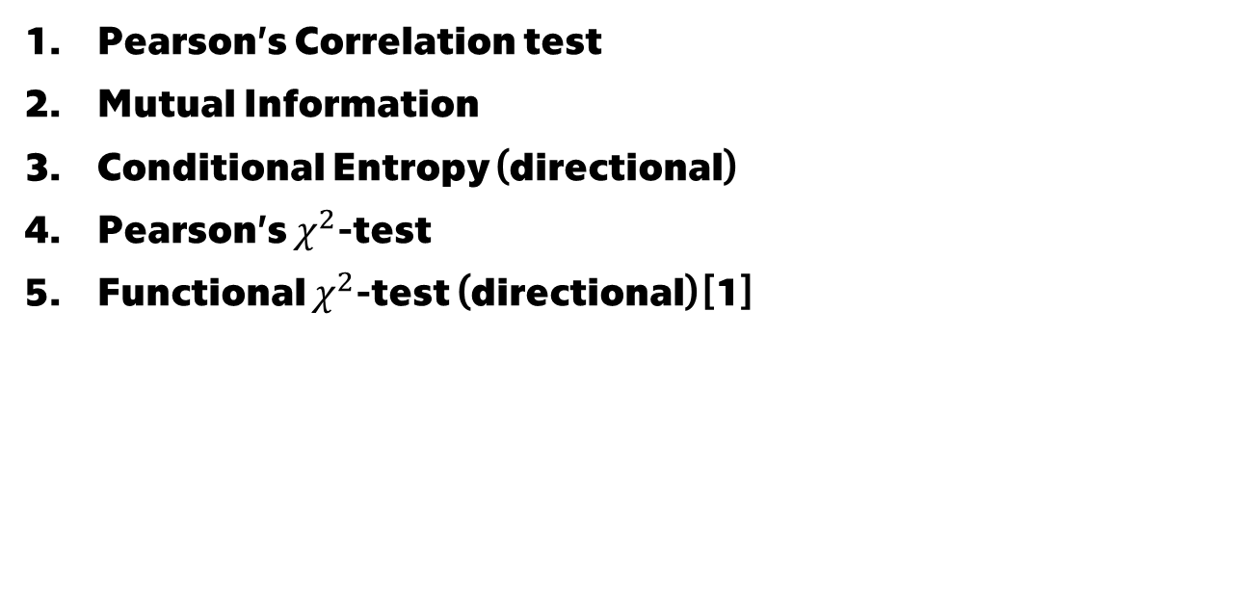
Methods
Pearson’s Correlation test
Mutual Information
Conditional Entropy (directional)
Pearson’s $χ^{2}$-test
Functional $χ^{2}$-test (directional) [1]

Slide 6
Simulated dataset
Size: 200 tables
Dimension : 3x3
Samples: 1000
Noise: 0.0, 0.2
Dropout: 0.2, 0.8, 0.9, 0.99
Configurations:
Detection of relationship
Detection of relationship direction

Slide 7
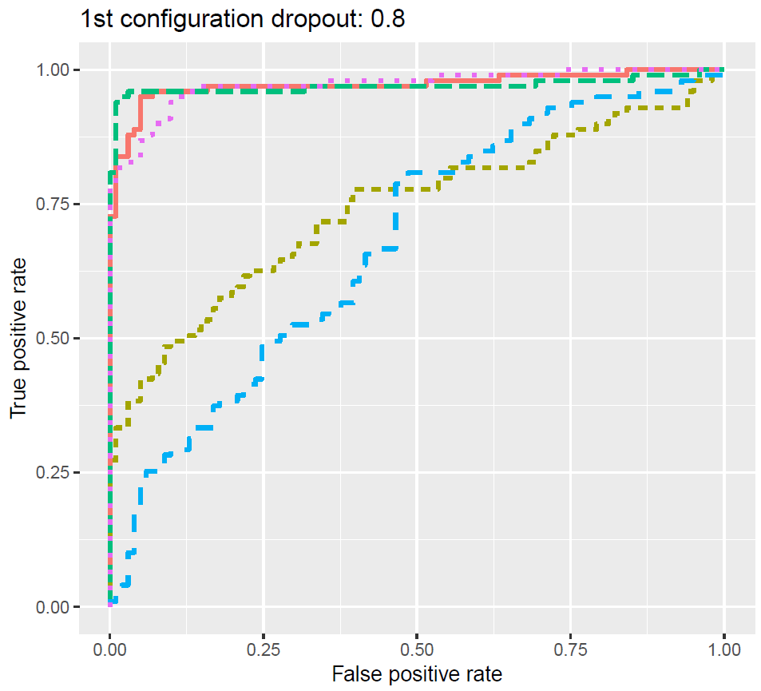
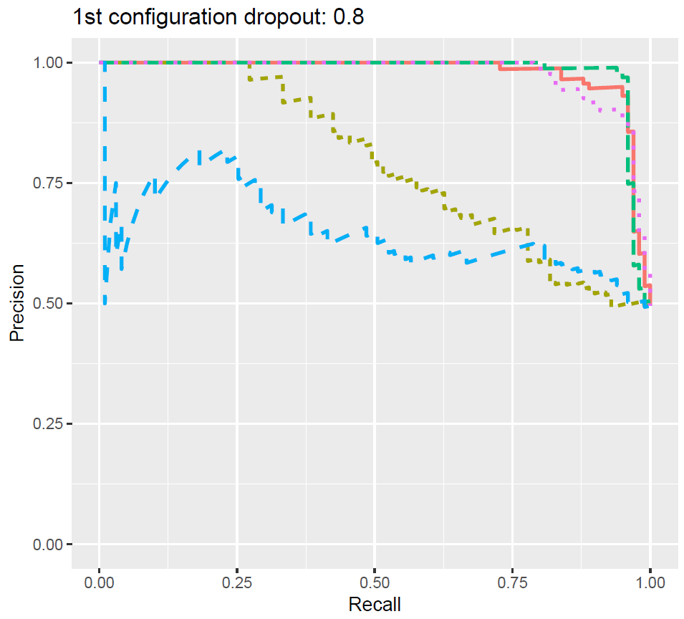
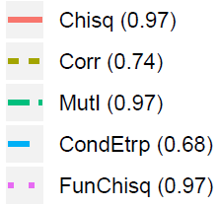
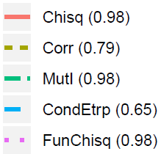
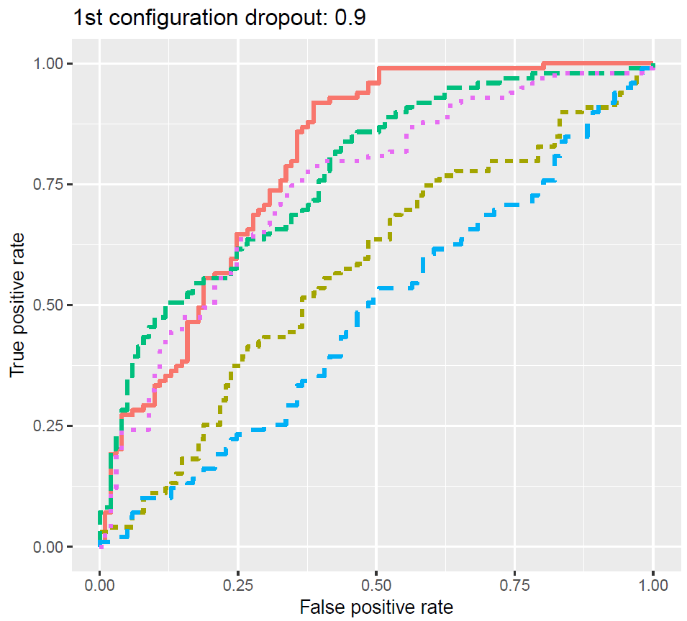
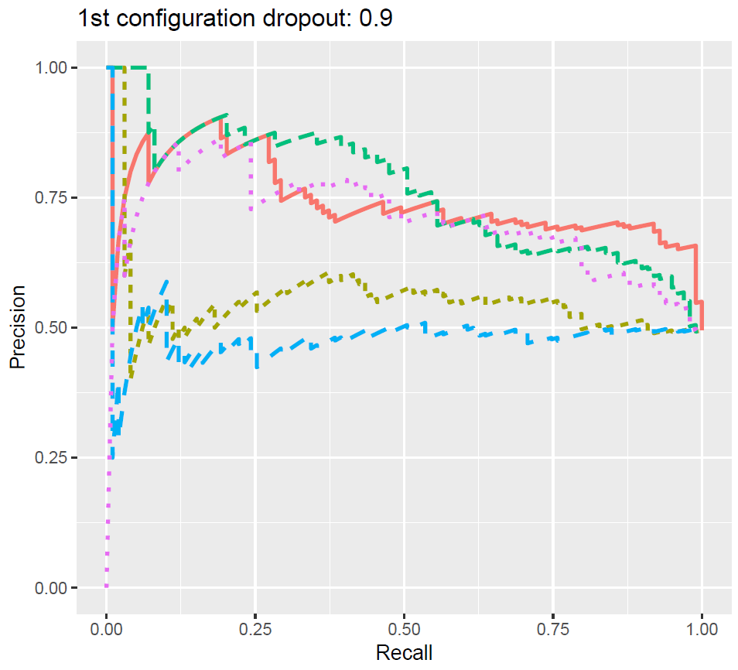
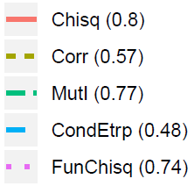
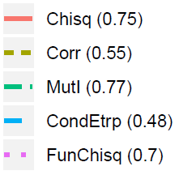
Results 1st Configuration

Slide 8
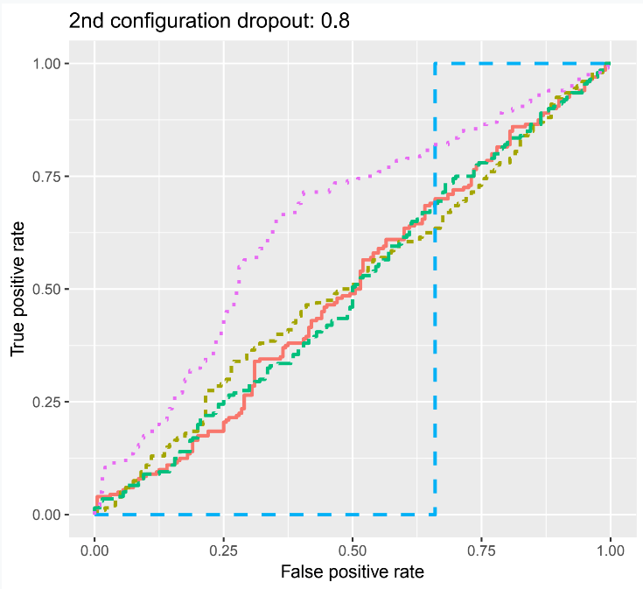
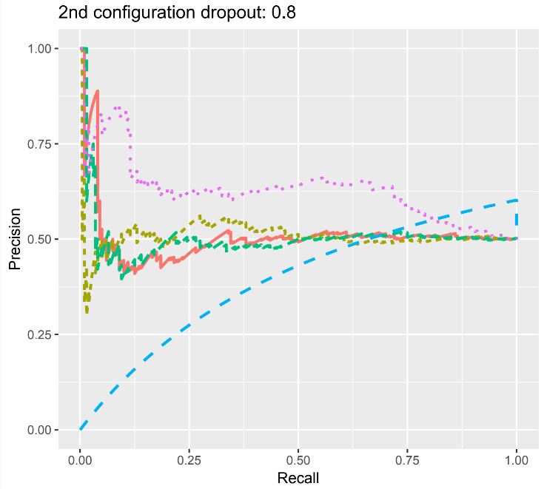
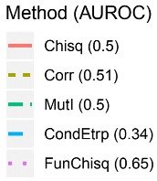
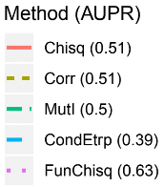
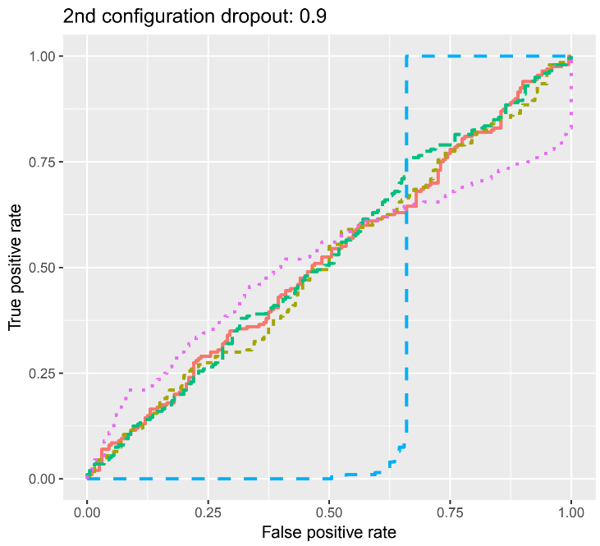
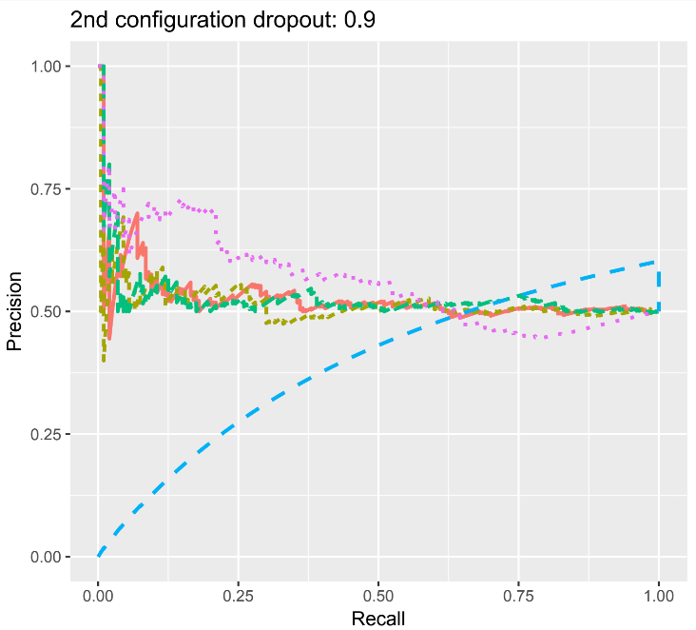
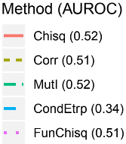
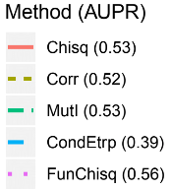
Results 2nd Configuration

Slide 9
Real dataset biological background
Dataset gained from Tung et al. [2]
single-cell Fluidigm C1 platform
three C1 replicates from three human induced pluripotent stem cell (iPSC) lines
unique molecular identifiers (UMI) to all samples
The paper is focused on finding source of variation in gene expression data.
Genotype
UMI counts are biased

Slide 10
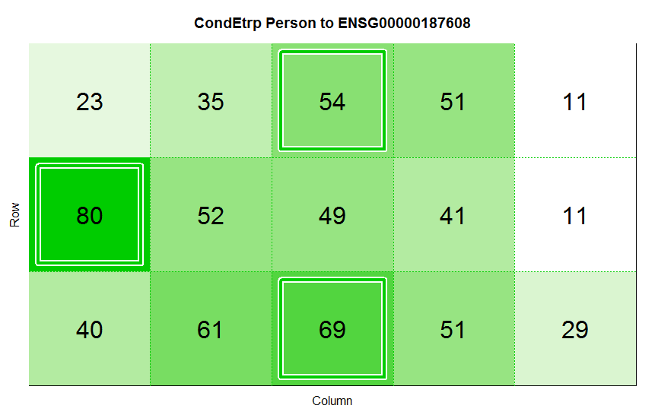
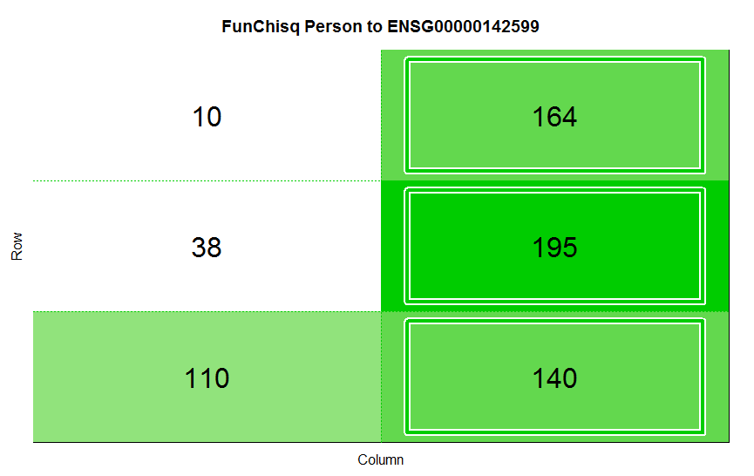
Real dataset
Subset of 40 genes
Configurations:
Person vs Gene (true) and Gene vs Person (false) only for differentially expressed genes.
Person vs Gene (true for differentially expressed genes)

Slide 11
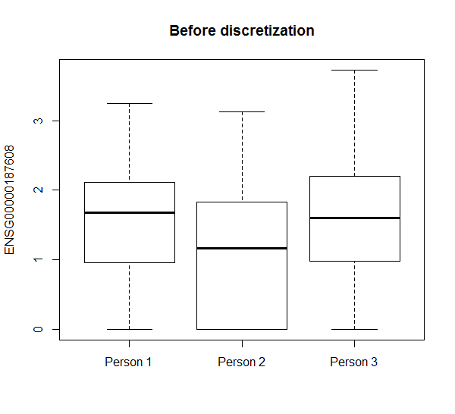
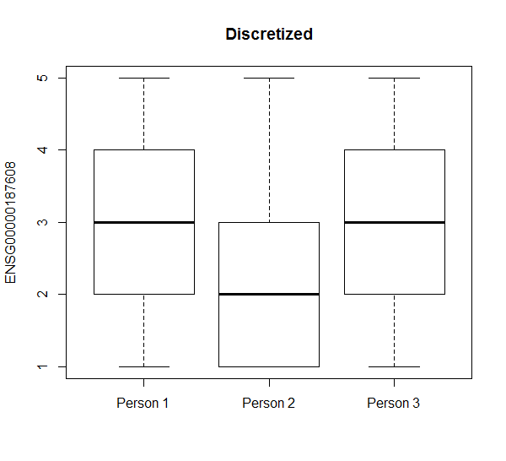
Data discretization

Slide 12
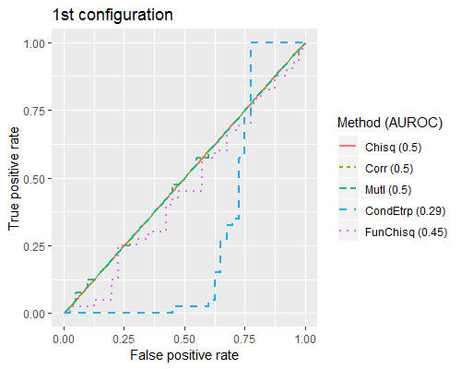
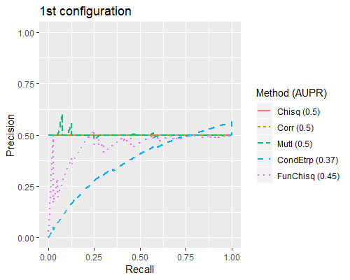
Results 1st configuration

Slide 13
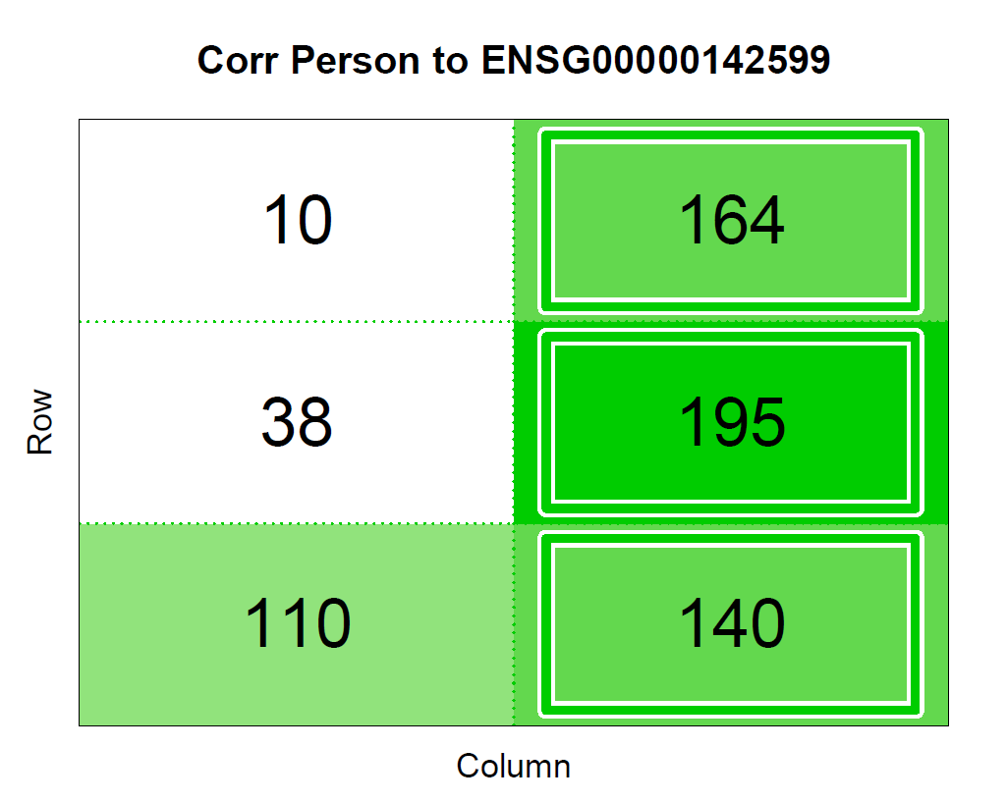
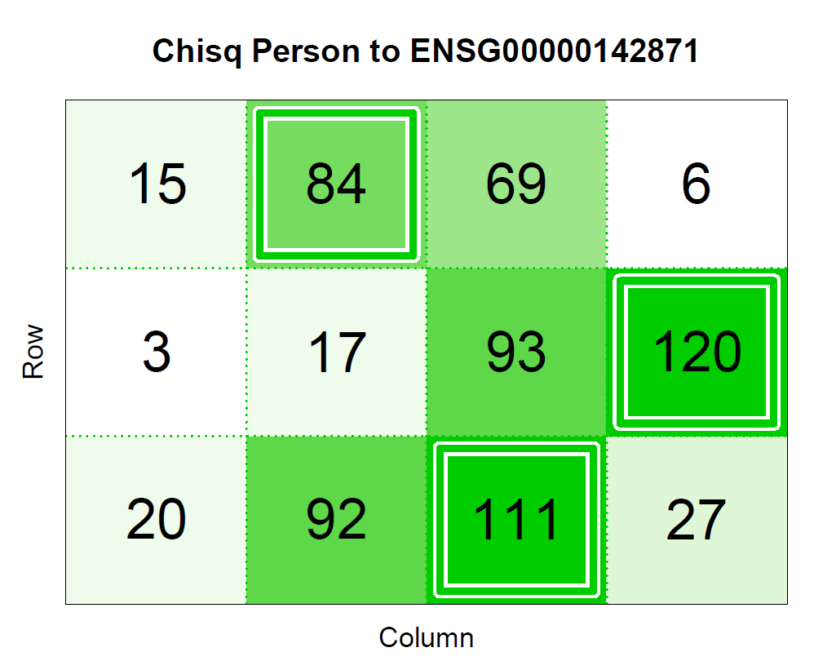

Tables with strongest inference for each method

Slide 14
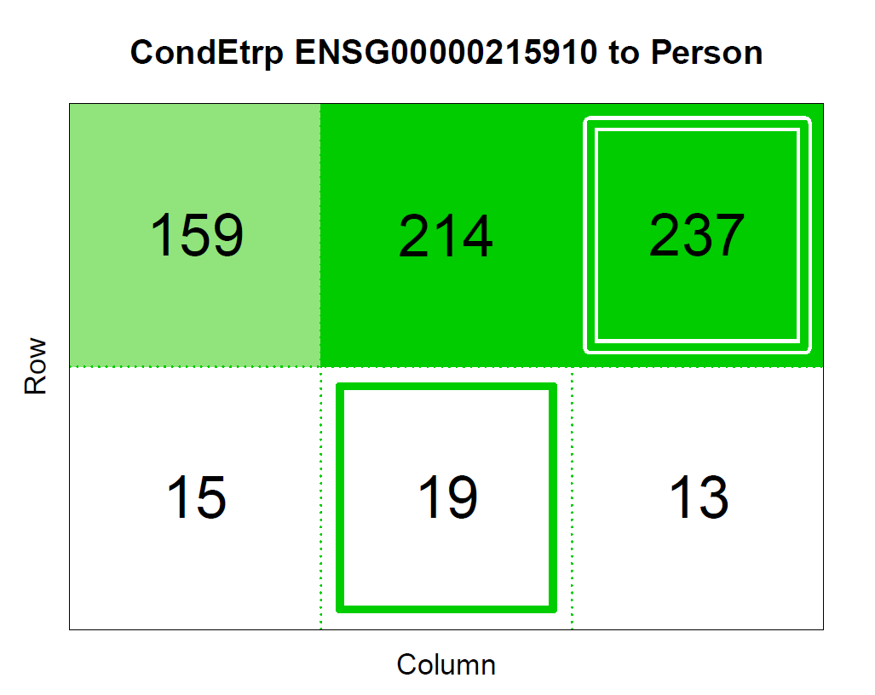
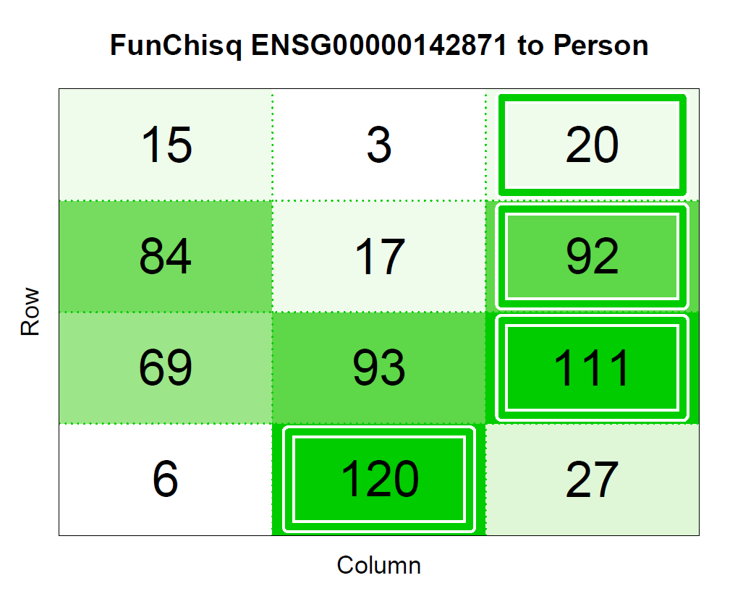
Tables with strongest inference for each method

Slide 15
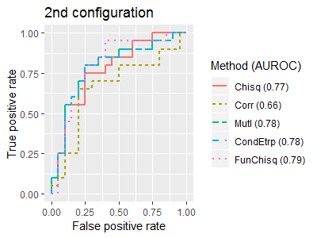
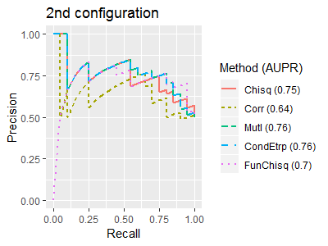
Results 2nd configuration

Slide 16
Conclusion
Simulated dataset
Real dataset
Future work
Answer How many samples are needed to gain at least 70% accuracy?
Add test for multiple noise
Process whole real dataset

Slide 17
References
[1] Zhang, Y., & Song, M. (2013). Deciphering interactions in causal networks without parametric assumptions. arXiv preprint arXiv:1311.2707.
[2] Tung, P.­Y., Blischak, J. D., Hsiao, C. J., Knowles, D. A., Burnett, J. E., Pritchard, J. K., &Gilad, Y. (2017). Batch effects and the effective design of single ­cell gene expression studies. Sci Rep, 7, 39921.

