Slide 1

Mind Raider
  Outlining & Mind Mapping for the Semantic Web
Martin Dvorak
http://e-mentality.blogspot.com
MindRaider@users.sourceforge.net
2005
Notes:
Hello everybody! Let me start my presentation ;-)

Slide 2


Agenda
How it began...
  Outlining & Mind Mapping
  The Semantic Web
Mind Raider
  SWAD
    Gnowsis & Knobot
  Innards
  Vision
Don't hold back!
Demo

Slide 3
How it began...

Slide 4

Motivation (contd.)
  Because I didn't find anything usable, I decided to build something which:
    I could use everyday for management of my resources (ideas, thoughts, bookmarks, documents, mails, etc.)
    Would not be based on proprietary formats for storing data
      Avoid intentional vendor lock
      Would be interoperable and enable further data processing
    Aims to be more than “yet another ordinary outliner”
      Be based on state of the art technologies & specifications
      Is aware of where the current web is going and where it will be over a few years
    Would open universe of the Semantic Web knowledge to my desktop

Slide 5
Motivation
  Personal
    Spare time self-education
      New specifications and technologies “hands on experience”
    Interdisciplinary subject
      Semantic Web
      AI
      Cognitive sciences
      Data visualization
      ...
    Opportunity to meet interesting & smart people from all the world
    :-) by Leo:
      “Fabulous effort to build something called the Semantic Web - often known as 'the topic with the URI http://www.w3.org/2001/sw'“

Slide 6
Gentle Introduction
to
Outlining & Mind Mapping

Slide 7
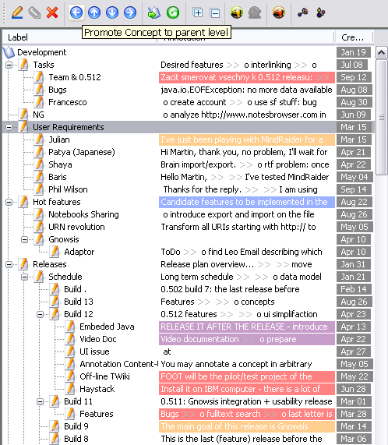
Outliners and Outlining
    Definition:
      “Outline helps the writer to organize his or her ideas and a summary which shows the logical flow of the paper”
      “Outliner is simple hierarchy editor”
    In early 1980s appeared a new successful kind of software called outliners
    Used by people who think - to plan, organize and present their ideas...
    Then it seemed that the category died out...

Slide 8
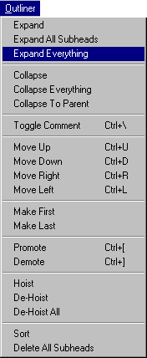
Outliners and Outlining
    ...but outliners infiltrated other programs:
      File system browsers, word processors, presentation programs, project planners, personal information managers - have outliners built into them
    The expanding and collapsing widget with promote, demote, up and down operations
    Lost ideas that are still unique like cloning, hoisting, mark-and-gather, flattening or outline math
    OPML
      OML, PML and XOXO
Notes:
Hoist: Focuses in on just the bullet and sub bullets that you are working on currently hoisting it to the top of the page and hiding everything else.
Clone: Make an identical item in the outline. When it or any of it's clones are changed, all other clones are changed in the same way.
mark and gather- It's possible to search and mark items and then gather them in excluding the other parts of the outline
Outline math: Excel has been around for a while an no one has questioned that, ever as far as I know. How about merging the ideas of outlining and table-based calculations? One outline could have a formula in it which result is passed on to its parent outline to be computed with its sibling outlines and so on.

Slide 9
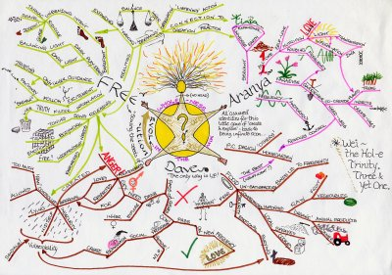
Mind Mapping
  Definition
    “A mind map is pictorial representation how a central concept is linked to other concepts and issues. Typically it is a multicoloured and image centered radial diagram that represents semantic or other connections between concepts.
    Used for centuries, for learning, brainstorming, memory and visual thinking

Slide 10
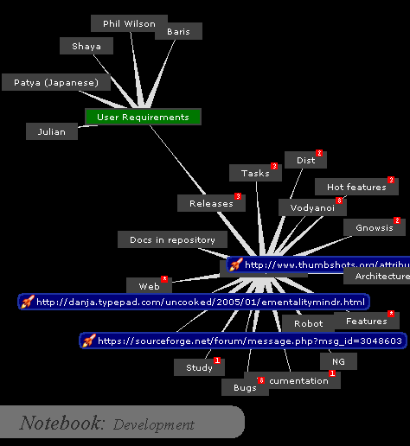
Mind Mapping
    Mind mapping guidelines
      Start in the centre with an image of the topic, using at least 3 colours (code).
      Use images, symbols, codes and dimensions throughout your Mind Map.
      Select key words and print using upper or lower case letters.
      Each word/image must be alone and sitting on its own line.
      The lines must be connected, starting from the central image. The central lines are thicker, organic and flowing, becoming thinner as they radiate out from the centre..
      Keep the Mind Map clear by using Radiant hierarchy, numerical order or outlines to embrace your branches.

Slide 11
Concept Maps
    Motto:
      “From tree structures to radial hierarchies and directed graphs”
    Concept mapping vs. Mind mapping:
      Mind Mapping is restricted to radial hierarchies and tree structures
    Concept maps allow for:
      A greater range of connections between concepts
      Encourage one to label the connections
      Enabling the potential as a true cognitive, intuitive, spatial and metaphorical mapping
    Strength vs. comprehensibility dilemma
      Is general graph easy to comprehend?
      Creation, maintenance and visualization challenge
    Haven't you seen this somewhere before?
      ... indeed, it is RDF described informally :-)

Slide 12
The Semantic Web Challenge

Slide 13

Problem Statement
The Semantic Web promises to open innumerable opportunities for automation and information retrieval by standardizing the protocols for metadata exchange. However, unfolding of the Semantic Web vision depends on users getting powerful but easy-to-use tools for building, visualizing and managing their information. Only thus can be enabled quick creation of semantically enriched (web) resources comprehensible for both humans and machines.
Semantic Web content
  Resources, annotations, identifiers, ...
  Humans vs. machines
  Quality of data
    Semantical enrichment vs. meaning resolution

Slide 14

Positioning
MindRaider is Semantic Web outliner. It aims to connect the tradition of outline editors with emerging technologies. MindRaider mission is to organize not only the content of your hard drive but also your cognitive base and social relationships in a way that enables quick navigation, concise representation and inferencing.
<číslo>

Slide 15
Power of SW enabled MM
MR enables you to capture your thinking...
  Particular thought immediately becomes resource that has assigned unique URI
  Resource can be annotated with various types of the content
  As the mind map grows other resources are linked via their URIs – either from annotations or just by inter URI relationships
    Target of the relationship can be any URIfied resource – MR concept or even any Semantic Web ontological resource
  Rich set of relationships form metadata layer on top of resources

Slide 16
Power of SW enabled MM
MR
  Smoothly turns mind maps into quality SW content
  Semi-automated creation of semantically enriched content
  Since there is no radial limitation on relationships, facets can be used to view mind map from various perspectives
  Correlation of annotations
It's clear that SW specifications suite & technologies fit the Mind mapping UC and vice versa :-)

Slide 17
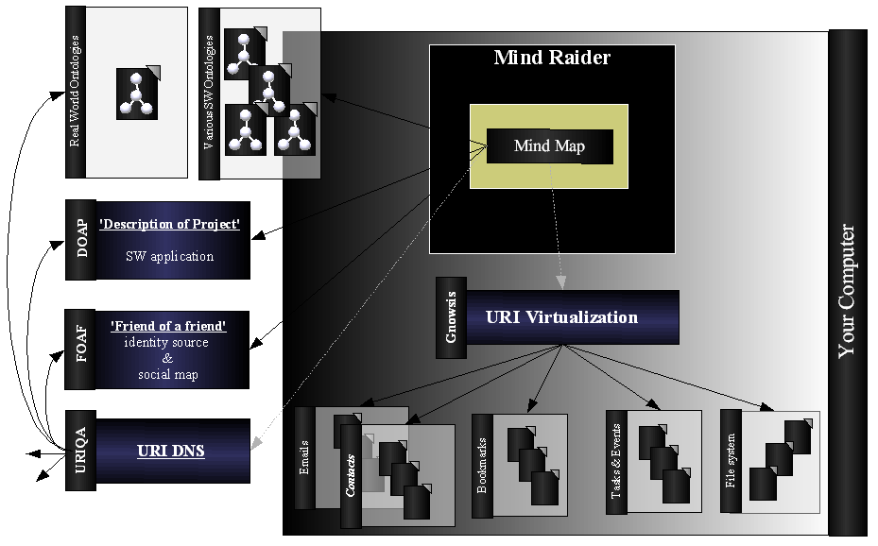
Power of SW enabled MM

Slide 18
Semantic Web Context
Standards & Technologies
  Resource Description Framework (RDF)
  Web Ontology Language (OWL)
  Simple Protocol And RDF Query Language (SPARQL)
  The URI Query Agent Model (URIQA)
  ...more in demo ;-)
Ontologies & Vocabularies
  Simple Knowledge Organization System (SKOS)
  Friend of a Friend (FOAF)
  Dublin Core (DC)
  Custom OWL ontologies e.g. Classification
  :-) Real world common semantics ontologies like Wikipedia
    Artificial vs. real-world
    URI crisis: URI vs URL; content oriented navigation

Slide 19
Let your mind rule the brain!

Slide 20
Abstractions
Mind Raider
  Folders
    Notebooks
      Concepts
        Annotations
        Attachments
        Classification
Concepts interlinking
  Radial
  Ad-hoc
  Content-based

Slide 21
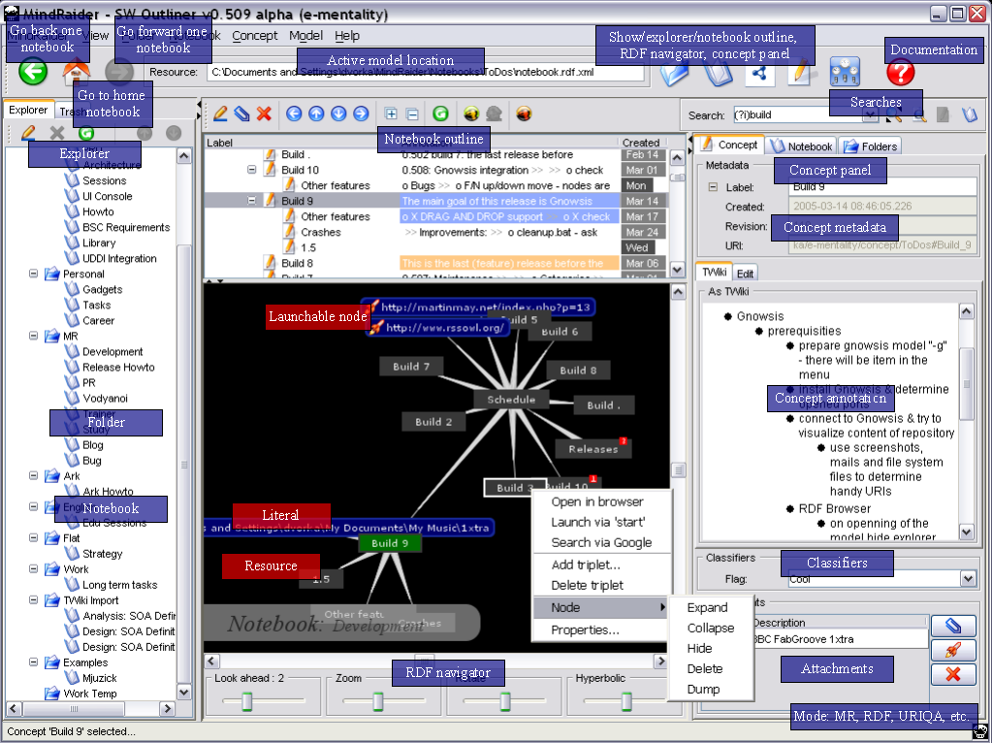
MM+SW=MR

Slide 22
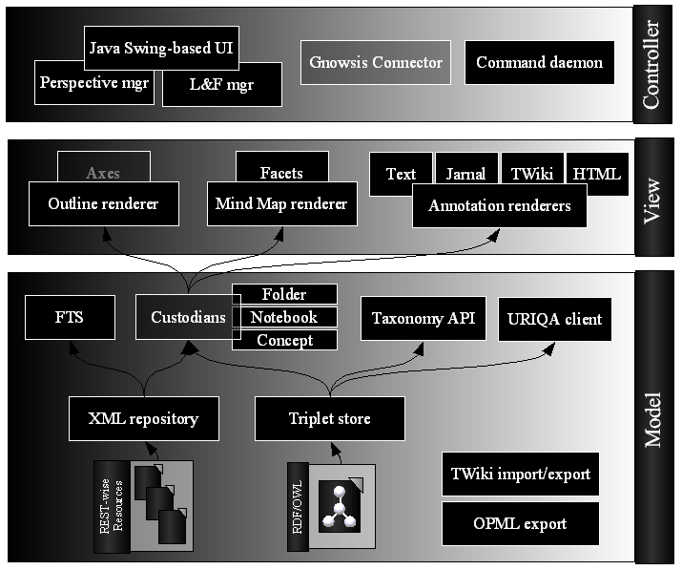
Big Picture

Slide 23

Features
Mission:
  “Capture, correlate and categorize resources in a way that is human mind -friendly”
Feature highlights
  Open formats, standards and technologies
    No vendor lock – you can quit anytime ;-)
    Cognition post-processing
  Hierarchical, radial organization with optional interlinking
  Flexible mind map visualizations enabled by underlaying RDF model
    Multiple concept structures in single mind map
      For example: packages by functionality or widget type
    Axes
    Facet based filtering
  ...particular features in demo

Slide 24
Semantic Web Applications Integration

Slide 25
SWAD
Semantic Web Advanced Development
    http://www.w3.org/2000/01/sw/
    Activities (SWAD, SWAD-Europe) aiming to accelerate SW adoption by delivering live demos, applications and real world oriented research
    DOAP based bulleting board (check MR ;-)
      http://esw.w3.org/topic/SemanticWebDOAPBulletinBoard
SW community volunteers & enthusiast
    Semantic Web related applications building
    Integration (SW as medium)
    Exchange & sharing of ideas and experiences

Slide 26

Gnowsis (contd.)
Gnowsis Semantic Desktop (http://www.gnowsis.org/)
  “Browse your files, friends, and photos like they were in a tiny little World Wide Web, using browsers and search engines. Bookmark everything, link everything and enjoy surfing your data.”
  Leo Sauermann (http://leobard.twoday.net/)
    Head of the Gnowsis project hosted by Knowledge Management Department of German Research Center for AI (DFKI)
  Gnowsis rulez
    Central hub
    Add SW interface to every desktop application
      Firefox, Thunderbird, Outlook, file system, IMAP
    Assign URI to every Resource maintained by interfaced application
    Build RDF based metadata on top of URIfied resources

Slide 27
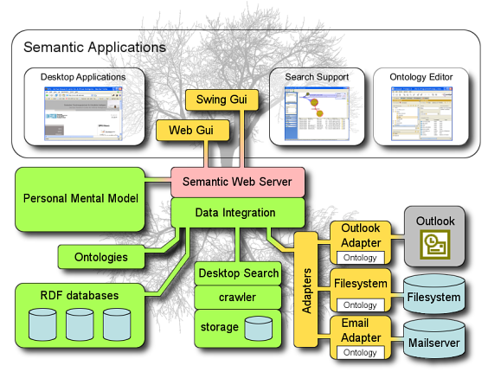
Gnowsis

Slide 28
MR & Gnowsis
Integration UCs
  Link Concept
    Mind Raider's native Concept URI is sent to Gnowsis hub in order to be linked with other resources
  Browse Concept
    Mind Raider actives Gnowsis hub browser for active Concept
  Browse Central hub repository
    URIQA interface
    SPARQL (for operations with HTTP GET binding)
See also
  http://www.gnowsis.org/News/MindRaiderVSGnowsis

Slide 29
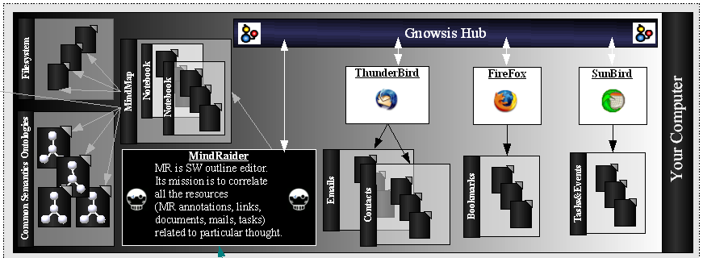
MR & Gnowsis
Demo scenario...

Slide 30
Knobot
  Knobot (http://wymiwyg.org/knobot)
    “An agent for decentralised knowledge exchange”
    By Reto Bachmann-Gmür
    Open source software
    Developed in Java
    Using the Jena framework
      All contents and meta-information is stored in RDF
  Rendering to various output formats is done with XSLT transforming RDF serialized as R3X or TriX into HTML/Atom/RSS

Slide 31
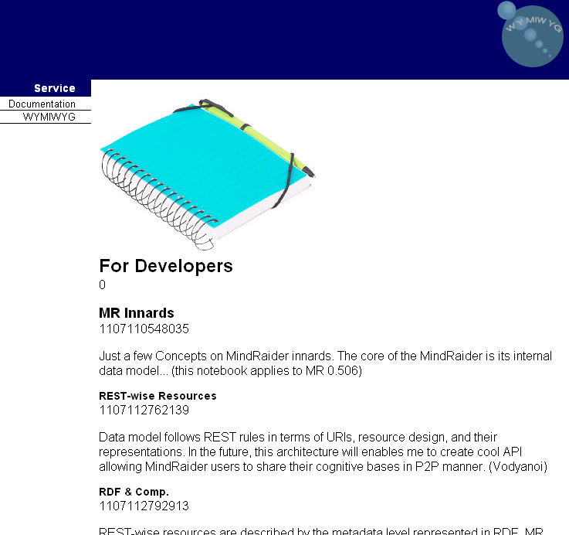
MR & Knobot (contd.)
    Integration UC: MR 2 Knobot
      Prototyped rendering & maintenance of MR notebooks natively in Knobot
      Check Sample Notebook live

Slide 32
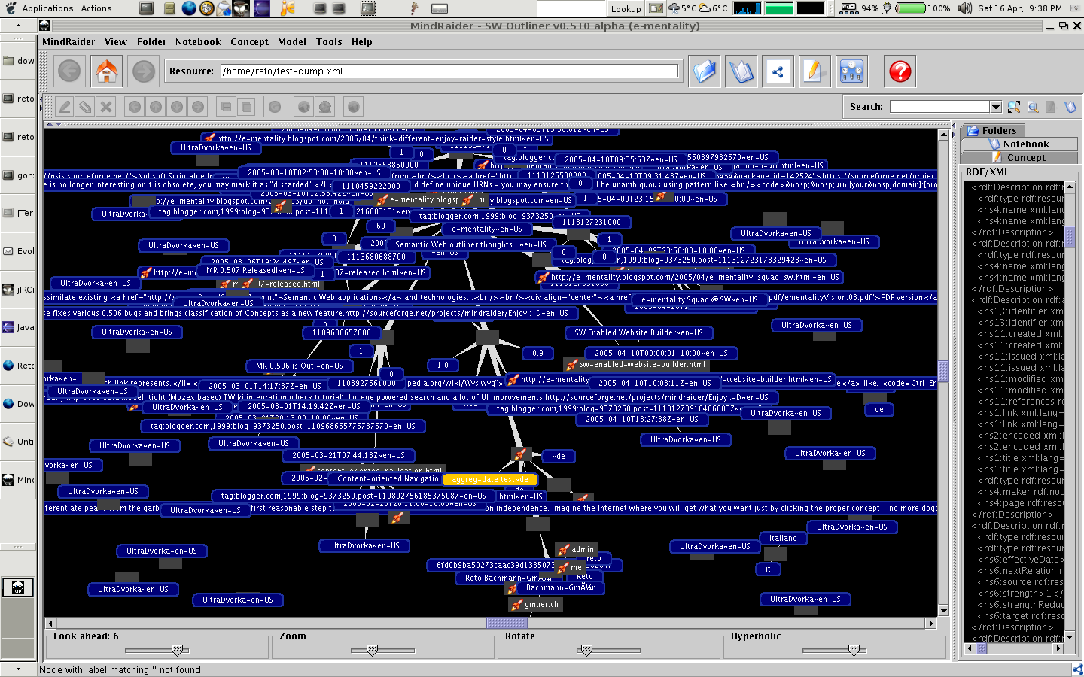
MR & Knobot
  Integration UC: Repository Crawler
    Browsing of Knobot repository via:
      URIQA endpoint
        http://wymiwyg.org/uriqa/?uri=http://wymiwyg.org/
      File system dump

Slide 33
URIQA
  URIQA (http://sw.nokia.com/)
    “URIQA (URI Query Agent) is a model for knowledge discovery, both from authoritative sources as well as from arbitrary third party sources.”
    By Patrick Stickler
    Mission:
      URIQA is here to maintain explicit knowledge about resources, gathered from disparate sources
      It enables sharing of authoritative knowledge about a given resource, based solely on the URI denoting that resource
      DNS for SW (URI vs location)
    Works with optimal unit of specific knowledge about particular resource:
      Concise Bounded Resource Descriptions (CBRD)

Slide 34
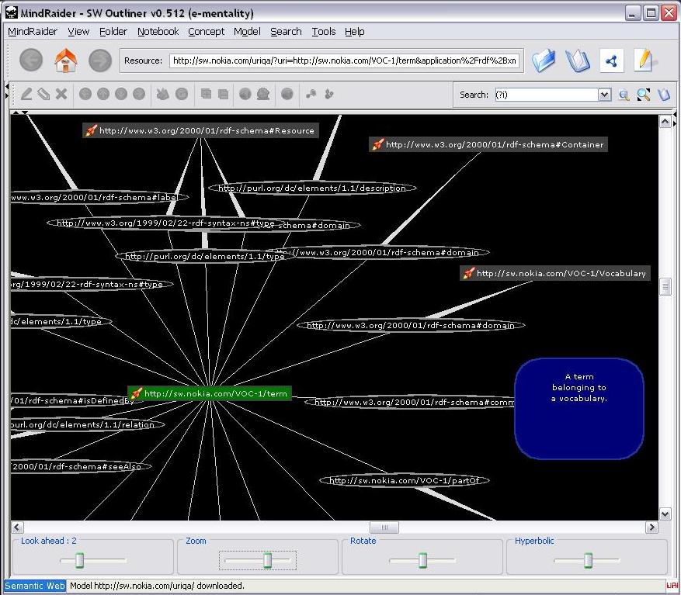
MR & URIQA
  Visual URIQA browser
    CBD to CBD navigation
    Incremental browsing
    Canonical/Inferred
    Snapshot
    Representation
      Graph
      RDF/XML
    Facet based filtering

Slide 35
Mind Raider Innards

Slide 36
Technical Details
Programming language:
  Java 5.0
Forge:
  http://www.sourceforge.net/ project
  Build with Apache Ant & Maven
  Developed in Eclipse
Team
  Lead:
    Martin Dvorak (since early college days in middle 90' ;-)
  Contributors:
    Francesco Tinti (since 9/2005; 1.5 transition, localization and Maven)
    (Reto Bachman Gmuer, Coen Shalkwijk)

Slide 37
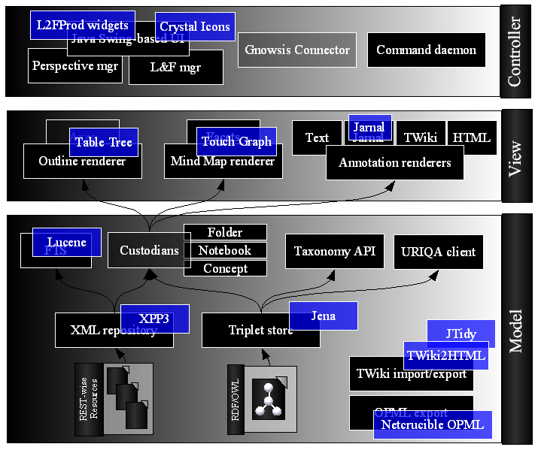
Architectural Overview

Slide 38
OSS Synergy
Jena
  Semantic Web Framework by HP
TouchGraph LLC
  by Alexander Shapiro
XML Pull Parser 3
  by Aleksander Slominski
Lucene, Log4J and Commons
  by Jakarta Apache
TWiki2Html and Html2Twiki
  by Frederic Luddeni
Jarnal
  by David K. Levine and Gunnar Teege
Crystal Icons
  by Everaldo Coelho
Browser Launcher
  by Eric Albert
TableTree SWING component
  by Philip Milne and Scott Violet
OPML CSS/JS/XSLT
  by Joshua Allen
L2FProd.com Common Components
JTidy
JPedal PDF decoder

Slide 39
Long-term Vision

Slide 40
E-mentality
E-mentality = Mind Raider u Vodyanoi
Vodyanoi
  “The vodyanoi is an unfriendly creature who lives in a crystal palace at the bottom of a river, lake or sea. He decorates his home with treasures from sunken ships, and he dislikes human beings so much that he drowns them or makes them his slaves, giving them the ability to live underwater too. It is said that he is only seen or heard at night. He sometimes looks like a large fish and sometimes like an enormous frog, as large as a seal, with a human face. He is blamed for breaking dams to let the waters flow”
  Also China Mieville weird race
  Mission
    Enable sharing of mind maps among users
    Provide quality SW content
      State of the art XHTML/RDF symbiosis
      Easily comprehensible for machines and humans

Slide 41
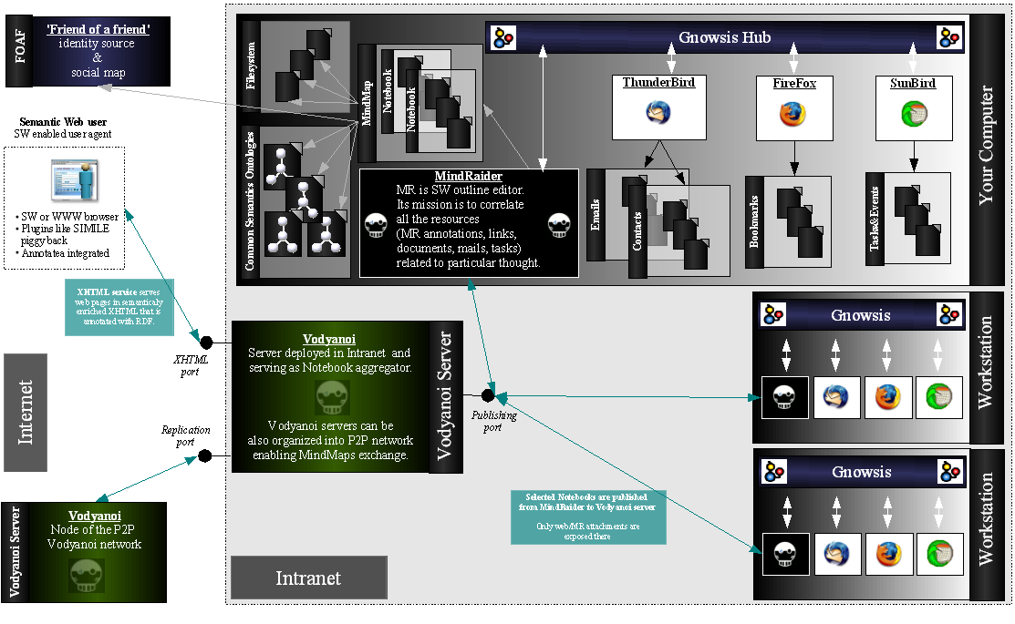
E-mentality Squad

Slide 42
Do not hold back!

Slide 43
Contribute ;-)
OSS/GPL
Ideas, suggestions, critique?
  Do not hesitate to contact me at:
    MindRaider@users.sourceforge.net
Just want to help somehow?
  Localization
  Cool visualization
  New features
  ...
How to start?
  http://mindraider.sourceforge.net
  Download & checkout from CVS repository & build

Slide 44
References
Peter Gärdenfors, Conceptual Spaces: The Geometry of Though, MIT Press, 2000
Steven Pinker, How the Mind Works, W.W. Norton, 1997
Outlining
  http://www.outliners.com/ by Dave Winer
  http://en.wikipedia.org/wiki/Outliner
Mind Mapping
  http://en.wikipedia.org/wiki/Mind_mapping
Concept Mapping
  http://en.wikipedia.org/wiki/Concept_map
  http://en.wikipedia.org/wiki/Concept
Desktops
  http://www.gnowsis.org/
  http://haystack.lcs.mit.edu/
REST Architectural Style by Roy Fielding
  http://www.ics.uci.edu/~fielding/pubs/dissertation/rest_arch_style.htm

Slide 45
;-)

Slide 46
Remarks
Steven Pinker citation
Leo Diploma thesis
Logical big picture
  Real world: RSS, XEmacs outlines (OPML and other formats)
REUSE
  Haystack.ppt (user annotation); do not forget lucene FTS+navigation
Though: organize ideas BUT simple get them and navigate through them – spiders, tree, FTS & sematic queries ;-) -> draw it in some image about internals
Haystack paper: MOTIVATION – a tool to build semantically enriched documents quickly and simply ;-)
Agreagation: RSS
Blogs
Vodyanoi – sw wiki like

Slide 47
Paradigms & Axioms
REST architectural style
  Representation State Transfer by Roy Fielding
    <url>
MVC
  Model/View/Controller driven implementation
Standards

Slide 48
UC: Social Networks
Personal social network
  FOAF based
Taxonomic categorization
Navigation
Queries

Slide 49
Other Features
TWiki integration
RDF browser (and editor)
Gnowsis
<insert WHAT IS from web or plea>
  <url>
<Gnowsis image (web) goes here>
<My big picture goes here>
<reuse gnowsis poster where possible>
TODO procti si diplomku a vykopiruj zajimavosti (ostatni veci a idea)

Slide 50
Outliners
  WIKIPAD
  <ROOT article>
  Examples ~ competitors

Slide 51
MR Innards

