Slide 1
Budapest Data Forum - Hive workshop
Zsolt Fekete, Zoltan Haindrich, Daniel Voros
2017 June

Slide 2
Who we are
Hortonworks’ Sustaining Engineering DB team
Zsolt Fekete (zfekete@hortonworks.com)
Daniel Voros (dvoros@hortonworks.com)
Zoltan Haindrich (zhaindrich@hortonworks.com)

Slide 3
Hive overview
2003, Hadoop: HDFS + MapReduce
commodity hardware
2007, Hive
SQL for data on HDFS
compiles SQL-like queries to MapReduce jobs
Apache License
WordCount example

Slide 4
Current Setup
Hortonworks Data Platform (HDP)
Azure, HDInsight
you can try this with a free Azure account
4 WN x 8core CPU,56GB mem, 400 GB SSD
https://azure.microsoft.com/en-us/services/hdinsight

Slide 5
Requirements
DBeaver http://dbeaver.jkiss.org
Should come with Java 8
putty http://www.putty.org

Slide 6
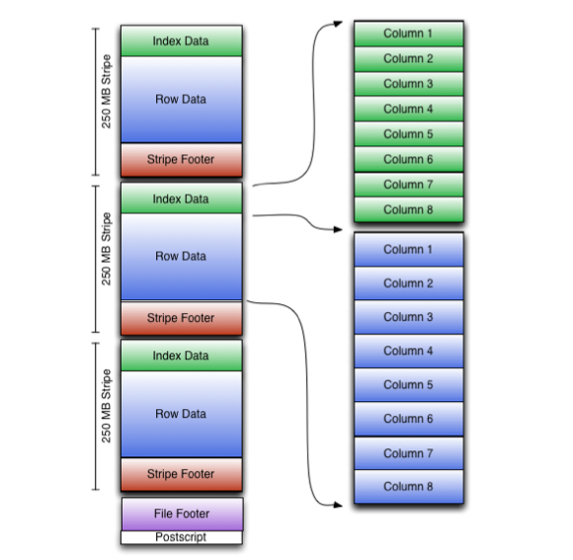
ORC file format
column-major file format
metadata is stored with data
better compression, better performance

Slide 7
ACID
ACID is a database property
Before: Hive could only update whole partitions
ACID table = ORC + bucketed + "transactional"="true"
Storage as base file and delta files
Writes get transaction id from Metastore
Reads don’t need locks

Slide 8
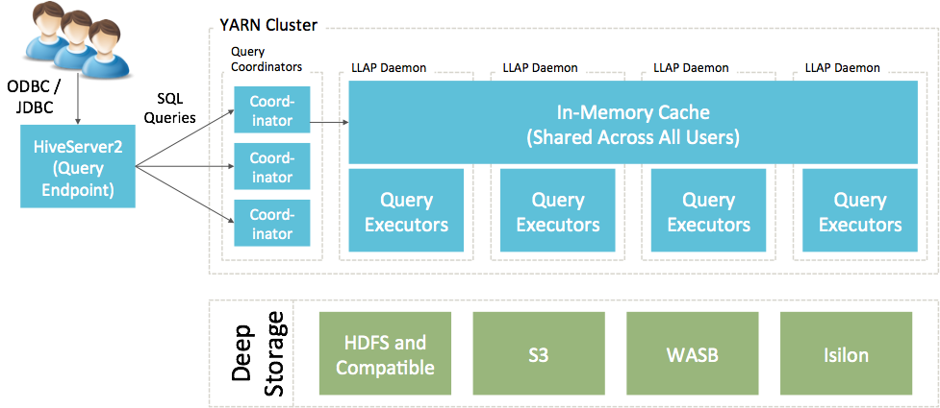
LLAP
https://cwiki.apache.org/confluence/display/Hive/LLAP

Slide 9
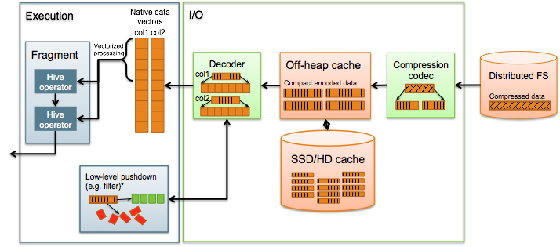
LLAP
https://cwiki.apache.org/confluence/display/Hive/LLAP

Slide 10
Summary, What did we learn?
Hive basics
Hive SQL:
create tables, load data
query data
How data is stored
Performance
partitioning, bucketing
ORC
LLAP, tez

Slide 11
Thanks for Your Attention!
Questions/Comments?

