Slide 1
Tab-Jump
By Darryl Vas Prabhu
https://github.com/dvp-git/Tab-Jump

Slide 2

Problem Statement
You're deep in research, frantically opening tab after tab. Fifteen minutes later, your browser looks like a complex web of interconnected thoughts – half of which you'll never find again. Worse yet, some of those tabs contain sensitive information you'd rather not have lingering in your browser history but would like to check at a later point in time,

Slide 3
The Challenge: How can we transform the chaotic, overwhelming experience of browser tab management into an intelligent, intuitive system that respects both productivity and privacy?
Why this Problem Needed Solving: - Finding the right webpage feels daunting when you have 100+ tabs open. - Productive momentum gets derailed by navigational friction. - Privacy concerns and loss of information on clearing browser history.
Key Constraints or Limitations: Must work seamlessly within the Chrome browser / edge browser and be user-friendly.

Slide 4
Fear Not! Tab-Jump is here

Slide 5
TabJump is a Chrome extension that offers intelligent tab navigation and management features. It provides an easy-to-use search box for navigating multiple tabs, but its functionality extends beyond simple tab searching.

Slide 6
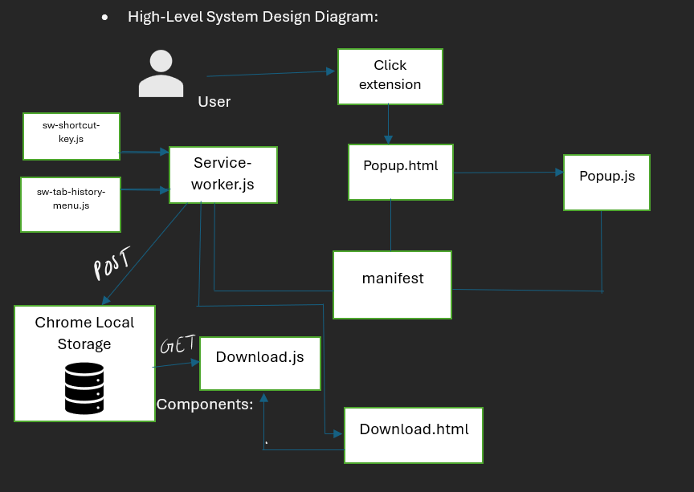
Technical Architecture: HTML, CSS, JavaScript, Chrome API

Slide 7
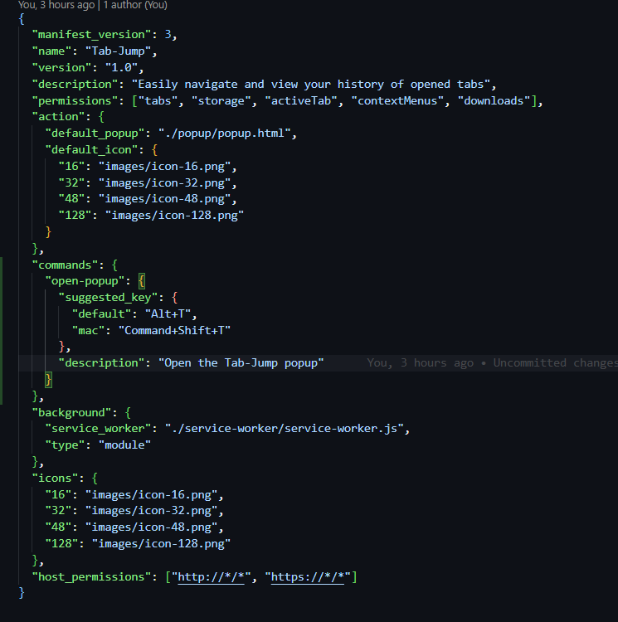
Code Walkthrough
The Core: Manifest V3
The manifest.json is a file that defines the structure of your chrome extension.
It contains permissions for the host machine to use specific chrome api’s, tabs, HTML pages, custom scripts, storage, background scripts called service worker.

Slide 8
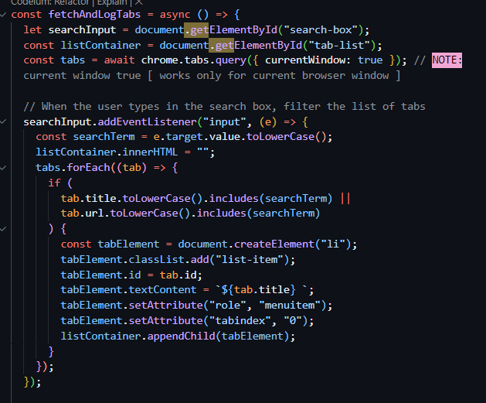
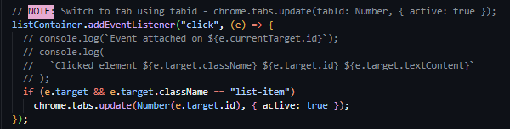
Code Walkthrough
Search Logic: popup.js
Get the current window Tabs from chrome.tabs.query and compare each term with the input typed.
Switch to the particular tab using it’s id. Make sure its number and not string.

Slide 9
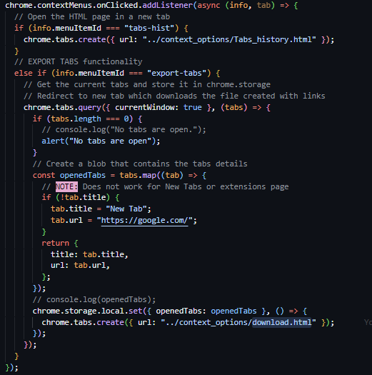
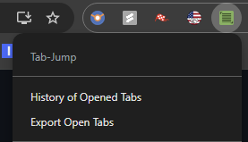
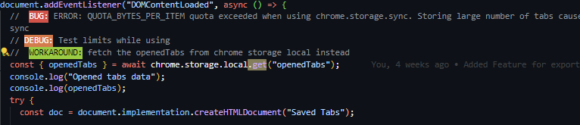
Code Walkthrough
Tab restoration Logic: sw-tab-history-menu.js, download_.js :
This file creates the context menus on the extension
The click on “Export Open Tabs” will check all tab.length property to determine if there are open tabs. An exception or special case condition is to not store multiple New Tabs with default https://google.com .
The map function iterates through all the open tabs and returns a list of Opened tabs in the variable openedTabs.
This variable is then stored in the chrome.storage.local.
Why ? The chrome.tabs API is only accessible from popupjs, service-workers, but not content scripts or other scripts not declared in the manifest.
The downloads_.js script can access the browser chrome.local.storage to fetch the relevant tabs.

Slide 10
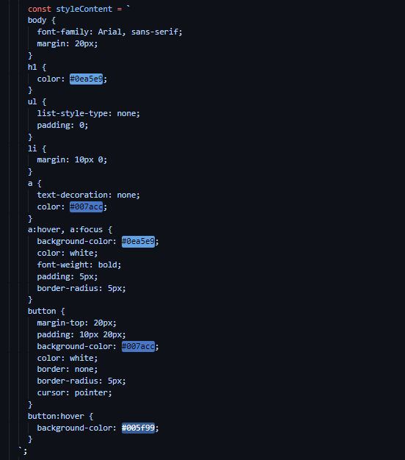
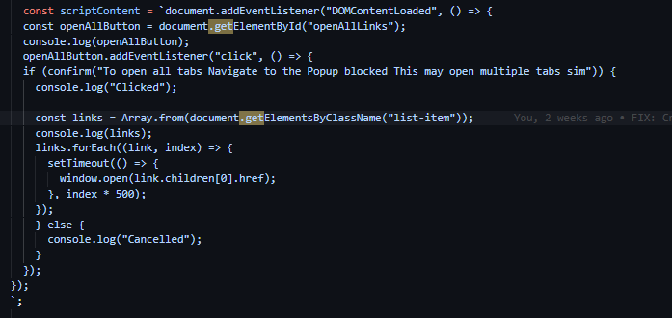
Code Walkthrough
Tab restoration Logic: download_.js
Security: The chrome browser does not allow scripts to run if they are explicitly input via text string to prevent injection attacks.
In order to allow our script to run, the meta HTML tags need to contain the script with additional attributes. But the recommended way is to hash the script and send it over to tighten the security.
This ensures only the scripts included i.e. the scriptHash256 for Javascript and stylehash256 for CSS embedded code are executed by the browser environment.

Slide 11
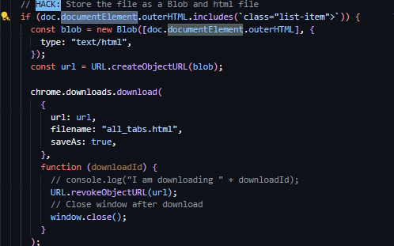
Code Walkthrough
Tab restoration Logic: download_.js
Export: Export the entire document created by the download.js file

Slide 12
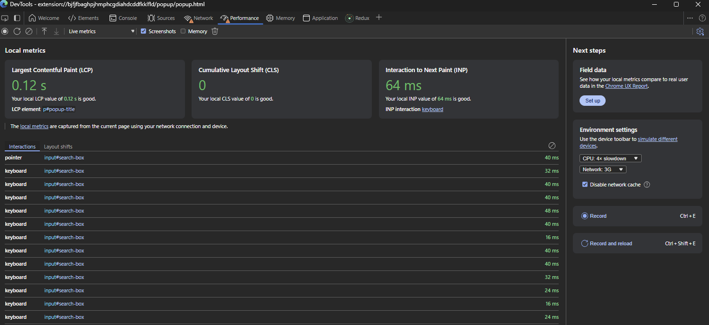
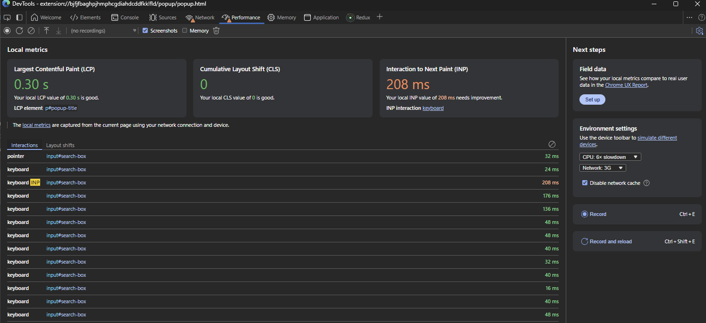
Performance Metrics
Response Times: Near-instantaneous response for search queries.
With throttling as well, the response time is not too bad.
INP measures the responsiveness of a web page which is crucial for browser extensions as they often involve user interactions. It is defined as the delay between a user's input (such as clicking a button or typing) and the visible response on the screen.
INP is considered good if below 200ms and needs improvement if between 200 – 500ms.

Slide 13

Lessons Learned
Technical Insights: Importance of efficient usage of manifest v3 and chrome API
Process Improvements: Iterative development ( GitHub ) with user feedback.
Personal Growth: What began as a daily annoyance became a powerful learning experience that transcended mere code writing.
JavaScript Mastery: Diving deep into the nuanced world of Chrome API extension development.
Problem-Solving Architecture: Translating real-world friction into elegant solutions.
API Interaction Skills: Navigating the complex ecosystem of browser-level programming.
Challenges Overcome:
Created a context-aware search mechanism that surfaces tabs instantly, eliminating navigation friction with a minimal, intuitive design that appears and disappears seamlessly.
Engineered a one-click session recovery system that bypasses Chrome's history page, ensuring users never lose critical browsing context again.

Slide 14

Future Enhancements
Publishing the chrome extension in chrome store is in the roadmap after more rigorous testing and possible future enhancements.
Adding more customization options for users.
History of websites actually read by user.
Analytics of time spent on each tab to understand user reading habits.
Explore integration with other browsers like Firefox.

Slide 15

Conclusion
Project Impact: Improved user productivity by simplifying tab management and tab restoration.
Please feel free to ask any questions.

Slide 16

THANK YOU

