Slide 1
Estimating occupancy with R
Adapted from Olivier Gimenez and others

Slide 2
Lecture 1
Introduction
Estimating occupancy with R

Slide 3
Occupancy to map species distribution
Occupancy: proportion of an area occupied by a species
Species range dynamics
Habitat preferences
Metapopulation dynamics
0 | 0 | 1 | 0 | 0
0 | 1 | 0 | 0 | 0
0 | 1 | 1 | 0 | 0
0 | 0 | 1 | 0 | 0
1 | 0 | 1 | 0 | 0
0 | 1 | 0 | 0 | 0
0 | 0 | 0 | 0 | 1
0 | 0 | 0 | 0 | 1
10/40 = 0.25
- …
Levins 1967, McKenzie et al. 2003, 2006

Slide 4
Issue of detectability < 1
0 | 0 | 1 | 0 | 0
0 | 1 | 0 | 0 | 0
0 | 1 | 1 | 0 | 0
0 | 0 | 1 | 0 | 0
1 | 0 | 1 | 0 | 0
0 | 1 | 0 | 0 | 0
0 | 0 | 0 | 0 | 1
0 | 0 | 0 | 0 | 1
True occupancy = 25%

Slide 5
Issue of detectability < 1
0 | 0 | 1 | 0 | 0
0 | 1 | 0 | 0 | 0
0 | 1 | 1 | 0 | 0
0 | 0 | 1 | 0 | 0
1 | 0 | 1 | 0 | 0
0 | 1 | 0 | 0 | 0
0 | 0 | 0 | 0 | 1
0 | 0 | 0 | 0 | 1
0 | 0 | 1 | 0 | 0
0 | 1 | 0 | 0 | 0
0 | 1 | 1 | 0 | 0
0 | 0 | 1 | 0 | 0
1 | 0 | 1 | 0 | 0
0 | 1 | 0 | 0 | 0
0 | 0 | 0 | 0 | 1
0 | 0 | 0 | 0 | 1
True occupancy = 25%
Species detected in 6 occupied sites

Slide 6
Occupancy underestimation
0 | 0 | 1 | 0 | 0
0 | 1 | 0 | 0 | 0
0 | 1 | 1 | 0 | 0
0 | 0 | 1 | 0 | 0
1 | 0 | 1 | 0 | 0
0 | 1 | 0 | 0 | 0
0 | 0 | 0 | 0 | 1
0 | 0 | 0 | 0 | 1
0 | 0 | 1 | 0 | 0
0 | 1 | 0 | 0 | 0
0 | 1 | 1 | 0 | 0
0 | 0 | 1 | 0 | 0
1 | 0 | 1 | 0 | 0
0 | 1 | 0 | 0 | 0
0 | 0 | 0 | 0 | 1
0 | 0 | 0 | 0 | 1
True occupancy = 25%
Species detected in 6 occupied sites
Naive occupancy estimate = 6/40 = 15%

Slide 7
Issue of detectability < 1
Pr
detectability
true occupancy
time

Slide 8
Bias in occupancy trends
Pr
detectability
true occupancy observed occupancy
time

Slide 9
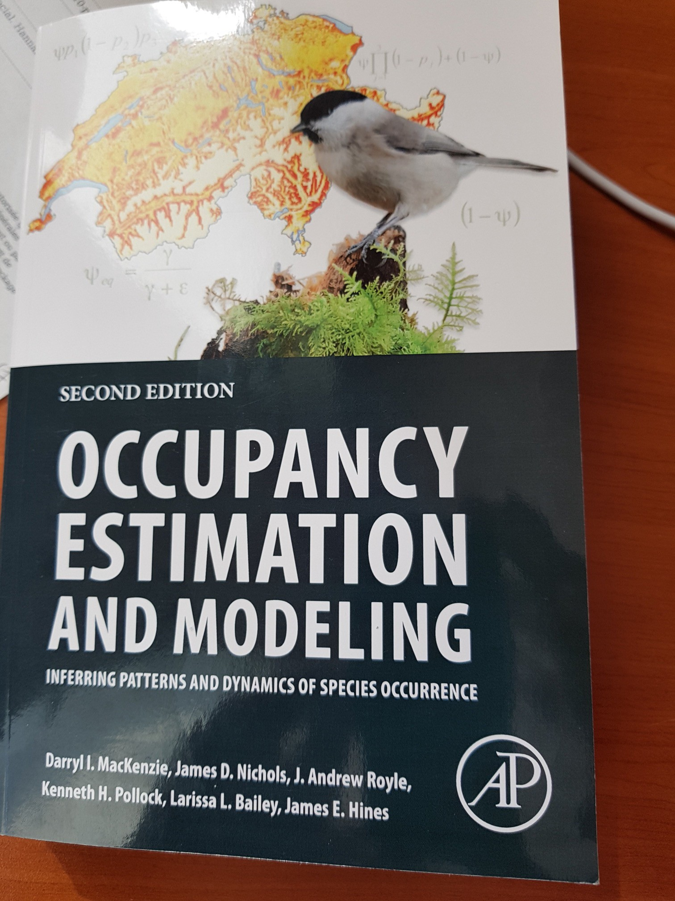

Occupancy models

Slide 10
Occupancy protocol
Several sampling units surveyed

Slide 11
Occupancy protocol
1
0
Several sampling units surveyed
0
Collection of detection/non-detection
1
1
0

Slide 12
Occupancy protocol
1001
0011
Several sampling units surveyed
0000
Collection of detection/non-detection
1011
Replicate surveys in each unit
1111
0000

Slide 13
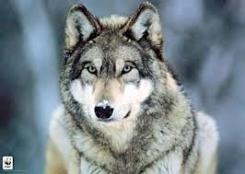
True or false absence?
1001
0011
0000
1011
1111
reality

Slide 14
True or false absence?
1001
0011
1001
0011
0000
0000
1011
1011
1111
1111
0000
reality
observation

Slide 15
True or false absence?
1001
0011
1001
0011
0000
0000
1011
1011
1111
0000
1111
reality
observation

Slide 16
True or false absence?
1001
0011
1001
0011
?
0000
1011
1011
1111
?
1111
reality
observation

Slide 17
Data structure
Sampling units = sites
We do repeated observations at each site
 | visit 1 | visit 2 | visit 3
site 1 | 1 | 0 | 1
site 2 | 0 | 1 | 1
… | … | … | …
site 3 | 0 | 0 | 0

Slide 18
Lecture 2
Static aka single-season occupancy models
Estimating occupancy with R

Slide 19
Single-season occupancy model likelihood
∴ϑ₁ = prob. a site is initially occupied - occupancy
p = prob. species is detected (given presence) – detection

Slide 20
Single-season occupancy model likelihood
∴ϑ₁ = prob. a site is initially occupied - occupancy
p = prob. species is detected (given presence) – detection
Assuming closure, and independence of surveys: Pr(1001) = ?

Slide 21
Single-season occupancy model likelihood
∴ϑ₁ = prob. a site is initially occupied - occupancy
p = prob. species is detected (given presence) – detection
Assuming closure, and independence of surveys: Pr(1001) = ∴ϑ₁ p (1 – p) (1 – p) p

Slide 22
Single-season occupancy model likelihood
∴ϑ₁ = prob. a site is initially occupied - occupancy
p = prob. species is detected (given presence) – detection
Assuming closure, and independence of surveys: Pr(0000) = ?

Slide 23
Single-season occupancy model likelihood
∴ϑ₁ = prob. a site is initially occupied - occupancy
p = prob. species is detected (given presence) – detection
Assuming closure, and independence of surveys: Pr(0000) = ∴ϑ₁ (1 – p) (1 – p) (1 – p) (1 – p) + (1 - ∴ϑ₁)

Slide 24
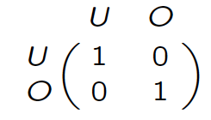


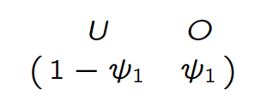
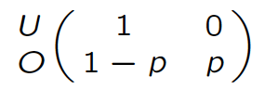
Single-season occupancy model
Initial states
State process
Observation process
Markov model
hidden
O = occupied; U = unoccupied
∴ϑ₁ = occupancy, p = detection

Slide 25
Single-season occupancy model
Initial states
State process
Observation process
hidden
t+1
t
Markov model
O = occupied; U = unoccupied
∴ϑ₁ = occupancy, p = detection

Slide 26
Single-season occupancy model
Initial states
State process
Observation process
t+1
t
t
t
Markov model
hidden
O = occupied; U = unoccupied
∴ϑ₁ = occupancy, p = detection

Slide 27
Data structure
We do repeated observations at each site
 | visit 1 | visit 2 | visit 3
site 1 | 1 | 0 | 1
site 2 | 0 | 1 | 1
… | … | … | …
site 10 | 0 | 0 | 0

Slide 28
Covariates

Slide 29
Covariates
Site-level covariates (e.g. % forest cover)
 | visit 1 | visit 2 | visit 3 |  | habitat
site 1 | 1 | 0 | 1 |  | good
site 2 … site 10 | 0 … 0 | 1 … 0 | 1 … 0 |  | bad … bad

Slide 30
Covariates
Observation-level covariates (e.g. temperature)
 | visit 1 | visit 2 | visit 3 |  | date1 | date2 | date3
site 1 | 1 | 0 | 1 |  | 2 | 5 | 0
site 2 … site 10 | 0 … 0 | 1 … 0 | 1 … 0 |  | -4 … -1 | 8 2 | 2 -3

Slide 31
Covariates
Allow occupancy and detection to be a function of covariates
When dealing with probabilities between 0 and 1, we need a link function (as in GLMs) to force estimates to remain in range
We usually use the logit function logit 𝜃 = log
!
"#!

Slide 32
Covariates
Allow occupancy and detection to be a function of covariates
When dealing with probabilities between 0 and 1, we need a link function (as in GLMs) to force estimates to remain in range
We usually use the logit function logit 𝜃 = log
!
"#!
E.g. for a site-level covariate % forest cover measured at site i :
logit 𝜓$ = 𝑎 + 𝑏 forest$
Where paramaters a and b are intercept and slope to be estimated

Slide 33
Covariates
Allow occupancy and detection to be a function of covariates
When dealing with probabilities between 0 and 1, we need a link function (as in GLMs) to force estimates to remain in range
We usually use the logit function logit 𝜃 = log
!
"#!
E.g. for an observation-level covariate temperature at site i in visit j :
logit 𝑝$% = 𝑎 + 𝑏 temperature$%
Where paramaters a and b are intercept and slope to be estimated

Slide 34
Key occupancy model assumptions
Sites are closed (occupation does not change)
Independent detections
No unmodelled heterogeneity
No false positives

Slide 35
Key occupancy model assumptions
Sites are not closed (occupation does change)
Occupancy should be interpreted as ‘use’.
Relax assumption, see Lecture 3.

Slide 36
Key occupancy model assumptions
Dependent detections
Species easier/more difficult to detect at a site where it has already been detected, or sampling close in time.
Adapt sampling design; account for dependence in model.

Slide 37
Key occupancy model assumptions
Heterogeneity in detection
Occupancy is lower than it should be.
Account for heterogeneity in model (random effects [package ubms], finite mixtures, Royle-Nichols model if heterogeneity due to variation in abundance [function occuRN() in unmarked]).

Slide 38
Key occupancy model assumptions
4. False positives
- See Lecture 4.

Slide 39


Slide 40
Lecture 3
Dynamic aka multiple-season occupancy models
Estimating occupancy with R

Slide 41
Single-season model assumptions
Sites are closed (occupation does not change)
Independent detections
No unmodelled heterogeneity
No false positives

Slide 42
Single-season model assumptions
Sites are not closed (occupation does change)
Independent detections
No unmodelled heterogeneity
No false positives

Slide 43
Data structure
We do repeated observations at each site
 |  | season 1
 | visit 1 | visit 2 | visit 3
site 1 | 1 | 0 | 1
site 2 | 0 | 1 | 1
… | … | … | …
site 10 | 0 | 0 | 0

Slide 44
Data structure
We do repeated observations at each site within season (or year)
 |  | season 1 |  |  | season 2
 | visit 1 | visit 2 | visit 3 | visit 1 | visit 2 | visit 3
site 1 | 1 | 0 | 1 | 0 | 0 | 1
site 2 | 0 | 1 | 1 | 0 | 1 | 1
… | … | … | … | … | … | …
site 10 | 0 | 0 | 0 | 0 | 1 | 0

Slide 45
Data structure
We do repeated observations at each site within season (or year)
 |  | season 1 |  |  | season 2 |  |  | season 3
 | visit 1 | visit 2 | visit 3 | visit 1 | visit 2 | visit 3 | visit 1 | visit 2 | visit 3
site 1 | 1 | 0 | 1 | 0 | 0 | 1 | 1 | 1 | 1
site 2 | 0 | 1 | 1 | 0 | 1 | 1 | 0 | 1 | 1
… | … | … | … | … | … | … | … | … | …
site 10 | 0 | 0 | 0 | 0 | 1 | 0 | 1 | 0 | 0

Slide 46
Data structure
A sequence of single-season studies conducted over several seasons (or years) at same sites
 |  | season 1 |  |  | season 2 |  |  | season 3
 | visit 1 | visit 2 | visit 3 | visit 1 | visit 2 | visit 3 | visit 1 | visit 2 | visit 3
site 1 | 1 | 0 | 1 | 0 | 0 | 1 | 1 | 1 | 1
site 2 | 0 | 1 | 1 | 0 | 1 | 1 | 0 | 1 | 1
… | … | … | … | … | … | … | … | … | …
site 10 | 0 | 0 | 0 | 0 | 1 | 0 | 1 | 0 | 0

Slide 47
Data structure
Sites are closed within season, but occupancy may change across
seasons due to colonisation/extinction events
 |  | season 1 |  |  | season 2 |  |  | season 3
 | visit 1 | visit 2 | visit 3 | visit 1 | visit 2 | visit 3 | visit 1 | visit 2 | visit 3
site 1 | 1 | 0 | 1 | 0 | 0 | 1 | 1 | 1 | 1
site 2 | 0 | 1 | 1 | 0 | 1 | 1 | 0 | 1 | 1
… | … | … | … | … | … | … | … | … | …
site 10 | 0 | 0 | 0 | 0 | 1 | 0 | 1 | 0 | 0

Slide 48
Dynamic of the states
season 1
occupied
unoccupied

Slide 49
Dynamic of the states
season 1
season 2
no extinction
occupied
extinction

Slide 50
Dynamic of the states
season 1
season 2
colonization
unoccupied
no colonization

Slide 51
Dynamic of the states
season 1
season 2
no extinction
occupied
ext.
col.
unoccupied
no colonization

Slide 52
Dynamic of the states
season 1
season 2
season 3
no extinction
no extinction
occupied
ext.
ext.
col.
col.
unoccupied
no colonization
no colonization
slide from D. MacKenzie

Slide 53
Dynamic (multi-season) occupancy models
extinction
O
U
Ε
O = occupied; U = unoccupied

Slide 54
Dynamic (multi-season) occupancy models
1 = species detected; 0 = species undetected
1
0
1
p
1-p p
extinction
O
U
Ε
O = occupied; U = unoccupied

Slide 55
Dynamic (multi-season) occupancy models
1 = species detected; 0 = species undetected
1
0
1
0
0
0
p
1-p p
1
1 1
extinction
O
U
Ε
O = occupied; U = unoccupied

Slide 56
Dynamic (multi-season) occupancy models
1 = species detected; 0 = species undetected
0
0
0
1
1
0
1
1 1
p
p 1-p
colonization
U
O
ψ
O = occupied; U = unoccupied

Slide 57
Dynamic (multi-season) occupancy models
∴ϑ₁ = prob. a site is occupied - occupancy
p = prob. species is detected (given presence) – detection
ψ = prob. unoccupied site becomes occupied – colonisation
χ = prob. occupied site becomes unoccupied – extinction

Slide 58
Dynamic occupancy model likelihood
∴ϑ₁ = occupancy
p = detection
ψ = colonisation
χ = extinction
Pr(110 000) = ?

Slide 59
Dynamic occupancy model likelihood
∴ϑ₁ = occupancy
p = detection
ψ = colonisation
χ = extinction
Pr(110 000) =
Three replicated surveys or secondary occasions Closure assumption

Slide 60
Dynamic occupancy model likelihood
∴ϑ₁ = occupancy
p = detection
ψ = colonisation
χ = extinction
Pr(110 000) = ∴∴1₁ p p (1 – p)
Three replicated surveys or secondary occasions Closure assumption

Slide 61
Dynamic occupancy model likelihood
∴ϑ₁ = occupancy
p = detection
ψ = colonisation
χ = extinction
Pr(110 000) = ∴∴φ₁ p p (1 – p) [ Ε + (1 – Ε) … ]

Slide 62
Dynamic occupancy model likelihood
∴ϑ₁ = occupancy
p = detection
ψ = colonisation
χ = extinction
Pr(110 000) = ∴∴1₁ p p (1 – p) [ τ + (1 – τ) (1 – p) (1 – p) (1 – p) ]

Slide 63
Dynamic occupancy model likelihood
∴ϑ₁ = occupancy
p = detection
ψ = colonisation
χ = extinction
Pr(000 010) = ?

Slide 64
Dynamic occupancy model likelihood
∴ϑ₁ = occupancy
p = detection
ψ = colonisation
χ = extinction
Pr(000 010) = [ ∴ϕϑ₁ (1 – p) (1 – p) (1 – p) (1 – 0) + (1 – ∴ϑ1₁) ψ ]

Slide 65
Dynamic occupancy model likelihood
∴ϑ₁ = occupancy
p = detection
ψ = colonisation
χ = extinction
Pr(000 010) = [ ∴ϕϑ₁ (1 – p) (1 – p) (1 – p) (1 – 0) + (1 – ∴ϕϑ₁) ψ ]
x (1 – p) p (1 – p)

Slide 66
Derived parameters
∴ϑ₁ = occupancy
- Season-specific occupancy:
ϕϑ_{t+1} = ϕϑ_{t} (1 – _{t}) + (1 – ϕϑ_{t}) _{t}
p = detection
ψ = colonisation
Ε = extinction
- Rate of change in occupancy:
Α_{t} = ϕϑ_{t+1} / ϕϑ_{t}

Slide 67
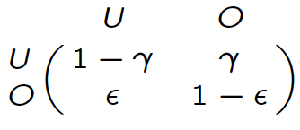
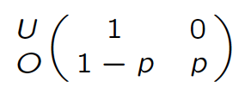
Dynamic occupancy model
Initial states
State process
Observation process
Markov model
hidden

Slide 68
Single-season is a particular case of multi-season
No colonization (ψ = 0) and no extinction (χ = 0)
Initial states
State process
Observation process

Slide 69
Lecture 4
Estimating species co-occurrence
Estimating occupancy with R

Slide 70
Rationale
Several (say 2) different species on a site
Interactions affect occupancy probabilities
Detection of a species affected by presence of another one: blurred interactions
Examples: predation, mutualism, competition, …

Slide 71
Questions you might want to ask
Are the species interacting or not? (beware: co-occurrence is not necessary interaction)
Do species interactions vary along an environmental gradient?
What is marginal occupancy probability of some species (that is averaged on presence/absence of all other species)
What is probability of some species conditional on presence or absence of other species
What is the relative contribution of environmental vs species interactions in occupancy?

Slide 72
States
U = site unoccupied
A = site occupied by species A only
B = site occupied by species B only AB = site occupied by both species

Slide 73
State process
∴ϑ^{Α} = prob. a site is occupied by species A
∴ϑ^{Β} = prob. a site is occupied by species B
∴ϑ^{ΑΒ} = prob. a site is occupied by species A and B

Slide 74
Conditional probabilities
∴ϑ^{Α|Β} = prob. a site is occupied by species A given presence of species B = ∴ϑ^{ΑΒ} / ∴ϑ^{Β}
∴ϑ^{Β|Α} = prob. a site is occupied by species B given presence of species A = ∴ϑ^{ΑΒ} / ∴ϑ^{Α}

Slide 75
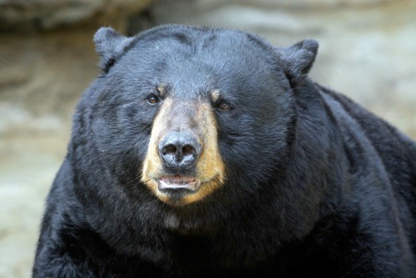
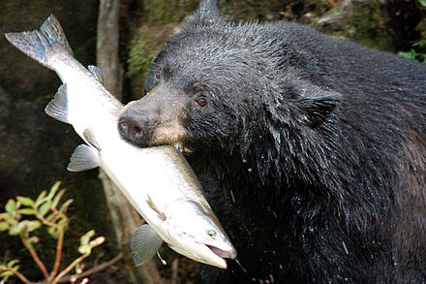
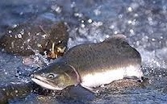
Venn diagram
Occupied by species A only
_{ϑ}Α _{– ϑ}ΑΒ
Occupied by both species
_{ϑ}ΑΒ
Occupied by species B only
_{ϑ}Β _{– ϑ}ΑΒ
Site unoccupied with prob.: 1 – ∴ϑϑ^{Α} – ∴ϑϑ^{Β} + ∴ϑϑ^{ΑΒ}

Slide 76
Events
0 = species undetected 1 = A detected
2 = B detected
3 = both species detected

Slide 77
Observation process
p^{A} = prob. detecting species A given only species A is present
p^{B} = prob. detecting species B given only species B is present
r^{AB} = prob. detecting both species A and B when both present r^{Ab} = prob. detecting species A but not B when both present r^{aB} = prob. detecting species B but not A when both present r^{ab} = prob. detecting neither species when both present

Slide 78
Initial states
Initial states
U
A
B
AB
⎡
⎢ 1− Σ
_{ψ} A _{− ψ} AB _{ψ} B _{− ψ} AB _{ψ} AB
⎣
⎦

Slide 79
State process
State process
U | A | B | AB
1 | 0 | 0 | 0
0 | 1 | 0 | 0
0 | 0 | 1 | 0
0 | 0 | 0 | 1
⎡
⎢
⎢
⎤
⎥
⎥
⎥
U A B
⎢
AB ⎢
⎥
⎣
⎦

Slide 80
Observation process
Observation process
0
1
1− p
1 | 2 | 3
0 | 0 | 0
_{p}A | 0 | 0
0 | _{p}B | 0
⎡
⎢
⎤
⎥
⎥
⎥
⎥
⎥⎦
U A
B
⎢
A
⎢ 1− p^{B}
⎢
_{r} Ab _{r}aB _{r} AB
AB ⎢⎣ 1− Σ

Slide 81
Quantifying interactions
Interaction estimated by: ρι = ∴/φ^{AB} / (∴/φ^{A} ∴/φ^{B})
ρι < 1 – avoidance (less frequent than expected)
ρι > 1 – convergence (more frequent than expected)
ρι = 1 – independence (∴/φ^{AB} = ∴/φ^{A} ∴/φ^{B})

Slide 82
Live demo
Estimating wolf occupancy with R

Slide 83
Conclusions
We covered several occupancy models
Single-season, dynamic models
False-positives
Species interactions

Slide 84
Conclusions
We covered several occupancy models
Single-season, dynamic models
False-positives
Species interactions
Implementation in R using package unmarked

Slide 85

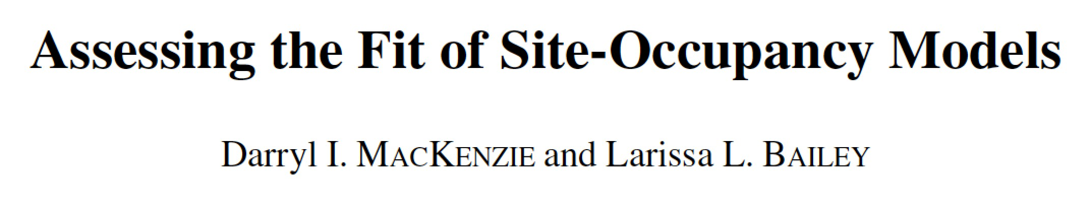
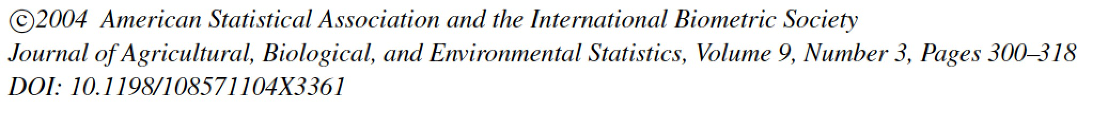
We did not cover…
How to choose sites? Occasions?
site selection
allocation of effort
design comparisons
survey timing
Goodness-of-fit testing
A few other models…
habitat and species occurrence dynamics, multistate, heterogeneity, …

Slide 86
References – methods & applications
Guillera-Arroita, G. (2017), Modelling of species distributions, range dynamics and communities under imperfect detection: advances, challenges and opportunities. Ecography, 40: 281-295.
Louvrier, J., C. Duchamp, V. Lauret, E. Marboutin, S. Cubaynes, R. Choquet, C. Miquel, O. Gimenez (2017). Mapping and explaining wolf recolonization in France using dynamic occupancy models and opportunistic data. Ecography. 41: 647-660.
MacKenzie, D. I., Nichols, J. D., Royle, J. A., Pollock, K. H., Bailey, L., & Hines, J. E. (2018). Occupancy estimation and modeling: Inferring patterns and dynamics of species occurrence, 2nd edition. San Diego, CA: Academic Press.
Miller, D. A. W., Nichols, J. D., Gude, J. A., Rich, L. N., Podruzny, K. M., Hines, J. E., & Mitchell, M. S. (2013). Determining occurrence dynamics when false positives occur: Estimating the range dynamics of wolves from public survey data. PLoS ONE, 8, e65808.
Rota, C. T., Fletcher Jr, R. J., Dorazio, R. M., & Betts, M. G. (2009). Occupancy estimation and the closure assumption. Journal of Applied Ecology, 46, 1173– 1181.

Slide 87
References – software
Doser, J. W., Finley, A. O., Kéry, M., & Zipkin, E. F. (2022). spOccupancy: An R package for single-species, multi-species, and integrated spatial occupancy models. Methods in Ecology and Evolution, 13, 1670– 1678.
Fiske, I., & Chandler, R. (2011). unmarked: An R Package for Fitting Hierarchical Models of Wildlife Occurrence and Abundance. Journal of Statistical Software, 43(10), 1–23.
Kellner, K.F., A.D. Smith, J.A. Royle, M. Kéry, J.L. Belant, R. B. Chandler (2023). The unmarked R package: Twelve years of advances in occurrence and abundance modelling in ecology. Methods in Ecology and Evolution. In Press.
Gimenez, O., Blanc, L., Besnard, A., Pradel, R., Doherty, P.F., Jr, Marboutin, E. and Choquet,
R. (2014), Fitting occupancy models with E-SURGE: hidden Markov modelling of presence– absence data. Methods in Ecology and Evolution, 5: 592-597.
Kellner, K. F., Fowler, N. L., Petroelje, T. R., Kautz, T. M., Beyer, D. E., & Belant, J. L. (2022). ubms: An R package for fitting hierarchical occupancy and N-mixture abundance models in a Bayesian framework. Methods in Ecology and Evolution, 13, 577– 584.

