Slide 1
Student Support Service Chatbot
Project Presentation with Frontend Views

Slide 2
What is it?
An AI chatbot for common student queries
Handles admissions, registration, support hours, and general FAQs
Built with Python, Flask, scikit-learn, and a responsive web UI

Slide 3
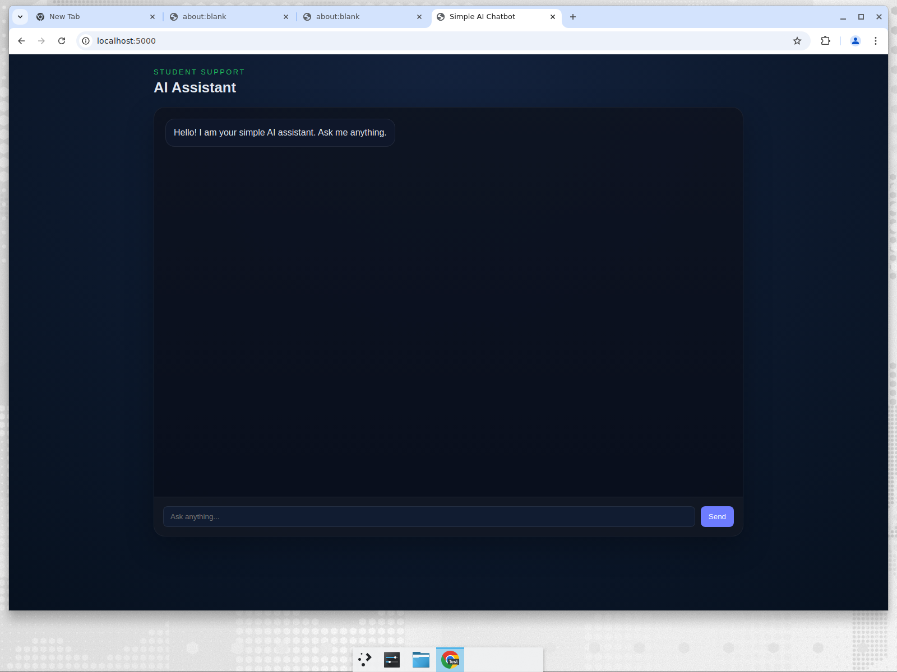
Frontend: Initial Chat View

Slide 4
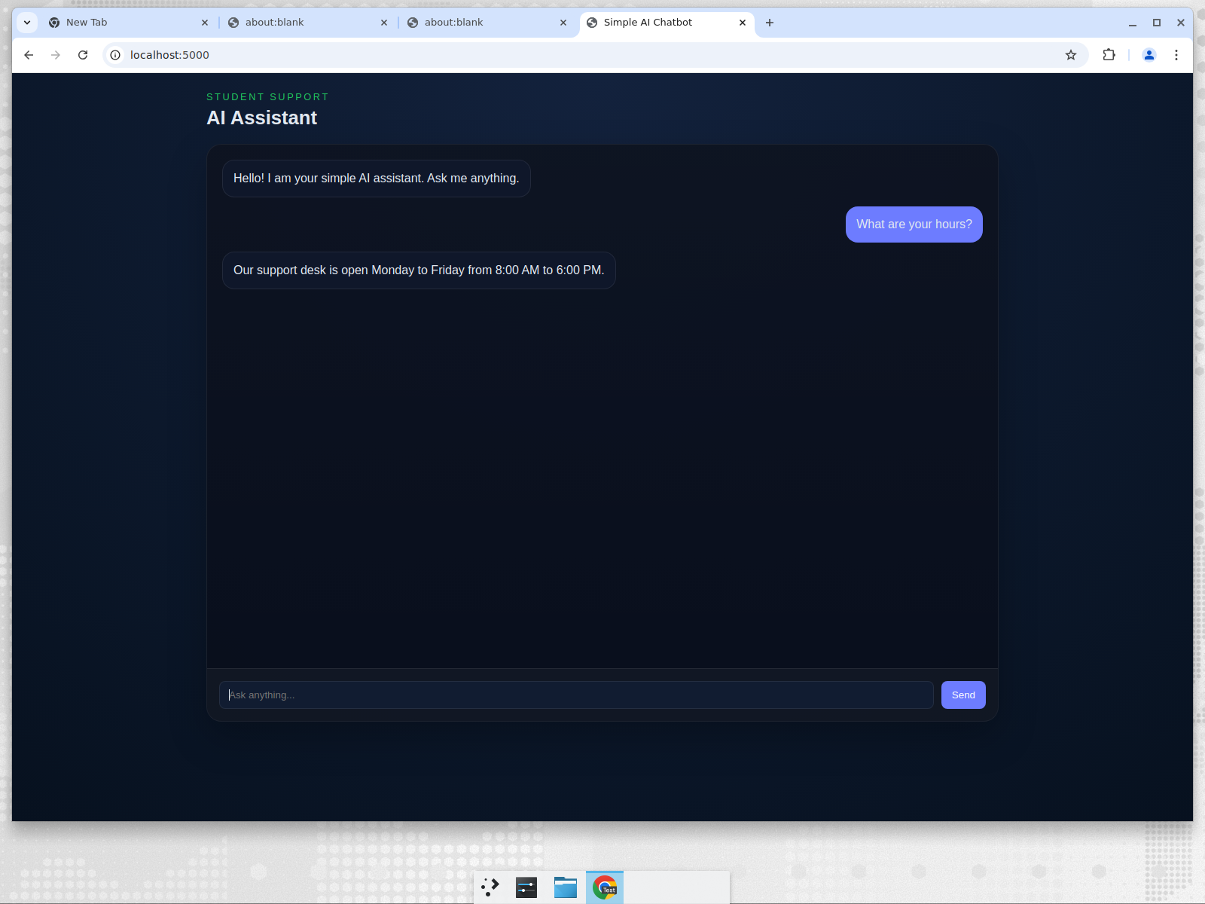
Conversation Demo

Slide 5
Tech Stack
Backend: Python + Flask
ML: scikit-learn (TF-IDF + Logistic Regression), joblib
Frontend: HTML, CSS, JavaScript
External AI: Google Gemini API (optional)
Testing: Python unittest

Slide 6
How it works
Browser sends message to Flask API
Response order:
1. ML classifier predicts the intent
2. Regex rule patterns match common FAQs
3. Optional Gemini API fallback

Slide 7
Deployment & Future
Run: pip install -r requirements.txt && python app.py
Open http://localhost:5000
Future: expand FAQs, add history/database, multi-language, cloud deploy

