Slide 1
Student Support Service Chatbot
Project Presentation with Frontend Views
Presented by [Devesh Chaudhary] | [CSE26 /AKTU]

Slide 2

What is it?
An AI chatbot for common student queries
Handles admissions, registration, support hours, and general FAQs
Built with Python, Flask, scikit-learn, and a responsive web UI

Slide 3
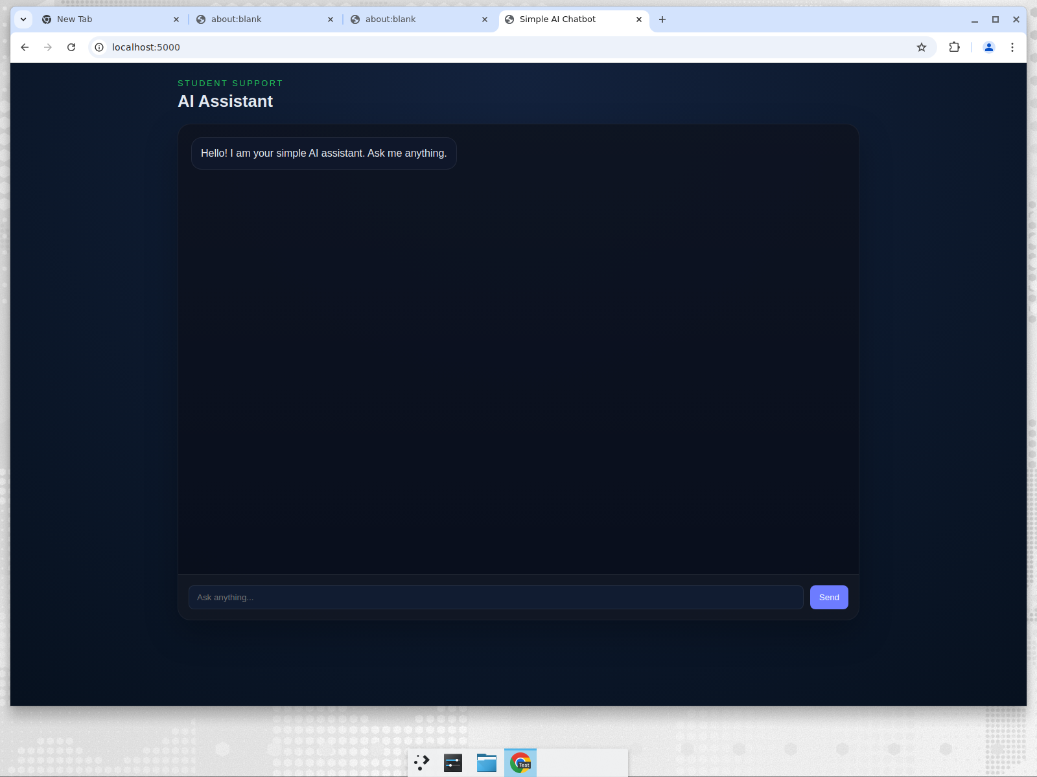
Frontend: Initial Chat View
Landing chat view — ask anything via the web interface

Slide 4
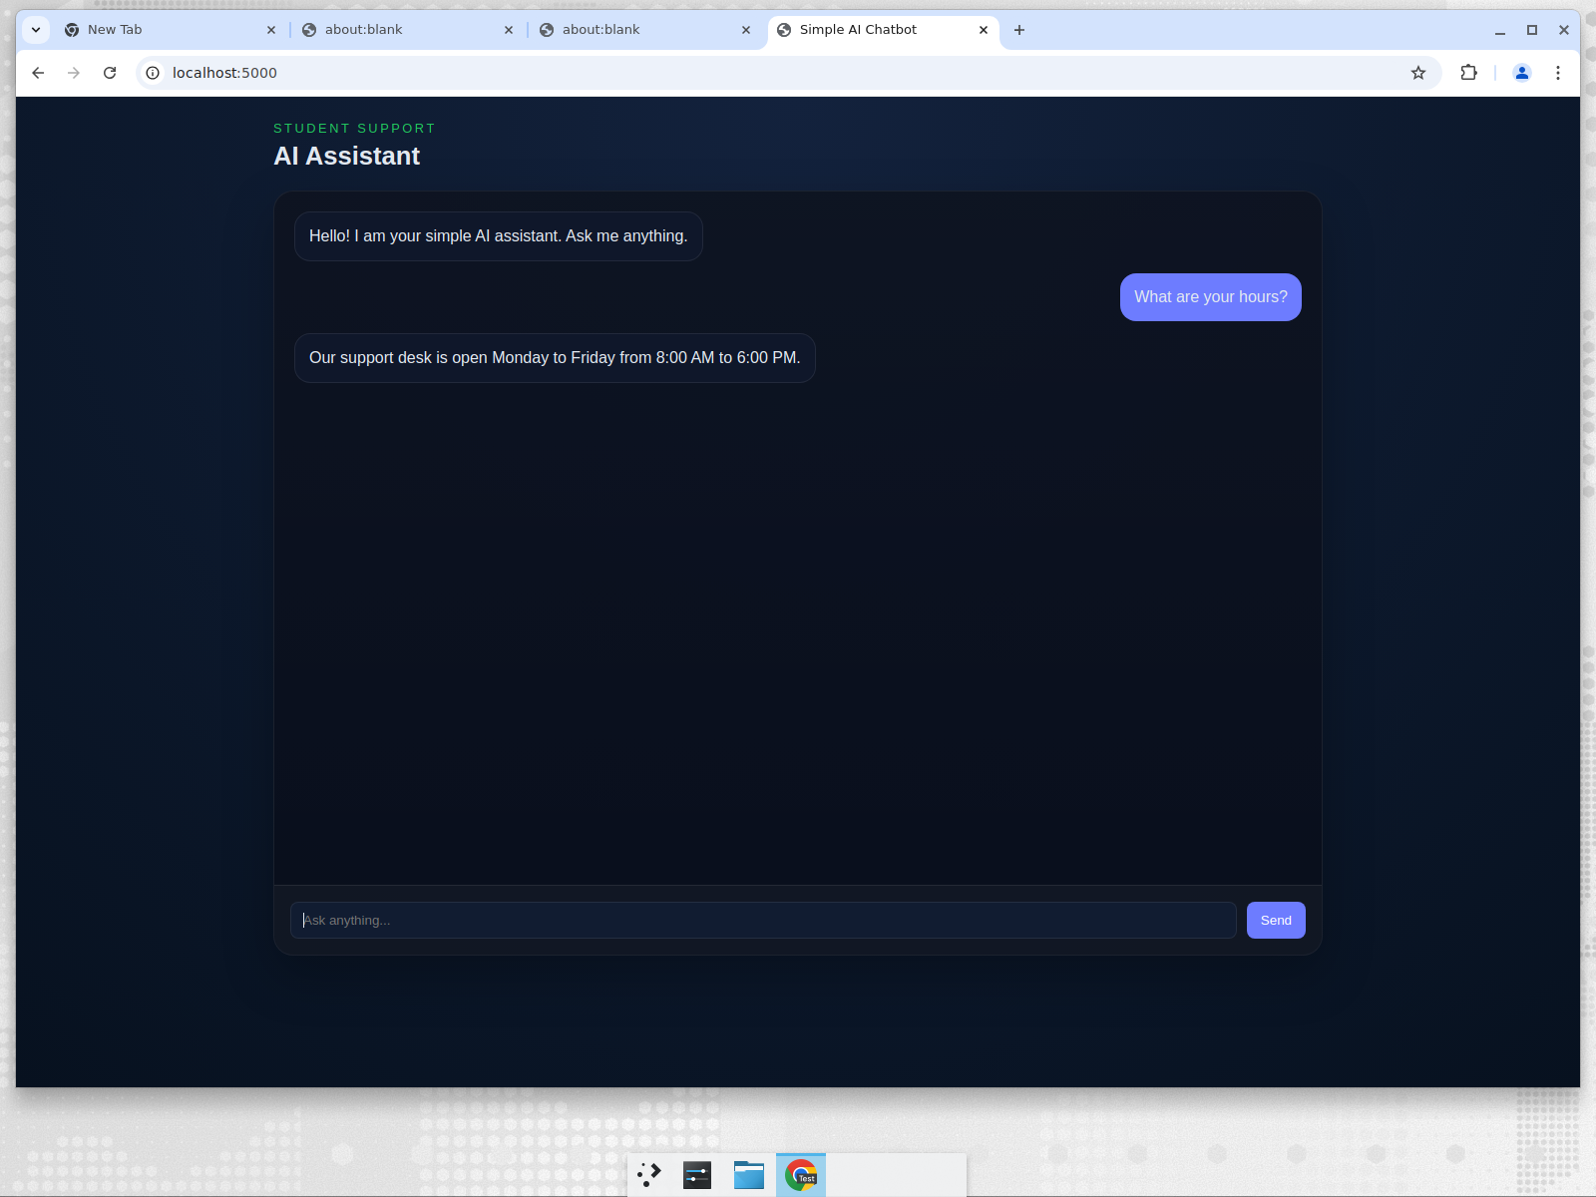
Conversation Demo
Example Q&A showing support hours response

Slide 5
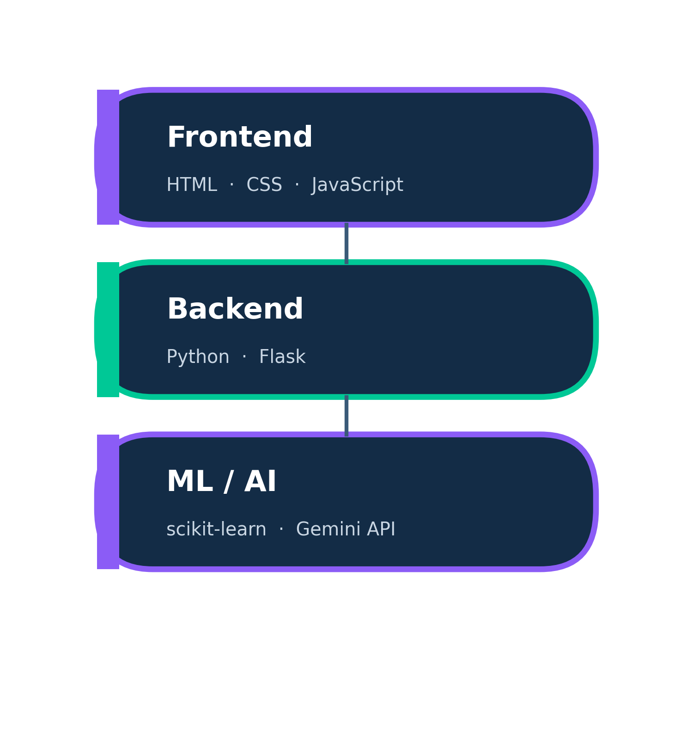
Tech Stack
Backend: Python + Flask
ML: scikit-learn (TF-IDF + Logistic Regression), joblib
Frontend: HTML, CSS, JavaScript
External AI: Google Gemini API (optional)
Testing: Python unittest

Slide 6
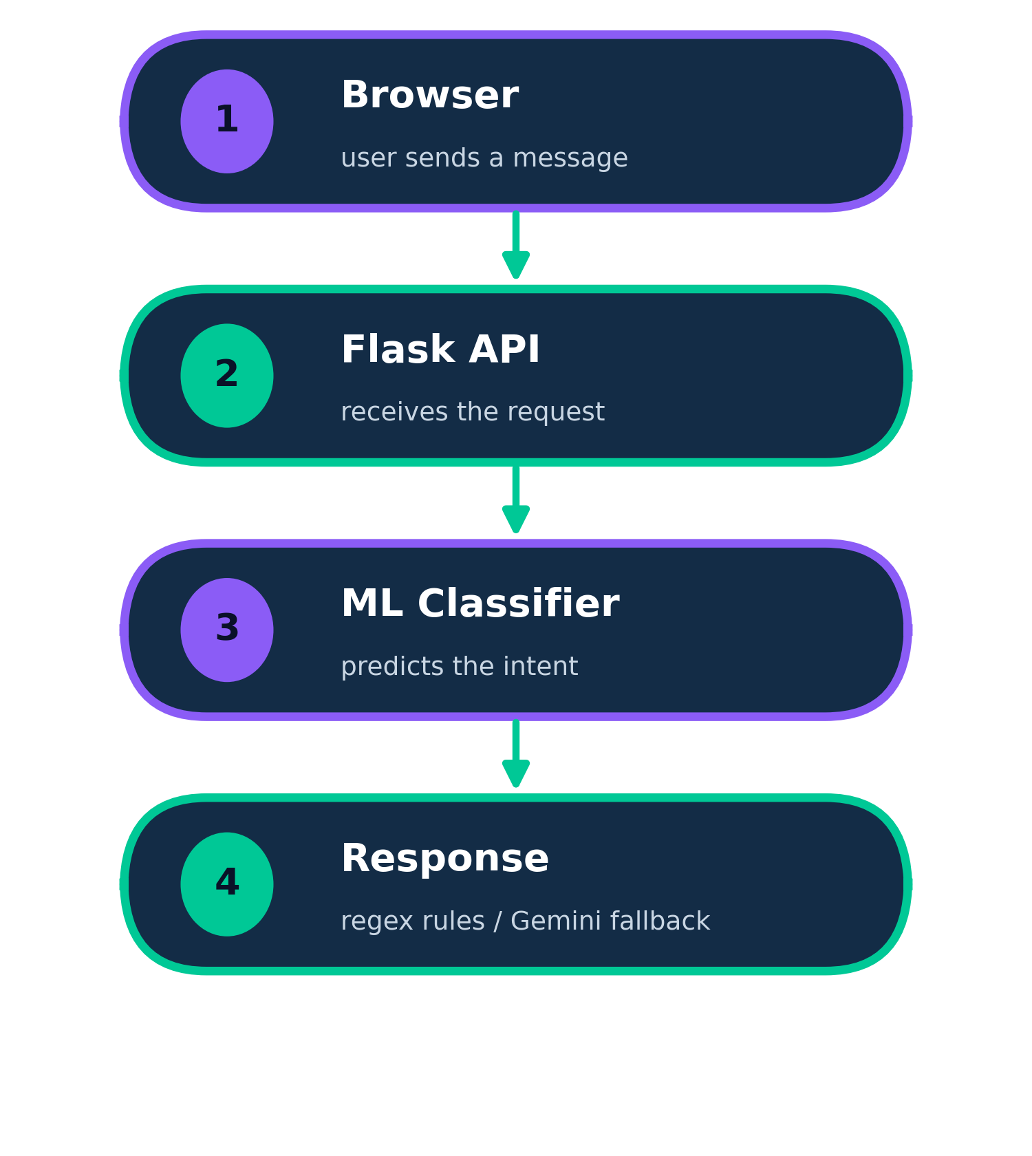
How it works
Browser sends a message to the Flask API
Response order:
1. ML classifier predicts the intent
2. Regex rule patterns match common FAQs
3. Optional Gemini API fallback

Slide 7
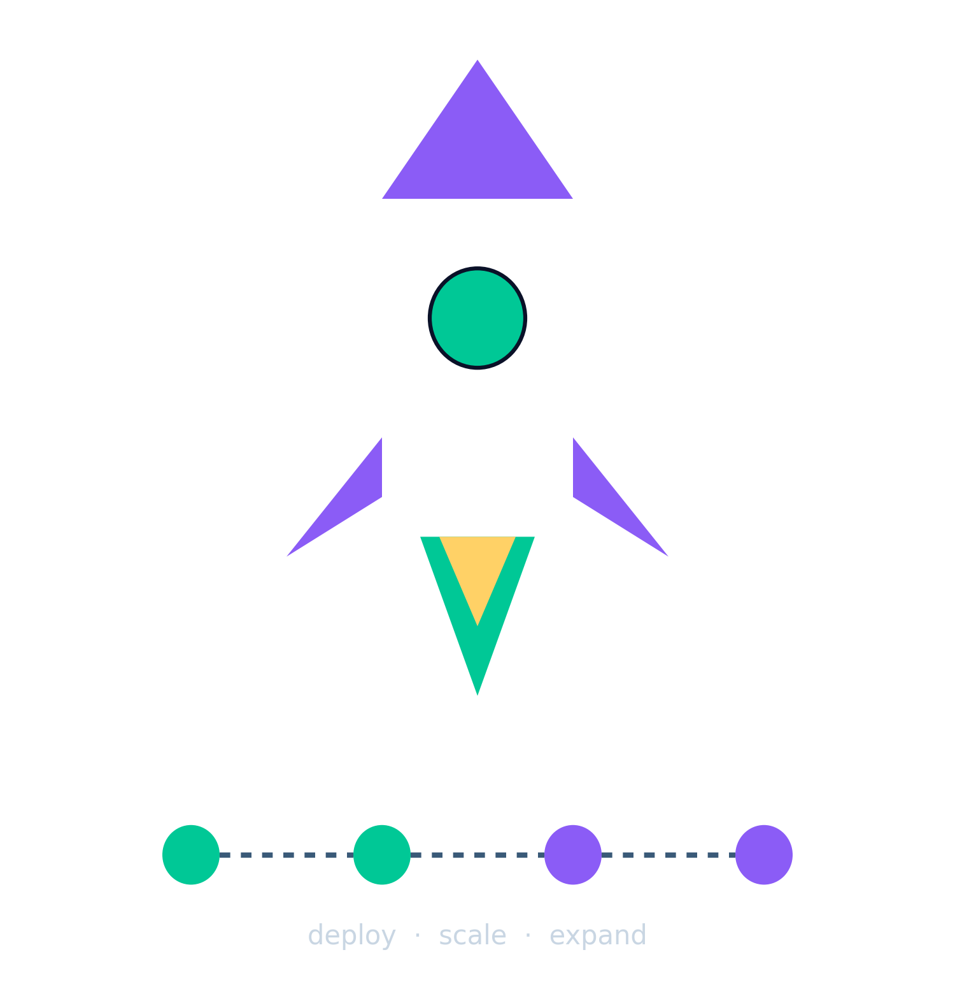
Deployment & Future
Run: pip install -r requirements.txt && python app.py
Open http://localhost:5000 in a browser
Future: expand FAQs, add conversation history/database
Future: multi-language support and cloud deploy

Slide 8
Thank You
Questions & Discussion
[https://github.com/dvrajgit/dev-student-support-service-chatbot]

