Slide 1
Student Support Service Chatbot
Tools & Libraries Used
An AI-powered student help desk • Flask + scikit-learn + Groq LLM

Slide 2
Project Overview
What it is
A web-based student support assistant that answers questions about college services, academics and internships through a simple chat interface.
How it answers – three layers
• ML intent model (scikit-learn TF-IDF + Logistic Regression) for common queries
• Rule-based regex patterns as a fast fallback
• Groq LLM (llama-3.1) for Academic & Internship modes, grounded on local JSON data
Chat modes
General • Academic (university data) • Internship (live-style listings)
Extras
Session login, browser-stored API key, and a unit-test suite.

Slide 3
How It Works
Browser UI
HTML / CSS / JS
Flask API
/api/chat, login
Chatbot Engine
ML → rules → LLM
Response
text reply
Groq LLM API and JSON knowledge files (university_data.json, internship_template.json) power the Academic and Internship modes; joblib loads the pre-trained scikit-learn pipeline.

Slide 4
Tech Stack at a Glance
Backend
• Python
• Flask
• requests
Machine Learning
• scikit-learn
• joblib
AI / LLM
• Groq API (llama-3.1)
Frontend
• HTML5
• CSS3
• JavaScript
Data
• JSON files
Testing
• unittest

Slide 5
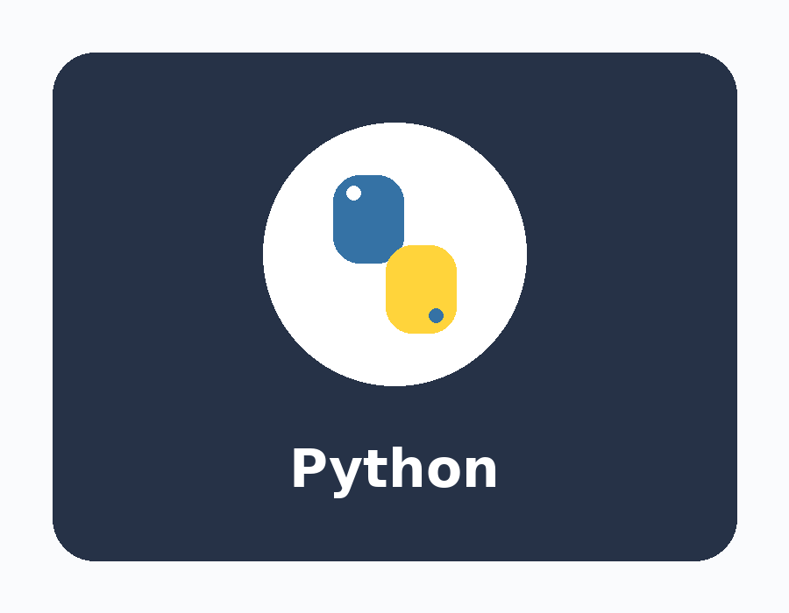
Python
Core programming language
• Runs the backend server and the ML training script
• Standard library: re, json, random, datetime for logic & data handling

Slide 6

Flask
Lightweight web framework
• Serves the static frontend and JSON REST API
• Routes: /api/login, /api/logout, /api/session, /api/chat
• Uses server-side sessions for login state

Slide 7

scikit-learn
Machine learning toolkit
• TfidfVectorizer + LogisticRegression in a Pipeline
• Classifies a message into an intent (greeting, hours, registration...)
• Trained by train_model.py

Slide 8
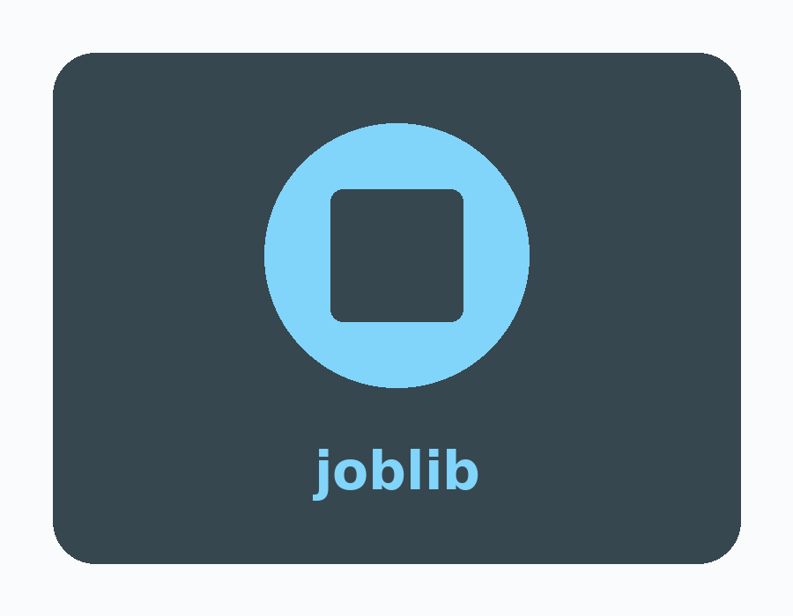
joblib
Model persistence
• Saves & loads the trained pipeline and responses
• Files: model/pipeline.joblib, model/responses.joblib
• Lets the app skip re-training at startup

Slide 9

requests
HTTP client library
• Calls the Groq chat-completions REST endpoint
• Sends the API key as a Bearer token with a 30s timeout
• Handles HTTP errors (rate limit, auth) gracefully

Slide 10
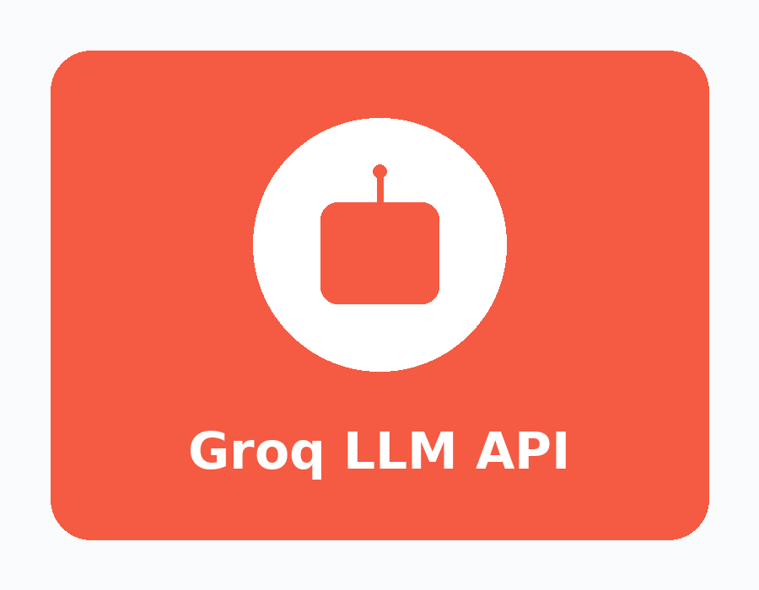
Groq LLM API
Large language model service
• Powers Academic & Internship modes (model: llama-3.1-8b-instant)
• Prompts are grounded on local university & internship JSON data
• Key supplied via env var or saved in the browser

Slide 11
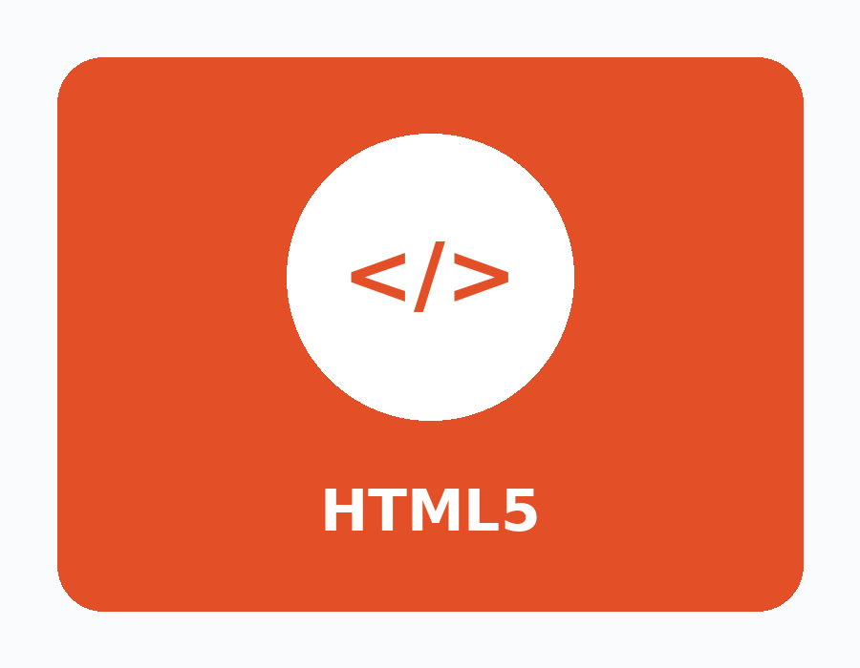
HTML5
Page structure
• index.html builds the login panel and chat UI
• Semantic markup with accessible labels & aria attributes

Slide 12
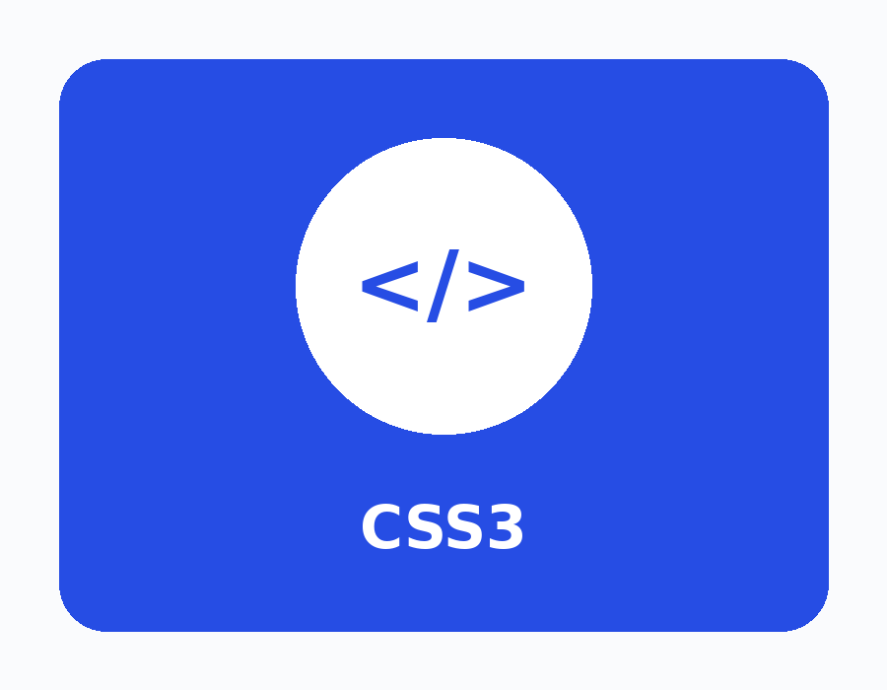
CSS3
Styling & layout
• styles.css themes the login card, chat bubbles and mode buttons
• Responsive, modern look with no CSS framework

Slide 13
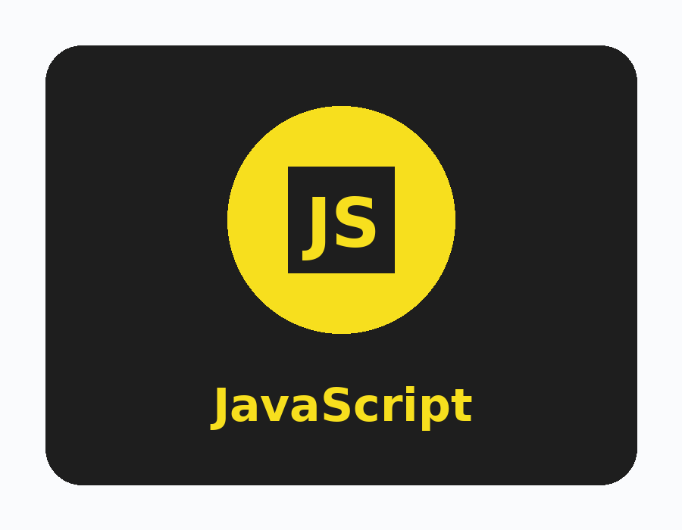
JavaScript (Vanilla)
Frontend logic
• app.js handles login, chat, typing indicator and mode switching
• Uses the Fetch API to talk to the Flask backend
• Stores the Groq API key in localStorage

Slide 14

JSON Data
Knowledge files
• university_data.json grounds Academic answers
• internship_template.json feeds the live-style internship feed
• Loaded and injected into LLM prompts

Slide 15
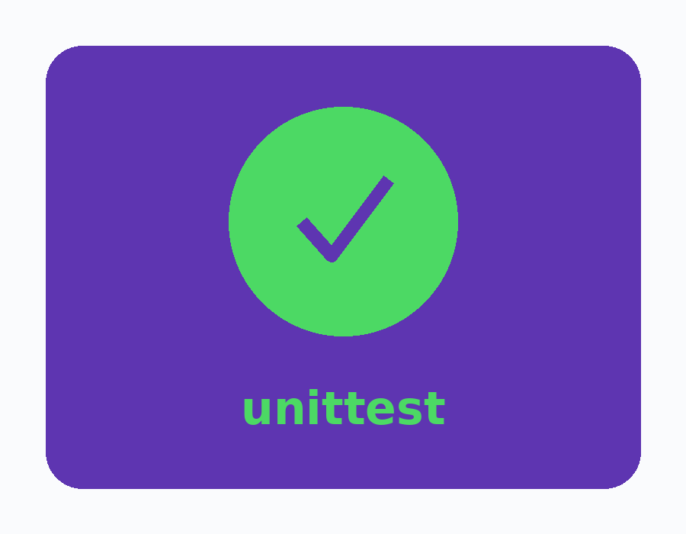
unittest
Automated testing
• tests/ verify chatbot replies and login-protected chat
• Mocks Groq calls and checks the API key is never leaked

Slide 16
Summary
A compact full-stack AI app built from focused, well-known tools:
• Python + Flask – backend & REST API
• scikit-learn + joblib – ML intent classification
• requests + Groq LLM – smart, grounded answers
• HTML / CSS / JavaScript – the chat interface
• JSON data + unittest – knowledge & quality
Simple to run: python app.py → http://127.0.0.1:5000/

