Slide 1

Linux Networking –
Revisão Rápida
SENAI - INFRAESTRUTURA ÁGIL
DENNY R S VRIESMAN – 2019
dvriesman@gmail.com

Slide 2
Switching
A
B

Slide 3
Switching
A
B

Slide 4
Switching
A
B
eth0
eth0
ip link
ip link

Slide 5
Switching
A
B
eth0
eth0
192.168.1.10
192.168.1.11
ip link
ip link
ip addr add 192.168.1.10/24 dev eth0
ip addr add 192.168.1.11/24 dev eth0

Slide 6
Routing
A
B
eth0
eth0
192.168.1.10
192.168.1.11
192.168.1.0
C
D
eth0
eth0
192.168.3.15
192.168.3.16
192.168.3.0

Slide 7
Routing
A
B
eth0
eth0
192.168.1.10
192.168.1.11
192.168.1.0
192.168.1.1
eth0
192.168.3.1
eth1
C
D
eth0
eth0
192.168.3.15
192.168.3.16
192.168.3.0

Slide 8
Routing
root@A~ route
Kernel ip routing table
Destination Gateway Genmask Flags Metrics Flag Use iface
root@A~ ip route add 192.168.3.0/24 via 192.168.1.1 dev eth0
root@A~ route
Kernel ip routing table
Destination Gateway Genmask Flags Metrics Use iface
192.168.3.0 192.168.1.1 255.255.0.0 UG 0 0 eth0
A
B
eth0
eth0
192.168.1.10
192.168.1.11
192.168.1.0
192.168.1.1
eth0
192.168.3.1
eth1
C
D
eth0
eth0
192.168.3.15
192.168.3.16
192.168.3.0

Slide 9
Routing
root@C~ route
Kernel ip routing table
Destination Gateway Genmask Flags Metrics Flag Use iface
root@C~ ip route add 192.168.1.0/24 via 192.168.3.1 dev eth0
root@C~ route
Kernel ip routing table
Destination Gateway Genmask Flags Metrics Use iface
192.168.1.0 192.168.3.1 255.255.0.0 UG 0 0 eth0
A
B
eth0
eth0
192.168.1.10
192.168.1.11
192.168.1.0
192.168.1.1
eth0
192.168.3.1
eth1
C
D
eth0
eth0
192.168.3.15
192.168.3.16
192.168.3.0

Slide 10
Routing
Internet
216.134.23.0
Internet
16.44.53.0
A
B
eth0
eth0
Internet
172.217.194.0
192.168.1.10
192.168.1.11
192.168.1.0
192.168.1.1
eth0
192.168.3.1
eth1
C
D
eth0
eth0
192.168.3.15
192.168.3.16
192.168.3.0

Slide 11
Routing
root@C~ route
Kernel ip routing table
Destination Gateway Genmask Flags Metrics Flag Use iface
root@C~ ip route add default via 192.168.3.1 dev eth0
root@C~ route
Kernel ip routing table
Destination Gateway Genmask Flags Metrics Use iface
default 192.168.3.1 255.255.0.0 UG 0 0 eth0
192.168.3.0 0.0.0.0 255.255.0.0 UG 0 0 eth0
A
B
eth0
eth0
192.168.1.10
192.168.1.11
192.168.1.0
192.168.1.1
eth0
192.168.3.1
eth1
C
D
eth0
eth0
192.168.3.15
192.168.3.16
192.168.3.0

Slide 12
Routing
A
B
eth0
eth0
Internet
192.168.1.10
192.168.1.11
192.168.1.0
192.168.1.1
eth0
192.168.3.1
eth1
echo 1 > /proc/sys/net/ipv4/ip_forward
etc/sysctl.conf
C
D
eth0
eth0
192.168.3.15
192.168.3.16
192.168.3.0

Slide 13
NAT – Network Address Translation
A
B
eth0
eth0
Internet
192.168.1.10
192.168.1.11
192.168.1.0
192.168.1.1
eth0
192.168.3.1
eth1
PROTO | IP interno | Porta Interna | Ip Externo | Porta Externa | Porta NAT
TCP | 192.168.1.10 | 32212 | 208.84.244.116 | 80 | 8008
C
D
#~ Iptables
eth0
#~ Iptables -t nat
eth0
192.168.3.15
192.168.3.16
192.168.3.0

Slide 14
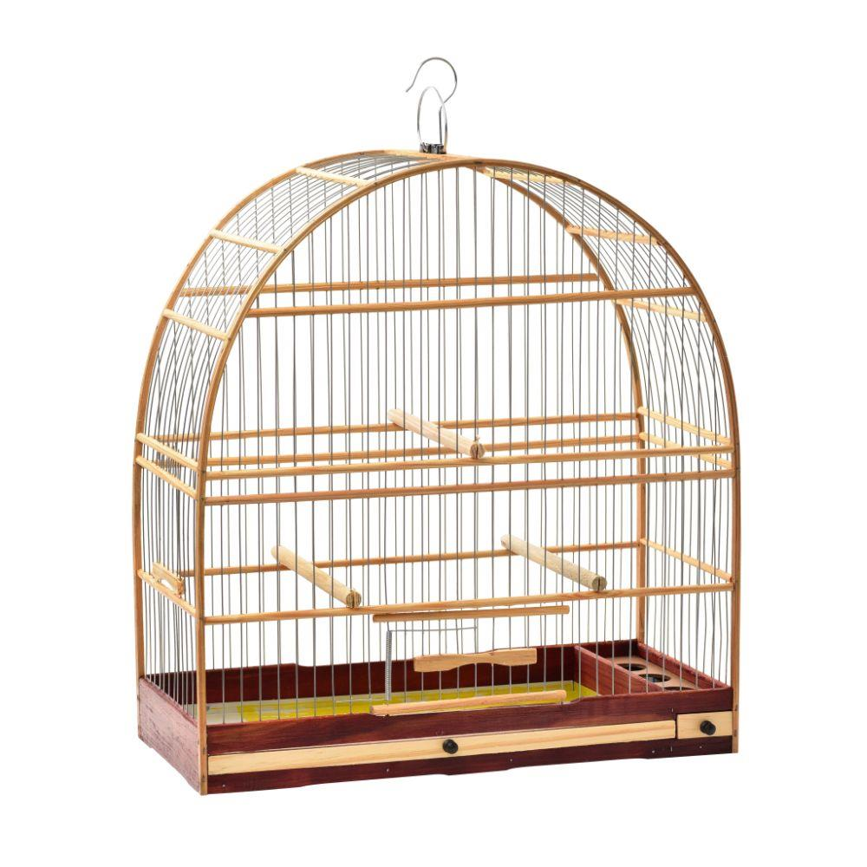
Linux - Network Namespace
SENAI - INFRAESTRUTURA ÁGIL
DENNY R S VRIESMAN – 2019
dvriesman@gmail.com

Slide 15
Namespace
==> Processos
==> Pontos de Montagem
==> Rede (Tabela de Roteamento, Table ARP, Interfaces).
==> cgroups
==> etc….
ls -al /proc/20932/ns

Slide 16
Criando novas namespaces de rede
root@machine~ ip netns add green
root@machine~ ip netns add yellow
eth0
root@machine~ ip netns
green
yellow

Slide 17
exec na namespaces
root@machine~ ip link
lo: ...
eth0: ...
root@machine~ ip netns exec green ip link
lo: ...
root@machine~ ip netns exec green ip link
lo: ...
root@machine~ ip netns exec green ip link
lo: ...
eth0
root@machine~ ip netns
green
yellow
root@machine~ ip -n yellow link
lo: ...
** Tentem ver a tabela arp e a tabela de rotas
Na namespace host, no green e no yellow

Slide 18
Virtual cable
root@machine~ ip link add veth-green type veth peer name veth-yellow
ip link list
root@machine~ ip link set veth-green netns green
veth-green
veth-yellow
eth0
root@machine~ ip netns
green
yellow
root@machine~ ip link set veth-yellow netns yellow

Slide 19
Atribuindo IP
root@machine~ ip -n green addr add 192.168.15.1/24 dev veth-green
veth-green
veth-yellow
192.168.15.1
192.168.15.2
root@machine~ ip -n yellow addr add 192.168.15.2/24 dev veth-yellow
eth0
root@machine~ ip netns
green
yellow
root@machineroot@machine~ ip -n yellow link set veth-yellow up
root@machineroot@machine~ ip -n green link set veth-green up

Slide 20
Ping
root@machine~ ip netns exec green ping 192.168.15.2
veth-green
veth-yellow
192.168.15.1
192.168.15.2
** Tentem fazer ping do namespace
yellow para 192.168.15.1
** Verifiquem a tabela ARP de ambas
as namespaces e da namespace default
eth0
root@machine~ ip netns
green
yellow

Slide 21

E se tivermos mais namespaces?
root@machine~ ip netns exec green ping 192.168.15.2
eth0
root@machine~ ip netns
green
yellow
LINUX BRIDGE

Slide 22
Criando a bridge
# Apaga o cabo virtual anterior
~ ip -n green link del veth-green
#Cria a bridge e deixa de pé
~ ip link add v-net-0 type bridge
~ ** brctl addbr v-net-0 **
~ ip link set dev v-net-0 up
root@machine~ ip netns exec green ping 192.168.15.2
eth0
root@machine~ ip netns
green
yellow
v-net-0

Slide 23
Criando novos cabos
ip link add veth-green type veth peer name veth-green-br
ip link add veth-yellow type veth peer name veth-yellow-br
ip link add veth-red type veth peer name veth-red-br
ip link add veth-blue type veth peer name veth-blue-br
root@machine~ ip netns exec green ping 192.168.15.2
eth0
root@machine~ ip netns
green
yellow
v-net-0

Slide 24
Ligando os cabos nas namespaces
ip link set veth-green netns green
ip link set veth-yellow netns yellow
ip link set veth-red netns red
ip link set veth-blue netns blue
root@machine~ ip netns exec green ping 192.168.15.2
veth-green
veth-yellow
eth0
root@machine~ ip netns
green
yellow
v-net-0
veth-red
veth-blue

Slide 25
Ligando os cabos na bridge
ip link set veth-green-br master v-net-0
ip link set veth-green-br up
ip link set veth-yellow-br master v-net-0
ip link set veth-yellow-br up
ip link set veth-red-br master v-net-0
ip link set veth-red-br up
ip link set veth-blue-br master v-net-0
ip link set veth-blue-br up
root@machine~ ip netns exec green ping 192.168.15.2
veth-green
veth-yellow
veth-green-br
veth-yellow-br
eth0
veth-red-br
veth-blue-br
root@machine~ ip netns
green
yellow
v-net-0
veth-red
veth-blue

Slide 26
Atribuindo IPS e levantando
ip -n green addr add 192.168.15.10/24 dev veth-green
ip -n green link set veth-green up
ip -n yellow addr add 192.168.15.11/24 dev veth-yellow
ip -n yellow link set veth-yellow up
ip -n red addr add 192.168.15.12/24 dev veth-red
ip -n red set link veth-red up
ip -n blue addr add 192.168.15.13/24 dev veth-blue
ip -n blue set link veth-blue up
192.168.15.10
192.168.15.11
root@machine~ ip netns exec green ping 192.168.15.2
veth-green
veth-yellow
veth-green-br
veth-yellow-br
eth0
veth-red-br
veth-blue-br
root@machine~ ip netns
green
yellow
v-net-0
192.168.15.12
192.168.15.12
192.168.15.13
veth-red
veth-blue

Slide 27
Linux Bridge
ping 192.168.15.10 ?
192.168.15.10
192.168.15.11
veth-green
veth-yellow
ip addr add 192.168.15.5/24 dev v-net-0
veth-green-br
veth-yellow-br
192.168.15.5
eth0
veth-red-br
veth-blue-br
root@machine~ ip netns
green
yellow
v-net-0
192.168.15.12
192.168.15.12
192.168.15.13
veth-red
veth-blue

Slide 28
Tráfego namespace para fora
ip netns exec blue ping 8.8.8.8 ?
192.168.15.10
192.168.15.11
veth-green
veth-yellow
ip netns exec blue route ?
veth-green-br
veth-yellow-br
O HOST tem a interface de rede que leva para fora !!!
192.168.15.5
eth0
veth-red-br
veth-blue-br
root@machine~ ip netns
green
yellow
v-net-0
192.168.15.12
ip netns exec blue ip route add default via 192.168.15.5 dev veth-blue
192.168.15.12
192.168.15.13
veth-red
veth-blue

Slide 29
Tráfego namespace para fora NAT
ip netns exec blue ping 8.8.8.8 ?
192.168.15.10
192.168.15.11
veth-green
veth-yellow
ip netns exec blue route ?
Faltou o NAT
veth-green-br
veth-yellow-br
192.168.15.5
eth0
veth-red-br
veth-blue-br
root@machine~ ip netns
green
yellow
v-net-0
192.168.15.12
iptables -t nat -A POSTROUTING -s 192.168.15.0/24 -j MASQUERADE
192.168.15.12
192.168.15.13
veth-red
veth-blue

Slide 30
Tráfego fora para dentro
E como um host externo vai acessar um serviço rodando na namespace GREEN ? 192.168.15.10 ?
192.168.15.10
192.168.15.11
veth-green
veth-yellow
No modelo Docker - Não vai acessar diretamente, somente através do HOST
veth-green-br
veth-yellow-br
192.168.15.5
eth0
Port Masquerade
veth-red-br
root@machine~ ip netns
green
yellow
v-net-0
veth-blue-br
192.168.15.12
iptables -t nat -A POSTROUTING --dport 80 --to-destination 192.168.15.13 -j DNAT
192.168.15.12
192.168.15.13
veth-red
veth-blue

Slide 31
Limpando o LAB
ip netns del yellow
ip netns del green
ip netns del blue
ip netns del red
ip link del v-net-0
iptables -t nat -D POSTROUTING 1

Slide 32
DevOps Automatiza tudo… praticando...
Crie um shellscript que cria 2 namespaces de rede, cria interfaces de rede para elas e as conectas em uma bridge senai-br
As namespaces deverão ter conexão com o mundo exterior.
Não é necessário fazer o mundo exterior se comunicar com as namespaces.

Slide 33

Redes no Docker
DENNY R S VRIESMAN – 2019
dvriesman@gmail.com

Slide 34
Redes no Docker
Sem rede:
docker run --network none nginx
Com a rede do Host (namespace default)
docker run --network host nginx
Com uma rede Bridge:
docker run nginx

Slide 35
Redes no Docker
~ docker network ls
---
df3f7d9776de bridge bridge local
ba890342ade3 host host local
25a65622674b nanobox bridge local
~ ip link
=> docker0 DOWN
O que acontece se dermos um “ip netns list” após subir um container ?

Slide 36
Acessando as namespaces de rede do docker
Vamos rodar um container
~ docker run –name nginx -d nginx
Vamos pegar o PID do container
~ pid=$(docker inspect -f '{{.State.Pid}}' "nginx")
Vamos criar um link com o sistema netns
~ln -sf /proc/$pid/ns/net "/var/run/netns/nginx"
O que acontece se dermos um “ip netns list” ?

Slide 37
Criando/Removendo uma nova rede docker
docker network create \
--driver=bridge \
--subnet=172.28.0.0/16 \
--ip-range=172.28.5.0/24 \
--gateway=172.28.5.254 \
my-personal-network
docker network rm my-personal-network

Slide 38
Exercício...
Instâncie o container dvriesman/xapi:2.0 numa rede 10.2.2.0/24
Exponha a porta 80 do container
Verifique o resultado de pingar esse container através de um container iterativo na rede default. (use o alpine – é mais leve).
Verifique o resultado de pingar esse container através de um container iterativo na rede 10.2.2.0/24.

