Slide 1
Python General operations to process data
For drawing the charts and processing csv files

Slide 2
Preparation: Basic

Slide 3
String operations
split() and join()
str_to_list = ‘value1:value2:value3’.split(‘:’)
List_to_str = ‘:’.join(str_to_list)
replace()
list_to_str = list_to_str.replace(‘value1’, ‘value5’)
strip(), lstrip(), rstrip()
list_to_str=list_to_str.strip(‘3’)
lower(), upper(), islower(), isupper(), capitalize(), swapcase()
startswith(), endswith()
ljust)(), rjust(), center()
count()
Text=‘hello’
Test.count(‘l’)
index()
isalnum(), isalpha(), isdigit(), isprintable()

Slide 4
LIST operations
Add an item to a list
my_list.append(item)
Add a list to a list
my_list.entend([‘hello’, 1, 3])
Remove the duplicated items in the list and keep the original order
sorted(set(old_list), key=lambda x: old_list.index(x))
List slicing
my_list = [‘a’, ‘b’, ‘c’, ‘d’, ‘e’, ‘f’, ‘g’]
print(my_list[2:5]) #list index starts from 0. It will print the 3rd and the 4th items
[‘c’, ‘d’]
print(my_list[3:]) #items from the 4th item to the end
[‘d’, ‘e’, ‘f’, ‘g’]
print(my_list[:]) #items from beginning to the end
Print(my_list[:-2] #items from beginning to the second last item (not include it)
insert(), remove(), pop(), clear(), index(), count(), sort(), reverse(), copy()
del the 2nd item
del my_list[1]
Check item in the list
if(item in my_list)
for item in my_list

Slide 5
String operations
Samples
my_list=[a.upper() for a in my_list]
new_x_list=[old_list[int(x)] if x.isdigit() and int(x) < len(old_list) else x.lower() for x in x_list]

Slide 6
Pandas dataframe

Slide 7
Convert a file to dataframe
import pandas as pd
import os.path
from os import path
def is_file(file):
return path.isfile(file)
def get_df(file, sep=','):
return pd.read_csv(file, encoding="ISO-8859-1", sep=sep, low_memory=False)

Slide 8
Topic1:Math operations

Slide 9

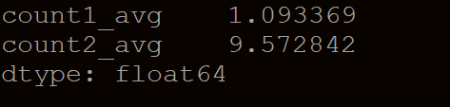

Mean(), max(), min(), sum(), description()
When we have columns count1, count2.., we want to get the mean, max, min, sum or description. We can do the following:
df[[‘count1’]].mean()
df[[‘count1’, ‘count2’]].sum()
Step1: Read the file and convert the file to a pandas dataframe
Step2: Access the columns. E.g, column “count1” can be accessed:
df = pd.read_csv(“example.csv”, …)
print(df[[‘count1’]].mean()) OK. Print a dataframe with mean value of column count1
print(df[[‘count’, ‘count2’]].mean()) OK. Print a dataframe with mean values of column count1 and count2
df[[‘count’]] is a dataframe with one column ‘count1’. df[‘count’] is a series
print(df[‘count1’].mean()) OK. Print a float value
df[‘count1’, ‘count2’] is invalid
print(df[‘count1’, ‘count2’].mean()) KEY ERROR

Slide 10

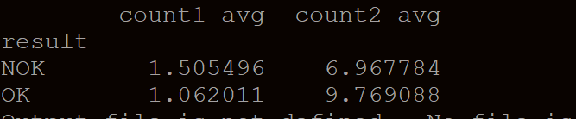
Mean, max, min, sum, description – groupby – mean()
When we have columns count1, count2 and groupby columns count3, count4, we want to get the mean, max, min, sum or description. We can do the following:
df.groupby([‘count3, count4’])[[‘count1’, ‘count2’]].mean().reset_index()
Sample:
df.groupby(‘result’)[[‘count1’, ‘count2’]].mean().reset_index()
If we don’t call reset_index(), it will have multiple column index as below:

Slide 11
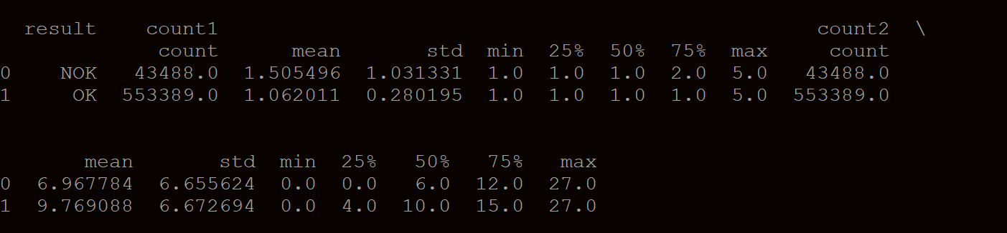
Mean, max, min, sum, description – groupby – describe()
When we have columns count1, count2 and groupby columns count3, count4, we want to get the mean, max, min, sum or description. We can do the following:
df.groupby([‘count3, count4’])[[‘count1’, ‘count2’]]. description().reset_index()
Sample:
df.groupby(‘result’)[[‘count1’, ‘count2’]]. description().reset_index()
Called “reset_index()” but still gets multiple index. How to make it to be single level of column???

Slide 12
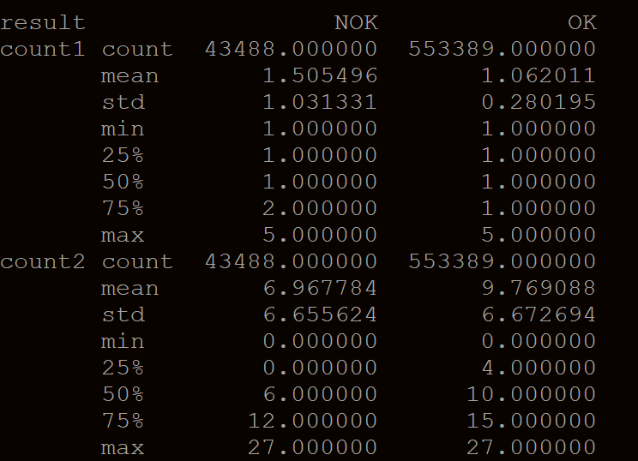
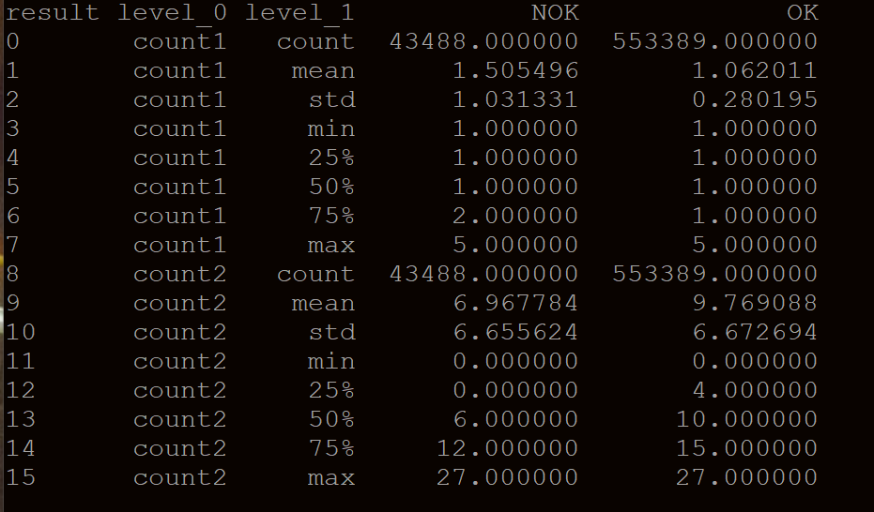
Mean, max, min, sum, description – groupby – describe()Option one
Using transpose()
df.groupby([‘count3, count4’])[[‘count1’, ‘count2’]]. description().reset_index().transpose().reset_index().transpose()
Sample:
df.groupby(‘result’)[[‘count1’, ‘count2’]]. description().reset_index().transpose().reset_index().transponse()
After first transpose(): After reset_index() and second transpose():

Slide 13
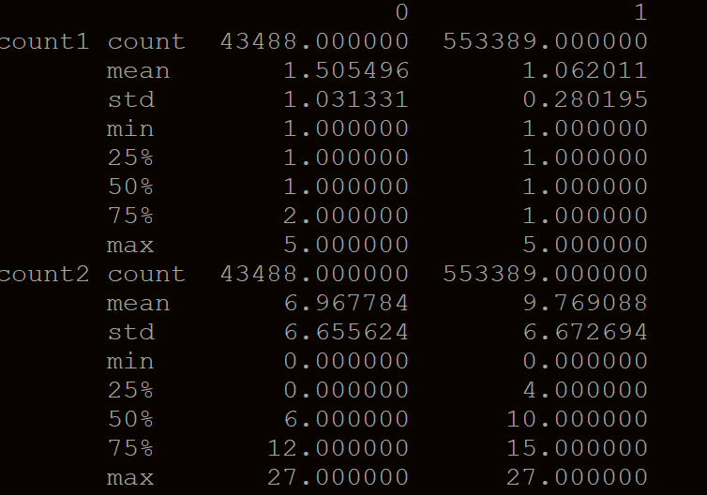
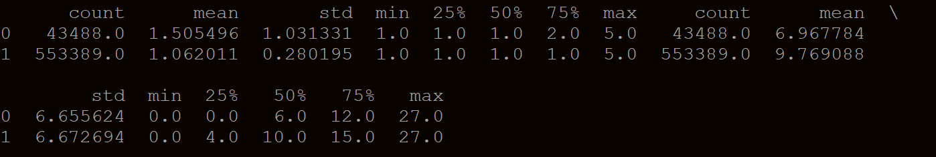
Mean, max, min, sum, description – groupby – describe() continue
Using transpose()
df.groupby([‘count3, count4’])[[‘count1’, ‘count2’]]. description().reset_index().transpose().reset_index().transpose()
Sample:
df.groupby(‘result’)[[‘count1’, ‘count2’]]. description().reset_index(level=0, drop=True).transpose().reset_index(level=0, drop=True).transponse()
After first transpose(): After second transpose():
The problem is we will have duplicated column names for count1 and count2

Slide 14
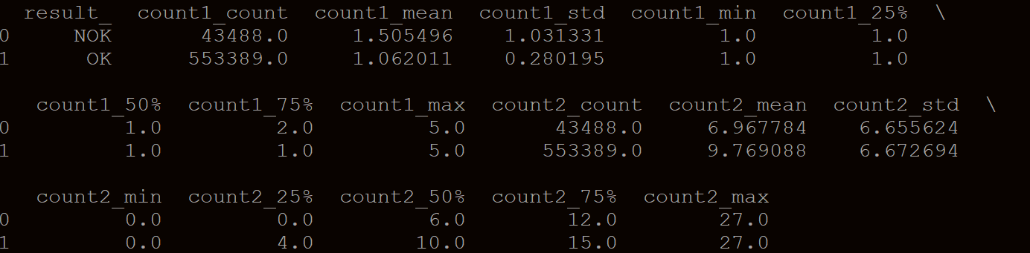
Mean, max, min, sum, description – groupby – describe()Option Two
Modify columns to pair multiple columns to one
df.groupby([‘count3, count4’])[[‘count1’, ‘count2’]]. description().reset_index()
df.columns = [“_”.join(pair) for pair in df.columns]
Sample:
df.groupby(‘result’)[[‘count1’, ‘count2’]]. description().reset_index()
df.columns = [“_”.join(pair) for pair in df.columns]
print(df)

