Slide 1
Python Date/Time Libs
For drawing the charts and processing csv files

Slide 2
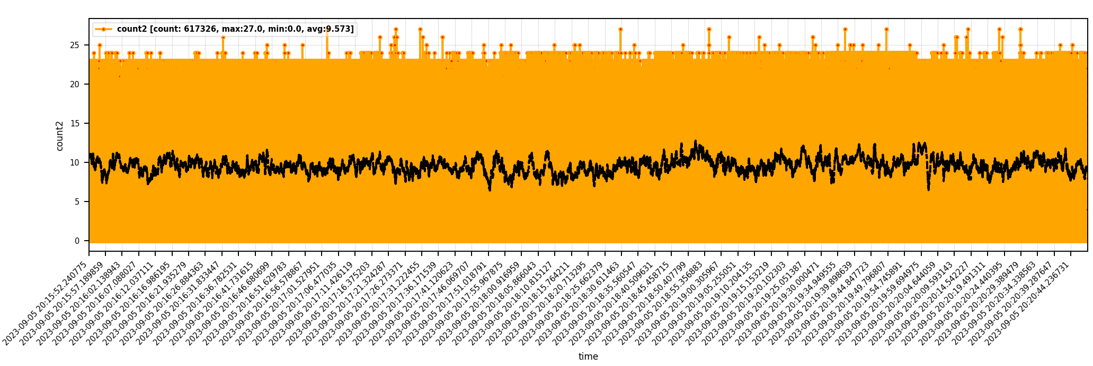
When we do statistics, we may need to deal with date/time
Draw a nice chart with timestamps showing on x axis as xticks to find out the change trend

Slide 3
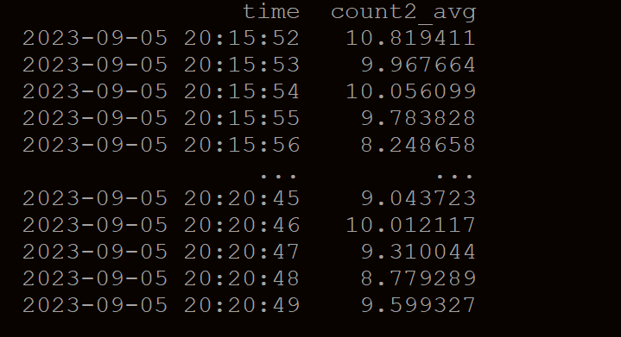
When we do statistics, we may need to deal with date/time
We may want to get avg of the column values per second
We may want to print out local time as logging purpose

Slide 4
Topic1： Object/string to datetime

Slide 5
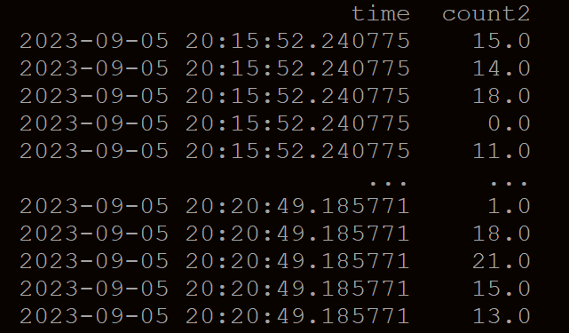
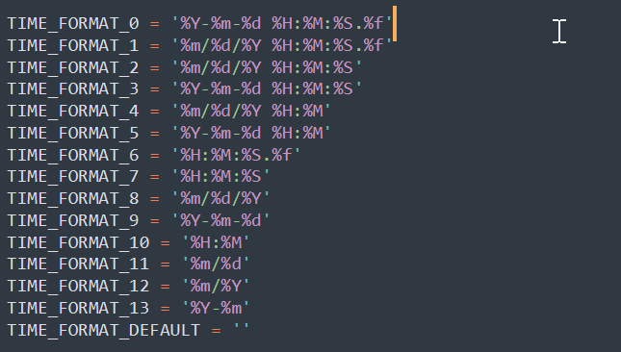
data/time columns in csv or raw files
Format of time column is “%Y-%m-%d %H:%M:%S.%f”
%Y: year
%m: month
%d: date
%H: hour
%M: minute
%S: second
%f: either 3 digits (one millisecond) or 6 digits (1 microsecond)
More formats:

Slide 6
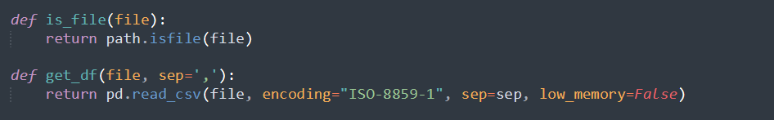
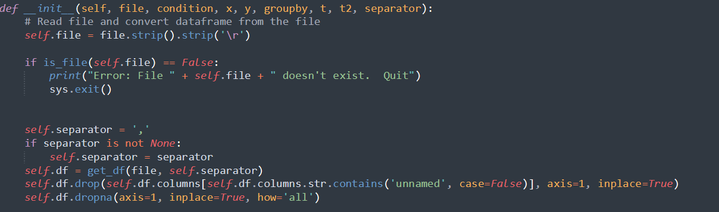
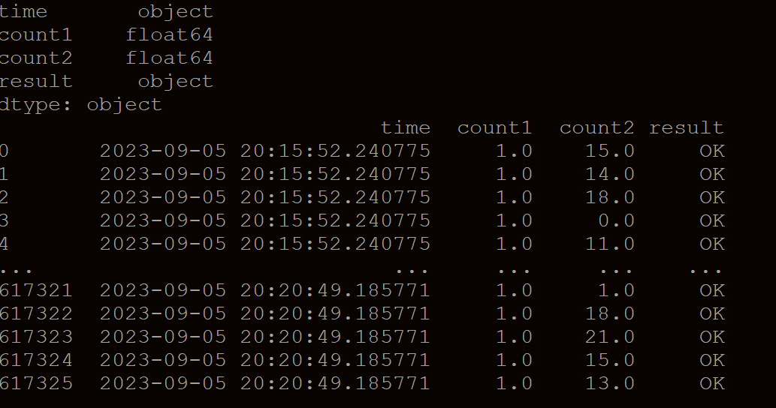
default dtypes for date/time column in python IS OBJECT
When we read .csv file and load it as pandas dataframe, time column by default will have dtypes as “object” unless you define its dtypes
import pandas as pd
pd.read_csv()
Step1: using path lib to check if the file exists
Step2: using pandas lib to read csv and get
a dataframe
Step3: format this dataframe to drop unnamed
columns and columns if all values are null/NA
Step4: print(self.df.dtypes), python can detect
numeric columns but other columns
will set the dtypes as object (for string)
Step5: if time column is string format, we can sort
them by string by some operations may not
supported

Slide 7
Convert the OBJECT/string format date/time to datetime object
https://pandas.pydata.org/pandas-docs/stable/reference/api/pandas.to_datetime.html
Pandas.to_datetime() can be used to convert int, float, str, datetime, list, tuple, 1-d array, Series, DataFrame/dict-like object to a datetime object
Sample code:
self.df[‘time’] = pd.to_datetime(self.df[‘time’], format=‘'%Y-%m-%d %H:%M:%S.%f’)
If we need to process different csv files, their date/time format may different, is there a way we can detect the right format when we need to convert time string object to datetime object??? Solution is in next page

Slide 8
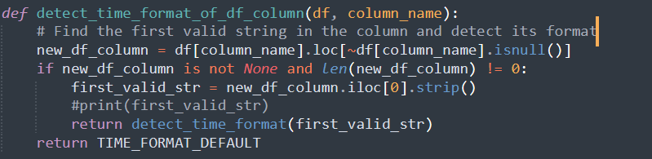
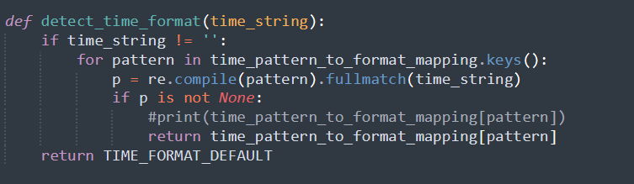
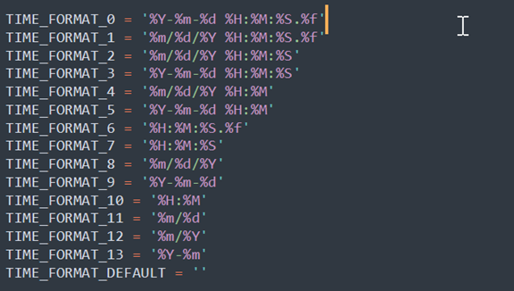
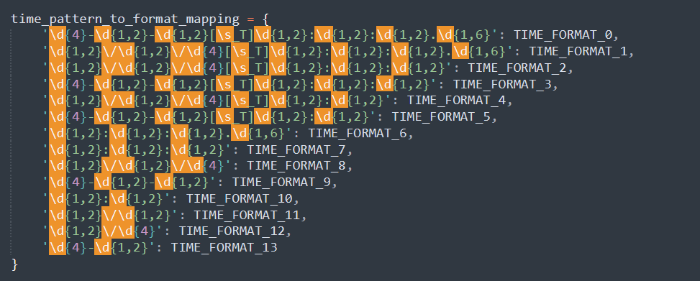
How to detect the right format WHEN reading csv file? – My solution is to use pattern search
Step1: Get the date/time column and find the first valid cell (ignore the empty cells in this column)
Step2: Using the string in the first non-empty cell to match the time format pattern

Slide 9
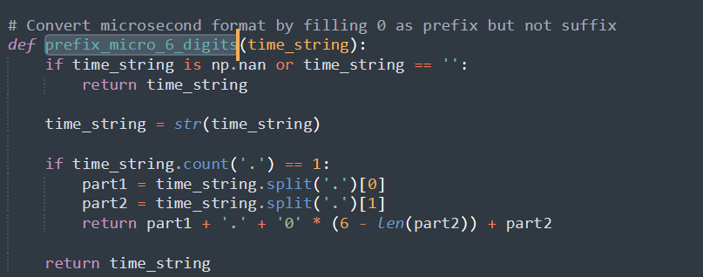
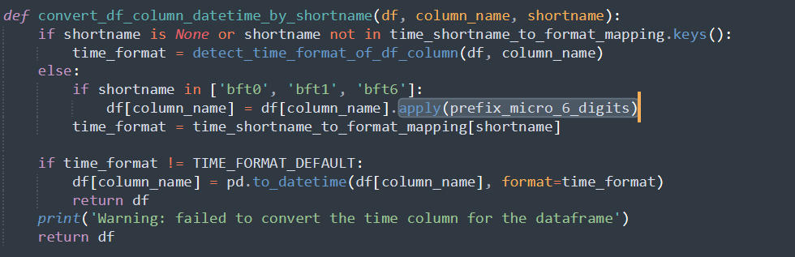
Special cases when convert string/object to datatime
Sometimes we see the time format as “02:03:04.5678”. It may mean “02:03:04.005678” or “02:03:04.567800”. In this situation, we will need to process the string to add “00” either as suffix or prefix before calling to_datatime(). By default, to_datatime() will add “00” as suffix if we don’t covert it to be 6 digits
Using dataframe apply() or lambda function to convert column values

Slide 10
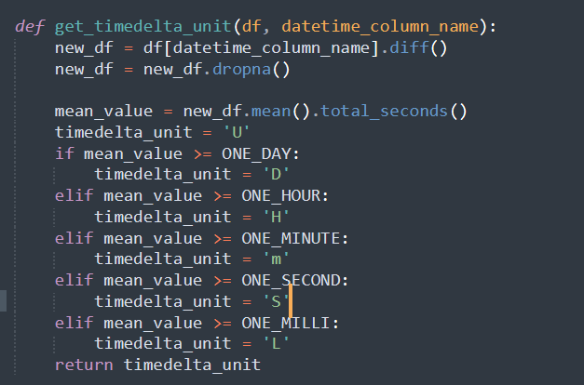
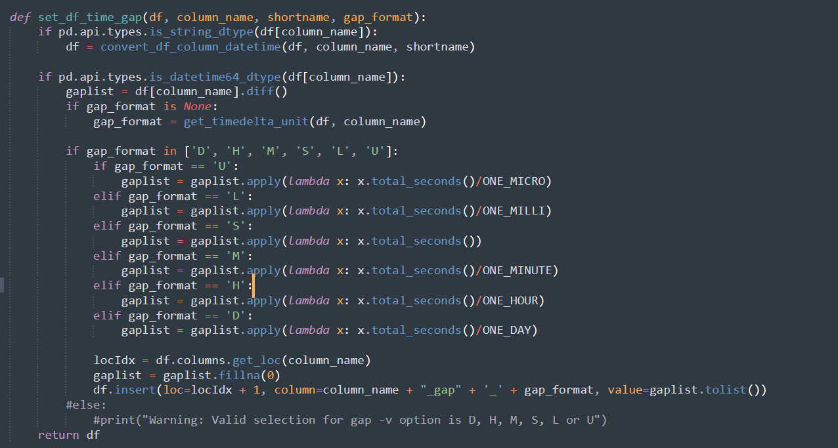
Special cases when convert string/object to datatime - timedelta
https://pandas.pydata.org/pandas-docs/stable/reference/api/pandas.Timedelta.html
The duration between two dates or times can be days, hours, minutes, seconds, milliseconds…
We may need to identify the right unit for timedelta object. One sample code is below:
Step1: Check the diff of the datetime object between each two rows to get a list of time diff
Step2: Get the average values of this time diff list
Step3: If the average diff time is more than a day, we set unit to “D” (means day unit). Otherwise, if the average diff time is more than a hour, se set unit to “H”…
When we calculate the gaps of the date/time columns, we can get the appropriate timedelta unit

Slide 11
Topic2： datetime to STRING

