Slide 1
DSA CAPSTONE · WEEK REVIEW
RIDESIM
Driver–Rider Matching Engine · Progress Review
Phase 1 complete — greedy and exact assignment built, benchmarked and demoable.
YASH BANDIPALLY · DESIGN & ANALYSIS OF ALGORITHMS
Notes:
Recap in one line: last review was the plan, this one is the working engine. Everything on the next four slides is running code.

Slide 2
What shipped
PHASE 1 · CORE MATCHING ENGINE
01
Cost model
Euclidean driver→rider cost matrix, built per dispatch batch from live positions.
02
Greedy baseline
Nearest-neighbour dispatch, one O(n) scan per driver. O(n²), never reconsiders.
03
Exact solver
Kuhn–Munkres (Hungarian) with potentials + augmenting paths. O(n³), provably minimal.
04
Simulation harness
RideSim: same scenario into both solvers, animated dispatch, per-pair distance log.
Notes:
Four deliverables, all in one codebase. The harness is the part that makes the rest provable.

Slide 3
Greedy is fast. It is also wrong.
MEAN TOTAL PICKUP DISTANCE · 300 RANDOM SCENARIOS PER FLEET SIZE
27.5%
distance saved at n=100
11.0%
saved even at n=4
1.4 ms
Hungarian solve, n=100
0.19 ms
greedy solve, n=100
The gap widens with fleet size — exactly where dispatch actually operates.
Notes:
Key point: greedy is ~7x faster but loses 27.5% distance at n=100, and the loss grows with n. Sub-2ms at n=100 means exact solving is affordable per batch.

Slide 4
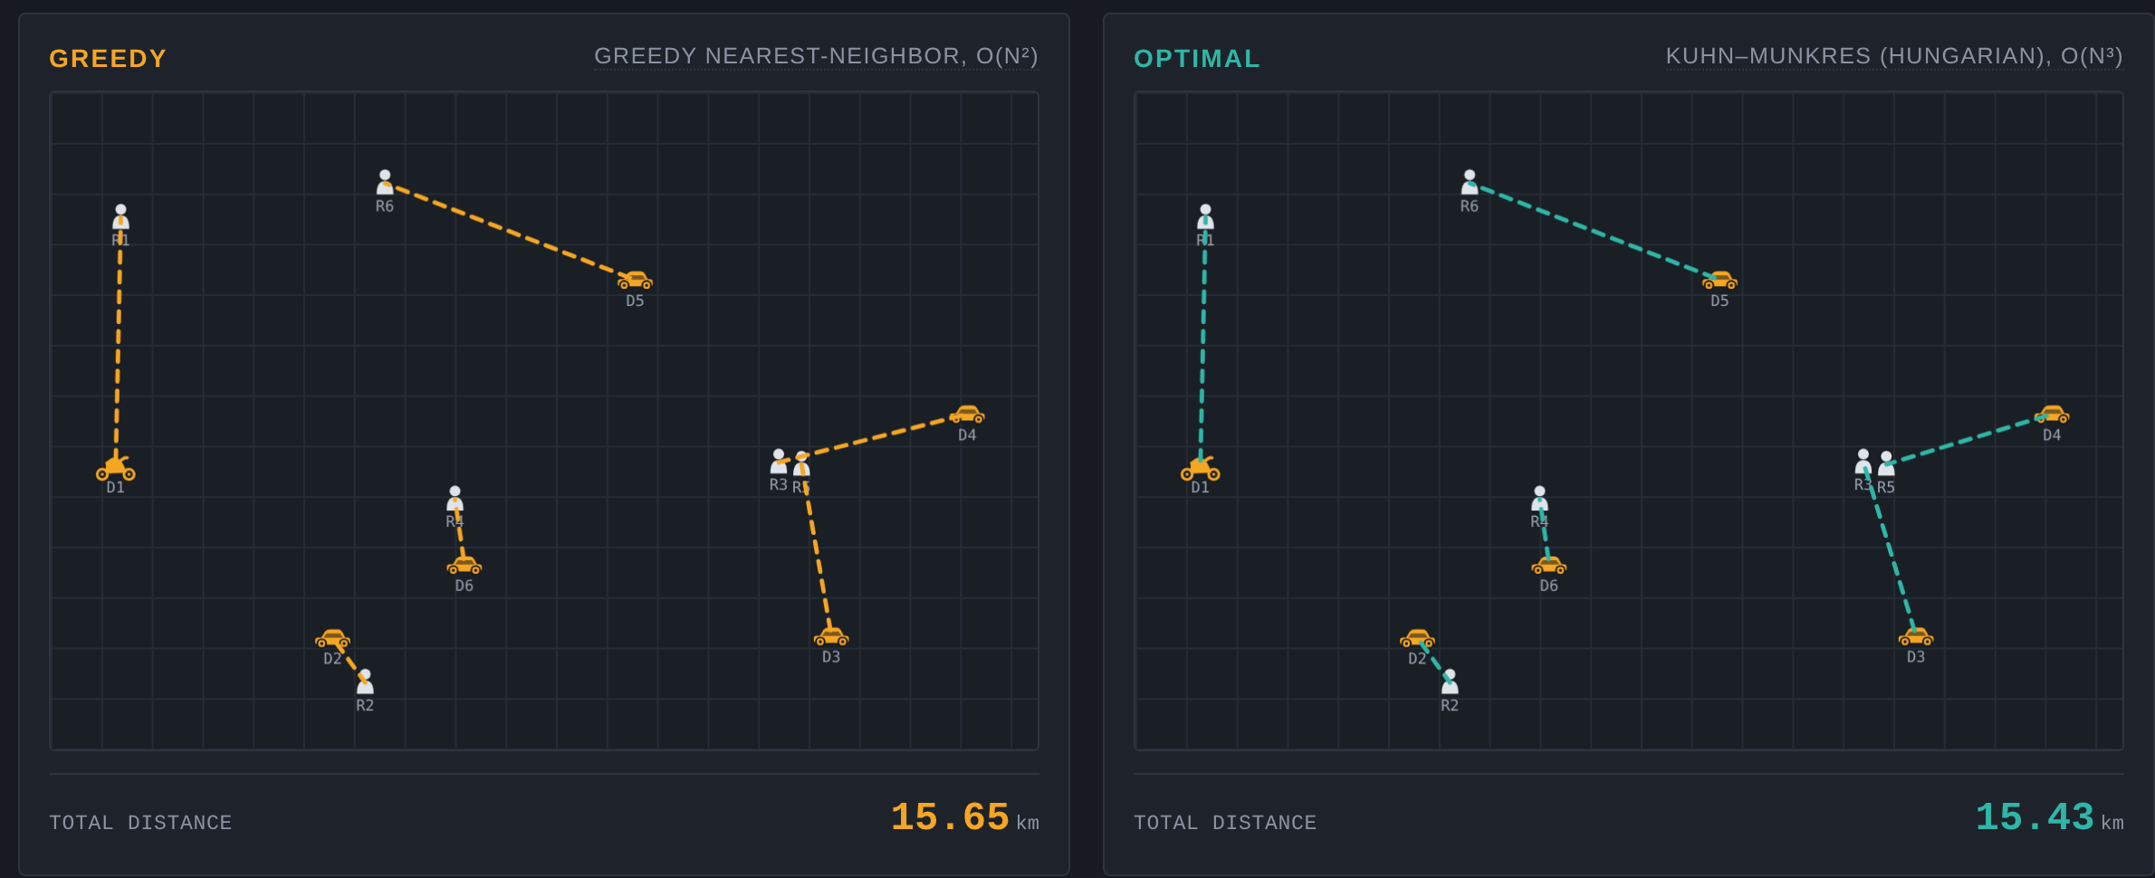
Live: RideSim
SAME RIDERS, SAME DRIVERS — TWO ALGORITHMS, TWO OUTCOMES
Notes:
Switch to the browser. Run Match, then New Scenario a few times, then Jackpot x30 to show the gap opening up at scale. Hover any pair to show its distance.

Slide 5
Next
PHASE 2 · FROM ONE BATCH TO A CITY
01
02
Pool matching
Max-flow zone balancing
Group riders with overlapping routes — batch bipartite matching plus an approximation layer.
Dinic on a zone graph to move idle supply toward demand before requests arrive.
03
04
Surge signal
Latency fallback
Read the multiplier off max-flow saturation instead of a hand-tuned heuristic.
Switch greedy↔exact on queue depth, so the SLA holds when the batch gets big.
Notes:
Ask for feedback on which of these to prioritise. Pool matching is the biggest algorithmic step; zone balancing is the biggest system step.

