Slide 1

CS 484 Intro to Machine Learning
Week 2
September 2, 2020

Slide 2

Instructor Virtual Office Hour
Dr. Ming-Long Lam
Fridays, 2 to 4 PM
mlam5@iit.edu
15-minutes Zoom link provided on request
By email appointment in advance

Slide 3
Teaching Assistant Virtual Office Hours
Mr. Olugbenga Abdulai (Olu)
Mondays and Wednesdays, 2:00 PM - 2:30 PM
Mondays: https://meet.google.com/umm-yogw-oau
Wednesdays: https://meet.google.com/ydi-uunt-rct
oabdulai@hawk.iit.edu

Slide 4
Week 2: Non-parametric Methods
Empirical Density Estimation
Basic Statistical Outlier
Nearest Neighbors
Chapter 2 of the Machine Learning book

Slide 5
Non-parametric Methods
Like Father, Like Son
What is Common Among these Phrases?
What Goes Around Comes Around
Garbage In, Garbage Out

Slide 6
Similar Inputs Generate Similar Outputs
Input A
Machine Learning Algorithm
Output A
Input B
Machine Learning Algorithm
Output B
If Input A is identical with Input B, the Output A should be identical with Output B
If Input A is similar to Input B, the Output A is expected to be similar to Output B

Slide 7
Similar Inputs Generate Similar Outputs
Fundamental Belief / Proposition / Axiom
Examples:
Two cars made at the same plant in the same week probably will break down for similar reasons after the same number of years.
The majority of students in this class have eaten their supper.
Fine Prints:
Unless the output is completely determined by the inputs, the same inputs may not have the same output.
Although similarity is a subjective concept, we will use some metrics to measure the extent of similarity.

Slide 8
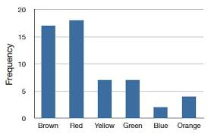
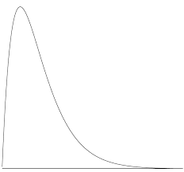
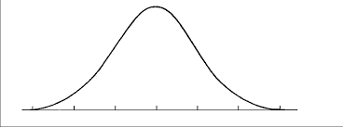
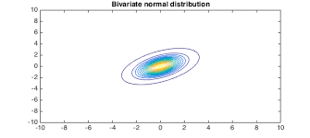
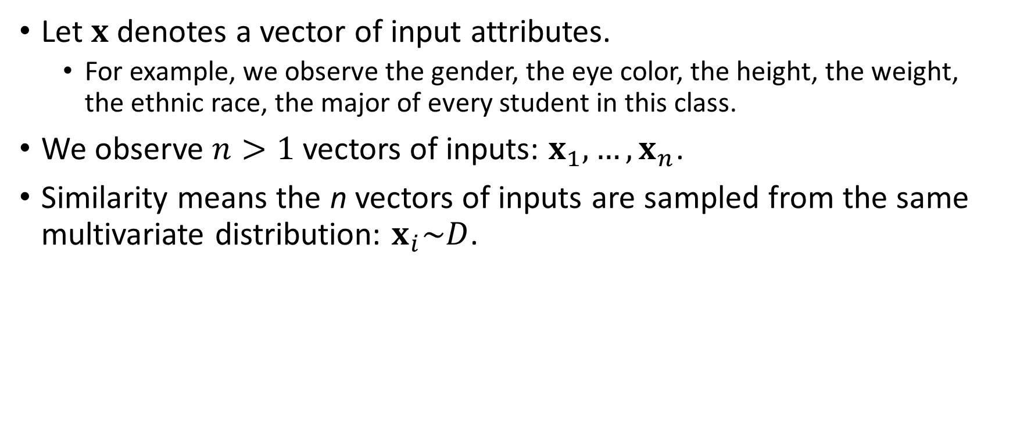
Similar Inputs
Let $x$ denotes a vector of input attributes.
For example, we observe the gender, the eye color, the height, the weight, the ethnic race, the major of every student in this class.
We observe $n>1$ vectors of inputs: $x_{1},…,x_{n}$.
Similarity means the n vectors of inputs are sampled from the same multivariate distribution: $x_{i}\sim D$.

Slide 9
How to Describe a Distribution?
Parametric
Describe the probability density (mass) by a mathematical formula
The formula contains parameters which control the shape and the scale of the probability density (mass) function.
Non-Parametric
Describe the probability density (mass) by ALL the moments.
First moment is mean
Second moment is variance
Third moment is skewness
Fourth moment is kurtosis
All the i^{th}, i = 5, … are unnamed

Slide 10
How to Describe a Distribution?
Parametric
Calculate the probability arithmetically or programmatically
Non-Parametric
Can mix-and-match categorical and continuous values in domain (e.g., 1, 2, [3, 5), 5, [6, 10), 11, …)
Complete describe the probability (mass) by a few parameters
Cons
Pros
A burden to determine if the mathematical function is appropriate
Pros
Free from assuming any mathematical function
Cons
If we can/may not calculate all the infinitely many moments, we will never completely describe the probability density (mass).
Domain is either categorical or continuous (except a few special cases)

Slide 11
One Input Variable at a Time
Without assuming a parameterized distribution, it is quite difficult to compare two multivariate empirical distributions.
On the other hand, we can compare two univariate empirical distributions. But this means we will ignore the associations among the dimensions of the input vector.
Our compromise is we traded statistical accuracy for practicality.
Compare the univariate marginal empirical distributions.
If the marginal distributions are not similar, then the joint distribution is likely not similar.
The inverse may not hold. That is, even if the marginal distributions are similar, the joint distribution can still be different. See Kowalski (1973). Non-Normal Bivariate Distributions with Normal Marginals, The American Statistician, v.27, pp.103-106.

Slide 12
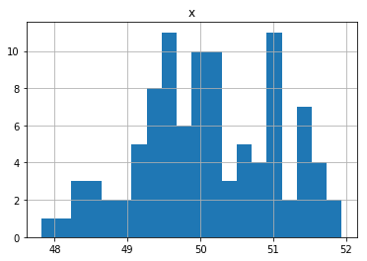
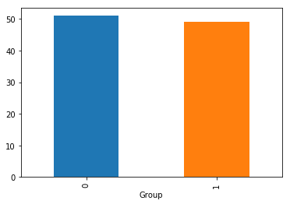
Compare Two Distributions
Since we only observed the data (i.e., the individual values), we need to first construct the distributions before comparing them.
The common tool for visualizing a distribution
A histogram and a box-plot for interval (i.e., continuous) feature
A bar chart for a nominal (i.e., categorical) feature.

Slide 13
A Procedure for Constructing a Histogram
Select a positive bin width.
Select the mid-points of the bins
Construct the bins
Left-open and right-closed, i.e., (a,b], or
Left-closed and right-open, i.e., [a,b)
Count the number of observations in each individual bin
Plot the numbers of observations against the bin definitions, either horizontally or vertically.

Slide 14
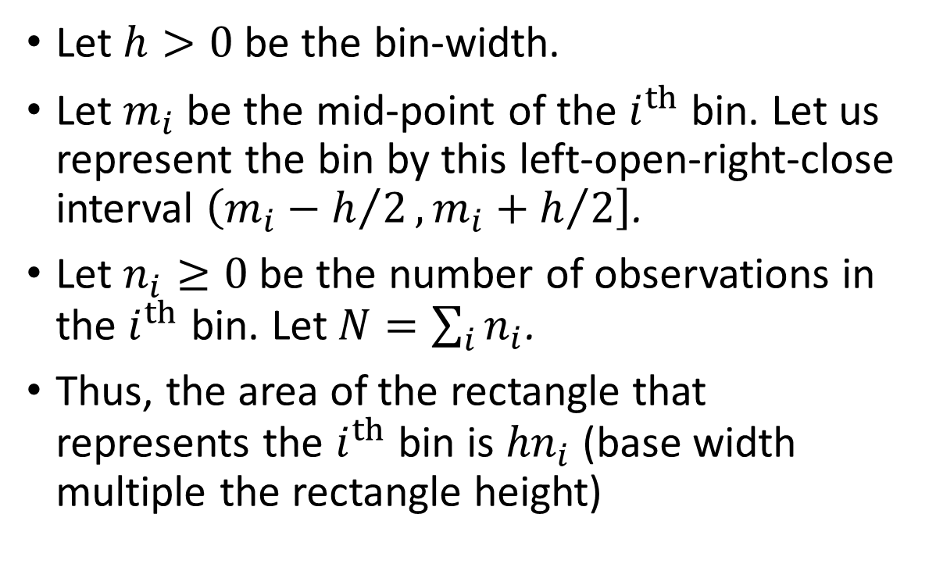



Use a Histogram to Estimate the Density
Let $h>0$ be the bin-width.
Let $m_{i}$ be the mid-point of the $i^{th}$ bin. Let us represent the bin by this left-open-right-close interval $\left(m_{i}−h/2,\left.m_{i}+h/2\right]\right.$.
Let $n_{i}≥0$ be the number of observations in the $i^{th}$ bin. Let $N=\sum_{i}{n_{i}}$.
Thus, the area of the rectangle that represents the $i^{th}$ bin is ${hn}_{i}$ (base width multiple the rectangle height)
$$n_{i}$$
$$m_{i}$$
$$h$$

Slide 15
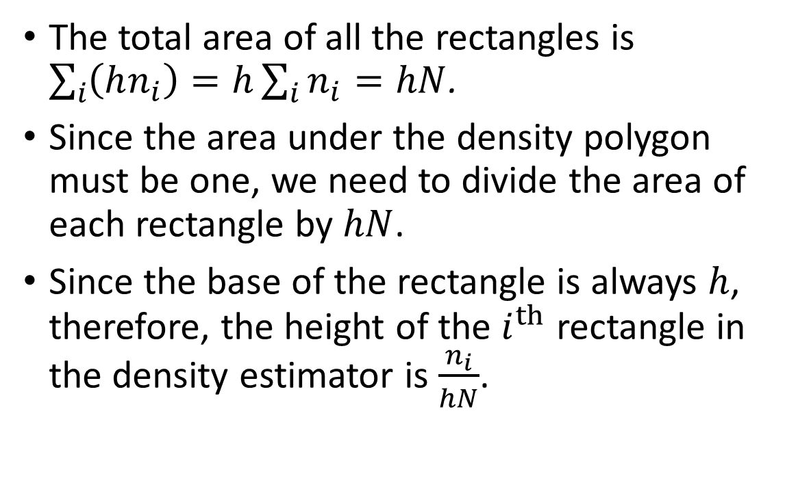
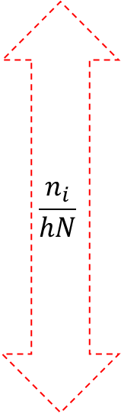
Use a Histogram to Estimate the Density
The total area of all the rectangles is $\sum_{i}{\left(hn_{i}\right)=h\sum_{i}{n_{i}}=hN}$.
Since the area under the density polygon must be one, we need to divide the area of each rectangle by $hN$.
Since the base of the rectangle is always $h$, therefore, the height of the $i^{th}$ rectangle in the density estimator is $\frac{n_{i}}{hN}$.
$$\frac{n_{i}}{hN}$$
$$m_{i}$$
$$h$$

Slide 16
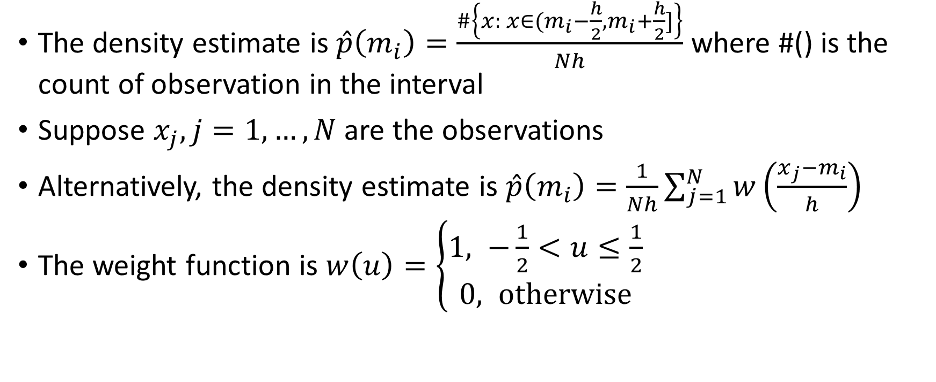
Use a Histogram to Estimate the Density
The density estimate is $\hat{p}\left(m_{i}\right)=\frac{\#\left\{x: x∈(m_{i}−\frac{h}{2},m_{i}+\frac{h}{2}]\right\}}{Nh}$ where #() is the count of observation in the interval
Suppose $x_{j}, j=1,…, N$ are the observations
Alternatively, the density estimate is $\hat{p}\left(m_{i}\right)=\frac{1}{Nh}\sum_{j=1}^{N}{w\left(\frac{x_{j}−m_{i}}{h}\right)}$
The weight function is $w\left(u\right)=\left\{\begin{aligned}1, −\frac{1}{2}<u≤\frac{1}{2} \\ &0, otherwise\end{aligned}\right.$

Slide 17
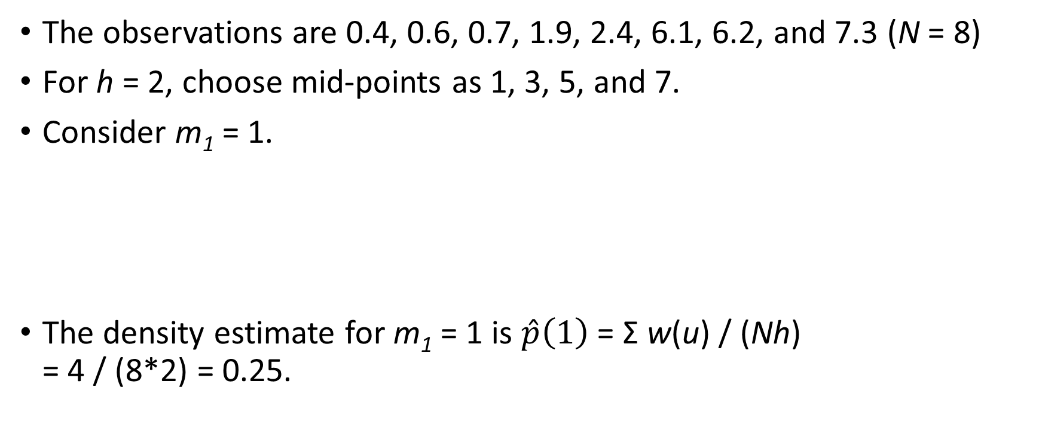
Density Estimation Example
The observations are 0.4, 0.6, 0.7, 1.9, 2.4, 6.1, 6.2, and 7.3 (N = 8)
For h = 2, choose mid-points as 1, 3, 5, and 7.
Consider m₁ = 1.
The density estimate for m₁ = 1 is $\hat{p}\left(1\right)$ = Σ w(u) / (Nh) = 4 / (8*2) = 0.25.
x_{i} | 0.4 | 0.6 | 0.7 | 1.9 | 2.4 | 6.1 | 6.2 | 7.3
u = (x_{i} - m₁)/2 | -0.3 | -0.2 | -0.15 | 0.45 | 0.7 | 2.55 | 2.6 | 3.15
w(u) | 1 | 1 | 1 | 1 | 0 | 0 | 0 | 0

Slide 18
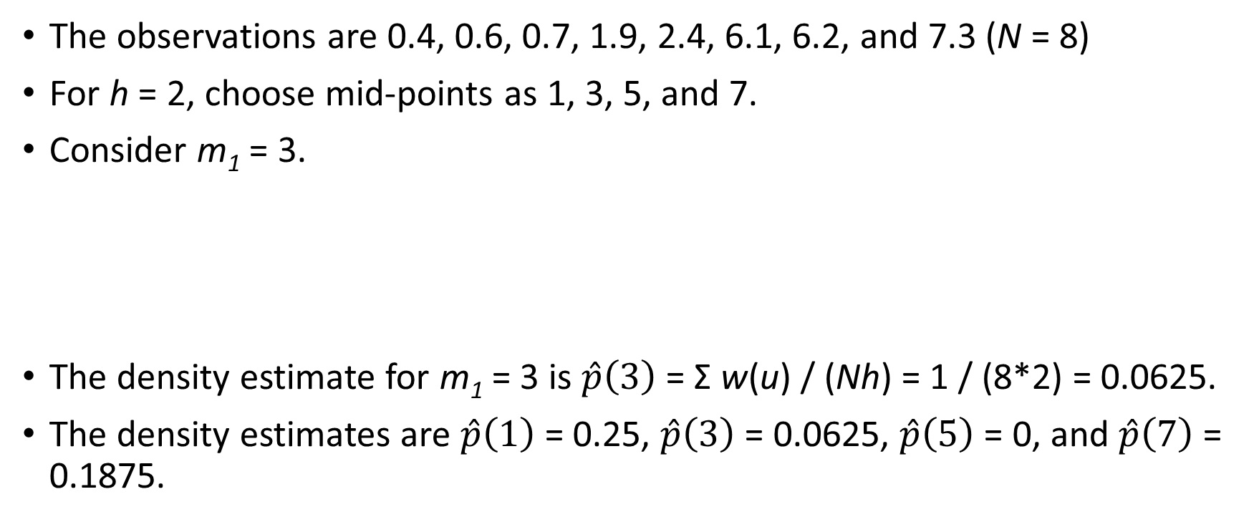
Density Estimation Example
The observations are 0.4, 0.6, 0.7, 1.9, 2.4, 6.1, 6.2, and 7.3 (N = 8)
For h = 2, choose mid-points as 1, 3, 5, and 7.
Consider m₁ = 3.
The density estimate for m₁ = 3 is $\hat{p}\left(3\right)$ = Σ w(u) / (Nh) = 1 / (8*2) = 0.0625.
The density estimates are $\hat{p}\left(1\right)$ = 0.25, $\hat{p}\left(3\right)$ = 0.0625, $\hat{p}\left(5\right)$ = 0, and $\hat{p}\left(7\right)$ = 0.1875.
x_{i} | 0.4 | 0.6 | 0.7 | 1.9 | 2.4 | 6.1 | 6.2 | 7.3
u = (x_{i} - m₁)/2 | -1.3 | -1.2 | -1.15 | -0.55 | -0.3 | 1.55 | 1.6 | 2.15
w(u) | 0 | 0 | 0 | 0 | 1 | 0 | 0 | 0

Slide 19
Density Estimation Example
h= 2
m_{i} | p(m_{i})
1 | 0.25
3 | 0.0625
5 | 0
7 | 0.1875
h = 0.5
m_{i} | p(m_{i})
0.25 | 0.25
0.75 | 0.5
1.25 | 0
1.75 | 0.25
2.25 | 0.25
2.75 | 0
3.25 | 0
3.75 | 0
4.25 | 0
4.75 | 0
5.25 | 0
5.75 | 0
6.25 | 0.5
6.75 | 0
7.25 | 0.25
7.75 | 0
h = 1
m_{i} | p(m_{i})
0.5 | 0.375
1.5 | 0.125
2.5 | 0.125
3.5 | 0
4.5 | 0
5.5 | 0
6.5 | 0.25
7.5 | 0.125

Slide 20
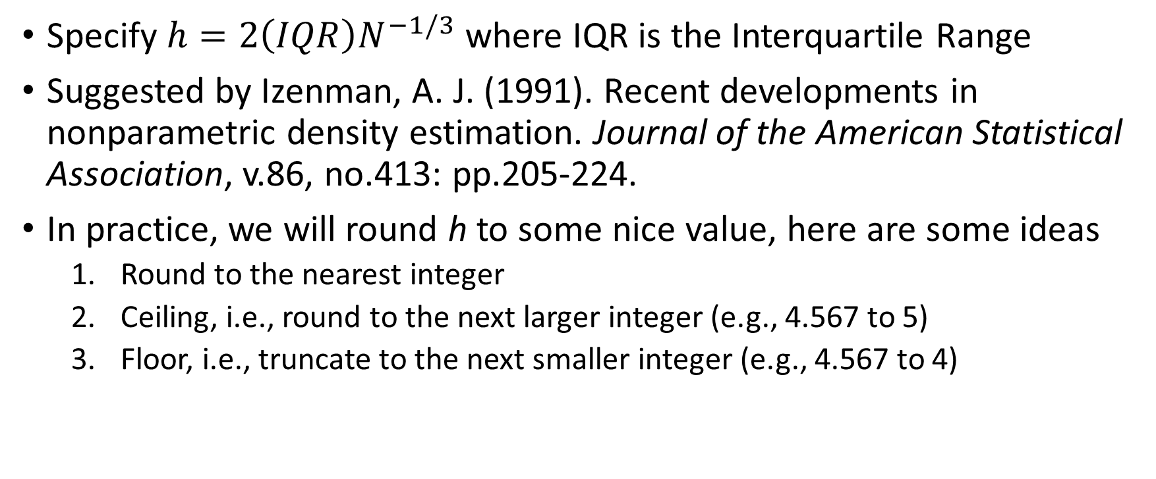
How to Specify the Bin-Width?
Specify $h=2\left(IQR\right)N^{−1/3}$ where IQR is the Interquartile Range
Suggested by Izenman, A. J. (1991). Recent developments in nonparametric density estimation. Journal of the American Statistical Association, v.86, no.413: pp.205-224.
In practice, we will round h to some nice value, here are some ideas
Round to the nearest integer
Ceiling, i.e., round to the next larger integer (e.g., 4.567 to 5)
Floor, i.e., truncate to the next smaller integer (e.g., 4.567 to 4)

Slide 21
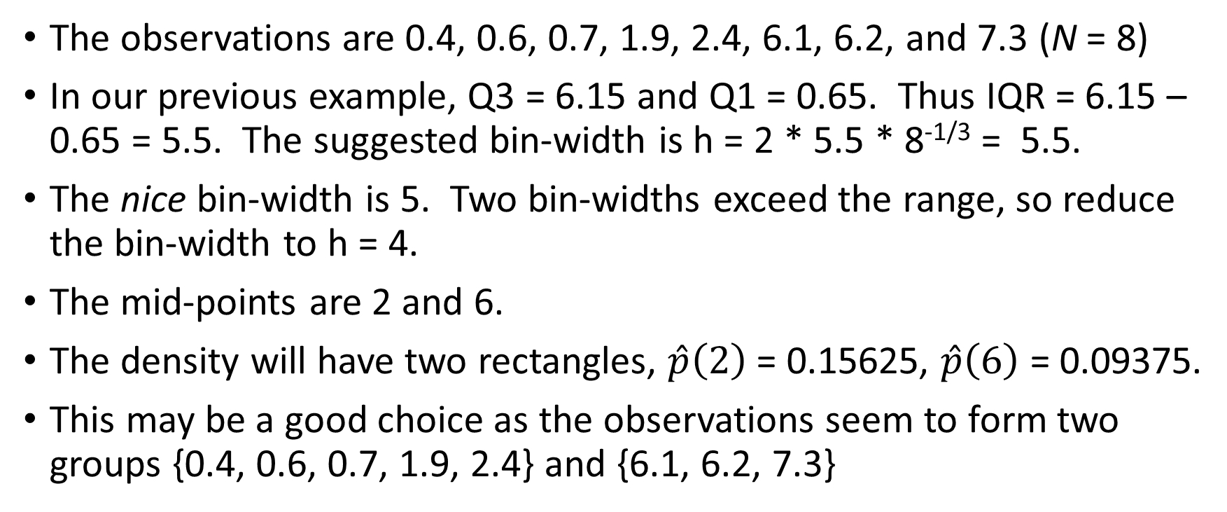
How to Specify the Bin-Width?
The observations are 0.4, 0.6, 0.7, 1.9, 2.4, 6.1, 6.2, and 7.3 (N = 8)
In our previous example, Q3 = 6.15 and Q1 = 0.65. Thus IQR = 6.15 – 0.65 = 5.5. The suggested bin-width is h = 2 * 5.5 * 8^{-1/3} = 5.5.
The nice bin-width is 5. Two bin-widths exceed the range, so reduce the bin-width to h = 4.
The mid-points are 2 and 6.
The density will have two rectangles, $\hat{p}\left(2\right)$ = 0.15625, $\hat{p}\left(6\right)$ = 0.09375.
This may be a good choice as the observations seem to form two groups {0.4, 0.6, 0.7, 1.9, 2.4} and {6.1, 6.2, 7.3}

Slide 22
How to Specify the Bins’ Mid-points?
First mid-point is the minimum value + bin-width / 2.
Second mid-point is the first mid-point + bin-width
Recursively, the current mid-point is the previous mid-point + bin-width
Stop when the current mid-point has exceeded the maximum value
Then beautify the mid-points, e.g., round the mid-points to the least number of significant digits such that the mid-points are still visually different.

Slide 23
A Procedure for Constructing a Box-Plot
Calculate the five-number summary which is the minimum, the first quartile, the median, the third quartile, and the maximum.
The first quartile (Q1) is the 25th percentile
The median (Q2) is the 50th percentile
The third quartile (Q3) is the 75th percentile
Draw a box, either horizontally or vertically
The centerline represents the median
The left or the lower box boundary represents the first quartile.
The right or the upper box boundary represents the third quartile
25%
25%
Q1
Q2
Q3

Slide 24
A Procedure for Constructing a Box-Plot
Calculate the Interquartile Range IQR = Q3 – Q1.
Draw two whiskers which extend from the ends of the box
The left or the lower whisker extends to the larger of Q1 – 1.5 * IQR and the minimum.
The right or the upper whisker extends to the smaller of Q3 + 1.5 * IQR and the maximum.
Q1 -1.5*IQR
Q3 +1.5*IQR
25%
25%
Q1
Q2
Q3

Slide 25
Why 1.5 Times of the IQR?
For a standard normal distribution (i.e., mean = 0 and standard deviation = 1)
Q1 = -0.67449, Q2 = 0, and Q3 = 0.67449.
Therefore IQR = Q3 – Q1 = 1.34898 and 1.5*IQR = 2.02347.
The lower whisker is Q1 – 1.5*IQR = -2.69796 and the upper whisker is Q3 + 1.5*IQR = 2.69796.
Common wisdom says any values more than three standard deviations from the mean are outliers.
If the multiplier is 2, then the upper whisker is 3.37245 > 3.
If the multiplier is 1, then the upper whisker is 2.02347 << 3.
The 1.5 multiplier is sort of the compromise.

Slide 26
Detect Outliers Using a Box-Plot
Observations whose values lie outside the whiskers Q1 – 1.5*IQR and Q3 + 1.5*IQR are considered outliers.
Actually, there are another set of whiskers which are Q1 – 3*IQR and Q3 + 3*IQR. Observations whose values lie outside these whiskers are considered extreme values.
Q1 -1.5*IQR
Q3 +1.5*IQR
25%
25%
Q1 -3*IQR
Q1
Q2
Q3
Q3 +3*IQR

Slide 27
Memory-Based Learning (MBL)
Nearest Neighbors Algorithm:
A memorization technique based on similarity
Memorizes a fixed number of observations in training data
How can I determine that fixed number?
Identify the observations (i.e., neighbors) that most resemble attributes of the probe
Summarize neighbors using central tendency statistics
Mode of neighbors for classification
Mean or median of neighbors for prediction

Slide 28
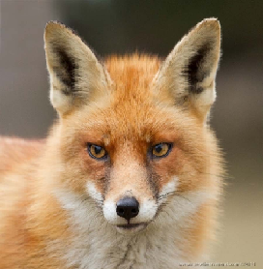
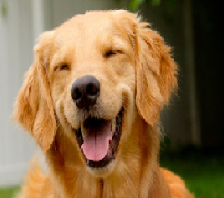
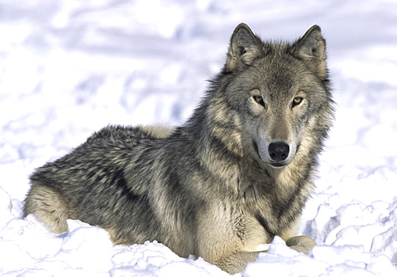
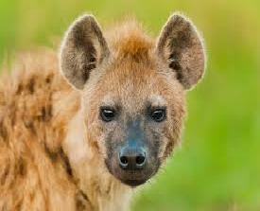
Nearest Neighbors Basic Idea
If a creature walks like a dog, looks like a dog, sits like a dog, and eats like a dog then it is probably a dog.
Well, it may not bark and be obedient as a dog.
Fox
Dog
Wolf
Hyena

Slide 29
k-Nearest Neighbors (kNN) Algorithm
Memory-Based:
Observations in the training dataset
A distance metric to compute the distance between observations
The integer value k which is the number of nearest neighbors to retrieve
Learning:
Classify or predict for an arbitrary observation
Compute distance to all observations in training dataset
Identify k observations with shortest distances
Uses these k neighbors for classification or prediction

Slide 30
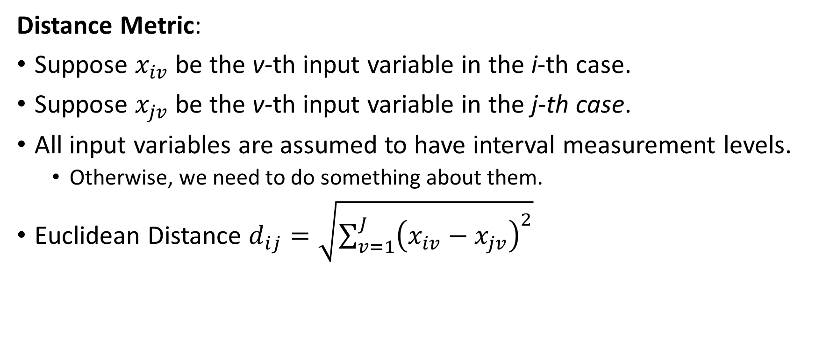
k-Nearest Neighbors (kNN) Algorithm
Distance Metric:
Suppose $x_{iv}$ be the v-th input variable in the i-th case.
Suppose $x_{jv}$ be the v-th input variable in the j-th case.
All input variables are assumed to have interval measurement levels.
Otherwise, we need to do something about them.
Euclidean Distance $d_{ij}=\sqrt{\sum_{v=1}^{J}{{\left(x_{iv}−x_{jv}\right)}^{2}}}$

Slide 31
k-Nearest Neighbors (kNN) Algorithm
Data Preparation:
Since distance metric works only on interval predictors, dummy variables have to be created for nominal or ordinal predictors first.
Example:
CAT is a nominal predictor with levels: “A”, “B”, and “C”
CAT_A = 1 if CAT = “A”, and 0 otherwise
CAT_B = 1 if CAT = “B”, and 0 otherwise
CAT_C = 1 if CAT = “C”, and 0 otherwise

Slide 32
k-Nearest Neighbors (kNN) Algorithm
Optionally Scaling of Input Variables:
Perform principal component analysis to scale or transform input (excluding target) variables into orthonormal components.
Any two orthonormal components have zero correlation
All orthonormal components have the same variance
Two reasons to scale or orthonormalize the input variables
Avoid highly correlated input variables to contribute unnecessary addition to the distance metric
Avoid input variables that have relatively large absolute values to exert unwanted leverages on the results

Slide 33
k-Nearest Neighbors (kNN) Algorithm
Data Preparation:
Example (attributes of a person):
BMI Table: Height may vary from 4 feet 10 inches to 6 feet 4 inches
BMI Table: Weight may vary from 91 pounds to 443 pounds
Annual Income may vary from $20,000 to $500,000
Difference:
10 inches difference in height is very visible
10 pounds difference in weight may worry some but not all the people
10 dollars difference in income won’t make one person richer than the others

Slide 34
Orthonormal Transformation
Suppose X = {x_{ij}} where x_{ij} is the i-th observation of the j-th variable and the dimension is n by k.
Compute X^{t}X (superscript t is the matrix transpose operator) and the resulting matrix has dimension k by k.
Eigenvalue decomposition will find a k by k diagonal matrix D and a k by k matrix V such that:
V^{t}V = I where I is a k by k identity matrix (this implies V⁻¹ = V^{t})
X^{t}XV = VD or (XV)^{t}(XV) = D or (XVD^{-1/2})^{t}(XVD^{-1/2}) = I (D^{-1/2} is k by k diagonal matrix whose elements are reciprocal of the square root of those of D)
The transformation XVD^{-1/2} is the orthonormal transformation of X

Slide 35
Orthonormalization in Python: First Principle
import numpy as np
from numpy import linalg as LA
import pandas as pd
# Input the matrix X
x = np.matrix([[5.1, 160, 82000],
[5.2, 170, 84000],
[5.3, 180, 86000],
[5.4, 190, 88000],
[5.5, 200, 90000],
[5.6, 110, 81000],
[5.7, 120, 83000],
[5.8, 130, 85000],
[5.9, 140, 87000],
[6.0, 150, 89000]])
print("Input Matrix = \n", x)
print("Number of Dimensions = ", x.ndim)
print("Number of Rows = ", np.size(x,0))
print("Number of Columns = ", np.size(x,1))
xtx = x.transpose() * x
print("t(x) * x = \n", xtx)
# Eigenvalue decomposition
evals, evecs = LA.eigh(xtx)
print("Eigenvalues of x = \n", evals)
print("Eigenvectors of x = \n",evecs)
# Here is the transformation matrix
transf = evecs * LA.inv(np.sqrt(np.diagflat(evals)))
print("Transformation Matrix = \n", transf)
# Here is the transformed X
transf_x = x * transf
print("The Transformed x = \n", transf_x)
# Check columns of transformed X
xtx = transf_x.transpose() * transf_x
print("Expect an Identity Matrix = \n", xtx)
Week 2 Eigenvalue.py

Slide 36
Orthonormalization in Python: First Principle
Input Matrix =
[[5.1e+00 1.6e+02 8.2e+04]
[5.2e+00 1.7e+02 8.4e+04]
[5.3e+00 1.8e+02 8.6e+04]
[5.4e+00 1.9e+02 8.8e+04]
[5.5e+00 2.0e+02 9.0e+04]
[5.6e+00 1.1e+02 8.1e+04]
[5.7e+00 1.2e+02 8.3e+04]
[5.8e+00 1.3e+02 8.5e+04]
[5.9e+00 1.4e+02 8.7e+04]
[6.0e+00 1.5e+02 8.9e+04]]
Number of Dimensions = 2
Number of Rows = 10
Number of Columns = 3
t(x) * x =
[[3.0885e+02 8.5600e+03 4.7480e+06]
[8.5600e+03 2.4850e+05 1.3305e+08]
[4.7480e+06 1.3305e+08 7.3185e+10]]
Eigenvalues of x =
[3.53398246e-02 6.61645828e+03 7.31852422e+10]
Eigenvectors of x =
[[ 9.99941038e-01 1.08589624e-02 -6.48765732e-05]
[ 1.08588266e-02 -9.99939389e-01 -1.81799265e-03]
[-8.46141548e-05 1.81718097e-03 -9.99998345e-01]]
Transformation Matrix =
[[ 5.31914951e+00 1.33498240e-04 -2.39814890e-10]
[ 5.77631278e-02 -1.22930851e-02 -6.72017163e-09]
[-4.50101879e-04 2.23401143e-05 -3.69647288e-06]]
The Transformed x =
[[-0.53859114 -0.1343234 -0.30311185]
[-0.32924867 -0.21256067 -0.31050487]
[-0.1199062 -0.29079794 -0.31789788]
[ 0.08943627 -0.36903521 -0.32529089]
[ 0.29877874 -0.44727248 -0.3326839 ]
[-0.3170709 0.45805749 -0.29941504]
[-0.10772843 0.37982022 -0.30680806]
[ 0.10161404 0.30158295 -0.31420107]
[ 0.31095651 0.22334568 -0.32159408]
[ 0.52029898 0.1451084 -0.3289871 ]]
Expect an Identity Matrix =
[[ 9.99999953e-01 1.00405564e-08 -2.52808885e-12]
[ 1.00405564e-08 9.99999998e-01 1.23873134e-13]
[-2.52808885e-12 1.23873134e-13 1.00000000e+00]]
(XVD^{-1/2})^{t}(XVD^{-1/2}) = I
Week 2 Eigenvalue.py

Slide 37
Orthonormalization in Python: SciPy Function
import numpy as np
from numpy import linalg as LA
import pandas as pd
# Input the matrix X
x = np.matrix([[5.1, 160, 82000],
[5.2, 170, 84000],
[5.3, 180, 86000],
[5.4, 190, 88000],
[5.5, 200, 90000],
[5.6, 110, 81000],
[5.7, 120, 83000],
[5.8, 130, 85000],
[5.9, 140, 87000],
[6.0, 150, 89000]])
# Orthonormalize using the orth function
import scipy
from scipy import linalg as LA2
orthx = LA2.orth(x)
print("The orthonormalize x = \n", orthx)
# Check columns of the ORTH function
check = orthx.transpose().dot(orthx)
print("Also Expect an Identity Matrix = \n", check)
Week 2 Eigenvalue.py

Slide 38
Comparison
First Principles
The Transformed x =
[[-0.53859114 -0.1343234 -0.30311185]
[-0.32924867 -0.21256067 -0.31050487]
[-0.1199062 -0.29079794 -0.31789788]
[ 0.08943627 -0.36903521 -0.32529089]
[ 0.29877874 -0.44727248 -0.3326839 ]
[-0.3170709 0.45805749 -0.29941504]
[-0.10772843 0.37982022 -0.30680806]
[ 0.10161404 0.30158295 -0.31420107]
[ 0.31095651 0.22334568 -0.32159408]
[ 0.52029898 0.1451084 -0.3289871 ]]
Expect an Identity Matrix =
[[ 9.99999953e-01 1.00405564e-08 -2.52808885e-12]
[ 1.00405564e-08 9.99999998e-01 1.23873134e-13]
[-2.52808885e-12 1.23873134e-13 1.00000000e+00]]
SciPy orth() Function
The orthonormalize x =
[[-0.30311185 0.1343234 0.53859115]
[-0.31050487 0.21256067 0.32924868]
[-0.31789788 0.29079794 0.1199062 ]
[-0.32529089 0.36903521 -0.08943628]
[-0.3326839 0.44727248 -0.29877875]
[-0.29941504 -0.45805749 0.31707091]
[-0.30680806 -0.37982022 0.10772844]
[-0.31420107 -0.30158295 -0.10161404]
[-0.32159408 -0.22334568 -0.31095652]
[-0.3289871 -0.1451084 -0.52029899]]
Also Expect an Identity Matrix =
[[ 1.00000000e+00 2.77555756e-17 1.11022302e-16]
[ 2.77555756e-17 1.00000000e+00 -1.11022302e-16]
[ 1.11022302e-16 -1.11022302e-16 1.00000000e+00]]
Switched Sign
Week 2 Eigenvalue.py

Slide 39
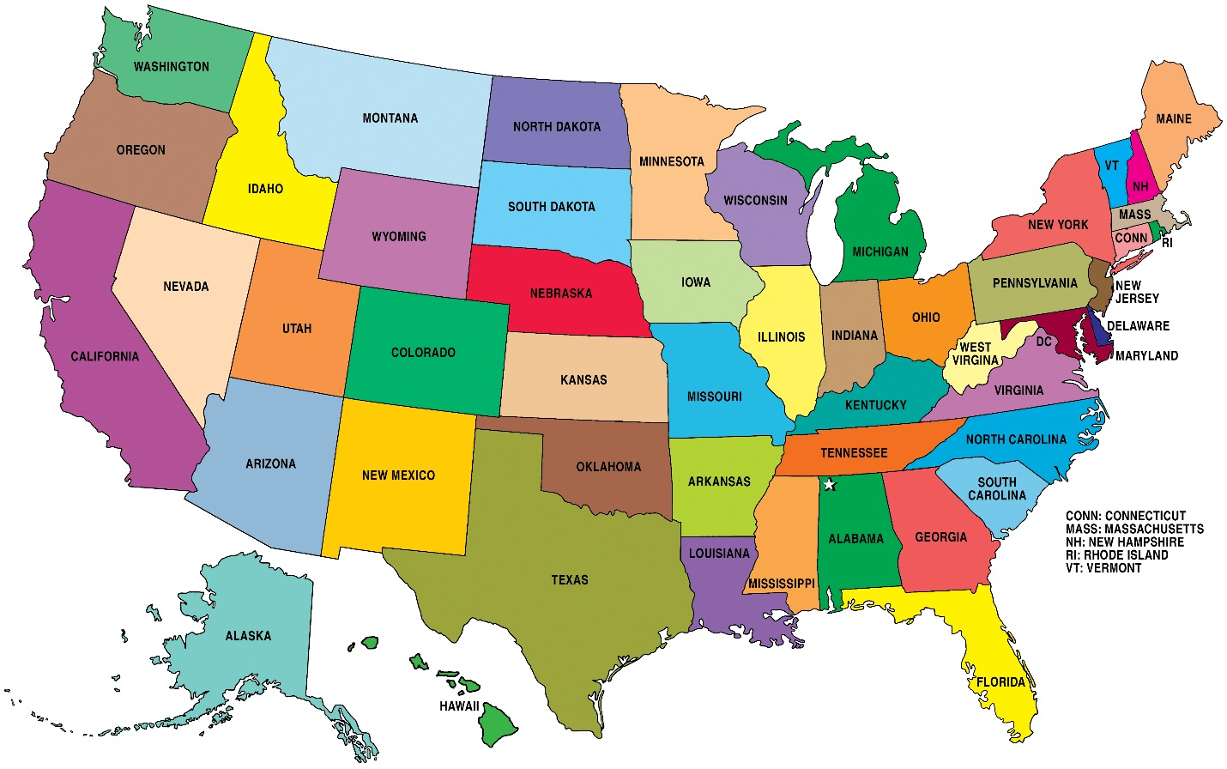
Number of Neighbors
The k value must be an integer greater than zero
The choice can be subjective
If k is too small (say 1), then the results are either sensitive to noise observations or biased.
If k is too large (say 50), then the neighborhood may include observations which may cause more distraction than adding information.

Slide 40
Determine the Number of Neighbors
Has Target Variable
Adjust the number of neighbors until the classifications (or predictions) are more “consistent” with the observed target value(s)
No Target Variable
I am not aware of the answer when there is no target variable
Use your best analytical judgment!
Consistency is defined in terms of lower misclassification or prediction error

Slide 41
Number of Neighbors
Grid Search for the Number of Neighbors:
Select a range of integers, say 1 ≤ k ≤ 20
Choose the lower bound based on your idea of the minimum number of neighbors to make up a community
Choose the upper bound according to your ability to comprehend that many numbers of neighbors
Run nearest neighbors algorithm for each value of k and obtain predicted values of the target variable
Select your value of k such that the predicted values are most correlated with the observed values of the target variable

Slide 42
Classification or Prediction
Classification:
Target is categorical
Probabilities of the categories from the neighbors are calculated
The category with the highest probability is the predicted target value
Prediction:
Target is of interval type
Mean or median of the neighbors is the predicted target value

Slide 43
Toy Example
CaseID | x1 | x2 | y
1 | 7.7 | -37 | 4
2 | 9.5 | -38 | 1
3 | 3 | -34 | 2
4 | 9.1 | -75 | 1
5 | 2.2 | -31 | 2
6 | 4.8 | -7 | 4
7 | 5.5 | -6 | 3
8 | 10 | -61 | 1
9 | 4.2 | -23 | 2
10 | 1.6 | -54 | 1
Two input variables: x1 and x2
One target: y
Ten observations
Distance between first two cases:
SQRT((7.7 – 9.5)² + ((-37) – (-38))²) = SQRT(4.24) = 2.0591 (up to 4 decimal places)

Slide 44
Toy Example
Distance Matrix:
 | CaseID
CaseID | 1 | 2 | 3 | 4 | 5 | 6 | 7 | 8 | 9 | 10
1 | 0 | 2.0591 | 5.5758 | 38.0258 | 8.1394 | 30.1398 | 31.0780 | 24.1100 | 14.4309 | 18.0613
2 | 2.0591 | 0 | 7.6322 | 37.0022 | 10.1139 | 31.3543 | 32.2490 | 23.0054 | 15.9088 | 17.8440
3 | 5.5758 | 7.6322 | 0 | 41.4513 | 3.1048 | 27.0599 | 28.1114 | 27.8927 | 11.0653 | 20.0489
4 | 38.0258 | 37.0022 | 41.4513 | 0 | 44.5377 | 68.1358 | 69.0938 | 14.0289 | 52.2304 | 22.2991
5 | 8.1394 | 10.1139 | 3.1048 | 44.5377 | 0 | 24.1404 | 25.2169 | 30.9974 | 8.2462 | 23.0078
6 | 30.1398 | 31.3543 | 27.0599 | 68.1358 | 24.1404 | 0 | 1.2207 | 54.2498 | 16.0112 | 47.1088
7 | 31.0780 | 32.2490 | 28.1114 | 69.0938 | 25.2169 | 1.2207 | 0 | 55.1838 | 17.0496 | 48.1582
8 | 24.1100 | 23.0054 | 27.8927 | 14.0289 | 30.9974 | 54.2498 | 55.1838 | 0 | 38.4401 | 10.9343
9 | 14.4309 | 15.9088 | 11.0653 | 52.2304 | 8.2462 | 16.0112 | 17.0496 | 38.4401 | 0 | 31.1088
10 | 18.0613 | 17.8440 | 20.0489 | 22.2991 | 23.0078 | 47.1088 | 48.1582 | 10.9343 | 31.1088 | 0

Slide 45
Toy Example
Rank the distances:
1 = the most nearest neighbor which is yourself
10 = the least nearest (i.e., most distant) neighbor
 | CaseID
CaseID | 1 | 2 | 3 | 4 | 5 | 6 | 7 | 8 | 9 | 10
1 | 0 | 2.0591 | 5.5758 | 38.0258 | 8.1394 | 30.1398 | 31.0780 | 24.1100 | 14.4309 | 18.0613
Rank | 1 | 2 | 3 | 10 | 4 | 8 | 9 | 7 | 5 | 6

Slide 46
Toy Example
Rank of Distance Matrix:
 | CaseID
CaseID | 1 | 2 | 3 | 4 | 5 | 6 | 7 | 8 | 9 | 10
1 | 1 | 2 | 3 | 10 | 4 | 8 | 9 | 7 | 5 | 6
2 | 2 | 1 | 3 | 10 | 4 | 8 | 9 | 7 | 5 | 6
3 | 3 | 4 | 1 | 10 | 2 | 7 | 9 | 8 | 5 | 6
4 | 5 | 4 | 6 | 1 | 7 | 9 | 10 | 2 | 8 | 3
5 | 3 | 5 | 2 | 10 | 1 | 7 | 8 | 9 | 4 | 6
6 | 6 | 7 | 5 | 10 | 4 | 1 | 2 | 9 | 3 | 8
7 | 6 | 7 | 5 | 10 | 4 | 2 | 1 | 9 | 3 | 8
8 | 5 | 4 | 6 | 3 | 7 | 9 | 10 | 1 | 8 | 2
9 | 4 | 5 | 3 | 10 | 2 | 6 | 7 | 9 | 1 | 8
10 | 4 | 3 | 5 | 6 | 7 | 9 | 10 | 2 | 8 | 1

Slide 47
Toy Example
Find neighbors of CaseID = 1
k = 1: # 1
k = 2: # 1, 2
k = 3: # 1, 2, 3
k = 4: # 1, 2, 3, 5
k = 5: # 1, 2, 3, 5, 9
k = 6: # 1, 2, 3, 5, 9, 10
k = 7: # 1, 2, 3, 5, 9, 10, 8
k = 8: # 1, 2, 3, 5, 9, 10, 8, 6
k = 9: # 1, 2, 3, 5, 9, 10, 8, 6, 7
k = 10: # 1, 2, 3, 5, 9, 10, 8, 6, 7, 4
 | CaseID
CaseID | 1 | 2 | 3 | 4 | 5 | 6 | 7 | 8 | 9 | 10
1 | 0 | 2.0591 | 5.5758 | 38.0258 | 8.1394 | 30.1398 | 31.0780 | 24.1100 | 14.4309 | 18.0613
Rank | 1 | 2 | 3 | 10 | 4 | 8 | 9 | 7 | 5 | 6

Slide 48
Toy Example
CaseID | x1 | x2 | y
1 | 7.7 | -37 | 4
2 | 9.5 | -38 | 1
3 | 3 | -34 | 2
4 | 9.1 | -75 | 1
5 | 2.2 | -31 | 2
6 | 4.8 | -7 | 4
7 | 5.5 | -6 | 3
8 | 10 | -61 | 1
9 | 4.2 | -23 | 2
10 | 1.6 | -54 | 1
Predicted Value of CaseID = 1
k = 5: # 1, 2, 3, 5, 9
Observed y: 4, 1, 2, 2, 2
Predicted y: = (4 + 1 + 2 + 2 + 2) / 5 = 2.2
 | CaseID
CaseID | 1 | 2 | 3 | 4 | 5 | 6 | 7 | 8 | 9 | 10
1 | 0 | 2.0591 | 5.5758 | 38.0258 | 8.1394 | 30.1398 | 31.0780 | 24.1100 | 14.4309 | 18.0613
Rank | 1 | 2 | 3 | 10 | 4 | 8 | 9 | 7 | 5 | 6

Slide 49
Toy Example
Predicted Value of CaseID = 1
CaseID | y | k | Prediction
1 | 4 | 1 | 4
1 | 4 | 2 | 2.5
1 | 4 | 3 | 2.3333
1 | 4 | 4 | 2.25
1 | 4 | 5 | 2.2
1 | 4 | 6 | 2
1 | 4 | 7 | 1.8571
1 | 4 | 8 | 2.125
1 | 4 | 9 | 2.2222
1 | 4 | 10 | 2.1
This is the observed y of CaseID = 1 when k = 1

Slide 50
Example: 2014 Automobile Data
Input data is Cars.csv.
Feature Variables:
Invoice: Invoice price in 2004 ($9,875 – $173,560)
Horsepower: Number of horsepower units (73 – 500 hp)
Weight: Curb Weight (1,850 – 7,190 pounds)
Identification Variable:
CaseID: Make and Row Index (e.g., Porsche_335)
Number of Neighbors:
K = 4

Slide 51
Specifications for Nearest Neighbors
The distance metric is Euclidean
The algorithm is brute (i.e., calculate the distance between each possible pair of observations)
Other algorithms are KD-TREE and BALL-TREE. These algorithms may avoid calculating distances by storing similar observations together
KD-TREE: Bentley, J. L. (1975). Multidimensional Binary Search Trees Used for Associate Searching, Communications of the ACM, v.18, n.9, pp.509-517.
BALL-TREE: Omohundro (1989). Five Balltree Construction Algorithms, International Computer Science Institute Technical Report.

Slide 52
Unsupervised, Original Scale
cars = pandas.read_csv('C:\\Users\\minlam\\Documents\\IIT\\Machine Learning\\Data\\cars.csv',
delimiter=',')
cars["CaseID"] = cars["Make"] + "_" + cars.index.values.astype(str)
cars_wIndex = cars.set_index("CaseID")
# Specify the kNN
kNNSpec = kNN(n_neighbors = 4, algorithm = 'brute', metric = 'euclidean')
# Specify the training data
trainData = cars_wIndex[['Invoice', 'Horsepower', 'Weight']]
trainData.describe()
# Build nearest neighbors
nbrs = kNNSpec.fit(trainData)
distances, indices = nbrs.kneighbors(trainData)
Week 2 Nearest Neighbors Unsupervised.py

Slide 53
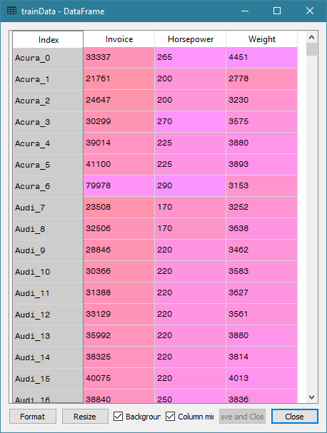
Training Data

Slide 54
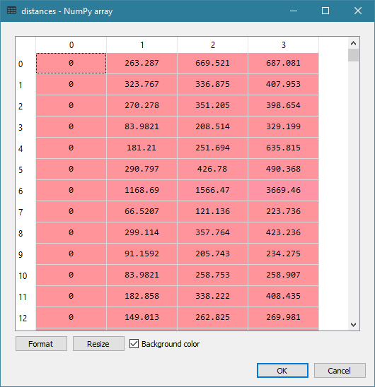
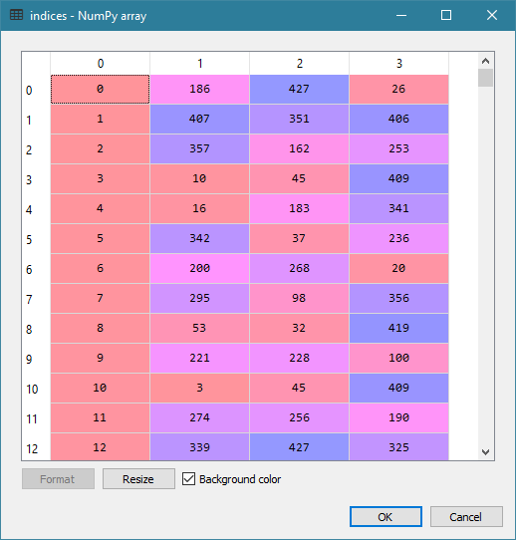
Distances and Indices

Slide 55
Find Neighbors
# Find the nearest neighbors of these focal observations
focal = [[173560, 477, 3131], # 334: Porsche 911 GT2 2dr
[119600, 493, 4473], # 262: Mercedes-Benz CL600 2dr
[117854, 493, 4429], # 271: Mercedes-Benz SL600 convertible 2dr
[113388, 493, 4235]] # 270: Mercedes-Benz SL55 AMG 2dr
myNeighbors = nbrs.kneighbors(focal, return_distance = False)
print("My Neighbors = \n", myNeighbors)
My Neighbors =
[[334 262 271 270] 261: Mercedes-Benz CL500 2dr [88324, 302, 4085]
[262 271 270 261]
[271 262 270 261]
[270 271 262 261]]

Slide 56
Unsupervised, Orthonormalized
# Orthonormalized the training data
x = numpy.matrix(trainData.values)
xtx = x.transpose() * x
print("t(x) * x = \n", xtx)
# Eigenvalue decomposition
evals, evecs = numpy.linalg.eigh(xtx)
print("Eigenvalues of x = \n", evals)
print("Eigenvectors of x = \n",evecs)
# Here is the transformation matrix
transf = evecs * numpy.linalg.inv(numpy.sqrt(numpy.diagflat(evals)));
print("Transformation Matrix = \n", transf)
# Here is the transformed X
transf_x = x * transf;
print("The Transformed x = \n", transf_x)
# Check columns of transformed X
xtx = transf_x.transpose() * transf_x;
print("Expect an Identity Matrix = \n", xtx)
nbrs = kNNSpec.fit(transf_x)
distances, indices = nbrs.kneighbors(transf_x)

Slide 57
Orthonormalization
t(x) * x =
[[518478936590 3219102117 48492493679]
[ 3219102117 22151103 345284887]
[ 48492493679 345284887 5725124540]]
Eigenvalues of x =
[5.21119307e+05 1.18095293e+09 5.23044738e+11]
Eigenvectors of x =
[[ 0.00272996 -0.09349631 -0.99561588]
[-0.99930601 0.03673123 -0.00618944]
[ 0.03714888 0.99494184 -0.09333115]]
Transformation Matrix =
[[ 3.78170771e-06 -2.72068445e-06 -1.37664638e-06]
[-1.38429904e-03 1.06885585e-06 -8.55818530e-09]
[ 5.14608751e-05 2.89521886e-05 -1.29049758e-07]]
The Transformed x =
[[-0.0117161 0.03844998 -0.04646993]
[-0.05160776 0.02143814 -0.03031741]
[-0.01743343 0.02667263 -0.03434875]
...
[-0.02200692 -0.0097789 -0.05908168]
[ 0.00307681 0.0148444 -0.03428758]
[ 0.03402063 0.02081924 -0.04607865]]
Expect an Identity Matrix =
[[ 1.00000000e+00 -9.72052300e-14 -2.69346177e-14]
[-9.72052300e-14 1.00000000e+00 -2.77555756e-17]
[-2.69346177e-14 -2.77555756e-17 1.00000000e+00]]

Slide 58
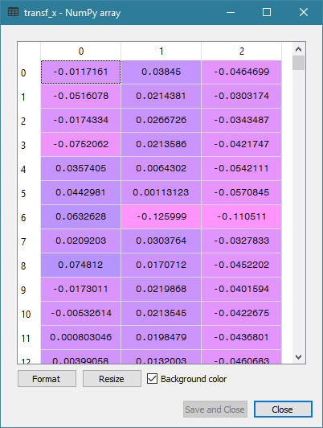
Orthonormalized Training Data

Slide 59
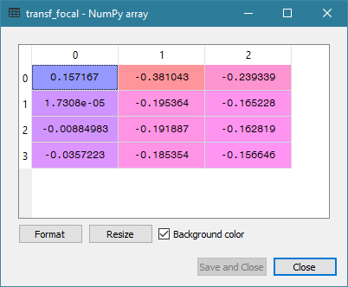
Orthonormalized Focal Data

Slide 60
Find Neighbors After Orthonormalization
# Find the nearest neighbors of these focal observations
focal = [[173560, 477, 3131], # Porsche_335
[119600, 493, 4473], # Mercedes-Benz_263
[117854, 493, 4429], # Mercedes-Benz_272
[113388, 493, 4235]] # Mercedes-Benz_271
transf_focal = focal * transf;
myNeighbors_t = nbrs.kneighbors(transf_focal, return_distance = False)
print("My Neighbors = \n", myNeighbors_t)
My Neighbors =
[[206 382 168 345] # 206 - Kia Rio 4dr manual (9875, 104, 2403)
[206 382 168 345] # 382 - Toyota Echo 2dr manual (10144, 108, 2035)
[206 382 168 345] # 168 - Hyundai Accent 2dr hatch (10107, 103, 2255)
[206 382 168 345]] # 345 - Saturn Ion1 4dr (10319, 140, 2692)

Slide 61
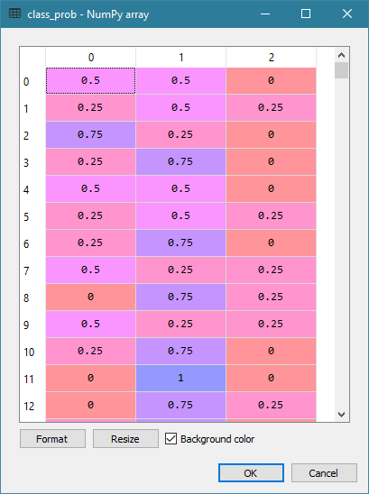
Classification
from sklearn.neighbors import KNeighborsClassifier
# Specify target: 0 = Asia, 1 = Europe, 2 = USA
target = cars['Origin']
neigh = KNeighborsClassifier(n_neighbors=4 , algorithm = 'brute', metric = 'euclidean')
nbrs = neigh.fit(trainData, target)
# See the classification probabilities
class_prob = nbrs.predict_proba(trainData)
print(class_prob)
Week 2 Nearest Neighbors Supervised.py

Slide 62
Misclassification Rate
# Calculate the Misclassification Rate
targetClass = ['Asia', 'Europe', 'USA']
nMissClass = 0
for i in range(cars_wIndex.shape[0]):
j = numpy.argmax(class_prob[i][:])
predictClass = targetClass[j]
if (predictClass != target.iloc[i]):
nMissClass += 1
rateMissClass = nMissClass / cars_wIndex.shape[0]
print('Misclassification Rate = ', rateMissClass)
Misclassification Rate = 0.32009345794392524

Slide 63
Python SKLEARN Nearest Neighbors
http://scikit-learn.org/stable/modules/neighbors.html#unsupervised-neighbors
Pros
Produces results that are readily understandable.
Works efficiently on almost any number of variables.
Offers three algorithms for storing the training data.
Cons
Cannot handle training data with nominal and interval features.
Returns NaN distance for some feature (e.g., try adding the Cylinders)
Does not suggest an optimal number of neighbors

Slide 64
Assignment 1
Open CS484_Machine_Learning_Assignment_1.docx
Due at 11:59 PM on Wednesday, September 9, 2020.
You must submit your answers as a PDF file.
You must also submit your Python codes as .py files
You can attempt to submit your answers no more than two times.
Only the most recently submitted answers will be graded.

