Slide 1

CS 484 Intro to Machine Learning
Week 4
September 16, 2020

Slide 2
Week 4: Cluster Discovery
K-Mean Clustering
Bi-Clustering
Spectral Clustering
Chapter 4 of the Machine Learning book

Slide 3
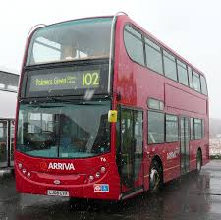
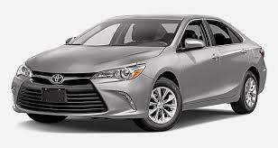

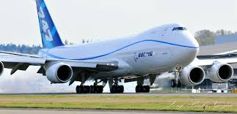
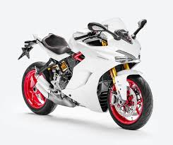
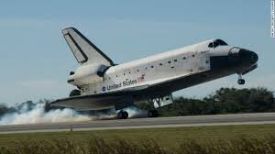
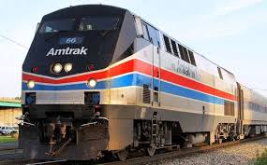




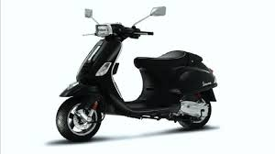
Group These Motorized Vehicles

Slide 4
Quantitatively, Group By What Criteria?
Physical Attributes
Number of Wheels? 0, 2, 4, …
Presence of Wings? 0 or 1
Weight? 300 lb. (motorcycle) to Infinity
Top Speed? 23 mph (cruise ship) to 17,500 mph (space shuttle)
Maximum Payload? 200 lb. (motorcycle), 50 tons (space shuttle), 248 tons (747), 50,000 tons (cruise ship) to Infinity (freight train)
Socio-Economic Attributes
Number of Passengers? 1, 2, 3, 4, …
Sticker Price? $20,000 (car) to Infinity
Personal Ownership? 0 or 1
Travel Environment? Sea, Land, Air, or Space
Satisfaction of Owning The Vehicle? High, Medium, and Low

Slide 5
Group By Common Sense …

Slide 6
Cluster Analysis: Overview
Motivation: Consider the observations come from multiple populations
Objective: Discover and identify clusters among observations
Objects within the same cluster are as similar as possible
Objects from different clusters are as dissimilar as possible
These clusters represent their respective populations
Process: Partition the observations into disjoint clusters
Similar observations are put into the same cluster
Observations in different clusters are dissimilar

Slide 7
Cluster Analysis: What is a Cluster?
The short answer is: a cluster is a collection of observations.
From a statistician point of view, a cluster is a collection of observations that have similar characteristics of attributes.
From a domain expert point of view, a cluster is a gathering of observations that share some common business values that are reflected by their similar characteristics of attributes.
A statistician’s job is to discover the clusters, a domain expert’s job is to give the clusters their identities – what the clusters tell us about the observations.
As a data scientist, you are expected to do both jobs.

Slide 8
Cluster Analysis
Specifications for Clustering:
What is the definition of “similar” or “dissimilar”?
How to assign observations into clusters?
How many clusters are there (or do we need)?
Post-Clustering:
How do we describe the clusters?
What are the dominant characteristics of clusters?

Slide 9
Cluster Analysis: What is Similar or Dissimilar?
We use a distance metric to measure similarity or dissimilarity.
Suppose there are three observations: x₁, x₂, and x₃. We will say that x₁ is similar to x₂, but dissimilar to x₃ if d(x₁,x₂) < d(x₁,x₃) where d(.,.) is a distance metric.
A function is a distance metric if it has the following four properties:
Non-negativity: d(x₁,x₂) ≥ 0
Coincidence: d(x₁,x₂) = 0 if and only if x₁ = x₂
Symmetry: d(x₁,x₂) = d(x₂,x₁)
Triangle Inequality: d(x₁,x₂) + d(x₂,x₃) ≥ d(x₁,x₃)

Slide 10
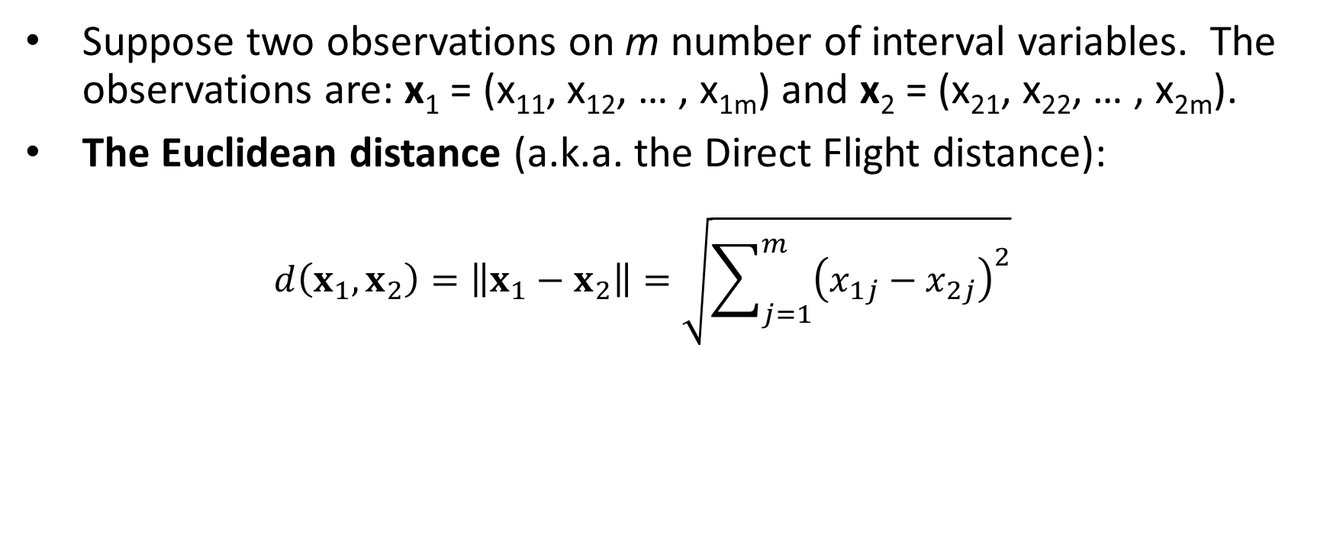
Distance Metric for Interval Variables
Suppose two observations on m number of interval variables. The observations are: x₁ = (x₁₁, x₁₂, … , x_{1m}) and x₂ = (x₂₁, x₂₂, … , x_{2m}).
The Euclidean distance (a.k.a. the Direct Flight distance): $d\left(x_{1},x_{2}\right)=\left\|x_{1}−x_{2}\right\|=\sqrt{\sum_{j=1}^{m}{{\left(x_{1j}−x_{2j}\right)}^{2}}}$

Slide 11
Normalization of Interval Variables
If all variables are measured in the same units (for example, feet) or of similar variances, then normalization might not be necessary.
Otherwise, some form of normalization is recommended because variables that have substantially larger variances tend to affect the distance measure more than variables that have smaller variances.

Slide 12
Normalization for Interval Variables
Standardization
The transformation is (value – mean) / (standard deviation).
The resulting variable has a mean of 0 and a variance of 1.
Range
The transformation is (value – minimum) / (maximum – minimum).
The resulting variable has a minimum of 0 and a maximum of 1.

Slide 13
Cluster Analysis: Centroids
Centroids represent the center of a cluster
Centroids give identity to a cluster
Centroids are usually the arithmetic means of the interval variables
If we can visualize a cluster as a two-dimensional ellipse, then the centroid of the cluster is the center of the ellipse.
X

Slide 14
Cluster Analysis: Cluster Identifier
Clusters are sequentially labeled from 1 to the number of clusters (or from 0 to one less than the number of clusters)
The Cluster Identifiers are integers
The Cluster Identifiers do not indicate the discovery order of the clusters, the relative magnitudes of the centroids, or any relationships among the clusters

Slide 15
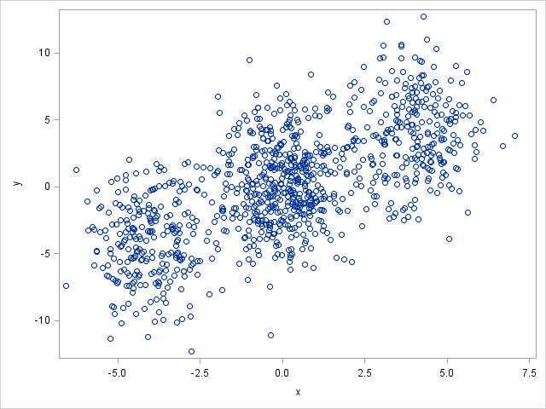
The Basic Idea of the K-Means Algorithm
Assign observations into non-overlapping hyperspheres
The radii of hyper-spheres are as small as possible
Each observation must belong to one and only one hyper-sphere

Slide 16
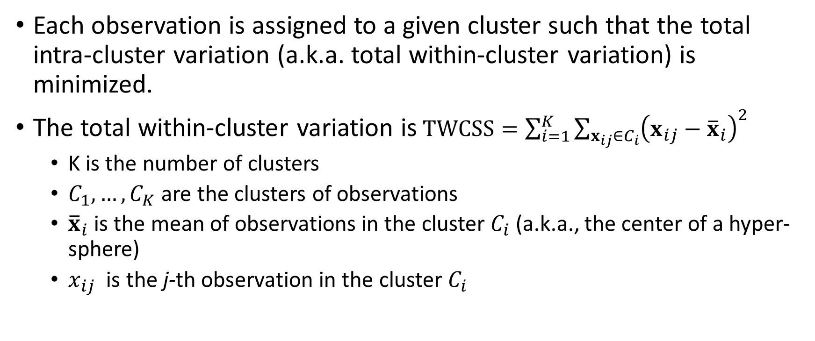
The Basic Idea of the K-Means Algorithm
Each observation is assigned to a given cluster such that the total intra-cluster variation (a.k.a. total within-cluster variation) is minimized.
The total within-cluster variation is$TWCSS=\sum_{i=1}^{K}{\sum_{x_{ij}∈C_{i}}{{\left(x_{ij}−{\overline{x}}_{i}\right)}^{2}}}$
K is the number of clusters
$C_{1},…,C_{K}$ are the clusters of observations
${\overline{x}}_{i}$ is the mean of observations in the cluster $C_{i}$ (a.k.a., the center of a hyper-sphere)
$x_{ij}$ is the j-th observation in the cluster $C_{i}$

Slide 17
Cluster Analysis: K-Means Algorithm
Summary of the K-Means Algorithm:
Specify the number of clusters (K > 1)
Select K observations as initial centroids
Repeat
Form K clusters by assigning all observations to the closest centroids
Re-compute centroids of all K clusters
Until the Total Within-Cluster variation converges (in practice, check that the centroids converge within a tolerance limit)

Slide 18
Cluster Analysis: Initial Centroids
Common strategies for choosing the initial centroids
Scan the first K complete records and use their values as initial centroids (i.e., first complete record’s values are the first cluster’s initial centroid, and so on)
Randomly choose K complete records and use their values as initial centroids (used by the sklearn.cluster.Kmeans)
Usually, the choice of the initial centroids will not affect the final results. It may impact the number of iterations.

Slide 19
History of the K-Means Algorithm
K-means is often referred to as Lloyd’s algorithm.
Lloyd, S. P. (1957). "Least square quantization in PCM". Bell Telephone Laboratories Paper.
Pulse-code modulation (PCM) is a method used to digitally represent sampled analog signals.
Republished later as Lloyd., S. P. (1982). "Least squares quantization in PCM”. IEEE Transactions on Information Theory. 28 (2): 129–137.
Forgy, E. W. (1965). "Cluster analysis of multivariate data: efficiency versus interpretability of classifications". Biometrics. 21: 768–769.
Hartigan, J. A., and Wong, M. A. (1979). “Algorithm AS 136: A K-Means Clustering Algorithm”. Applied Statistics. 28(1): 100-108.

Slide 20
Simple Example
Five observations in ascending order: 0.1, 0.3, 0.4, 0.8, and 0.9
Find the two clusters solution using the Euclidean distance
For one dimension, this distance is simply the absolute difference
Iteration 1:
Initial centroids: C1 = 0.1, C2 = 0.3
Distance from C1: 0, 0.2, 0.3, 0.7, and 0.8 (WCSS = 0)
Distance from C2: 0.2, 0, 0.1, 0.5, and 0.6 (WCSS = 0.62)
Total WCSS = 0.62
Cluster membership: 1, 2, 2, 2, 2
New centroid: C1 = 0.1, C2 = (0.3+0.4+0.8+0.9)/4 = 0.6
Week 4 Kmeans.py

Slide 21
Simple Example
Five observations: 0.1, 0.3, 0.4, 0.8, and 0.9
Find the two clusters solution using the Euclidean distance
Iteration 2:
Initial centroids: C1 = 0.1, C2 = 0.6
Distance from C1: 0, 0.2, 0.3, 0.7, and 0.8 (WCSS = 0.04)
Distance from C2: 0.5, 0.3, 0.2, 0.2, and 0.3 (WCSS = 0.17)
Total WCSS = 0.21
Cluster membership: 1, 1, 2, 2, 2
New centroid: C1 = (0.1+0.3)/2 = 0.2, C2 = (0.4+0.8+0.9)/3 = 0.7

Slide 22
Simple Example
Five observations: 0.1, 0.3, 0.4, 0.8, and 0.9
Find the two clusters solution using the Euclidean distance
Iteration 3:
Initial centroids: C1 = 0.2, C2 = 0.7
Distance from C1: 0.1, 0.1, 0.2, 0.6, and 0.7 (WCSS = 0.06)
Distance from C2: 0.6, 0.4, 0.3, 0.1, and 0.2 (WCSS = 0.05)
Total WCSS = 0.11
Cluster membership: 1, 1, 1, 2, 2
New centroid: C1 = (0.1+0.3+0.4)/3 = 0.267, C2 = (0.8+0.9)/2 = 0.85

Slide 23
Simple Example
Five observations: 0.1, 0.3, 0.4, 0.8, and 0.9
Find the two clusters solution using the Euclidean distance
Iteration 4:
Initial centroids: C1 = 0.267, C2 = 0.85
Distance from C1: 0.167, 0.003, 0.133, 0.533, and 0.633 (WCSS = 0.0467)
Distance from C2: 0.75, 0.55, 0.45, 0.05, and 0.05 (WCSS = 0.005)
Total WCSS = 0.051667
Cluster membership: 1, 1, 1, 2, 2
New centroid: C1 = (0.1+0.3+0.4)/3 = 0.267, C2 = (0.8+0.9)/2 = 0.85
Iteration ends because the centroids converged and there are no changes in cluster memberships

Slide 24
Simple Example
import numpy
import sklearn.cluster as cluster
X = numpy.array([[0.1], [0.3], [0.4], [0.8], [0.9]])
kmeans = cluster.KMeans(n_clusters=2, random_state=0).fit(X)
print("Cluster Assignment:", kmeans.labels_)
print("Cluster Centroid 0:", kmeans.cluster_centers_[0])
print("Cluster Centroid 1:", kmeans.cluster_centers_[1])
Cluster Assignment: [1 1 1 0 0]
Cluster Centroid 0: [0.85]
Cluster Centroid 1: [0.26666667]

Slide 25
K-Means Algorithm (Observations’ Order)
Five observations in random order: 0.8, 0.3, 0.1, 0.4, and 0.9
Find the two clusters solution using the Euclidean distance
Iteration 1:
Initial centroids: C1 = 0.8, C2 = 0.3
Distance from C1: 0, 0.5, 0.7, 0.4, and 0.1 (WCSS = 0.01)
Distance from C2: 0.5, 0, 0.2, 0.1, and 0.6 (WCSS = 0.05)
Total WCSS = 0.06
Cluster membership: 1, 2, 2, 2, 1
New centroid: C1 = (0.8 + 0.9) = 0.85, C2 = (0.3+0.1+0.4)/3 = 0.2667

Slide 26
K-Means Algorithm
Five observations in random order: 0.8, 0.3, 0.1, 0.4, and 0.9
Find the two clusters solution using the Euclidean distance
Iteration 2:
Initial centroids: C1 = 0.85, C2 = 0.2667
Distance from C1: 0.05, 0.55, 0.75, 0.45, and 0.05 (WCSS = 0.005)
Distance from C2: 0.5333, 0.0333, 0.1667, 0.1333, and 0.6333 (WCSS = 0.04667)
Total WCSS = 0.05167
Cluster membership: 1, 2, 2, 2, 1
New centroid: C1 = (0.8 + 0.9) = 0.85, C2 = (0.3+0.1+0.4)/3 = 0.2667
Iteration ends because the centroids converged and there are no changes in cluster memberships.

Slide 27
Simple Example
X2 = numpy.array([[0.8], [0.3], [0.1], [0.4], [0.9]])
kmeans = cluster.KMeans(n_clusters=2, random_state=0).fit(X2)
print("Cluster Assignment:", kmeans.labels_)
print("Cluster Centroid 0:", kmeans.cluster_centers_[0])
print("Cluster Centroid 1:", kmeans.cluster_centers_[1])
Cluster Assignment: [0 1 1 1 0]
Cluster Centroid 0: [0.85]
Cluster Centroid 1: [0.26666667]

Slide 28
What is the Number of Clusters?
Preferably, what is the optimal number of clusters?
This is necessary information which we usually do not know
We try a different number of clusters from a range of integers (greater than one) and find an optimal value based on some selection criteria.
Elbow method
Silhouette method

Slide 29
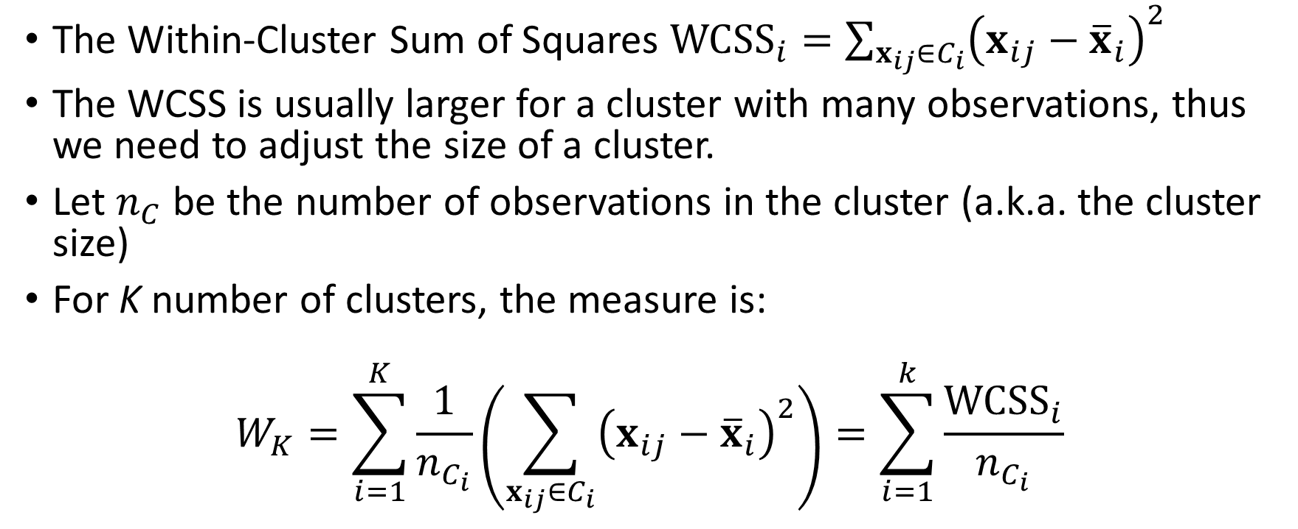
The Elbow Method
The Within-Cluster Sum of Squares ${WCSS}_{i}=\sum_{x_{ij}∈C_{i}}{{\left(x_{ij}−{\overline{x}}_{i}\right)}^{2}}$
The WCSS is usually larger for a cluster with many observations, thus we need to adjust the size of a cluster.
Let $n_{C}$ be the number of observations in the cluster (a.k.a. the cluster size)
For K number of clusters, the measure is:
$$W_{K}=\sum_{i=1}^{K}{\frac{1}{n_{C_{i}}}\left(\sum_{x_{ij}∈C_{i}}{{\left(x_{ij}−{\overline{x}}_{i}\right)}^{2}}\right)=\sum_{i=1}^{k}{\frac{{WCSS}_{i}}{n_{C_{i}}}}}$$

Slide 30
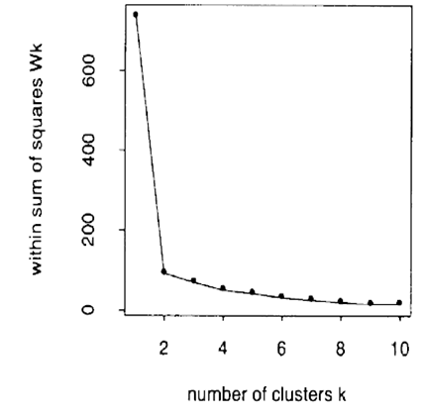
The Elbow Method
Create clusters for K = 1, 2, … and up to a conventionally specified upper limit
Plot W_{K} versus K
The curve is decreasing in theory
Select the K corresponding to the first elbow in the L-curve (e.g., 2 from the graph on the right)

Slide 31
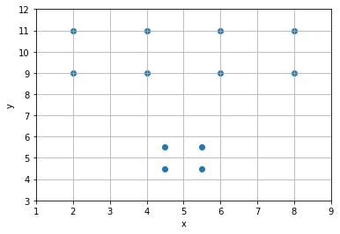
How Many Clusters Are There?
x | y
2 | 11
4 | 11
2 | 9
4 | 9
6 | 11
8 | 11
6 | 9
8 | 9
4.5 | 5.5
5.5 | 5.5
5.5 | 4.5
4.5 | 4.5

Slide 32
One-Clusters Solution …
Centroids
Cluster | x | y | Size
0 | 5 | 25/3 | 12
The centroid of the One-Cluster solution is basically the means of the variables

Slide 33
One-Clusters Solution …
x | y | Cluster | Centroid | Squared Distance From Centroid | WCSS | WCSS / Cluster Size
2 | 11 | 0 | (5, 25/3) | 16.111111 | 116.66667 | 9.7222222
4 | 11 | 0 |  | 8.1111111
2 | 9 | 0 |  | 9.4444444
4 | 9 | 0 |  | 1.4444444
6 | 11 | 0 |  | 8.1111111
8 | 11 | 0 |  | 16.111111
6 | 9 | 0 |  | 1.4444444
8 | 9 | 0 |  | 9.4444444
4.5 | 5.5 | 0 |  | 8.2777778
5.5 | 5.5 | 0 |  | 8.2777778
5.5 | 4.5 | 0 |  | 14.944444
4.5 | 4.5 | 0 |  | 14.944444
Total |  |  |  |  | 116.66667 | 9.7222222

Slide 34
Two-Clusters Solution …
Centroids
Cluster | x | y | Size
0 | 5 | 10 | 8
1 | 5 | 5 | 4

Slide 35
Two-Clusters Solution …
x | y | Cluster | Centroid | Squared Distance From Centroid | WCSS | WCSS / Cluster Size
2 | 11 | 0 | (5,10) | 10 | 48 | 6
4 | 11 | 0 |  | 2
2 | 9 | 0 |  | 10
4 | 9 | 0 |  | 2
6 | 11 | 0 |  | 2
8 | 11 | 0 |  | 10
6 | 9 | 0 |  | 2
8 | 9 | 0 |  | 10
4.5 | 5.5 | 1 | (5,5) | 0.5 | 2 | 0.5
5.5 | 5.5 | 1 |  | 0.5
5.5 | 4.5 | 1 |  | 0.5
4.5 | 4.5 | 1 |  | 0.5
Total |  |  |  |  | 50 | 6.5

Slide 36
Three-Clusters Solution …
Centroids
Cluster | x | y | Size
0 | 3 | 10 | 4
1 | 5 | 5 | 4
2 | 7 | 10 | 4

Slide 37
Three-Clusters Solution …
x | y | Cluster | Centroid | Squared Distance From Centroid | WCSS | WCSS / Cluster Size
2 | 11 | 0 | (3,10) | 2 | 8 | 2
4 | 11 | 0 |  | 2
2 | 9 | 0 |  | 2
4 | 9 | 0 |  | 2
6 | 11 | 2 | (7,10) | 2 | 8 | 2
8 | 11 | 2 |  | 2
6 | 9 | 2 |  | 2
8 | 9 | 2 |  | 2
4.5 | 5.5 | 1 | (5,5) | 0.5 | 2 | 0.5
5.5 | 5.5 | 1 |  | 0.5
5.5 | 4.5 | 1 |  | 0.5
4.5 | 4.5 | 1 |  | 0.5
Total |  |  |  |  | 18 | 4.5

Slide 38
Four-Clusters Solution …
Centroids
Cluster | x | y | Size
0 | 5 | 5 | 4
1 | 6 | 10 | 2
2 | 3 | 10 | 4
3 | 8 | 10 | 2

Slide 39
Four-Clusters Solution …
x | y | Cluster | Centroid | Squared Distance From Centroid | WCSS | WCSS / Cluster Size
2 | 11 | 2 | (3,10) | 2 | 8 | 2
4 | 11 | 2 |  | 2
2 | 9 | 2 |  | 2
4 | 9 | 2 |  | 2
6 | 9 | 1 | (6,10) | 1 | 2 | 1
6 | 11 | 1 |  | 1
8 | 9 | 3 | (8,10) | 1 | 2 | 1
8 | 11 | 3 |  | 1
4.5 | 5.5 | 0 | (5,5) | 0.5 | 2 | 0.5
5.5 | 5.5 | 0 |  | 0.5
5.5 | 4.5 | 0 |  | 0.5
4.5 | 4.5 | 0 |  | 0.5
Total |  |  |  |  | 14 | 4.5

Slide 40
Five-Clusters Solution …
Centroids
Cluster | x | y | Size
0 | 5 | 5 | 4
1 | 6 | 10 | 2
2 | 2 | 10 | 2
3 | 8 | 10 | 2
4 | 4 | 10 | 2

Slide 41
Six-Clusters Solution …
Centroids
Cluster | x | y | Size
0 | 4 | 10 | 2
1 | 5 | 5 | 4
2 | 6 | 10 | 2
3 | 2 | 10 | 2
4 | 8 | 11 | 1
4 | 8 | 9 | 1

Slide 42
Summary
Number of Clusters | Within-Cluster Sum of Squares | Elbow Value
1 | 116.6667 | 9.7222
2 | 50 | 6.5
3 | 18 | 4.5
4 | 14 | 4.5
5 | 10 | 4.5
6 | 8 | 3.5

Slide 43
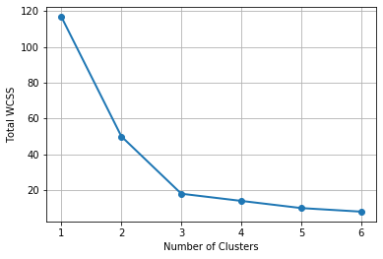
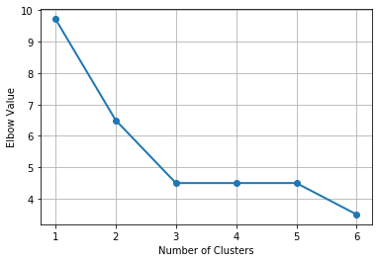
Within-Cluster-SS versus Elbow Value
The elbow is the point where the slope changes substantially. We can spot that point easier in the Elbow chart.

Slide 44


The Silhouette Method
Ideally, observations within a cluster should be close together but they should be far away from other clusters.

Slide 45
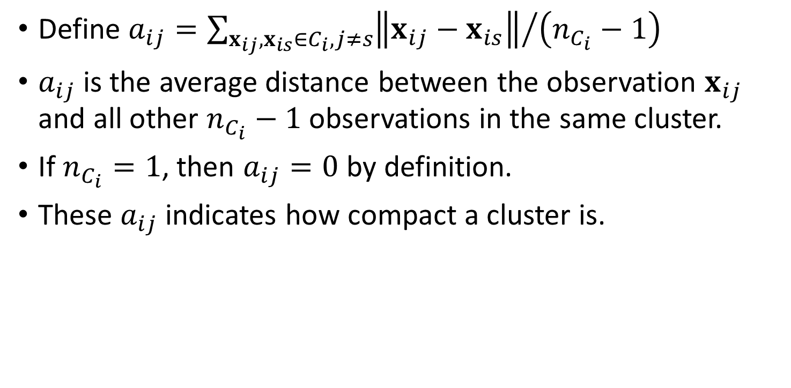
The Silhouette Method
Define $a_{ij}={\sum_{x_{ij},x_{is}∈C_{i},j≠s}{\left\|x_{ij}−x_{is}\right\|}}/{\left(n_{C_{i}}−1\right)}$
$a_{ij}$is the average distance between the observation $x_{ij}$ and all other $n_{C_{i}}−1$ observations in the same cluster.
If $n_{C_{i}}=1$, then $a_{ij}=0$ by definition.
These $a_{ij}$ indicates how compact a cluster is.

Slide 46

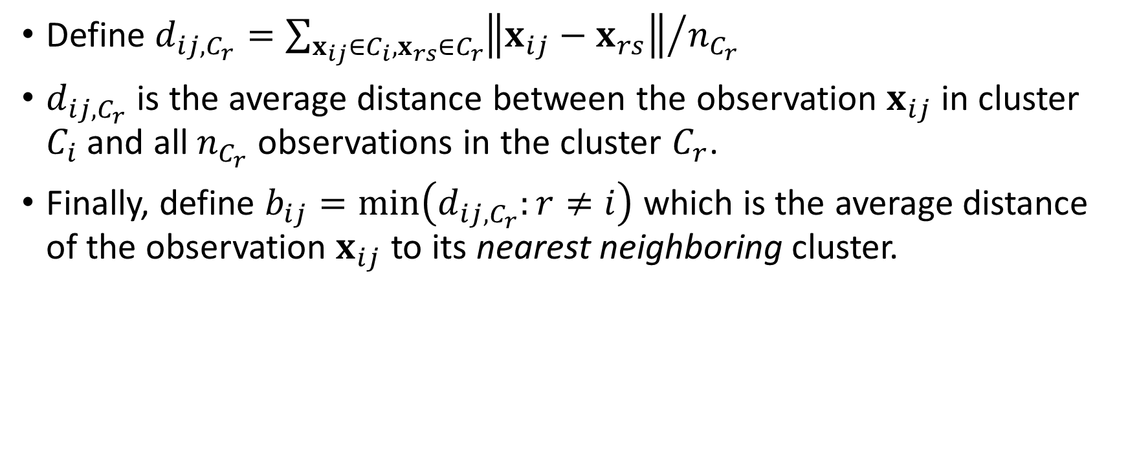
The Silhouette Method
Define $d_{ij,C_{r}}={\sum_{x_{ij}∈C_{i},x_{rs}∈C_{r}}{\left\|x_{ij}−x_{rs}\right\|}}/{n_{C_{r}}}$
$d_{ij,C_{r}}$ is the average distance between the observation $x_{ij}$ in cluster $C_{i}$and all $n_{C_{r}}$observations in the cluster $C_{r}$.
Finally, define $b_{ij}=min\left(d_{ij,C_{r}}:r≠i\right)$ which is the average distance of the observation $x_{ij}$ to its nearest neighboring cluster.

Slide 47
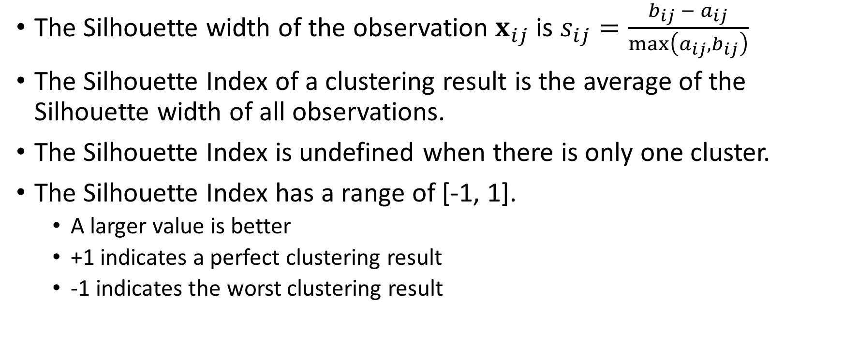
The Silhouette Method
The Silhouette width of the observation $x_{ij}$ is $s_{ij}=\frac{b_{ij} − a_{ij}}{max\left(a_{ij},b_{ij}\right)}$
The Silhouette Index of a clustering result is the average of the Silhouette width of all observations.
The Silhouette Index is undefined when there is only one cluster.
The Silhouette Index has a range of [-1, 1].
A larger value is better
+1 indicates a perfect clustering result
-1 indicates the worst clustering result

Slide 48
Two-Clusters Solution …
Centroids
Cluster | x | y | Size
0 | 5 | 10 | 8
1 | 5 | 5 | 4

Slide 49
Two-Clusters Solution …
x | y | Cluster | Distance from (2,11) | Sum
2 | 11 | 0 | 0 | 27.6251184 | Divide Sum by (8 – 1) gives a_ij = 3.94644548572608
4 | 11 | 0 | 2
2 | 9 | 0 | 2
4 | 9 | 0 | 2.828427125
6 | 11 | 0 | 4
8 | 11 | 0 | 6
6 | 9 | 0 | 4.472135955
8 | 9 | 0 | 6.32455532
4.5 | 5.5 | 1 | 6.041522987 | 26.90733106 | Divide Sum by 4 gives b_ij = 6.72683276517717
5.5 | 5.5 | 1 | 6.519202405
5.5 | 4.5 | 1 | 7.38241153
4.5 | 4.5 | 1 | 6.964194139

Slide 50
Two-Clusters Solution …
x | y | Cluster | Distance from (4.5, 5.5) | Sum
2 | 11 | 0 | 6.041522987 | 40.37861359 | Divide Sum by 8 gives b_ij = 5.047326698
4 | 11 | 0 | 5.522680509
2 | 9 | 0 | 4.301162634
4 | 9 | 0 | 3.535533906
6 | 11 | 0 | 5.700877125
8 | 11 | 0 | 6.519202405
6 | 9 | 0 | 3.807886553
8 | 9 | 0 | 4.949747468
4.5 | 5.5 | 1 | 0 | 3.414213562 | Divide Sum by (4 – 1) gives a_ij = 1.138071187
5.5 | 5.5 | 1 | 1
5.5 | 4.5 | 1 | 1.414213562
4.5 | 4.5 | 1 | 1

Slide 51
Two-Clusters Solution …
Some b_ij values in Cluster 1 are less than that in Cluster 0 ➔ Cluster 0 may be divided
x | y | Cluster | a_ij | b_ij | s_ij
2 | 11 | 0 | 3.946445486 | 6.726832765 | 0.413327843
4 | 11 | 0 | 2.875570029 | 6.103398018 | 0.528857528
2 | 9 | 0 | 3.946445486 | 5.024900574 | 0.214622175
4 | 9 | 0 | 2.875570029 | 4.15363238 | 0.307697512
6 | 11 | 0 | 2.875570029 | 6.103398018 | 0.528857528
8 | 11 | 0 | 3.946445486 | 6.726832765 | 0.413327843
6 | 9 | 0 | 2.875570029 | 4.15363238 | 0.307697512
8 | 9 | 0 | 3.946445486 | 5.024900574 | 0.214622175
4.5 | 5.5 | 1 | 1.138071187 | 5.047326698 | 0.774520007
5.5 | 5.5 | 1 | 1.138071187 | 5.047326698 | 0.774520007
5.5 | 4.5 | 1 | 1.138071187 | 5.95705517 | 0.808954063
4.5 | 4.5 | 1 | 1.138071187 | 5.95705517 | 0.808954063
 |  |  |  | Silhouette Value = | 0.507996521
Cluster 1 has smaller a_ij values than Cluster 0 ➔ Cluster 1 is more compact than Cluster 0

Slide 52
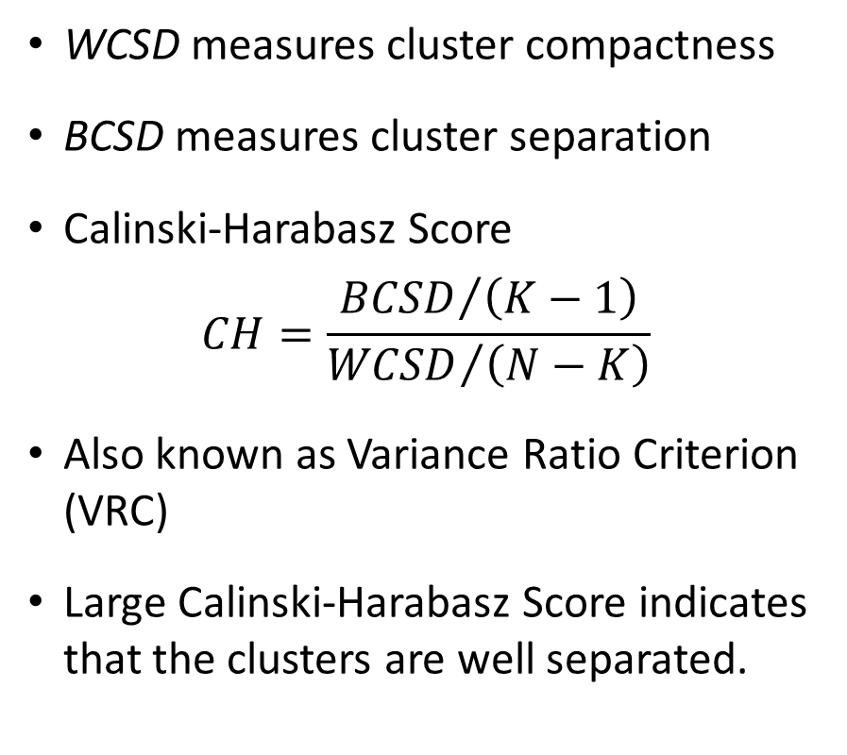
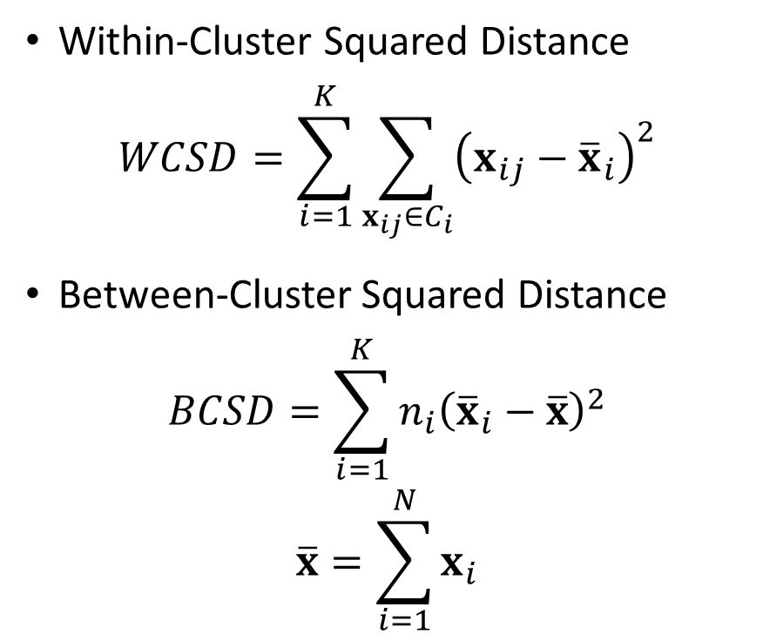
The Calinski-Harabasz Score
Within-Cluster Squared Distance
$$WCSD=\sum_{i=1}^{K}{\sum_{x_{ij}∈C_{i}}{{\left(x_{ij}−{\overline{x}}_{i}\right)}^{2}}}$$
Between-Cluster Squared Distance
$$BCSD=\sum_{i=1}^{K}{n_{i}{\left({\overline{x}}_{i}−\overline{x}\right)}^{2}}$$
$$\overline{x}=\sum_{i=1}^{N}{x_{i}}$$
WCSD measures cluster compactness
BCSD measures cluster separation
Calinski-Harabasz Score
$$CH=\frac{{BCSD}/{\left(K−1\right)}}{{WCSD}/{\left(N−K\right)}}$$
Also known as Variance Ratio Criterion (VRC)
Large Calinski-Harabasz Score indicates that the clusters are well separated.

Slide 53
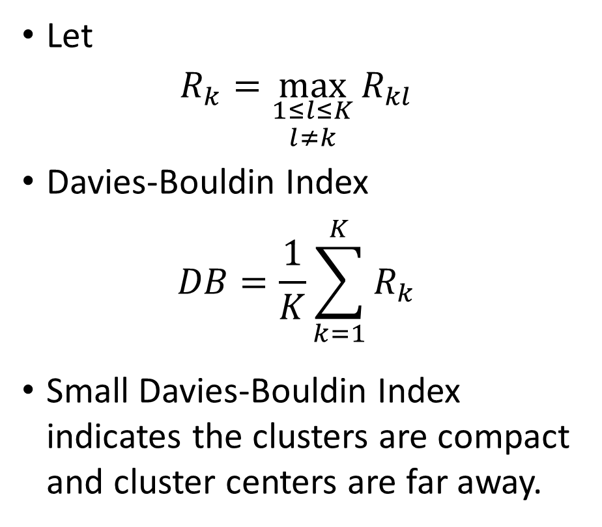
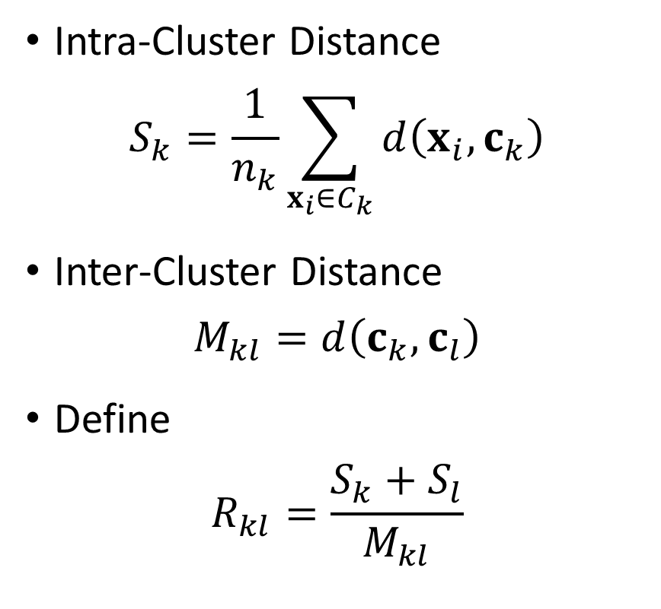
The Davies-Bouldin Index
Intra-Cluster Distance
$$S_{k}=\frac{1}{n_{k}}\sum_{x_{i}∈C_{k}}{d\left(x_{i},c_{k}\right)}$$
Inter-Cluster Distance
$$M_{kl}=d\left(c_{k},c_{l}\right)$$
Define
$$R_{kl}=\frac{S_{k}+S_{l}}{M_{kl}}$$
Let
$$R_{k}=\max_{\begin{aligned}1≤l≤K \\ l≠k\end{aligned}}{R_{kl}}$$
Davies-Bouldin Index
$$DB=\frac{1}{K}\sum_{k=1}^{K}{R_{k}}$$
Small Davies-Bouldin Index indicates the clusters are compact and cluster centers are far away.

Slide 54
Summary
Number of Clusters | Within-Cluster Sum of Squares | Elbow Value | Silhouette Value | Calinski-Harabasz Score | Davies-Bouldin Index
1 | 116.6667 | 9.7222 | Undefined | Undefined | Undefined
2 | 50 | 6.5 | 0.5080 | 13.3333 | 0.5991
3 | 18 | 4.5 | 0.5515 | 24.6667 | 0.6027
4 | 14 | 4.5 | 0.4025 | 19.5556 | 0.7997
5 | 10 | 4.5 | 0.3715 | 18.6667 | 0.8670
6 | 8 | 3.5 | 0.3119 | 16.3000 | 0.7049

Slide 55
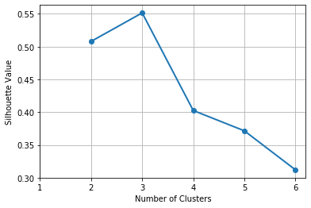
Elbow Value versus Silhouette Value
Except for noisy data, both the Elbow Chart and the Silhouette Chart will conclude the same “number of clusters”
Week 4 Toy KMeans.py

Slide 56
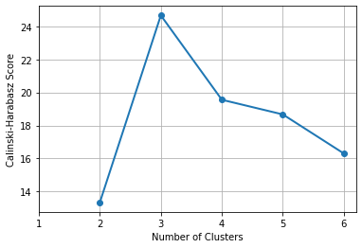
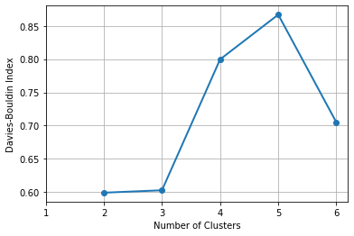
Calinski-Harabasz Score, Davies-Bouldin Index
Calinski-Harabasz Score suggests three clusters
Although Davies-Bouldin Index suggests two clusters, this index is close to that of the three clusters.
Week 4 Toy KMeans.py

Slide 57
Clusters of Distances From Chicago
CityState | StateCode | City | DrivingMilesFromChicago |  | CityState | StateCode | City | DrivingMilesFromChicago
Albany, NY | NY | Albany | 820 |  | Little Rock, AR | AR | Little Rock | 655
Albuquerque, NM | NM | Albuquerque | 1341 |  | Los Angeles, CA | CA | Los Angeles | 2028
Atlanta, GA | GA | Atlanta | 712 |  | Louisville, KY | KY | Louisville | 297
Baltimore, MD | MD | Baltimore | 704 |  | Memphis, TN | TN | Memphis | 536
Billings, MT | MT | Billings | 1247 |  | Miami, FL | FL | Miami | 1373
Birmingham, AL | AL | Birmingham | 661 |  | Milwaukee, WI | WI | Milwaukee | 92
Boise, ID | ID | Boise | 1702 |  | Minneapolis, MN | MN | Minneapolis | 407
Boston, MA | MA | Boston | 986 |  | Nashville, TN | TN | Nashville | 472
Buffalo, NY | NY | Buffalo | 531 |  | New Orleans, LA | LA | New Orleans | 927
Charleston, WV | WV | Charleston | 484 |  | New York, NY | NY | New York | 811
Charleston, SC | SC | Charleston | 911 |  | Norfolk, VA | VA | Norfolk | 891
Charlotte, NC | NC | Charlotte | 770 |  | Oklahoma City, OK | OK | Oklahoma City | 796
Cheyenne, WY | WY | Cheyenne | 968 |  | Omaha, NE | NE | Omaha | 469
Cleveland, OH | OH | Cleveland | 342 |  | Orlando, FL | FL | Orlando | 1152
Columbia, SC | SC | Columbia | 802 |  | Philadelphia, PA | PA | Philadelphia | 761
Columbus, OH | OH | Columbus | 352 |  | Phoenix, AZ | AZ | Phoenix | 1804
Dallas, TX | TX | Dallas | 933 |  | Pittsburgh, PA | PA | Pittsburgh | 460
Denver, CO | CO | Denver | 1009 |  | Portland, ME | ME | Portland | 1087
Des Moines, IA | IA | Des Moines | 333 |  | Portland, OR | OR | Portland | 2122
Detroit, MI | MI | Detroit | 278 |  | Rapid City, SD | SD | Rapid City | 909
EL Paso, TX | TX | EL Paso | 1488 |  | Reno, NV | NV | Reno | 1924
Fargo, ND | ND | Fargo | 644 |  | Saint Louis, MO | MO | Saint Louis | 300
Grand Junction, CO | CO | Grand Junction | 1252 |  | Salt Lake City, UT | UT | Salt Lake City | 1404
Hartford, CT | CT | Hartford | 903 |  | San Antonio, TX | TX | San Antonio | 1210
Houston, TX | TX | Houston | 1089 |  | San Diego, CA | CA | San Diego | 2088
Indianapolis, IN | IN | Indianapolis | 179 |  | San Francisco, CA | CA | San Francisco | 2148
Jackson, MS | MS | Jackson | 747 |  | Seattle, WA | WA | Seattle | 2070
Jacksonville, FL | FL | Jacksonville | 1058 |  | Washington, DC | DC | Washington | 705
Kansas City, MO | MO | Kanas City | 529 |  | Wichita, KS | KS | Wichita | 725
Las Vegas, NV | NV | Las Vegas | 1755
Data
DistanceFromChicago.csv
Clustering
Discover up to 15 clusters
Week 4 Distance From Chicago.py
Driving distances (in miles) from Chicago to 59 cities

Slide 58
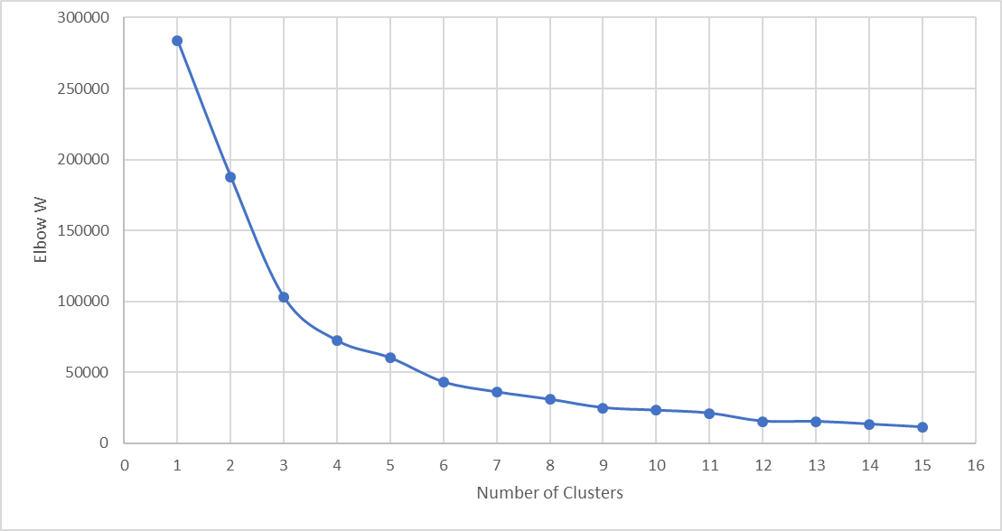
Clusters of Distances From Chicago
Number of Clusters | Elbow W
1 | 283894.49470
2 | 187758.44330
3 | 102762.12850
4 | 72117.19284
5 | 59977.70978
6 | 43009.44740
7 | 35976.15443
8 | 30744.71677
9 | 24872.10349
10 | 23059.31235
11 | 21039.24087
12 | 15339.02335
13 | 15204.20374
14 | 13337.71644
15 | 11278.23727

Slide 59
Clusters of Distances From Chicago
Number of Clusters | Elbow W | Slope | Acceleration
1 | 283894.49470
2 | 187758.44330 | -96136.05
3 | 102762.12850 | -84996.31 | 11139.74
4 | 72117.19284 | -30644.94 | 54351.38
5 | 59977.70978 | -12139.48 | 18505.45
6 | 43009.44740 | -16968.26 | -4828.78
7 | 35976.15443 | -7033.29 | 9934.97
8 | 30744.71677 | -5231.44 | 1801.86
9 | 24872.10349 | -5872.61 | -641.18
10 | 23059.31235 | -1812.79 | 4059.82
11 | 21039.24087 | -2020.07 | -207.28
12 | 15339.02335 | -5700.22 | -3680.15
13 | 15204.20374 | -134.82 | 5565.40
14 | 13337.71644 | -1866.49 | -1731.67
15 | 11278.23727 | -2059.48 | -192.99
Largest Acceleration (i.e., change of slope)

Slide 60
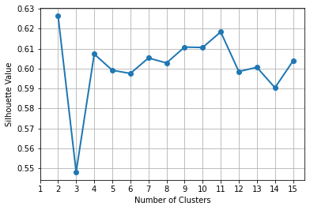
Clusters of Distances From Chicago
Number of Clusters | Silhouette Score
1
2 | 0.6264
3 | 0.5481
4 | 0.6073
5 | 0.5991
6 | 0.5975
7 | 0.6053
8 | 0.6028
9 | 0.6108
10 | 0.6106
11 | 0.6184
12 | 0.5985
13 | 0.6006
14 | 0.5904
15 | 0.6038

Slide 61
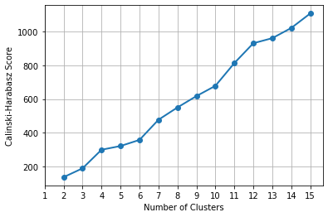
Clusters of Distances From Chicago
Number of Clusters | Calinski-Harabasz Score
1
2 | 135.7099
3 | 188.3643
4 | 298.7964
5 | 320.9637
6 | 357.1838
7 | 476.9584
8 | 550.1409
9 | 617.6819
10 | 678.6652
11 | 813.9098
12 | 931.9576
13 | 962.0584
14 | 1022.7607
15 | 1108.9120
Cannot Determine Number of Clusters!

Slide 62
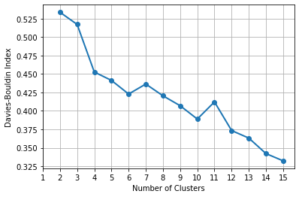
Clusters of Distances From Chicago
Number of Clusters | Davies-Bouldin Index
1
2 | 0.5337
3 | 0.5172
4 | 0.4527
5 | 0.4413
6 | 0.4229
7 | 0.4364
8 | 0.4205
9 | 0.4070
10 | 0.3890
11 | 0.4122
12 | 0.3734
13 | 0.3632
14 | 0.3422
15 | 0.3323
Cannot Determine Number of Clusters!

Slide 63
Four-Cluster Solution
Cluster 0 |  | Cluster 1 | Cluster 2 | Cluster 3
Size = 23 |  | 9 | 16 | 11
Centroid = 815.2 miles |  | 1,960.1 | 378.8 | 1,245.5
WCSS = 280,147.9 mile² |  | 228,916. 9 | 255,120.4 | 204,122.7
Albany, NY Atlanta, GA Baltimore, MD Birmingham, AL Boston, MA Charleston, SC Charlotte, NC Cheyenne, WY Columbia, SC Dallas, TX Denver, CO Fargo, ND Hartford, CT Jackson, MS Little Rock, AR New Orleans, LA | New York, NY Norfolk, VA Oklahoma City, OK Philadelphia, PA Rapid City, SD Washington, DC Wichita, KS | Boise, ID Las Vegas, NV Los Angeles, CA Phoenix, AZ Portland, OR Reno, NV San Diego, CA San Francisco, CA Seattle, WA | Buffalo, NY Charleston, WV Cleveland, OH Columbus, OH Des Moines, IA Detroit, MI Indianapolis, IN Kansas City, MO Louisville, KY Memphis, TN Milwaukee, WI Minneapolis, MN Nashville, TN Omaha, NE Pittsburgh, PA Saint Louis, MO | Albuquerque, NM Billings, MT EL Paso, TX Grand Junction, CO Houston, TX Jacksonville, FL Miami, FL Orlando, FL Portland, ME Salt Lake City, UT San Antonio, TX

Slide 64
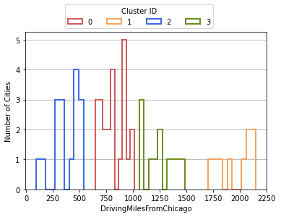
Visualize How Well Clusters are Separated
Cluster 1 is well-separated from the other three clusters.
Cluster 2 is fairly separated from the other three clusters
Cluster 0 and Cluster 3 narrowly separated from each other
Unfilled histogram bars allow for overlapping clusters

Slide 65
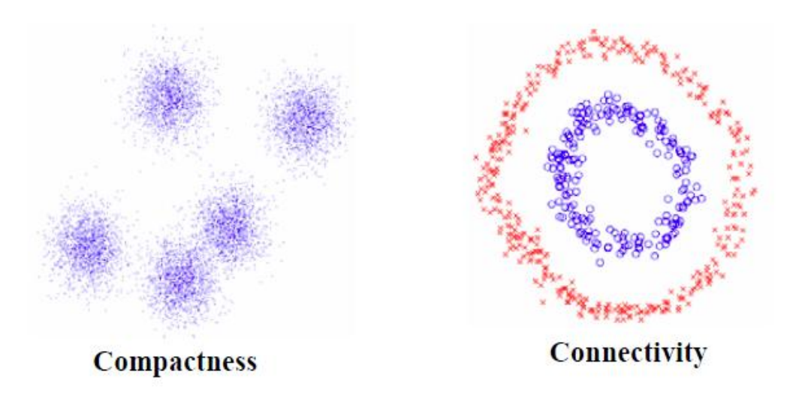
Spectral Clustering
The K-Means algorithm works well if the data are compact
When the data are connected but not necessarily compact, then the K-Means algorithm does not work well (or does not work at all)
Spectral clustering is a technique for clustering based on transformation by dimensionality reduction.
References: Ulrike von Luxburg (2007). “A Tutorial on Spectral Clustering”. Statistics and Computing. 17(4): 395-416.

Slide 66
Spectral Clustering Algorithm
Calculate the distances among the observations
Calculate the Adjacency matrix based on these distances
Calculate the Degree matrix based on the Adjacency matrix
Calculate the Laplacian matrix by subtracting the Adjacency matrix from the Degree matrix
Obtain eigenvectors of the Laplacian matrix
Apply the K-Means algorithm on the selected eigenvectors

Slide 67
Adjacency Matrix
2
 | 1 | 2 | 3 | 4
1 | a11 | a12 | a13 | a14
2 | a21 | a22 | 0 | 0
3 | a31 | 0 | a33 | a34
4 | a41 | 0 | a43 | a44
1
4
Symmetry requirement: aij = aji
Points further away have lower adjacency value, i.e., a11 ≥ a13 ≥ a14 ≥ a12 ≥ 0
We may use the Nearest Neighbors to explicitly assign zero to points that are not a point’s nearest neighbors.
3

Slide 68
Degree Matrix
2
 | 1 | 2 | 3 | 4
1 | d11 | 0 | 0 | 0
2 | 0 | d22 | 0 | 0
3 | 0 | 0 | d33 | 0
4 | 0 | 0 | 0 | d44
1
4
dij = ai1 + ai2 + ai3 + ai4
The Degree value of a point is higher when more points are connected to it.
3

Slide 69
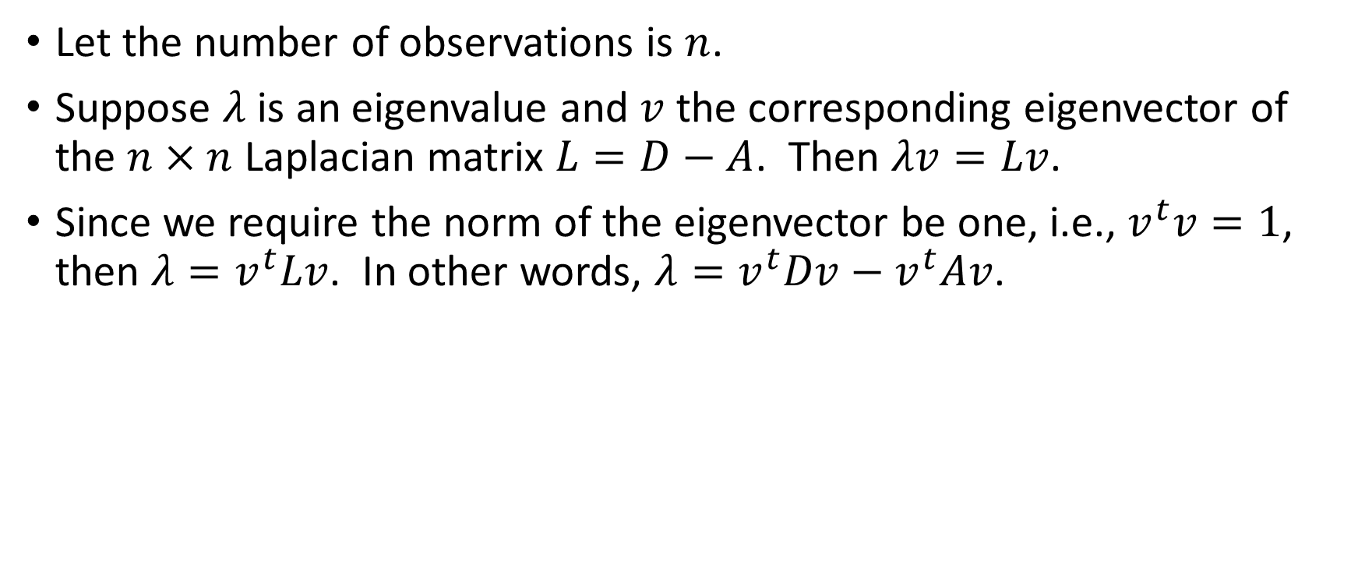
Eigen-Decomposition of Laplacian Matrix
Let the number of observations is $n$.
Suppose $λ$ is an eigenvalue and $v$ the corresponding eigenvector of the $n×n$ Laplacian matrix $L=D−A$. Then $λv=Lv$.
Since we require the norm of the eigenvector be one, i.e., $v^{t}v=1$, then $λ=v^{t}Lv$. In other words, $λ=v^{t}Dv−v^{t}Av$.

Slide 70
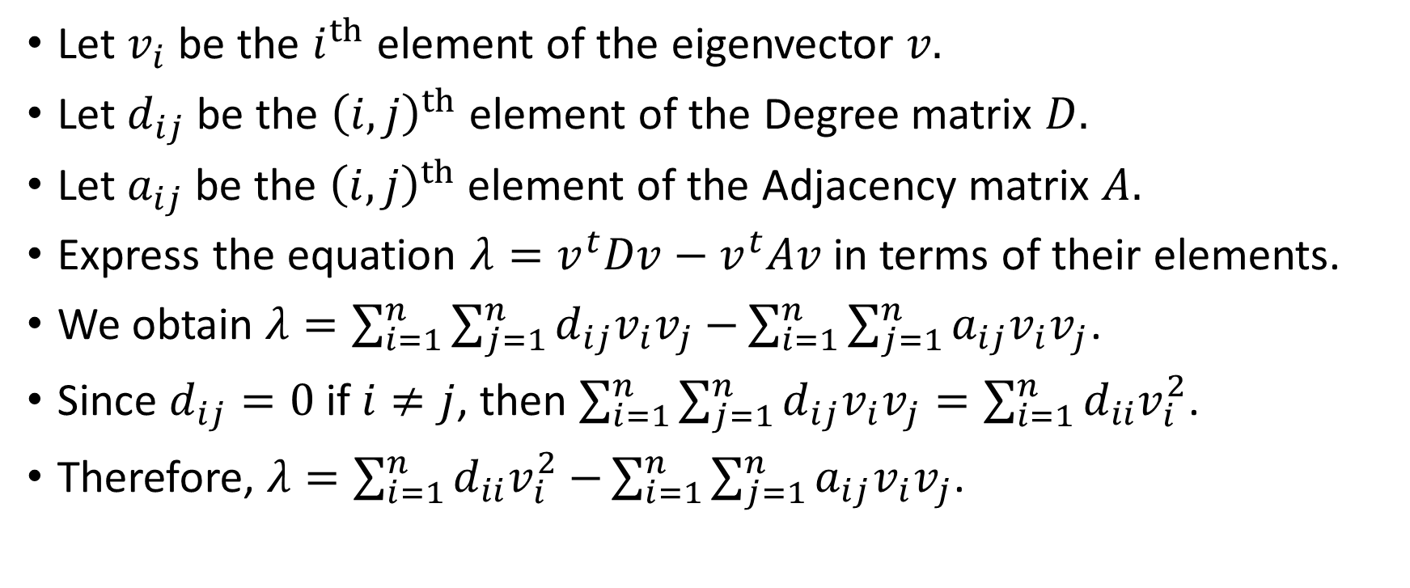
Eigen-Decomposition of Laplacian Matrix
Let $v_{i}$ be the $i^{th}$ element of the eigenvector $v.$
Let $d_{ij}$ be the ${\left(i,j\right)}^{th}$ element of the Degree matrix $D.$
Let $a_{ij}$ be the ${\left(i,j\right)}^{th}$ element of the Adjacency matrix $A.$
Express the equation $λ=v^{t}Dv−v^{t}Av$ in terms of their elements.
We obtain $λ=\sum_{i=1}^{n}{\sum_{j=1}^{n}{d_{ij}v_{i}v_{j}}−}\sum_{i=1}^{n}{\sum_{j=1}^{n}{a_{ij}v_{i}v_{j}}}$.
Since $d_{ij}=0$ if $i≠j$, then $\sum_{i=1}^{n}{\sum_{j=1}^{n}{d_{ij}v_{i}v_{j}}=\sum_{i=1}^{n}{d_{ii}v_{i}^{2}}}$.
Therefore, $λ=\sum_{i=1}^{n}{d_{ii}v_{i}^{2}−}\sum_{i=1}^{n}{\sum_{j=1}^{n}{a_{ij}v_{i}v_{j}}}$.

Slide 71
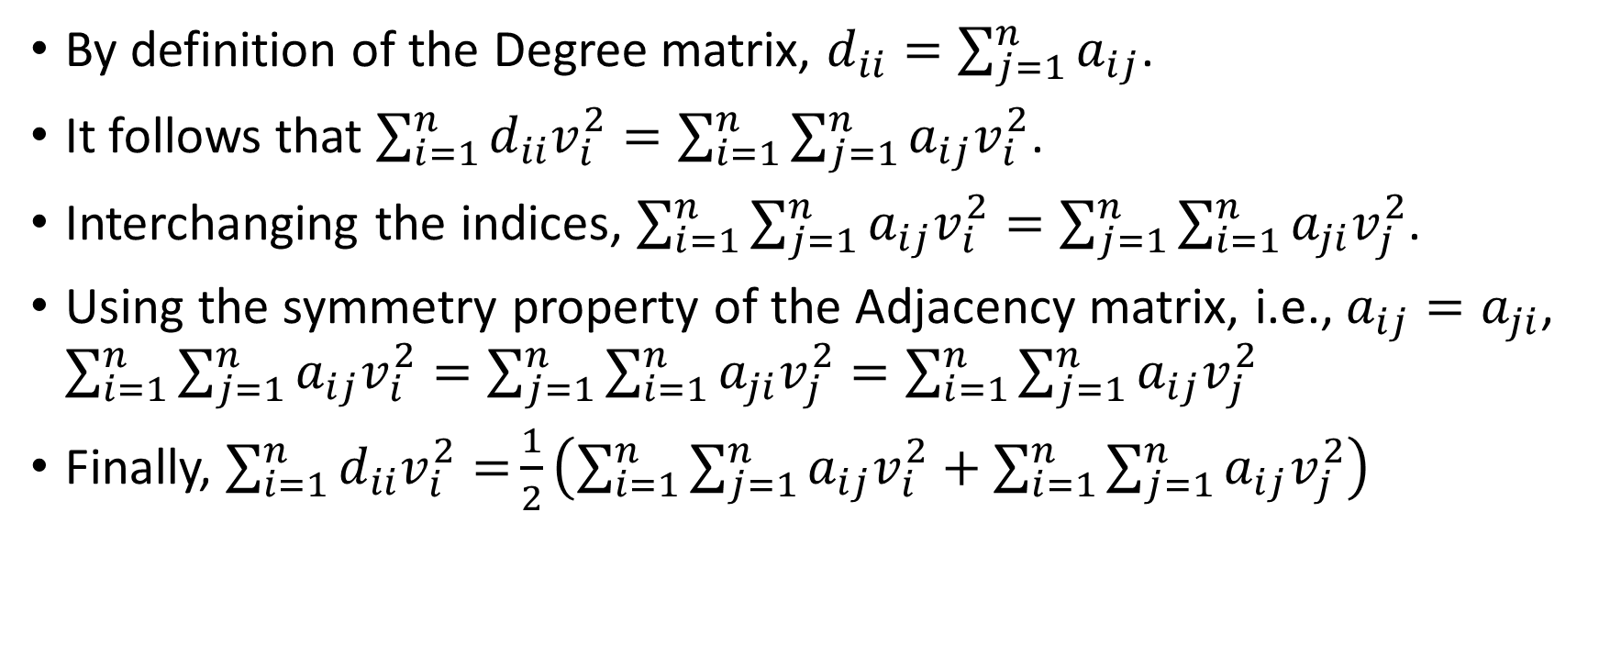
Eigen-Decomposition of Laplacian Matrix
By definition of the Degree matrix, $d_{ii}=\sum_{j=1}^{n}{a_{ij}}$.
It follows that $\sum_{i=1}^{n}{d_{ii}v_{i}^{2}=\sum_{i=1}^{n}{\sum_{j=1}^{n}{a_{ij}v_{i}^{2}}}}$.
Interchanging the indices, $\sum_{i=1}^{n}{\sum_{j=1}^{n}{a_{ij}v_{i}^{2}}}=\sum_{j=1}^{n}{\sum_{i=1}^{n}{a_{ji}v_{j}^{2}}}$.
Using the symmetry property of the Adjacency matrix, i.e., $a_{ij}=a_{ji}$, $\sum_{i=1}^{n}{\sum_{j=1}^{n}{a_{ij}v_{i}^{2}}}=\sum_{j=1}^{n}{\sum_{i=1}^{n}{a_{ji}v_{j}^{2}}}=\sum_{i=1}^{n}{\sum_{j=1}^{n}{a_{ij}v_{j}^{2}}}$
Finally, $\sum_{i=1}^{n}{d_{ii}v_{i}^{2}=}\frac{1}{2}\left(\sum_{i=1}^{n}{\sum_{j=1}^{n}{a_{ij}v_{i}^{2}}}+\sum_{i=1}^{n}{\sum_{j=1}^{n}{a_{ij}v_{j}^{2}}}\right)$

Slide 72
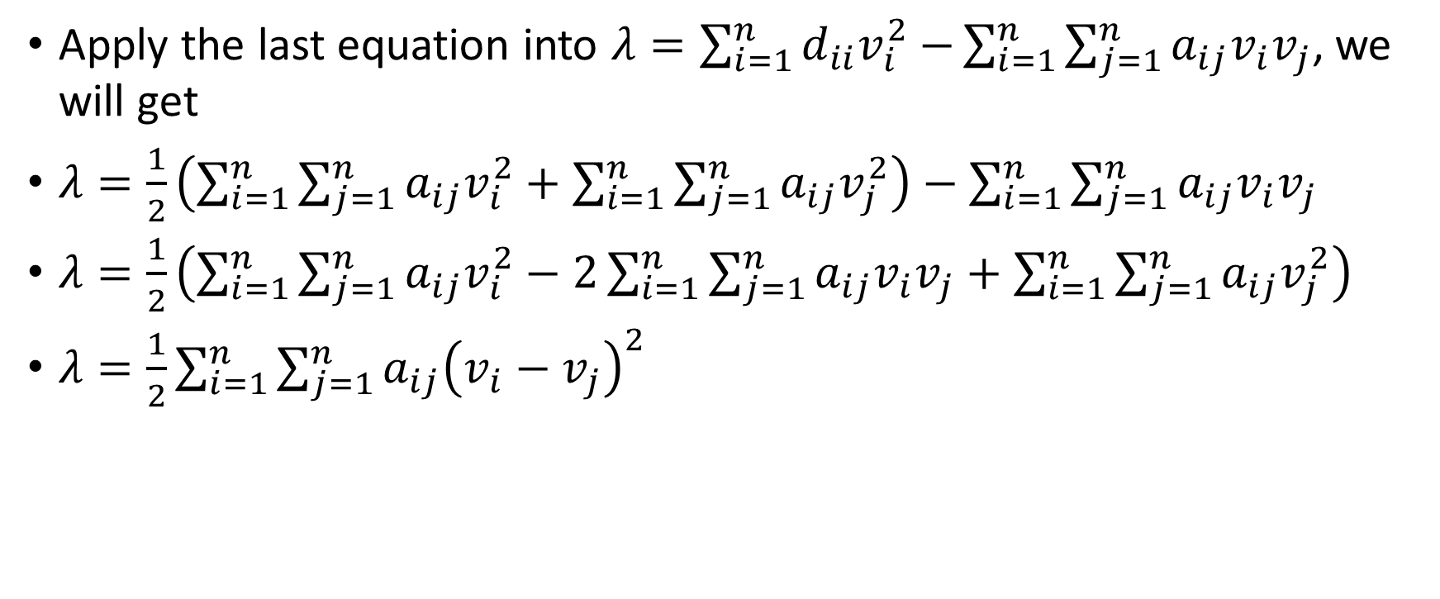
Eigen-Decomposition of Laplacian Matrix
Apply the last equation into $λ=\sum_{i=1}^{n}{d_{ii}v_{i}^{2}−}\sum_{i=1}^{n}{\sum_{j=1}^{n}{a_{ij}v_{i}v_{j}}}$, we will get
$λ=\frac{1}{2}\left(\sum_{i=1}^{n}{\sum_{j=1}^{n}{a_{ij}v_{i}^{2}}}+\sum_{i=1}^{n}{\sum_{j=1}^{n}{a_{ij}v_{j}^{2}}}\right)−\sum_{i=1}^{n}{\sum_{j=1}^{n}{a_{ij}v_{i}v_{j}}}$
$λ=\frac{1}{2}\left(\sum_{i=1}^{n}{\sum_{j=1}^{n}{a_{ij}v_{i}^{2}}}−2\sum_{i=1}^{n}{\sum_{j=1}^{n}{a_{ij}v_{i}v_{j}}}+\sum_{i=1}^{n}{\sum_{j=1}^{n}{a_{ij}v_{j}^{2}}}\right)$
$λ=\frac{1}{2}\sum_{i=1}^{n}{\sum_{j=1}^{n}{a_{ij}{\left(v_{i}−v_{j}\right)}^{2}}}$

Slide 73
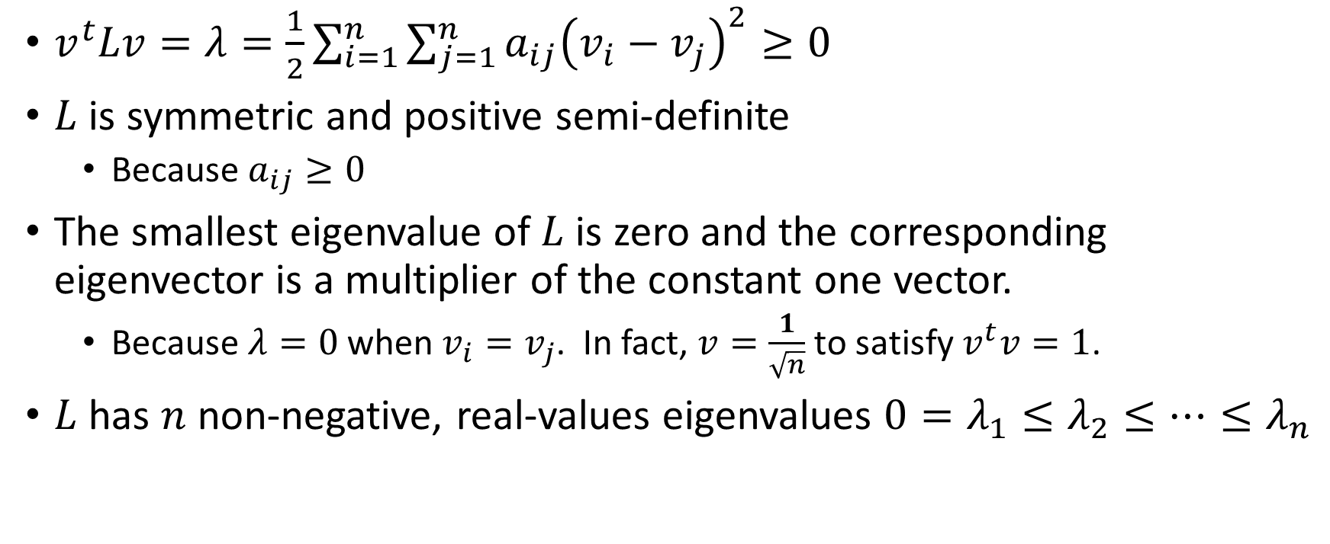
Properties of Laplacian Matrix
$v^{t}Lv=λ=\frac{1}{2}\sum_{i=1}^{n}{\sum_{j=1}^{n}{a_{ij}{\left(v_{i}−v_{j}\right)}^{2}}}≥0$
$L$ is symmetric and positive semi-definite
Because $a_{ij}≥0$
The smallest eigenvalue of $L$ is zero and the corresponding eigenvector is a multiplier of the constant one vector.
Because $λ=0$ when $v_{i}=v_{j}$. In fact, $v=\frac{1}{\sqrt{n}}$ to satisfy $v^{t}v=1$.
$L$ has $n$ non-negative, real-values eigenvalues $0=λ_{1}≤λ_{2}≤…≤λ_{n}$

Slide 74
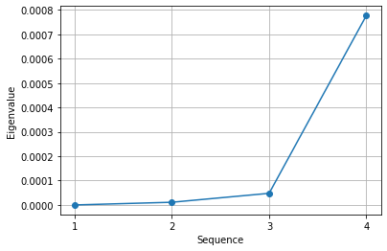

Number of Connected Components (i.e., Clusters)
The multiplicity $k$ of the zero eigenvalue of $L$ equals the number of connected components. See proof in the article and the Book.
Procedure
Plot a few eigenvalues from the smallest to the highest
Count the number of eigenvalues that are “practically” zero
That number is your choice for the number of clusters (e.g., that number is 2 in the left graph since one cluster is not an acceptable solution)

Slide 75
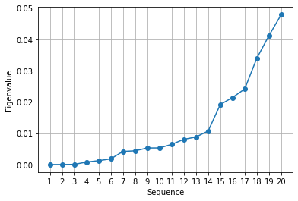
Number of Nearest Neighbors
Procedure
Plot a few more eigenvalues from the smallest to the highest
Spot for an obvious jump in the graph
Count the number of eigenvalues before the jump
That number either re-affirm our choice of the number of neighbors or suggest another choice (e.g., the left graph suggests fourteen neighbors is appropriate)
See the Book for more details on determining the number of nearest neighbors.

Slide 76
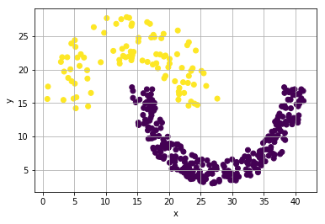
Example of Spectral Clustering
Sample data: http://cs.joensuu.fi/sipu/datasets/jain.txt
373 observations
Two input fields with a known cluster identifier field
Week 4 Jain Spiral.py

Slide 77
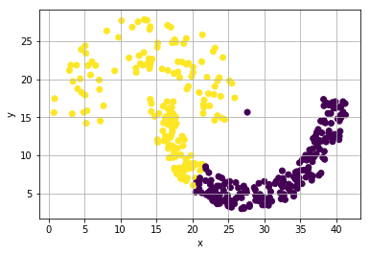
Directly Apply K-Mean on the Sample Data
Use K-Mean, request a two-cluster solution.
The upper arc is almost completed identified correctly.
About 1/3 of the lower arc is not identified correctly.
A lone point in the upper arc is incorrectly identified.

Slide 78
Adjacency and Degree Matrices
Calculate the Euclidean distance among all observations
Calculate the Adjacency value as exp(- distance**2), these Adjacency values will go down quickly
Make the Adjacency matrix symmetric
Except for the 8 nearest neighbors of the row’s diagonal element, assign zeros to all other columns. (Note: we will find out in a moment that 8 nearest neighbors is good. As for now, think of it as a good guess)
Calculate the Degree matrix
Calculate the Laplacian matrix which is a 373 x 373 symmetric square matrix
Calculate the eigenvalues and the corresponding eigenvectors

Slide 79
Adjacency and Degree Matrices
# Fourteen nearest neighbors
kNNSpec = neighbors.NearestNeighbors(n_neighbors = 14,
algorithm = 'brute', metric = 'euclidean')
nbrs = kNNSpec.fit(trainData)
d3, i3 = nbrs.kneighbors(trainData)
# Retrieve the distances among the observations
distObject = neighbors.DistanceMetric.get_metric('euclidean')
distances = distObject.pairwise(trainData)
# Create the Adjacency matrix
Adjacency = numpy.zeros((nObs, nObs))
for i in range(nObs):
for j in i3[i]:
Adjacency[i,j] = math.exp(- (distances[i][j])**2 )
# Make the Adjacency matrix symmetric
Adjacency = 0.5 * (Adjacency + Adjacency.transpose())
# Create the Degree matrix
Degree = numpy.zeros((nObs, nObs))
for i in range(nObs):
sum = 0
for j in range(nObs):
sum += Adjacency[i,j]
Degree[i,i] = sum
# Create the Laplacian matrix
Lmatrix = Degree - Adjacency
# Obtain the eigenvalues and the eigenvectors of the Laplacian matrix
evals, evecs = linalg.eigh(Lmatrix)
# Series plot of the smallest five eigenvalues to determine the number of clusters
sequence = numpy.arange(1,5,1)
plt.plot(sequence, evals[0:4,], marker = "o")
plt.xlabel('Sequence')
plt.ylabel('Eigenvalue')
plt.xticks(sequence)
plt.grid("both")
plt.show()
# Series plot of the smallest twenty eigenvalues to determine the number of neighbors
sequence = numpy.arange(1,21,1)
plt.plot(sequence, evals[0:20,], marker = "o")
plt.xlabel('Sequence')
plt.ylabel('Eigenvalue')
plt.grid("both")
plt.xticks(sequence)
plt.show()

Slide 80
Number of Nearest Neighbors
Plot the first twenty eigenvalues
Spot a jump between the 14th and the 15th eigenvalue
The graph confirms our guess of fourteen nearest neighbors is appropriate

Slide 81
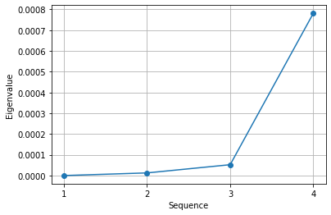
Number of Clusters
Zoom into the first four eigenvalues
The first eigenvalue is obviously zero
The second eigenvalue is very small
Let us study the first two eigenvalues

Slide 82
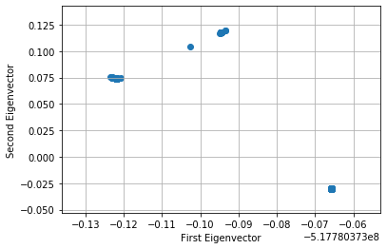
First Two Eigenvectors of Laplacian Matrix
Statistics | First Eigenvector | Second Eigenvector
Mean | -0.05177803730784978 | -1.9986228936363597e-12
Standard Deviation | 2.2394961593225162e-12 | 0.051778037307849765
Coefficient of Variation | -4.325185495169394e-11 | -25906856902.67618
The first eigenvector is essentially constant because it has very small coefficient of variation
Although the second eigenvector is not constant, we still choose two clusters
Plot the first two eigenvectors show two clusters (Note: the first eigenvector is auto-scaled, scaling factor shown)

Slide 83
Final K-Mean Solution
# Perform 2-cluster K-mean on the first two eigenvectors
kmeans_spectral = cluster.KMeans(n_clusters = 2, random_state = 0).fit(Z)
Spiral['SpectralCluster'] = kmeans_spectral.labels_
plt.scatter(Spiral['x'], Spiral['y'], c = Spiral['SpectralCluster'])
plt.xlabel('x')
plt.ylabel('y')
plt.grid(True)
plt.show()
It looks like the spectral clustering method works for this dataset.

Slide 84
Assignment 2
Assignment 2 has been posted
Due date is 11:59 pm on Sunday, September 27, 2020
Submit your answers as a PDF file
Submit your Python codes as .py files, otherwise liable for 50% deduction
Can submit your answers no more than two times
Only the most recently submitted answers will be graded.

