Slide 1

CS 484 Intro to Machine Learning
Week 3
September 9, 2020

Slide 2

Week 3: Association Rule Learner
Bayes Theorem
Association Rule
Market Basket
Chapter 3 of the Machine Learning book

Slide 3
Bayesian Decision in a Nutshell
I assume a parametric probability distribution for the observations
I observed the data
I estimate the distribution parameters based on your observations
Since I have posterior information about the parameters, I improve my inferences about the parameters
I have some prior information about the parameters of the distribution

Slide 4
An Example of Bayesian Decision
According to http://bulletin.iit.edu/undergraduate/university-overview/student-demographics/, 37% of students who enrolled in IIT in Fall 2018 are female.
Before teaching this class, 37% is my best guess about the percentage of female students in my class.
After teaching this class for three weeks, I observed that p% of the students are female.
Given this piece of new information, I will update the percent of female students as q% for future classes where q% is between p% and 37%.

Slide 5
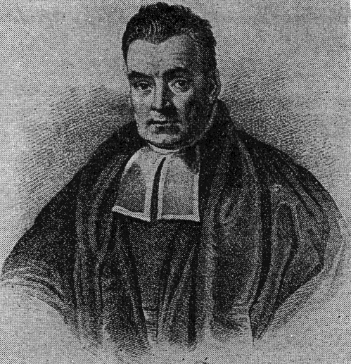
The Term “Bayesian”
The term comes from the widespread usage of Bayes’ theorem
Named after the Reverend Thomas Bayes (1702 – 1761), an eighteenth-century English statistician, philosopher, and Presbyterian minister.
Rev. Bayes was interested in solving the question of inverse probability: after observing a collection of events, what is the probability of the occurrence of a single event?

Slide 6
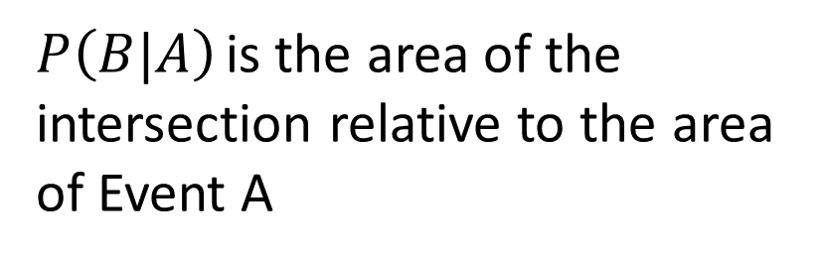
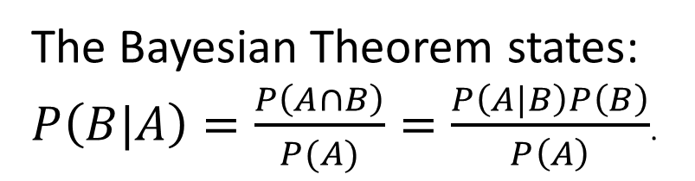
Bayesian Theorem
Marginal Probability P(B) > 0
The Bayesian Theorem states: $P\left(B|A\right)=\frac{P\left(A∩B\right)}{P(A)}=\frac{P\left(A|B\right)P\left(B\right)}{P\left(A\right)}$.
Event A
Event B
$P\left(B|A\right)$ is the area of the intersection relative to the area of Event A
Marginal Probability P(A) > 0

Slide 7
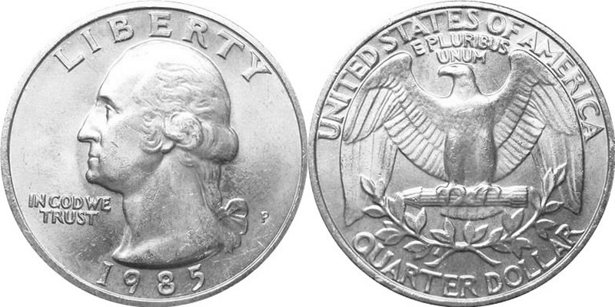
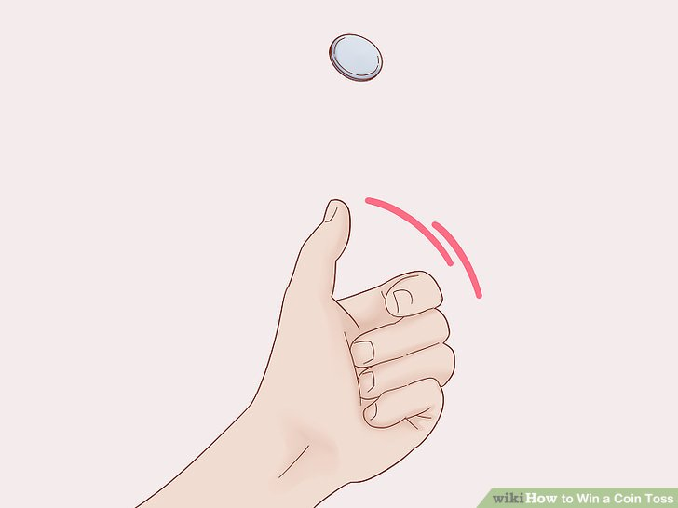

A Class Exercise
Get a fair coin, e.g., a US Quarter coin
Toss the coin ten times using your left hand only, record the number of times of getting a Head
Toss the coin ten times using your right hand only, record the number of times of getting a Head

Slide 8
A Class Exercise
Before completing this class exercise, I always think that I use both hands equally, i.e. Pr(Left Hand) = 0.5 and Pr(Right Hand) = 0.5
My Observations
After this class exercise, I learned that the probability of getting a Head when my left hand tossed it is 3/10 = 0.3 (i.e., Pr(Head | Left Hand) = 0.3.
Similarly, the conditional probability Pr(Head | Right Hand) = 8/10 = 0.8.
Out Of 10 Tosses … | Left Hand Toss | Right Hand Toss
Number of Heads | 3 | 8
Number of Tails | 7 | 2

Slide 9
A Class Exercise
Prior probabilities based on our presumption about hand usage
Pr(Left Hand) = 0.5
Pr(Right Hand) = 0.5
After the exercise
Pr(Head | Left Hand) = 0.3
Pr(Tail | Left Hand) = 0.7
Pr(Head | Right Hand) = 0.8
Pr(Tail | Right Hand) = 0.2
The Bayesian Theorem says
Pr(Head & Left Hand) = Pr(Head|Left Hand) * Pr(Left Hand) = 0.3 * 0.5 = 0.15
Pr(Head & Right Hand) = Pr(Head|Right Hand) * Pr(Right Hand) = 0.8 * 0.5 = 0.4

Slide 10
A Class Exercise
If I get a Head, then how likely I have used my Left Hand? Pr(Left Hand | Head) = Pr(Left Hand & Head) / Pr(Head)
Since we will not use both hand in tossing the coin, then Pr(Head) = Pr(Head & Left Hand) + Pr(Head & Right Hand) = 0.15 + 0.4
Pr(Left Hand | Head) = Pr(Left Hand & Head) / Pr(Head) = 0.15 / (0.15 + 0.4) = 0.15 / 0.55 = 3/11 Pr(Right Hand | Head) = Pr(Right Hand & Head) / Pr(Head) = 0.4 / (0.15 + 0.4) = 0.4 / 0.55 = 8/11
Conclusion: if I got a Head, then the probability that I have used my Left Hand is 3/11 = 27%.

Slide 11
Bayesian Theorem - Independence
If the two events A and B are independent, then the joint probability P(A ∩ B) = P(A) P(B)
On the other hand, the Bayesian Theorem states that P(A ∩ B) = P(A|B) P(B) = P(B|A) P(A)
Therefore, P(A) P(B) = P(A|B) P(B) = P(B|A) P(A)
Finally, P(A|B) = P(A) and P(B|A) = P(B)
This means that when the two events A and B are independent, then knowing the outcome of one event DOES NOT change the outcome of another event.

Slide 12
Bayesian Theorem - Independence
If you get the same number of Heads whether you toss the coin using your left hand or your right hand (an example below)
Then the outcome of the coin will not be affected by the hand used.
Out Of 10 Tosses … | Left Hand Toss | Right Hand Toss
Number of Heads | 3 | 3
Number of Tails | 7 | 7

Slide 13
Interpret Probability (Advanced Concept)
There are two approaches in interpreting probability
Frequentist
Bayesian

Slide 14
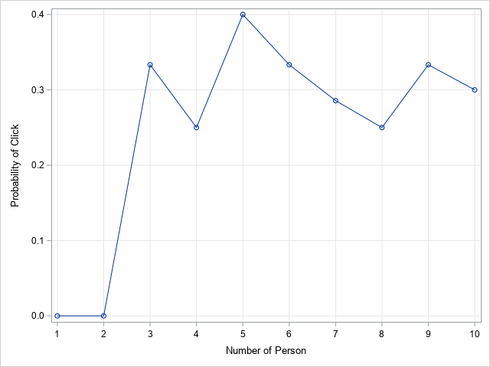
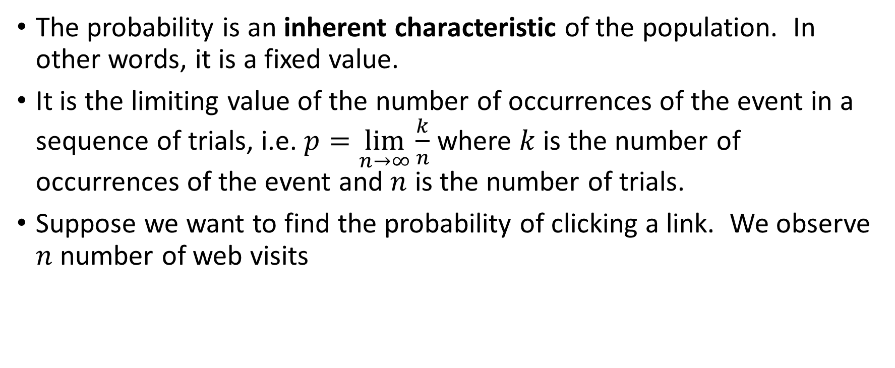
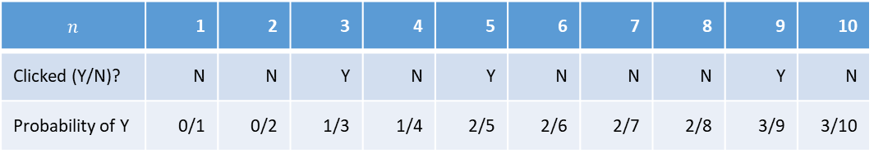
Frequentist Approach (Advanced Concept)
The probability is an inherent characteristic of the population. In other words, it is a fixed value.
It is the limiting value of the number of occurrences of the event in a sequence of trials, i.e. $p=\lim_{n→∞}{\frac{k}{n}}$ where $k$ is the number of occurrences of the event and $n$ is the number of trials.
Suppose we want to find the probability of clicking a link. We observe $n$ number of web visits
$$n$$ | 1 | 2 | 3 | 4 | 5 | 6 | 7 | 8 | 9 | 10
Clicked (Y/N)? | N | N | Y | N | Y | N | N | N | Y | N
Probability of Y | 0/1 | 0/2 | 1/3 | 1/4 | 2/5 | 2/6 | 2/7 | 2/8 | 3/9 | 3/10

Slide 15
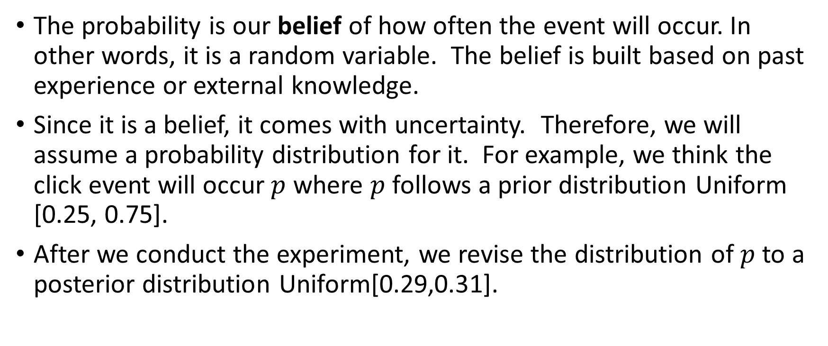
Bayesian Approach (Advanced Concept)
The probability is our belief of how often the event will occur. In other words, it is a random variable. The belief is built based on past experience or external knowledge.
Since it is a belief, it comes with uncertainty. Therefore, we will assume a probability distribution for it. For example, we think the click event will occur $p$ where $p$ follows a prior distribution Uniform [0.25, 0.75].
After we conduct the experiment, we revise the distribution of $p$ to a posterior distribution Uniform[0.29,0.31].

Slide 16
Association Rule Discovery Motivated
Remember your last time shopped at grocery stores, supercenters, home improvement stores, etc.
Do you notice that there are items that you very likely buy together?
bread, deli meats, fruit, veggies, ice cream
egg, flour, sugar, pancake syrup, butter or shortening
paint, tray, roller frame, roller covers, brush, painter’s tape
ice cream, cones, toppings, syrup, scoop

Slide 17
Association Rule Discovery Motivated
Identifying credible associations can help the merchants make decisions such as:
Which coupons to distribute?
When to put a product on sale?
What products are put together on the shelf?

Slide 18
Association Rule Discovery Defined
Association rule discovery is the identification of items that occur together in a given event or record (commonly called a transaction). This technique is also known as market basket analysis.
Point-of-Sale transaction processing systems often provide the data sources for association rule discovery. It treats all items as categorical data.
Association rules are based on frequency counts of the number of times items occur alone and in combination in the database.
The rules are expressed as “if item A is part of a transaction, then item B is also part of the transaction X percent of the time.” where 0 < X ≤ 100.
The rules should not be interpreted as direct causation but as association between two or more items.

Slide 19
Examples of Association Rule
80% of shoppers who buy ice-cream also purchase ice-cream cones.
85% of the “do-it-yourselfers” also buy roller covers IF they bought latex paint.
40% of investors who hold an equity index fund will have a bond fund in their portfolio.
99% of shoppers who buy new ice-maker equipped refrigerator will also buy a new water line and home delivery service.

Slide 20
Association Rule Discovery History
Proposed by Agrawal, Imielinski, and Swami in their 1993 paper
“Mining Association Rules between Sets of Items in Large Databases”, Proceedings of the 1993 ACM SIGMOD Conference Washington DC, May 1993
ACM SIGMOD: Association for Computing Machinery Special Interest Group on Management Of Data
Initially used for Market Basket analysis to find how items purchased by customers are related
Most algorithms are related to the Apriori algorithm due to Agrawal and Srikant 1994 paper
“Fast Algorithms for Mining Association Rules”, Proceedings of the 20th VLDB Conference Santiago, Chile, 1994
VLDB: Very Large Data Bases

Slide 21
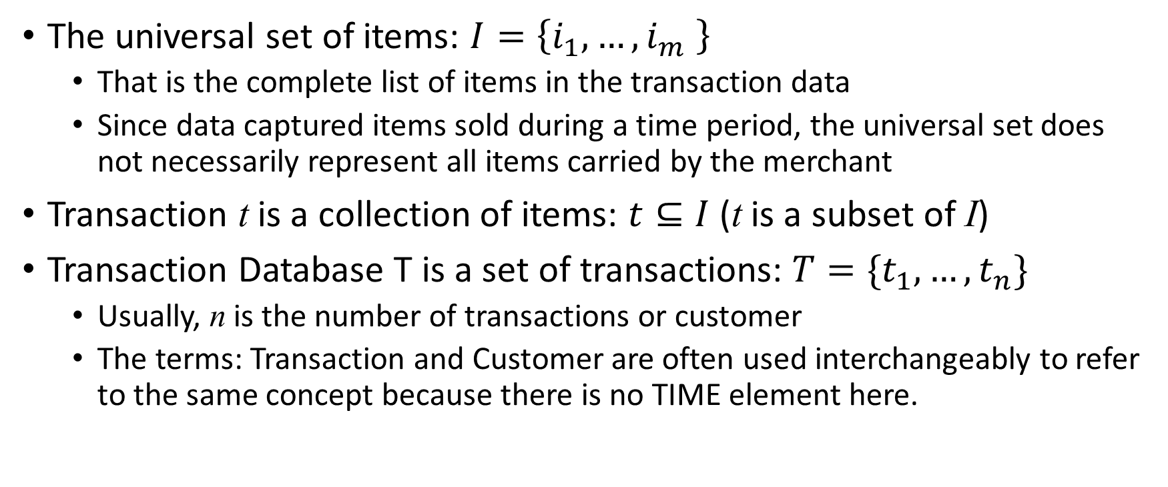
Data for Association Rule Discovery
The universal set of items: $I=\left\{i_{1},…,i_{m} \right\}$
That is the complete list of items in the transaction data
Since data captured items sold during a time period, the universal set does not necessarily represent all items carried by the merchant
Transaction t is a collection of items: $t⊆I$ (t is a subset of I)
Transaction Database T is a set of transactions: $T=\{t_{1},…,t_{n}\}$
Usually, n is the number of transactions or customer
The terms: Transaction and Customer are often used interchangeably to refer to the same concept because there is no TIME element here.

Slide 22
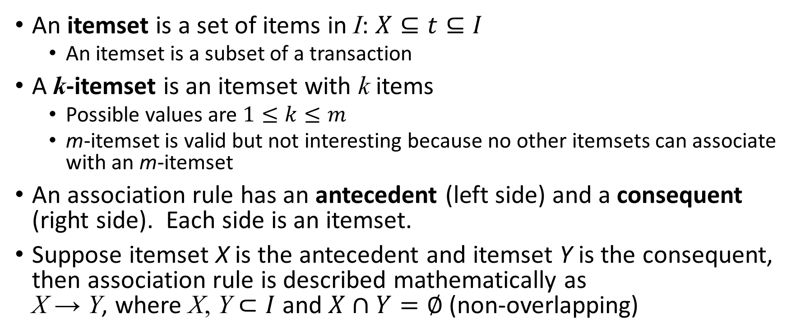
Association Rules
An itemset is a set of items in I: $X⊆t⊆I$
An itemset is a subset of a transaction
A k-itemset is an itemset with k items
Possible values are $1≤k≤m$
m-itemset is valid but not interesting because no other itemsets can associate with an m-itemset
An association rule has an antecedent (left side) and a consequent (right side). Each side is an itemset.
Suppose itemset X is the antecedent and itemset Y is the consequent, then association rule is described mathematically as X → Y, where X, Y $⊂I$ and $X∩Y=∅$ (non-overlapping)

Slide 23
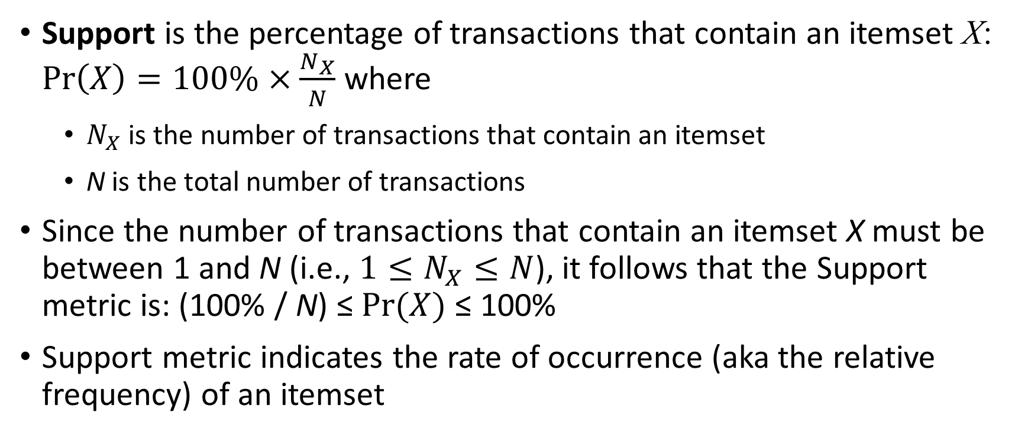
Association Rules: Support Metric
Support is the percentage of transactions that contain an itemset X: $Pr\left(X\right)=100\%×\frac{N_{X}}{N}$ where
$N_{X}$ is the number of transactions that contain an itemset
N is the total number of transactions
Since the number of transactions that contain an itemset X must be between 1 and N (i.e., $1≤N_{X}≤N$), it follows that the Support metric is: (100% / N) ≤ $Pr(X)$ ≤ 100%
Support metric indicates the rate of occurrence (aka the relative frequency) of an itemset

Slide 24
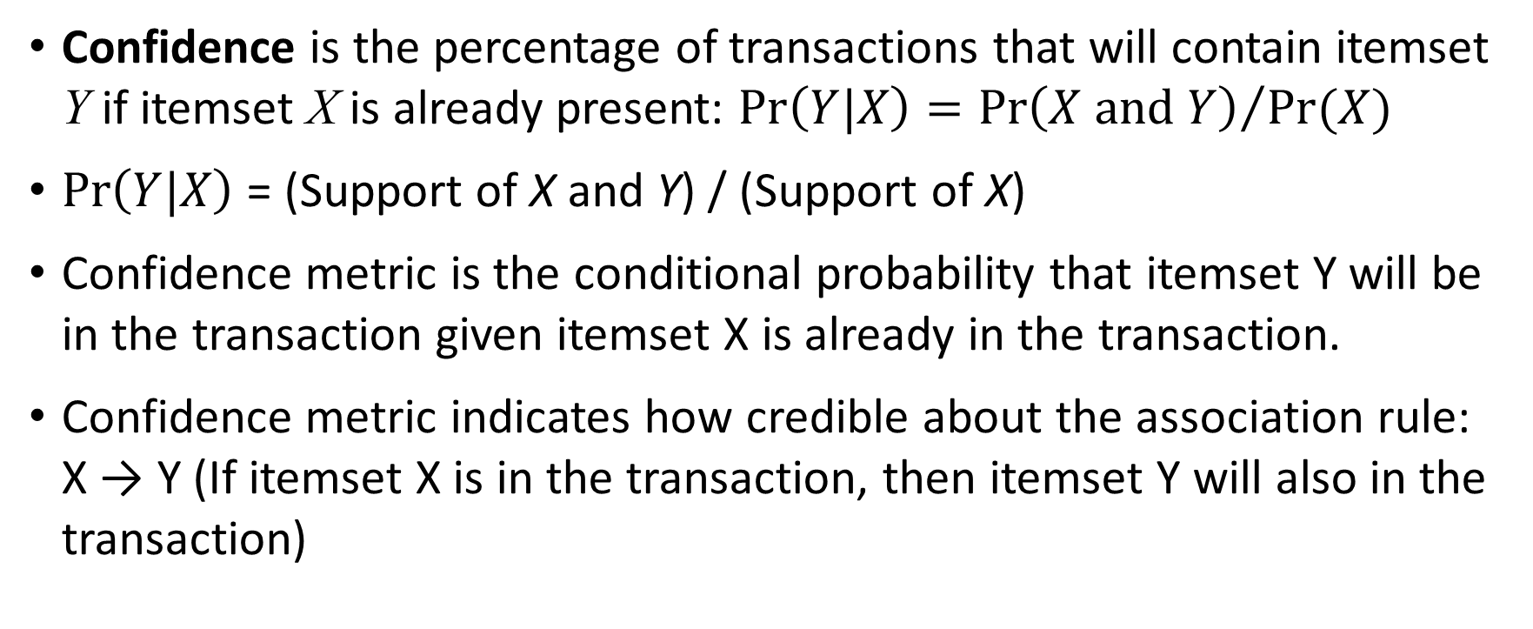
Association Rules: Confidence Metric
Confidence is the percentage of transactions that will contain itemset Y if itemset X is already present: $Pr\left(Y|X\right)={Pr\left(X and Y\right)}/{Pr(X)}$
$Pr\left(Y|X\right)$ = (Support of X and Y) / (Support of X)
Confidence metric is the conditional probability that itemset Y will be in the transaction given itemset X is already in the transaction.
Confidence metric indicates how credible about the association rule: X → Y (If itemset X is in the transaction, then itemset Y will also in the transaction)

Slide 25
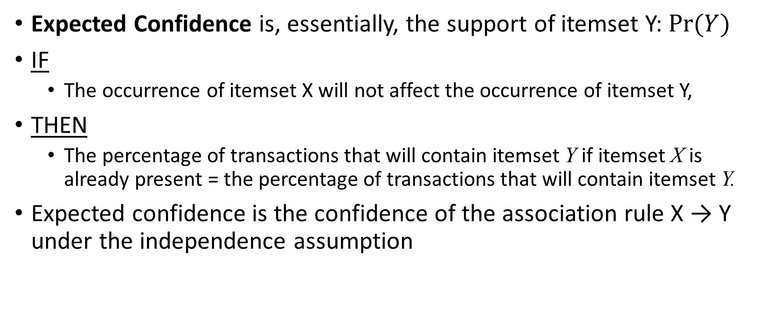
Association Rules: Expected Confidence Metric
Expected Confidence is, essentially, the support of itemset Y: $Pr(Y)$
IF
The occurrence of itemset X will not affect the occurrence of itemset Y,
THEN
The percentage of transactions that will contain itemset Y if itemset X is already present = the percentage of transactions that will contain itemset Y.
Expected confidence is the confidence of the association rule X → Y under the independence assumption

Slide 26
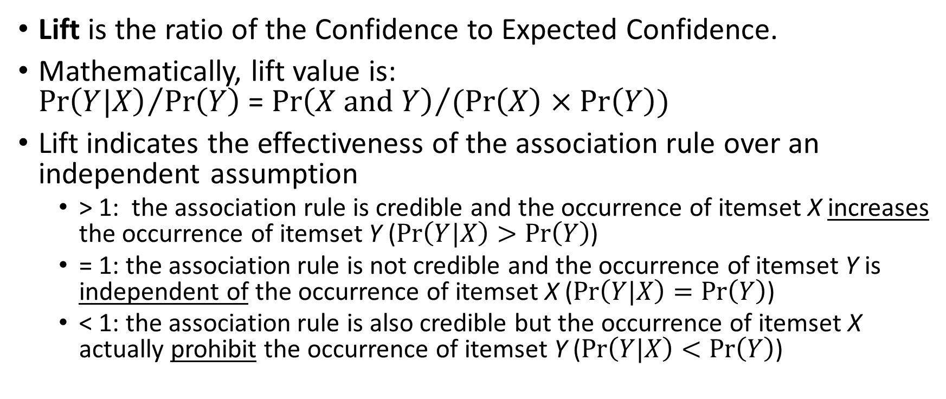
Association Rules: Lift Metric
Lift is the ratio of the Confidence to Expected Confidence.
Mathematically, lift value is: ${Pr\left(Y|X\right)}/{Pr\left(Y\right)}$ = ${Pr\left(X and Y\right)}/{(Pr\left(X\right)×Pr\left(Y\right))}$
Lift indicates the effectiveness of the association rule over an independent assumption
> 1: the association rule is credible and the occurrence of itemset X increases the occurrence of itemset Y ($Pr\left(Y|X\right)>Pr\left(Y\right)$)
= 1: the association rule is not credible and the occurrence of itemset Y is independent of the occurrence of itemset X ($Pr\left(Y|X\right)=Pr\left(Y\right)$)
< 1: the association rule is also credible but the occurrence of itemset X actually prohibit the occurrence of itemset Y ($Pr\left(Y|X\right)<Pr\left(Y\right)$)

Slide 27
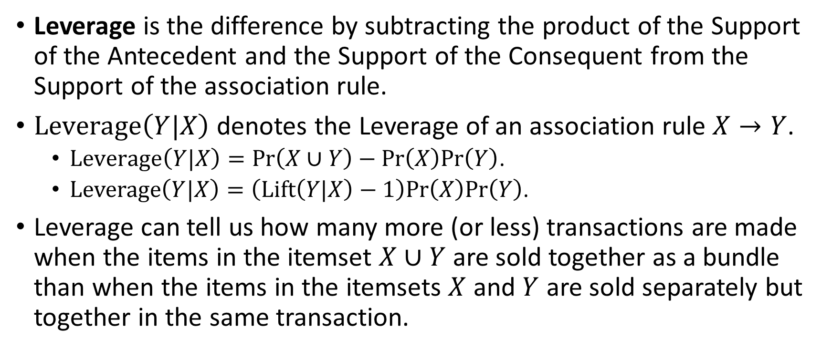
Association Rules: Leverage Metric
Leverage is the difference by subtracting the product of the Support of the Antecedent and the Support of the Consequent from the Support of the association rule.
$Leverage\left(Y|X\right)$ denotes the Leverage of an association rule $X→Y$.
$Leverage\left(Y|X\right)=Pr\left(X∪Y\right)−Pr\left(X\right)Pr\left(Y\right)$.
$Leverage\left(Y|X\right)=\left(Lift\left(Y|X\right)−1\right)Pr\left(X\right)Pr\left(Y\right)$.
Leverage can tell us how many more (or less) transactions are made when the items in the itemset $X∪Y$ are sold together as a bundle than when the items in the itemsets $X$ and $Y$ are sold separately but together in the same transaction.

Slide 28
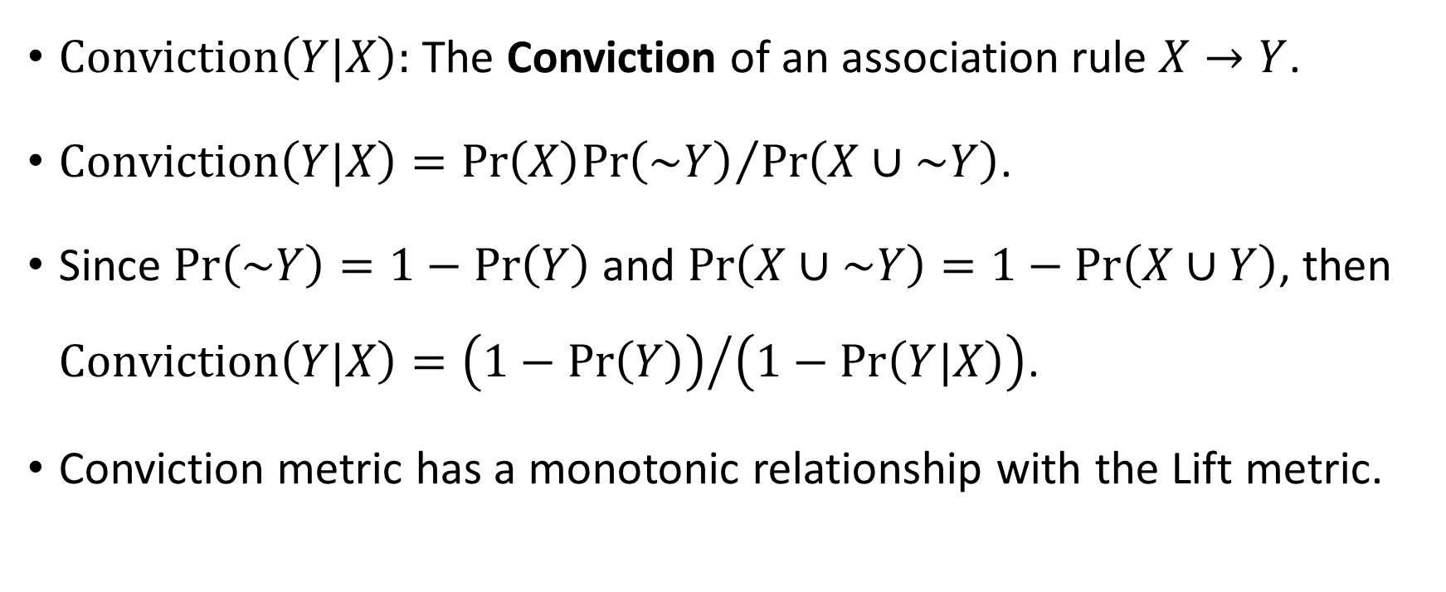
Association Rules: Conviction Metric
$Conviction\left(Y|X\right):$ The Conviction of an association rule $X→Y$.
$Conviction\left(Y|X\right)={Pr\left(X\right)Pr\left(\sim Y\right)}/{Pr\left(X∪\sim Y\right)}$.
Since $Pr\left(\sim Y\right)=1−Pr\left(Y\right)$ and $Pr\left(X∪\sim Y\right)=1−Pr\left(X∪Y\right)$, then $Conviction\left(Y|X\right)={\left(1−Pr\left(Y\right)\right)}/{\left(1−Pr\left(Y|X\right)\right)}$.
Conviction metric has a monotonic relationship with the Lift metric.

Slide 29
A Toy Example of Association Rules
Suppose a store sells only four items: A, B, C, and D
1-Itemset: {A}, {B}, {C}, {D}
2-Itemset: {A,B}, {A,C}, {A,D}, {B,C}, {B,D}, {C,D}
3-Itemset: {A,B,C}, {A,B,D}, {A,C,D}, {B,C,D}
4-Itemset: {A,B,C,D}
Number of possible itemsets: $2^{4}−1=15$
How many association rules that you can possibly generate from the above 15?

Slide 30
All Association Rules (by Antecedent)
1 | {A} | → | {B} | 15 | {C} | → | {A} | 29 | {A,B} | → | {C} | 41 | {B,D} | → | {A}
2 | {A} | → | {C} | 16 | {C} | → | {B} | 30 | {A,B} | → | {D} | 42 | {B,D} | → | {C}
3 | {A} | → | {D} | 17 | {C} | → | {D} | 31 | {A,B} | → | {C,D} | 43 | {B,D} | → | {A,C}
4 | {A} | → | {B,C} | 18 | {C} | → | {A,B}
5 | {A} | → | {B,D} | 19 | {C} | → | {A,D} | 32 | {A,C} | → | {B} | 44 | {C,D} | → | {A}
6 | {A} | → | {C,D} | 20 | {C} | → | {B,D} | 33 | {A,C} | → | {D} | 45 | {C,D} | → | {B}
7 | {A} | → | {B,C,D} | 21 | {C} | → | {A,B,D} | 34 | {A,C} | → | {B,D} | 46 | {C,D} | → | {A,B}
8 | {B} | → | {A} | 22 | {D} | → | {A} | 35 | {A,D} | → | {B} | 47 | {A,B,C} | → | {D}
9 | {B} | → | {C} | 23 | {D} | → | {B} | 36 | {A,D} | → | {C}
10 | {B} | → | {D} | 24 | {D} | → | {C} | 37 | {A,D} | → | {B,C} | 48 | {A,B,D} | → | {C}
11 | {B} | → | {A,C} | 25 | {D} | → | {A,B}
12 | {B} | → | {A,D} | 26 | {D} | → | {A,C} | 38 | {B,C} | → | {A} | 49 | {A,C,D} | → | {B}
13 | {B} | → | {C,D} | 27 | {D} | → | {B,C} | 39 | {B,C} | → | {D}
14 | {B} | → | {A,C,D} | 28 | {D} | → | {A,B,C} | 40 | {B,C} | → | {A,D} | 50 | {B,C,D} | → | {A}

Slide 31
All Association Rules (by Consequent)
1 | {B} | → | {A} | 15 | {A} | → | {C} | 29 | {C} | → | {A,B} | 41 | {A} | → | {B,D}
2 | {C} | → | {A} | 16 | {B} | → | {C} | 30 | {D} | → | {A,B} | 42 | {C} | → | {B,D}
3 | {D} | → | {A} | 17 | {D} | → | {C} | 31 | {C,D} | → | {A,B} | 43 | {A,C} | → | {B,D}
4 | {B,C} | → | {A} | 18 | {A,B} | → | {C}
5 | {B,D} | → | {A} | 19 | {A,D} | → | {C} | 32 | {B} | → | {A,C} | 44 | {A} | → | {C,D}
6 | {C,D} | → | {A} | 20 | {B,D} | → | {C} | 33 | {D} | → | {A,C} | 45 | {B} | → | {C,D}
7 | {B,C,D} | → | {A} | 21 | {A,B,D} | → | {C} | 34 | {B,D} | → | {A,C} | 46 | {A,B} | → | {C,D}
8 | {A} | → | {B} | 22 | {A} | → | {D} | 35 | {B} | → | {A,D} | 47 | {D} | → | {A,B,C}
9 | {C} | → | {B} | 23 | {B} | → | {D} | 36 | {C} | → | {A,D}
10 | {D} | → | {B} | 24 | {C} | → | {D} | 37 | {B,C} | → | {A,D} | 48 | {C} | → | {A,B,D}
11 | {A,C} | → | {B} | 25 | {A,B} | → | {D}
12 | {A,D} | → | {B} | 26 | {A,C} | → | {D} | 38 | {A} | → | {B,C} | 49 | {B} | → | {A,C,D}
13 | {C,D} | → | {B} | 27 | {B,C} | → | {D} | 39 | {D} | → | {B,C}
14 | {A,C,D} | → | {B} | 28 | {A,B,C} | → | {D} | 40 | {A,D} | → | {B,C} | 50 | {A} | → | {B,C,D}

Slide 32
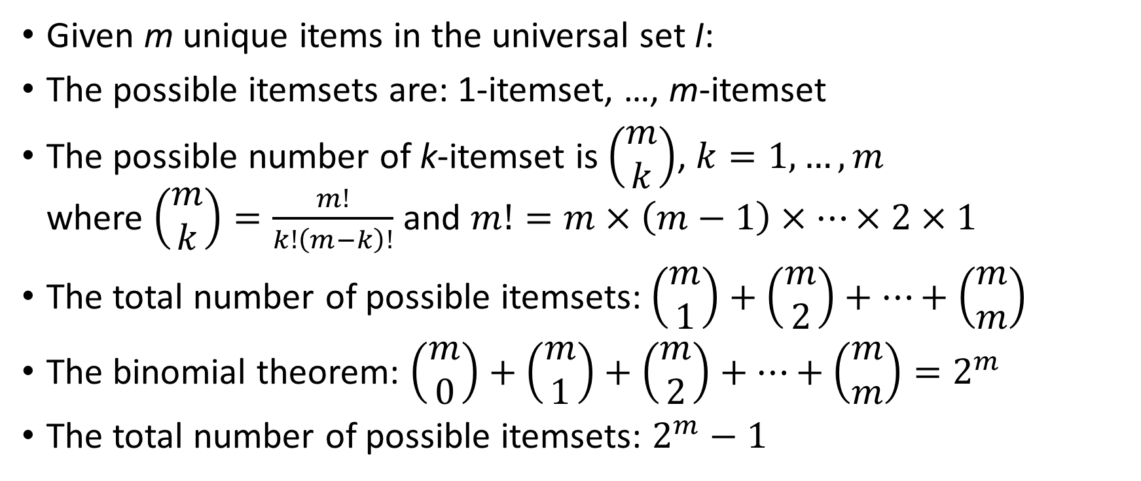
Number of Possible Itemsets
Given m unique items in the universal set I:
The possible itemsets are: 1-itemset, …, m-itemset
The possible number of k-itemset is $\left(\begin{matrix}m \\ k\end{matrix}\right)$, $k=1,…,m$ where $\left(\begin{matrix}m \\ k\end{matrix}\right)=\frac{m!}{k!\left(m−k\right)!}$ and $m!=m×\left(m−1\right)×⋯×2×1$
The total number of possible itemsets:$\left(\begin{matrix}m \\ 1\end{matrix}\right)+\left(\begin{matrix}m \\ 2\end{matrix}\right)+…+\left(\begin{matrix}m \\ m\end{matrix}\right)$
The binomial theorem: $\left(\begin{matrix}m \\ 0\end{matrix}\right)+\left(\begin{matrix}m \\ 1\end{matrix}\right)+\left(\begin{matrix}m \\ 2\end{matrix}\right)+…+\left(\begin{matrix}m \\ m\end{matrix}\right)=2^{m}$
The total number of possible itemsets: $2^{m}−1$

Slide 33
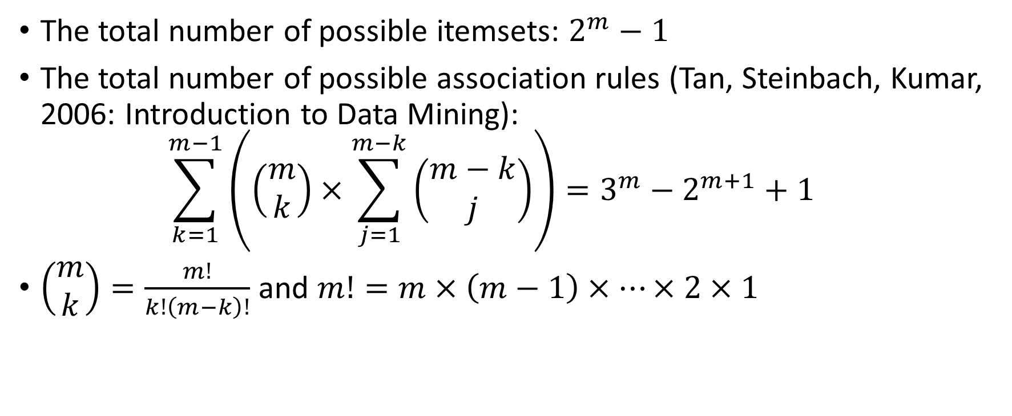
Maximum Number of Association Rules
The total number of possible itemsets: $2^{m}−1$
The total number of possible association rules (Tan, Steinbach, Kumar, 2006: Introduction to Data Mining): $\sum_{k=1}^{m−1}{\left(\left(\begin{matrix}m \\ k\end{matrix}\right)×\sum_{j=1}^{m−k}{\left(\begin{matrix}m−k \\ j\end{matrix}\right)}\right)=3^{m}−2^{m+1}+1}$
$\left(\begin{matrix}m \\ k\end{matrix}\right)=\frac{m!}{k!\left(m−k\right)!}$ and $m!=m×\left(m−1\right)×⋯×2×1$
Read Book for Proof

Slide 34
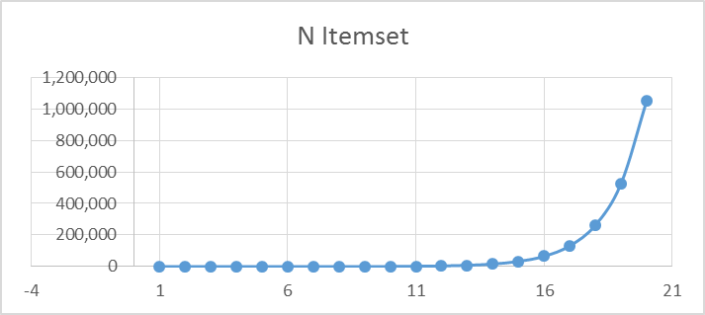
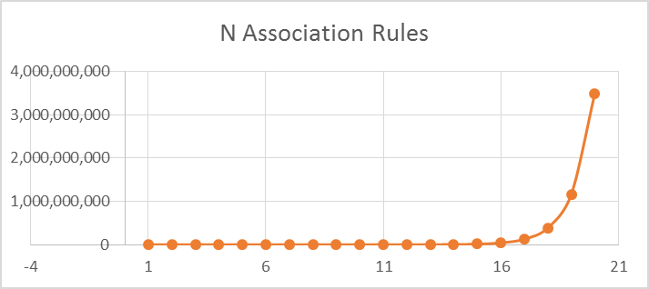
Maximum Number of Association Rules
m | N Itemset | N Association Rules
1 | 1 | 0
2 | 3 | 2
3 | 7 | 12
4 | 15 | 50
5 | 31 | 180
6 | 63 | 602
7 | 127 | 1,932
8 | 255 | 6,050
9 | 511 | 18,660
10 | 1,023 | 57,002
11 | 2,047 | 173,052
12 | 4,095 | 523,250
13 | 8,191 | 1,577,940
14 | 16,383 | 4,750,202
15 | 32,767 | 14,283,372
16 | 65,535 | 42,915,650
17 | 131,071 | 128,878,020
18 | 262,143 | 386,896,202
19 | 524,287 | 1,161,212,892
20 | 1,048,575 | 3,484,687,250

Slide 35
A Toy Example of Association Rules
Suppose a store sells only four items: A, B, C, and D
Transaction data for 10 customers
Since Association Rules discovery concerns whether an item occurs in a transaction, multiple occurrences of a single item (e.g., 3 Ds in customer 1) is no different from a single occurrence.

Slide 36
A Toy Example of Association Rules
Support for {A}:
Occurred in customers 1, 7, 8, 9
Equals 4/10 = 40%
Support for {B, D}:
Occurred in customers 1, 4, 6
Equals 3/10 = 30%
Support for {B, C, D}:
Occurred in customers 1, 6
Equals 2/10 = 20%

Slide 37
A Toy Example of Association Rules
RULE | SET_SIZE | EXP_CONF | CONF | SUPPORT | LIFT | COUNT | RULE
 | 1 | 40 |  | 40 |  | 4 | A
 | 1 | 50 |  | 50 |  | 5 | B
 | 1 | 40 |  | 40 |  | 4 | C
 | 1 | 70 |  | 70 |  | 7 | D
1 | 2 | 50 | 25 | 10 | 0.5 | 1 | A ==> B
2 | 2 | 40 | 50 | 20 | 1.25 | 2 | A ==> C
3 | 2 | 70 | 75 | 30 | 1.07 | 3 | A ==> D
4 | 2 | 40 | 20 | 10 | 0.5 | 1 | B ==> A
5 | 2 | 40 | 60 | 30 | 1.5 | 3 | B ==> C
6 | 2 | 70 | 60 | 30 | 0.86 | 3 | B ==> D
7 | 2 | 40 | 50 | 20 | 1.25 | 2 | C ==> A
8 | 2 | 50 | 75 | 30 | 1.5 | 3 | C ==> B
9 | 2 | 70 | 75 | 30 | 1.07 | 3 | C ==> D
10 | 2 | 40 | 42.86 | 30 | 1.07 | 3 | D ==> A
11 | 2 | 50 | 42.86 | 30 | 0.86 | 3 | D ==> B
12 | 2 | 40 | 42.86 | 30 | 1.07 | 3 | D ==> C
13 | 3 | 30 | 25 | 10 | 0.83 | 1 | A ==> B & C
14 | 3 | 30 | 25 | 10 | 0.83 | 1 | A ==> B & D
15 | 3 | 30 | 50 | 20 | 1.67 | 2 | A ==> C & D
RULE | SET_SIZE | EXP_CONF | CONF | SUPPORT | LIFT | COUNT | RULE
16 | 3 | 40 | 100 | 10 | 2.5 | 1 | A & B ==> C
17 | 3 | 70 | 100 | 10 | 1.43 | 1 | A & B ==> D
18 | 3 | 50 | 50 | 10 | 1 | 1 | A & C ==> B
19 | 3 | 70 | 100 | 20 | 1.43 | 2 | A & C ==> D
20 | 3 | 50 | 33.33 | 10 | 0.67 | 1 | A & D ==> B
21 | 3 | 40 | 66.67 | 20 | 1.67 | 2 | A & D ==> C
22 | 3 | 20 | 20 | 10 | 1 | 1 | B ==> A & C
23 | 3 | 30 | 20 | 10 | 0.67 | 1 | B ==> A & D
24 | 3 | 30 | 40 | 20 | 1.33 | 2 | B ==> C & D
25 | 3 | 40 | 33.33 | 10 | 0.83 | 1 | B & C ==> A
26 | 3 | 70 | 66.67 | 20 | 0.95 | 2 | B & C ==> D
27 | 3 | 40 | 33.33 | 10 | 0.83 | 1 | B & D ==> A
28 | 3 | 40 | 66.67 | 20 | 1.67 | 2 | B & D ==> C
29 | 3 | 10 | 25 | 10 | 2.5 | 1 | C ==> A & B
30 | 3 | 30 | 50 | 20 | 1.67 | 2 | C ==> A & D
31 | 3 | 30 | 50 | 20 | 1.67 | 2 | C ==> B & D
32 | 3 | 40 | 66.67 | 20 | 1.67 | 2 | C & D ==> A
33 | 3 | 50 | 66.67 | 20 | 1.33 | 2 | C & D ==> B
34 | 3 | 10 | 14.29 | 10 | 1.43 | 1 | D ==> A & B
35 | 3 | 20 | 28.57 | 20 | 1.43 | 2 | D ==> A & C
36 | 3 | 30 | 28.57 | 20 | 0.95 | 2 | D ==> B & C

Slide 38
A Toy Example of Association Rules
RULE | SET_SIZE | EXP_CONF | CONF | SUPPORT | LIFT | COUNT | RULE
29 | 3 | 10 | 25 | 10 | 2.5 | 1 | C ==> A & B
30 | 3 | 30 | 50 | 20 | 1.67 | 2 | C ==> A & D
31 | 3 | 30 | 50 | 20 | 1.67 | 2 | C ==> B & D
32 | 3 | 40 | 66.67 | 20 | 1.67 | 2 | C & D ==> A
33 | 3 | 50 | 66.67 | 20 | 1.33 | 2 | C & D ==> B
34 | 3 | 10 | 14.29 | 10 | 1.43 | 1 | D ==> A & B
35 | 3 | 20 | 28.57 | 20 | 1.43 | 2 | D ==> A & C
36 | 3 | 30 | 28.57 | 20 | 0.95 | 2 | D ==> B & C
37 | 4 | 20 | 25 | 10 | 1.25 | 1 | A ==> B & C & D
38 | 4 | 30 | 100 | 10 | 3.33 | 1 | A & B ==> C & D
39 | 4 | 70 | 100 | 10 | 1.43 | 1 | A & B & C ==> D
40 | 4 | 40 | 100 | 10 | 2.5 | 1 | A & B & D ==> C
41 | 4 | 30 | 50 | 10 | 1.67 | 1 | A & C ==> B & D
42 | 4 | 50 | 50 | 10 | 1 | 1 | A & C & D ==> B
43 | 4 | 30 | 33.33 | 10 | 1.11 | 1 | A & D ==> B & C
44 | 4 | 20 | 20 | 10 | 1 | 1 | B ==> A & C & D
45 | 4 | 30 | 33.33 | 10 | 1.11 | 1 | B & C ==> A & D
46 | 4 | 40 | 50 | 10 | 1.25 | 1 | B & C & D ==> A
47 | 4 | 20 | 33.33 | 10 | 1.67 | 1 | B & D ==> A & C
48 | 4 | 10 | 25 | 10 | 2.5 | 1 | C ==> A & B & D
49 | 4 | 10 | 33.33 | 10 | 3.33 | 1 | C & D ==> A & B
50 | 4 | 10 | 14.29 | 10 | 1.43 | 1 | D ==> A & B & C

Slide 39
Rule Searching Algorithm
Brute force type algorithm (i.e., listing all possible association rules) is inefficient (takes too long) and infeasible (not enough computer memory) when m is moderately large.
Need a smarter way to search for rules because:
We want to limit the number of items appeared in a rule, an antecedent, or a consequent
We are interested in rules whose supports and/or confidence are above a particular threshold
We are interested in rules that show significant lift

Slide 40
Apriori Algorithm
Apriori algorithm constrains the search space for rules by discovering frequent itemsets and only examining rules that are made up of frequent itemsets.
Apriori algorithm proceeds in two stages:
First, it identifies frequent itemsets in the data, and
Then it generates rules from the table of frequent itemsets.

Slide 41
Apriori Algorithm: First Step
The first step in Apriori is to identify frequent itemsets.
A frequent itemset is defined as an itemset with support greater than or equal to the user-specified minimum support threshold.
The algorithm begins by scanning the data and identifying the single-item itemsets (i.e. individual items, or itemsets of length 1) that satisfy this criterion.
Any single items that do not satisfy the criterion are not be considered further because of this inequality support(A and B) ≤ support(A).
Proof: P(A U B) ≤ P(A).

Slide 42
Apriori Algorithm: Second Step
The second step is to select rules. For each frequent itemset L with length k > 1, the following procedure is applied:
Generate all observable rules from this itemset L.
For each generated rule, calculate the evaluation measure (e.g., rule confidence) for the rule.
If the evaluation measure is greater than the user-specified threshold, then add the rule to the rule table.

Slide 43
Summary: Input Transaction Data Structure
The input data should be in a transactional data structure
Sale Receipt format
Item List format.
Item Indicator format

Slide 44
Sale Receipt Format
Customer | Item
C1 | D
C1 | D
C1 | C
C1 | B
C1 | A
C1 | D
C1 | B
C1 | C
C2 | D
C3 | B
C4 | B
C4 | D
C4 | B
C4 | D
C5 | C
C5 | B
C6 | B
C6 | B
C6 | C
C6 | D
C6 | C
C7 | D
C7 | C
C7 | A
C8 | A
C9 | D
C9 | D
C9 | A
C10 | D
C10 | D
The input data table should contain these two fields.
The first field is the identifiers of customers
The second field is the identifiers of the items (or products) that are purchased by (or associated with) the customers.
Each customer has as many records as the number of items.
Each record is for each item purchased by the customer.
Commonly used format because the number of fields is fixed at two and the fields are stored as strings.

Slide 45
Item List Format
Each customer has one record
The input data table should contain these two fields.
The first field contains the identifiers of customers
The second field is a list (or array) of the item identifiers.
Also, a common format but the second field requires special storage type (a list of strings with a variable number of strings)
['D', 'D', 'C', 'B', 'A', 'D', 'B', 'C']
['D']
['B']
['B', 'D', 'B', 'D']
['C', 'B']
['B', 'B', 'C', 'D', 'C']
['D', 'C', 'A']
['A']
['D', 'D', 'A’]
['D', 'D']

Slide 46
Item Indicator Format
Each customer has one record
The number of fields is equal to one plus the number of distinct items.
The first field is the identifiers of customers
The second to the last fields are the Boolean values that indicate whether an item has been purchased.
A handy format for developing codes but requires more storages. It is because most customers will only purchase a handful of items.
A B C D
0 True True True True
1 False False False True
2 False False False True
3 False True False False
4 False True False True
5 False True True False
6 False True True True
7 True False True True
8 True False False False
9 True False False True

Slide 47
Summary: Preprocess Data
Duplicated items of a customer are removed.
The number of customers is known at this time.
The number of unique items is known at this time.
The number of unique items of each customer is also known at this time.

Slide 48
Summary: Algorithm Parameters
Max_k = Maximum size of itemset (i.e., the maximum k)
Min_S = Minimum Support Level
Min_C = Minimum Confidence Level

Slide 49
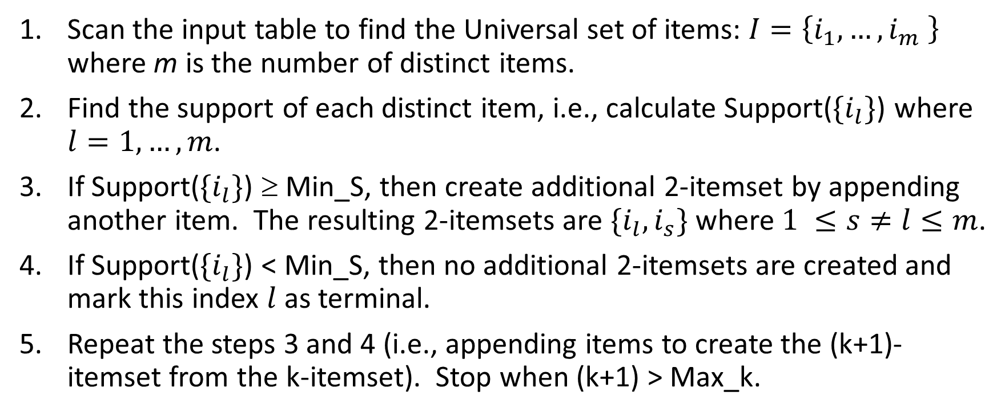
Summary: Find Frequent Itemset
Scan the input table to find the Universal set of items: $I=\left\{i_{1},…,i_{m} \right\}$ where m is the number of distinct items.
Find the support of each distinct item, i.e., calculate Support($\{i_{l}\}$) where $l=1,…,m$.
If Support($\{i_{l}\}$) ≥ Min_S, then create additional 2-itemset by appending another item. The resulting 2-itemsets are $\{i_{l},i_{s}\}$ where $1 ≤s≠l≤m$.
If Support($\{i_{l}\}$) < Min_S, then no additional 2-itemsets are created and mark this index $l$ as terminal.
Repeat the steps 3 and 4 (i.e., appending items to create the (k+1)- itemset from the k-itemset). Stop when (k+1) > Max_k.

Slide 50
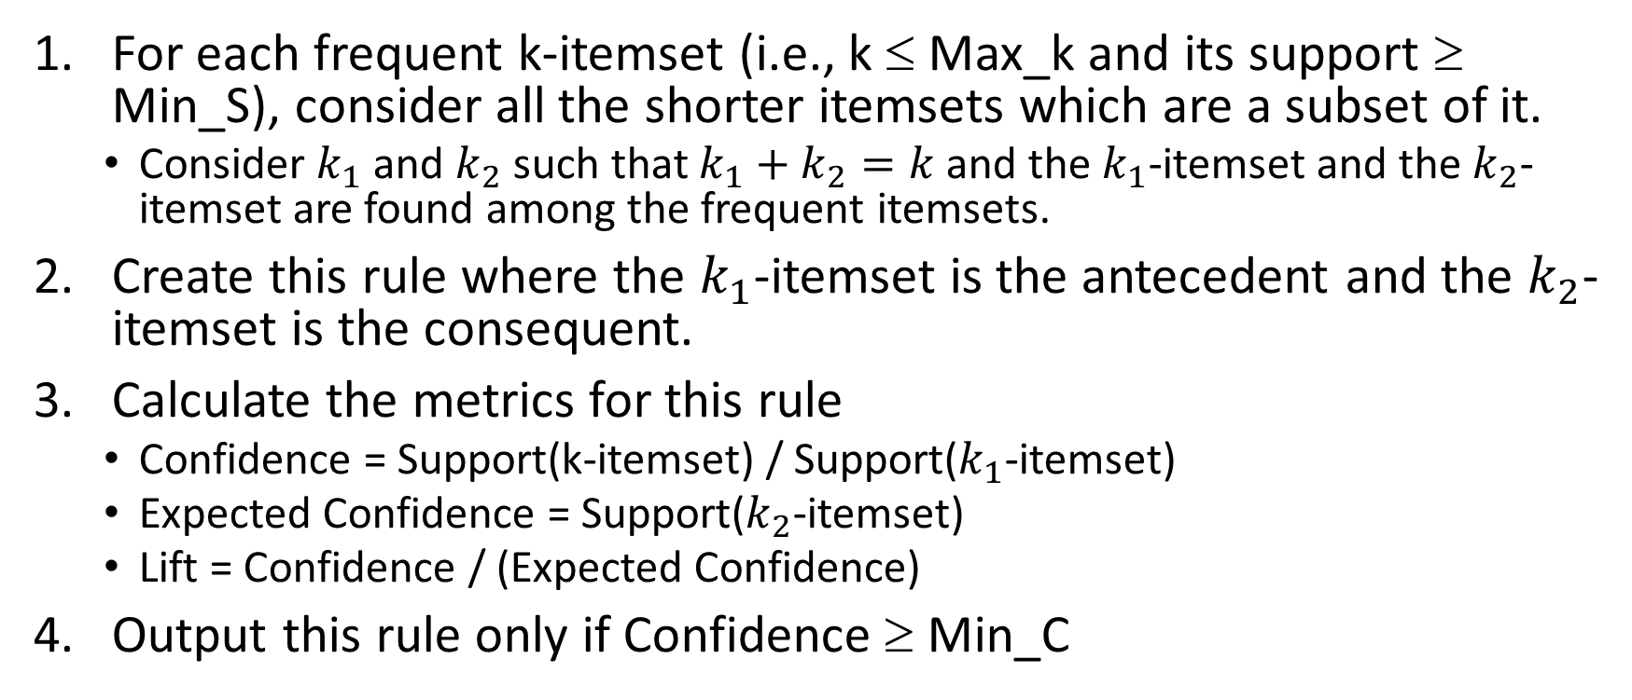
Summary: Find Rules
For each frequent k-itemset (i.e., k ≤ Max_k and its support ≥ Min_S), consider all the shorter itemsets which are a subset of it.
Consider $k_{1}$ and $k_{2}$ such that $k_{1}+k_{2}=k$ and the $k_{1}$-itemset and the $k_{2}$-itemset are found among the frequent itemsets.
Create this rule where the $k_{1}$-itemset is the antecedent and the $k_{2}$-itemset is the consequent.
Calculate the metrics for this rule
Confidence = Support(k-itemset) / Support($k_{1}$-itemset)
Expected Confidence = Support($k_{2}$-itemset)
Lift = Confidence / (Expected Confidence)
Output this rule only if Confidence ≥ Min_C

Slide 51
Apriori Algorithm Applied to the Toy Example
Support for {A}:
Occurred in customers 1, 7, 8, 9
Equals 4/10 = 40%
Support for {B, D}:
Occurred in customers 1, 4, 6
Equals 3/10 = 30%
Support for {B, C, D}:
Occurred in customers 1, 6
Equals 2/10 = 20%

Slide 52
Apriori Algorithm Applied to the Toy Example
Support(A) = 0.4, Support(B) = 0.5, Support(C) = 0.4, Support(D) = 0.7
If the Minimum Support Threshold = 0.5, then we can ignore all itemsets that contain A or C.
As a result, we only consider these itemsets: (B), (D), and (B,D).
Since Support(B & D) = 0.3, this 2-itemset (B,D) will also be ignored.
Only 1-itemset (B) and (D) will survive, but no association rules can be created from these 1-itemsets.

Slide 53
Apriori Algorithm Applied to the Toy Example
Support(A) = 0.4, Support(B) = 0.5, Support(C) = 0.4, Support(D) = 0.7
If the Minimum Support Threshold = 0.3, then all four 1-itemsets will survive.
The 2-itemsets (A,D), (B,C), (B,D)and (C,D) will be the final frequent itemsets
Create rules: B → D and D → B.
Conf(B → D) = Support(B & D) / Support(B) = 0.3 / 0.5 = 0.6
Conf(D → B) = Support(B & D) / Support(D) = 0.3 / 0.7 = 0.4285
If the Minimum Confidence Threshold is 0.5, then the rule D → B will be ignored.

Slide 54
Apriori Algorithm Applied to the Toy Example
Install mlxtend from https://anaconda.org/conda-forge/mlxtend
The apriori(trainData, min_support=, max_len=, use_colnames=) function finds the frequent itemsets. See for details. http://rasbt.github.io/mlxtend/user_guide/frequent_patterns/Apriori/
The association_rules(frequent_itemsets, metric=“”, min_threshold=) function generates the association rules. See http://rasbt.github.io/mlxtend/user_guide/frequent_patterns/association_rules/ for details.

Slide 55
Apriori Algorithm Applied to the Toy Example
import pandas
ToyAssoc = pandas.read_csv('C:\\Users\\minlam\\Documents\\IIT\\Machine Learning\\Data\\AssociationRuleToyExample.csv’, delimiter=',')
ListItem = ToyAssoc.groupby(['Customer'])['Item'].apply(list).values.tolist() # Sale Receipt -> Item List
from mlxtend.preprocessing import TransactionEncoder
te = TransactionEncoder()
te_ary = te.fit(ListItem).transform(ListItem)
trainData = pandas.DataFrame(te_ary, columns=te.columns_) # Item List -> Item Indicator
from mlxtend.frequent_patterns import apriori
from mlxtend.frequent_patterns import association_rules
frequent_itemsets = apriori(trainData, min_support = 0.3, max_len = 2, use_colnames = True)
assoc_rules = association_rules(frequent_itemsets, metric = "confidence", min_threshold = 0.5)
Week 3 Association Rule.py

Slide 56
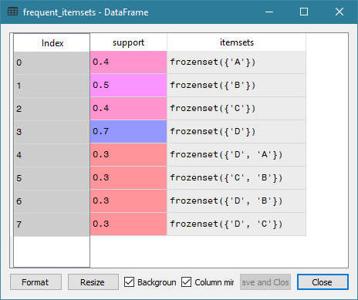
Apriori Algorithm Applied to the Toy Example
Found 8 itemsets whose support is 0.3 or higher
1-itemset
{A}, {B}, {C}, and {D}
2-itemset
{A, D}, {B, C}, {B, D}, and {C, D}

Slide 57
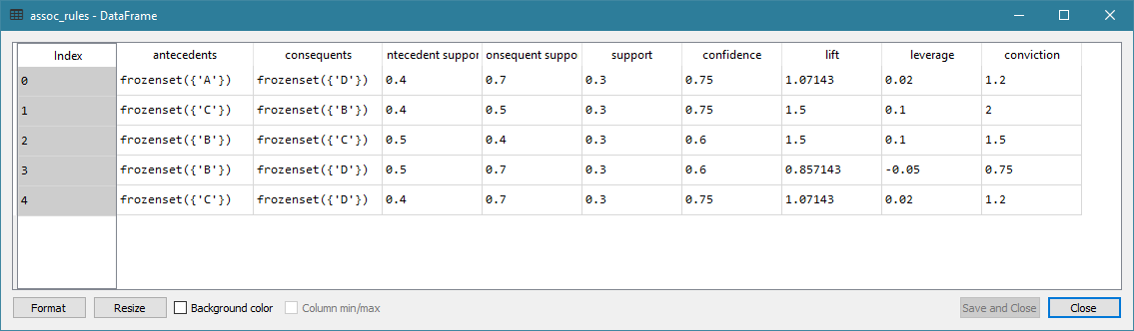
Apriori Algorithm Applied to the Toy Example

Slide 58
Choice of Parameters
What is the maximum size of itemset?
What is the minimum Support?
What is the minimum Confidence?
A too high value takes a long time to get all the itemsets
A too low value risks missing some interesting rules

Slide 59
Maximum Size of Itemset
Calculate the number of items purchased by each customer
Create a frequency table of the results from (1)
Consider the median number of items purchased
Choose a lower number if the median is still too high

Slide 60
Minimum Support and Confidence
If resources permits, try low Support and Confidence thresholds.
Try threshold = 0.01 (i.e., 1%)
Plot Support versus Confidence (i.e., Support on the vertical axis and Confidence on the horizontal axis)
Optionally make the size of marker proportional to Lift
Determine the practical thresholds for Support and Confidence
Use your analytical judgment to choose rules whose Confidence are above your comfort level, to draw a boundary to separate rules according to their Support.

Slide 61
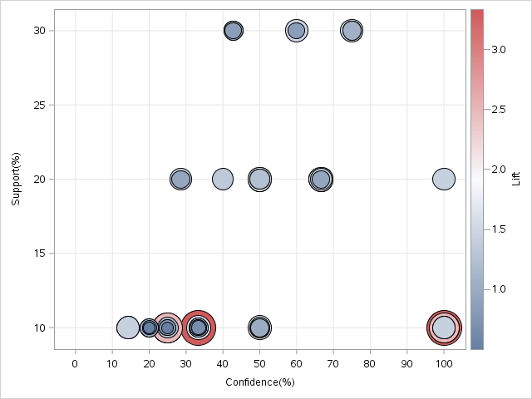
Scatterplot of Support vs. Confidence
Credible and Common Rules
Highly Credible, though Rare, Rules
Gray Area
Accidental Rules That Are Not Trustworthy

Slide 62
Imaginary Store Market Basket Example
Our imaginary store sales the following items: bananas, bologna, bread, buns, butter, cereal, cheese, chips, eggs, hotdogs, mayo, milk, mustard, oranges, pickles, and soda.
We have recorded transactions of 995 customers in this CSV file: imaginary_Store.csv. This CSV file has 7,037 rows of observations and two variables.
The variables are:
Customer: A unique identifier of a customer
Item: Item purchased by the customer

Slide 63
Number of Customs Who Bought Item
Item | Frequency | Support
Chips | 698 | 0.702
Cheese | 696 | 0.699
Cereal | 639 | 0.642
Butter | 583 | 0.586
Buns | 571 | 0.574
Bread | 560 | 0.563
Bologna | 512 | 0.515
Bananas | 467 | 0.469
Eggs | 458 | 0.460
Hotdogs | 432 | 0.434
Mayo | 397 | 0.399
Milk | 341 | 0.343
Mustard | 248 | 0.249
Oranges | 220 | 0.221
Pickles | 129 | 0.130
Soda | 86 | 0.086
Since duplicated items in a customer’s basket are ignored, then the Frequency is the number of customers who bought that item.
For example, 698 customers have Chips in their basket. This means Support{Chips} = 0.702
Since including additional items will only decrease the Support, this suggests that the maximum support we can have is 0.702.
Week 3 Imaginary Store Association Rule.py

Slide 64
Recommended Maximum Size of Itemset
Read this frequency table like there are 28 customers who purchased 2 distinct items in their baskets
The median number of distinct items is 7.
So we set the maximum size of itemset to be 7.
Without additional information, we set the minimum Support to 0.01 and the minimum Confidence to 0.5
Found 53,516 rules
Item | Frequency
2 | 28
3 | 26
4 | 95
5 | 95
6 | 175
7 | 136
8 | 167
9 | 108
10 | 101
11 | 44
12 | 17
13 | 2
14 | 1
Week 3 Imaginary Store Association Rule.py

Slide 65
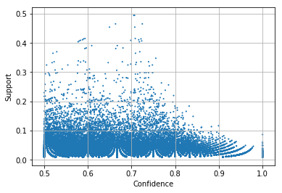
Support versus Confidence
Relatively fewer rules have Support > 0.3
We can set an aggressive Confidence threshold
Try min. Support = 0.1 and min. Confidence = 0.8.

Slide 66
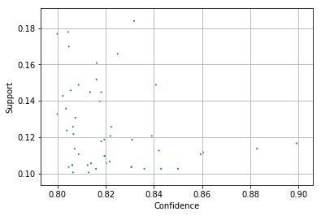
Support versus Confidence
There are 51 rules where Support > 0.1 and Confidence > 0.8
The Lift values vary between 1.14 to 1.37 with a median of 1.168

Slide 67
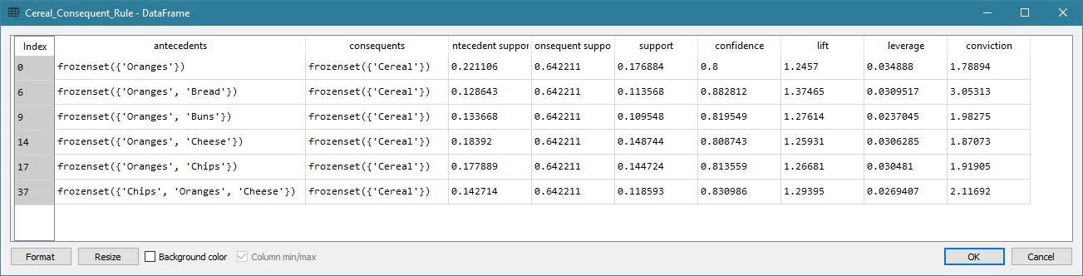
Rules with a Particular Consequent
Suppose you are promoting Cereal. You want to study the purchase behavior that, with high confidence, leads to buying Cereal only.
In other words, you want the Consequent to contain Cereal only.

Slide 68
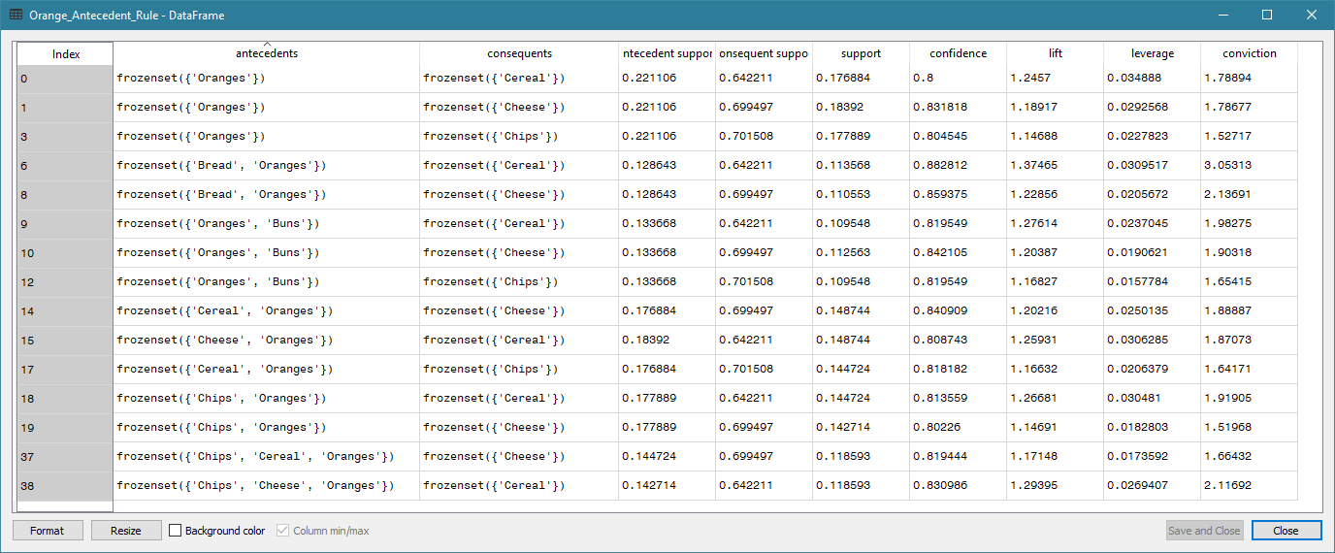
Rules with a Particular Antecedent
Suppose you want to study what else people buy if they already bought Oranges.
In other words, you want the Antecedent to contain Oranges.

Slide 69
Reading for Next Week
Chapter 4: Clustering Discovery of the Machine Learning book
https://scikit-learn.org/stable/modules/clustering.html#clustering

