Slide 1

CS 484 Intro to Machine Learning
Week 8
October 14, 2020

Slide 2
Week 8 Agenda: Logistic Regression, Interactions, Parameters
Odds and Odds Ratio
Interactions Among Predictors
Interpretation of Parameters
Chapter 6 of the Machine Learning book

Slide 3
Odds for a Binary Outcome
The odds of an Event is the ratio by dividing the probability of the Event occurring by the probability of the Non-Event occurring.
Suppose the probability of the Event occurring is $0≤p≤1$, the Odds is $p/{\left(1−p\right)}$.
Suppose the probability of the Event occurring is 0≤𝑝≤1, the Odds is 𝑝∕(1−𝑝) .
The Event will never occur, i.e., $p=0$, then Odds = 0
The Event will never occur, i.e., 𝑝=0, then Odds = 0
50/50 Event chance, i.e., $p=\frac{1}{2}$, then Odds = 1.
50/50 Event chance, i.e., 𝑝=1/2, then Odds = 1.
Odds is a number in the interval $\left[0\right.,∞)$.
Odds is a number in the interval [0┤,∞).
The Event will surely occur, i.e., $p=1$, then Odds = $∞$
The Event will surely occur, i.e., 𝑝=1, then Odds = ∞

Slide 4
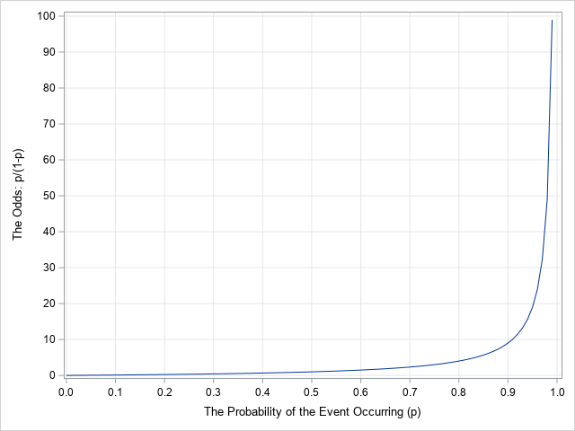
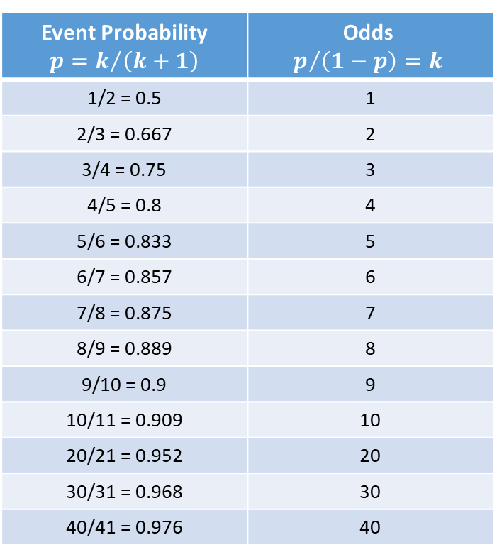
Odds for a Binary Outcome
Event Probability $$p=k/{\left(k+1\right)}$$ | Odds $$p/{\left(1−p\right)=k}$$
1/2 = 0.5 | 1
2/3 = 0.667 | 2
3/4 = 0.75 | 3
4/5 = 0.8 | 4
5/6 = 0.833 | 5
6/7 = 0.857 | 6
7/8 = 0.875 | 7
8/9 = 0.889 | 8
9/10 = 0.9 | 9
10/11 = 0.909 | 10
20/21 = 0.952 | 20
30/31 = 0.968 | 30
40/41 = 0.976 | 40

Slide 5

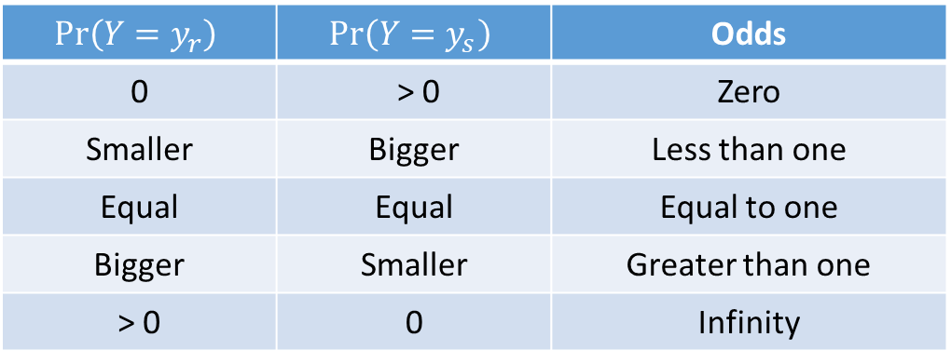
Odds for a Nominal Outcome
Suppose the nominal variable $Y$ has $J$ outcomes, namely, $\left\{y_{1},…,y_{J}\right\}$
The odds in favor of event $y_{r}$ against event $y_{s}$ is the ratio by dividing the probability of event $y_{r}$ occurring by the probability of event $y_{s}$ is occurring. Mathematically, this odds is ${Pr\left(Y=y_{r}\right)}/{Pr\left(Y=y_{s}\right)}$.
$$Pr\left(Y=y_{r}\right)$$ | $$Pr\left(Y=y_{s}\right)$$ | Odds
0 | > 0 | Zero
Smaller | Bigger | Less than one
Equal | Equal | Equal to one
Bigger | Smaller | Greater than one
> 0 | 0 | Infinity

Slide 6
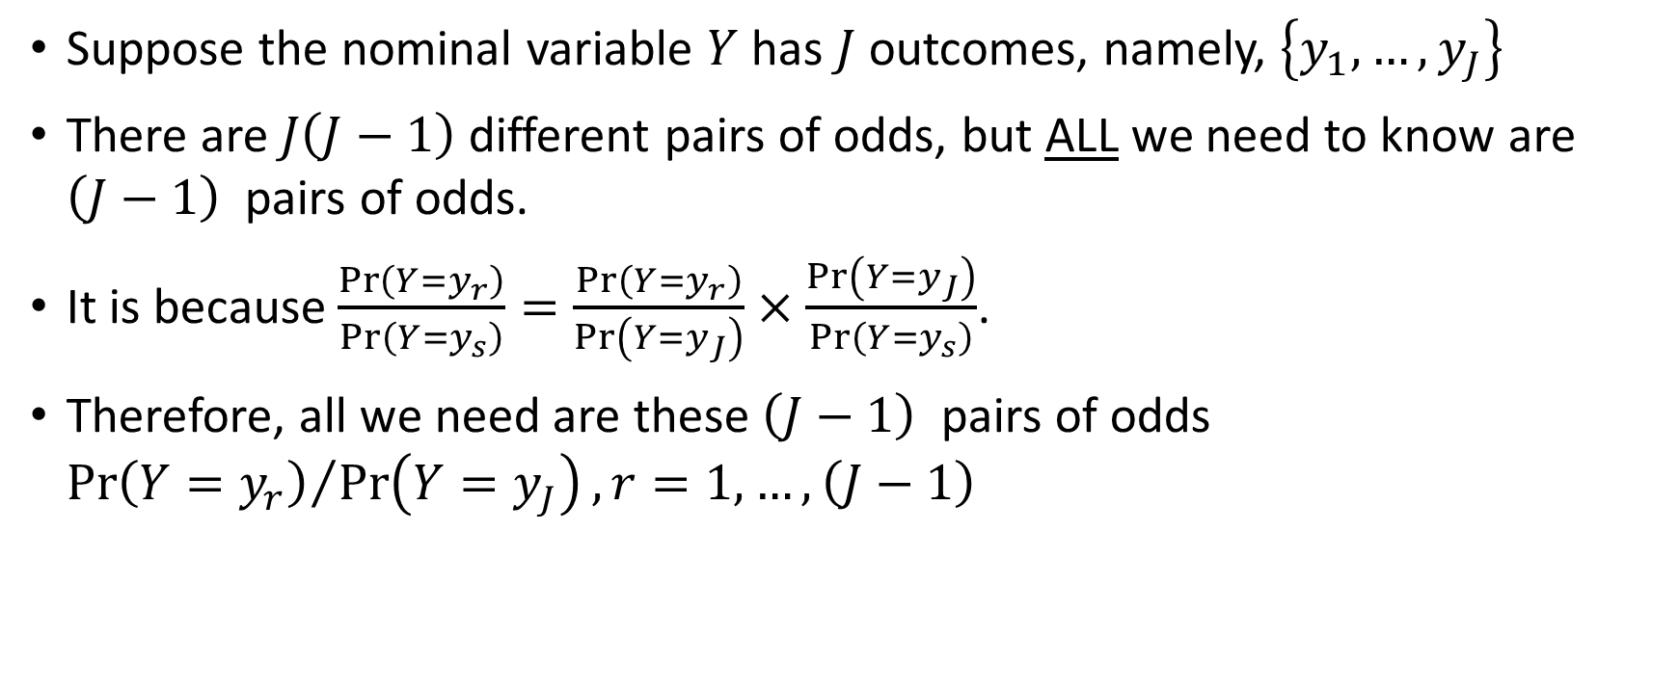
Odds for a Nominal Outcome
Suppose the nominal variable $Y$ has $J$ outcomes, namely, $\left\{y_{1},…,y_{J}\right\}$
There are $J\left(J−1\right)$ different pairs of odds, but ALL we need to know are $\left(J−1\right)$ pairs of odds.
It is because $\frac{Pr\left(Y=y_{r}\right)}{Pr\left(Y=y_{s}\right)}=\frac{Pr\left(Y=y_{r}\right)}{Pr\left(Y=y_{J}\right)}×\frac{Pr\left(Y=y_{J}\right)}{Pr\left(Y=y_{s}\right)}$.
Therefore, all we need are these $\left(J−1\right)$ pairs of odds ${Pr\left(Y=y_{r}\right)}/{Pr\left(Y=y_{J}\right)}, r=1,…,\left(J−1\right)$

Slide 7

Examples of Odds for a Nominal Outcome
The nominal outcome is Origin, the original region of the car manufacturer.
Three categories: Asia, Europe, and USA
$J=3$, so 2 distinct pairs of odds are sufficient
In Favor Of | Against | Odds
Origin = Asia | Origin = USA | Prob(Origin = Asia) / Prob(Origin = USA)
Origin = Europe | Origin = USA | Prob(Origin = Europe) / Prob(Origin = USA)

Slide 8
Express Odds as a Ratio of Two Numbers
Odds = $\frac{\text{The} \text{probability} \text{of} \text{the} \text{occurrence} \text{of} \text{the} \text{event}}{\text{T}\text{he} \text{probability} \text{of} \text{the} \text{occurrence} \text{of} \text{another} \text{event}}$
Odds = "The probability of the occurrence of the event" /"The probability of the occurrence of another event"
Commonly express the Odds as a ratio of two numbers
Odds = 4.5 or as 90 : 20 (the event occurs 4.5 times more often than another event)
Odds = 1 is expressed as 50 : 50 (the event and another event occurs equal likely)
Both numbers are positive integers
Odds = 0.3333 or as 1 : 3 (another event occurs almost 3 times more often than the event)

Slide 9

Express Odds as a Ratio of Two Numbers
The odds of winning the Powerball drawing is 1 in 292 million.
Interpretation: the probability of not winning the Powerball is 292 million times of the probability of winning the Powerball.
Let p denotes the probability of winning the Powerball, then (1 – p) is the probability of not winning the Powerball.
The odds statement implies (1 – p) / p = 292 x 10⁶.
p = 1 / (1 + 292 x 10⁶) = 3.42 x 10⁻⁹ = 0.000 000 003 42

Slide 10
Odds Ratio (OR)
Definition
A ratio of two odds
Usage
A measure of association
Suppose the probabilities are influenced by a predictor
The odds ratio measures the strength and the direction of the association between the nominal outcome and the predictor.
Specifically, the state of the predictor, e.g. X versus Not X.
An example is OR = $\frac{\text{Prob}\text{(}\text{Origin}\text{=}\text{USA}\text{ | }\text{X}\text{)} \text{/} \text{Prob}\text{(}\text{Origin}\text{=}\text{Asia}\text{ | }\text{X}\text{)}}{\text{Pr}\text{ob}\text{(}\text{Origin}\text{=}\text{USA}\text{ | }\text{not} \text{X}\text{)} \text{/} \text{Prob}\text{(}\text{Origin}\text{=}\text{Asia}\text{ | }\text{not} \text{X}\text{)}}$
An example is OR = "Prob(Origin=USA | X) / Prob(Origin=Asia | X)" /"Prob(Origin=USA | not X) / Prob(Origin=Asia | not X)"

Slide 11
Odds Ratio (OR)
Indicates the relative odds of the occurrence of the outcome of interest, given presence of a particular predictor value.
Is a particular exposure a risk factor for a particular outcome?
OR < 1 implies the exposure associated with lower odds of the outcome
OR = 1 implies exposure does not affect the odds of the outcome
Exposure = Presence of the Predictor Value
OR > 1 implies exposure associated with higher odds of the outcome

Slide 12
Example of Odds Ratio
The Outcome is Event or Non-Event
The Exposure is Present or Absent
Cross-tabulate the counts: A, B, C, and D
A / B is the Odds in favor of having the Event when the Exposure is Present
C / D is the Odds in favor of having the Event when the Exposure is Absent
Odds Ratio = (A / B) / (C / D)
 |  | Outcome
 |  | Event | Non-Event
Exposure | Present | A | B
 | Absent | C | D

Slide 13
Example of Odds Ratio
 |  | Outcome
 |  | Event | Non-Event
Exposure | Present | 60 | 40
 | Absent | 50 | 50
OR = (60 / 40) / (50 / 50) = 1.5
OR = (50 / 50) / (60 / 40) = 0.6667
OR = (60 / 40) / (60 / 40) = 1
 |  | Outcome
 |  | Event | Non-Event
Exposure | Present | 50 | 50
 | Absent | 60 | 40
 |  | Outcome
 |  | Event | Non-Event
Exposure | Present | 60 | 40
 | Absent | 60 | 40

Slide 14
Interactions Among Predictors
The overall odds in favor of the event BAD = 1 against the event BAD = 0 is 20.3757 / 79.6243 = 0.26
The corresponding odds for the level combinations of REASON and JOB vary from 0.12 to 0.78.
Are there evidence that the variations depend on the level combinations of REASON and JOB?
 |  |  | Row Percent of BAD
REASON | JOB | N | 0 | 1 | Odds
DebtCon | Mgr | 572 | 79.7203 | 20.2797 | 0.25
DebtCon | Office | 620 | 85.1613 | 14.8387 | 0.17
DebtCon | Other | 1,604 | 79.2394 | 20.7606 | 0.26
DebtCon | ProfExe | 847 | 84.7698 | 15.2302 | 0.18
DebtCon | Sales | 97 | 64.9485 | 35.0515 | 0.54
DebtCon | Self | 73 | 56.1644 | 43.8356 | 0.78
HomeImp | Mgr | 174 | 67.8161 | 32.1839 | 0.47
HomeImp | Office | 301 | 89.0365 | 10.9635 | 0.12
HomeImp | Other | 716 | 71.3687 | 28.6313 | 0.40
HomeImp | ProfExe | 405 | 81.9753 | 18.0247 | 0.22
HomeImp | Sales | 12 | 66.6667 | 33.3333 | 0.50
HomeImp | Self | 115 | 81.7391 | 18.2609 | 0.22
Overall |  | 5,536 | 79.6243 | 20.3757 | 0.26

Slide 15
Interactions Among Predictors
When JOB = Office, the Odds of REASON = HomeImp is less than that of REASON = DebtCon
 |  |  | Row Percent of BAD
REASON | JOB | N | 0 | 1 | Odds
HomeImp | Office | 301 | 89.0365 | 10.9635 | 0.12
DebtCon | Office | 620 | 85.1613 | 14.8387 | 0.17
DebtCon | ProfExe | 847 | 84.7698 | 15.2302 | 0.18
HomeImp | ProfExe | 405 | 81.9753 | 18.0247 | 0.22
HomeImp | Self | 115 | 81.7391 | 18.2609 | 0.22
DebtCon | Mgr | 572 | 79.7203 | 20.2797 | 0.25
DebtCon | Other | 1604 | 79.2394 | 20.7606 | 0.26
HomeImp | Other | 716 | 71.3687 | 28.6313 | 0.40
HomeImp | Mgr | 174 | 67.8161 | 32.1839 | 0.47
HomeImp | Sales | 12 | 66.6667 | 33.3333 | 0.50
DebtCon | Sales | 97 | 64.9485 | 35.0515 | 0.54
DebtCon | Self | 73 | 56.1644 | 43.8356 | 0.78
Overall |  | 5536 | 79.6243 | 20.3757 | 0.26
When JOB = Other, the Odds of REASON = HomeImp is greater than that of REASON = DebtCon
When JOB = Sales, the Odds of REASON = HomeImp is less than that of REASON = DebtCon

Slide 16
Interactions Among Predictors
This is evidence that the level combinations of JOB and REASON, i.e., interaction between JOB and REASON, will jointly influence the Odds.
 |  |  | Row Percent of BAD
REASON | JOB | N | 0 | 1 | Odds
HomeImp | Office | 301 | 89.0365 | 10.9635 | 0.12
DebtCon | Office | 620 | 85.1613 | 14.8387 | 0.17
DebtCon | ProfExe | 847 | 84.7698 | 15.2302 | 0.18
HomeImp | ProfExe | 405 | 81.9753 | 18.0247 | 0.22
HomeImp | Self | 115 | 81.7391 | 18.2609 | 0.22
DebtCon | Mgr | 572 | 79.7203 | 20.2797 | 0.25
DebtCon | Other | 1604 | 79.2394 | 20.7606 | 0.26
HomeImp | Other | 716 | 71.3687 | 28.6313 | 0.40
HomeImp | Mgr | 174 | 67.8161 | 32.1839 | 0.47
HomeImp | Sales | 12 | 66.6667 | 33.3333 | 0.50
DebtCon | Sales | 97 | 64.9485 | 35.0515 | 0.54
DebtCon | Self | 73 | 56.1644 | 43.8356 | 0.78
Overall |  | 5536 | 79.6243 | 20.3757 | 0.26

Slide 17
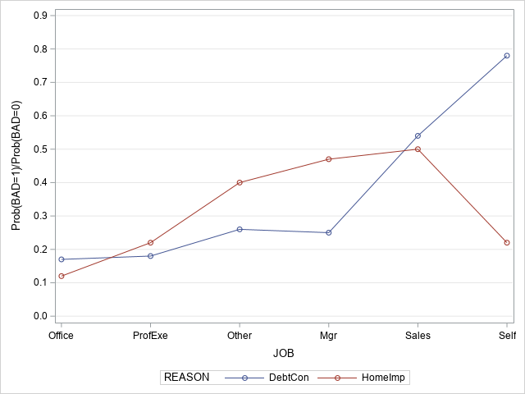
Interactions Among Predictors
We created an Interaction Plot (sometimes also known as a Profile Plot) that plot the Odds versus the JOB for each category of REASON.
Since the two series do cross each other, we can be more assured that the interaction effect REASON * JOB should be considered in the model.

Slide 18
Interactions Among Predictors
Represent the interaction effect between REASON and JOB by this effect REASON * JOB
Create indicator (a.k.a. dummy) variables for REASON * JOB
Note: The zeros are omitted intentionally to leave the spaces blank
REASON | JOB | REASON_DebtCon | REASON_HomeImp | JOB_Mgr | JOB_Office | JOB_Other | JOB_ProfExe | JOB_Sales | JOB_Self | REASON_DebtCon * JOB_Mgr | REASON_DebtCon * JOB_Office | REASON_DebtCon * JOB_Other | REASON_DebtCon * JOB_ProfExe | REASON_DebtCon * JOB_Sales | REASON_DebtCon * JOB_Self | REASON_HomeImp * JOB_Mgr | REASON_HomeImp * JOB_Office | REASON_HomeImp * JOB_Other | REASON_HomeImp * JOB_ProfExe | REASON_HomeImp * JOB_Sales | REASON_HomeImp * JOB_Self
DebtCon | Mgr | 1 |  | 1 |  |  |  |  |  | 1
DebtCon | Office | 1 |  |  | 1 |  |  |  |  |  | 1
DebtCon | Other | 1 |  |  |  | 1 |  |  |  |  |  | 1
DebtCon | ProfExe | 1 |  |  |  |  | 1 |  |  |  |  |  | 1
DebtCon | Sales | 1 |  |  |  |  |  | 1 |  |  |  |  |  | 1
DebtCon | Self | 1 |  |  |  |  |  |  | 1 |  |  |  |  |  | 1
HomeImp | Mgr |  | 1 | 1 |  |  |  |  |  |  |  |  |  |  |  | 1
HomeImp | Office |  | 1 |  | 1 |  |  |  |  |  |  |  |  |  |  |  | 1
HomeImp | Other |  | 1 |  |  | 1 |  |  |  |  |  |  |  |  |  |  |  | 1
HomeImp | ProfExe |  | 1 |  |  |  | 1 |  |  |  |  |  |  |  |  |  |  |  | 1
HomeImp | Sales |  | 1 |  |  |  |  | 1 |  |  |  |  |  |  |  |  |  |  |  | 1
HomeImp | Self |  | 1 |  |  |  |  |  | 1 |  |  |  |  |  |  |  |  |  |  |  | 1

Slide 19
Intrinsic Aliasing in Design (aka Model) Matrix
Aliasing (or redundancy) indicates that a column in the design matrix is linearly dependent on other columns.
An aliased column can be expressed as a linear combination (i.e., a weighted sum) of the other columns.
Intrinsic means the aliasing occurs as a result of how we construct the design matrix. On the contrary, extrinsic means the aliasing is a feature or an artifact in the data.
There are many strategies to deal with aliasing. The popular strategy is to fix the parameter corresponding to the aliased column to zero.

Slide 20
Intrinsic Aliasing in Design (aka Model) Matrix
The sum of the two columns REASON_DebtCon and REASON_HomeImp equals to the column of Intercept
The sum of the six columns JOB_Mgr, JOB_Office, JOB_Other, JOB_ProfExe, JOB_Sales, and JOB_Self equals to the column of Intercept
The sum of the twelve columns for REASON * JOB equals to the column of Intercept
Intercept | REASON_DebtCon | REASON_HomeImp | JOB_Mgr | JOB_Office | JOB_Other | JOB_ProfExe | JOB_Sales | JOB_Self | REASON_DebtCon * JOB_Mgr | REASON_DebtCon * JOB_Office | REASON_DebtCon * JOB_Other | REASON_DebtCon * JOB_ProfExe | REASON_DebtCon * JOB_Sales | REASON_DebtCon * JOB_Self | REASON_HomeImp * JOB_Mgr | REASON_HomeImp * JOB_Office | REASON_HomeImp * JOB_Other | REASON_HomeImp * JOB_ProfExe | REASON_HomeImp * JOB_Sales | REASON_HomeImp * JOB_Self
1 | 1 | 0 | 1 | 0 | 0 | 0 | 0 | 0 | 1 | 0 | 0 | 0 | 0 | 0 | 0 | 0 | 0 | 0 | 0 | 0
1 | 1 | 0 | 0 | 1 | 0 | 0 | 0 | 0 | 0 | 1 | 0 | 0 | 0 | 0 | 0 | 0 | 0 | 0 | 0 | 0
1 | 1 | 0 | 0 | 0 | 1 | 0 | 0 | 0 | 0 | 1 | 1 | 0 | 0 | 0 | 0 | 0 | 0 | 0 | 0 | 0
1 | 1 | 0 | 0 | 0 | 0 | 1 | 0 | 0 | 0 | 0 | 0 | 1 | 0 | 0 | 0 | 0 | 0 | 0 | 0 | 0
1 | 1 | 0 | 0 | 0 | 0 | 0 | 1 | 0 | 0 | 0 | 0 | 0 | 1 | 0 | 0 | 0 | 0 | 0 | 0 | 0
1 | 1 | 0 | 0 | 0 | 0 | 0 | 0 | 1 | 0 | 0 | 0 | 0 | 0 | 1 | 0 | 0 | 0 | 0 | 0 | 0
1 | 0 | 1 | 1 | 0 | 0 | 0 | 0 | 0 | 0 | 0 | 0 | 0 | 0 | 0 | 1 | 0 | 0 | 0 | 0 | 0
1 | 0 | 1 | 0 | 1 | 0 | 0 | 0 | 0 | 0 | 0 | 0 | 0 | 0 | 0 | 0 | 1 | 0 | 0 | 0 | 0
1 | 0 | 1 | 0 | 0 | 1 | 0 | 0 | 0 | 0 | 0 | 0 | 0 | 0 | 0 | 0 | 0 | 1 | 0 | 0 | 0
1 | 0 | 1 | 0 | 0 | 0 | 1 | 0 | 0 | 0 | 0 | 0 | 0 | 0 | 0 | 0 | 0 | 0 | 1 | 0 | 0
1 | 0 | 1 | 0 | 0 | 0 | 0 | 1 | 0 | 0 | 0 | 0 | 0 | 0 | 0 | 0 | 0 | 0 | 0 | 1 | 0
1 | 0 | 1 | 0 | 0 | 0 | 0 | 0 | 1 | 0 | 0 | 0 | 0 | 0 | 0 | 0 | 0 | 0 | 0 | 0 | 1

Slide 21


Locate the Aliased Columns
How to check if a column is a linear combination of other columns?
Linear Regression!

Slide 22
Locate the Aliased Columns
Suppose the Design Matrix has p columns
For i = 1, …, p
Regress the i-th column on the previous 1,…,(i-1)-th columns provided these columns are not aliased
If the sum of squared residual is practically zero, then the i-th column is aliased.

Slide 23
Locate the Aliased Columns
Regression Equation | Sum of Squared Residuals
REASON_DebtCon = 0.5 * Intercept | 3.0
REASON_HomeImp = Intercept - REASON_DebtCon | 0.0
JOB_Mgr = 0.1667 * Intercept | 1.6667
JOB_Office = 0.2 * Intercept – 0.2 * JOB_Mgr | 1.6
JOB_Other = 0.25 * Intercept – 0.25 * JOB_Mgr – 0.25 * JOB_Office | 1.5
JOB_ProfExe = 0.3333 * Intercept – 0.3333 * JOB_Mgr – 0.3333 * JOB_Office – 0.3333 * JOB_Other | 1.3333
JOB_Sales = 0.5 * Intercept – 0.5 * JOB_Mgr – 0.5 * JOB_Office – 0.5 * JOB_Other – 0.5 * JOB_ProfExe | 1.0
JOB_Self = Intercept – JOB_Mgr – JOB_Office – JOB_Other – JOB_ProfExe – JOB_Sales | 0.0

Slide 24
Locate the Aliased Columns (*)
Intercept | REASON_DebtCon | REASON_HomeImp (*) | JOB_Mgr | JOB_Office | JOB_Other | JOB_ProfExe | JOB_Sales | JOB_Self (*) | REASON_DebtCon * JOB_Mgr | REASON_DebtCon * JOB_Office | REASON_DebtCon * JOB_Other | REASON_DebtCon * JOB_ProfExe | REASON_DebtCon * JOB_Sales | REASON_DebtCon * JOB_Self (*) | REASON_HomeImp * JOB_Mgr (*) | REASON_HomeImp * JOB_Office (*) | REASON_HomeImp * JOB_Other (*) | REASON_HomeImp * JOB_ProfExe (*) | REASON_HomeImp * JOB_Sales (*) | REASON_HomeImp * JOB_Self (*)
1 | 1 | 0 | 1 | 0 | 0 | 0 | 0 | 0 | 1 | 0 | 0 | 0 | 0 | 0 | 0 | 0 | 0 | 0 | 0 | 0
1 | 1 | 0 | 0 | 1 | 0 | 0 | 0 | 0 | 0 | 1 | 0 | 0 | 0 | 0 | 0 | 0 | 0 | 0 | 0 | 0
1 | 1 | 0 | 0 | 0 | 1 | 0 | 0 | 0 | 0 | 1 | 1 | 0 | 0 | 0 | 0 | 0 | 0 | 0 | 0 | 0
1 | 1 | 0 | 0 | 0 | 0 | 1 | 0 | 0 | 0 | 0 | 0 | 1 | 0 | 0 | 0 | 0 | 0 | 0 | 0 | 0
1 | 1 | 0 | 0 | 0 | 0 | 0 | 1 | 0 | 0 | 0 | 0 | 0 | 1 | 0 | 0 | 0 | 0 | 0 | 0 | 0
1 | 1 | 0 | 0 | 0 | 0 | 0 | 0 | 1 | 0 | 0 | 0 | 0 | 0 | 1 | 0 | 0 | 0 | 0 | 0 | 0
1 | 0 | 1 | 1 | 0 | 0 | 0 | 0 | 0 | 0 | 0 | 0 | 0 | 0 | 0 | 1 | 0 | 0 | 0 | 0 | 0
1 | 0 | 1 | 0 | 1 | 0 | 0 | 0 | 0 | 0 | 0 | 0 | 0 | 0 | 0 | 0 | 1 | 0 | 0 | 0 | 0
1 | 0 | 1 | 0 | 0 | 1 | 0 | 0 | 0 | 0 | 0 | 0 | 0 | 0 | 0 | 0 | 0 | 1 | 0 | 0 | 0
1 | 0 | 1 | 0 | 0 | 0 | 1 | 0 | 0 | 0 | 0 | 0 | 0 | 0 | 0 | 0 | 0 | 0 | 1 | 0 | 0
1 | 0 | 1 | 0 | 0 | 0 | 0 | 1 | 0 | 0 | 0 | 0 | 0 | 0 | 0 | 0 | 0 | 0 | 0 | 1 | 0
1 | 0 | 1 | 0 | 0 | 0 | 0 | 0 | 1 | 0 | 0 | 0 | 0 | 0 | 0 | 0 | 0 | 0 | 0 | 0 | 1

Slide 25
Aliasing Detection (Besides SWEEP Operator)
Consider sympy which is Python library for symbolic mathematics
The Matrix.rref() method of sympy can identify these aliased columns in the Design Matrix
The Matrix().rref() method transforms a matrix into reduced row echelon form (i.e., the lower triangular part is zero)
The Matrix().rref() returns a tuple of two elements.
The first is the reduced row echelon form
The second is a tuple of indices of the pivot columns.
The indices of the pivot columns are the non-aliased column number

Slide 26
Intrinsic Aliasing in Design (aka Model) Matrix
# A function that find the non-aliased columns, fit a logistic model, and return the full parameter estimates
def build_mnlogit (fullX, y, debug = 'N'):
# Number of all parameters
nFullParam = fullX.shape[1]
# Number of target categories
y_category = y.cat.categories
nYCat = len(y_category)
# Find the non-redundant columns in the design matrix fullX
reduced_form, inds = sympy.Matrix(fullX.values).rref()
# Extract only the non-redundant columns for modeling
X = fullX.iloc[:, list(inds)]
# The number of free parameters
thisDF = len(inds) * (nYCat - 1)
# Build a multionomial logistic model
logit = stats.MNLogit(y, X)
thisFit = logit.fit(method='newton', full_output = True, maxiter = 100, tol = 1e-8)
thisParameter = thisFit.params
thisLLK = logit.loglike(thisParameter.values)
# Recreat the estimates of the full parameters
workParams = pandas.DataFrame(numpy.zeros(shape = (nFullParam, (nYCat - 1))))
workParams = workParams.set_index(keys = fullX.columns)
fullParams = pandas.merge(workParams, thisParameter, how = "left", left_index = True, right_index = True)
fullParams = fullParams.drop(columns = '0_x').fillna(0.0) ## Need to work on this more
# Return model statistics
return (thisLLK, thisDF, fullParams)

Slide 27
Example of Interaction Effect
Home Equity Loan (hmeq.csv) ● Drop all missing values 5,536 observations ● Target: BAD ● Predictors: REASON and JOB
REASON: Reason for Loan DebtCon = debt consolidation; HomeImp = home improvement
JOB: Occupation category (Mgr, Office, Other, ProfExe, Sales, Self)
Main Effect: REASON
Main Effect: JOB
BAD: Status of loan 0 (Non-Event) and 1 (Event)
Interaction Effect: REASON * JOB
Week 8 HMEQ Logistic with Interaction.py

Slide 28
Example for Interaction Effect
Step | Model | Number of Free Parameters | Log-likelihood | Deviance | Degrees of Freedom | Significance
0 | Intercept | 1 | -2798.8197
1 | Intercept + REASON | 2 | -2794.5332 | 8.5729 | 1 | 0.0034
2 | Intercept + REASON + JOB | 7 | -2755.5512 | 77.9639 | 5 | 2.2367e-15
3 | Intercept + REASON + JOB + REASON * JOB | 12 | -2737.8261 | 35.4504 | 5 | 1.2232e-06
All significances are less than 5%. Therefore, all three effects REASON, JOB, and REASON * JOB are significant

Slide 29
Parameter Estimates
Parameter | BAD = 1
const | -1.4987723
REASON_DebtCon | 1.2509362
REASON_HomeImp | 0
JOB_Mgr | 0.7534394
JOB_Office | -0.5957071
JOB_Other | 0.5854127
JOB_ProfExe | -0.0159032
JOB_Sales | 0.8056252
JOB_Self | 0
REASON_DebtCon * JOB_Mgr | -1.8745059
REASON_DebtCon * JOB_Office | -0.9037645
REASON_DebtCon * JOB_Other | -1.6769934
REASON_DebtCon * JOB_ProfExe | -1.4529178
REASON_DebtCon * JOB_Sales | -1.1745632
REASON_DebtCon * JOB_Self | 0
REASON_HomeImp * JOB_Mgr | 0
REASON_HomeImp * JOB_Office | 0
REASON_HomeImp * JOB_Other | 0
REASON_HomeImp * JOB_ProfExe | 0
REASON_HomeImp * JOB_Sales | 0
REASON_HomeImp * JOB_Self | 0
The complete list has 21 parameters.
9 parameters are aliased
12 parameters are not aliased
Since the Matrix().rref() method always starts from the first column, the aliased columns usually appear later in an effect
HomeImp in REASON
Self in JOB
DebtCon in REASON and Self in JOB

Slide 30
MNL: Interpretation of Parameters
Simple Case: $\log_{e}\left(\frac{π_{ij}}{π_{iJ}}\right)=xβ_{j}$
Simple Case: log_𝑒⁡〖(𝜋_𝑖𝑗/𝜋_𝑖𝐽 )=𝑥𝛽_𝑗 〗
When x = $v_{0}$, $\log_{e}\left(\frac{π_{ij}^{0}}{π_{iJ}^{0}}\right)=v_{0}β_{j}$ , thus $\frac{π_{ij}^{0}}{π_{iJ}^{0}}=e^{v_{0}β_{j}}$
When x = 𝑣_0, log_𝑒⁡〖((𝜋_𝑖𝑗^0)/(𝜋_𝑖𝐽^0 ))=𝑣_0 𝛽_𝑗 〗 , thus (𝜋_𝑖𝑗^0)/(𝜋_𝑖𝐽^0 )=𝑒^(𝑣_0 𝛽_𝑗 )
When x = $v_{1}$, $\log_{e}\left(\frac{π_{ij}^{1}}{π_{iJ}^{1}}\right)=v_{1}β_{j}$, thus $\frac{π_{ij}^{1}}{π_{iJ}^{1}}=e^{v_{1}β_{j}}$
When x = 𝑣_1, log_𝑒⁡〖((𝜋_𝑖𝑗^1)/(𝜋_𝑖𝐽^1 ))=𝑣_1 𝛽_𝑗 〗, thus (𝜋_𝑖𝑗^1)/(𝜋_𝑖𝐽^1 )=𝑒^(𝑣_1 𝛽_𝑗 )
The Odds Ratio is ${\left(\frac{π_{ij}^{1}}{π_{iJ}^{1}}\right)}/{\left(\frac{π_{ij}^{0}}{π_{iJ}^{0}}\right)}=e^{{\left(v_{1}−v_{0}\right)β}_{j}}$.
The Odds Ratio is ((𝜋_𝑖𝑗^1)/(𝜋_𝑖𝐽^1 ))∕((𝜋_𝑖𝑗^0)/(𝜋_𝑖𝐽^0 )) =𝑒^((𝑣_1−𝑣_0 )𝛽_𝑗 ).

Slide 31
MNL: Interpretation of Parameters
Use the CARS.CSV dataset
Predict Origin (Asia, Europe, USA) by DriveTrain (AWD, FWD, RWD)
The observed counts and row percents are below:
Finding: Front-wheel drive (FWD) cars are made mostly in Asia, while Rear- wheel drive (RWD) cars are made mostly in Europe.
Frequency Table:
Origin Asia Europe USA All
DriveTrain
AWD 34 36 22 92
FWD 99 37 90 226
RWD 25 50 35 110
All 158 123 147 428
Percent Table:
Origin Asia Europe USA All
DriveTrain
AWD 36.956522 39.130435 23.913043 100.0
FWD 43.805310 16.371681 39.823009 100.0
RWD 22.727273 45.454545 31.818182 100.0
All 36.915888 28.738318 34.345794 100.0
Week 7 Cars Logistic

Slide 32
MNL: Interpretation of Parameters
 | Origin
 | Europe | USA
const | 0.6931472 | 0.3364722
DriveTrain_AWD | -0.6359888 | -0.7717903
DriveTrain_FWD | -1.6773491 | -0.4317824
DriveTrain_RWD | 0 | 0
A set of parameters:
Intercept
[DriveTrain = AWD]
[DriveTrain = FWD]
[DriveTrain = RWD]
One set of parameters for
Origin = Europe
Origin = USA
The Origin=Asia is the reference target category
Week 8 Cars Logistic.py

Slide 33
MNL: Interpretation of Parameters
The parameter [DriveTrain=RWD] is linearly dependent on the previous three parameters
[DriveTrain=AWD] + [DriveTrain=FWD] + [DriveTrain=RWD] = Intercept
We use sympy.Matrix.rref() to intentionally set [DriveTrain=RWD] = 0. This is a generally accepted convention in major statistical applications.
The statsmodels.api.MNLogit() function impose the above constraint in estimating the parameters

Slide 34
MNL: Interpretation of Parameters
The statsmodels.api.MNLogit function conventionally takes the lexically first target category as the reference. In this case, Origin = ‘Asia’ is the reference category.
The [0] column in the Parameter Estimates actually refers to the lexically second target category, which is Origin = ‘Europe’.
The [1] column in the Parameter Estimates actually refers to the lexically third (or last) target category, which is Origin = ‘USA’.
Regardless of the convention, the meanings of the parameter estimates are expressed in terms of the logits.

Slide 35
MNL: Interpretation of Parameters
First Logit: log_{e}(Pr(Origin=Europe)/Pr(Origin=Asia)) = Intercept(Europe) + [DriveTrain=AWD](Europe) + [DriveTrain=FWD](Europe) + [DriveTrain=RWD](Europe)
DriveTrain=AWD: log_{e}(Pr(Europe)/Pr(Asia)) = Intercept(Europe) + [DriveTrain=AWD](Europe)
DriveTrain=FWD: log_{e}(Pr(Europe)/Pr(Asia)) = Intercept(Europe) + [DriveTrain=FWD](Europe)
DriveTrain=RWD: log_{e}(Pr(Europe)/Pr(Asia)) = Intercept(Europe) + [DriveTrain=RWD](Europe)
Second Logit: log_{e}(Pr(Origin=USA)/Pr(Origin=Asia)) = Intercept(USA) + [DriveTrain=AWD](USA) + [DriveTrain=FWD](USA) + [DriveTrain=RWD](USA)
DriveTrain=AWD: log_{e}(Pr(USA)/Pr(Asia)) = Intercept(USA) + [DriveTrain=AWD](USA)
DriveTrain=FWD: log_{e}(Pr(USA)/Pr(Asia)) = Intercept(USA) + [DriveTrain=FWD](USA)
DriveTrain=RWD: log_{e}(Pr(USA)/Pr(Asia)) = Intercept(USA) + [DriveTrain=RWD](USA)

Slide 36
MNL: Interpretation of Parameters
First Logit for Europe vs Asia:
DriveTrain=AWD: log_{e}(Pr(Europe)/Pr(Asia)) = 0.6931472 + (-0.6359888)
DriveTrain=FWD: log_{e}(Pr(Europe)/Pr(Asia)) = 0.6931472 + (-1.6773491)
DriveTrain=RWD: log_{e}(Pr(Europe)/Pr(Asia)) = 0.6931472 + (0)
Second Logit for USA vs Asia:
DriveTrain=AWD: log_{e}(Pr(USA)/Pr(Asia)) = 0.3364722 + (-0.7717903)
DriveTrain=FWD: log_{e}(Pr(USA)/Pr(Asia)) = 0.3364722 + (-0.4317824)
DriveTrain=RWD: log_{e}(Pr(USA)/Pr(Asia)) = 0.3364722 + (0)
 | Origin
 | Europe | USA
const | 0.6931472 | 0.3364722
DriveTrain_AWD | -0.6359888 | -0.7717903
DriveTrain_FWD | -1.6773491 | -0.4317824
DriveTrain_RWD | 0 | 0

Slide 37
MNL: Interpretation of Parameters
First Logit for Europe vs Asia:
DriveTrain=AWD: log_{e}(Pr(Europe)/Pr(Asia)) = 0.6931472 + (-0.6359888)
DriveTrain=FWD: log_{e}(Pr(Europe)/Pr(Asia)) = 0.6931472 + (-1.6773491)
DriveTrain=RWD: log_{e}(Pr(Europe)/Pr(Asia)) = 0.6931472 + (0)
Interpretation:
When DriveTrain = AWD, the logit log_{e}(Pr(Europe)/Pr(Asia)) is -0.6359888 (i.e., less) than the same logit when DriveTrain = RWD
When DriveTrain = FWD, the logit: log_{e}(Pr(Europe)/Pr(Asia)) is -1.6773491 (i.e., less) than the same logit when DriveTrain = RWD

Slide 38
MNL: Interpretation of Parameters
First Logit for Europe vs Asia:
DriveTrain=AWD: log_{e}(Pr(Europe)/Pr(Asia)) = 0.6931472 + (-0.6359888) = 0.0571584
DriveTrain=FWD: log_{e}(Pr(Europe)/Pr(Asia)) = 0.6931472 + (-1.6773491) = -0.9842019
DriveTrain=RWD: log_{e}(Pr(Europe)/Pr(Asia)) = 0.6931472 + (0) = 0.6931472
Odds for Europe vs Asia:
DriveTrain=AWD: Pr(Europe)/Pr(Asia) = exp(0.0571584) = 1.0588
DriveTrain=FWD: Pr(Europe)/Pr(Asia) = exp(-0.9842019) = 0.3737
DriveTrain=RWD: Pr(Europe)/Pr(Asia) = exp(0.6931472) = 2.0000
Interpretation:
When DriveTrain=AWD, Pr(Europe) = 1.0588 * Pr(Asia)
When DriveTrain=FWD, Pr(Europe) = 0.3737 * Pr(Asia)
When DriveTrain=RWD, Pr(Europe) = 2.0000 * Pr(Asia)

Slide 39
MNL: Interpretation of Parameters
Second Logit for USA vs Asia:
DriveTrain=AWD: log_{e}(Pr(USA)/Pr(Asia)) = 0.3364722 + (-0.7717903) = -0.4353181
DriveTrain=FWD: log_{e}(Pr(USA)/Pr(Asia)) = 0.3364722 + (-0.4317824) = -0.0953102
DriveTrain=RWD: log_{e}(Pr(USA)/Pr(Asia)) = 0.3364722 + (0) = 0.3364722
Odds for USA vs Asia:
DriveTrain=AWD: Pr(USA)/Pr(Asia) = exp(-0.4353181) = 0.6471
DriveTrain=FWD: Pr(USA)/Pr(Asia) = exp(-0.0953102) = 0.9091
DriveTrain=RWD: Pr(USA)/Pr(Asia) = exp(0.3364722) = 1.4000
Interpretation:
When DriveTrain=AWD, Pr(USA) = 0.6471 * Pr(Asia)
When DriveTrain=FWD, Pr(USA) = 0.9091 * Pr(Asia)
When DriveTrain=RWD, Pr(USA) = 1.4000 * Pr(Asia)

Slide 40

MNL: Predicted Probabilities
When DriveTrain=All, it must come from Europe, USA, or Asia, therefore Pr(Europe) + Pr(USA) + Pr(Asia) = 1
For DriveTrain = AWD
Pr(Asia) = 1 * Pr(Asia)
Pr(Europe) = 1.0588 * Pr(Asia)
Pr(USA) = 0.6471 * Pr(Asia)
For DriveTrain = FWD
Pr(Asia) = 1 * Pr(Asia)
Pr(Europe) = 0.3737 * Pr(Asia)
Pr(USA) = 0.9091 * Pr(Asia)
For DriveTrain = RWD
Pr(Asia) = 1 * Pr(Asia)
Pr(Europe) = 2.0000 * Pr(Asia)
Pr(USA) = 1.4000 * Pr(Asia)
DriveTrain = AWD
1 = (1.0588 + 0.6471 + 1) * Pr(Asia)
Pr(Asia) = 1 / 2.7059 = 0.3696
Pr(Europe) = 1.0588 * 0.3696 = 0.3913
Pr(USA) = 0.6471 * 0.3696 = 0.2392
DriveTrain = FWD
Pr(Asia) = 0.4381
Pr(Europe) = 0.1637
Pr(USA) = 0.3983
DriveTrain = RWD
Pr(Asia) = 0.2273
Pr(Europe) = 0.4546
Pr(USA) = 0.3182

Slide 41
MNL: Predicted Probabilities
The observed row percents and the predicted probabilities are below:
FACT: Only if a logistic model includes only one categorical predictor, then the predicted probabilities are essentially the marginal row percents of that predictor.
Percent Table:
Origin Asia Europe USA All
DriveTrain
AWD 36.956522 39.130435 23.913043 100.0
FWD 43.805310 16.371681 39.823009 100.0
RWD 22.727273 45.454545 31.818182 100.0
All 36.915888 28.738318 34.345794 100.0
Predicted Probability | Origin
DriveTrain | Asia | Europe | USA | All
AWD | 0.3696 | 0.3913 | 0.2392 | 1.0001
FWD | 0.4381 | 0.1637 | 0.3983 | 1.0001
RWD | 0.2273 | 0.4546 | 0.3182 | 1.0001

Slide 42
A Common Question about Logistic Model
What is the impact on the predicted probabilities when a predictor changes its value, provided all other predictors remain fixed?
The short answer is we cannot know directly.
The longer answer is we can only tell the impact on the odds when a predictor changes its value, provided all other predictors remain the same.

Slide 43
Odds Ratio Estimates
Interval
For changing one unit in an interval predictor
It is 1 liter for EngineSize
It is 1 hp for HorsePower
It is 1 inch for Length
It is 1 pound for Weight
Categorical
For changing from one category to another category of a categorical variable
For DriveTrain, it is the change from FWD to RWD, or from RWD to AWD

Slide 44

Odds Ratio Estimates
DriveTrain = RWD
How does this change affect the logits?
DriveTrain = AWD
E liters engine size, H horsepower, L inches long, and weighs W pounds

Slide 45
Odds Ratio
Model is Intercept + DriveTrain + EngineSize + Horsepower + Length + Weight
Number of free parameters is 14
Model Parameter Estimates:
0 1
const 5.230680 -6.535259
DriveTrain_AWD -0.873406 -1.328556
DriveTrain_FWD -0.999260 0.015487
DriveTrain_RWD 0.000000 0.000000
EngineSize -1.397881 2.400626
Horsepower 0.021045 -0.031438
Length -0.063234 0.033081
Weight 0.001804 -0.000241
Week 8 Cars Logistic.py

Slide 46
Odds Ratio
Spot the differences?
DriveTrain = AWD
log_{e}(Pr(Origin=USA)/Pr(Origin=Asia) | DriveTrain = AWD)
A car has AWD drive train, E liters engine size, H horsepower, L inches long, and weighs W pounds
DriveTrain = RWD
log_{e}(Pr(Origin=USA)/Pr(Origin=Asia) | DriveTrain = RWD)
A car has RWD drive train, E liters engine size, H horsepower, L inches long, and weighs W pounds
Logit = -6.535259 + (-1.328556) + (2.400626)*E + (-0.031438)*H + (0.033081)*L + (-0.000241)*W
Logit = -6.535259 + (0) + (2.400626)*E + (-0.031438)*H + (0.033081)*L + (-0.000241)*W

Slide 47
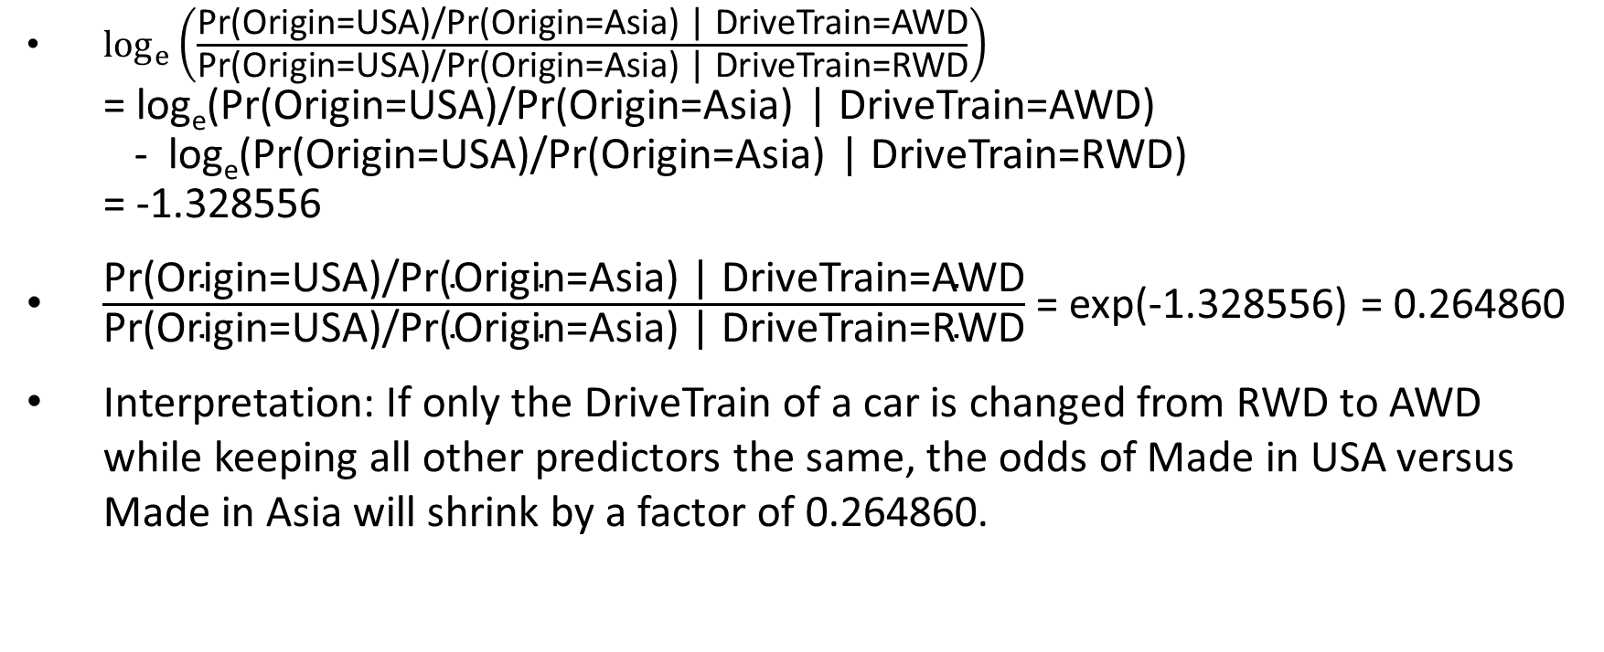
Odds Ratio
$\log_{e}\left(\frac{\text{Pr}\text{(}\text{Origin}\text{=}\text{USA}\text{)/}\text{Pr}\text{(}\text{Origin}\text{=}\text{Asia}\text{) | }\text{DriveTrain}\text{=}\text{AWD}}{\text{Pr}\text{(}\text{Origin}\text{=}\text{USA}\text{)/}\text{Pr}\text{(}\text{Origin}\text{=}\text{Asia}\text{) | }\text{DriveTrain}\text{=}\text{RWD}}\right)$ = log_{e}(Pr(Origin=USA)/Pr(Origin=Asia) | DriveTrain=AWD) - log_{e}(Pr(Origin=USA)/Pr(Origin=Asia) | DriveTrain=RWD) = -1.328556
$\frac{\text{Pr}\text{(}\text{Origin}\text{=}\text{USA}\text{)/}\text{Pr}\text{(}\text{Origin}\text{=}\text{Asia}\text{) | }\text{DriveTrain}\text{=}\text{AWD}}{\text{Pr}\text{(}\text{Origin}\text{=}\text{USA}\text{)/}\text{Pr}\text{(}\text{Origin}\text{=}\text{Asia}\text{) | }\text{DriveTrain}\text{=}\text{RWD}}$ = exp(-1.328556) = 0.264860
Interpretation: If only the DriveTrain of a car is changed from RWD to AWD while keeping all other predictors the same, the odds of Made in USA versus Made in Asia will shrink by a factor of 0.264860.

Slide 48
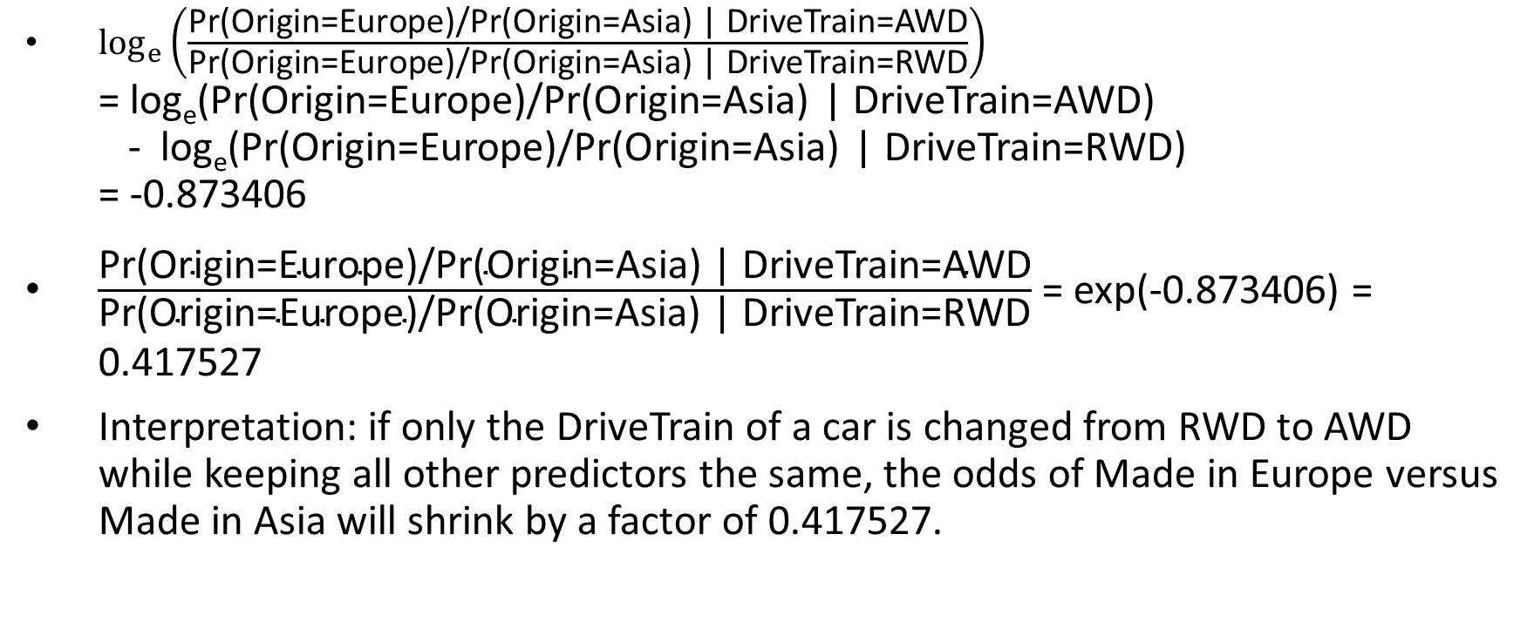
Odds Ratio
$\log_{e}\left(\frac{\text{Pr}\text{(}\text{Origin}\text{=}\text{Europe}\text{)/}\text{Pr}\text{(}\text{Origin}\text{=}\text{Asia}\text{) | }\text{DriveTrain}\text{=}\text{AWD}}{\text{Pr}\text{(}\text{Origin}\text{=}\text{Europe}\text{)/}\text{Pr}\text{(}\text{Origin}\text{=}\text{Asia}\text{) | }\text{DriveTrain}\text{=}\text{RWD}}\right)$ = log_{e}(Pr(Origin=Europe)/Pr(Origin=Asia) | DriveTrain=AWD) - log_{e}(Pr(Origin=Europe)/Pr(Origin=Asia) | DriveTrain=RWD) = -0.873406
$\frac{\text{Pr}\text{(}\text{Origin}\text{=}\text{Europe}\text{)/}\text{Pr}\text{(}\text{Origin}\text{=}\text{Asia}\text{) | }\text{DriveTrain}\text{=}\text{AWD}}{\text{Pr}\text{(}\text{Origin}\text{=}\text{Europe}\text{)/}\text{Pr}\text{(}\text{Origin}\text{=}\text{Asia}\text{) | }\text{DriveTrain}\text{=}\text{RWD}}$ = exp(-0.873406) = 0.417527
Interpretation: if only the DriveTrain of a car is changed from RWD to AWD while keeping all other predictors the same, the odds of Made in Europe versus Made in Asia will shrink by a factor of 0.417527.

Slide 49
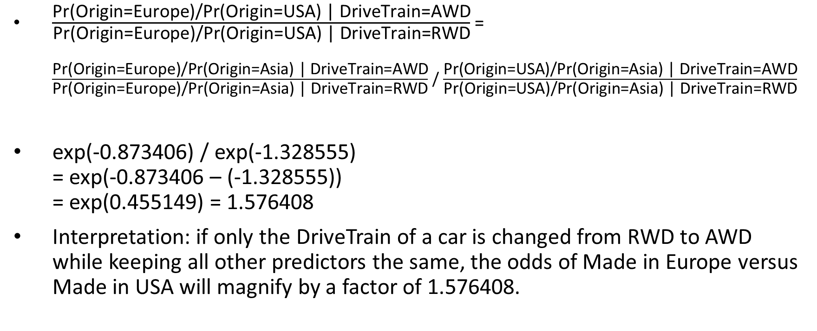
Odds Ratio (Compare USA to Europe)
$\frac{\text{Pr}\text{(}\text{Origin}\text{=}\text{Europe}\text{)/}\text{Pr}\text{(}\text{Origin}\text{=}\text{USA}\text{) | }\text{DriveTrain}\text{=}\text{AWD}}{\text{Pr}\text{(}\text{Origin}\text{=}\text{Europe}\text{)/}\text{Pr}\text{(}\text{Origin}\text{=}\text{USA}\text{) | }\text{DriveTrain}\text{=}\text{RWD}}$ = $\frac{\text{Pr}\text{(}\text{Origin}\text{=}\text{Europe}\text{)/}\text{Pr}\text{(}\text{Origin}\text{=}\text{Asia}\text{) | }\text{DriveTrain}\text{=}\text{AWD}}{\text{Pr}\text{(}\text{Origin}\text{=}\text{Europe}\text{)/}\text{Pr}\text{(}\text{Origin}\text{=}\text{Asia}\text{) | }\text{DriveTrain}\text{=}\text{RWD}}$ /$\frac{\text{Pr}\text{(}\text{Origin}\text{=}\text{USA}\text{)/}\text{Pr}\text{(}\text{Origin}\text{=}\text{Asia}\text{) | }\text{DriveTrain}\text{=}\text{AWD}}{\text{Pr}\text{(}\text{Origin}\text{=}\text{USA}\text{)/}\text{Pr}\text{(}\text{Origin}\text{=}\text{Asia}\text{) | }\text{DriveTrain}\text{=}\text{RWD}}$
exp(-0.873406) / exp(-1.328555) = exp(-0.873406 – (-1.328555)) = exp(0.455149) = 1.576408
Interpretation: if only the DriveTrain of a car is changed from RWD to AWD while keeping all other predictors the same, the odds of Made in Europe versus Made in USA will magnify by a factor of 1.576408.

Slide 50

Mid-Term Test
Open-book take-home test
Questions are available on Blackboard
Submit ALL answer online
No need to submit Python codes
Submit before 11:59 pm on Tuesday, October 20, 2020
No exceptions for late submission
Count 25% toward your course grade

