Slide 1
Getting Live Hardware Data
to the GPU, Faster
Comparing the transports that carry live measurements into GPU compute
Dami Thomas | NI Summer 2026 | 2026-07-29

Slide 2
The data path, not the math, is what slows real-time GPU work
Instruments send data without pause, and it has to reach the GPU in microseconds
The usual network path adds delay from the operating system and from copying data in memory
That delay, not the FFT math, is what usually holds real-time work back
So we measured the path in two stages, then compared transports at each stage
Live instrument data
▼
Part 1: across the network
▼
Part 2: into the GPU (FFT)
We measured the delay added at each stage.
Same application code throughout; only the transport underneath changes.

Slide 3
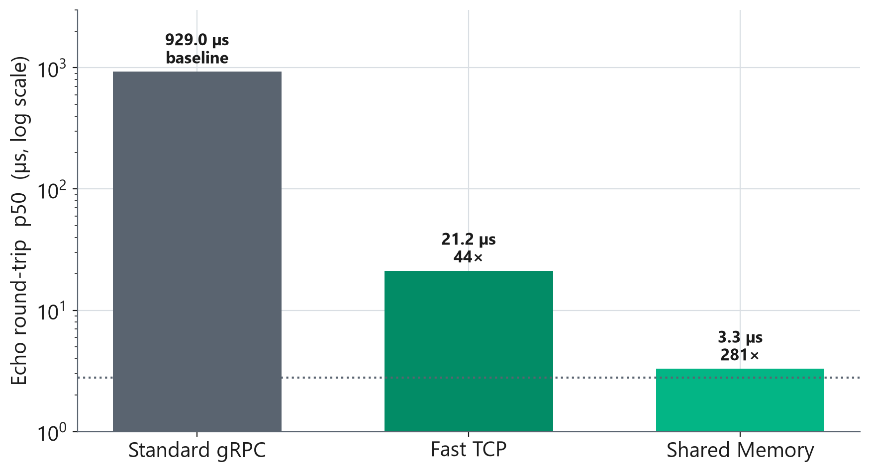
PART 1: ACROSS THE NETWORK
Keeping the same code but swapping the transport cut latency up to 281 times
When both sides run on the same machine, shared memory passes the data straight across and skips the operating system's copies. A round trip takes 3.3 microseconds. That is within half a microsecond of the machine's physical limit, and about 281 times faster than standard gRPC.
When the data has to reach a second machine, RDMA handles that instead. We put it head to head with NVIDIA on the next slides.
Same-host (localhost) echo round-trip, median p50. Dotted line is the machine's floor (2.78 microseconds); standard gRPC over loopback TCP sits near 1,000.

Slide 4
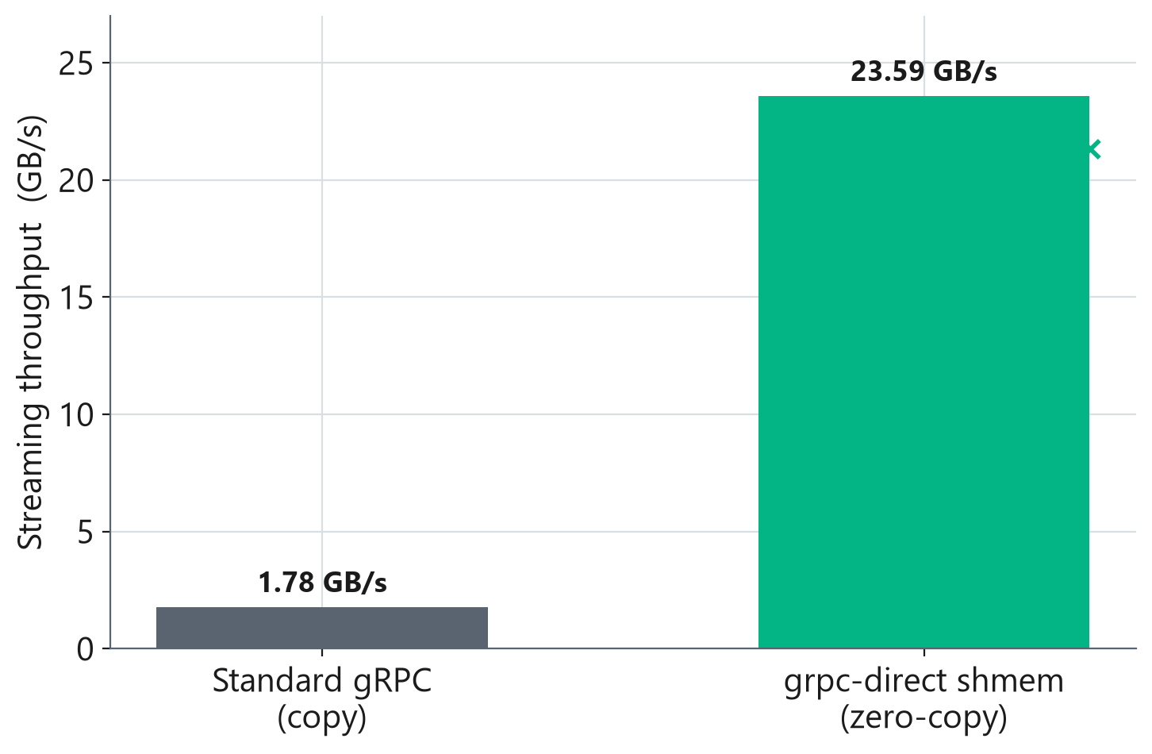
PART 1: ACROSS THE NETWORK
Skipping the memory copies gave almost four times the streaming throughput
Same-host streaming throughput. Zero-copy writes straight into shared memory instead of copying it twice.

Slide 5
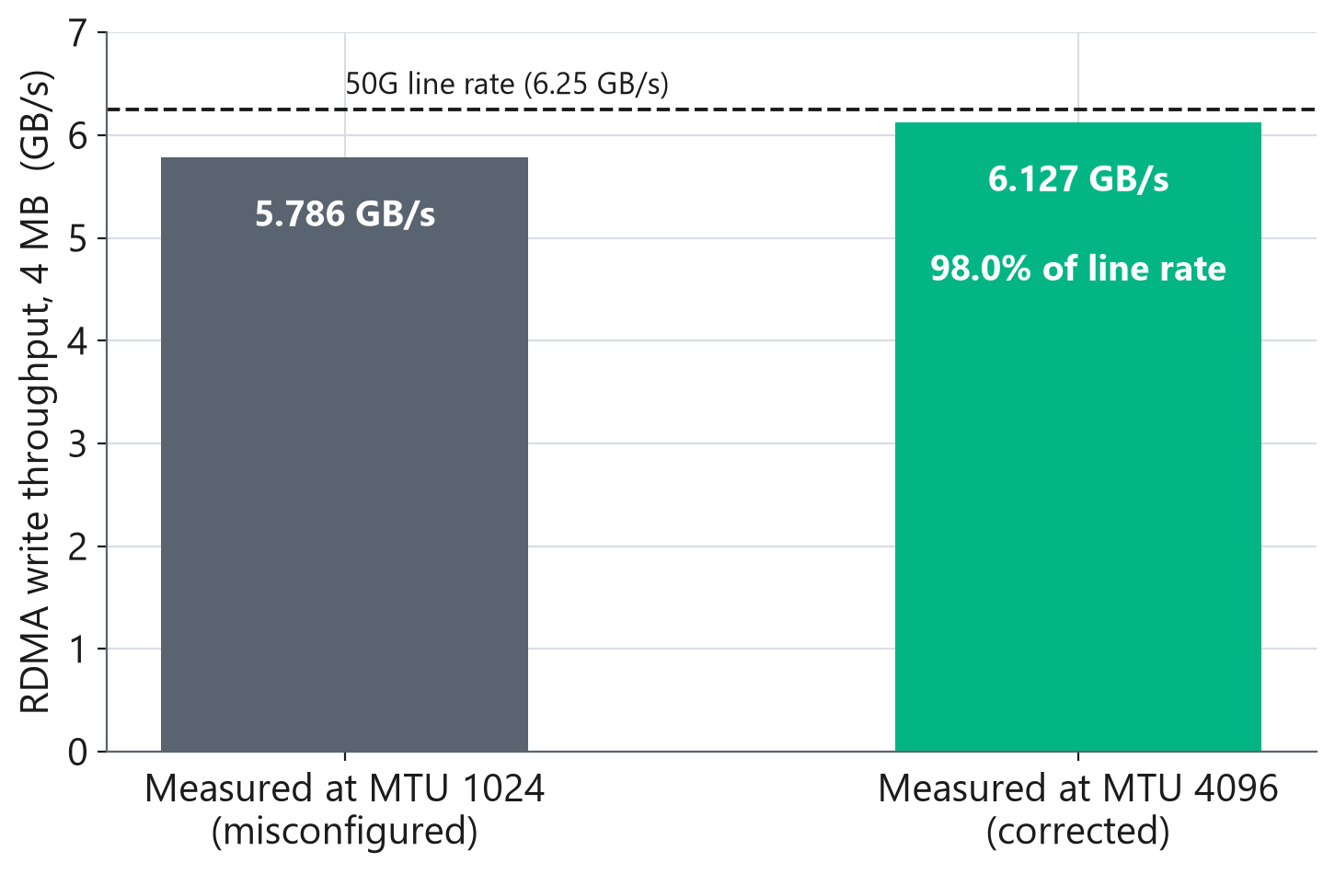
PART 1: ACROSS THE NETWORK
Our transport runs the network link at 98 percent of its rated speed
This test measures how much data per second crosses the 50-gigabit link.
Our first measurement came in at 5.8 gigabytes per second and we read it as the limit of the hardware. It was not. The network was configured with an undersized packet size. Once corrected, the same link carried 6.13 gigabytes per second, which is 98 percent of what a 50-gigabit link can theoretically deliver.
There is almost nothing left to win on the wire. Everything that remains is in what happens after the data arrives, which is Part 2.
Raw network throughput between two machines, 4 MB transfers. This is not the GPU latency test. An earlier version of this slide compared us against NVIDIA here; that comparison measured the misconfigured network on both sides and has been withdrawn.

Slide 6
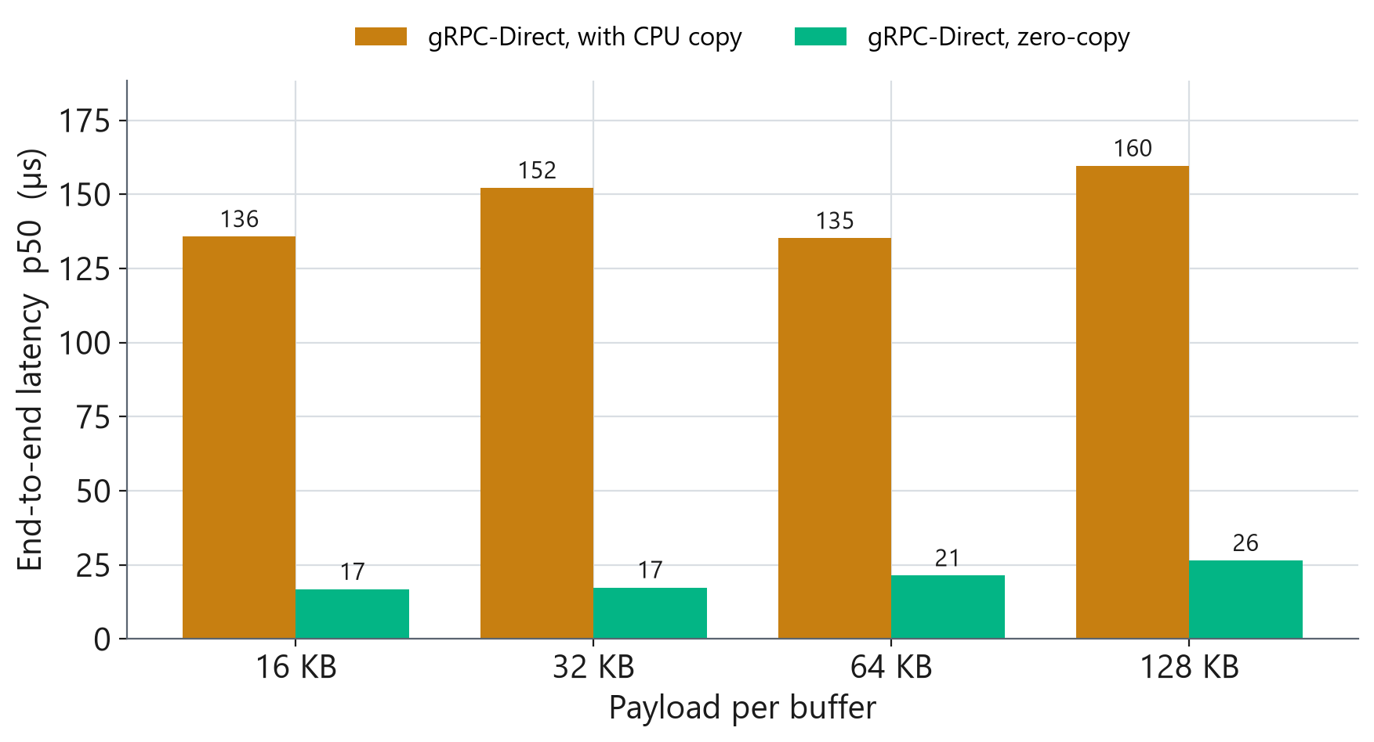
PART 2: INTO THE GPU
In the GPU pipeline, both transports now skip the big CPU copy
One small copy still happens on the GPU. The large copy on the CPU side is gone.

Slide 7
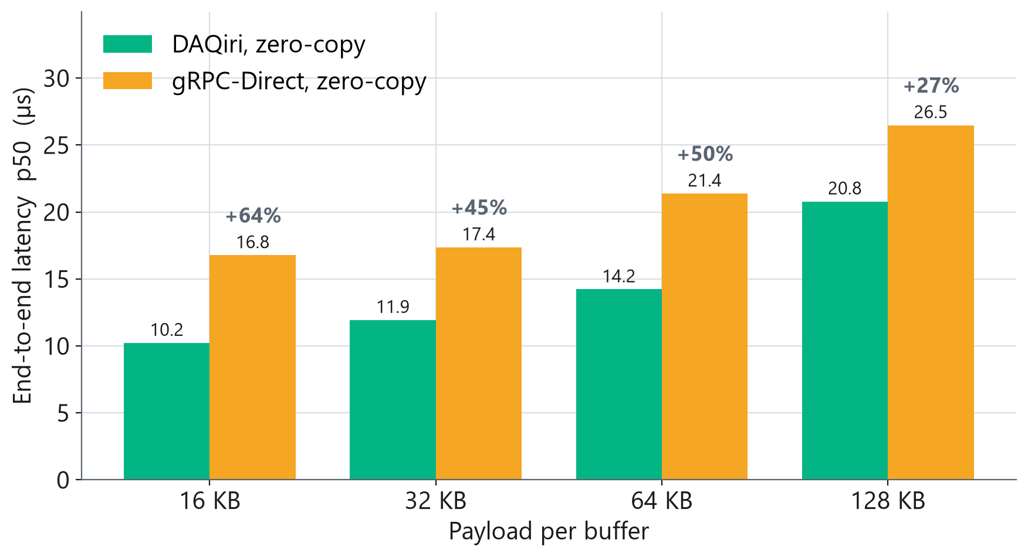
PART 2: INTO THE GPU
Getting a buffer into the GPU, DAQiri was faster at every size we tested
The two transports tied on raw throughput in Part 1. For the time one buffer takes to reach the GPU, DAQiri came out ahead at every payload.
Throughput and latency are separate questions, and here they point different ways.
End-to-end latency per buffer (p50), both pipelines paced the same for a fair test.

Slide 8
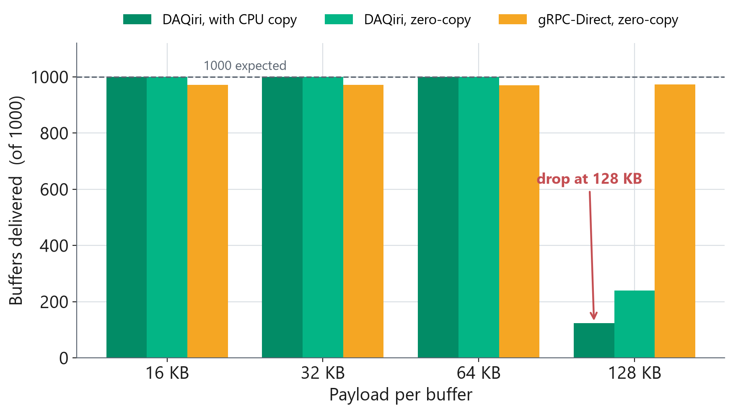
PART 2: INTO THE GPU
One open item: at the largest payload, DAQiri delivered fewer messages
The messages that did arrive were still fast. We are checking whether this is a limit of the test link or a setting we can change.
Under investigation. It does not change the latency results above.

Slide 9
The bottom line: moving data faster lets the GPU act in real time
Up to 281 times lower latency and about four times the throughput, with no change to application code
A software transport that keeps pace with dedicated acquisition hardware on the network
A GPU pipeline that reaches the accelerator in tens of microseconds instead of hundreds
That headroom makes tighter control loops and faster inference practical, and widens the hardware we can support

Slide 10
Next: close the open item, then test on production-style hardware
Find what causes the large-payload delivery limit and run the test again
Confirm the results on the main network-to-GPU path once the test system is back online
Write up the findings as a transport recommendation other NI teams can use
Thanks. Happy to take questions.

