Slide 1
Transport Benchmark for
Hardware-to-GPU Inference
Technical Design Review - gRPC-Direct and NVIDIA DAQiri, TCP / shared memory / RDMA / GPU FFT
Presenter: Dami Thomas - NI Summer 2026 - 2026-07-29
Classification: NI Internal - Review type: Results and open-issue review

Slide 2
OVERVIEW
Agenda and Review Scope
Objectives and success criteria
Background: transports, zero-copy, and the GPU FFT pipeline
System architecture and data path
Test configuration and measurement methodology
Phase 1 results: transport benchmark (latency, throughput, RDMA)
Phase 2 results: DAQiri vs gRPC-Direct GPU FFT pipeline
Part 3: closing the gap. Root cause, the remainder, the memory finding, and the RDMA receiver
Open-issue analysis: large-payload delivery
Risk, limitations, conclusions, verification status, and action items

Slide 3
MIL-STD / NASA REVIEW
Objectives and Success Criteria
Objective
Quantify the latency and throughput cost of the data transport in a live hardware-to-GPU inference path
Compare NI gRPC-Direct against standard gRPC and against NVIDIA DAQiri under matched conditions
Success Criteria
ID | Criterion | Result
SC-1 | Measure transport latency with a fair, repeatable method | MET
SC-2 | Show transport-only speedup with unchanged application API | MET (up to 281x)
SC-3 | Compare GPU-pipeline latency, DAQiri vs gRPC-Direct | MET (DAQiri faster all sizes)
SC-4 | Characterize delivery / drops across payload sizes | MET (128 KB drop found)
SC-5 | Find and fix the cause of the large-payload gap | MET (1.80x at 4 MB)
SC-6 | Localize whatever remains to a named component | MET (79 percent inside cuFFT)
Verification status detailed on the conclusions slide.

Slide 4
CONTEXT
Background and Definitions
Standard gRPC over TCP: general-purpose RPC; kernel, scheduler and serialization overhead dominate small payloads
gRPC-Direct: NI transport that keeps the gRPC API but swaps TCP for shared memory, low-latency TCP, or RDMA
NVIDIA DAQiri: purpose-built data-acquisition framework with a kernel-bypass NIC-to-GPU path and a portable socket engine
Zero-copy: serialize data directly into the transport buffer, removing host-side memory copies
GPU FFT pipeline: receive buffer -> host-to-device transfer -> cuFFT -> report end-to-end latency
Metric: p50 (median) end-to-end latency per buffer; delivery = buffers received of those sent

Slide 5
ARCHITECTURE
System Architecture and Data Path
Instrument /
Signal source
>
Transport
(shmem / RDMA /
DAQiri socket)
>
Host to device
transfer
(H2D copy)
>
GPU FFT
(cuFFT)
Zero-copy removes the large host-side CPU copy at the transport boundary
gRPC-Direct zero-copy still performs one small device-side realign copy where required; DAQiri buffers are already aligned
Both pipelines are paced identically so the GPU sees the same duty cycle (clock-fair comparison)
Timing window for p50 excludes transport receive; it spans H2D transfer through FFT completion.

Slide 6
MIL-STD TEST SETUP
Test Configuration
Item | Configuration
Compute node | NVIDIA DGX Spark (spark-ac69), Grace-Blackwell GB10, unified memory
Second node | NI PXIe-8881, x86_64, NI Linux Real-Time
Interconnect | 50G RoCE dedicated link + 10G L2 management network
GPU / FFT | cuFFT R2C, CUDA 13; 16-byte-aligned input
Signal | Sum of sines (500/1200/2500 Hz) + noise, 1 MHz sample rate
Transports | standard gRPC, gRPC-Direct shmem / TCP-LL / RDMA, DAQiri socket
Payloads | 4K/8K/16K/32K samples = 16 / 32 / 64 / 128 KB
GPU clocks are not lockable on this platform (>10x DVFS swing); addressed by pacing (see methodology).

Slide 7
METHOD
Measurement Methodology (Airtight A/B)
Matched-pair design: both pipelines run the identical workload and payload sweep
Identical pacing at 400 microseconds per buffer to neutralize GPU frequency scaling (DVFS)
On-GPU FFT execution time used as a clock-match probe; near-equal FFT p50 confirms fair clocks
1000 measured buffers per run, 100 warmup discarded, 5 trials per cell
Report the median-of-trials of each per-run p50; latency and delivery reported separately
CPU pinning applied; server processes isolated to avoid scheduler cross-talk
Rationale: clocks cannot be locked, so pacing equalizes duty cycle and FFT time verifies the match.

Slide 8
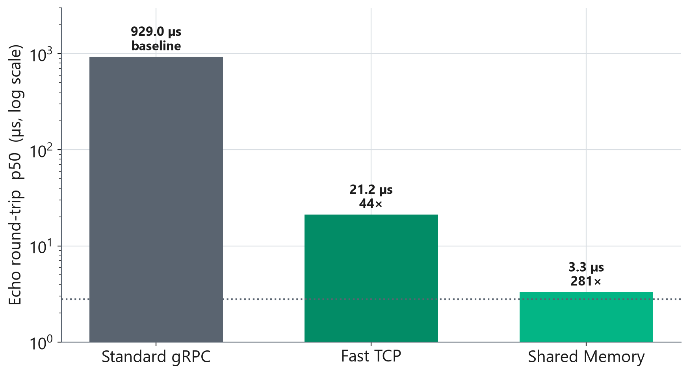
RESULTS / TRANSPORT
Phase 1 - Small-Payload Latency
Standard gRPC baseline ~1,000 us (p50)
shmem: 3.3 us = 281x faster
TCP low-latency: 21.2 us = 44x
RDMA (50G): 36.8 us = 29x
Same gRPC API; only the transport changes
Echo round-trip p50, C++ interceptor path.

Slide 9
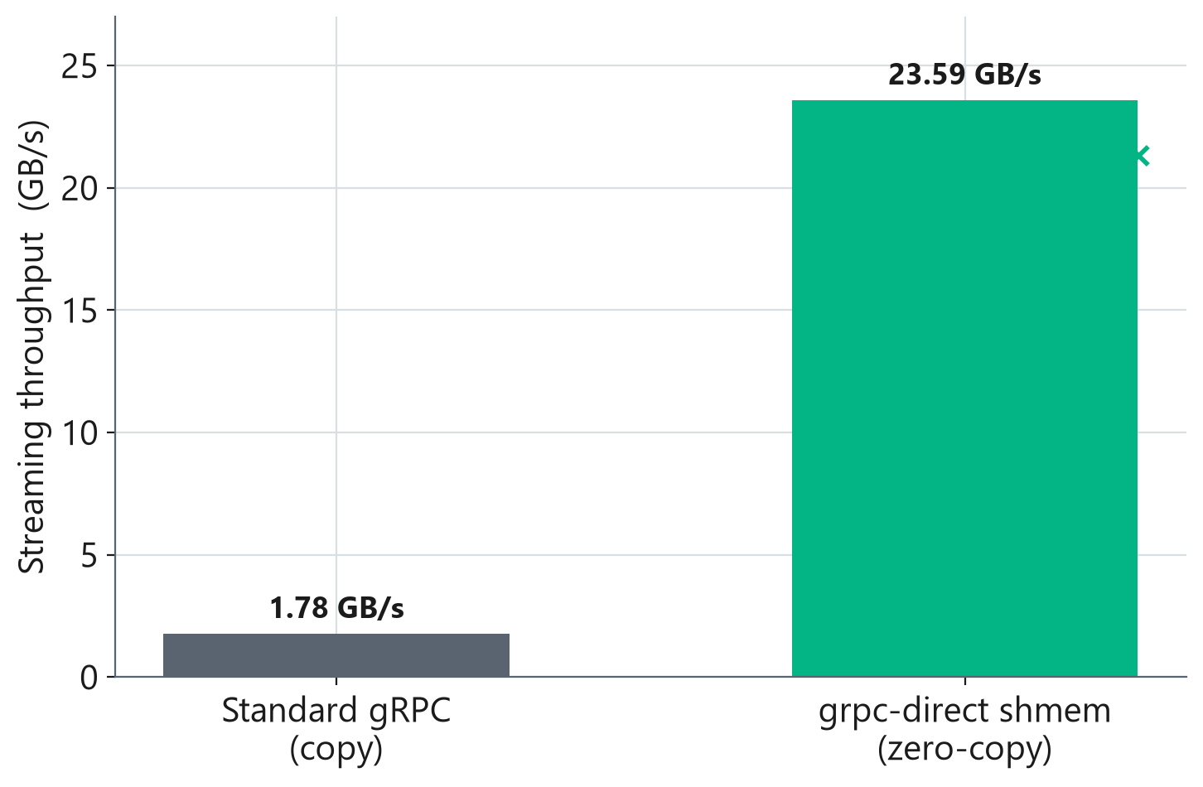
RESULTS / TRANSPORT
Phase 1 - Zero-Copy Streaming Throughput
Standard gRPC copy path: 1.78 GB/s
gRPC-Direct shmem zero-copy: 23.59 GB/s
3.9x gain from removing two heap copies per message
Zero-copy effective in C++ (loan buffer + in-place serialization); Python retains a residual copy
ReadContinuously streaming, steady state.

Slide 10
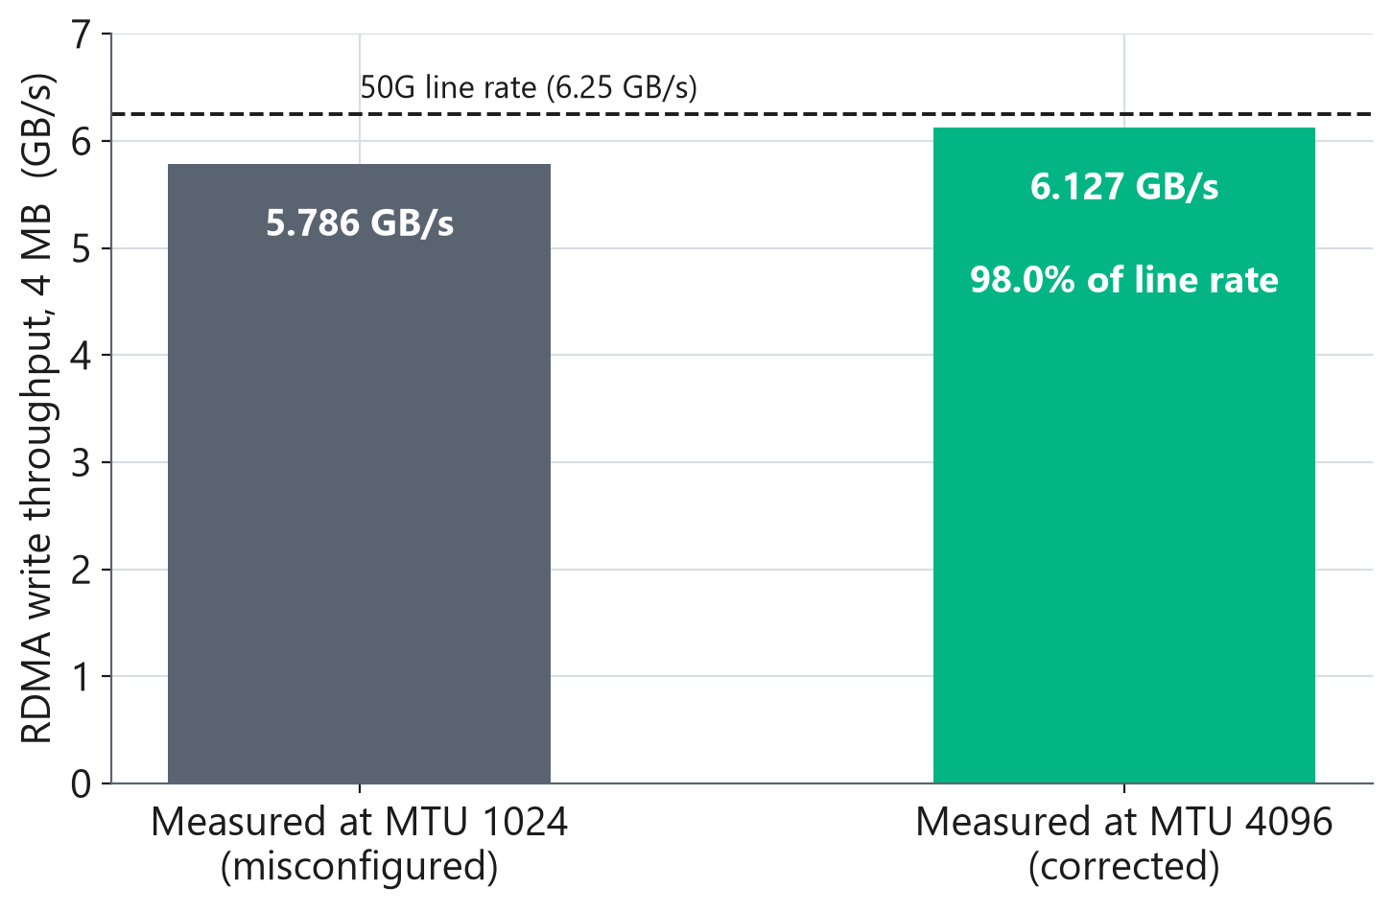
RESULTS / TRANSPORT
Phase 1 - RDMA vs Line Rate
The first run measured 5.786 GB/s and was read as a fabric limit
It was a 1024-byte RoCE MTU, a misconfiguration, not the API
Same link at MTU 4096: 6.127 GB/s = 98.0% of 50G line rate
A 2-byte control did not move, which attributes the gain to the MTU
The old DAQiri bar is removed: it was the same misconfigured fabric
Raw ib_write_bw, 4 MB, PXI writing into the Spark. The DAQiri tie this slide used to assert is retracted; see handoff 7p.

Slide 11
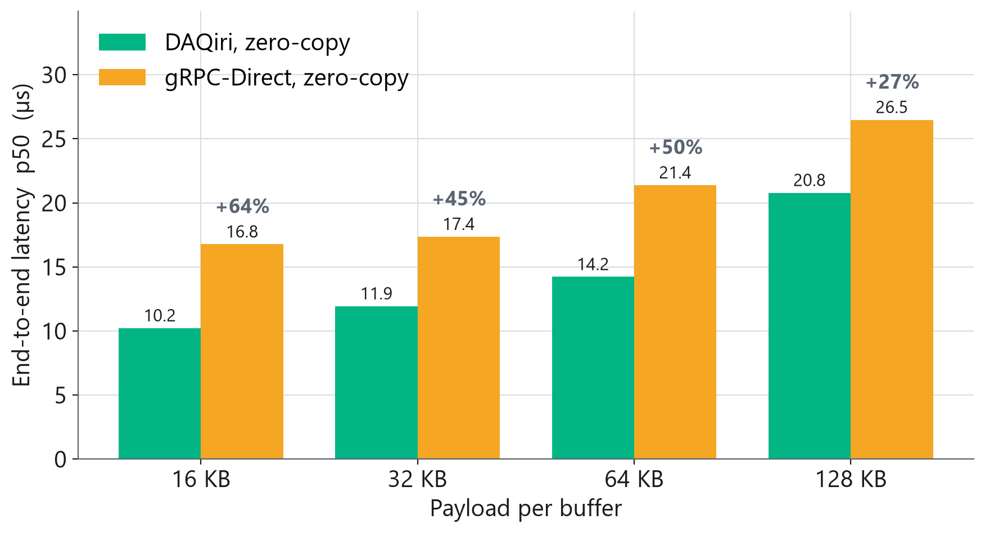
RESULTS / GPU PIPELINE
Phase 2 - GPU Pipeline Latency (Zero-Copy)
DAQiri lower p50 at every payload
Advantage: +64% (16 KB) to +27% (128 KB)
FFT p50 matched A vs B: clocks fair
Median of 5 trials, paced 400 us
End-to-end p50; transport receive excluded from timing window.

Slide 12
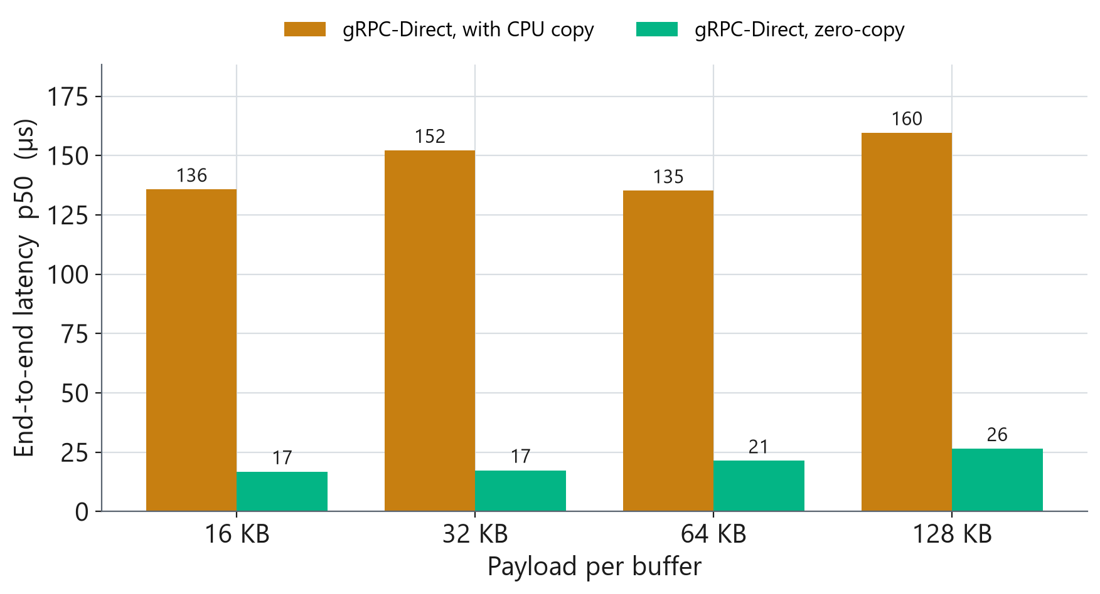
RESULTS / GPU PIPELINE
Phase 2 - Removing the CPU Copy
Copy path pays ~117-131 us host staging
Zero-copy removes the large CPU copy
gRPC-Direct copy p50: 136-160 us
gRPC-Direct zero-copy p50: 17-26 us
One small device-side realign copy remains in zero-copy mode.

Slide 13
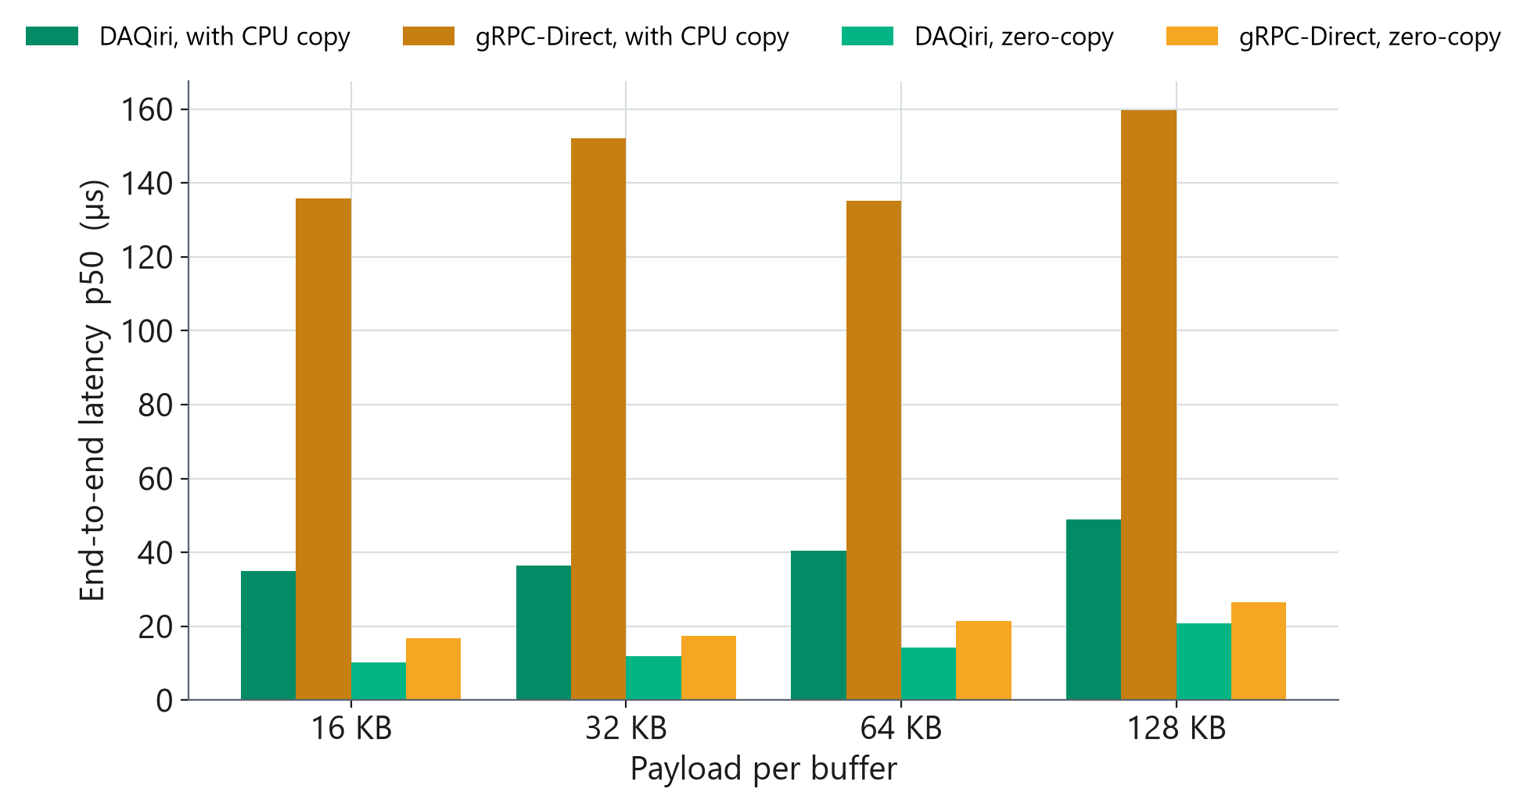
RESULTS / GPU PIPELINE
Phase 2 - Four-Way Head-to-Head
DAQiri copy is far cheaper than gRPC copy (no host staging); zero-copy narrows but DAQiri still leads.

Slide 14
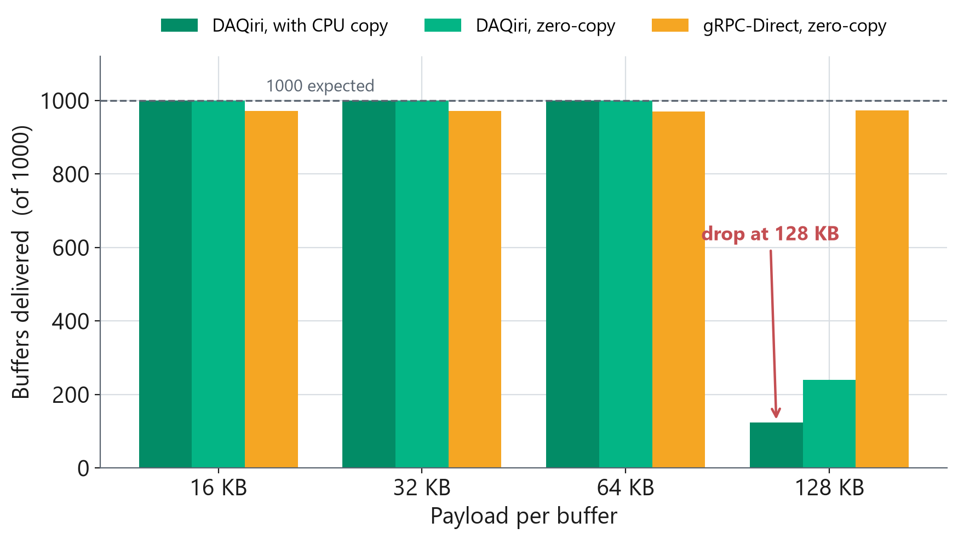
RESULTS / GPU PIPELINE
Phase 2 - Delivery and the 128 KB Drop
16-64 KB: full delivery (~1000)
128 KB DAQiri copy: ~124 delivered
128 KB DAQiri zero-copy: ~240
gRPC-Direct: ~973 at all sizes
Latency of delivered buffers stays valid
128 KB = 32768 samples x 4 bytes = 131072 B (fits under configured max payload 131136 B).

Slide 15
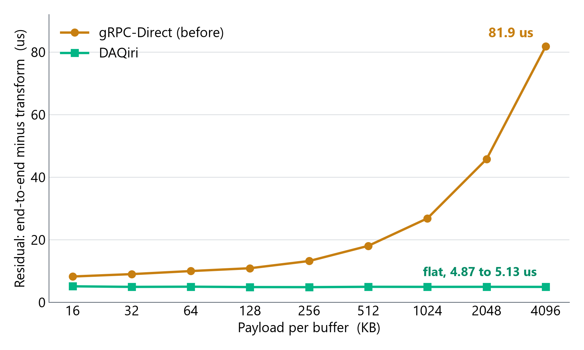
PART 3 / LOCALIZING
Where the Gap Was, and How We Found It
Residual = end-to-end minus the measured transform time
A cost that does not change with payload is fixed overhead
A cost that grows with the byte count means something is touching every byte
DAQiri stays flat, 4.87 to 5.13 us, across a 256x range of payload
gRPC-Direct climbs to 81.88 us at 4 MB
The shape identified a per-byte cost before we knew what it was
Source: data/headline_runs.csv, 9 payload sizes, 2 reps per cell. The 4 MB effect is roughly 20x the measured noise floor.

Slide 16
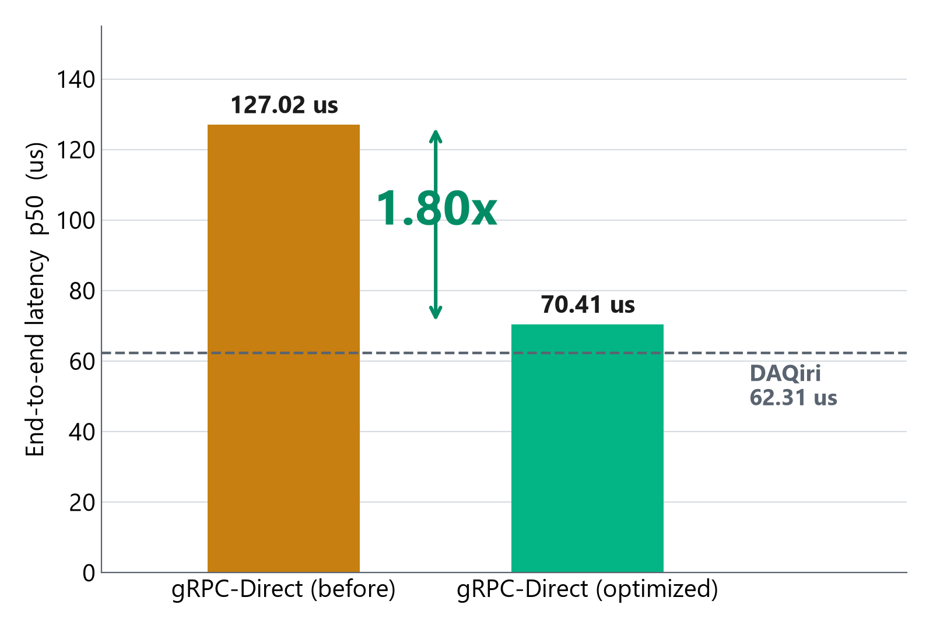
PART 3 / ROOT CAUSE
Root Cause: an Alignment Test That Could Not Pass
protobuf guarantees 8-byte alignment for its arena buffers
The zero-copy path tested for 16-byte alignment before using the buffer in place
Every message failed that test and took a staging copy that cuFFT never required
It hid because the timer around cudaMemcpyAsync read 3.5 us: that call only enqueues, so the cost landed outside the window being measured
Copy measured directly: 77.01 us. Residual gap predicted: 76.53 us. Two independent measurements of the same cost.
4 MB payload. DAQiri shown as a reference line, not a competitor: the claim on this slide is what the fix did to gRPC-Direct.

Slide 17
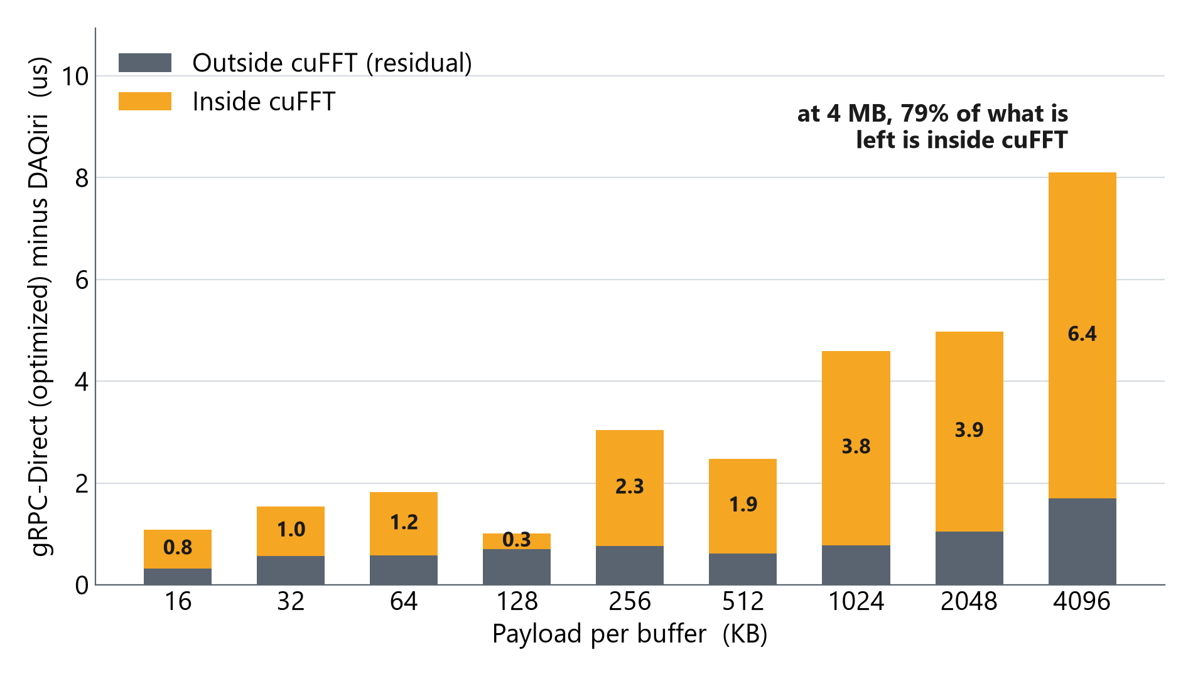
PART 3 / THE REMAINDER
What Was Left, and Where It Lives
After the fix, gRPC-Direct is still about 8 us behind at 4 MB
Split that remainder into the part inside cuFFT and the part outside it
Kernel launch overhead does not depend on payload, so a remainder that grows with the byte count is not launch overhead
At 4 MB, 6.40 us of 8.10 us, about 79 percent, is inside cuFFT itself
Same GPU, same plan, same transform size. What differs is where the input buffer lives
Source: data/headline_runs.csv, 2 reps per cell. The dips at 128 KB and 512 KB are rep-to-rep noise at that count, not structure.

Slide 18
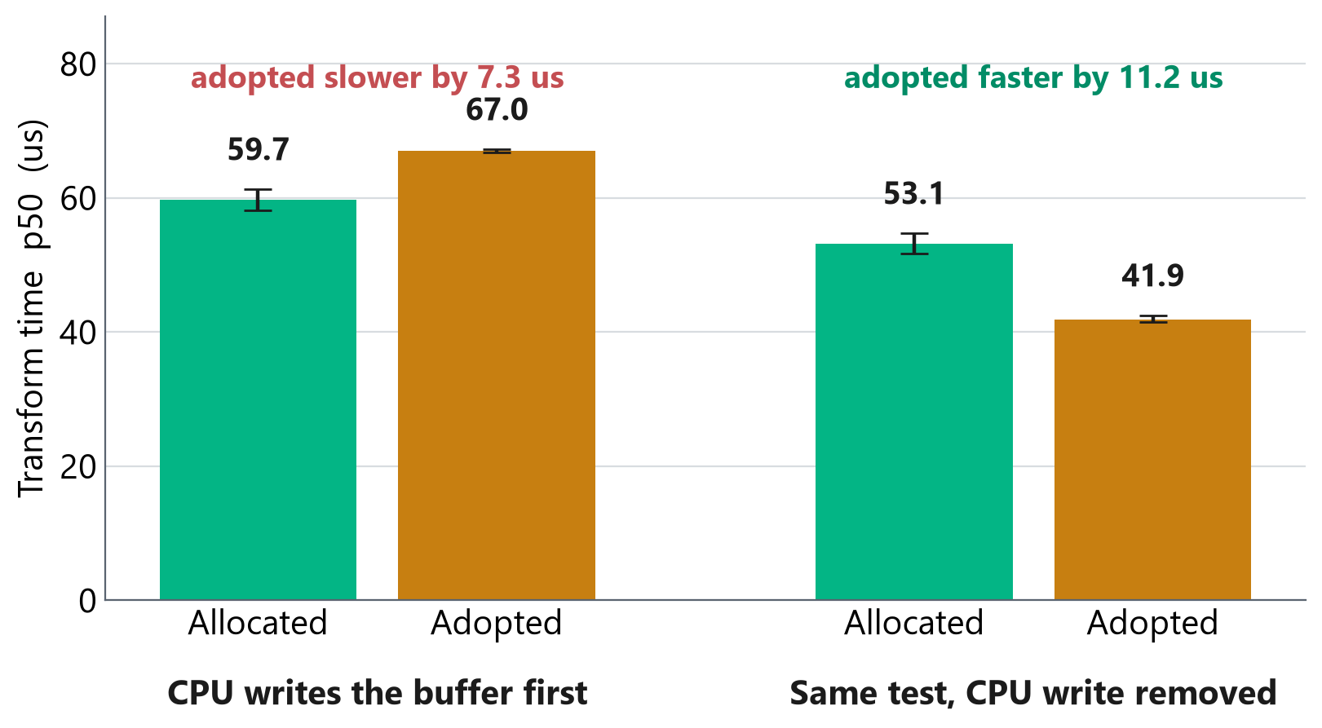
PART 3 / SCOPING
The Memory Finding: a Result That Inverted
Two ways to get host memory the GPU can read: allocated by cudaHostAlloc, or adopted by registering pages the process already owns
Adopted measured slower every way it was tried: 7.3 us in the chart at left, and 10.94 us in a separate 15-rep rotation across page sizes
Then the CPU write that filled the buffer was removed, and the sign inverted: adopted became 11.2 us faster
Confirmed in the real RDMA receiver, where the NIC writes and the CPU never touches the buffer: the two are indistinguishable, p = 1.0
Both measurements were correct about what they measured. The error available here was carrying one of them into a configuration it had not measured, which is the configuration that ships.
Sources: data/memsrc_2x2_1048576.csv, data/memsrc_2x2_nowrite_1048576.csv, data/pagesize_rot.csv. 4 MiB payload. Error bars are distribution-free intervals of the median.

Slide 19
PART 3 / THE TRANSPORT
What Got Built: RDMA Straight into GPU-Readable Memory
PXI chassis
(no CUDA)
>
50G RoCE
link
>
NIC writes
by DMA
>
One host buffer:
cudaHostAlloc + ibv_reg_mr
>
cuFFT reads
in place
No staging copy anywhere on this path. The NIC and the GPU address the same allocation.
GPUDirect RDMA is not available on GB10: unified memory means there is no separate GPU aperture for the NIC to target
Registering a cudaHostAlloc buffer with the NIC is the supported route on this hardware
The receiver runs the transform on a dedicated CUDA stream
Measured at 98.0 percent of 50G line rate, once the RoCE MTU was corrected
Runs PXI to Spark. DAQiri cannot: it requires CUDA on both ends, and the PXI chassis has no GPU
That is a capability difference, not a latency difference
Throughput from ib_write_bw, 4 MB writes, PXI to Spark. Latency numbers for this transport are on the next slide.

Slide 20
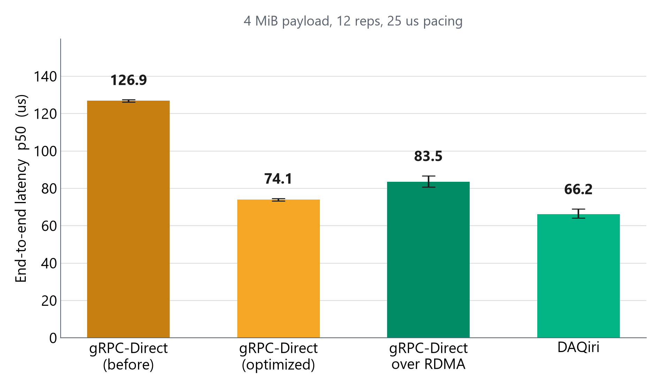
PART 3 / RESULT
Where It Ended: Four Arms at 4 MiB
12 reps per arm, each arm rotated through all four running positions
Error bars are distribution-free intervals of the median, so the chart shows what the measurement can and cannot resolve
gRPC-Direct is 1.71x faster than it was, and now sits 6.96 us behind DAQiri (12 of 12 reps, interval 5.31 to 9.41 us)
That 6.96 us does not depend on how hard the arms are driven: the same test at an eight times lower offered rate gives 7.02 us
The before arm has the fastest transform because it reads device memory after paying a 77 us copy to get there
Only the RDMA arm cares about offered rate: 23 us between the two pacing regimes, against under 2 us for every other arm.
Source: data/deck_4arm_4mib.csv, saturated regime. 4 MiB payload, 1000 messages per cell, SM clock gated at 2400 MHz and recorded per cell. The unsaturated regime was measured at the same rep count and is the sensitivity result quoted above.

Slide 21
OPEN ITEM
OPEN
Open Issue: 128 KB Delivery Analysis
Observation
DAQiri delivers only ~12-24% of buffers at 128 KB over the TCP loopback socket engine; gRPC-Direct is unaffected.
Candidate hypotheses (to test)
Send-side vs receive-side: capture TX-sent vs RX-received counts (the binary prints both plus engine stats)
Socket buffer limits: raise SO_SNDBUF / SO_RCVBUF via DAQiri socket_setsockopt (no sudo required)
Configuration: revisit num_bufs, batch_size, and max_payload_size headroom in the YAML
Transport ceiling: a genuine TCP-loopback limit at this payload (flagship kernel-bypass path would differ)
Diagnostic plan
Foreground 128 KB run capturing full summary to isolate send vs receive (Step 1)
Apply no-sudo socket tuning symmetrically, re-run (Step 2); if drops persist, document as transport ceiling (Step 3)
Blocked on test-hardware availability; hardware relocated 2026-07.

Slide 22
MIL-STD RISK
Risk and Limitations
Area | Limitation | Mitigation
GPU clocks | Not lockable, >10x DVFS swing | Clocks warmed to 2400 MHz and recorded per cell
Topology | Part 3 arms all run same-box, DAQiri as an RC loopback | Same for every arm, which is what makes them comparable
Offered rate | The RDMA arm moves 23 us between pacing regimes; no other arm moves more than 2 us | Both regimes measured at 12 reps; the headline names the one it uses
Delivery | 128 KB drop on DAQiri (open) | Diagnostic plan defined; latency unaffected
Rep count | Slides on payload shape rest on 2 reps per cell | Rep count printed on those slides; 4 MiB conclusions use 12
Latency medians are robust to the drop (drops reduce sample count, not the median of delivered buffers)
Throughput and reliability at 128 KB is the only affected result and is flagged as open

Slide 23
CLOSURE
Conclusions and Verification Status
Finding | Status
Transport swap gives up to 281x lower latency, same API | VERIFIED
Zero-copy gives 3.9x streaming throughput | VERIFIED
RDMA transport runs at 98.0 percent of 50G line rate | VERIFIED
Earlier claim that RDMA ties DAQiri at the fabric limit | RETRACTED - measured a misconfigured MTU
Large-payload root cause found and fixed: 1.80x at 4 MB | VERIFIED
Remaining gap to DAQiri at 4 MiB: 6.96 us, 12 of 12 reps | VERIFIED
Host memory choice is neutral when the CPU does not write | VERIFIED
128 KB DAQiri delivery limit | OPEN - under analysis
Transport, not compute, governs hardware-to-GPU latency. The remaining difference at 4 MiB is about 7 us and is located inside cuFFT, not in the API
One delivery item remains open before full sign-off

Slide 24
ACTIONS
Action Items and Next Steps
# | Action | Owner | Depends on
1 | Foreground 128 KB run: isolate send vs receive | D. Thomas | Hardware online
2 | No-sudo socket tuning, symmetric re-run | D. Thomas | Item 1
3 | Validate on flagship NIC-to-GPU path | D. Thomas | SmartNIC access
4 | Package transport recommendation for NI teams | D. Thomas | Items 1-3
Current blocker: DGX Spark and PXI test systems relocated; work resumes when reachable.

Slide 25
BACKUP
Backup - Aggregated Phase 2 Data (median of 5 trials)
Payload | Pipeline / mode | Deliv | E2E p50 (us) | FFT p50 (us) | MB/s
16 KB | DAQiri zero-copy | 1000 | 10.22 | 5.15 | 1602
16 KB | gRPC-Direct zero-copy | 972 | 16.77 | 8.61 | 977
32 KB | DAQiri zero-copy | 1000 | 11.94 | 6.85 | 2749
32 KB | gRPC-Direct zero-copy | 972 | 17.36 | 8.51 | 1888
64 KB | DAQiri zero-copy | 1000 | 14.22 | 9.15 | 4607
64 KB | gRPC-Direct zero-copy | 971 | 21.38 | 11.58 | 3066
128 KB | DAQiri zero-copy | 240 | 20.78 | 15.78 | 6316
128 KB | gRPC-Direct zero-copy | 973 | 26.48 | 15.52 | 4950
Copy-mode rows and Phase 1 detail available in the project repository (data/ and README).

